Slide 1
(Programming) Recursion
Emira

Slide 2
What is it?
A child couldn't sleep, so her mother told her a story about a little frog, who couldn't sleep, so the frog's mother told her a story about a little bear, who couldn't sleep, so the bear's mother told her a story about a little weasel... who fell asleep. ...and the little bear fell asleep; ...and the little frog fell asleep; ...and the child fell asleep.
Recursion is a basic programming technique, in which a method calls itself to solve some problem. A method that uses this technique is recursive.

Slide 3
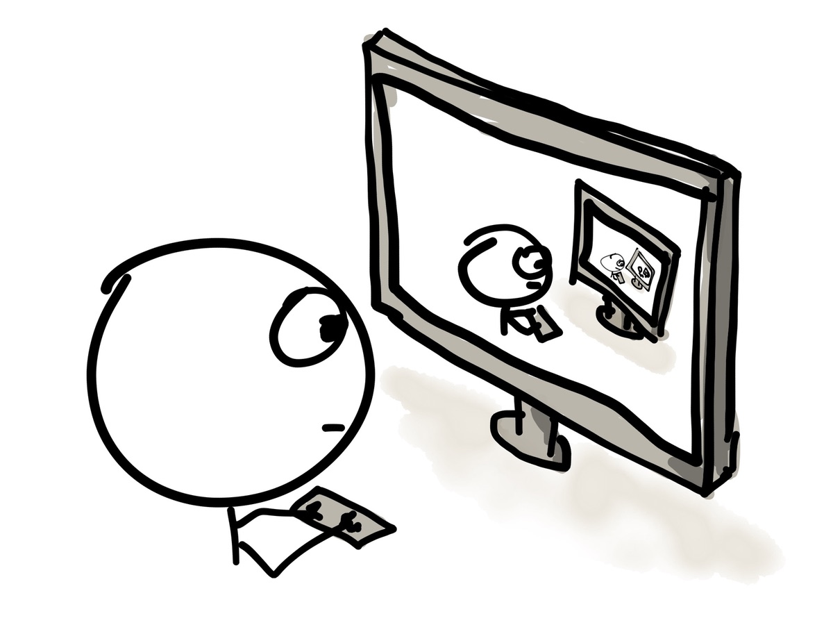
Where can you use recursion?
“Recursion is best used when a recursive solution makes the code simpler and easier to follow.”
When to use recursion:
Trees
Linked Lists
File system traversal

Slide 4
General Pattern of Recursion
Def RecFunction(){
Base Case; //(stopping condition).
RecFunction; //Call RecFunction itself
//do something else if you want or STOP
}

Slide 5
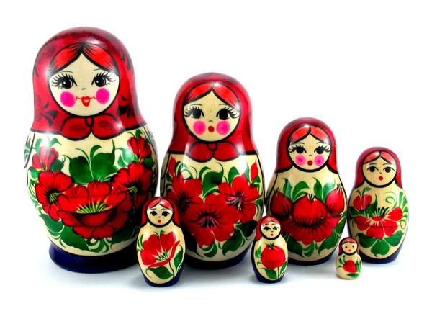
Examples of recursion
Printing numbers (from 1…n) in reverse order using recursion
Factorial example
Fibonacci numbers example
Print linked lists elements in reverse order using recursion
*Russian Dolls

