Slide 1
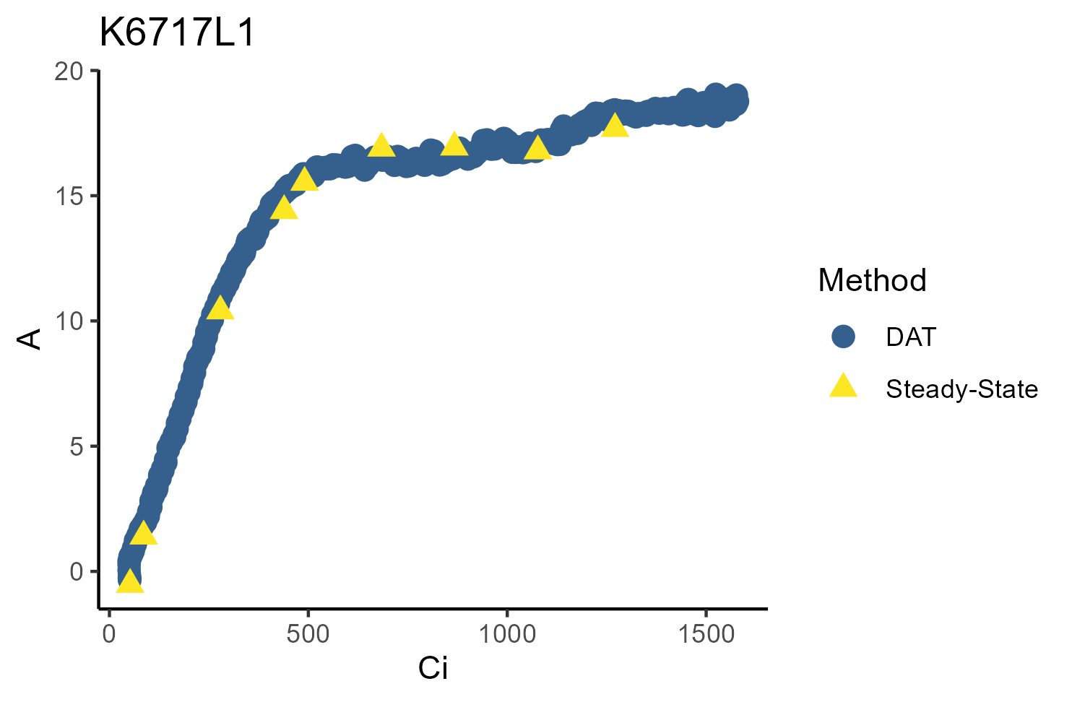
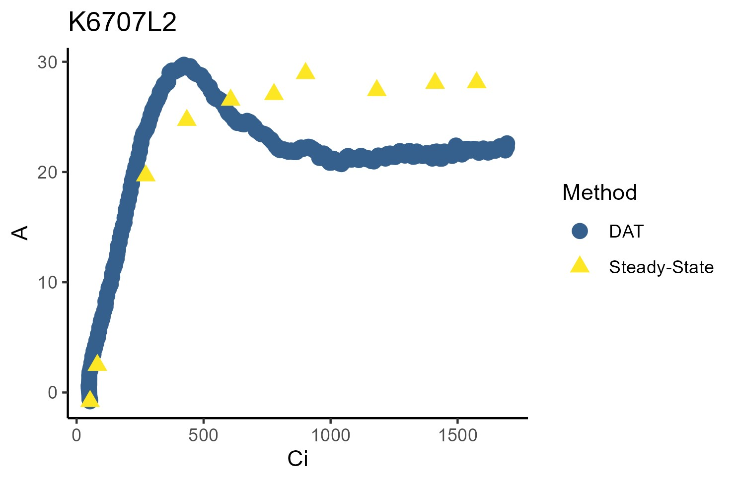
a
b
Aparisthmium cordatum, Leaf 1
Tachigali chrysophylla, Leaf 2
A_{net} (μmol m⁻² s⁻¹)
A_{net} (μmol m⁻² s⁻¹)
C_{i} (μmol mol⁻¹)
C_{i} (μmol mol⁻¹)
Figure 1: Example curves of assimilation (A_{net}; μmol m⁻² s⁻¹) versus intercellular CO₂ concentration (C_{i}; μmol mol⁻¹), where the DAT method (blue) aligned with the steady-state method (yellow) (a), or showed overshoot (b). Curves with overshoot exhibited Rubisco-limited A_{net} rates similar to steady-state before peaking in the RuBP-limited region (here, approximately 300 - 550 C_{i}, often exceeding steady-state limitations. This was followed by a rapid decline in A_{net} and a subsequent plateau at rates below steady-state rates and, in some cases, a subtle increase in A_{net} in the latter portions of the curve (here, approximately 550 - 1800 C_{i}).

Slide 2
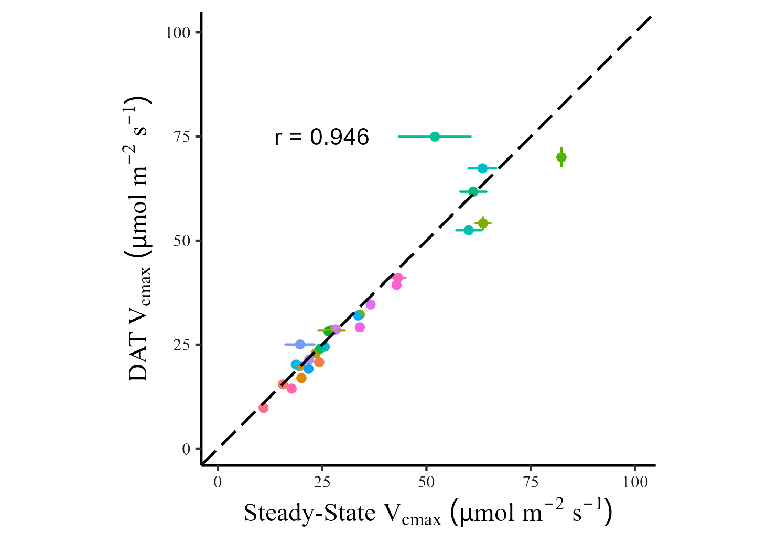
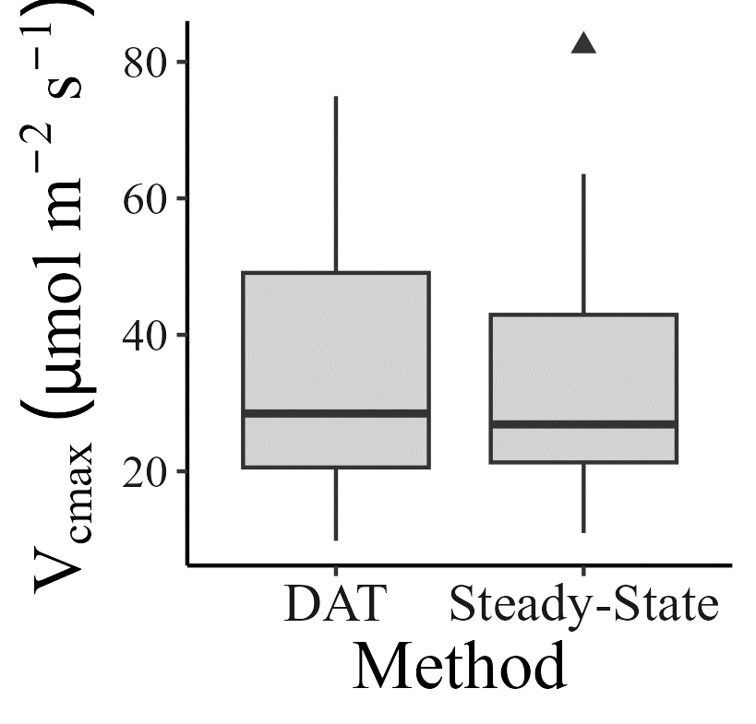
Without TPU
Notes:
Full dataset of Vcmax, without TPU fitting

Slide 3
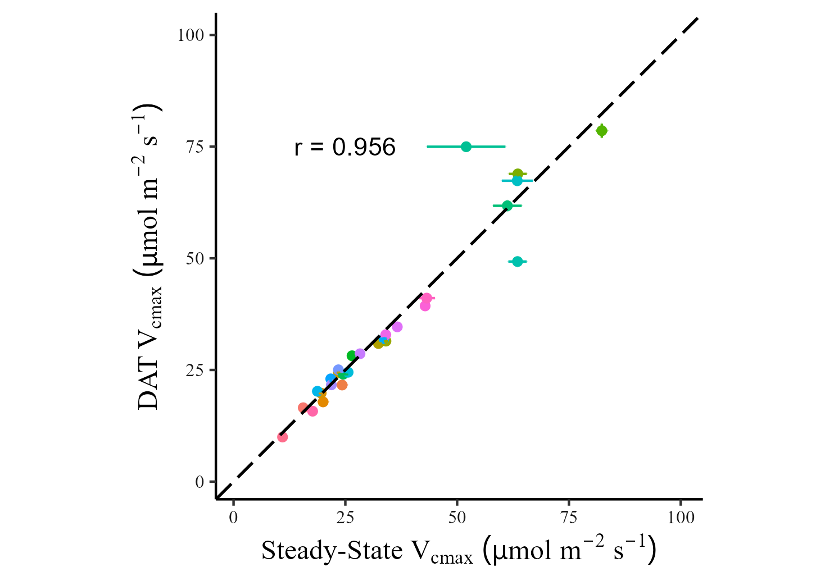
With TPU
Notes:
Full dataset of Vcmax, with TPU fitting

Slide 4
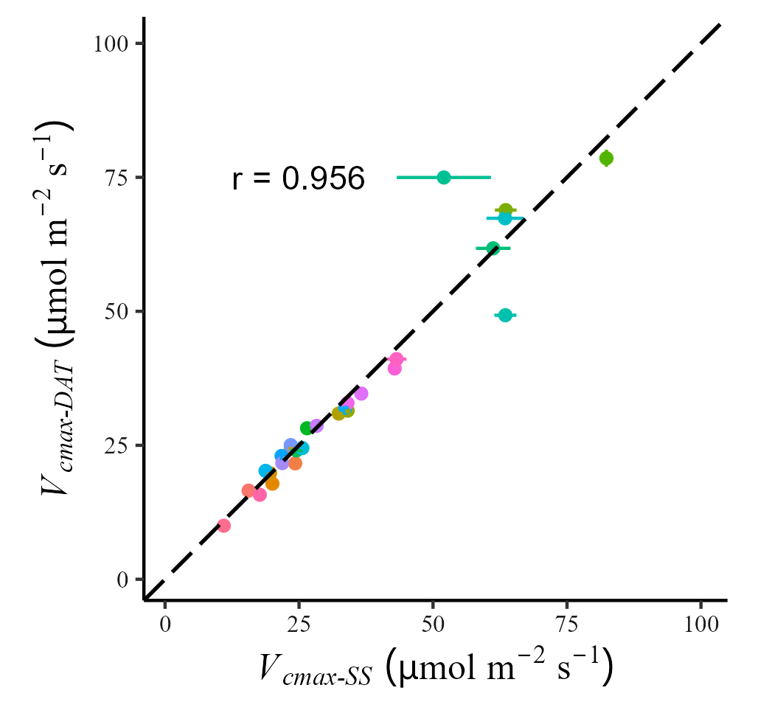
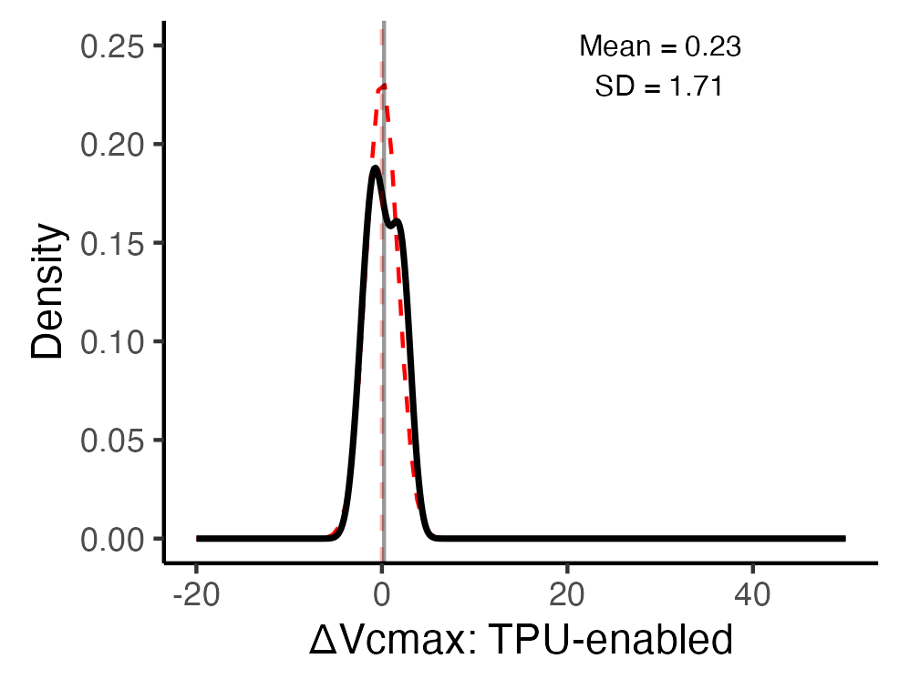
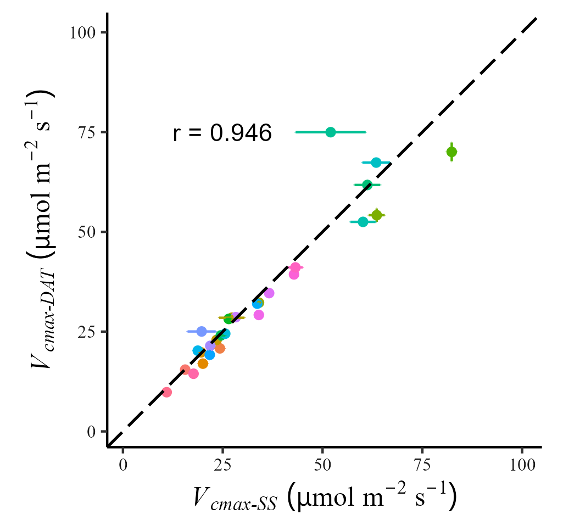
a
With TPU
b
Without TPU
Figure 2: Comparison of V_{cmax} between DAT and Steady-State. There was a marginal but significant difference between curve types when TPU was not fit (a) but not when TPU was fit (b). Error bars represent the standard errors derived from the model (many of which are smaller than the points and not visibly distinguishable). Colors represent individual leaves.

Slide 5
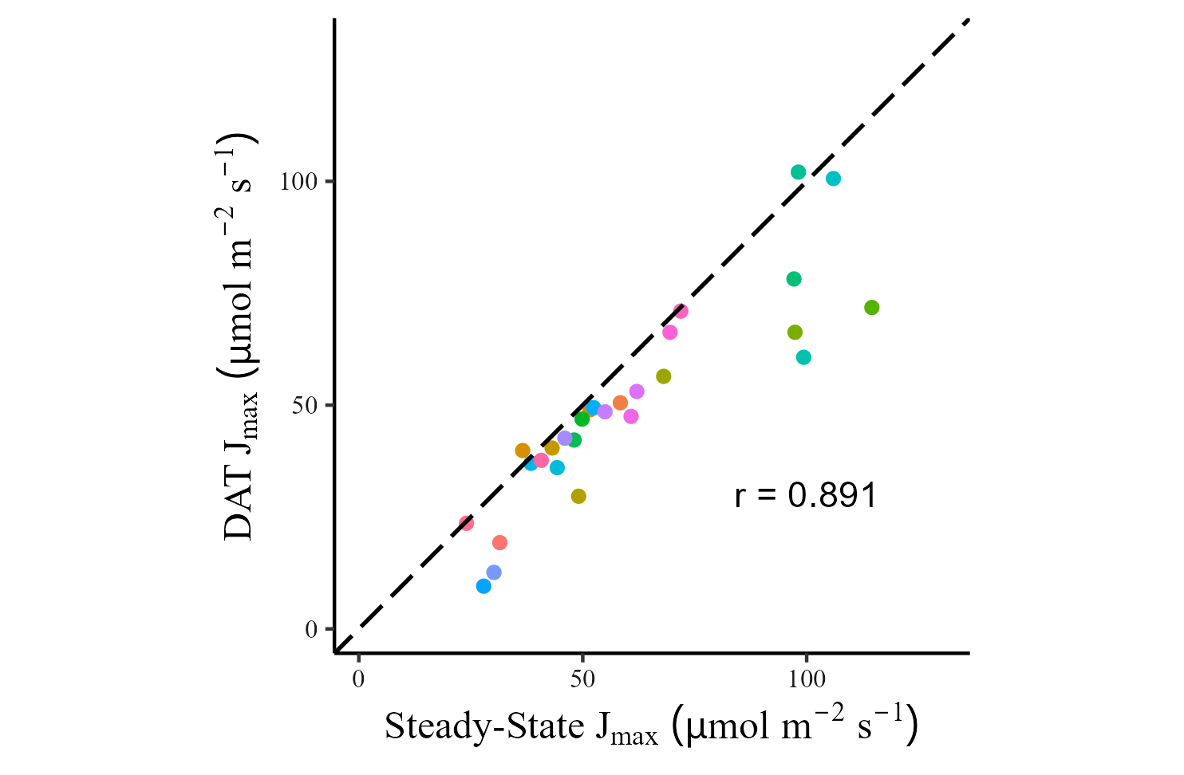
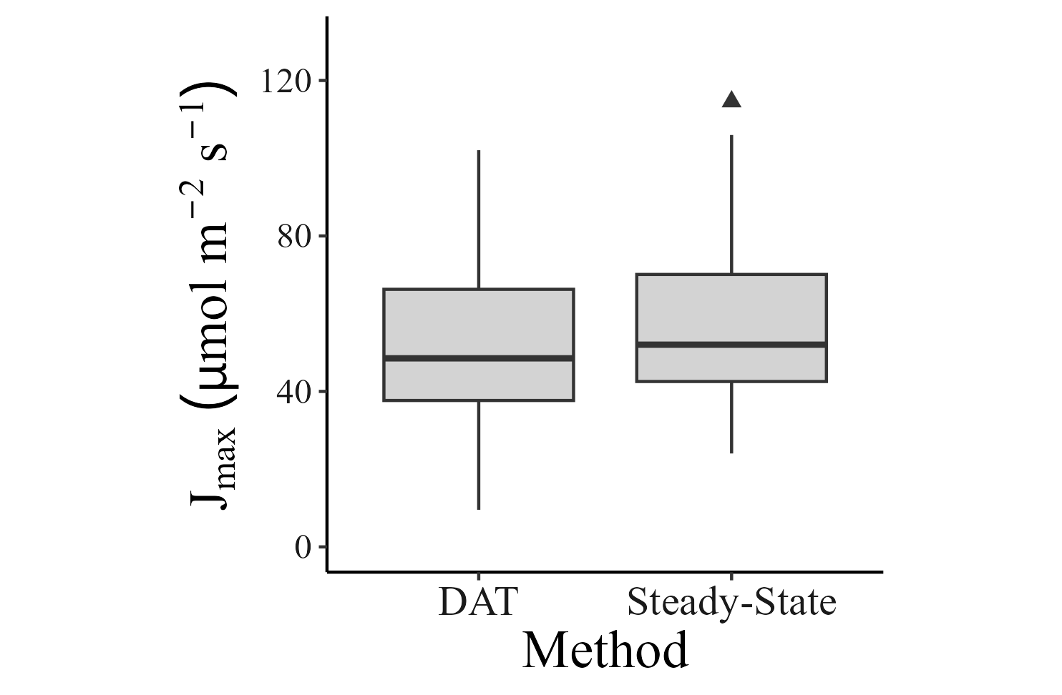
Without TPU
Notes:
Full dataset of Jmax, without TPU fitting

Slide 6
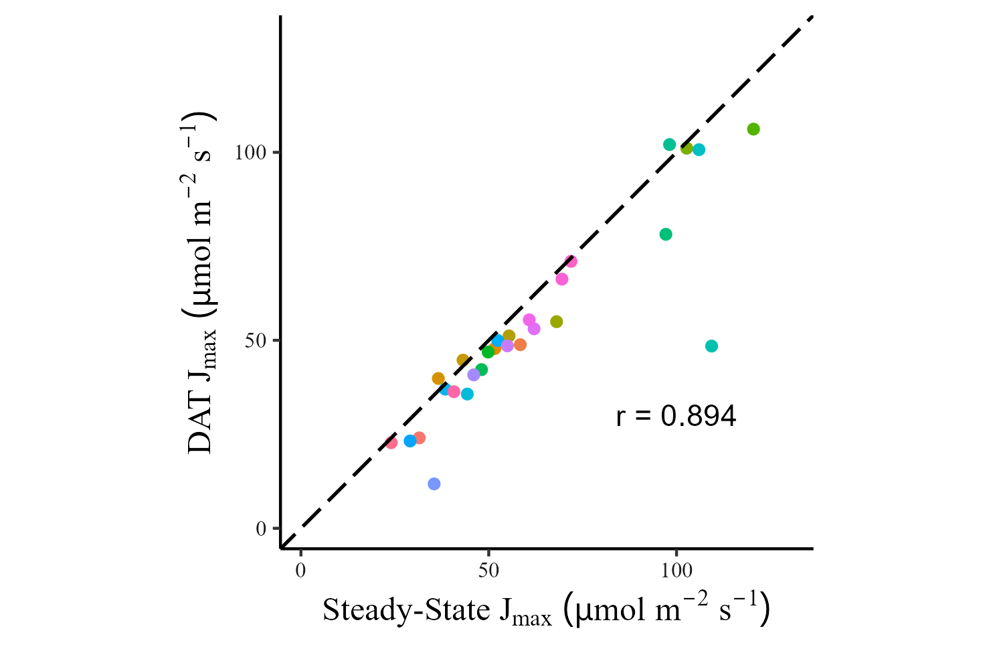

With TPU

Slide 7
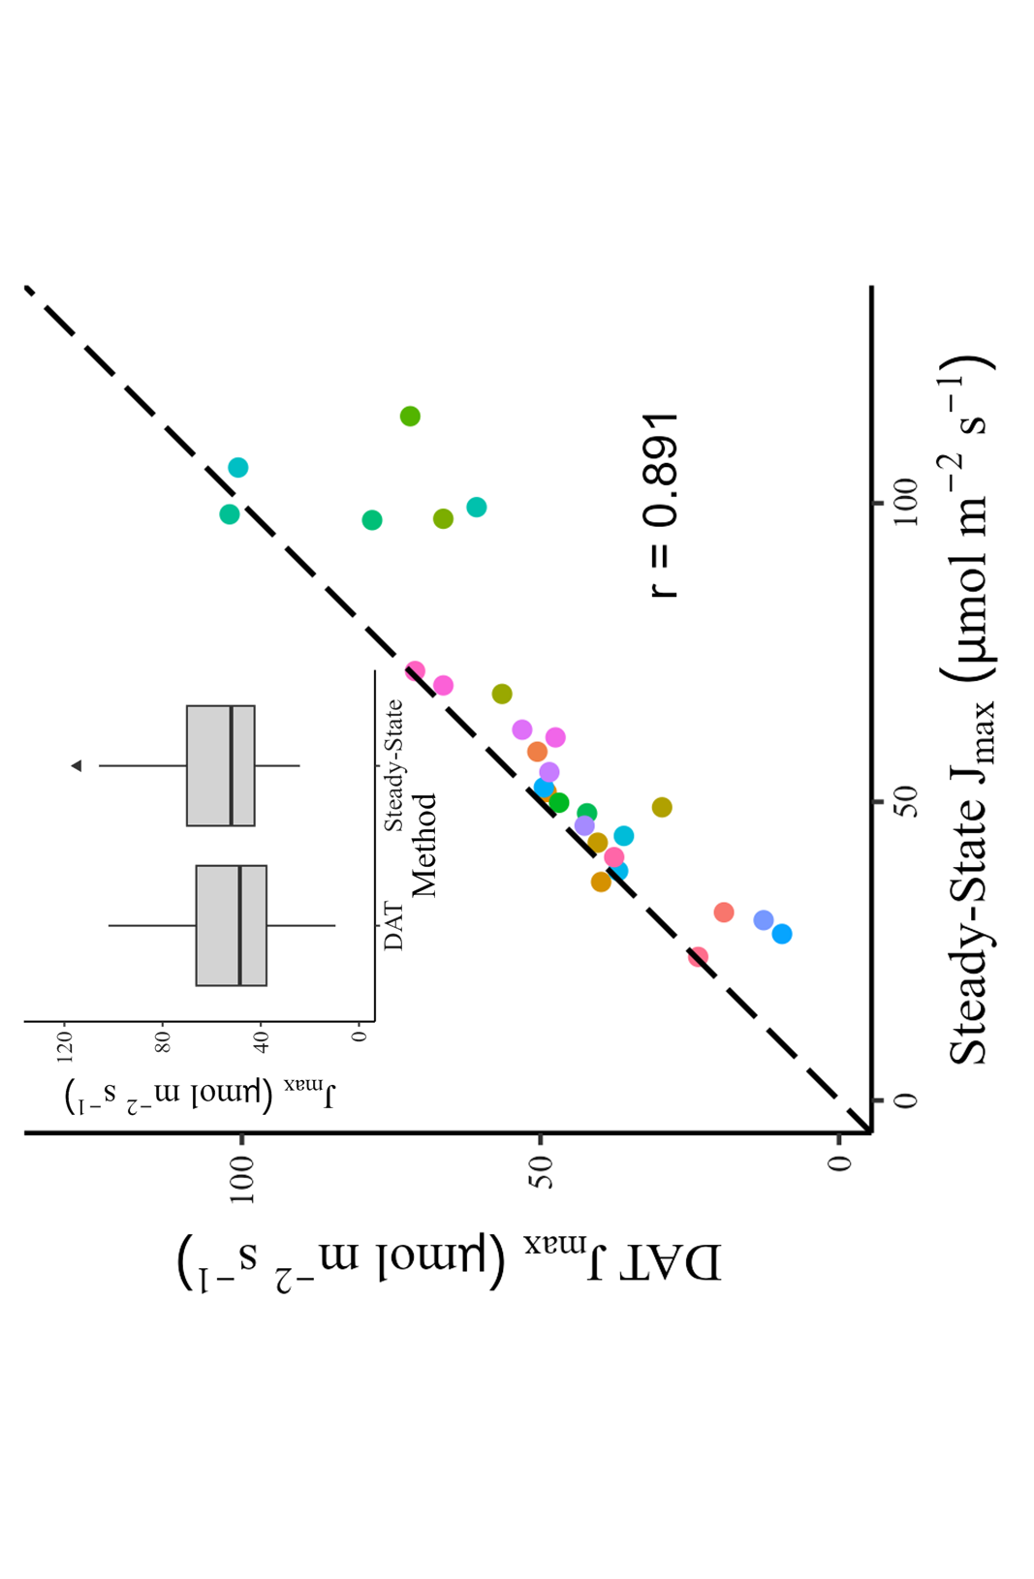
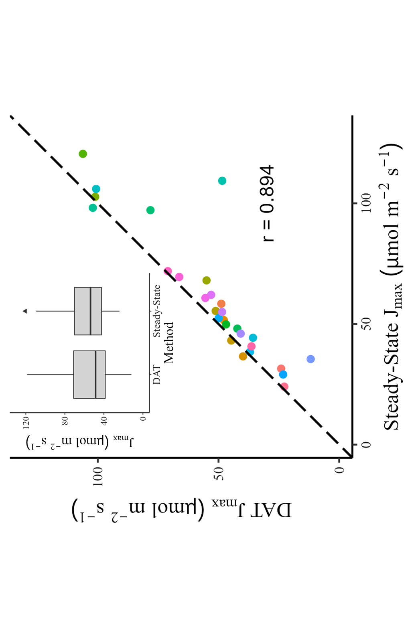
Figure 3: Comparison of J_{max} between DAT and Steady-State. There was a marginal but significant difference between curve types when TPU was not fit (a) but not when TPU was fit (b). Error bars represent the standard errors derived from the model (many of which are smaller than the points and not visibly distinguishable). Colors represent individual leaves.
a
b
Without TPU
With TPU

Slide 8
