Slide 1
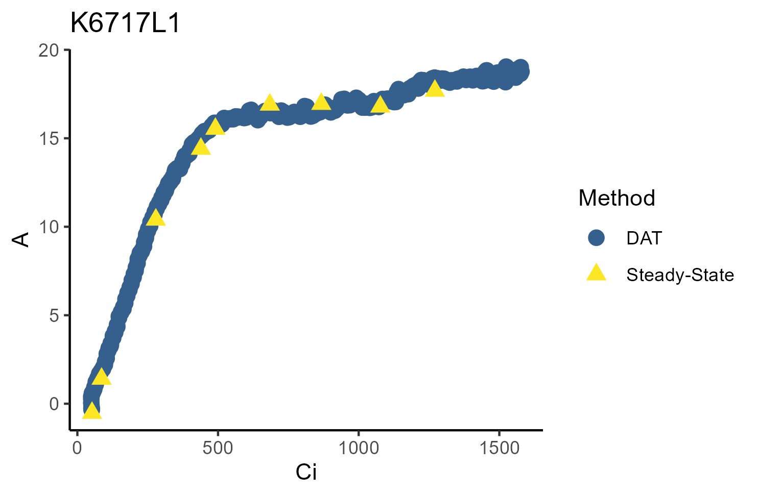
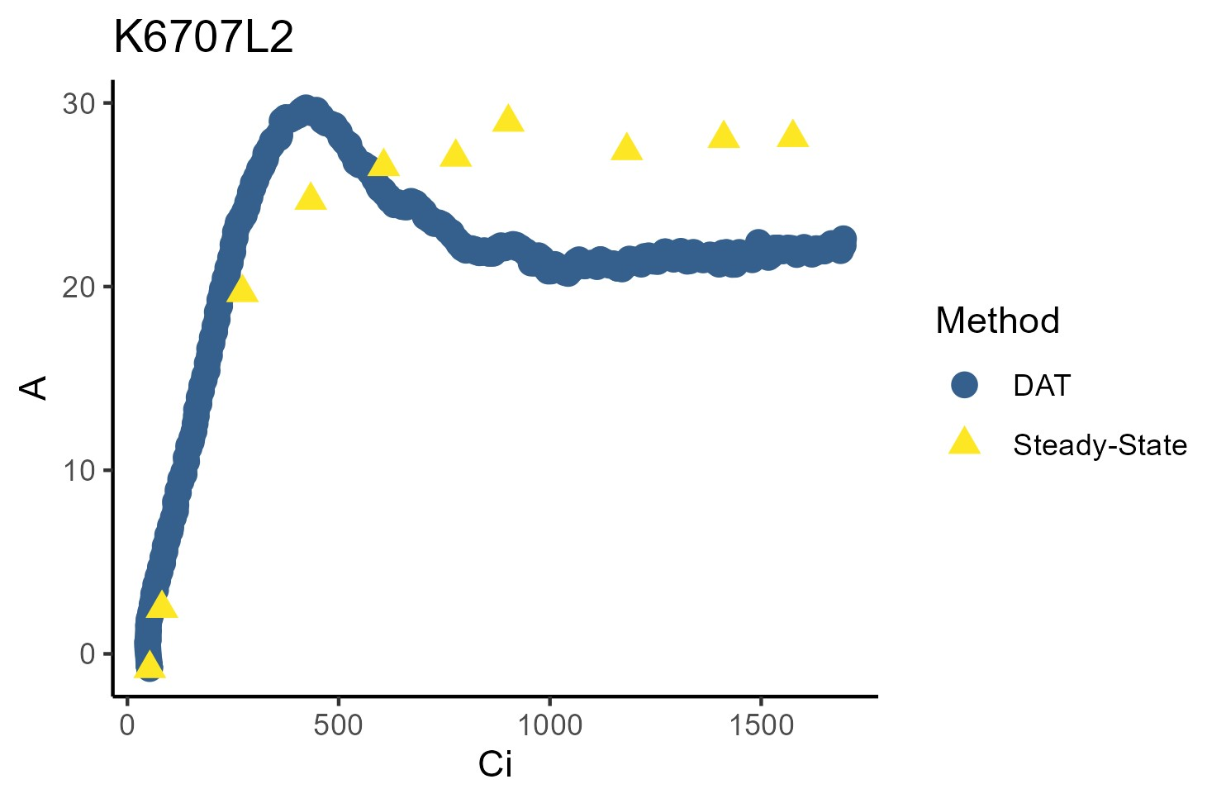
a
b
Aparisthmium cordatum, Leaf 1
Tachigali chrysophylla, Leaf 2
A (μmol m⁻² s⁻¹)
A (mol m⁻² s⁻¹)
C_{i} (μmol mol⁻¹)
C_{i} (μmol mol⁻¹)
Figure 1: Example curves of assimilation (A) versus intercellular CO2 concentration (Ci), where the DAT method aligned with the steady-state traditional method (a), or showed overshoot (b). Curves with overshoot exhibited Rubisco-limited A rates similar to steady-state before peaking in the RuBP-limited region, often exceeding steady-state limitations. This was followed by a rapid decline in A and subsequent plateau at rates below steady-state rates and, in some cases, a subtle increase in A in the latter portions of the curve.

Slide 2
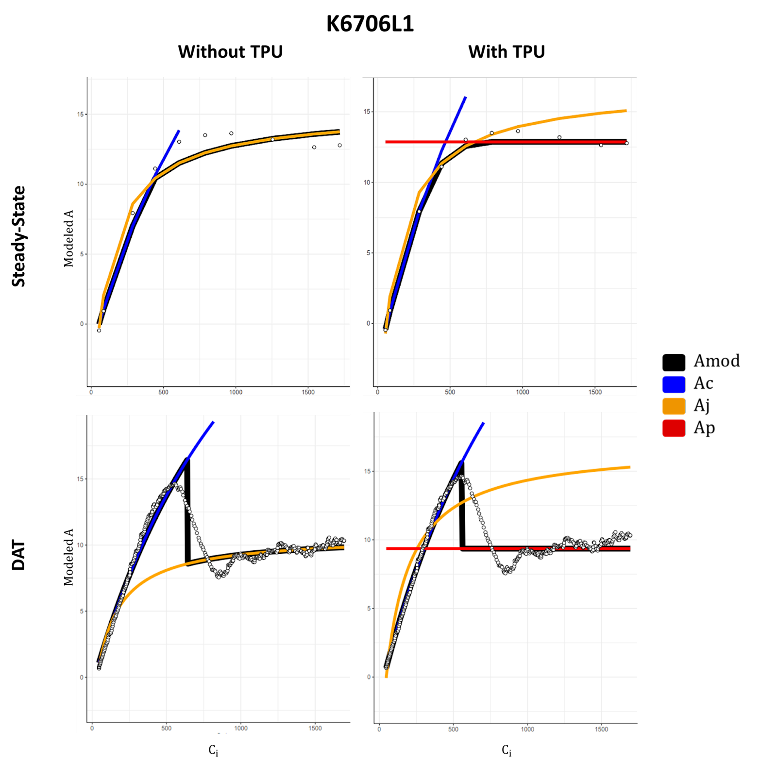
Figure 2: Example steady-state and DAT curve fits, both with and without TPU fitting enabled. The full set of curve fits is provided in Figure S2.

Slide 3
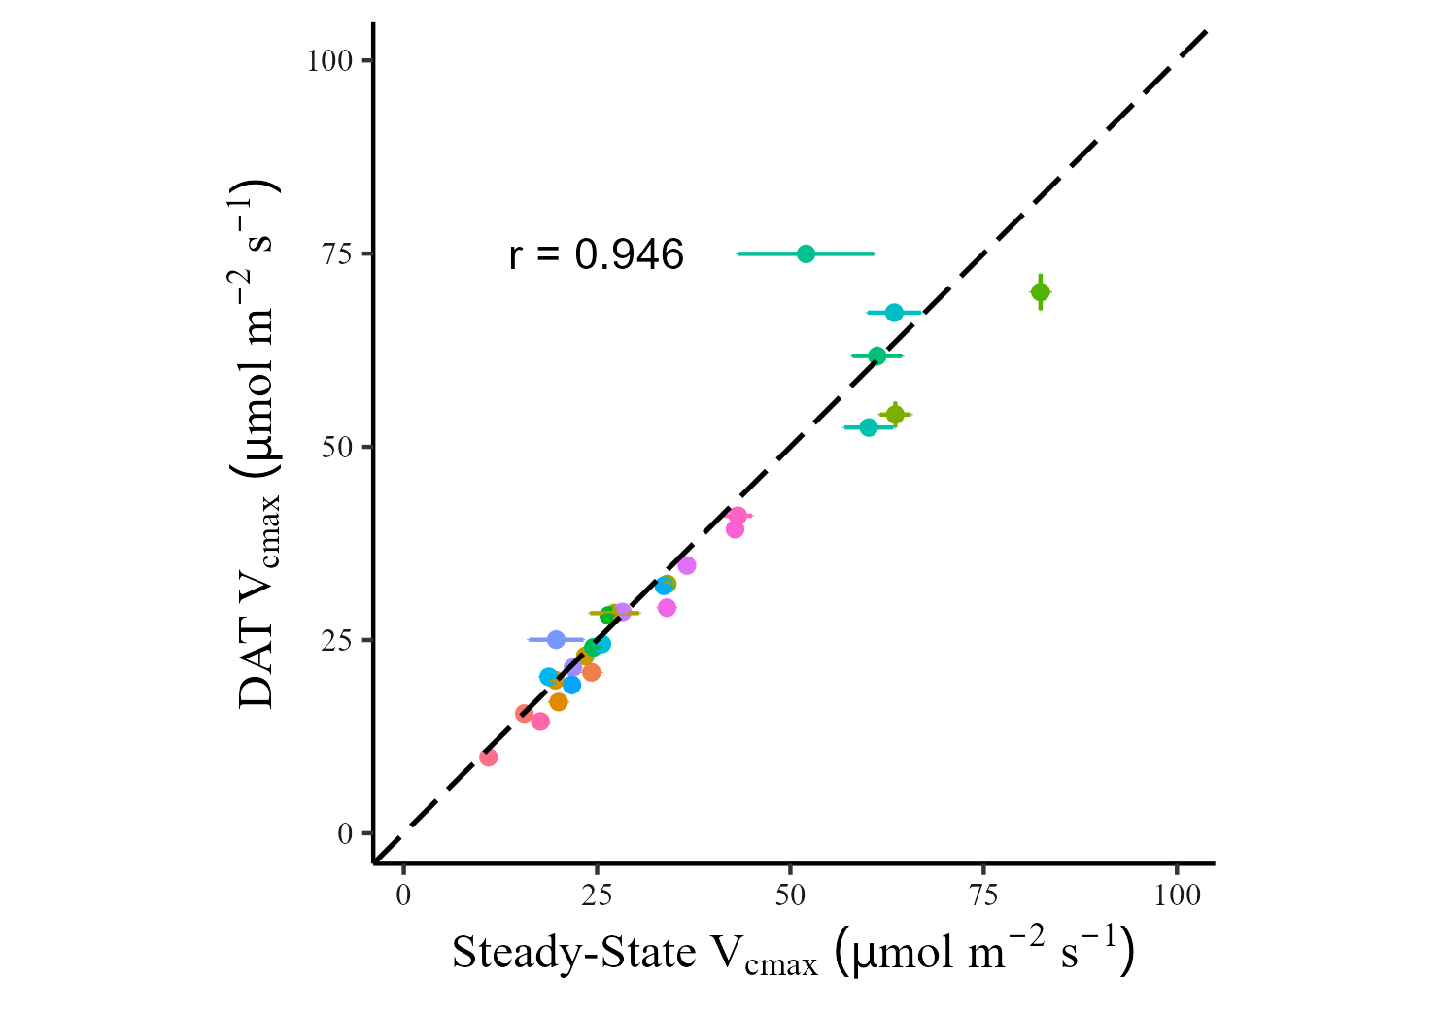
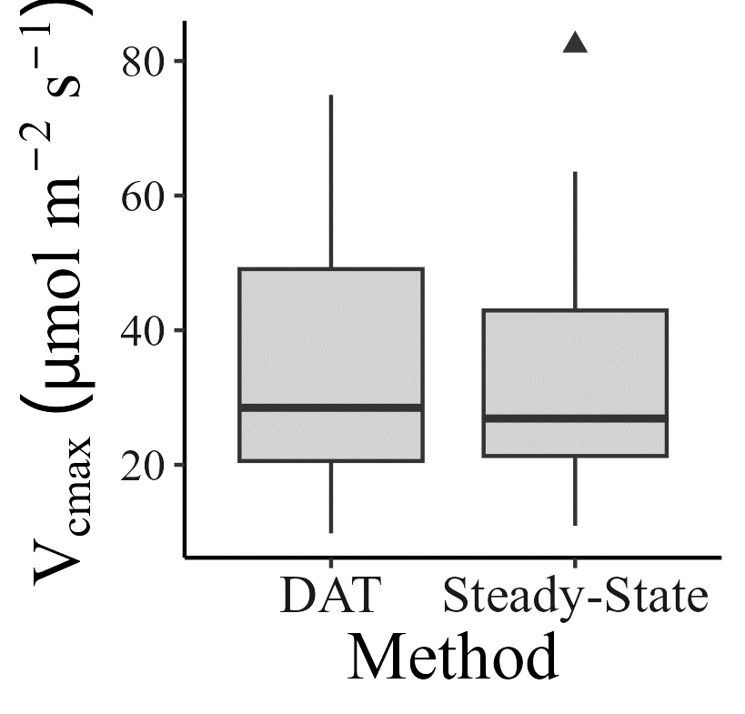
Without TPU
Notes:
Full dataset of Vcmax, without TPU fitting

Slide 4
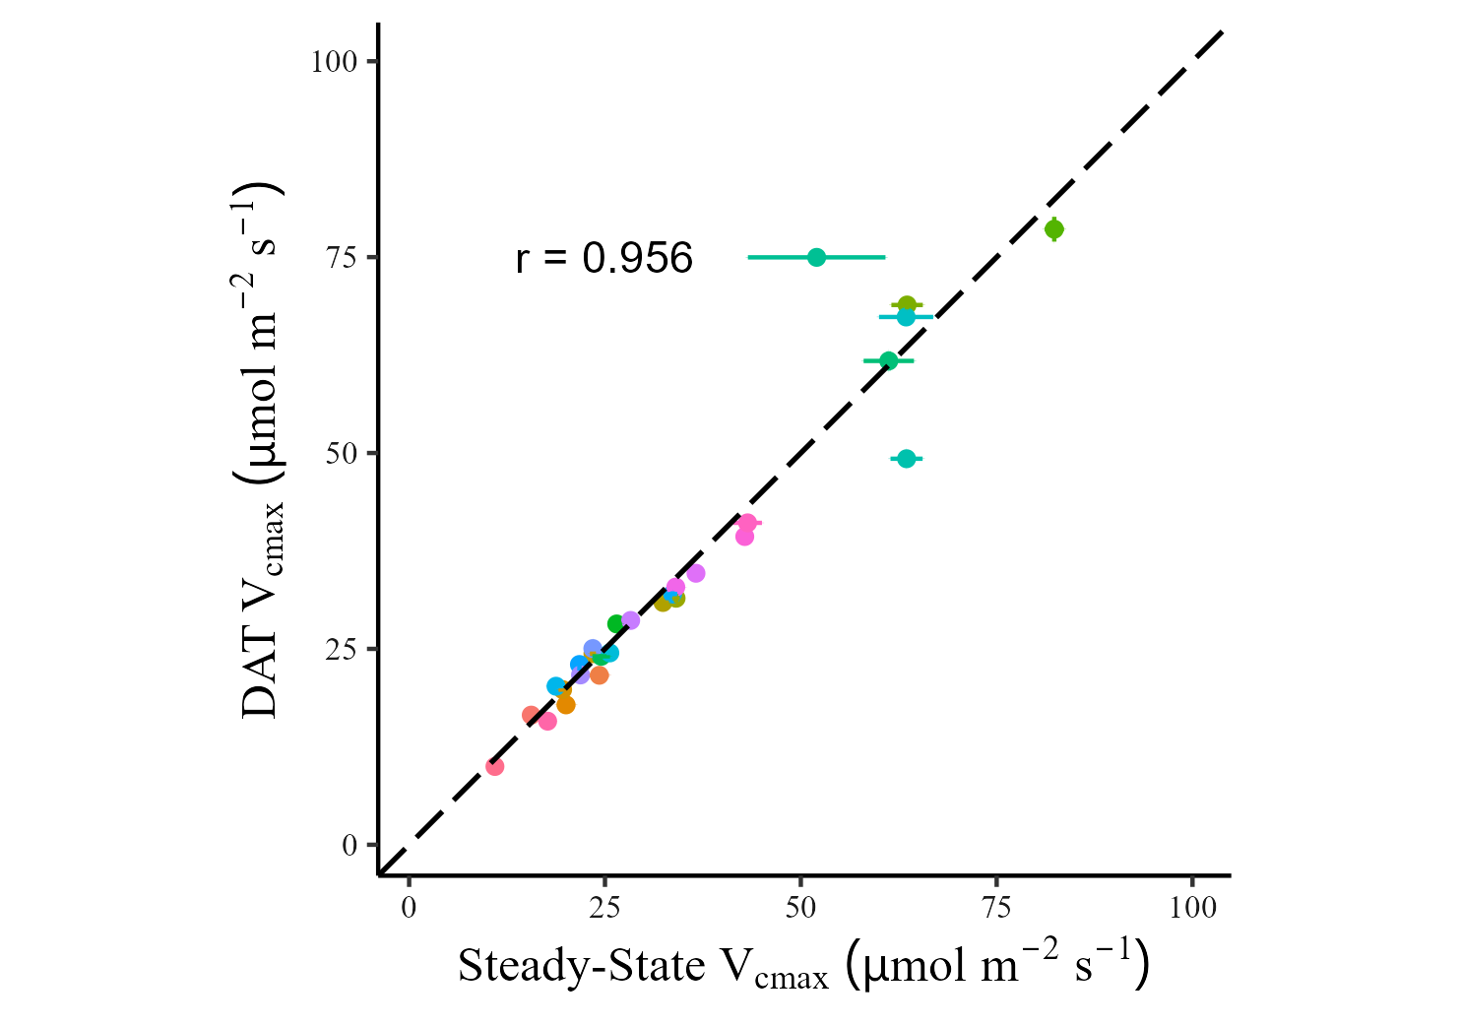
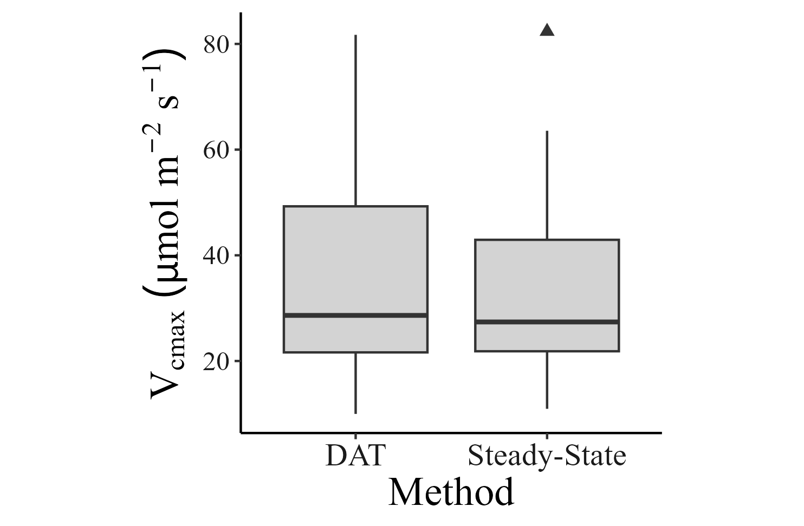
With TPU
Notes:
Full dataset of Vcmax, with TPU fitting

Slide 5
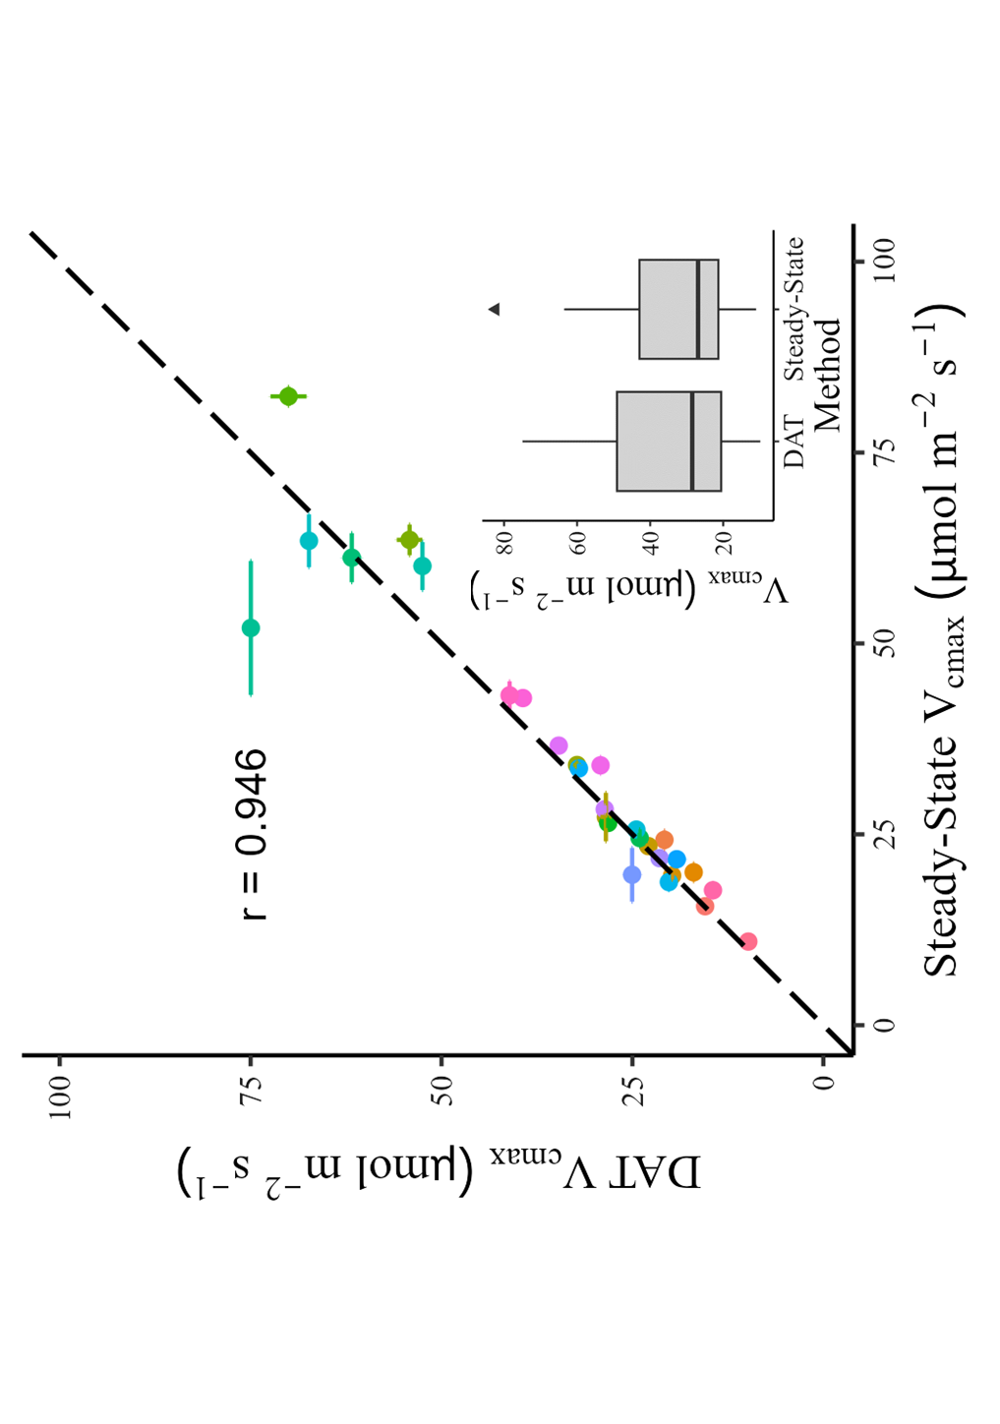
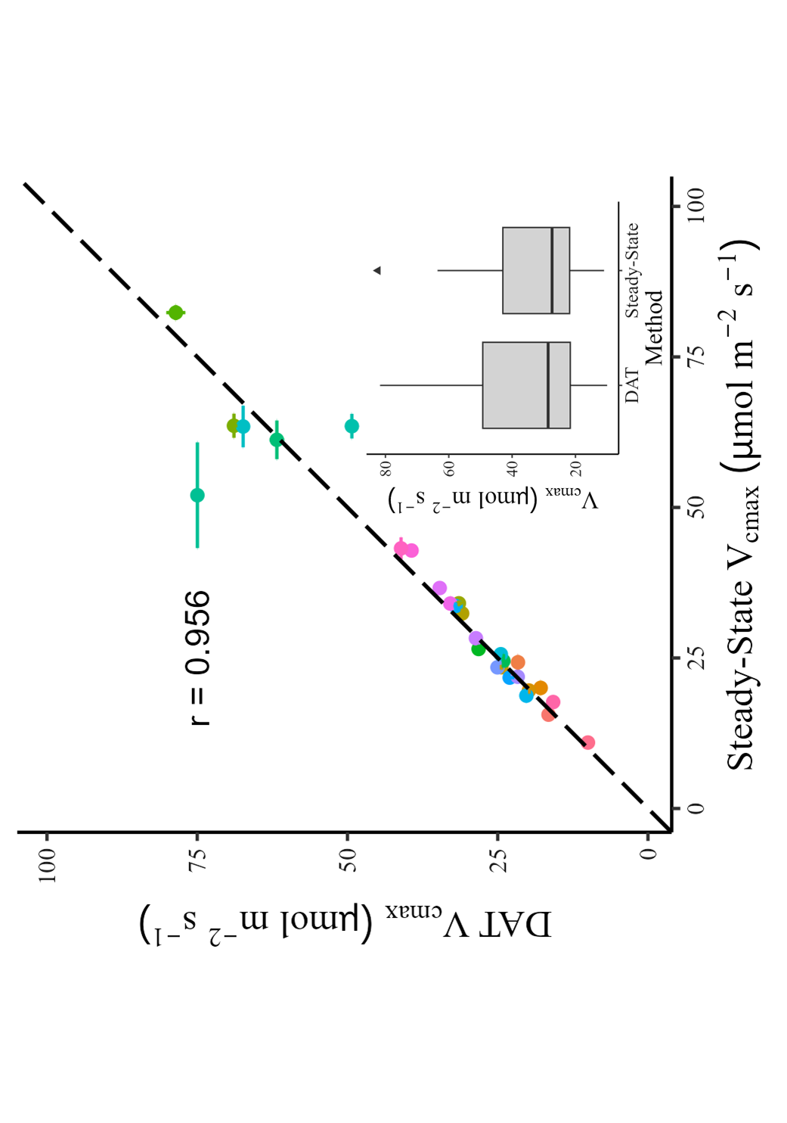
Figure 2: Comparison of V_{cmax} between DAT and Steady-State. There was a marginal but significant difference between curve types when TPU was not fit (a) but not when TPU was fit (b). Error bars represent the standard errors derived from the model (many of which are smaller than the points and not visibly distinguishable). Colors represent individual leaves.
a
b
Without TPU
With TPU

Slide 6
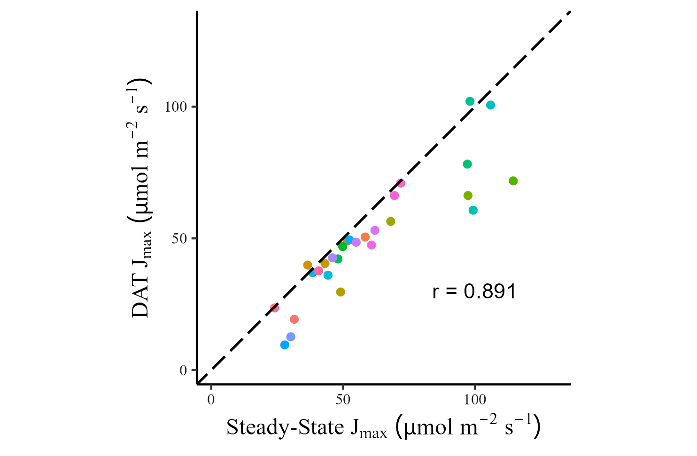
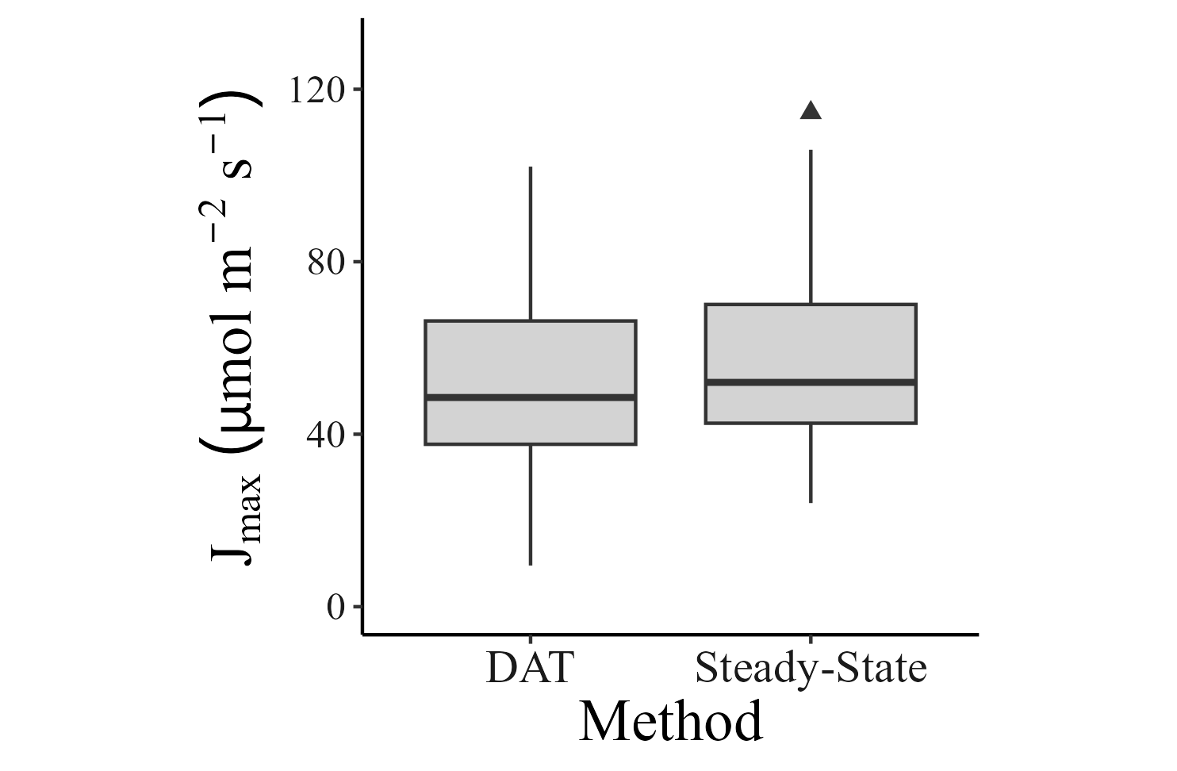
Without TPU
Notes:
Full dataset of Jmax, without TPU fitting

Slide 7
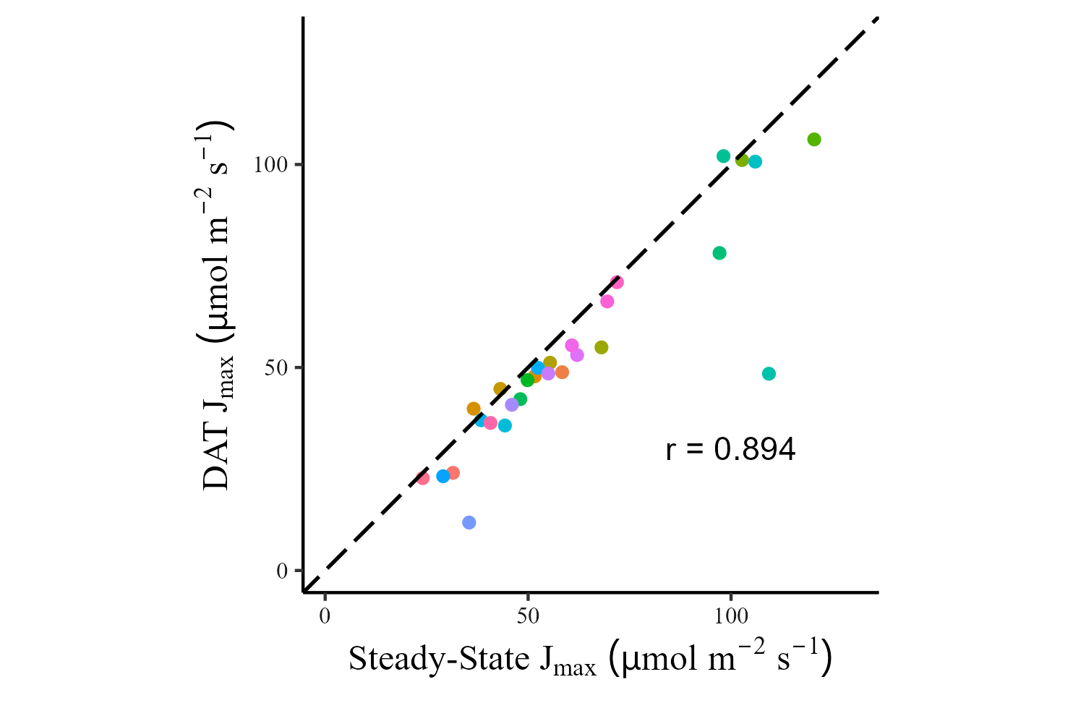

With TPU

Slide 8
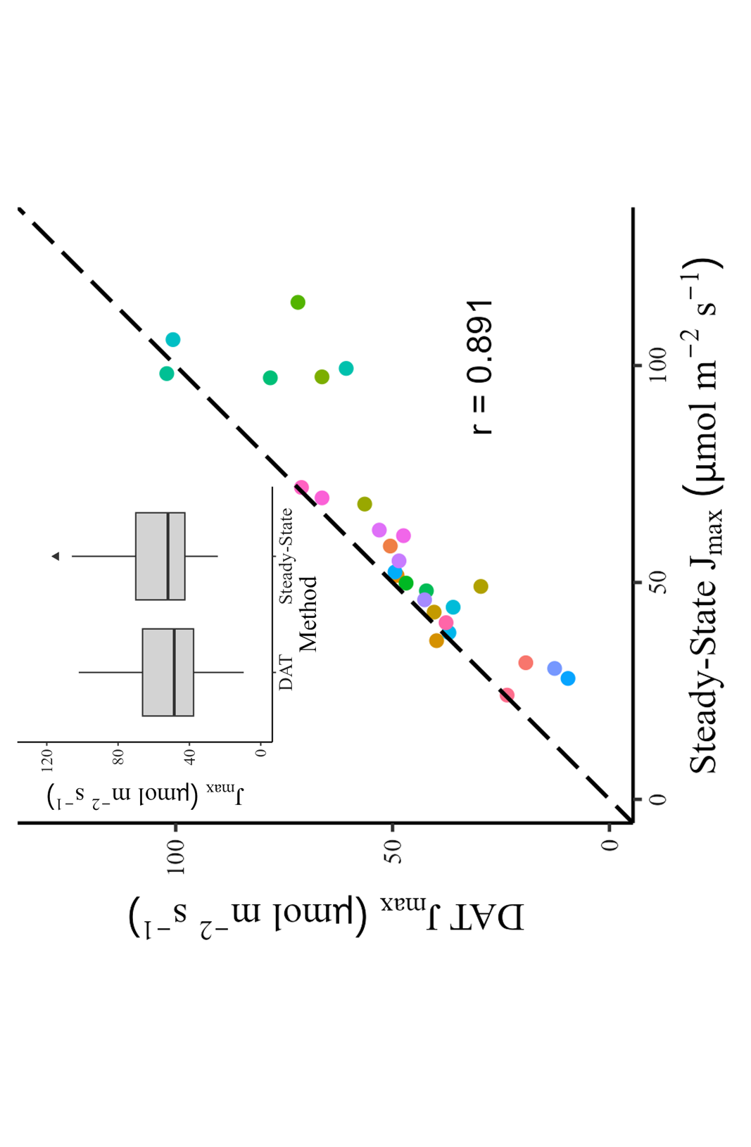
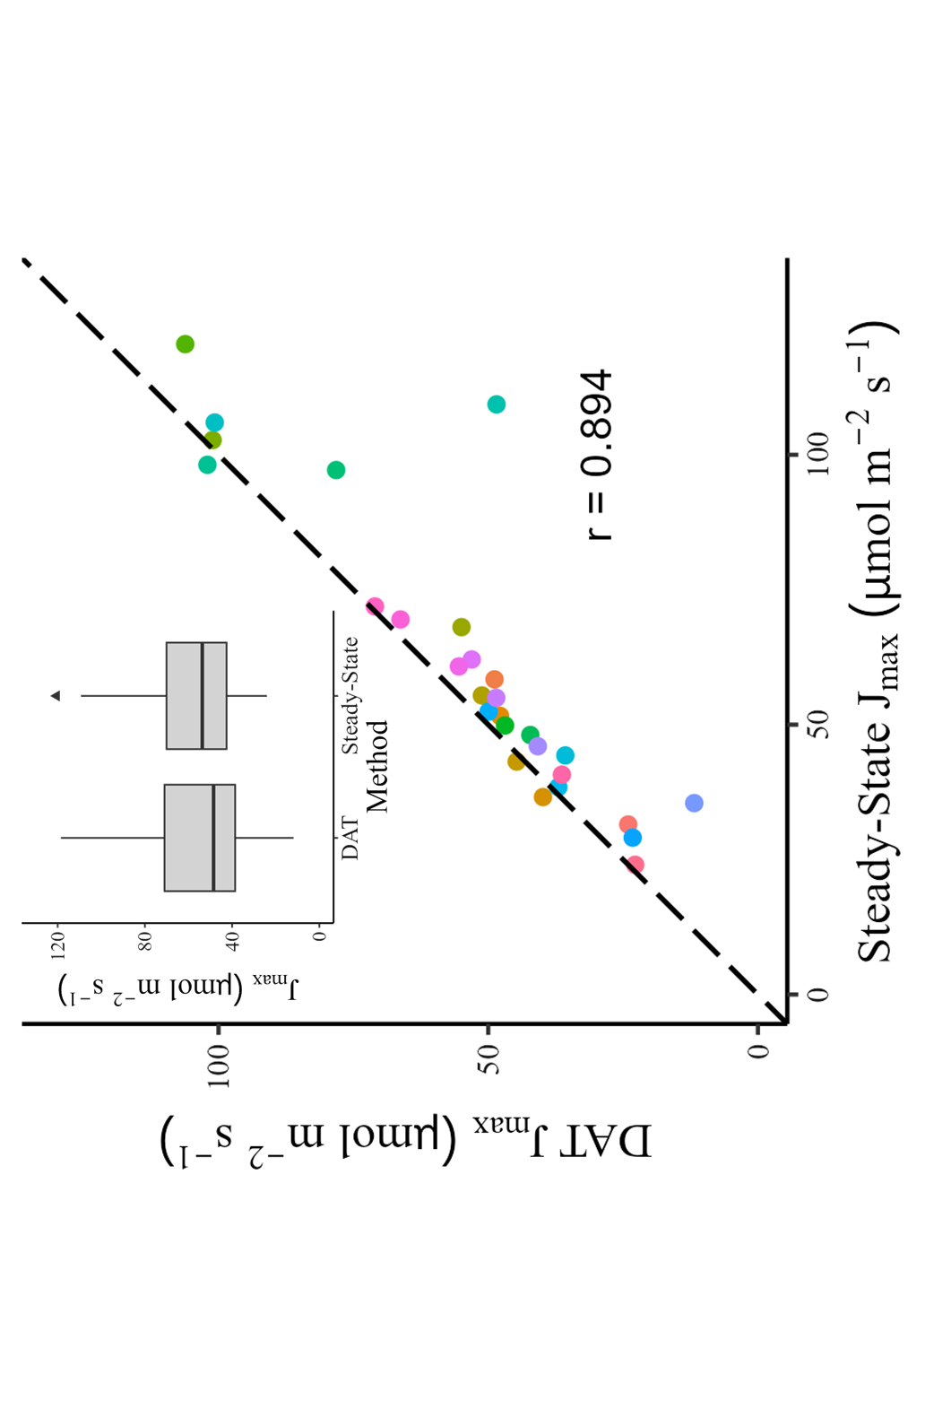
Figure 3: Comparison of J_{max} between DAT and Steady-State. There was a marginal but significant difference between curve types when TPU was not fit (a) but not when TPU was fit (b). Error bars represent the standard errors derived from the model (many of which are smaller than the points and not visibly distinguishable). Colors represent individual leaves.
a
b
Without TPU
With TPU

Slide 9
