Slide 1
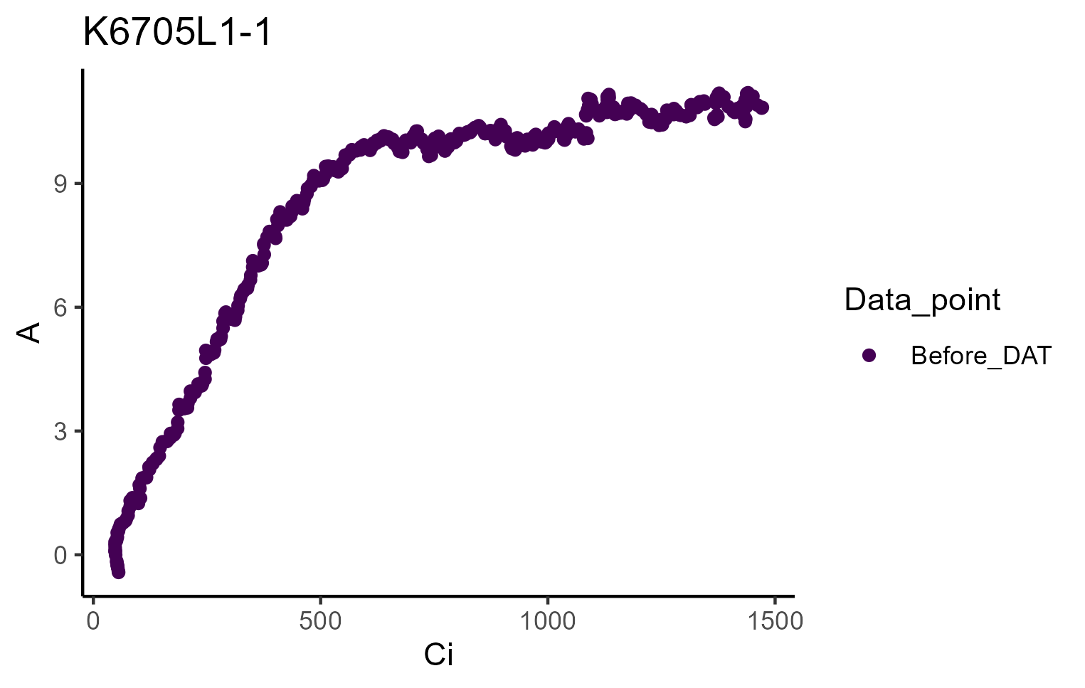


Figure S1: “Backwards” points observed at the beginning of each DAT curve.

Slide 2
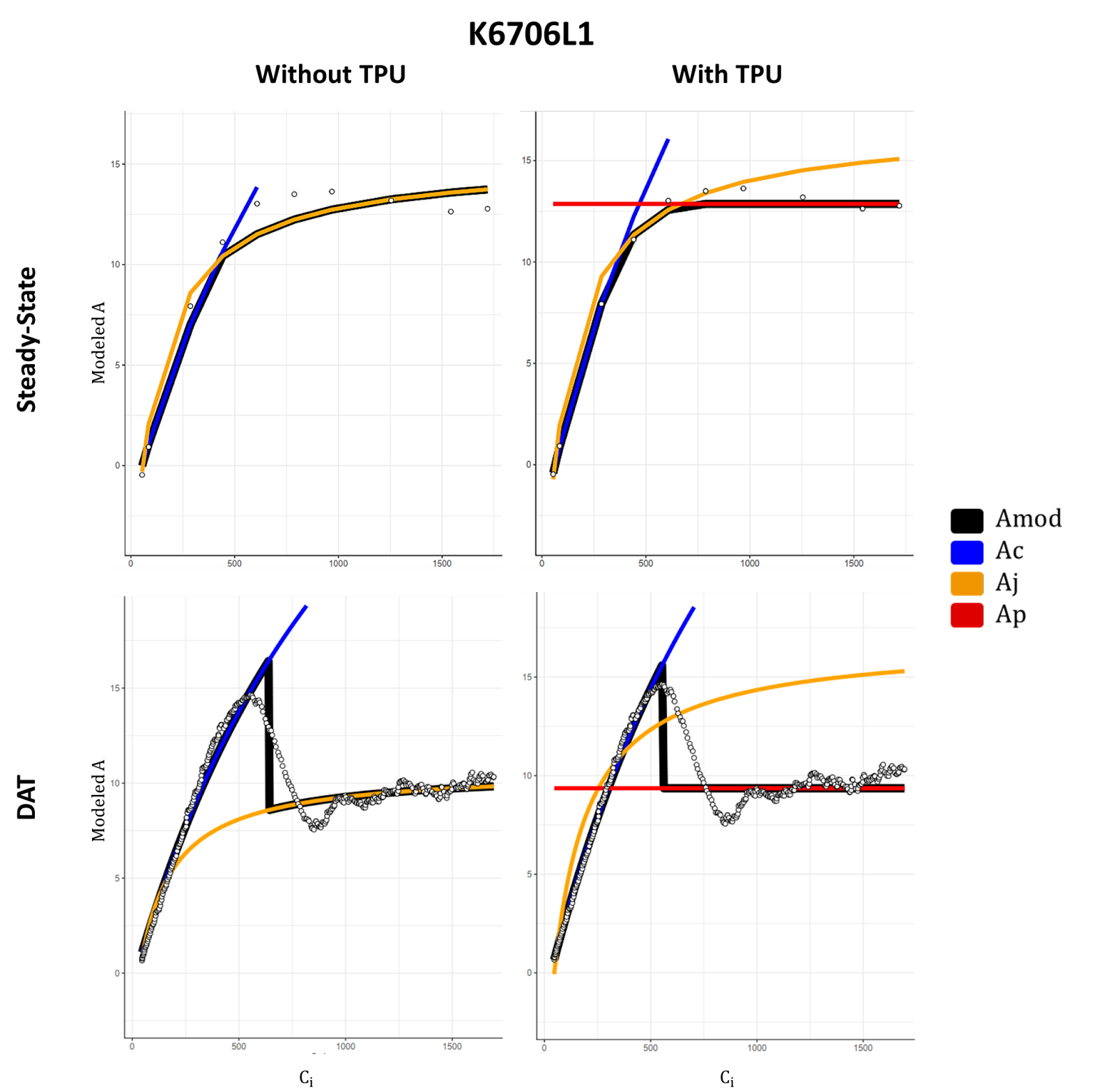
Figure S2: Steady-State and DAT curve fit with and without TPU fitting. Each panel represents a specific leaf with the tree species and leaf number. Those leaves where multiple DAT curves were run are also presented.

Slide 3
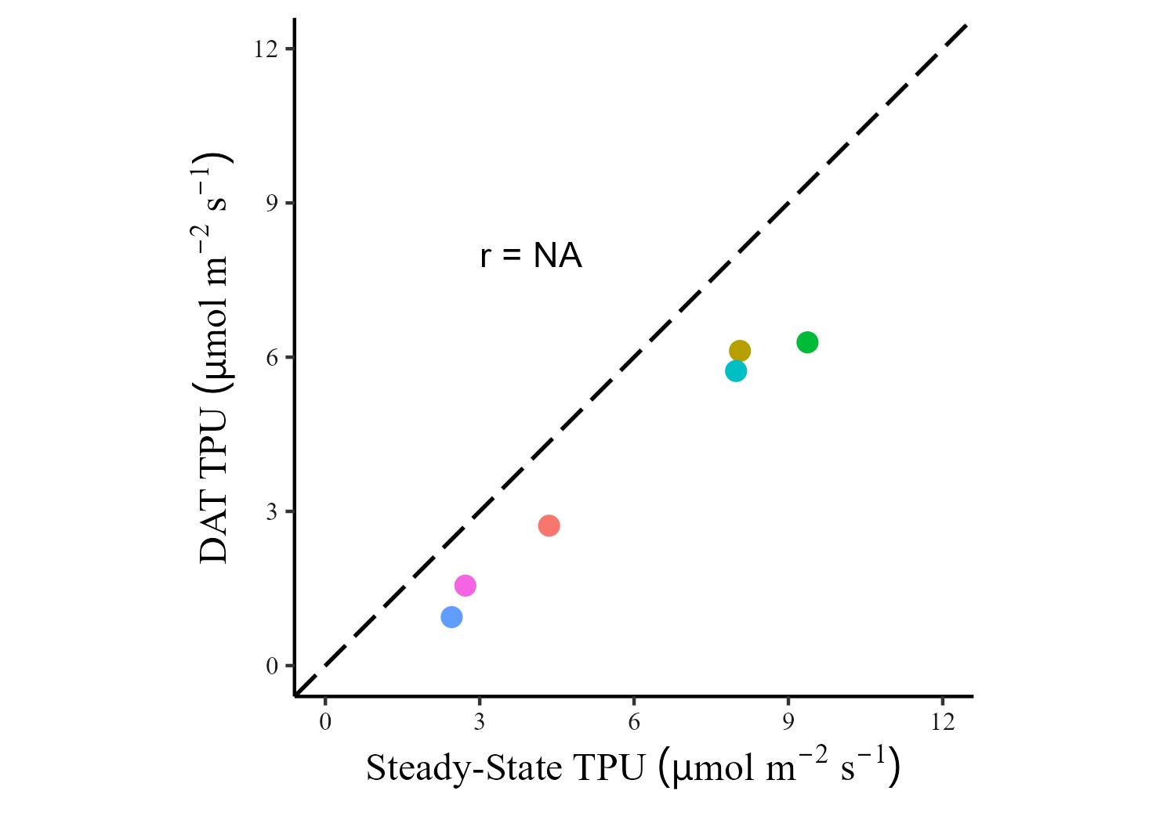
Figure S3: Comparison of TPU between DAT and steady-state curves. TPU was consistently underestimates in DAT curves as compared to steady-state.

Slide 4
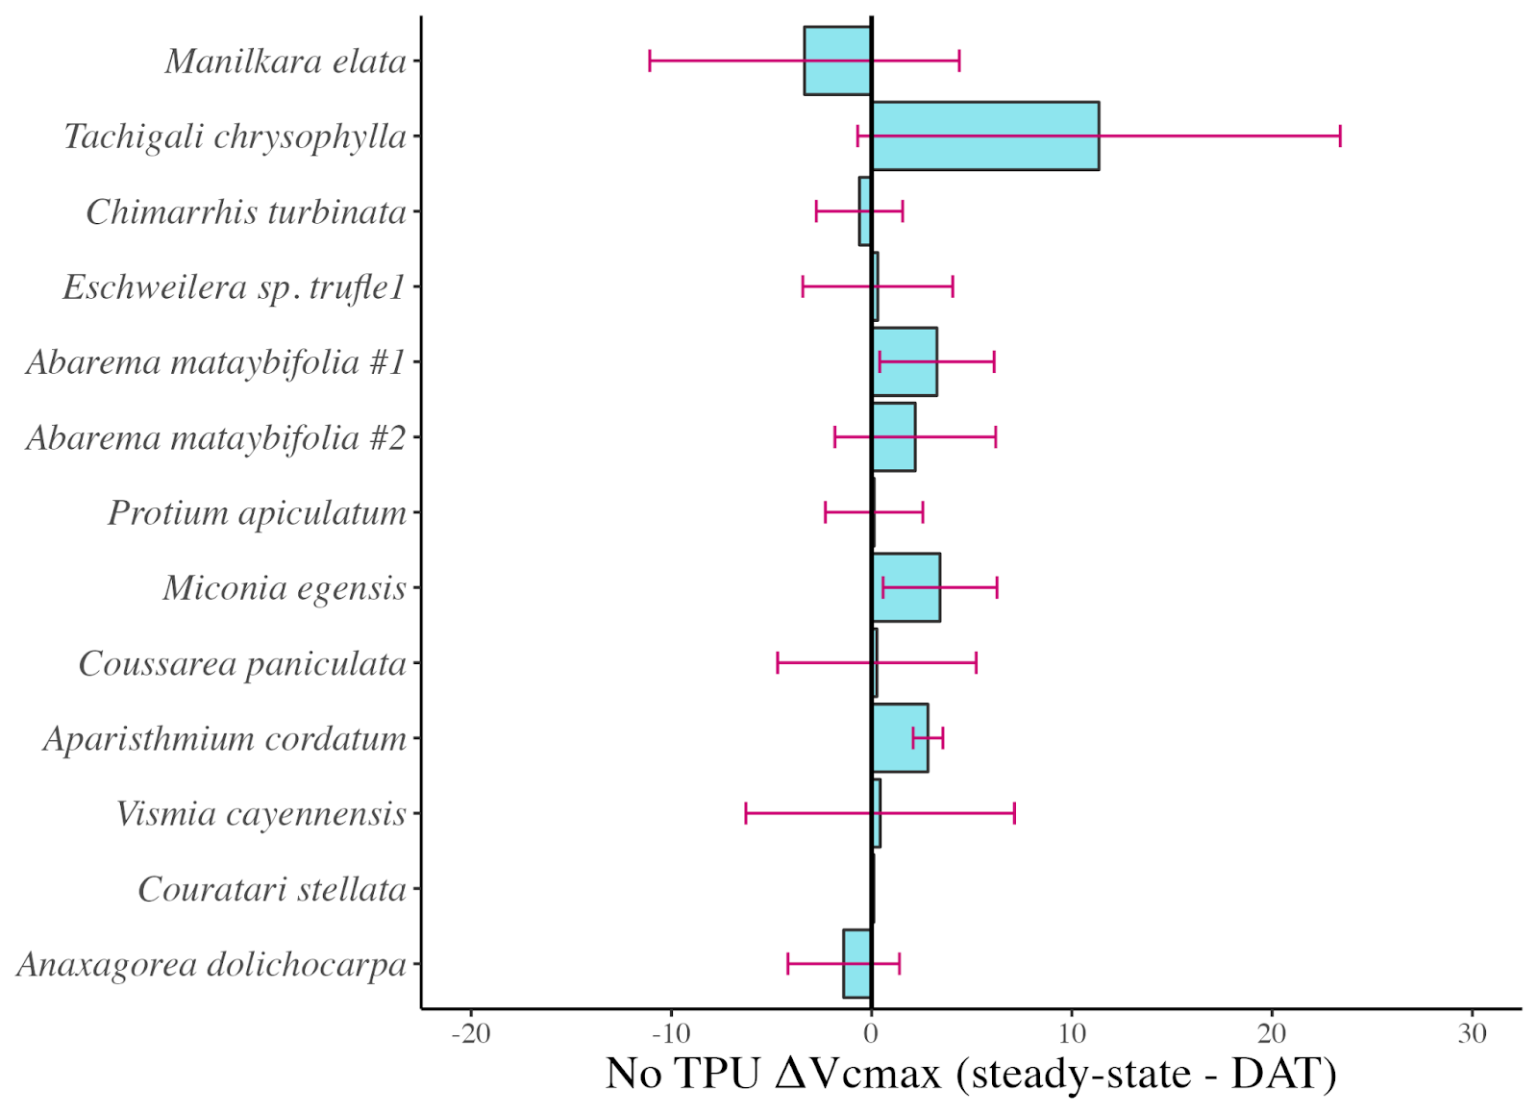
Figure S4. Vcmax differences (steady-state minus DAT) on a species basis for curves without TPU fitting. The large delta observed in Tachigali chrysophylla drives the statistically significant difference. Error bars represent the mean of the absolute standard deviations for DAT and steady-state parameter estimates. Species are organized by relative canopy height.

Slide 5
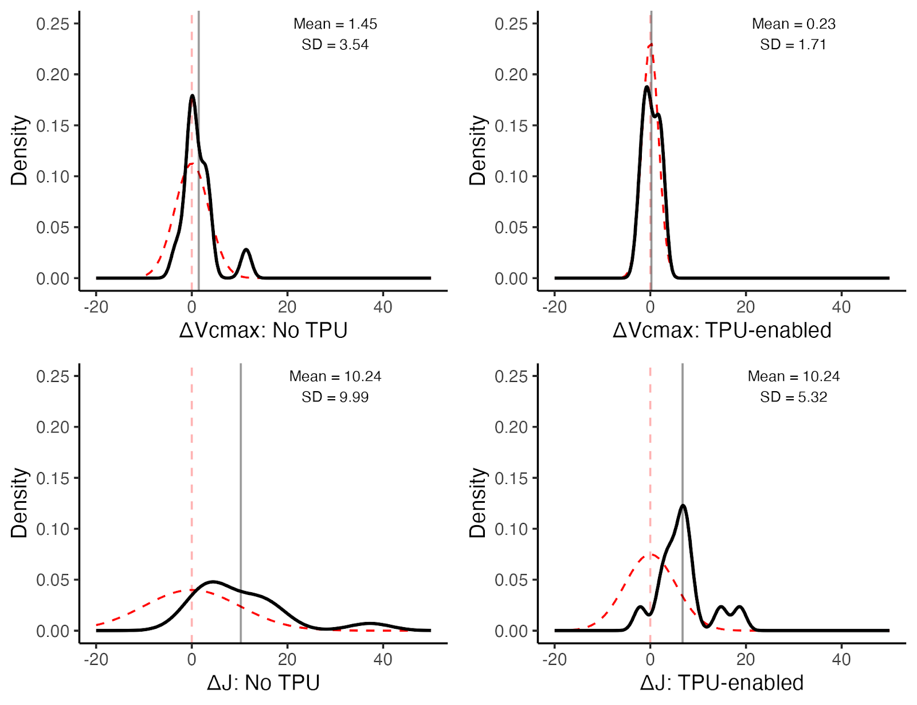
Figure S5: Density distribution of the difference between steady-state and DAT parameter estimates (solid black line). The mean of the difference is indicated with a solid gray line. Dashed red lines indicate a normal distribution with a mean of 0 and a standard deviation of the data within a given panel.

Slide 6
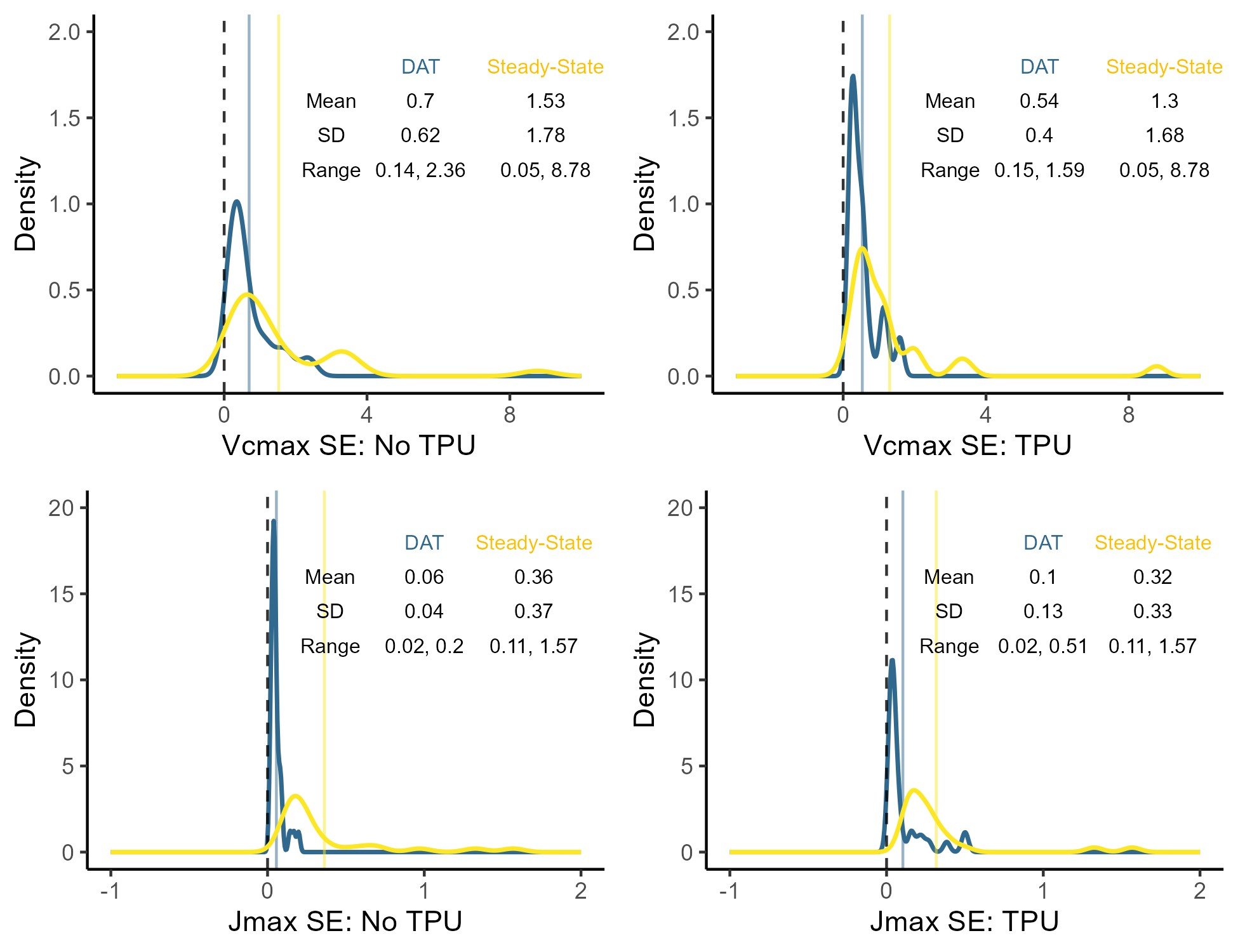
Figure s#: Density distribution of standard errors for calculated V_{cmax} and J_{max}. DAT distributions and means are represented in blue, steady-state distributions and means are represented in yellow, and Steady-state standard errors were higher than those derived from DAT.

