Slide 1
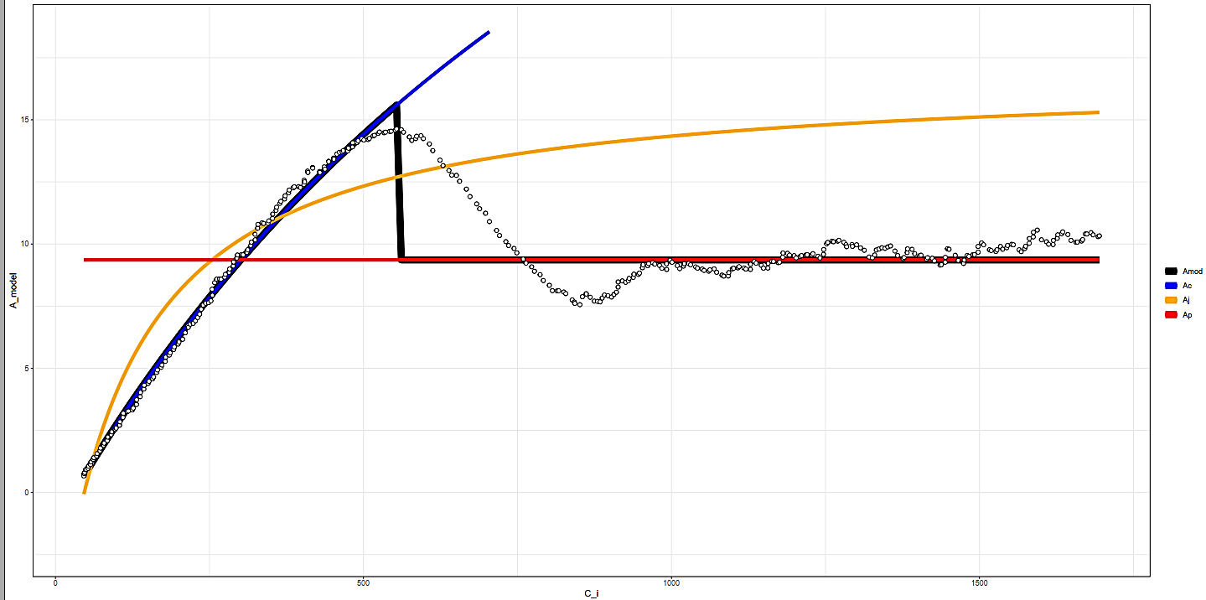

K6706L1
15
Modeled A
10
5
Amod
Ac
Aj
Ap
0
0
500
1000
1500
$$C_{i}$$

Slide 2
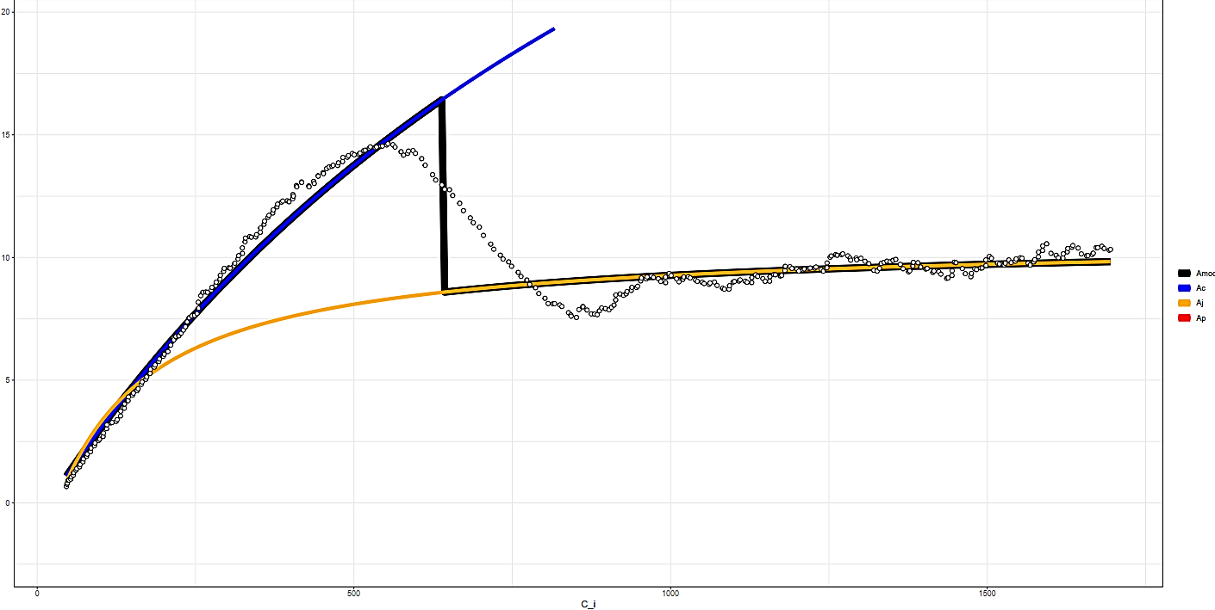
K6706L1
15
Modeled A
10
5
Amod
Ac
Aj
Ap
0
0
500
1000
1500
$$C_{i}$$

Slide 3
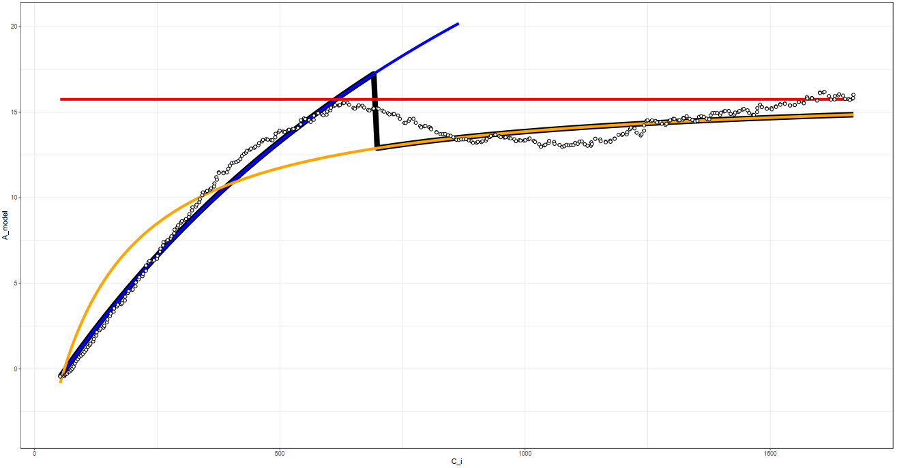

K6706L2
20
15
Modeled A
10
5
Amod
Ac
Aj
Ap
0
0
500
1000
1500
$$C_{i}$$

Slide 4

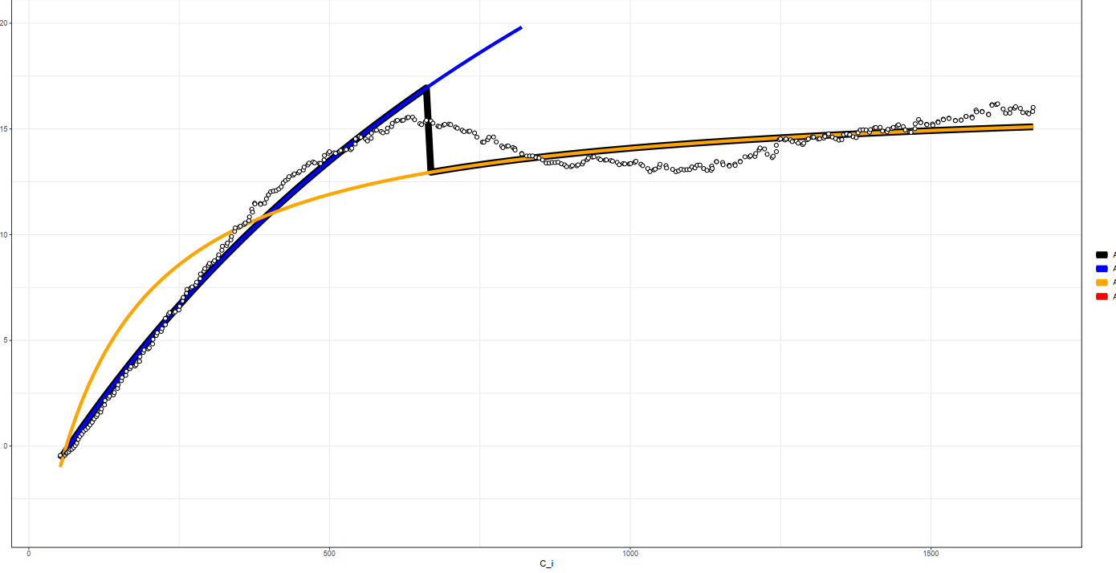
20
15
Modeled A
10
5
Amod
Ac
Aj
Ap
0
0
500
1000
1500
$$C_{i}$$

Slide 5
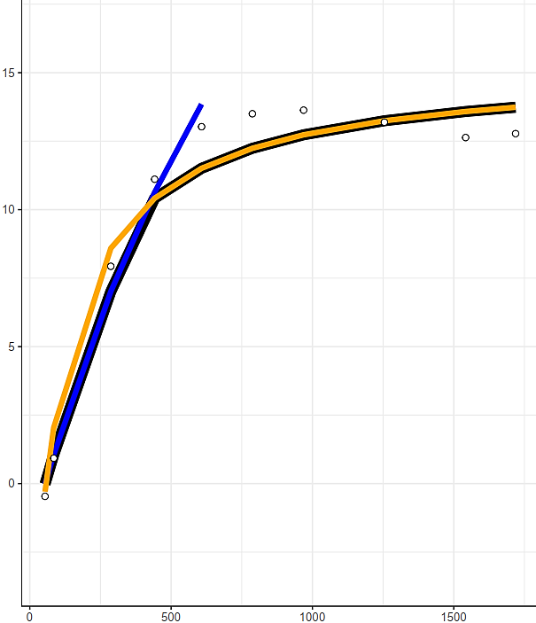
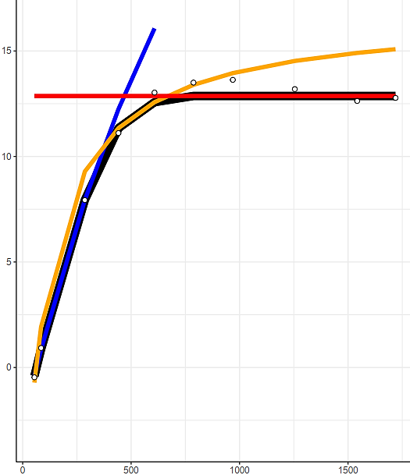
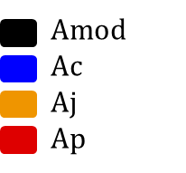
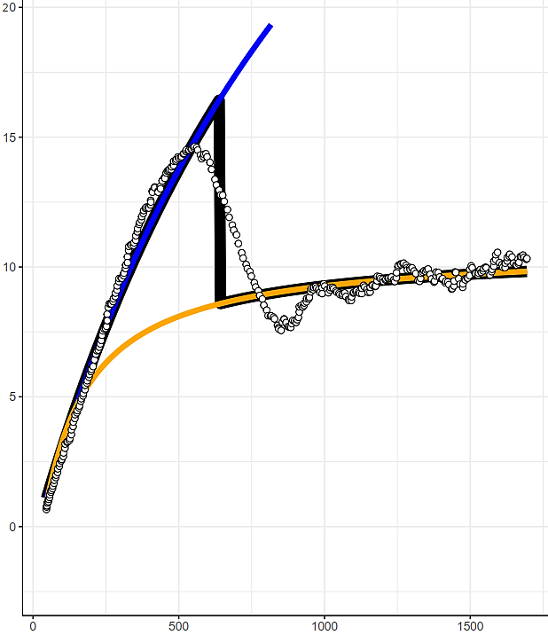
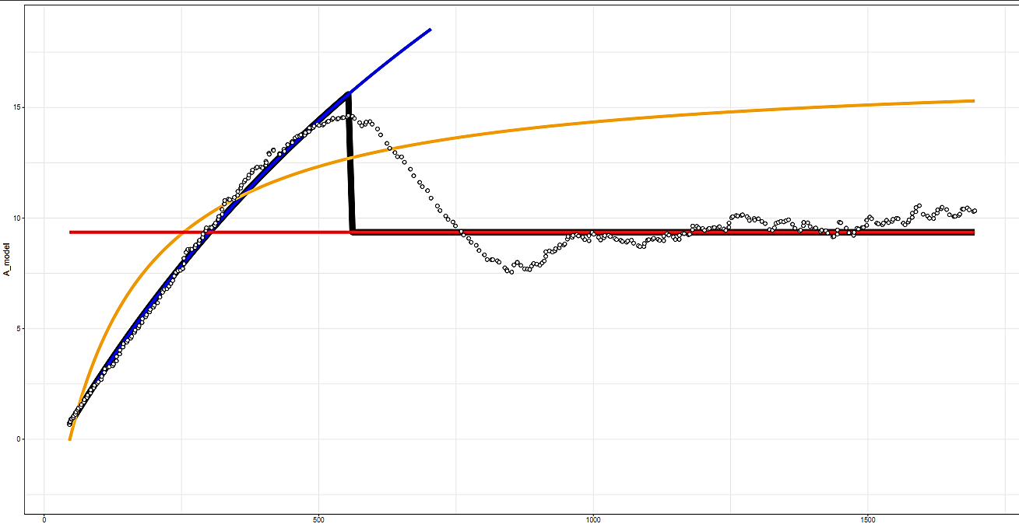


K6706L1
Without TPU
With TPU
Modeled A
Steady-State
DAT
Modeled A
$$C_{i}$$
$$C_{i}$$

