Slide 1
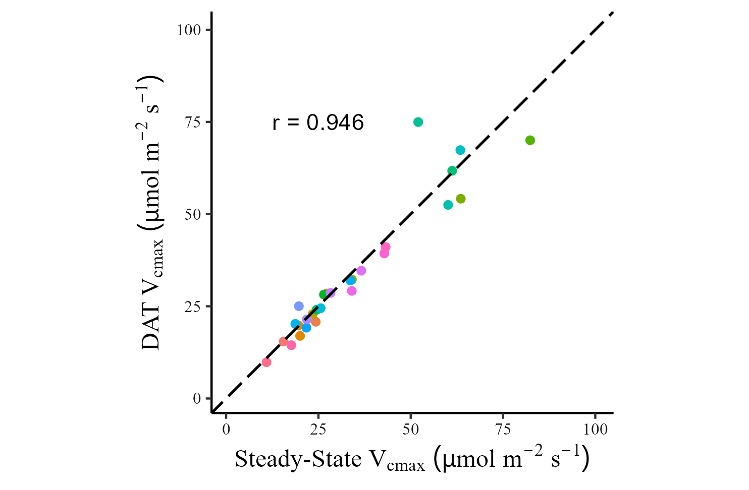
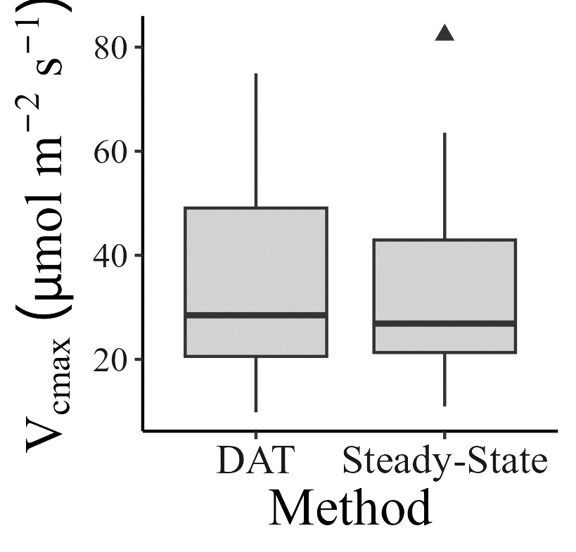
Without TPU
*
Notes:
Full dataset of Vcmax, without TPU fitting

Slide 2
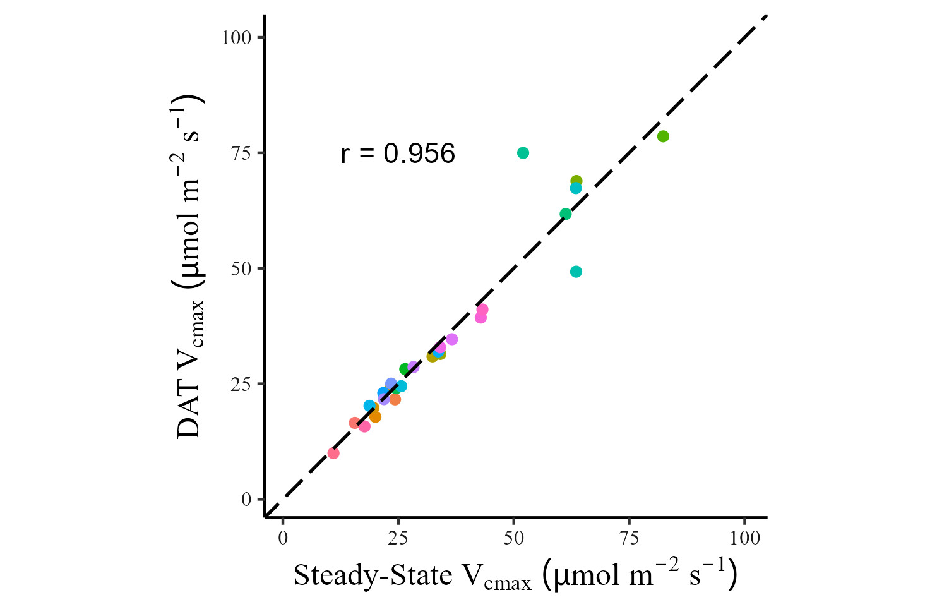
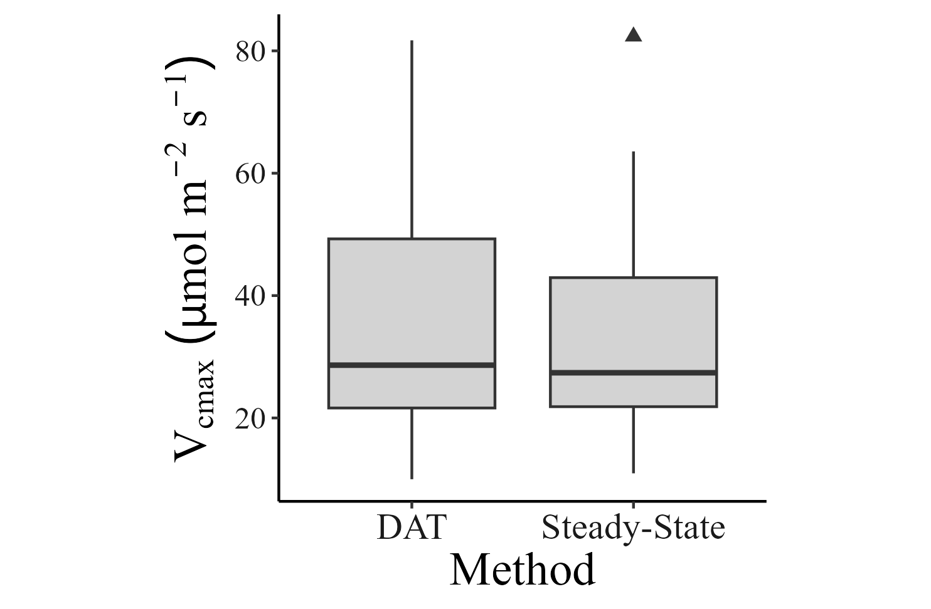
With TPU
Notes:
Full dataset of Vcmax, with TPU fitting

Slide 3
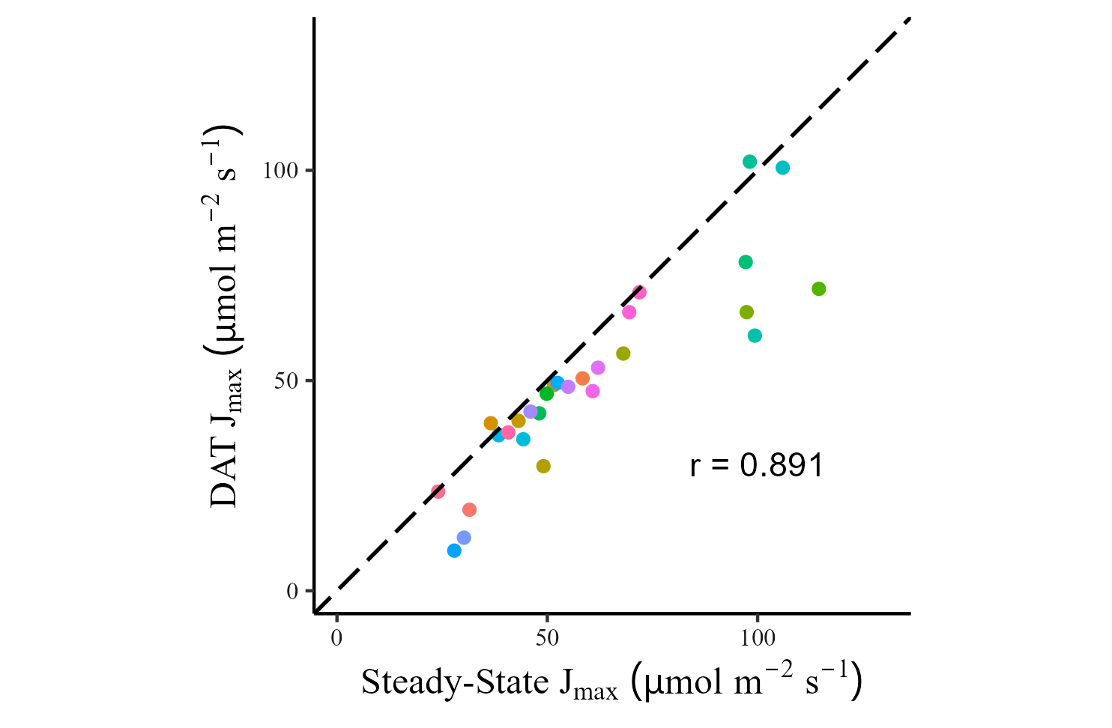
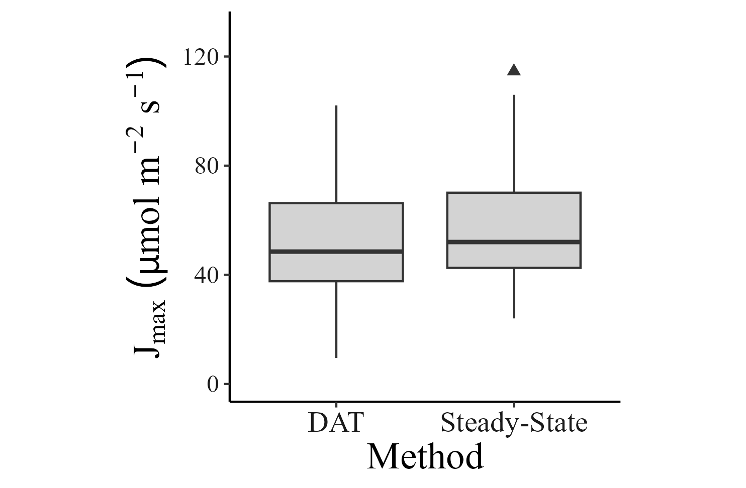
Without TPU
****
Notes:
Full dataset of Jmax, without TPU fitting

Slide 4
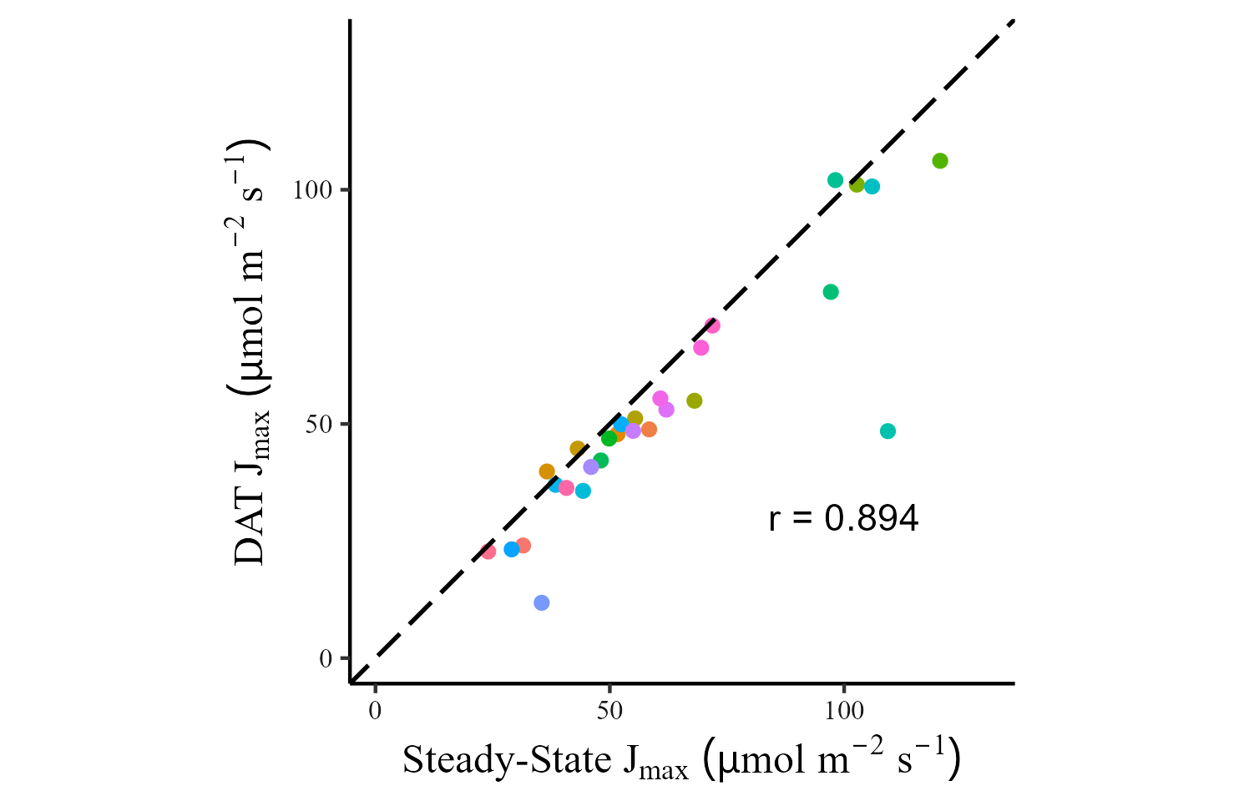


With TPU

Slide 5
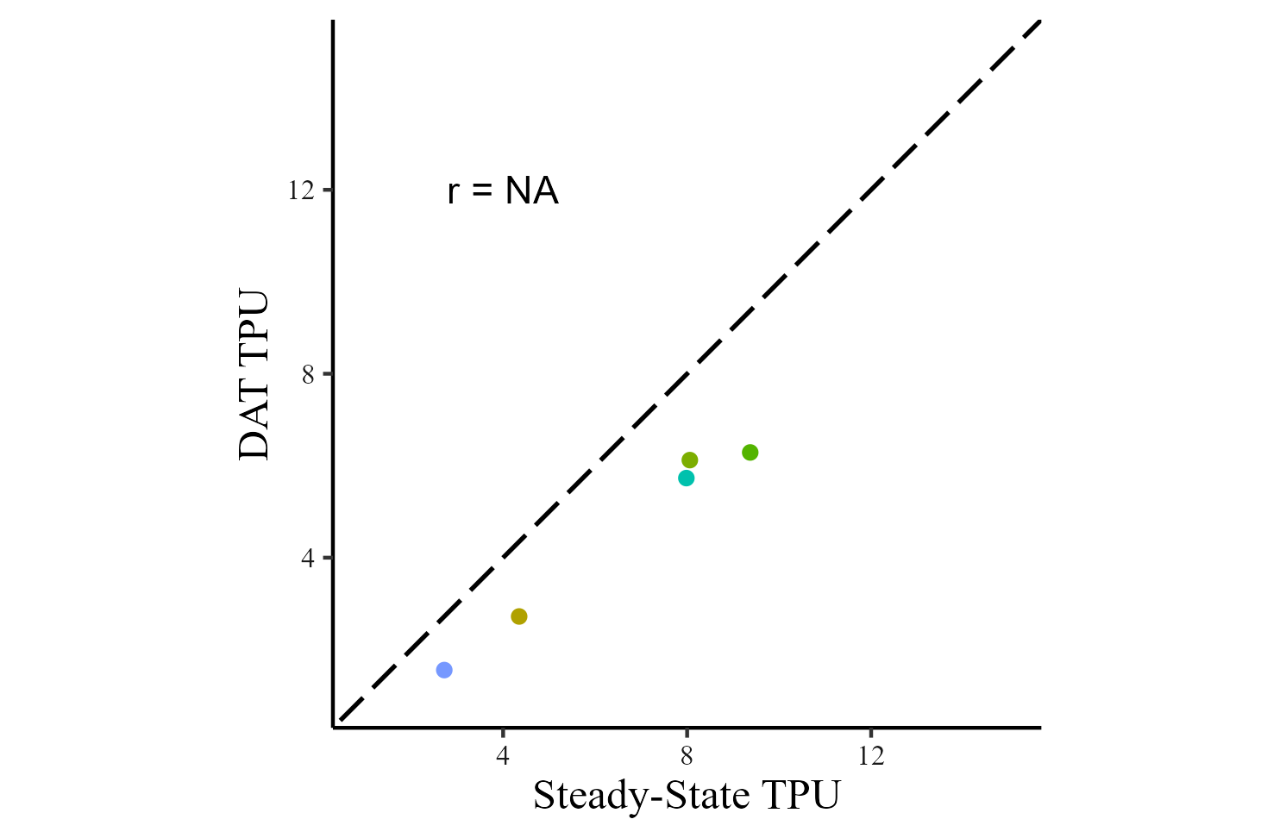
Notes:
Comparison of TPU between DAT and steady-state pairs

Slide 6
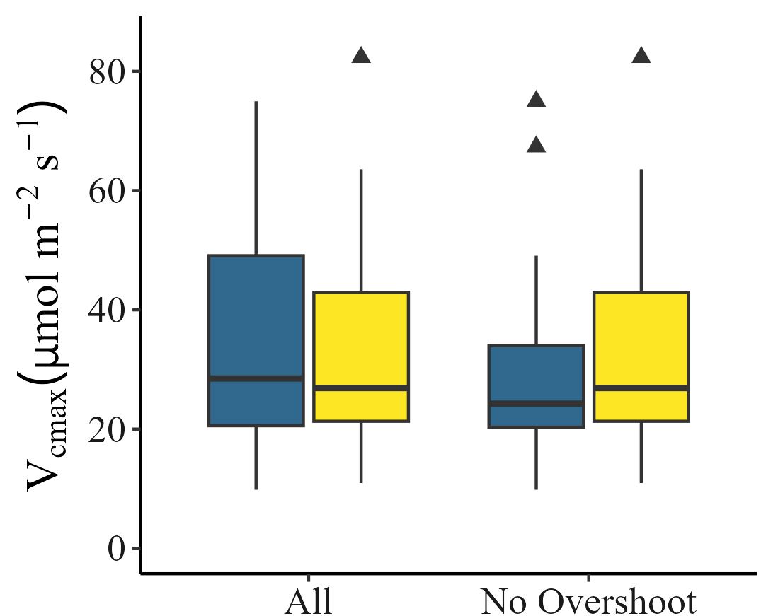
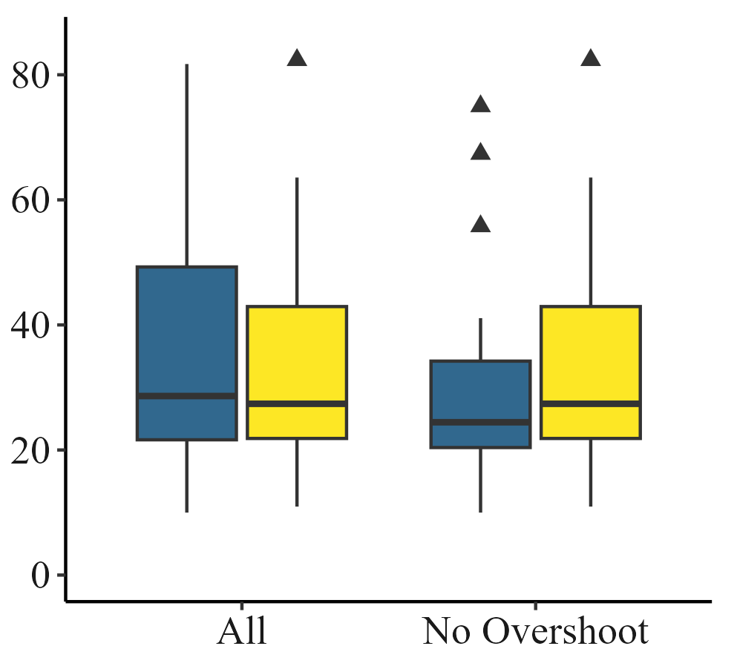
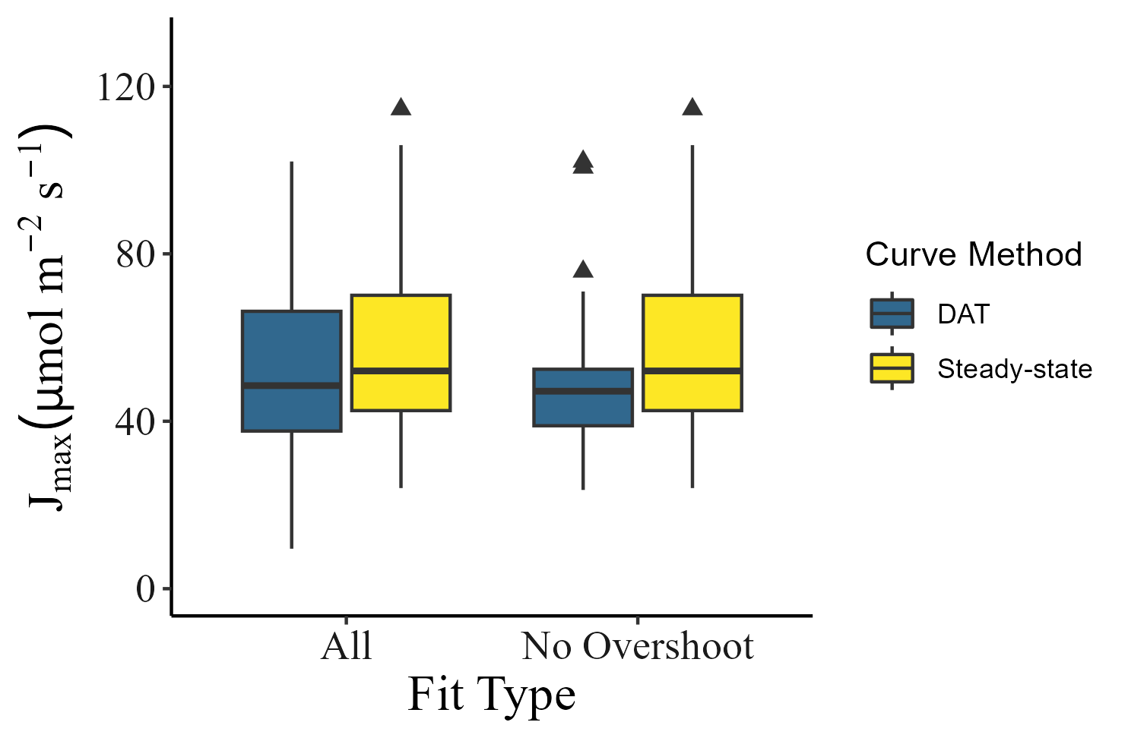
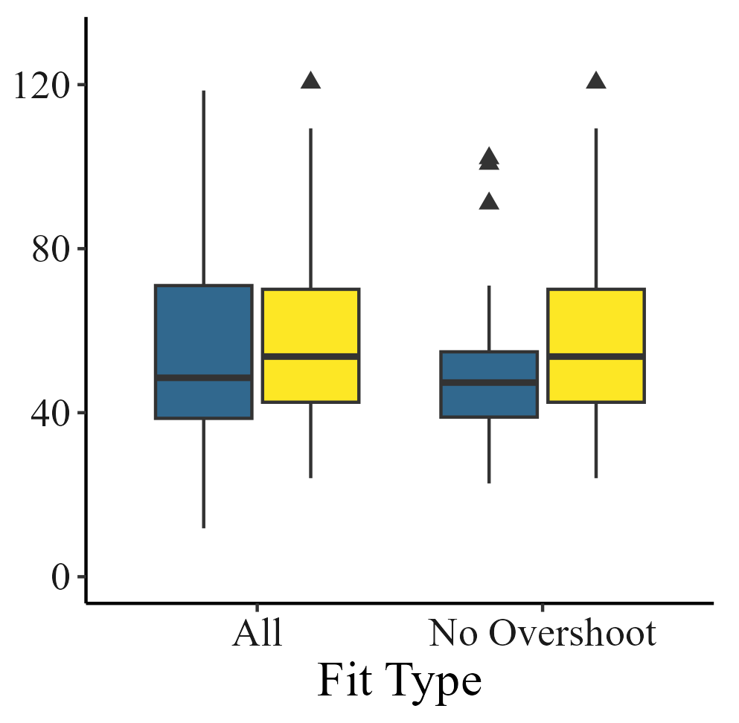
Without TPU
With TPU
Comparing all v no-overshoot data between methods, and between TPU fitting
a
*
b
c
****
***
d
****
***
Figure #: V_{cmax} and J_{max} estimates between the full dataset and the

Slide 7
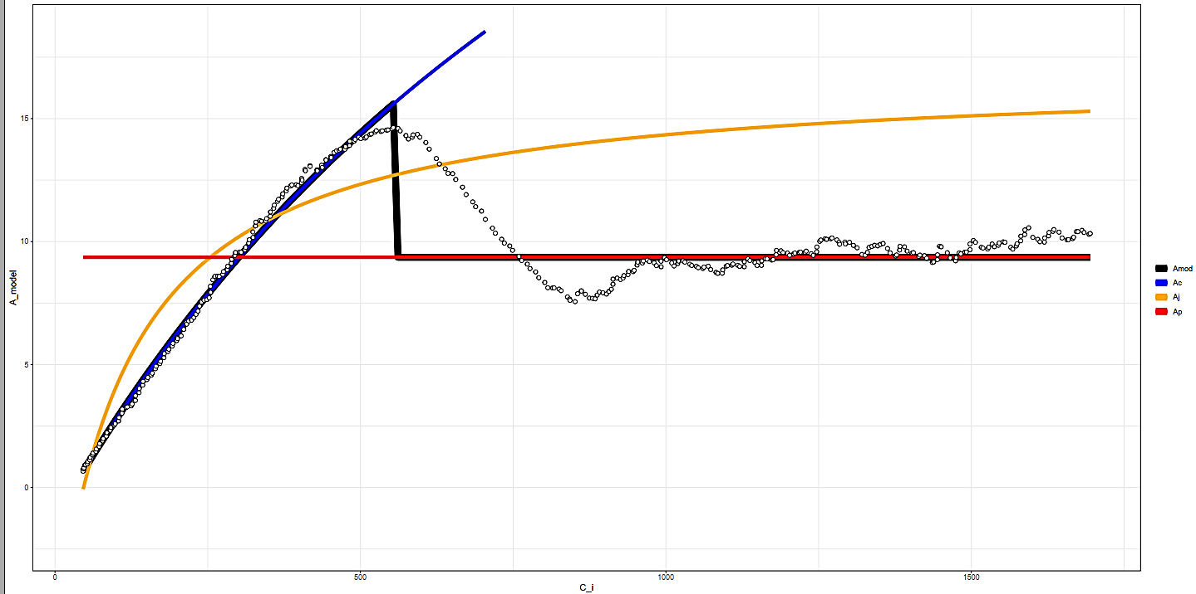

K6706L1
15
10
Modeled A
5
Amod
Ac
Aj
Ap
0
0
500
1000
1500
$$C_{i}$$

Slide 8
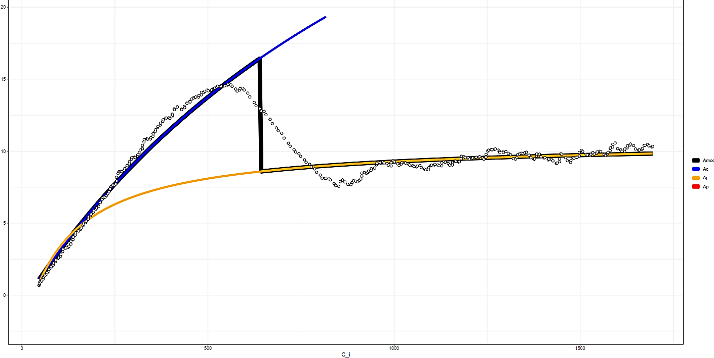

K6706L1
15
Modeled A
10
5
Amod
Ac
Aj
Ap
0
0
500
1000
1500
$$C_{i}$$

Slide 9
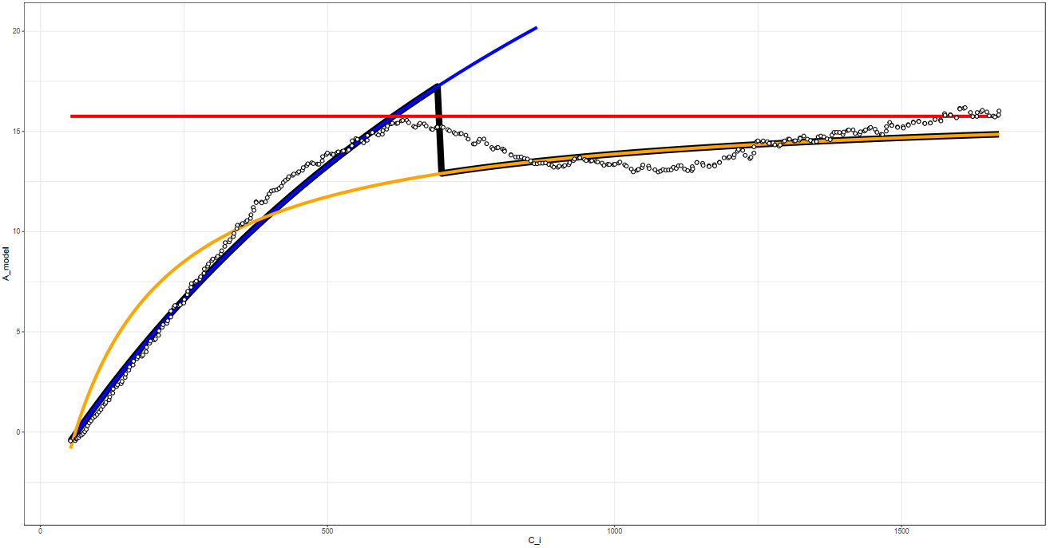

K6706L2
20
15
Modeled A
10
5
Amod
Ac
Aj
Ap
0
0
500
1000
1500
$$C_{i}$$

Slide 10

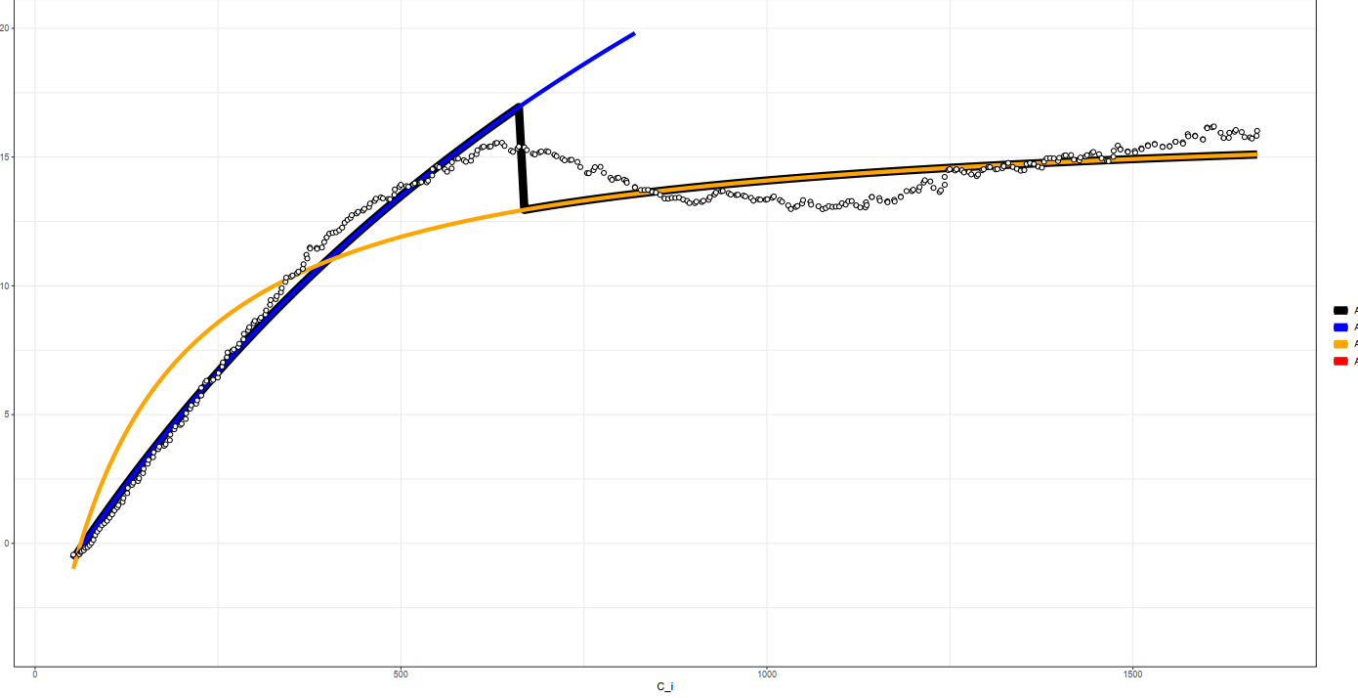
20
15
Modeled A
10
5
Amod
Ac
Aj
Ap
0
0
500
1000
1500
$$C_{i}$$

Slide 11
