Slide 1
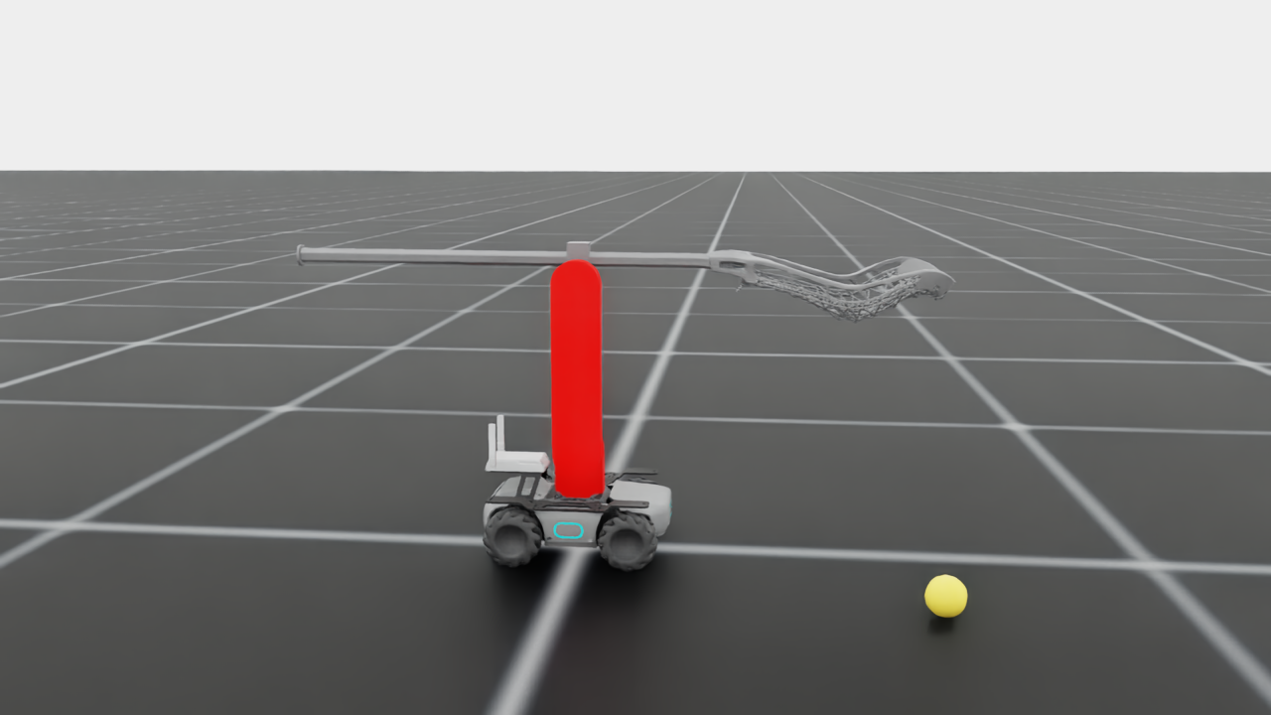
Scooping a Lacrosse Ball with a RoboMaster
Simulation progress report: open-loop scoop trajectory, robustness study, next steps
Isaac Lab task Isaac-RoboMaster-Lacrosse-Direct-v0 · October 2026
RoboMaster base + 2-DOF arm holding a 1.15 m lacrosse stick
Notes:
Goal: a RoboMaster mobile base with a 2-DOF arm holding a lacrosse stick drives up to a ball on the floor and scoops it into the net pocket. Everything here is in Isaac Lab simulation, but the robot model is grounded in measured real-robot numbers.

Slide 2
A hand-designed open-loop scoop is near-perfect in simulation
98.3%
300/300
±2 cm
393 / 400 robots hold the ball
with realistic uncertainty
alignment tolerance
1200 Hz physics, ball placed ±3 cm / ±1 cm at random
wheel-driven 4.14 kg base, slip, latency, friction, gravity-comp error
lateral ±2 cm and heading ±1° still 95–98%; ±4 cm or ±2° fails
Bottom line: the physics of the scoop itself is solved in sim. The remaining risk is getting the robot lined up with the ball, which needs closed-loop alignment, and then transfer to the real robot.
Notes:
Three headline numbers. 98.3% is the most recent large-scale run (400 robots, finer 1200 Hz physics, randomized ball placement). 300/300 is the validation with every realistic-uncertainty knob on. The red number is the open problem: the open-loop scoop only works if the robot is lined up within about 2 cm and 1 degree.

Slide 3
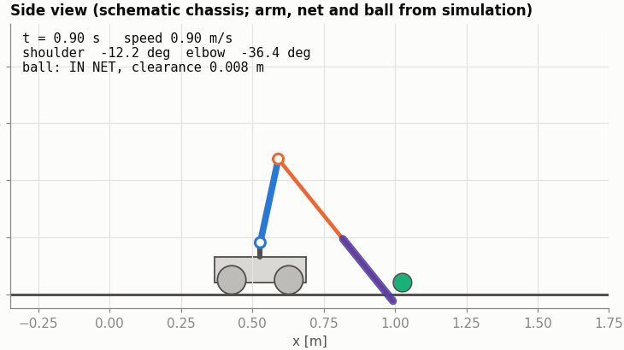
The simulated robot is built from measured real-robot numbers
Base
Wheel-driven RoboMaster, 4.14 kg total; 1.5 m/s² accel, ≤2 m/s; ±10% speed error
Arm
Shoulder on chassis, elbow motor at the elbow; link 1: 0.30 m, 0.68 kg incl. motor
Stick
1.146 m, 0.457 kg, CoM 0.142 m ahead of the elbow
Motors
MIT control: Kp 10 / 25, Kd 3, 4 N·m and 5 rad/s limits, gravity-comp feed-forward
Side view at the moment of contact (t = 0.9 s): the lip presses on the floor and the ball enters the pocket
Task
Ball (≈140 g, r 32 mm) at rest ~1 m ahead; success = ball held in the net, off the ground
Notes:
Masses, link lengths and motor parameters come from the real robot. Gains: with Kd fixed at 3 (from the motors), Kp 10 and 25 give damping ratio ~1.2 for the computed inertias. Gravity compensation is fed forward, so the stick holds its pose with under 0.5 degree error. The base is driven through its wheels with exact cylinder colliders; an earlier root-velocity base model caused unrealistic acceleration spikes.

Slide 4
Pure RL kept falling into local optima, so we switched approach
1
2
3
4
Fix the sim first
Shape the reward
Stage 1 worked, partly
Stage 2 failed
Contact stack overflow at 8192 envs dropped contacts; the first policy exploited it. Spawn height and ball placement were also fixed.
Policies folded the arm into a corner covering the ball. Fixed with a lip-to-ball reach term, arm range limits and a 2-stage curriculum.
Arm locked, forward-only: ball popped onto the net 99.4%, but the robot hit at 1.23 m/s and 32% of balls were carried out of the 3 m arena.
Unlocking the arm: untrained arm outputs raised the stick before impact. We stopped and switched to an open-loop trajectory (residual RL kept for later).
Notes:
RL runs used RSL-RL PPO with up to 8192 parallel environments. The main lesson is that the reward and the simulator both had exploitable holes. The pivot: design the motion by hand, search its few parameters, and keep RL for residual corrections.

Slide 5
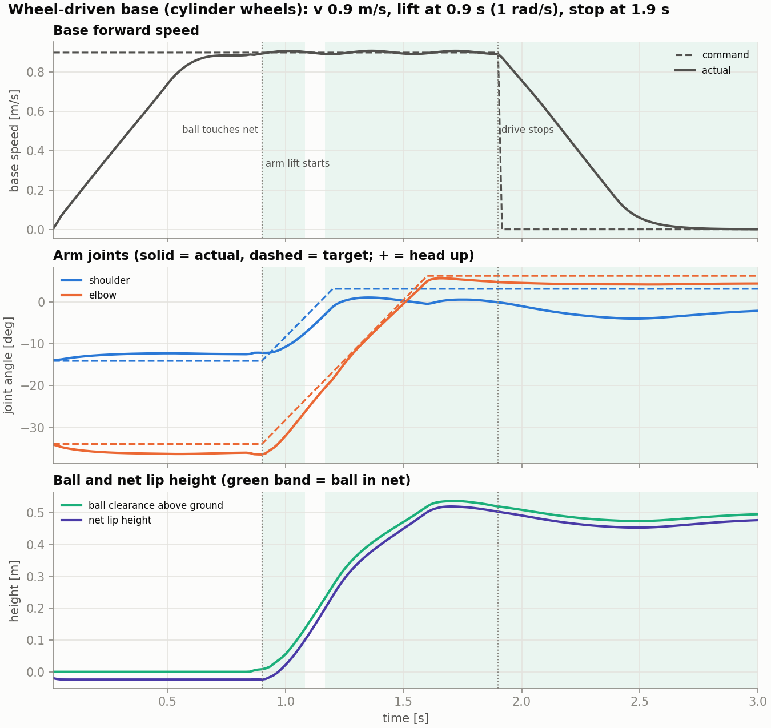
The scoop is a 5-parameter open-loop trajectory found by grid search
Drive
Press
Lift
Brake
ramp to v = 0.9 m/s
elbow FF −1.0 N·m holds the lip on the floor
at t = 0.9 s, 1 rad/s ramp: shoulder +0.3, elbow +0.7 rad
stop driving 1.0 s after lift
How the search works
Grid over speed, lift time, lift rate, joint targets, brake delay and press torque; each combo run in many parallel envs
Top combos re-validated with 150–500 randomized runs
Final grid run with every uncertainty knob on, so the winner is robust by construction
Key finding: the lip must be on the floor at impact. Lifting it 5 mm drops success to ~0%
Notes:
The trajectory is executed open loop: velocity command for the base, position + velocity targets and torque feed-forward for the arm motors. Scripts: traj_grid*.py for the searches, traj_validate*.py and traj_robust.py for validation. The plot is the final trajectory on the wheel-driven base: actual joint angles track targets closely, and the ball (green) rises with the lip to ~0.5 m.

Slide 6
Making the simulator realistic changed which trajectories work
Model iteration | What changed | Best trajectory
Soft arm PD | Kp 200, Kd 20, 50 N·m (not the real motors) | 96.0% (150 runs)
Stiff arm PD | Kp 500, Kd 5, 12 N·m: underdamped | 5.6% grid best
MIT motors + real masses | Kp 10/25, Kd 3, 4 N·m, gravity comp, new press-down torque | 96.0% (500 runs)
+ realistic base accel | 1.5 m/s² limit, ±10% speed error, re-searched under noise | 97.6% (500 runs)
Wheel-driven base | Wheels + exact cylinder colliders, 4.14 kg real mass | 300 / 300
Base-model artifact
Shoulder torque hit the 4 N·m limit before impact. The cause was not lip drag: the old velocity-overwrite base jittered (accel p50 2.4, max 9.4 m/s²).
Wheel-driven base: accel p50 0.12, max 1.55 m/s²; shoulder torque 0.8–1.6 N·m.
Notes:
Each row re-ran the trajectory search. The underdamped stiff-PD row shows the result depends heavily on the actuator model, which is why we moved to the real MIT-control parameters. The torque spike investigation showed the old base model was the problem, so we switched to driving the real wheels.

Slide 7
The scoop tolerates actuator and contact uncertainty
Reading the chart
Each knob alone costs ≤1.2 points
Only the old base-slip model (×0.7–1.2 speed, drift) broke it, and that model was unrealistic
With the measured slip (±10%) and the robust re-search: 97.6%, then 300/300 on the wheel-driven base
Notes:
These were run with the MIT-motor trajectory on the old base model, one knob at a time. Joint friction is explicit Coulomb + viscous torque; grav-comp error scales the feed-forward; latency is an action delay. The old slip model is the outlier, which led us to ask for real base numbers (1.7 m/s² accel, ±10% speed error).

Slide 8
Alignment with the ball is now the main limit
Open loop needs the robot lined up within ~2 cm and ~1°. Hypothesis (not yet verified): the curved scoop lip only touches the floor at its center, so off-center balls get pushed instead of scooped.
Realistic uncertainty on. Where a range was measured (e.g. 95–98%), the bar shows its midpoint.
Notes:
Scripts traj_alignment.py and traj_alignment_fine.py. The ball can be closer than nominal without much loss, but lateral and heading errors drop off sharply. This is the strongest argument for a closed-loop approach phase before the open-loop scoop.

Slide 9
Floor tilt matters, ball variation does not
Tilt
A sphere rolls ~5 cm in 0.9 s on a 1° slope. Indoor floors are typically 0.1–0.3°, inside the safe range.
Ball mass, CoM, size
137–145 g, CoM offset ≤2 mm, radius 31–33 mm: 100% in every case.
Mesh-ball caveat
Convex-mesh balls sink 2–5 mm into the floor; even a round mesh ball drops to 85%. A PhysX artifact, so ellipsoid results (64–78%) are not trusted.
Notes:
Floor tilt is a per-env kinematic platform with random roll/pitch. For the ball, placing it CoM-down matters: a randomly oriented off-center ball rolls up to 10 cm to settle, which is a setup artifact, not a scoop failure. Also worked around an Isaac Lab bug in RigidObject.set_coms_index.

Slide 10
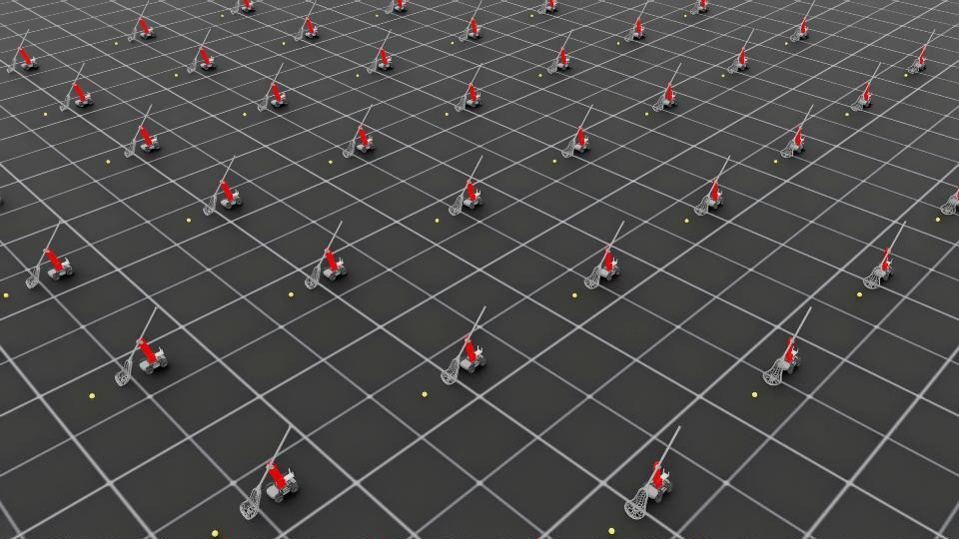
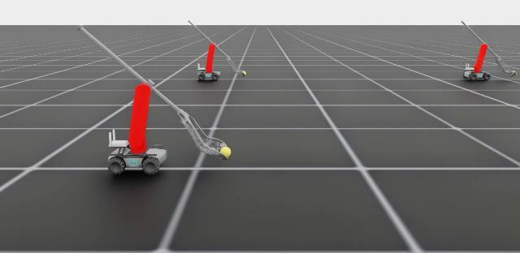
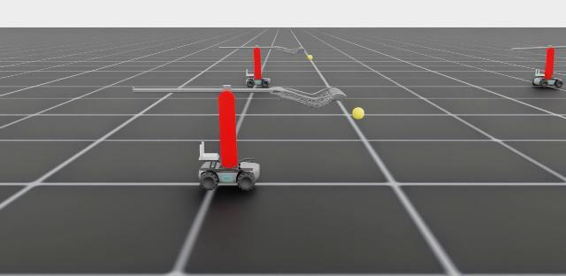
At 400 robots and 1200 Hz physics, 393 hold the ball
Failure close-up, robot #172: t = 1.02 s → 1.48 s
7 / 400 failures, one mode
Ball lifted to ~43 cm, then rolls out of the side of the pocket and leaves the 3 m arena
No tipping, no explosions, no fast-moving robots
Likely fix: a slower end of lift, or a final wrist/shoulder tilt to cradle the ball
10 × 10 slice of the rendered array; the robots drive diagonally toward the yellow balls
Notes:
render_array.py: 400 robots, physics at 1200 Hz (control 60 Hz), ball offsets up to ±3 cm along and ±1 cm across. 98.3% success. All 7 failures were balls that ended more than 3 m away. Close-ups with replay_closeup.py show the ball sliding out of the side of the pocket after lift.

Slide 11
What we learned
1
Contact at impact is everything
2
Sim artifacts look like physics
The lip must be pressed on the floor when it meets the ball. Hovering is fine only if it sets down before impact (95–98%); never setting down gives 3–13%.
Dropped contacts, the base-velocity jitter and mesh-ball penetration each produced convincing but wrong results. Each needed a dedicated check.
3
Ground the model, then search
4
Structure beats raw RL here
The best trajectory changed with each fidelity step (soft PD → MIT motors → real base). Searching under realistic noise gave the robust winner.
A 5-parameter motion was more reliable than PPO from scratch. RL is better used for residual corrections.
Notes:
Four takeaways that generalize beyond this task.

Slide 12
Possible next directions
1
Closed-loop approach
2
Residual RL
Perception of the ball (camera / tags) + an approach controller that lines up within ±2 cm, ±1° before the scoop starts.
PPO adds small corrections on top of the open-loop trajectory, trained with alignment error, tilt and full domain randomization.
3
Real-robot transfer
4
Widen the tolerance
System ID of the MIT motors and wheel speed tracking, measure the floor, run the trajectory on hardware and compare with sim.
Test the curved-lip hypothesis; try lip / pocket geometry, a slower end of lift or a cradle motion against side ejection.
Code, scripts, notes and result summaries: github.com/emmmum/IsaacLab, branch yifan/robomaster-lacrosse-scoop
Notes:
Suggested order: 1 and 3 in parallel, since alignment is the main sim-side limit and hardware data will tell us which uncertainty matters. Residual RL is the planned way to recover from alignment errors the approach controller leaves. Item 4 targets the remaining 1.7% failure mode and the narrow lateral tolerance.

