Slide 1

Etudes des besoins et correction du code selon le modèle MCV
Olivier MOREL en stage de développement

Slide 2

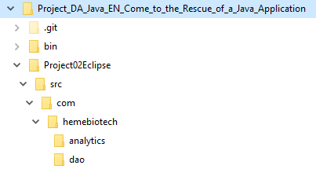
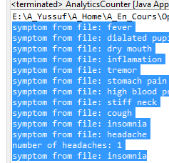
BufferedReader reader = new BufferedReader (new FileReader("symptoms.txt"));
symptoms.txt (Le fichier spécifié est introuvable)
By default the classes in the java.io package always resolve relative pathnames against the current user directory. This directory is named by the system property user.dir, and is typically the directory in which the Java virtual machine was invoked.
String path = System.getProperty("user.dir");
System.out.println(path);
(new FileReader(path+"/Project02Eclipse/symptoms.txt"));

Slide 3
Organisation Modèle, Vue, Contrôleur

