Slide 1

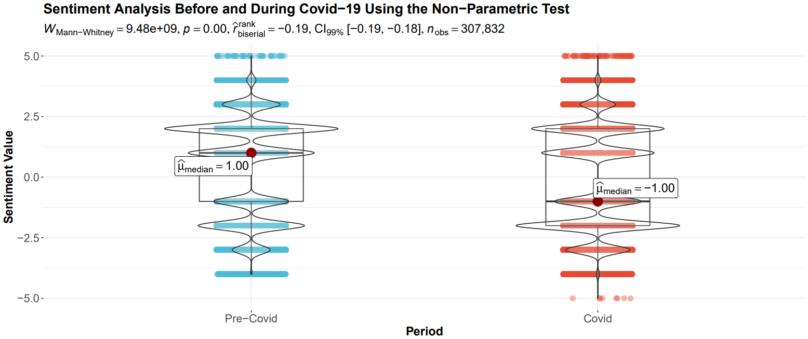
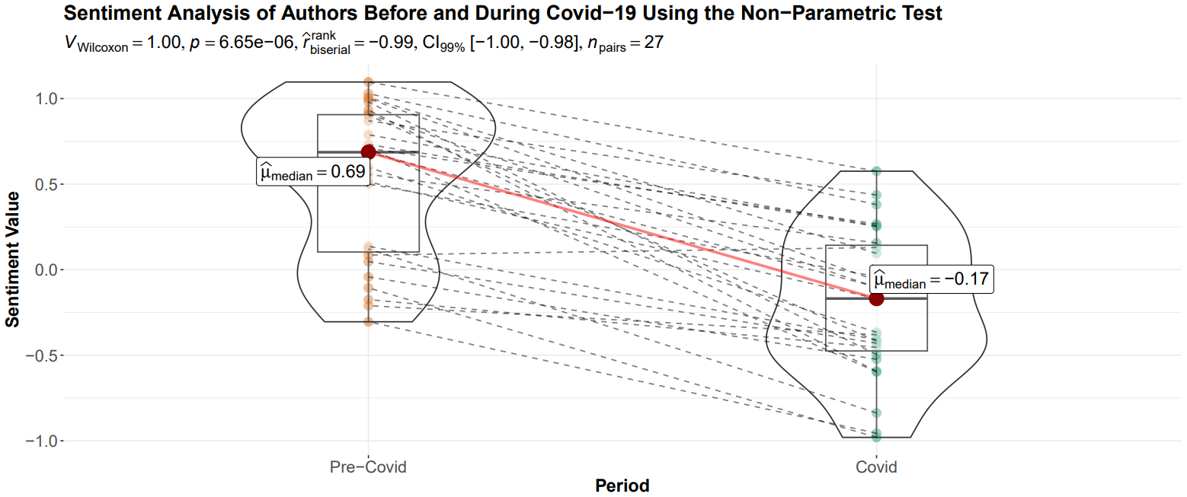
Sentiment Analysis Before and During the Covid-19 Pandemic
Emily Musgrove
Department of Mathematics & Computer Science, Ursinus College, Mentor: Hugo M. Montesinos-Yufa
Abstract
Results
Conclusion
This paper examines the change in connotative language use before and during the Covid-19 pandemic. By analyzing news articles from several major US newspapers, we found that there is a statistically significant correlation between the sentiment of the text and the publication period. Specifically, we document a large, systematic, and statistically significant decline in the overall sentiment of articles published in major news outlets. While our results do not directly gauge the sentiment of the population, our findings have important implications regarding the social responsibility of journalists and media outlets especially in times of crisis.
Using the robust Yuen’s trimmed mean t-test, we were able to study the impact of time on the sentiment value of our data utilizing a 99% confidence interval. The sentiment was calculated using the AFINN sentiment lexicon which ranges from -5 to 5. Before the Covid-19 pandemic, the trimmed sentiment mean was 0.474 (with a median of +1 in the non-parametric test). However, during the pandemic, the trimmed sentiment mean was -0.188 (which had a median of -1). The probability of this occurring by chance, under the null hypothesis of no difference in sentiment before and during Covid, was negligible (t-statistic of 92.4 using the robust method).
The results of this study show a statistically significant decrease in the average sentiment of articles published by three popular U.S. newspapers during the Covid-19 pandemic. We also found that the decline was systematic among newspapers and journalists studied. A more negative narrative inevitably affects how readers see the world around us, fostering a more pessimistic lens. This potential change in widespread sentiment and attitude could be linked to the rise in mental illnesses, such as depression and anxiety, recorded during the pandemic [1].
Journalists are not exempt from the attitudes of society which may permeate into their work. However, they need to be aware of the negative impacts of perpetuating these sentiments. Their failure to do so should at least call into discussion their moral obligations and social responsibilities, especially in times of need.
Methodology
To gather our data, we collected pdf copies of the articles we would be examining the sentiment of. We chose articles from the New York Times, Washington Post, and Wall Street Journal. For each newspaper, we chose 9 authors and 24 works per author, 12 written before and 12 written during the pandemic. Then, we followed a multi-step procedure to clean, convert, analyze, and graph the data. First, we scraped and cleaned the text from the articles and tabulated the words and a tally of their usage. We kept the text’s body and removed punctuation marks, newline characters, on-screen popups, URL elements (for example “https”), and words that were accidentally combined (such as “terribleand” rather than “terrible and”). We transformed our data into a corpus in tidy format and confirmed it was clean of any stop words, punctuation, or numbers. We merged the data with the AFINN sentiment lexicon to depict the sentiment of each word. The data are graphed with the y-axis representing the sentiment value and the x-axis representing the period. We then performed parametric, non-parametric, robust, and Bayesian statistical tests to compare the sentiment across categories. A methodological feature of this project is to keep the files in directories specific to their author, newspaper, and period. This allows us the flexibility to create new tables and graphs that compare the sentiment value with alternative categorical variables (such as the newspaper or author) for the x-axis.
Works Cited
[1] C. K. Ettman, S. M. Abdalla, G. H. Cohen, L. Sampson, P. M. Vivier, and S. Galea, “Prevalence of Depression Symptoms in US Adults Before and During the COVID-19 Pandemic,” JAMA Netw. Open, vol. 3, no. 9, p. e2019686, Sep. 2020, doi: 10.1001/jamanetworkopen.2020.19686.
[2] Grolemund, G., & Wickham, H. (2017, January 31). R for Data Science. Welcome. https://r4ds.had.co.nz/
[3] Robinson, D., & Silge, J. (2017, August 1). Text Mining with R: A Tidy Approach. Welcome to Text Mining with R | Text Mining with R. https://www.tidytextmining.com/
The author-specific within statistical analysis yields similar results. The median sentiment in the years 2018-2019 was 0.69, while in the years of 2020-2023 it was -0.17. The probability of this occurring by chance is negligible: 6.65e-06 (using the non-parametric Wilcoxon test) and 5.26e-10 (using the parametric t-test). The 99% confidence interval for the median decline is [-1.00, -0.98], and for the mean decline [-2.59, -1.00].
Acknowledgments
I would like to thank the Ursinus College Summer Fellows Program for funding this research. Secondly, I would like to thank Hugo M. Montesinos-Yufa for being a mentor for this research and co-author of the corresponding upcoming paper. Finally, we would also like to acknowledge the kindness of the Ursinus College REU (NSF grant #1851948) to allow me to sit in on lectures, which helped me to improve my research and writing abilities.

