Slide 1
Application of Machine Learning in Healthcare: Predictive Grading of Gliomas
Final Project for Module 12: Advanced Machine Learning in Health Care (AMLHC)
Can the malignancy grades of gliomas (LGG vs. GBM) be precisely predicted using k-NN and artificial neural networks?
Submitted by: Emilia Schloß
UMIT Tirol
12.06.2026

Slide 2
KDD Pipeline – Data Structure & Meaning of Values
Methodological core: 0 vs. NaN (the "Important Hint"):
NaN (Not a Number): Represents incomplete data or errors during data collection.
0 (zero value): Represents genuine, critical information in this project.
Biological significance: 0 = Wild type / No mutation present.
1 = Gene is mutated.
Preprocessing check result: The dataset contains 0 genuine missing values ​​(NaN). All zero values ​​are incorporated into the models as biological facts.
Dataset Overview (Glioma Grading Dataset):
Target variable (y): Grade -> Binary classification: 0 (Low-Grade Glioma) vs. 1 (Glioblastoma / High-Grade Glioma)
Clinical features: Age_at_diagnosis (metric), Gender & Race (categorical)
Molecular features: 20 specific gene mutations (e.g., IDH1, TP53, ATRX).

Slide 3
KDD Pipeline – Statistical Prerequisites
Analysis of age (Age_at_diagnosis):
Prerequisite check: Shapiro-Wilk test for normal distribution
Result: p-value < 0.05 -> Age is not normally distributed
Methodological consequence: Exclusion of the parametric Pearson coefficient. Use of non-parametric Spearman rank correlation for feature selection.
Analysis of mutations (binary features, 0/1):
The mathematical problem: Mutations are nominal/binary in nature; therefore, Pearson and t-tests are inappropriate, as they require continuous, normally distributed data.
Methodological solution: Use of the chi-square test of independence (χ²).
Objective: Identification of genes showing a statistically significant association (p < 0.05) with tumor grade.

Slide 4
Model 1 – K-Nearest Neighbors (K-NN)
Model characteristics:
Approach: Distance-based instance learner (lazy learning) -> No explicit model-building phase occurs during training
Parameter selection: k=5 (an odd number was chosen to rule out a tie in the majority vote for the binary classification of LGG vs. GBM)
Distance metric: Euclidean distance for determining nearest neighbors
Justification of Choices:
Problem: The `Age_at_diagnosis` feature has a value range of approximately 20 to 90 years, whereas the mutation data (genes) are purely binary (0 or 1).
Consequence without scaling: Age would mathematically dominate the Euclidean distance calculation entirely, rendering the biological information from the gene mutations ineffective for the model.
Solution: Mandatory standardization (StandardScaler) prior to modeling to ensure all features are weighted equally.

Slide 5
Model 2 – Artificial Neural Network (ANN)
Model characteristics:
Approach: Function-based classifier (Multi-Layer Perceptron / MLP)
Strength: Can automatically learn complex, non-linear relationships between clinical factors and gene mutations
Challenge: High computational cost compared to k-NN and lack of direct interpretability ("black box")
Network architecture selected for the project:
Input layer: Represents the number of statistically significant features (age + relevant gene mutations)
Hidden layer: 1 layer with 16 neurons (enables the learning of feature combinations)
Output layer: 1 neuron with binary output (0 for LLG, 1 for GBM)
Optimization: Max. 500 iterations (epochs) to ensure complete weight convergence via backpropagation

Slide 6
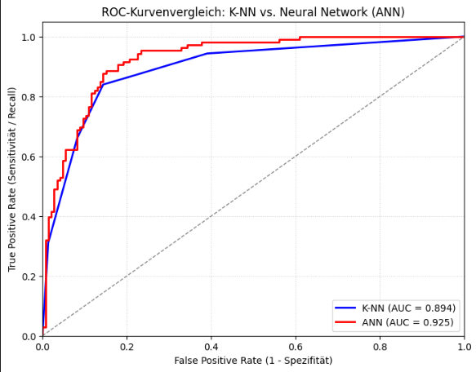
Results – Validation & Performance Metrics
Model comparison at a glance (test set & 5-fold CV):
Beyond Accuracy
The problem: The dataset exhibits an unbalanced class distribution (class skew). Optimizing solely for accuracy would be mathematically misleading.
The solution: Focus on recall (how many actual glioblastomas were detected in time?) and the F1-score as the harmonic mean.
Cross-validation: Use of stratified 5-fold cross-validation to ensure an unbiased estimate of generalization performance across unbalanced folds.
Metric (Class 1 / GBM) | Model 1: K-NN | Model 2: ANN (MLP)
Precision | 81,0% | 81,0%
Recall | 84,0% | 85,0%
Testset | 0,8200 | 0,8300
5-Fold VC | 0,8308 | 0,8418
Classification errors (total) | 38 patients | 37 patients

Slide 7
Interpretation & AI Ethics (AI Ethics and Bias)
The "Black Box" Conflict in Clinical Practice:
ANN (Neural Network): Achieves the best overall performance (higher recall of 85.0%) but functions as a "black box." Its complex internal weights are not directly interpretable by medical professionals
K-NN (Nearest Neighbor Search): Is mathematically slightly inferior (recall of 84.0%) but offers excellent transparency (Explainable AI). Decisions are based directly on the *k* most similar historical patient profiles
Implication: In medicine, a lack of transparency is a significant issue. Physicians require systems with interpretable logic to assume ultimate responsibility for aggressive cancer therapies
Risk of Misclassification & Focus on Recall:
A false negative (where a glioblastoma is erroneously classified as a low-grade glioma) delays vital, aggressive therapy
Consequently, maximizing recall for the high-risk class takes precedence over overall accuracy in a healthcare context
Data Bias & Fairness (TCGA Dataset):
The dataset is based on The Cancer Genome Atlas project
Critical assessment of representativeness regarding demographic characteristics (race, gender) is required; the underrepresentation of certain ethnic groups limits fair generalizability in diverse, real-world clinical practice

Slide 8
Interpretation & KI-Ethik (AI Ethics & Bias)
Der „Black Box“-Konflikt im Klinikalltag:
ANN (Neuronales Netz): Erzielt die beste Gesamtleistung (höherer Recall von 85,0 %), ist jedoch eine Black Box. Die verschachtelten Gewichte sind für Mediziner nicht direkt nachvollziehbar
K-NN (Nachbarschaftssuche): Ist mathematisch leicht unterlegen (Recall 84,0 %), besitzt aber eine exzellente Transparenz (Explainable AI). Entscheidungen basieren direkt auf den k ähnlichsten historischen Patientenprofilen
Konsequenz: In der Medizin wiegt der Mangel an Transparenz schwer. Ärzte benötigen nachvollziehbare Systeme, um die Letztverantwortung für aggressive Krebstherapien zu übernehmen
Fehlklassifikations-Risiko & Recall-Fokus:
Ein False Negative (Glioblastom wird fälschlicherweise als Low-Grade Gliom eingestuft) verzögert eine lebensnotwendige, aggressive Therapie
Die Maximierung des Recalls der Risikoklasse hat im Gesundheitswesen somit oberste Priorität vor der reinen Gesamtgenauigkeit (Accuracy)
Daten-Bias & Fairness (TCGA-Datenbasis):
Der Datensatz basiert auf dem Projekt The Cancer Genome Atlas
Kritische Prüfung der Repräsentativität bezüglich demografischer Merkmale (Race, Gender). Eine Unterrepräsentation bestimmter ethnischer Gruppen schränkt die faire Generalisierungsfähigkeit im realen, diversen Klinikalltag ein

