Slide 1
Computer Science Women’s Network

Slide 2
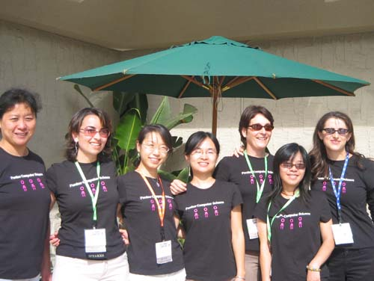
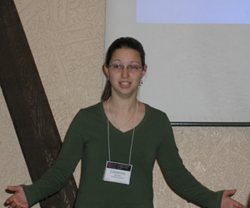
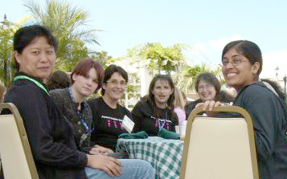
What We Do
Support women in computer science
Host tech talks
Host social events
Grace Hopper Conference Members
Kate Brown at INWIC
Having lunch

Slide 3
How to Reach Us
Website: http://www.cs.purdue.edu/cswn
Email: cswn@cs.purdue.edu
Office: Lawson B136

