Slide 1
Histology
The study of tissues

Slide 2
Tissue
A group of similar cells working together to perform a common function.

Slide 3
4 Types of Tissues
Epithelial
Connective
Muscle
Nervous

Slide 4
Epithelial Tissue
Covers a body surface or lines a body cavity

Slide 5
Characteristics of Epithelial Tissue
Composed of closely packed cells with specialized points of attachment
Have a free surface and attached to a basement membrane
Avascular but innervated
Rapid cell division
Specialized to form glands

Slide 6
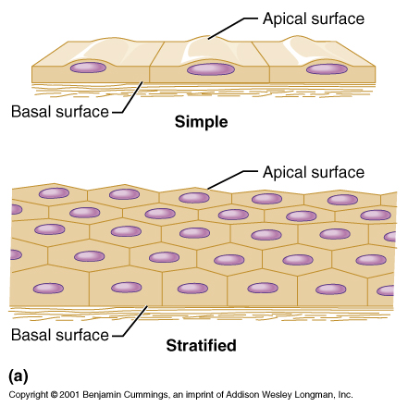

Slide 7
Functions of Epithelial Tissue
Protection
Absorption
Secretion
Filtration
Excretion
Sensory

Slide 8
Classification of Epithelial Tissue
Cell Shape:
Squamous – flattened cells
Cuboidal- boxes
Columnar-tall
Cell Arrangement:
Simple – single layers
Stratified – multiple layers

Slide 9
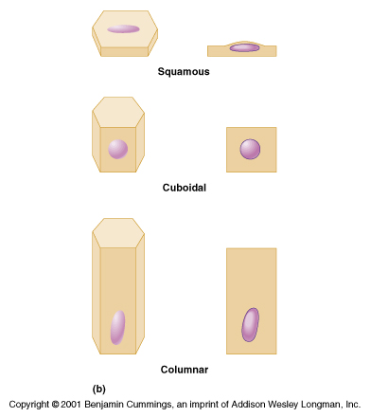

Slide 10
Examples of Epithelial Tissue

Slide 11
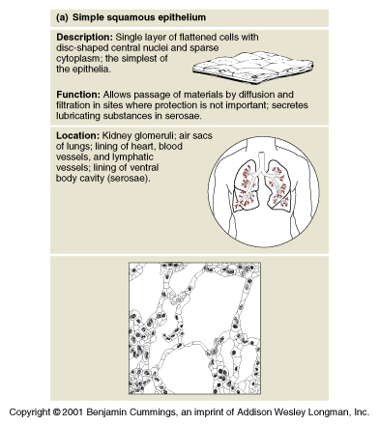

Slide 12
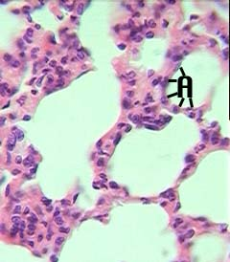
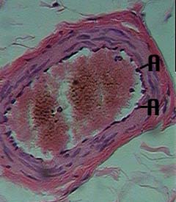
Simple Squamous Epithelium
(Alveoli of lungs & linings of Blood vessels)

Slide 13
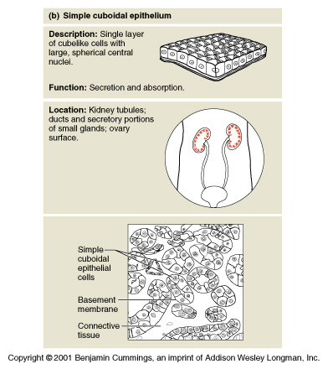

Slide 14
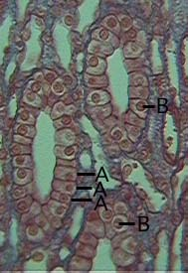
Simple Cuboidal Epithelium
(Kidney tubules)
Cuboidal cells
Nucleus of cell

Slide 15
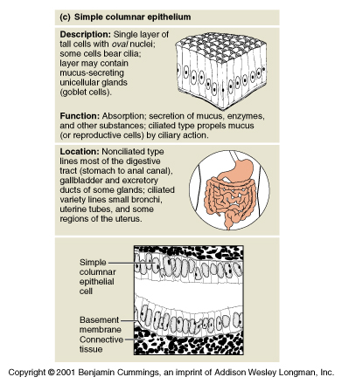

Slide 16
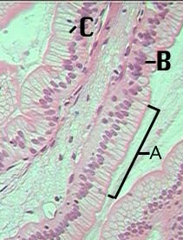
Simple Columnar Epithelium
(Digestive Tract)
Columnar cells
Nucleus
Cell membrane

Slide 17
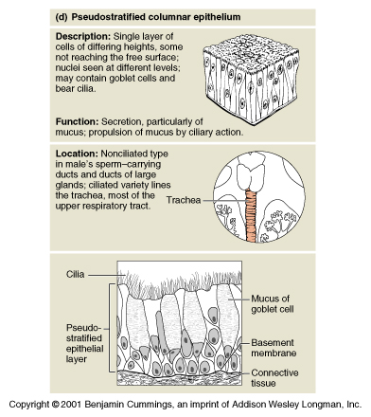

Slide 18
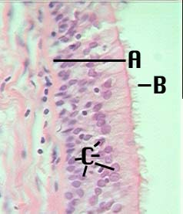
Pseudostratified Epithelium
(Trachea)
Basement membrane
Cilia
Nucleus

Slide 19
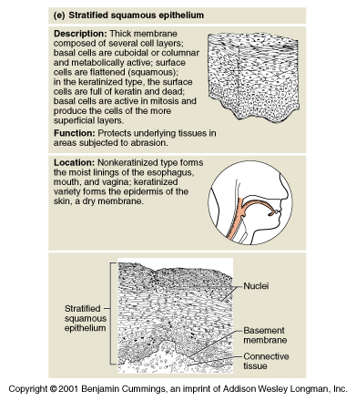

Slide 20
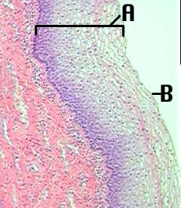
Stratified Squamous Epithelium
(Lining of mouth)
Layers of epithelium
Surface cells

Slide 21
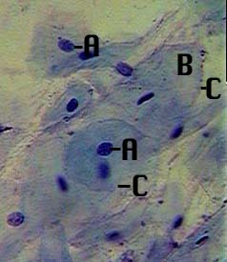
Stratified Squamous Epithelial
(Human Cheek Cells)
Nucleus
Cytoplasm
Cell Membrane

Slide 22
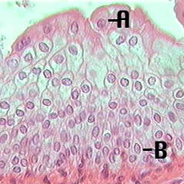
Transitional Epithelium
(Urinary bladder)
Surface cells
Attached cells
Specialized for stretching

Slide 23
Connective Tissue

Slide 24
Connective Tissue
Found everywhere in the body; most abundant and widely distributed of all the tissues.

Slide 25
Characteristics of Connective Tissue
Cells widely separated by an extracellular matrix
Varying degrees of vascularization

Slide 26
Functions of Connective Tissue
Binding and support
Protection
Insulation
Transportation

Slide 27
Structural Elements
Ground Substance – unstructured material that fills the space between the cells
Cells
Fibers
  Collagen fibers
  Elastic fibers
  Reticular fibers

Slide 28
Examples of Connective Tissue

Slide 29
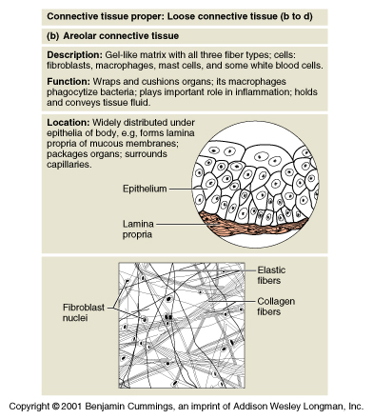

Slide 30
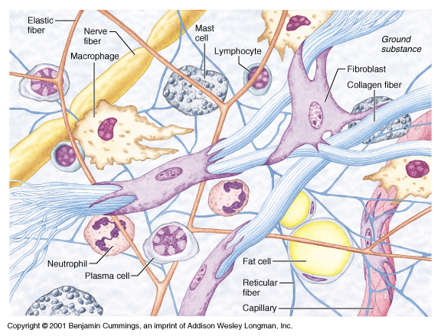

Slide 31
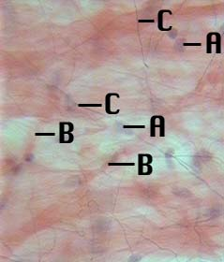
Areolar Connective Tissue
(beneath the skin)
Fibroblasts
Collagen fibers
Elastic fibers

Slide 32
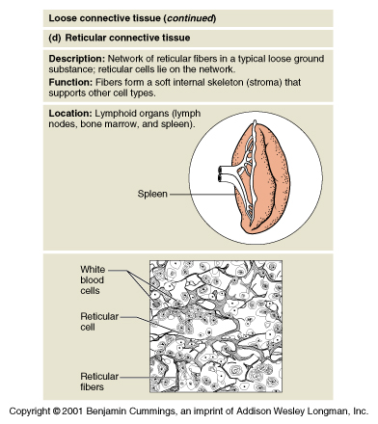

Slide 33
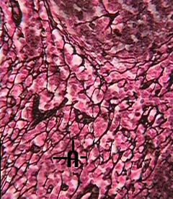
Reticular Tissue
(Spleen, liver, lymph nodes)
A. Reticular fibers

Slide 34
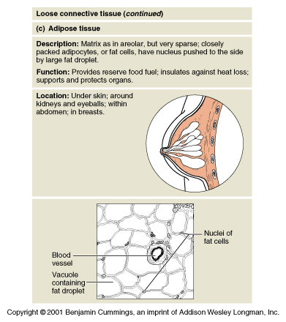

Slide 35
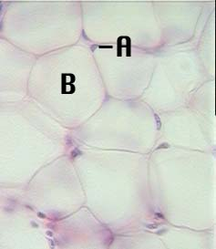
Adipose Tissue
(Fat)
Nucleus of fat cell
Fat droplet

Slide 36
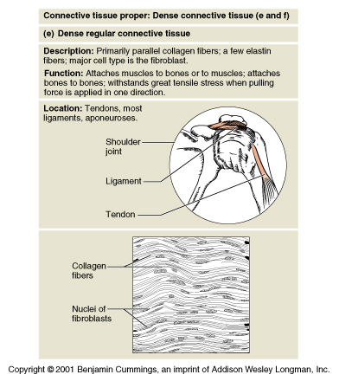

Slide 37
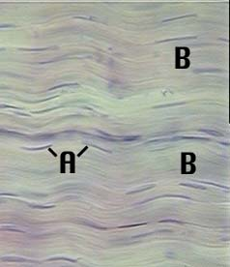
Dense Fibrous
Connective Tissue
(Tendons)
Fibroblasts
Collagenous fibers

Slide 38
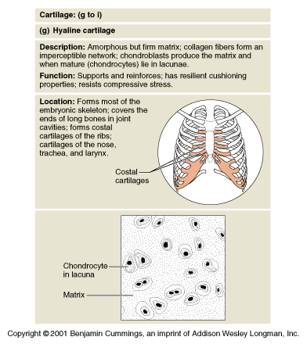

Slide 39
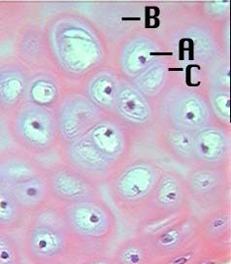
Hyaline Cartilage
(Ends of bones, trachea, larynx)
Chrondrocyte
Matrix
Lacuna

Slide 40
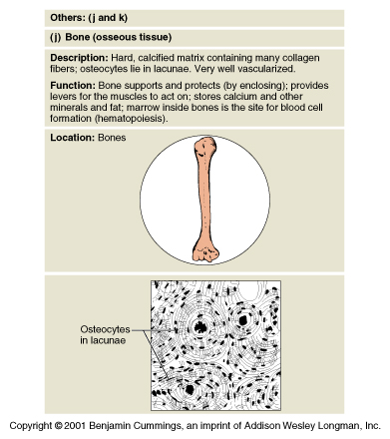

Slide 41
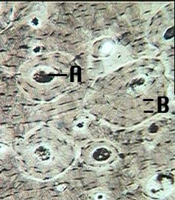
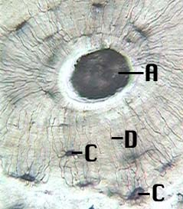
Bone
Central Canal
Lamellae
Osteocyte in lacuna
Canaliculi

Slide 42
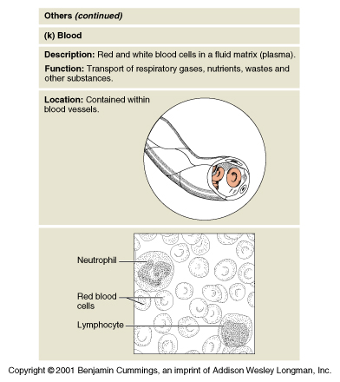

Slide 43
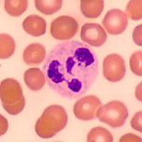
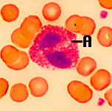
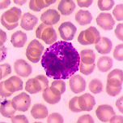
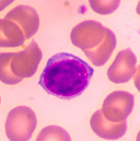
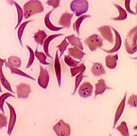
Blood
Leucocytes (White Blood Cells)
Erythrocytes (Red Blood Cells)
Sickle Cells

Slide 44
Muscle Tissue
Responsible for body movements

Slide 45
Classification
Location
  Skeletal
  Cardiac
  Visceral
Appearance
  Smooth
  Striated
Action
  Voluntary
  Involuntary

Slide 46
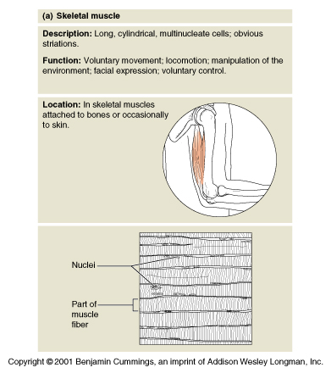

Slide 47
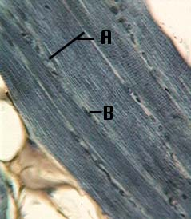
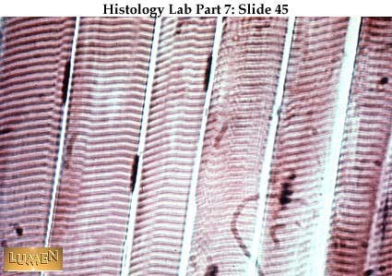
Skeletal Muscle:
Attached to bones for movement
AKA: Muscle fibers
Long, blunt, cylindrical
Multinucleated
Striated
Voluntary
Width of cell
Nucleus

Slide 48
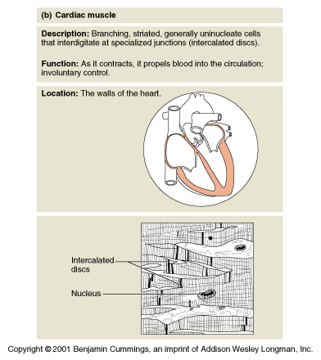

Slide 49
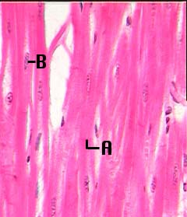
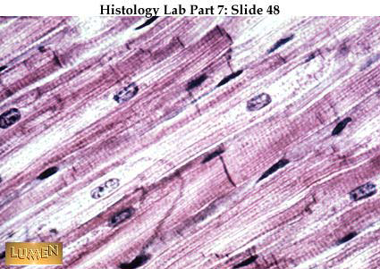
Cardiac Muscle:
Found in heart
Involuntary
Mononucleate
Branched
Striated
Intercalated discs
Nucleus

Slide 50
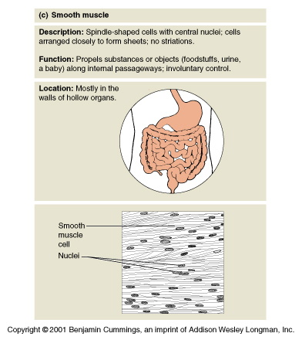

Slide 51
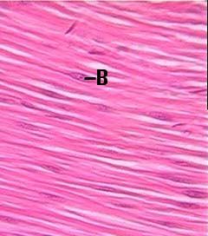
Visceral/Smooth Muscle:
Found in walls of hollow organs
Involuntary
Spindle-shaped
Mononucleate
No visible striations
B. Nucleus

Slide 52
Nervous Tissue
Regulates and controls body functions

Slide 53
2 Major Cell Types
Neurons
Generate and conduct nerve impulses
Functional cells of the nervous system
Supporting Cells
Nonconducting
Support, protect and insulate neurons
Neuroglia

Slide 54
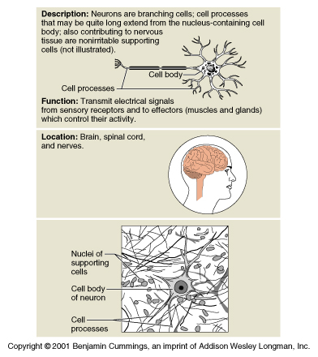

Slide 55
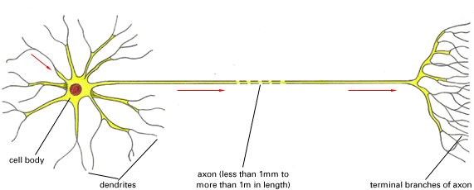
Parts of Neuron
Cell Body
Dendrite
  Receives information from sensory receptors
Axon
  Carries impulses away from cell body to target structure

Slide 56
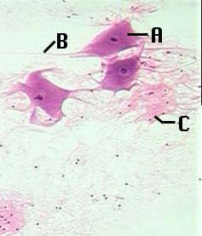
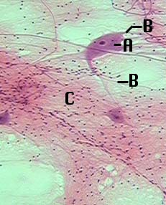
Neurons & Neuroglia
Cell Body
Cell Process (axon or dendrite)
Neuroglia (small dark dots)

Slide 57
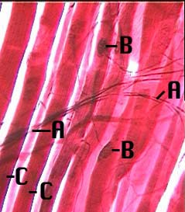
Neuromuscular Junction
Axon
Motor end plates
Skeletal cell

