Slide 1





Ingoude Company
Networking Presentation
Effective Smart Networking Strategies
Build relationships with intention.
www.reallygreatsite.com
Presented By:
Avery Davis

Slide 2
Datascience objective n ° 1
5G Dataset
www.reallygreatsite.com

Slide 3
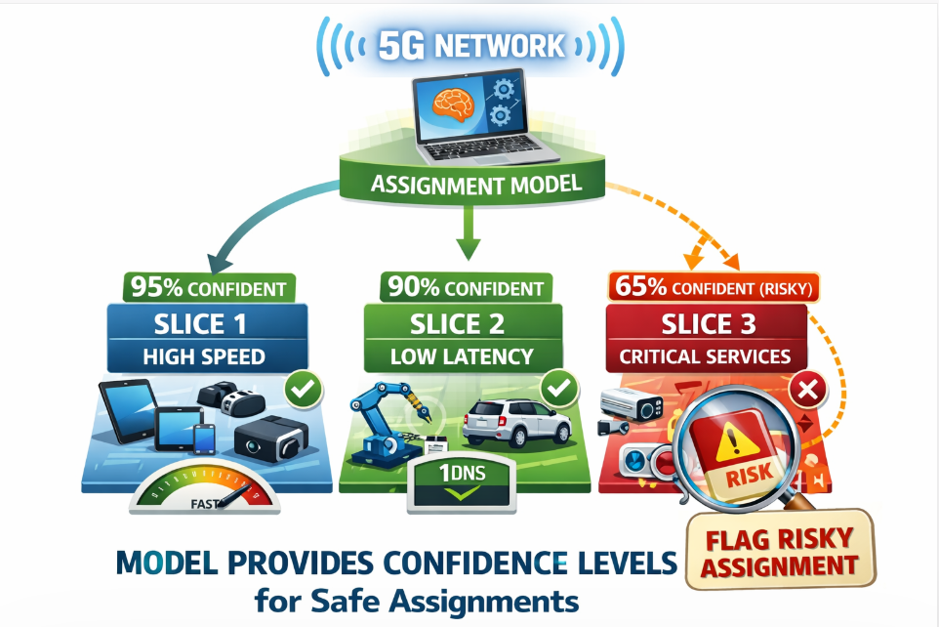



Slide 4






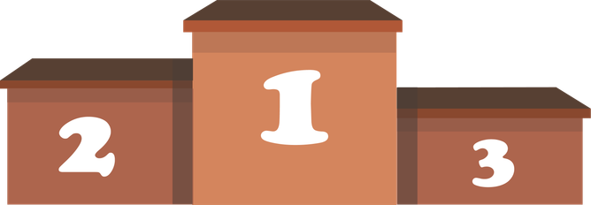

Evaluation metrics
Log loss
AUC - ROC
Accuracy

Slide 5

The 5G dataset
Size = 8.958
3 slice types
No missing values
high correlation
features bigger than others
16 feature + 1 target

Slide 6


Chosen models
Random forest
XGBoost
LightGBM
MLP
Sequential trees
faster and more memory efficient
Independant trees
Multilayer Perceptron
Logistic Regression

Slide 7
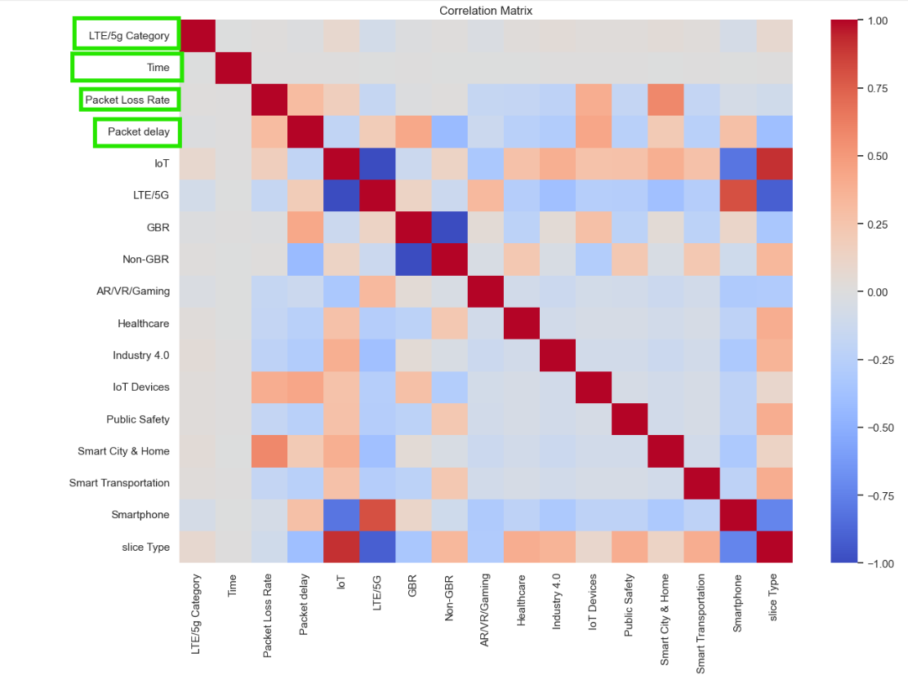


Selecting only clean features

Slide 8

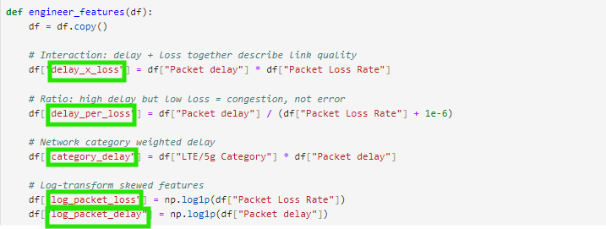

Feature engineering
delay_x_loss
delay_per_loss
category_delay
log_packet_loss
log_packet-delay
For random forest
delay_bin (4 zones)

Slide 9

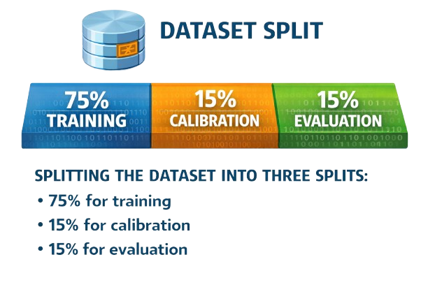

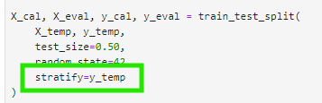

Three-way split
stratify function

Slide 10

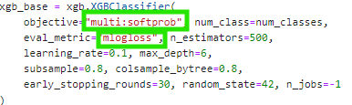

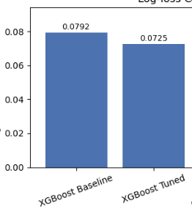
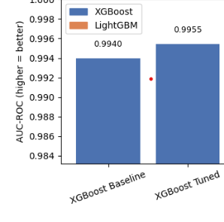

XGBoost
Baseline
Optuna
Log loss
AUC ROC

Slide 11
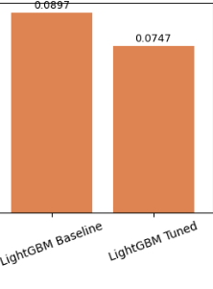
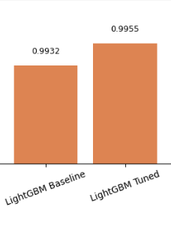
LightGBM
Log loss
AUC - ROC

Slide 12
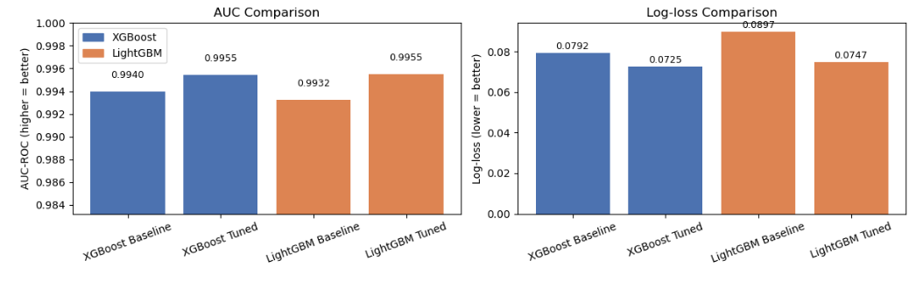
XGBoost vs LightGBM

Slide 13

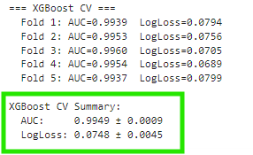
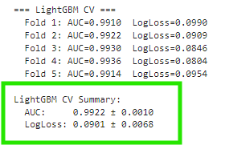
Stratified k-fold cross-validation
skf = StratifiedKFold(n_splits=5, shuffle=True, random_state=42)

Slide 14
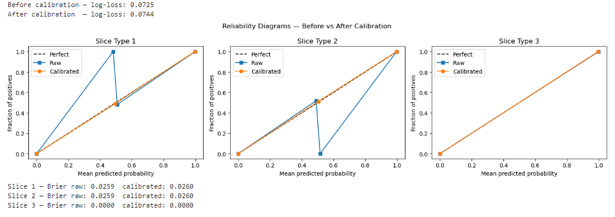
Probability calibration
Functions
Frozen estimator
sigmoid

Slide 15


Random Forest
Baseline
Optuna
training final tuned model

Slide 16
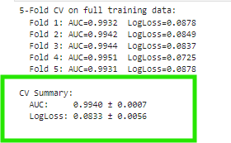
Stratified k-fold cross-validation
skf = StratifiedKFold(n_splits=5, shuffle=True, random_state=42)

Slide 17
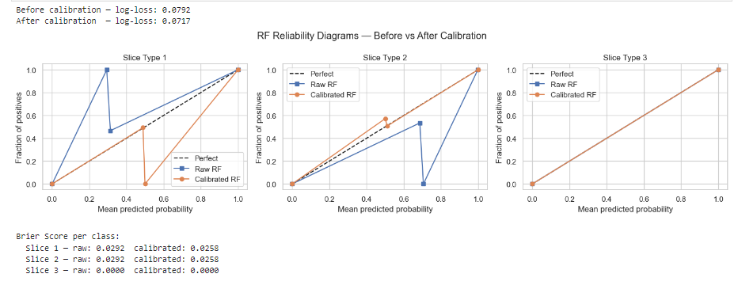
Probability calibration
Functions
Frozen estimator
sigmoid

Slide 18
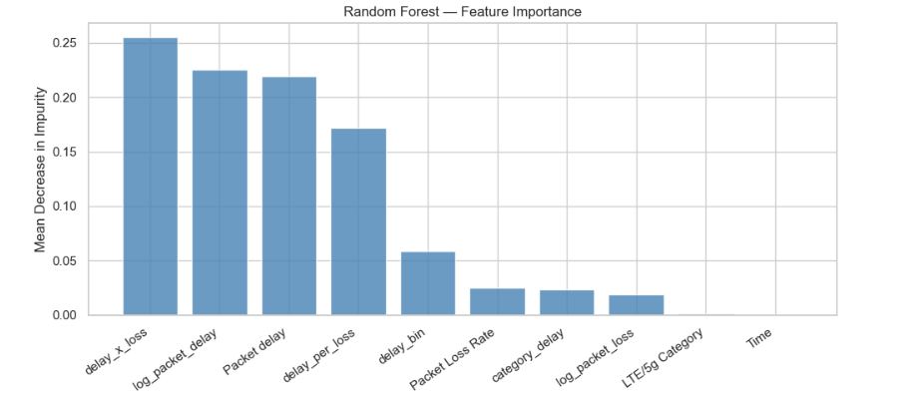
Feature importance

Slide 19
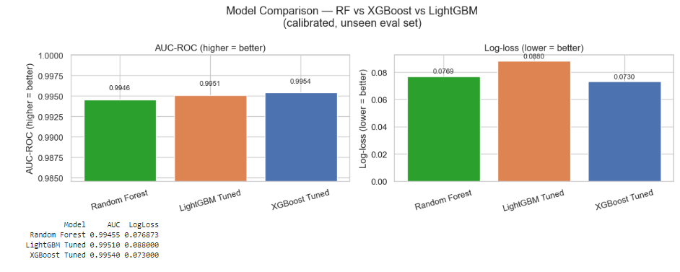
ML models comparison

Slide 20
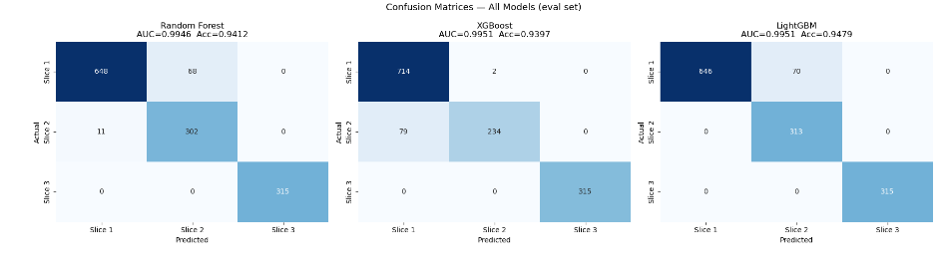
Confusion matrices side by side

Slide 21
Multilayer Perceptron
No Feature Should Dominate Due to Scale
Saturation of Activation Functions
Convergence Speed

Slide 22
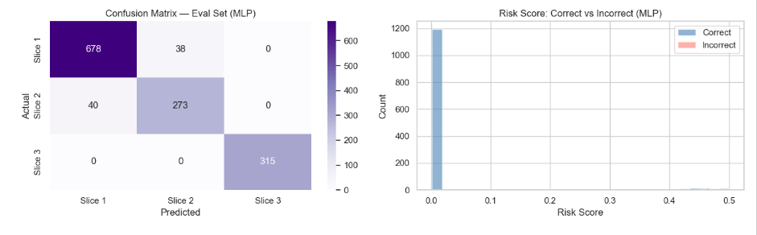
MLP final evaluation

Slide 23
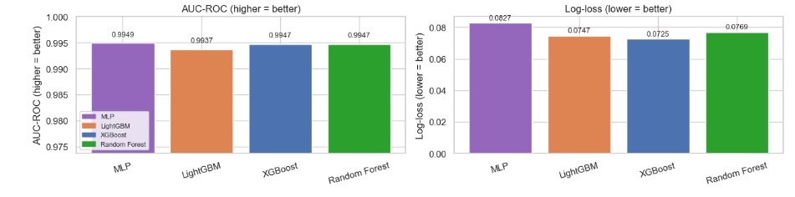
Comparison with other models
XGBoost is the best model

Slide 24
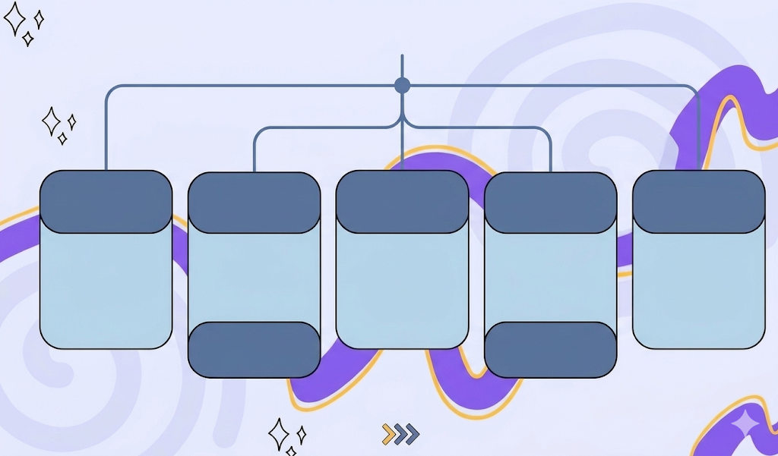
6G
ERLLC
umMTC
MBRLLC
mURLLC
feMBB

Slide 25
Data exploration 6G (quick recap)
10,000 samples
with 12 features + 1 target
5 classes of Slice Type
Presence of missing
values
Presence of duplicates
Use Case type is
strongly correlated
with slice type
=> The data will be biaised
The features are
not of the same type

Slide 26
Datascience objective n ° 1 Predict network congestion
6G Dataset

Slide 27
Network Classification
The goal is to predict the congestion state of a network slice before it causes any service degradation.

Slide 28
The classes we use
1 = Light congestion
3 = Critical congestion
0 = Normal

Slide 29
Chosen models
Logistic Regression
Random forest
Gradient Boosting
XGBoost
Robust
to
outliers
Handles Non linearity
Strong Generalization
Fast

Slide 30
⚠️ Data Leakage Detected & Fixed
SLA_Respected
Aggregated_QoS_Score
Latency_Score
Keep only the 12 raw features.
First version of the notebook produced 99.9% accuracy on all 4 models
After correction: Logistic Regression reaches ~84% and XGBoost reaches ~97.5%

Slide 31
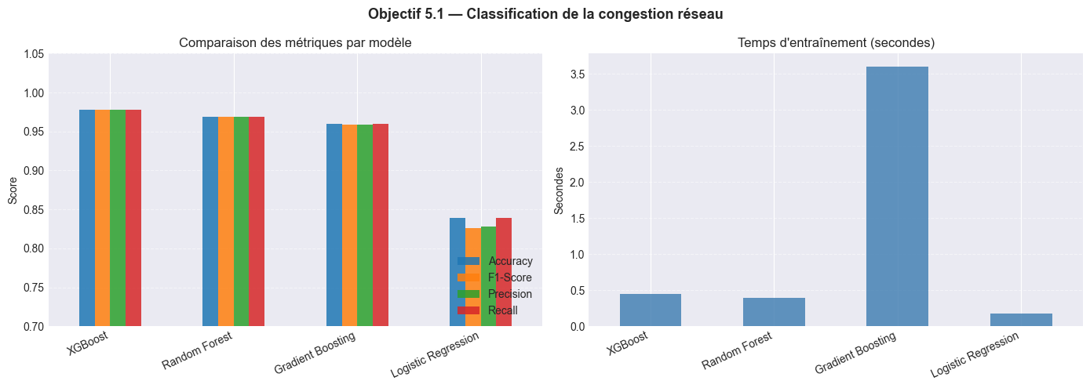
ML models comparison

Slide 32
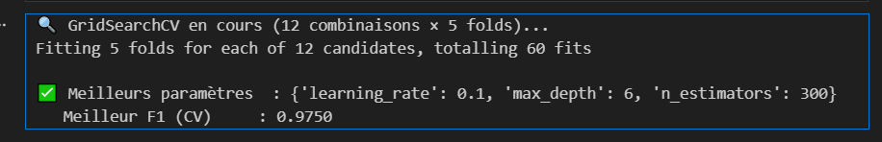
Cross-Validation & Hyperparameter Tuning —

Slide 33
Datascience objective n ° 2
Estimate QoS compliance probability
6G Dataset

Slide 34
probabilistic regression
quantify the confidence level that a network slice respects its SLA.
If QoS_Probability = 0.40 → only 40% chance this slice meets its SLA
QoS_Probability built via sigmoid function on 4 SLA gap features

Slide 35
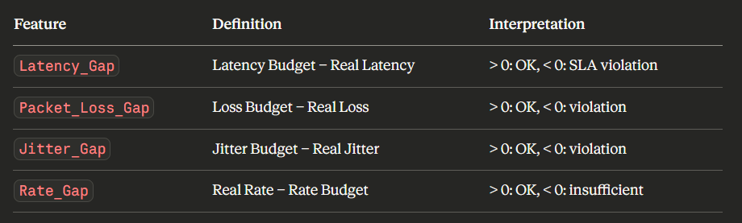
Feature Engineering
These 4 features directly represent the gap between SLA requirements and actual performance — the most direct signal of QoS compliance.

Slide 36
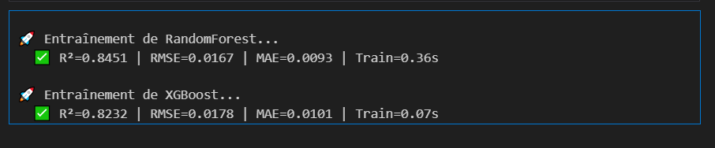
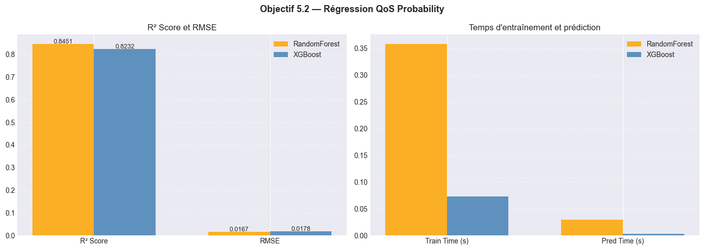
ML models comparison

Slide 37
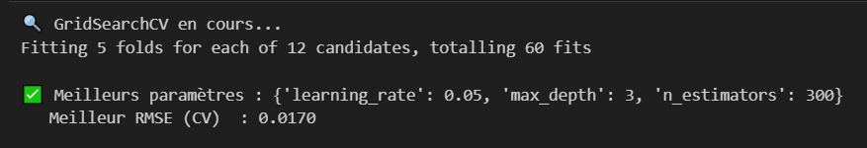
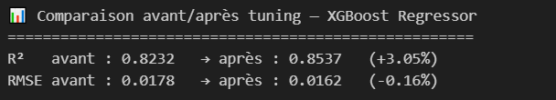
Cross-Validation & Hyperparameter Tuning —

Slide 38
What worked well
Limits
We corrected the data leakage
XGBoost dominant for classification (F1=0.9775)
Random Forest solid for regression (R²=0.845)
Cross-validation confirms generalization on both objectives
Dataset is synthetic → real-world performance may differ
QoS_Probability target was engineered, not measured directly
Class 2 (only 1 sample) had to be removed from Obj 5.1

Slide 39
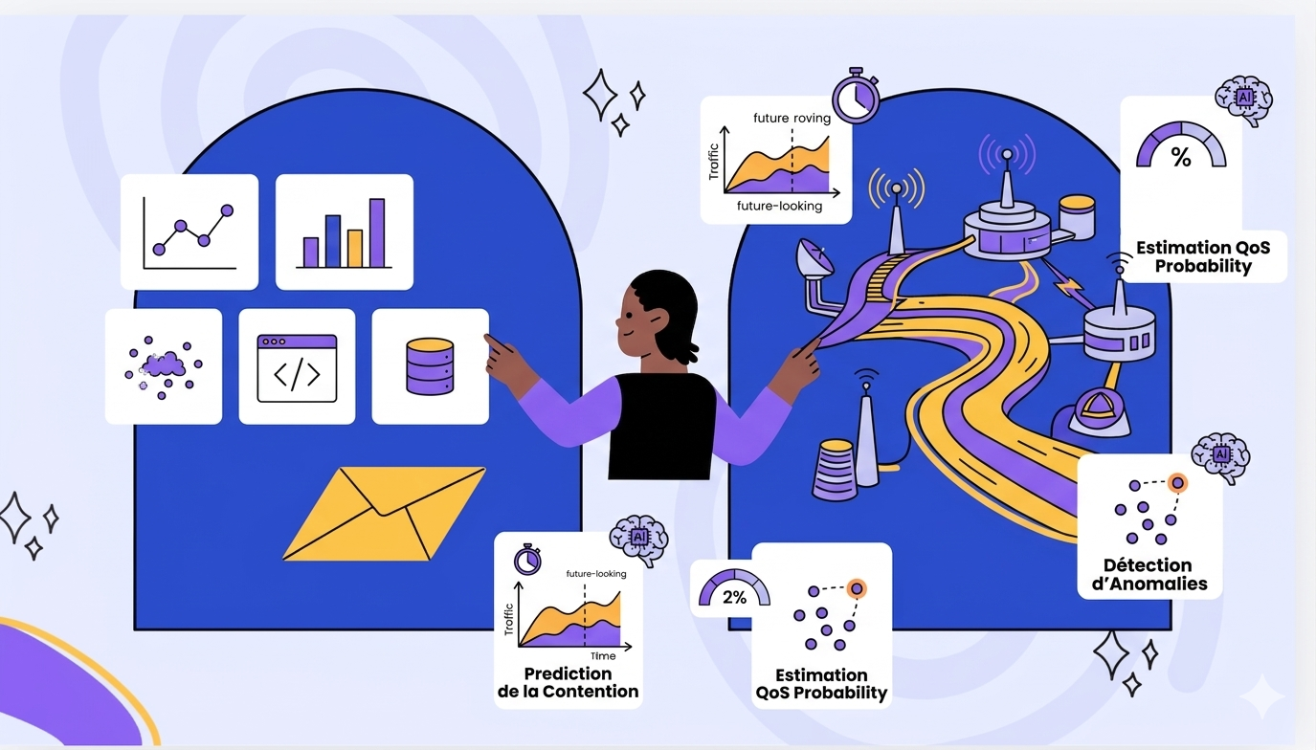

Conclusion

Slide 40
Thank you for your attention

