Slide 1
2
0
2
0
Housing Market Analysis
Emily Mobley
APR
2020

Slide 2

Introduction
Analyze housing data to assess status of housing market
Hypothesis:
December will be the best month to purchase a home.
May will be the worst month to purchase a home.
The housing market has recovered from the bubble.
Notes:
For this project, housing data from Zillow was analyzed to gain insights for potential home buyers and sellers. Everyone will probably purchase or sell a home one day, so I felt the housing market was a relatable topic for most people.
December was hypothesized to be the best month to purchase a home with the lowest prices. People are busy with holiday activities and the weather is cold so I didn’t think people would be too busy focused on home buying. I assumed there would be lower competition which would therefore drive down prices.
May was hypothesized to be the worst month to purchase a home with the highest prices. The reason being, spring time tends to be a popular season for home buying, the weather is warm and I assumed there would be higher competition which would drive up prices.

Slide 3
Questions
When is the best and worst time of the year to purchase/sell a home?
Has the housing market bounced back since the housing collapse in 2009?
How does the US Market compare to Minnesota?
Notes:
These are the questions motivated for the analysis.

Slide 4
Data Exploration & Clean Up
Data is in csv format from Zillow
Median Sale Prices
Location (US vs. MN)
Years: 2009 - 2019
Python for programming
Pandas for data mining
Matplotlib for graphing
Notes:
Housing data was found on https://www.zillow.com/research/data/ which contained seasonally adjusted prices for the United States and Minnesota. The scope includes data from 2009 - 2019. The programming was conducted in Python using a couple libraries. Pandas was used to create data frames and filter the data. Matplotlib was used to create the charts.

Slide 5
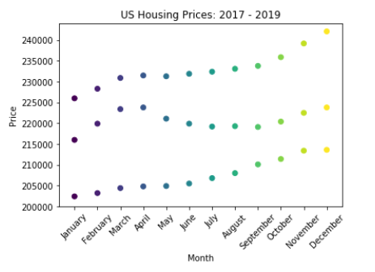
Housing Prices Analysis
Notes:
From 2017 to 2019, you can see a general trend upwards for home prices for the US.
There appears to be a high point in March/April but it only happens in 2 out of the 3 years. It's not sufficient enough to draw conclusions about an optimal month.
Overall, you can see prices increased over the three years.
Contrary to the hypothesis, prices seem to be high in December towards the end of the year, as prices increase throughout the year.

Slide 6
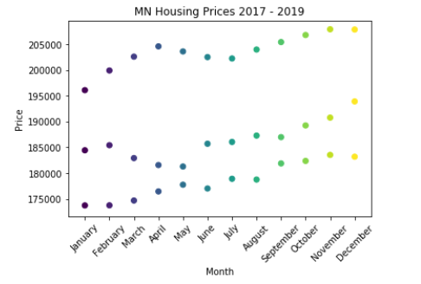
Housing Prices Analysis
Notes:
This graph shows Minnesota is a little more volatile compared to the US market, with more peaks and valleys from 2017-2019.
There aren’t any consistent patterns in regards to month compared to home prices, so again you can’t really draw any conclusions on an optimal month to purchase a home.
Again the hypothesis of December being the best month to purchase a home is rejected.

Slide 7
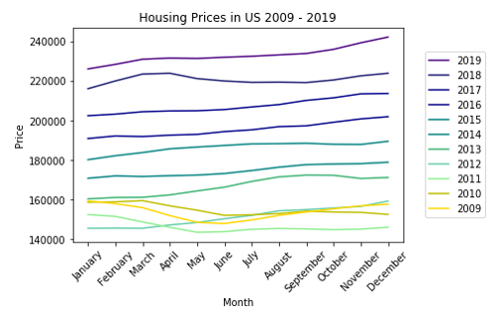
Housing Prices Analysis
Notes:
Again with this chart, there are not any visible relationships between home prices and month.
You can see the housing market did bounce back from the economic recession in 2009 - 2011. In those years you see home prices declining from left to right at the bottom of the graph. As time passes, housing prices start to continually increase up until 2019.

Slide 8
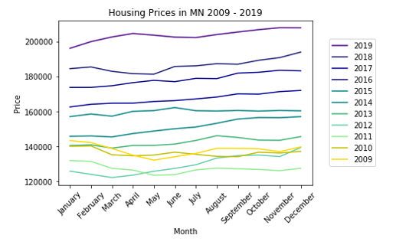
Housing Prices Analysis
Notes:
MN housing prices follow a similar pattern to the US Market . During those years (in yellow and green) home prices home prices start to decline and then they hit an all time low in 2011. From 2009 to 2011, home values declined by 3% each year. In 2012, prices shot up by 9-10%. Then after, they increased by 4.5% to 5.5% each year until 2019.

Slide 9
Conclusion
An “optimal” month to purchase home does not appear to exist
Home prices could be more impacted by economic factors
Suspect it’s best to purchase a home during a recession
The housing market has rebounded significantly since the collapse
Home prices generally increased by 4-6% since 2013
Notes:
After reviewing the data, there doesn’t appear to be an optimal month to purchase a home. Fluctuations in home prices are random when you compare them on a month to month basis. There are different peaks and valleys but none of them seem to be consistent.
Changes in prices seem to be motivated by external factors, instead of the time of year. Additional analysis could be conducted to see if there are relationships between home prices and economic factors.
The housing market has rebounded significantly since the collapse, with prices getting back to their pre-recession values by the end of 2012. Since 2013, prices have risen favorably around 4-6%. Financial experts consider houses a “moderate” risk investment which typically yield a return of 3%. That being said, from 2013-2019, the return on home purchases is above average.

Slide 10
Thank you
Questions?

