Slide 1

Housing Market Analysis
Briana Friendt
Emily Mobley James Turner

Slide 2
Questions
When is the best and worst time of the year to purchase/sell a home?
Has the housing market bounced back since the housing collapse in (Insert Year)?
Is purchasing a home a solid investment?
Notes:
Made Toyota the Success Story it is today.

Slide 3
Splitting up the work
-Everyone do one analysis/chart, figure out who’s presenting what next Tues
Briana -
Emily - Best/Worst times of year to purchase home
James - Days on Zillow

Slide 4
Methodology
Perform Data Analytics in a healthcare setting
Gain exposure to Health IT software applications
Develop a deeper understanding of Workflow Processes

Slide 5
7 Types of Waste = “Muda”
Defect: Missing or incorrect information
Overproduction: unnecessary activity due to complex processes and systems (too many approvals)
Waiting: delays, backlogs, waiting for instructions, idle time
Takt Time = time between a customer requesting a service and receiving it
Notes:
-A defect is when there is missing or incorrect information which results in a defective product
-Defects waste time for a customer and a company to fix and resolve what was incorrect
-A second type of waste is producing more than is needed by the customer or over-production
-
-

Slide 6
Title
add text
add text
add text
Takt Time = time between a customer requesting a service and receiving it
Notes:
-A defect is when there is missing or incorrect information which results in a defective product
-Defects waste time for a customer and a company to fix and resolve what was incorrect
-A second type of waste is producing more than is needed by the customer or over-production
-
-

Slide 7
Title
add text
add text
add text
Notes:
Made Toyota the Success Story it is today.

Slide 8
Title
add text
add text
add text
Notes:
Made Toyota the Success Story it is today.

Slide 9
Title
add text
add text
add text
Notes:
Made Toyota the Success Story it is today.

Slide 10
Title
add text
add text
add text
Notes:
Made Toyota the Success Story it is today.

Slide 11

At it’s core…
Dedicated towards eliminating waste
improving processes and work flow
to provide more value to the customer

Slide 12
7 Types of Waste = “Muda” Add 1 more
Transport: unnecessary movement of work
Inappropriate Processing
Unnecessary Inventory: holding information and material longer than required (ie. saving 5 years of information on OneNote)
Notes:
-A defect is when there is missing or incorrect information which results in a defective product
-Defects waste time for a customer and a company to fix and resolve what was incorrect
-A second type of waste is producing more than is needed by the customer or over-production
-
-

Slide 13

Business Solutions
Cross-departmental reporting
Adjudicating pharmacy claims
“How-To” documents

Slide 14
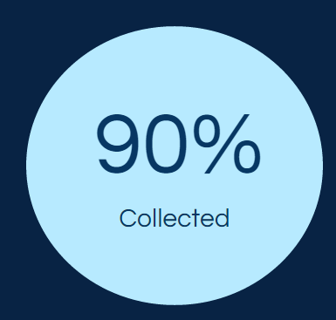
IT Inventory Management
Compiled data for 130 phones
Corresponded with over 20 clinics
Tracked response rates
Notes:
Compiled data for 130 phones to identify phones and their respective locations
Sent e-mails to employees at 20 different locations

Slide 15
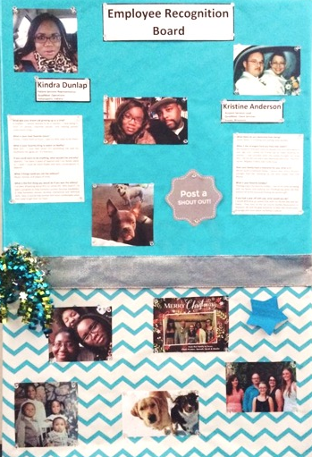
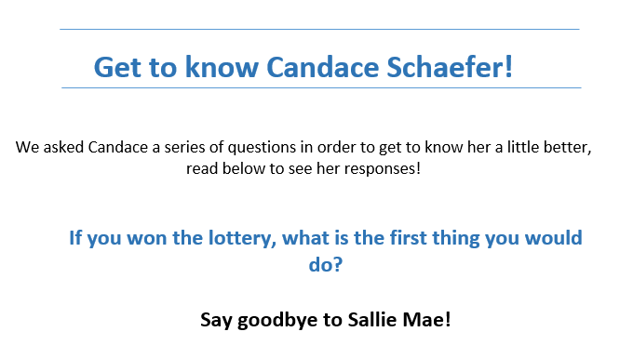
Employee Recognition Board
Notes:
Modeled after the program in Sussex office

Slide 16
Conclusion and Lessons Learned
Goals met and exceeded!
When in doubt, trust your best judgement
Be eager to try new things

Slide 17
Thank you
Questions?

