Slide 1
2
0
2
0
Housing Market Analysis
Briana Friendt
Emily Mobley
James Turner
APR
2020

Slide 2

Introduction
Analyze housing data to assess status of housing market
Hypothesis:
December will be the best month to purchase a home.
May will be the worst month to purchase a home.
The housing market has recovered from the bubble.
It takes 2-3 months to sell a home.
Notes:
-Emily can do this slide….
-So for our Project, we decided to review housing data from Zillow to assess the status of the housing market. Our intended audience is for potential home buyers and sellers to help give them insight on data for strategies they can use when buying or selling a home. We used the Zillow data because blah blah blah…
-December will be the best month to purchase a home, lowest prices people are busy with holiday activities, it’s cold out people want to stay indoors
-May will be the worst month to purchase a home, lots of competition, homebuyers want to start shopping and go outside
Then we also wanted to take a look at the average number of days it takes a home buyer to sell a home on Zillow. That can help sellers get an idea of how long the process takes.

Slide 3
Questions
When is the best and worst time of the year to purchase/sell a home?
Has the housing market bounced back since the housing collapse in 2009?
How many days on average does it take to sell a house?
Is there a difference between US and MN?
Notes:
-Compare US and MN see if they’re the similar or different.
-What motivated us to answer? We wanted to select a topic that was popular that everyone can relate to and that was relevant. Tossed around a couple ideas. Then narrowed it down to the housing market because that’s where we found the most robust and usable dataset. We found the data from Zillow.

Slide 4
Data Exploration & Clean Up
Data is in csv format from Zillow.
All data is for Minnesota, and as compared to the United States where applicable.
Median Sale Prices, Days on Zillow, Number of Home Sales
Performed some data clean up in Excel
Pandas to merge dataframes and functions to remove extra data
Matplotlib for the graphing
Notes:
First, we decided on the topic of the housing market, and found that Zillow provided data to analyze. After looking through the information that Zillow could provide, we decided that MN was the most relevant, and, in some cases, to compare it to the whole of the United States to see if they followed the same trends and how much of a relationship there was between each set of numbers.
The data we found was in a csv file, and not an API. There was a csv file with each piece of data – home sale prices, number of home sales, and days on the market. The csv files were also rather large and had a lot of columns as they were broken out my month from 2008 to 2020. So, our first steps were to narrow down the data in the csv files using Excel, and then we completed further cleanup in pandas. Based on our questions and how we wanted to generate our visuals, we had the files formatted a few different ways. In Excel, for some, we just removed all information except for 2019 or the last 3 years, and, others, we changed the layout to contain the month and year in rows instead of columns. All of them we narrowed down the data to MN and the whole of the United States. Within pandas, some of the files were merged, and the clean up steps involved replacing the zeroes with NaN to use the dropna function, and also deleting extra columns from the merge.

Slide 5
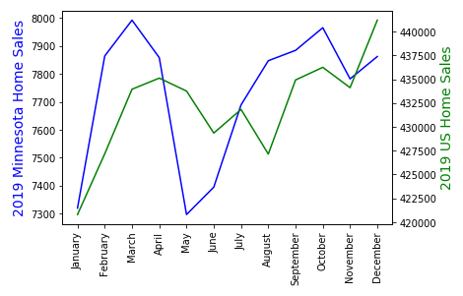
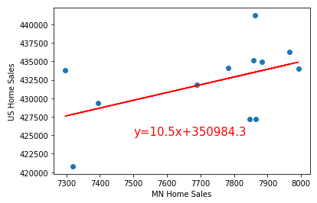
MN Homes Sold vs. US Homes Sold
Is May the best month of the year for buying/selling in Minnesota and how much does it affect the number of homes sold in the United States?
The correlation between MN and US home sales is 0.49.
The r-squared is 0.2426.
Pearson Correlation Coefficient and r-squared value show weaker relationship.
Notes:
Data Used
The first question we had was, what is the best month of the year for buying and selling in Minnesota and how much does it affect the number of homes sold in all of the U.S.? We all assumed that it would be May, being that we’ve heard Spring is the busiest season and it’s the first relatively warm month of the year. For this information, we decided the most recent year of data was most relevant and went with monthly data from 2019.
The analysis process
We started off with two line charts, and found a way to combine them into one figure with two different y-axes values, so you could view the lines on top of each other. We also calculated the Pearson’s correlation coefficient, and did a linear regression analysis of the number of Minnesota Home Sales.
Conclusions
From the line charts, you can conclude that we were completely wrong about May being the best time to buy or sell a home in Minnesota considering May is the month with the lowest number of homes sold. It turns out last year that the month with the most home sales was March. However, in the Unites States, the lowest month was January and the highest month was December. In both cases, we were incorrect about May being the best home sales month.
If you evaluate the correlation between the number of homes sold in Minnesota and in the United States, the value is .49. Zero implies no relationship, and positive one implies a positive relationship between the two factors and all points lying on the line. So, with this, we can determine that MN home sales do have a positive effect on the United States, as you would suspect. If we use the r-squared value, we can also determine that the MN home sales affect the United States home sales, but the relationship is on the weaker side because only about 25% of the points fall on the line.

Slide 6
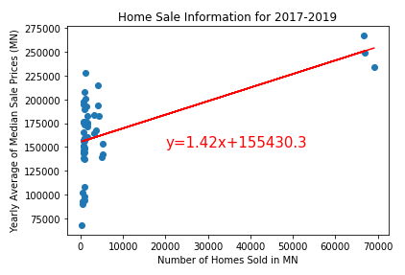
Median Sale Price vs Homes Sold in MN
How much of an effect does the number of homes sold have on the median sale price?
The correlation between MN and US home sales is 0.56.
The r-squared is 0.3163.
Pearson Correlation Coefficient and r-squared value show weaker relationship.
Notes:
Data Used
The question we had for this diagram was, how much of an effect does the number of homes sold have on the median sale price? The data used for this plot is 2017-2019, and the points are regions in MN that contained a price and a number of home sales each month over the course of these 3 years. This data was merged on the region and the year. For this plot, we were illustrating if the number of homes sold had a strong effect on the median sale price in Minnesota, like we suspected it did.
The analysis process
Each point represents the home sale count and average of the median sale price for the year of a region in Minnesota. In addition to creating a scatter plot, we calculated the Pearson’s correlation coefficient, and did a linear regression analysis.
Conclusions
First, we noticed the 3 data points hanging out by the maxes of the axes. We determined that this is because the largest region is the Twin Cities, and all the other regions with all the data are very small compared to it.
The correlation between number of homes sold and median sale price in Minnesota is .49. Again, zero implies no relationship, and positive one implies a positive relationship. If this number is accurate, it tells us that homes sold does have a positive affect on the median sale price, as suspected. If we use the r-squared value, we can also determine that the relationship is on the weaker side because only about 30% of the points fall on the line, but there is a relationship between the numbers.

Slide 7
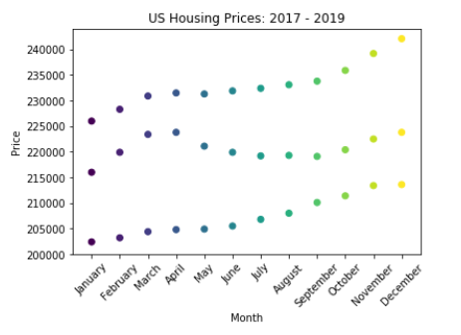
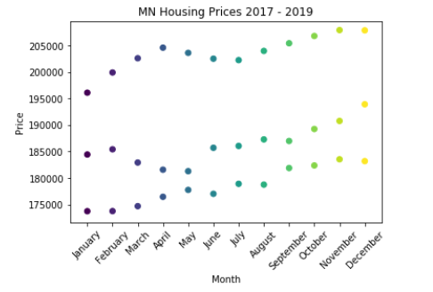
Housing Prices Analysis
Notes:
-Three year trend
-Over the past 3 years general trend upwards….
-MN Market a little more volatile than the US Market

Slide 8
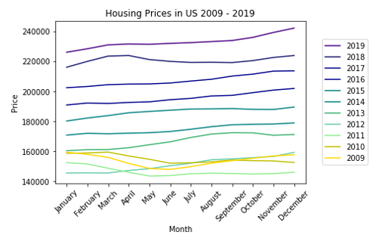
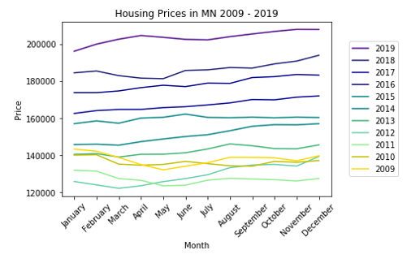
Housing Prices Analysis
Notes:
-How much have prices gone up since the great recession and what did the rise look like?
-**Work on the colors for 2009, 2010, 2011, 2012…
-Was it quick was it gradual?
-2009, looks like it went down…
-General trend, the price is going up.. during times of economic prosperity
-Look at the Average price change from 2009 to 2019….
-In 2009 - 2010 there’s more of a negative trend…
-Dollar amount and % wise how much has it increased by then…
-What’s the reason behind it…. is it inflation?.... consumer price index, housing foreclosures…. many possibilities…

Slide 9
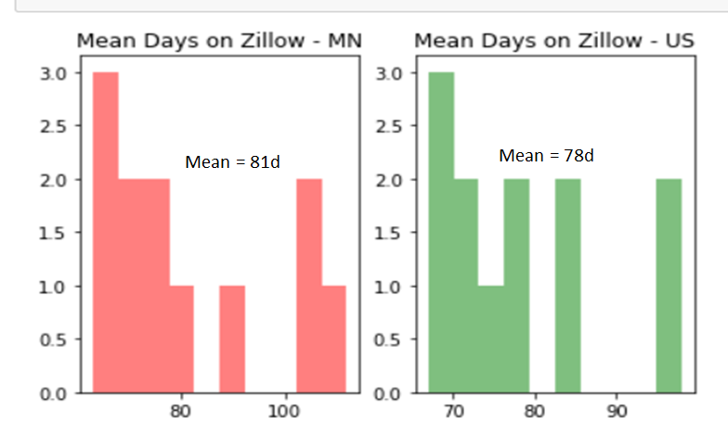
DAYS on ZILLOW
MN vs Rest of US
Notes:
Made Toyota the Success Story it is today.

Slide 10
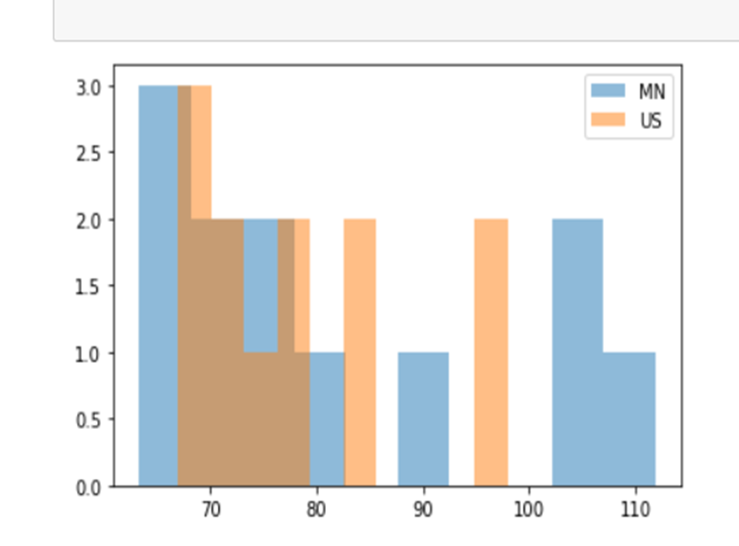
DAYS on ZILLOW
MN vs Rest of US
Notes:
Made Toyota the Success Story it is today.

Slide 11
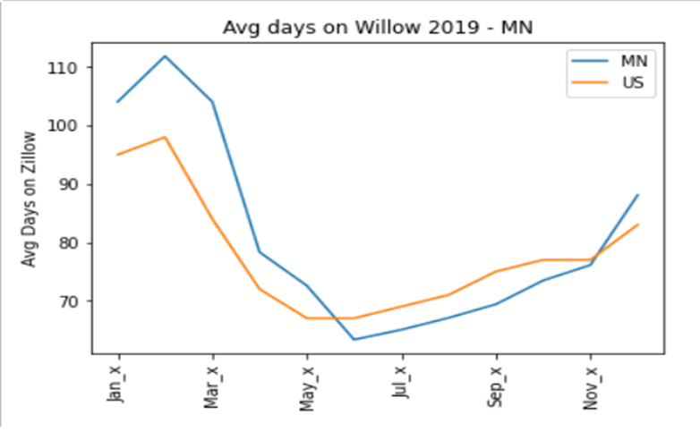
DAYS on ZILLOW THROUGH YEAR
MN vs Rest of US
Notes:
Made Toyota the Success Story it is today.

Slide 12
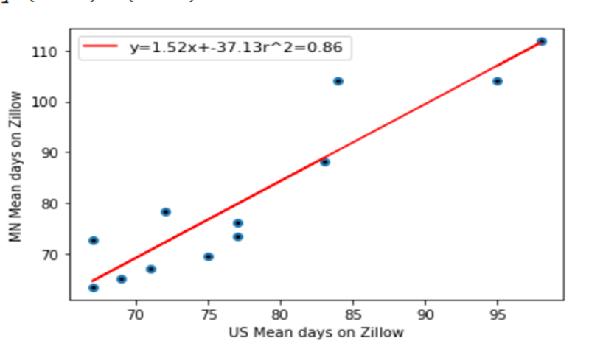
DAYS on ZILLOW
MN vs Rest of US
Notes:
Made Toyota the Success Story it is today.

Slide 13
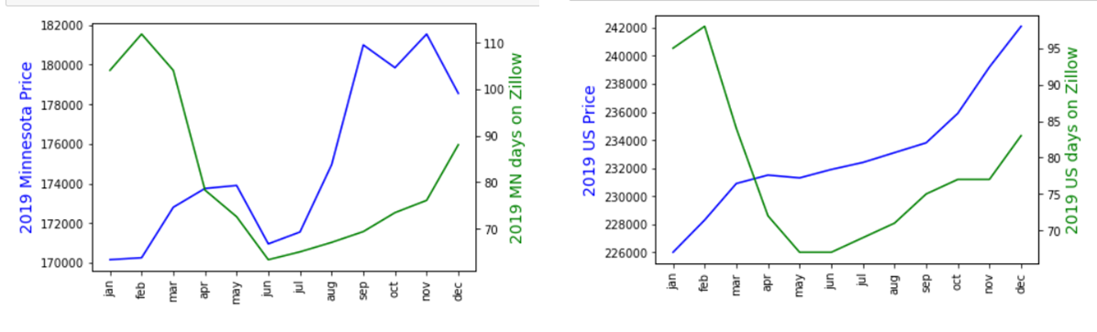
DAYS on ZILLOW & PRICE
MN vs Rest of US
MINNESOTA
REST USA
Notes:
Made Toyota the Success Story it is today.

Slide 14
Conclusion
Unable to determine ideal month to purchase a home
Suspect it’s best to purchase home during recession
Weak correlation between total number of homes sold in MN and US
Weak correlation between total number of homes sold and median sale price
Strong correlation between mean days on Zillow between MN and US
Mean days on Zillow 78 for rest of US, 81 for MN
Strikingly similar MN to US for time of year to sell and days on Zillow. (i.e. sell faster May-July, get more price in fall to late fall.
Notes:
The housing market has rebounded significantly from the collapse. We did not find an ideal month to purchase a home. The data does not have significant patterns based on month. But we can see during times of economic prosperity, the prices tend to rise, so we suspect it’s best to purchase a home when prices are low during a recession.
Marked similarity ie. strong correlation between mean days on Zillow between MN and US

Slide 15
Thank you
Questions?

