Slide 1


Stable Coin Supply & Activity Distribution
Project By Akash Biswas
Roll: 10400218022
Guided by Prof. Partha Sarathi Paul

Slide 2
ABSTRACT
One of the biggest changes in the crypto industry over the past years has been the emergence and development of stable coins. Split across many networks (Bitcoin, Ethereum, Cardano and many more) and issues (Tether, Circle/Coinbase, Binance, etc). These assets share many similarities such as the price, often use the same smart contract (ERC-20) and serve similar users.
In this project, we will look at stable coin’s network data and try to understand how their uses varies across the networks they are based on and their issuer. More particularly, we will look at Tether (on it’s Omni, Ethereum and Tron versions), Paxos, USDC, TrueUSD, Gemini Dollar, HUSD, Binance USD and USDK.

Slide 3
INTRODUCTION
Stable coins are cryptocurrencies that are linked or pegged to a real-world asset. Most often this is a fiat currency such as the US Dollar, The British Pound or even Indian Rupees, but they can also be tied to other assets like gold and oil. Stable coin offers steady valuation and stability in a market that is prone to extreme changes from one day to the next. There are few other purposes stable coins serve however, for example since a stable coin offers a predictable and steady value, it can be used for transaction just like a fiat currency. Many in the crypto industry view this as a significant step towards adoption. Additionally, since these coins have a stable value, they would be used for use for recurring payments, utilities, rent and salaries are always stable coins can be used. This in contrast to the volatility of other crypto currencies which makes it difficult to make regular payments since the value can change drastically from one month to the next quicker.
Stable coins offer a secure way to get into the crypto currency market without exposure to the volatility associated with the more standard crypto currencies available like Bitcoin and Ethereum. Stable coins with fiat backing provide investors with the opportunity to trade on crypto-to-crypto platforms without the need to first buy a major cryptocurrency.

Slide 4
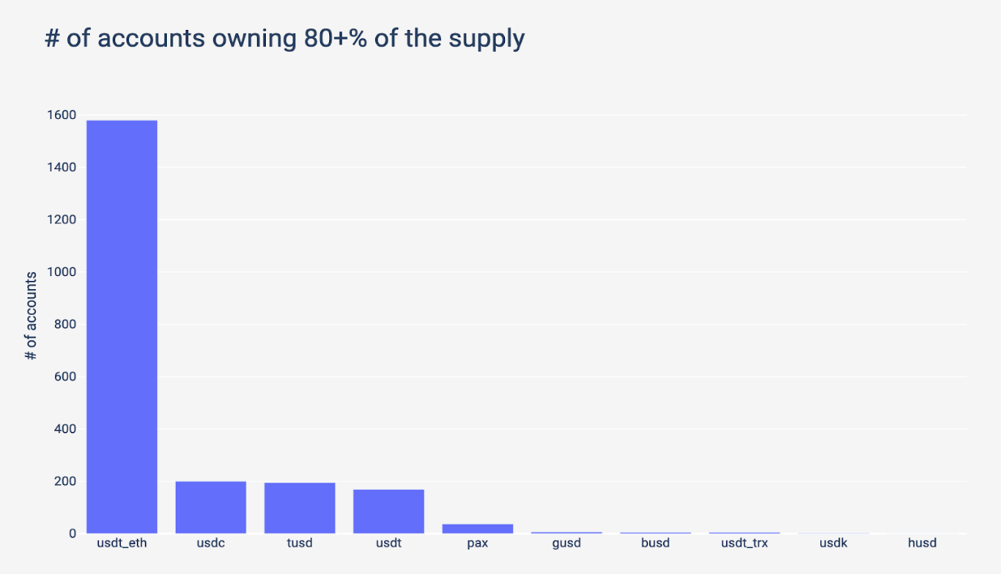
SUPPLY DISTRIBUTION
The supply distribution of a stable coin can help us understand how it is used. If it is only used on few exchanges without much other activity, most of the supply will be concentrated in few addresses. On the contrary, if it’s used by several exchanges and users, it will be more broadly distributed.
The USDT that is using ERC 20 smart contract shines as being particularly well distributed among it’s holders. Whereas, approximantely 6 accounts own 80% + of the supply for Gemini Dollar, BUSD (Binance USD), Tether (Tron), USDK and HUSD.
USDK has a particularly strange supply distribution. 3355 accounts hold USDK, but 3170 (94%) only own either $0.5 or $1 which they received in July 2019 from an account who in turn got it’s money from Okex.com. Given barely any recipient spent their money, it doesn’t seem to be a traditional airdrop.

Slide 5
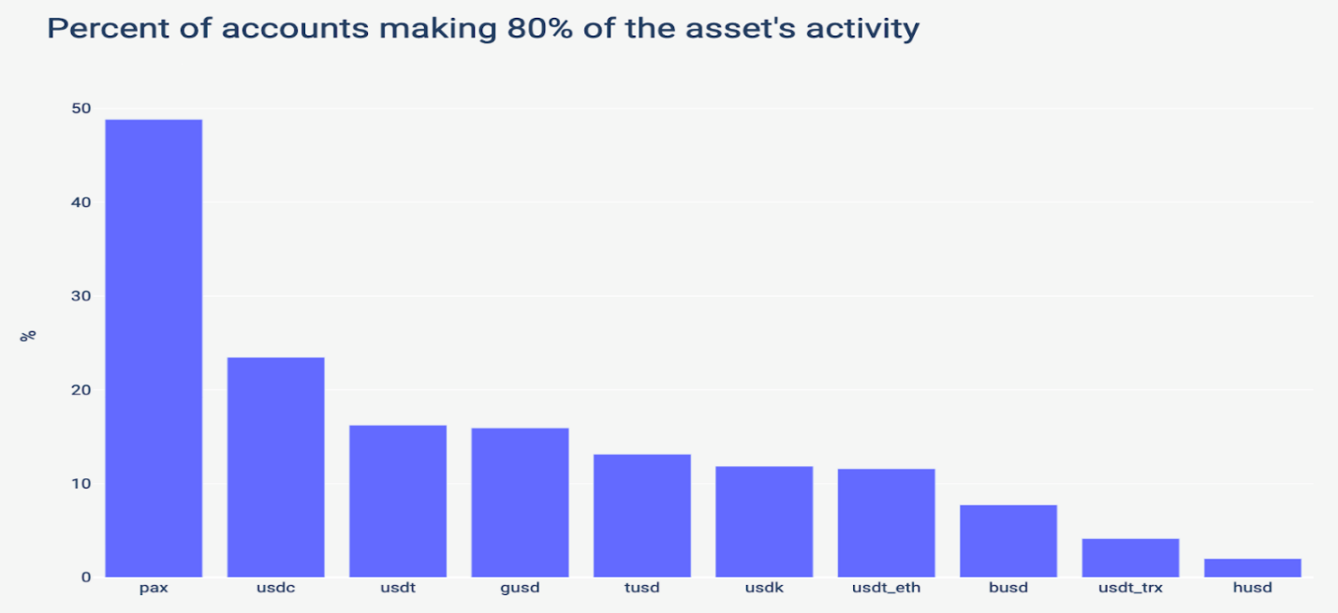
ACTIVITY DISTRIBUTION
One more way to compare stable coins is by looking at how many accounts are responsible for the majority of the on-chain activity. If a small number of accounts are responsible for most of the transactions, it shows a lack of use outside of a handful of exchanges
Note : We have excluded USDK as 94% of it’s holding are $0.5 to $1.

Slide 6
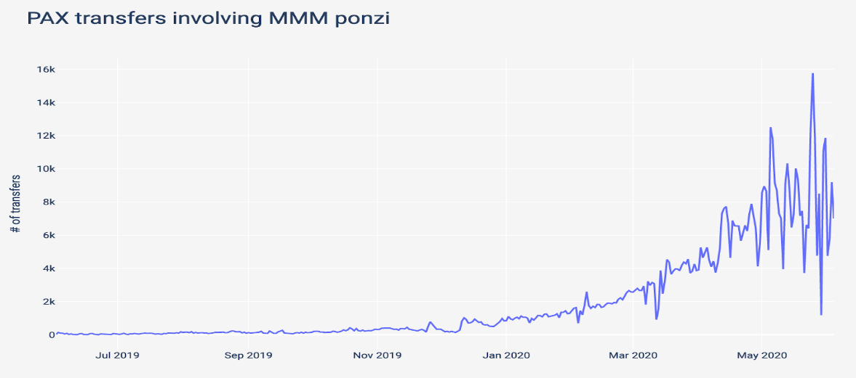
Here, Paxos appear to have a broad and active userbase but looking into it further, the top transactors on Paxos leads to an interesting discovery. The two most active accounts on Paxos are linked to MMMBSC, which is a ponzi scheme that underwent an exponential growth activity in the past year.

Slide 7
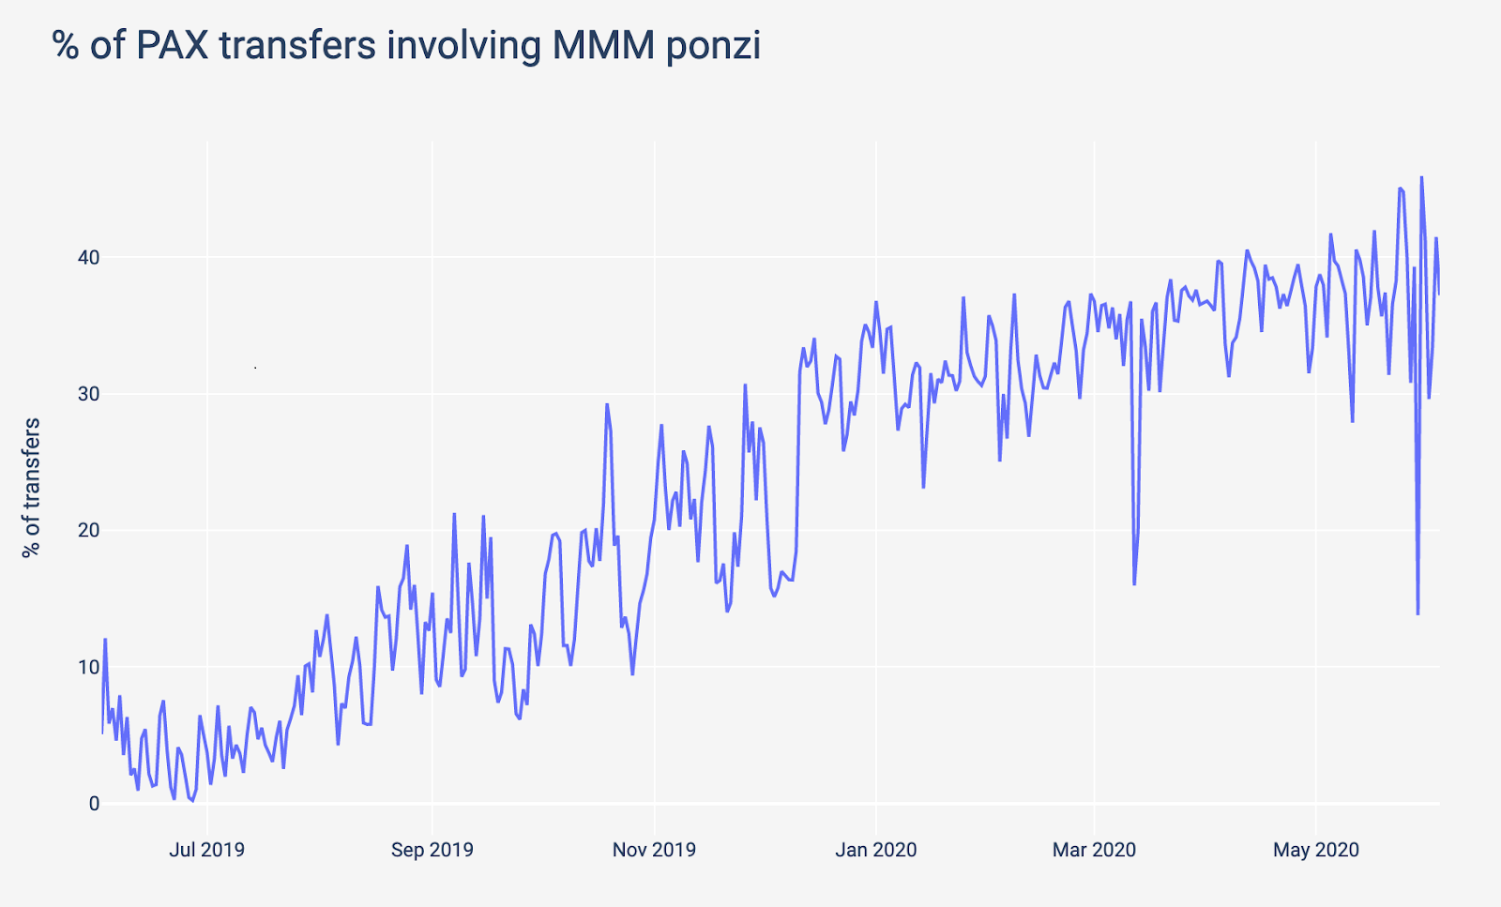
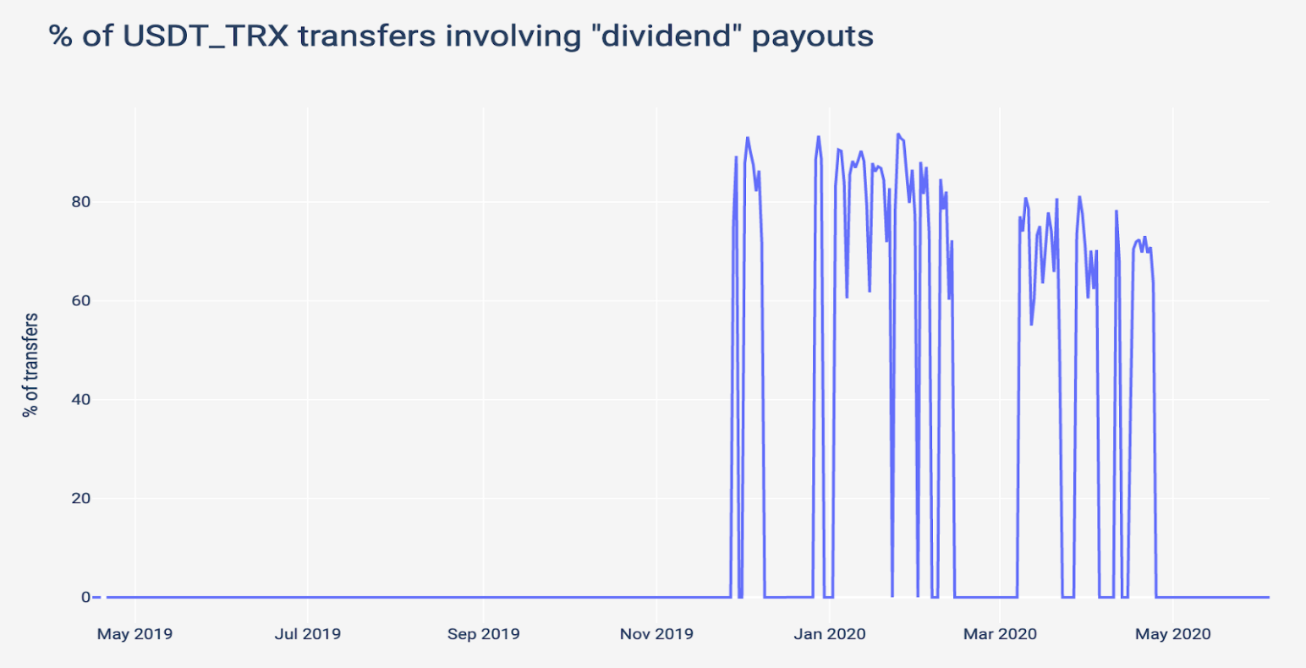
Another interesting anomaly is that the most active Tether on Tron accounts are “Dividend” payouts. In some days, this was responsible for 90+% of Tether on Tron transfers.
Nowadays, more than 40% of Paxos is directly linked to MMMBSC.

Slide 8
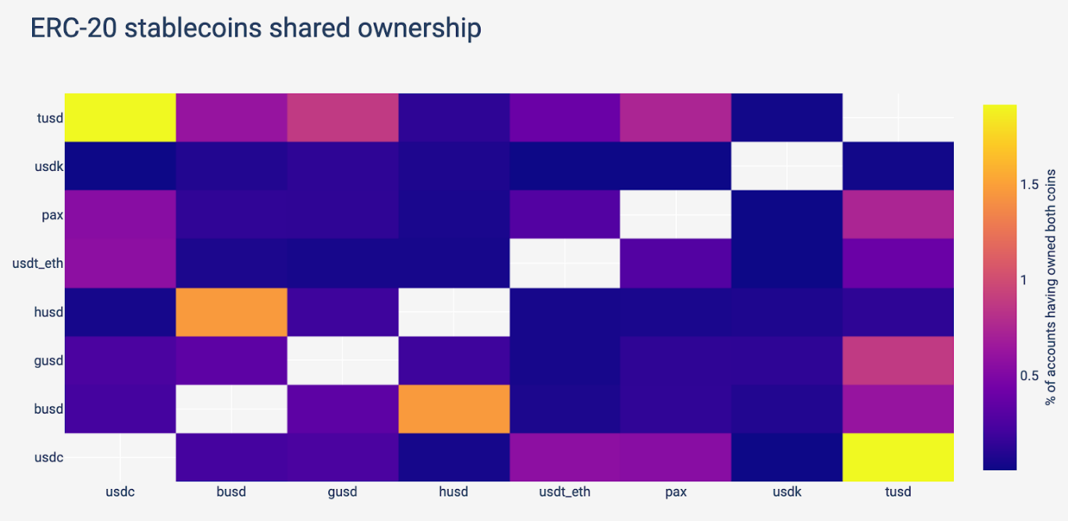
Shared Ownership
Are similar stable coins owned by the same accounts?
Due to the anonymity of blockchain network, it’s only possible to answer this question by analyzing stable coins that use the same network. For example, stable coins like PAX and USDC, which are both issued on the Ethereum blockchain. However, an address owning Tether on Tron cannot own USDC on Ethereum, as the addresses are not consistent across blockchains. As the great majority of stable coins are issued as Ethereum (ERC-20) tokens, this is the asset on which this analysis has been run:
Things to note from the chart:
Two pairs of assets stick out as being owned jointly by single charts accounts: TrueUSD with USDC and HUSD with Binance USD (BUSD).
TrueUSD owners seem to be more likely to own other stable coins.

Slide 9
Conclusion
Even though stable coins are often bunched together and treated as a whole but by looking deeply at network data, we can better understand how they differ. Even when issued by the same entity i.e. Tether, stable coins on different networks and smart contracts have varying outcomes in supply and activity distribution.

