Slide 1
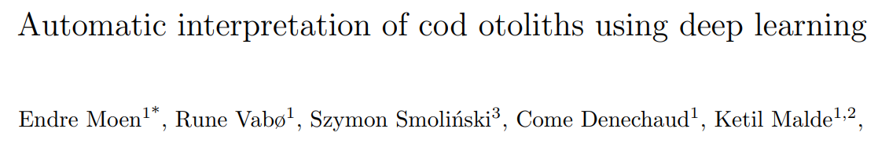
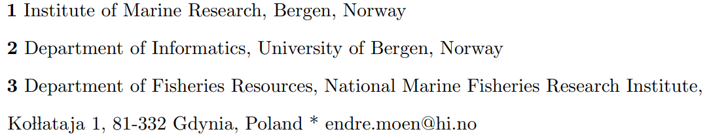
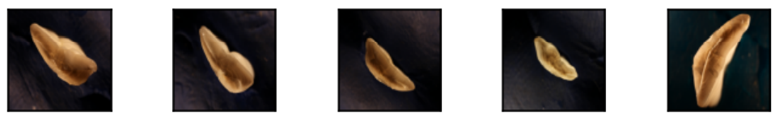
ICES ANNUAL SCIENCE CONFERENCE 2022
Otoliths record physiological and environmental factors in regular, resolved growth zones
Used worldwide as one of the primary sources of fish age estimates

Slide 2
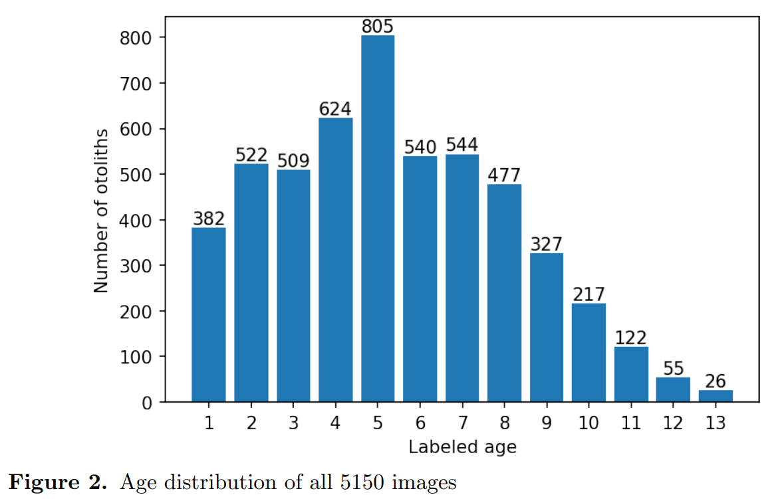
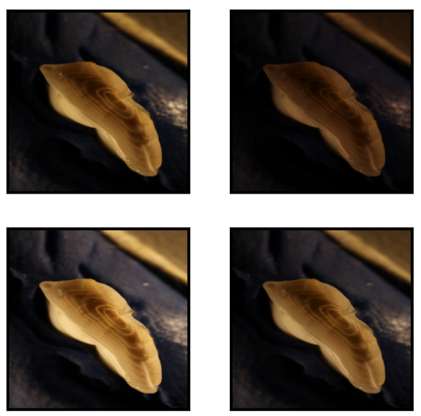
The dataset
5150 broken otoliths
4 different exposed images for each
Train(90%) -Test(10%) split
Medium
Low
High
9 channel

Slide 3
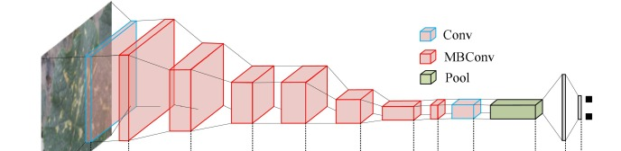
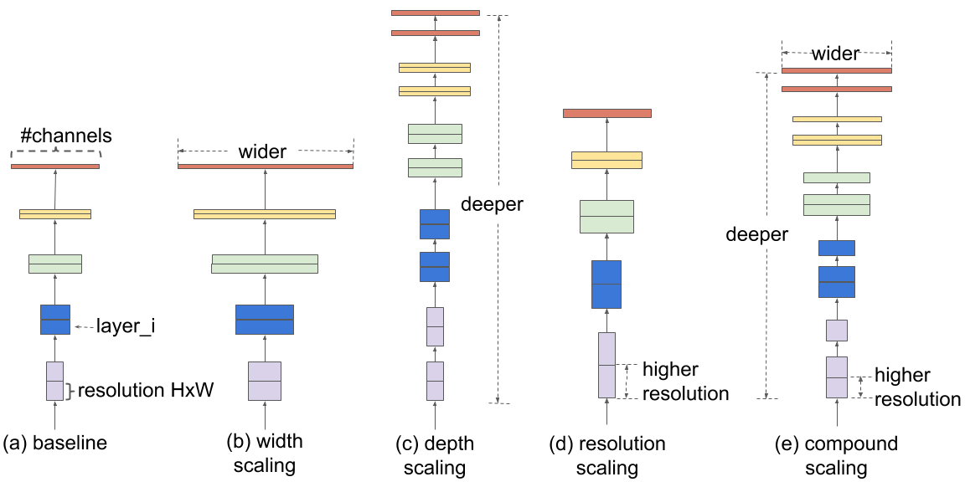
Convolutional Neural Network (CNN) Architectures
EfficientNetV1 (2019)
  Compound scaling method for width, depth and image resolution to form a baseline architecture.
  Three model sizes, B4, B5, B6
EfficientNetV2(2021)
  Two model sizes, medium and large.
image-size as given by architecture
Smallest network B4 trains in ca 4-5 days, largest B6 in 3-4 weeks

Slide 4
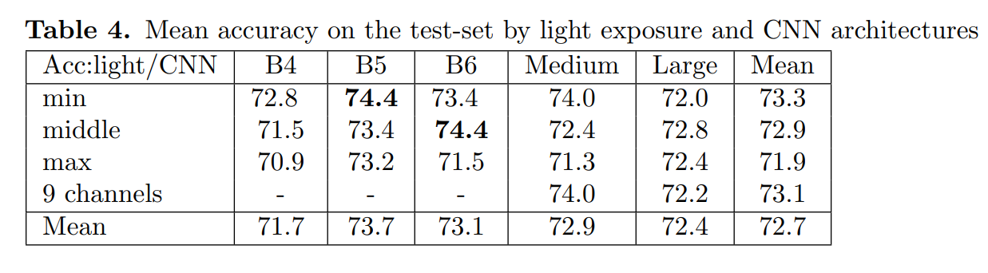
Results

Slide 5
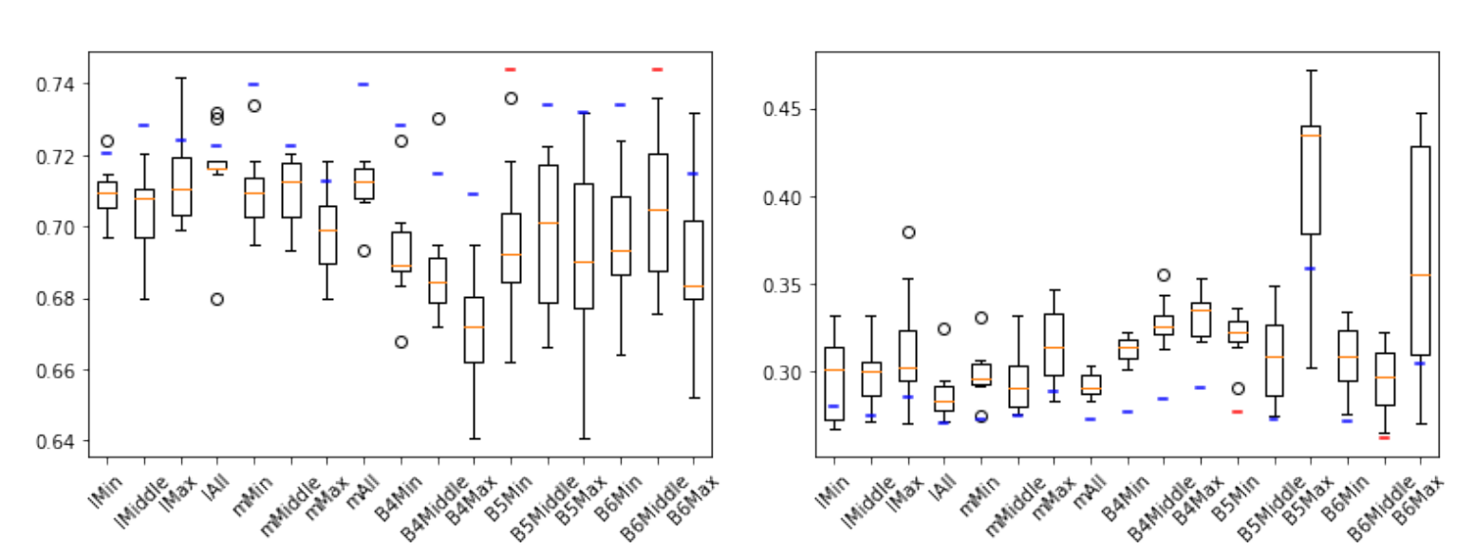
Results of all 17 models
Accuracy
MSE

Slide 6
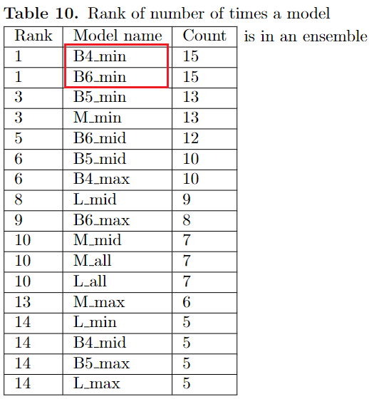
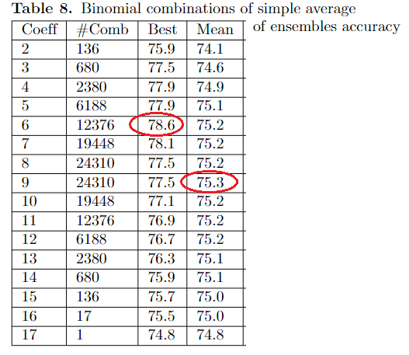
Simple average Ensembles

Slide 7
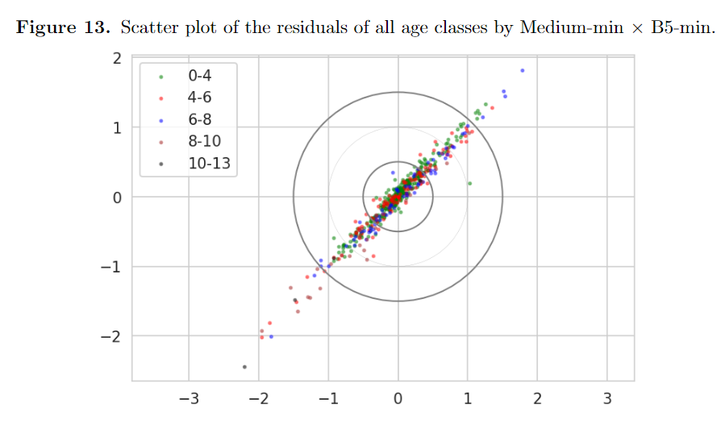
Scatter plot on test set of two least correlated models

Slide 8
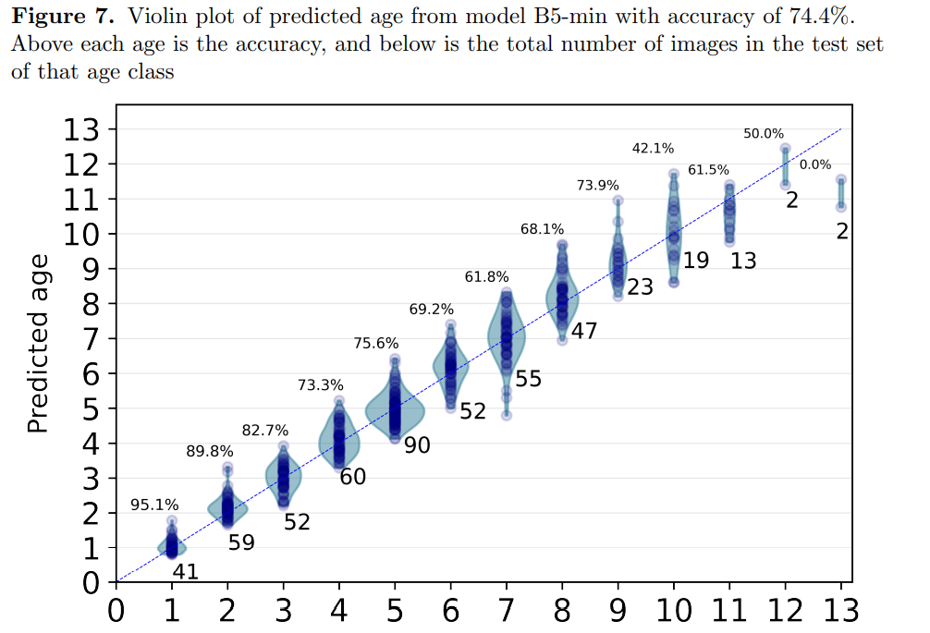
Results:
Distribution of predictions per age group
Best model

Slide 9
Conclusions
Major findings
Low exposure images gives the best performance.
Overall accuracy for different models is 71 – 74%.
Using ensembles improves performance to about 75%.
Younger age classes are easier to predict with accuracy > 90%.
–
Our results demonstrate that the use of deep learning techniques in the analysis of otoliths have a major potential for facilitating automation.
We believe that carefully trained CNNs could become a major component in automated pipelines that require minimal processing and could be able to produce near at sea age estimates.

