Slide 1

Application of Wavenet to financial times series prediction
Author: Endre Moen
Supervisor: Hans Karlsen
Master’s Thesis in statistics
Department of Mathematics
March 9, 2024

Slide 2
Objective
To investigate the claim in of a positive sharpe ratio of trend-following strategy in “Lim, B., S. Zohren, and S. Roberts (2019), Enhancing time series momentum strategies using deep neural networks, The Journal of Financial Data Science”

Slide 3
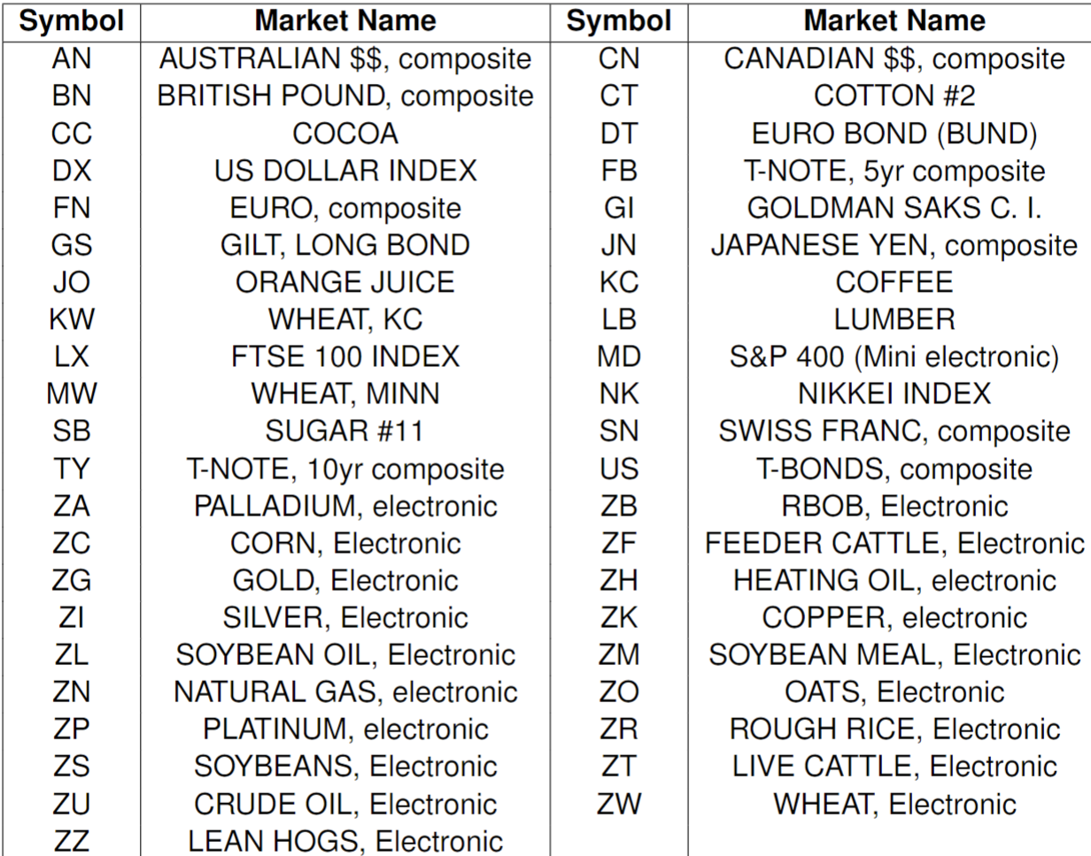
Pinnacle Continuously linked Commodities contracts

Slide 4
Setup
Data driven model as opposed to a rules first model
43 models created – of for each instrument
Predict next-day percent change of Close price, R_t
Model: WaveNet model – a CNN
Loss function: MSE
Evaluated on accuracy (> 50%) and edge (>0)
Train-validat-test split: Time series is dependent data. More careful splitting than with independent data

Slide 5
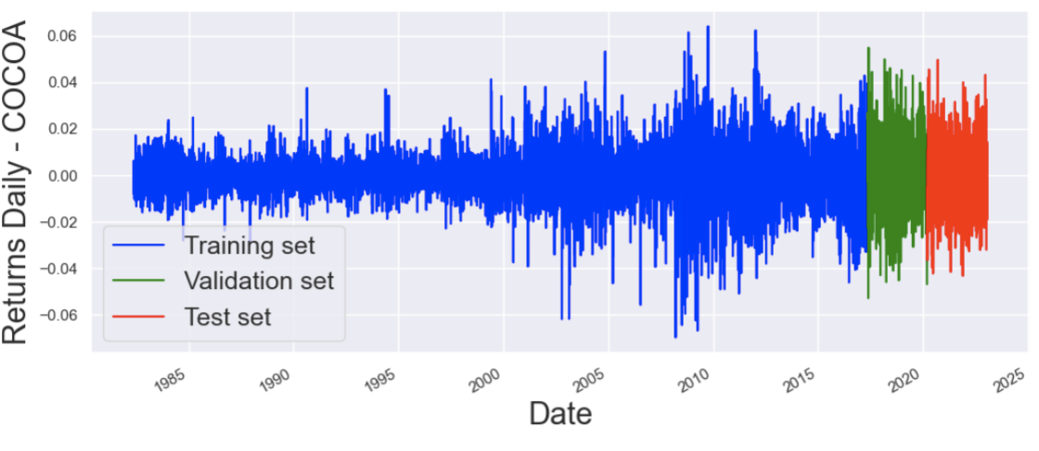
Training-validation-test set split

Slide 6
Preprocessing: Windowing
Univariate time-series is 1D - timestep
Multivariate time-series are 2D (timestep, feature)
To train the CNN – WaveNet we must window the data – it becomes 3D (batch-size, timestep, feature)

Slide 7
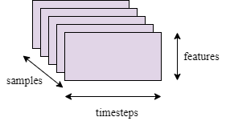
Sliding the window

Slide 8
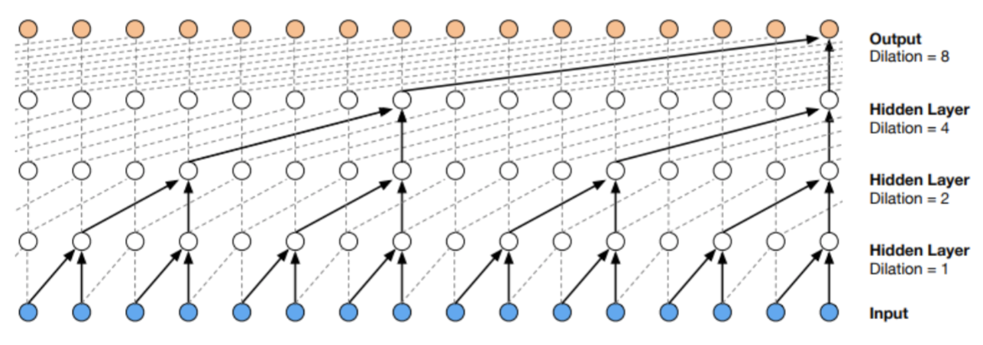
WaveNet

Slide 9
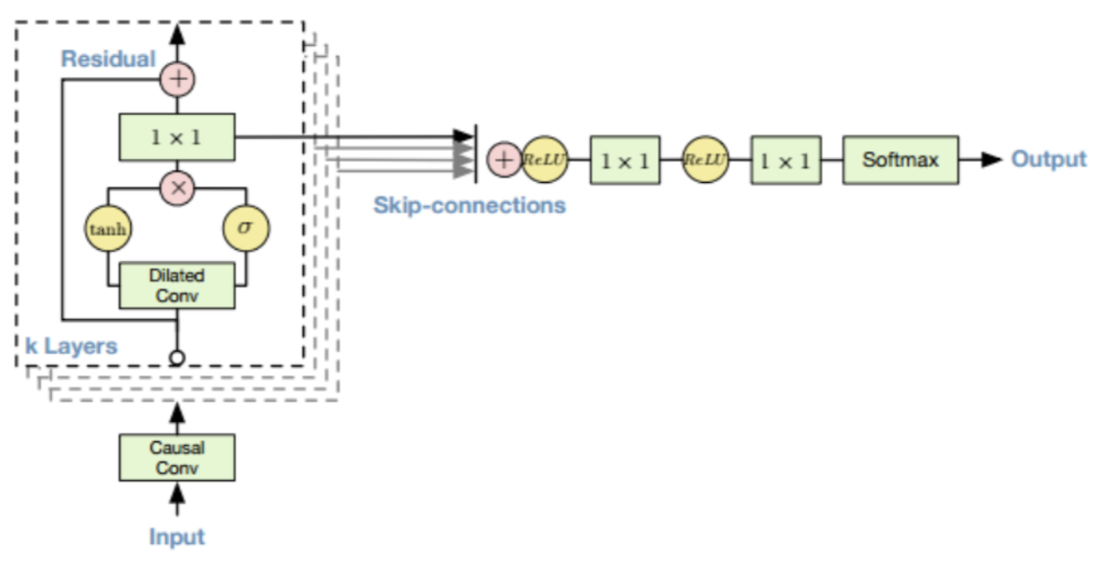
Each hidden layer
z=(tanh(W_f * x) . sigma(W_f * x) * V) + x

Slide 10
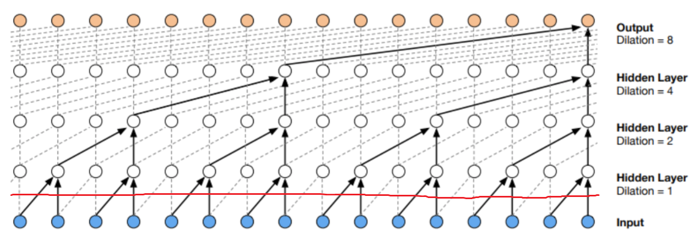
Univariate vs multivariate time series

Slide 11
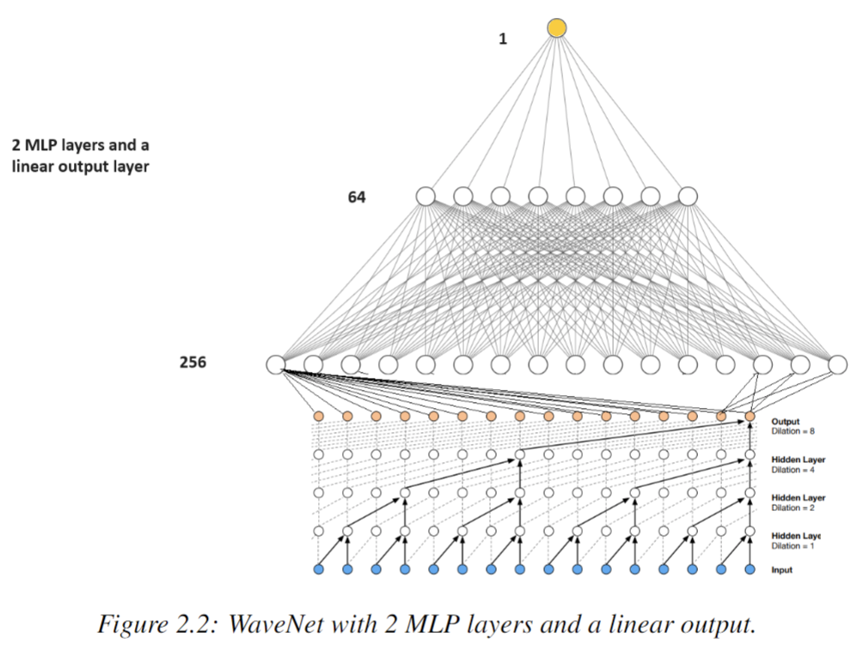
Implemented multivariate WaveNet

Slide 12
Feature-engineering
Features where taken by: https://github.com/maxlamberti/time-series-momentum which implements some aspects of Lim et al.
Contains only technical features like exponential smoothing average, and moving average convergence/divergence as well as fed interest rates

Slide 13
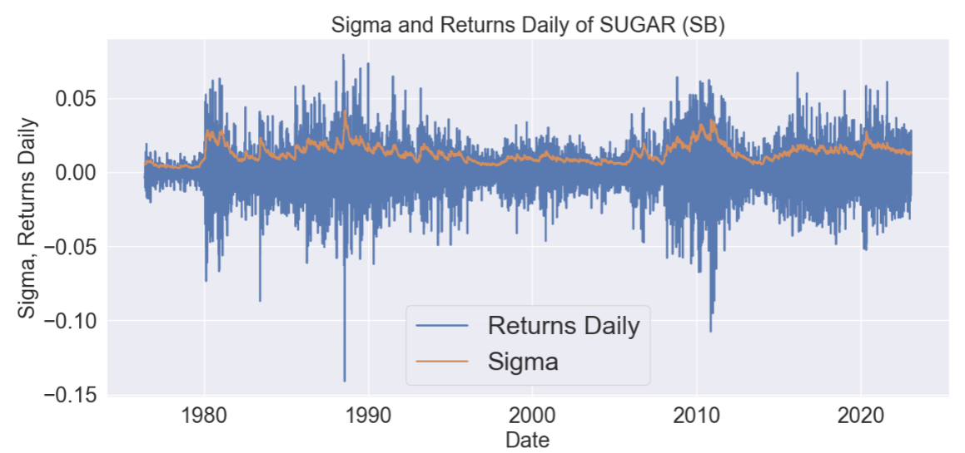
Predict: daily returns

Slide 14
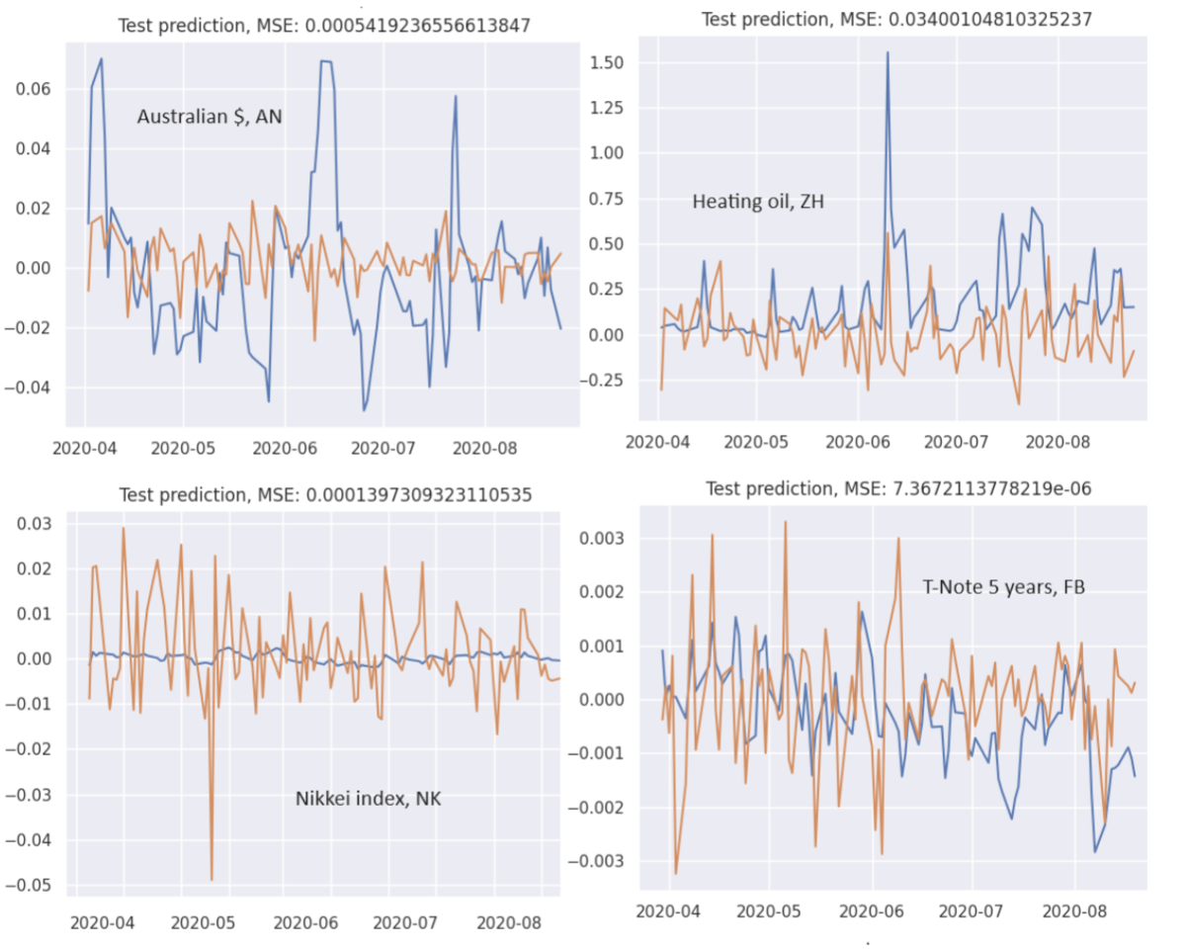
Results – example predictions
Red – is prediction
53%
53%
52%
52%

Slide 15
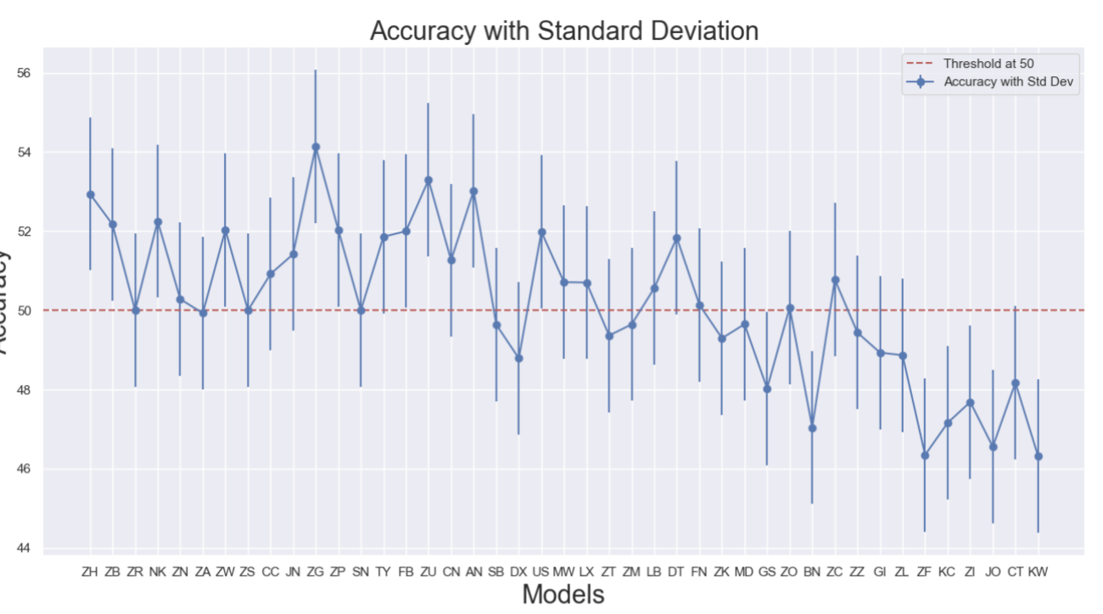
Results
22 of 43 models (44%) had a positive prediction accuracy which is not statistically significant

Slide 16
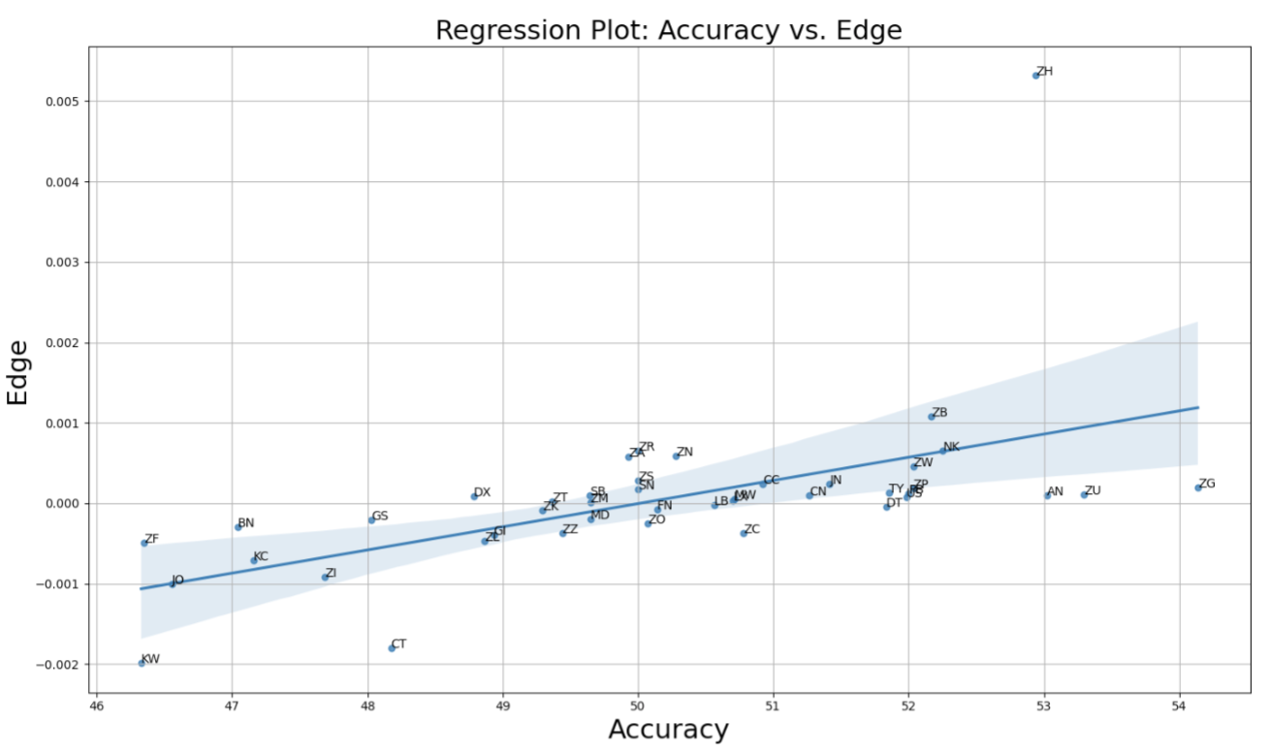
Edge and accuracy
Sum of edge is 0.17, -0.36 without ZH (heating oil)

Slide 17
Future development
Update model after each prediction
create more models of different regimes could be implemented by generating more data using CorrelationGan (Marti 2020)
Use other instruments as features to get correlations between them

Slide 18
Conclusion
The accuracy was < 50%, edge was 0.0017 > 0 but -0.0036 without heating oil
The work was not able to replicate what was found in Lim et al (2019) and does not contradict the efficient market hypothesis

