Slide 1

CHAPTER 9 / OPENING
01 / 64
Fossil Fuels
and Nuclear
Energy
Follow the energy.
Account for the consequences.
The hidden system behind the light switch
Main Source:
Manuel Molles and Brendan Borrell. Environment: Science, Issues, Solutions. W. H. Freeman, 2016. Chapter 9, printed pp. 262–263

Slide 2
CHAPTER 9 / CENTRAL QUESTION
02 / 64
How can we reduce the harm?
How can we manage nonrenewable energy resources in a way that reduces environmental harm?
SCIENCE → ISSUES → SOLUTIONS → TAKEAWAYS

Slide 3
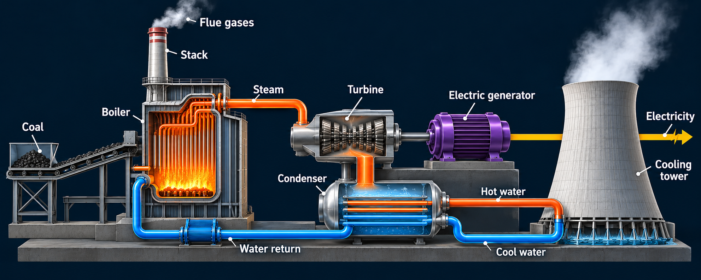
CHAPTER 9 / SCIENCE
03 / 64
Electricity Generation – Using Combustible Materials
Fig. 9.14, reconstructed. Burning fuel produces steam that turns a turbine and drives the electric generator.
Chemical Energy Electrical Energy

Slide 4
CHAPTER 9 / SCIENCE
04 / 64
Process of electricity generation from combustible fuels
CHEMICAL ENERGY
THERMAL ENERGY
MECHANICAL
ELECTRICAL
Fuel + oxygen
Boiler
Steam
turbine
Generator
Combustion releases heat
Steam expands
and turns the shaft
Magnetic induction
produces current
Flue gas leaves the stack.
Ash remains after combustion.
Condenser
Cooling system
Liquid water returns
Waste heat → environment
Fig. 9.14, redrawn: burning fuel supplies the heat that produces steam, turns a turbine, and drives an electrical generator.

Slide 5

CHAPTER 9 / SCIENCE
05 / 64
How an electrical generator works
Fig. 9.12, reconstructed. Rotation changes magnetic flux and induces voltage. A closed circuit allows current to flow.
Mechanical energy → electrical energy

Slide 6
CHAPTER 9 / SCIENCE
06 / 64
Three fuels, ancient chemical energy
Coal: buried plant material
Oil: transformed organic matter
Natural gas: predominantly methane

Slide 7
CHAPTER 9 / SCIENCE
07 / 64
Three fuels, ancient chemical energy
Coal: buried plant material
Oil: transformed organic matter
Natural gas: predominantly methane

Slide 8
CHAPTER 9 / SCIENCE
08 / 64
Coal formation: buried plant material
Swamp vegetation
Burial in sediment
Heat + pressure
Plant remains
Buried organic layer
Coal seam
Dead plant material collects
in waterlogged sediments.
Sediment covers and compresses
the organic-rich layer.
Deeper burial transforms the
material into coal.
Fig. 9.1, redrawn: plant remains buried in ancient swamp sediments become coal over millions of years. Layers are schematic.

Slide 9
CHAPTER 9 / SCIENCE
09 / 64
Coal grades differ in carbon and energy content
Energy content (kJ/kg) · approximate heights read from the book
Carbon content and hardness increase across these grades.
Fig. 9.2, redrawn approximately: energy content rises from lignite to bituminous coal, then decreases slightly for anthracite.

Slide 10
CHAPTER 9 / SCIENCE
10 / 64
Coal reserves are geographically concentrated
Share of global reserves (%) · 2008 book data · approximate bar readings
Nine countries hold more than 90% in the book’s dataset.
Fig. 9.3, national panel redrawn: known coal reserves cluster in a small number of countries. Regional pie/map omitted; full reference remains in the book.

Slide 11
CHAPTER 9 / SCIENCE
11 / 64
Regional coal reserves
Regional shares in the book’s 2008 dataset
Most coal reserves lie in Northern Eurasia, Asia Pacific and North America.
Fig. 9.3, reconstructed. Approximate slice sizes read from the printed pie; not exact source percentages.

Slide 12
CHAPTER 9 / SCIENCE
12 / 64
Three fuels, ancient chemical energy
Coal: buried plant material
Oil: transformed organic matter
Natural gas: predominantly methane

Slide 13
CHAPTER 9 / SCIENCE
13 / 64
Petroleum formation: buried marine organisms
Marine organisms
Burial in sediment
Heat + pressure
Organic remains
Buried organic layer
Petroleum
Algae and zooplankton settle
to the seafloor.
Organic-rich material becomes
buried under layers of rock.
Kerogen transforms into oil
over millions of years.
Fig. 9.4, redrawn: petroleum originates from buried marine organisms transformed over millions of years. Layers are schematic.

Slide 14
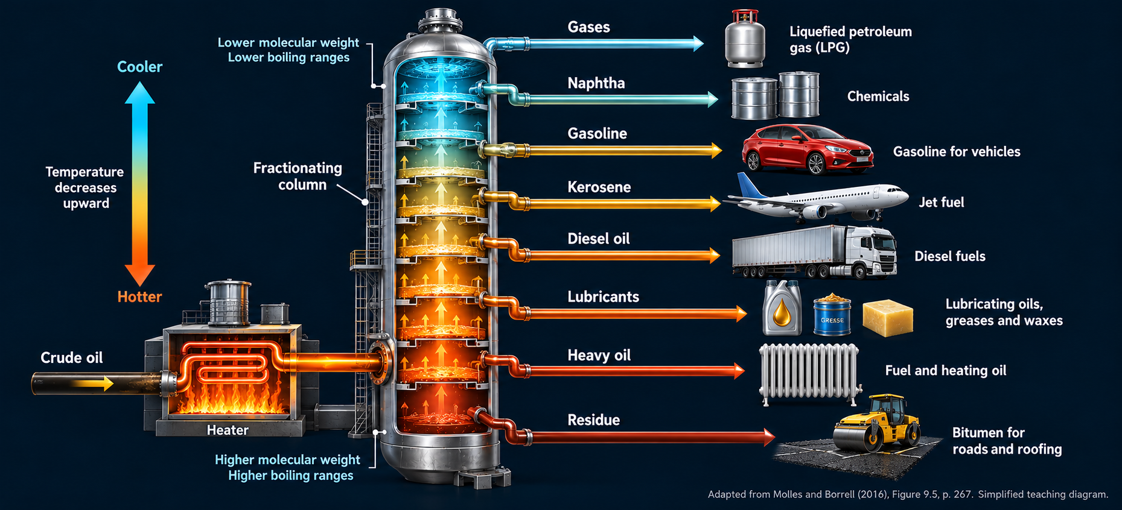
CHAPTER 9 / SCIENCE
14 / 64
Oil refining separates useful fractions
Fig. 9.5, redrawn: a fractionating column separates crude oil into useful fractions by their different boiling ranges; lighter fractions rise higher.

Slide 15
CHAPTER 9 / SCIENCE
15 / 64
Oil refining separates useful fractions
Cooler at the top
Gases
LPG
Naphtha
Chemical feedstocks
Gasoline
Vehicles
Kerosene
Jet fuel
Heated
crude oil
Diesel oil
Diesel engines
Lubricants
Oils, greases, waxes
Heavy oil
Fuel and heating oil
Hotter at the bottom
Residue
Roads and roofing
Fig. 9.5, redrawn: a fractionating column separates crude oil into useful fractions by their different boiling ranges; lighter fractions rise higher.

Slide 16
CHAPTER 9 / SCIENCE
16 / 64
Oil reserves: a different geographic pattern
Share of global reserves (%) · 2011 book data · approximate bar readings
The book locates just over half of proven reserves in the Middle East.
Fig. 9.6, national panel redrawn: 15 countries hold more than 90% of known oil reserves in this historical dataset.

Slide 17
CHAPTER 9 / SCIENCE
17 / 64
Regional oil reserves
Regional shares in the book’s 2011 dataset
The Middle East holds just over half of the reserves in this book figure.
Fig. 9.6, reconstructed. Approximate slice sizes read from the printed pie; not exact source percentages.

Slide 18
CHAPTER 9 / SCIENCE
18 / 64
Three fuels, ancient chemical energy
Coal: buried plant material
Oil: transformed organic matter
Natural gas: predominantly methane

Slide 19
CHAPTER 9 / SCIENCE
19 / 64
Natural gas contains several hydrocarbons
Methane
Ethane
Propane
Butane
H
H
H
H
H
H
H
H
H
H
H
C
H
H
C
C
H
H
C
C
C
H
H
C
C
C
C
H
H
H
H
H
H
H
H
H
H
H
CH₄
CH₃–CH₃
CH₃–CH₂–CH₃
CH₃–CH₂–CH₂–CH₃
Electricity, heating,
and cooking
Chemical
feedstocks
Heating, cooking,
and bottled fuel
Fuel and industrial
feedstocks
Fig. 9.7, redrawn: natural gas contains hydrocarbons, usually dominated by methane. All C–H and C–C bonds are shown. Flat structural diagrams do not show 3D bond angles.

Slide 20
CHAPTER 9 / SCIENCE
20 / 64
Natural gas reserves are also concentrated
Share of global reserves (%) · 2011 book data · approximate bar readings
Russia, Iran, and Qatar hold more than half in the book’s dataset.
Fig. 9.10, national panel redrawn: a few countries control a large share of known gas reserves. Historical distribution, not a current ranking.

Slide 21
CHAPTER 9 / SCIENCE
21 / 64
Regional natural gas reserves
Regional shares in the book’s 2011 dataset
The Middle East and Northern Eurasia dominate this historical distribution.
Fig. 9.10, reconstructed. Approximate slice sizes read from the printed pie; not exact source percentages.

Slide 22
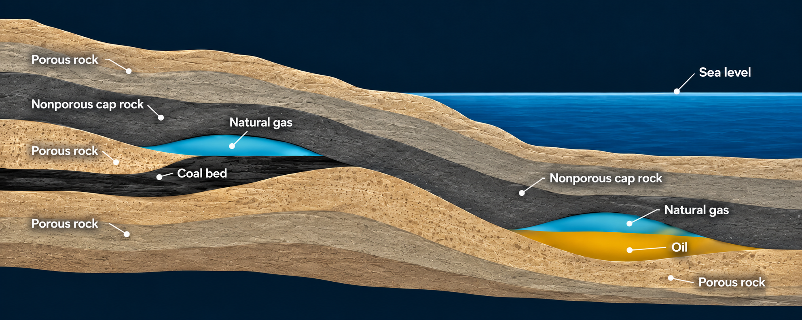
CHAPTER 9 / SCIENCE
22 / 64
Natural gas deposits, oil and coal beds
Gas can migrate through porous rock and collect beneath an impermeable layer.
Fig. 9.8, reconstructed teaching schematic. Colored zones represent fluids in rock pores, not open caverns.

Slide 23
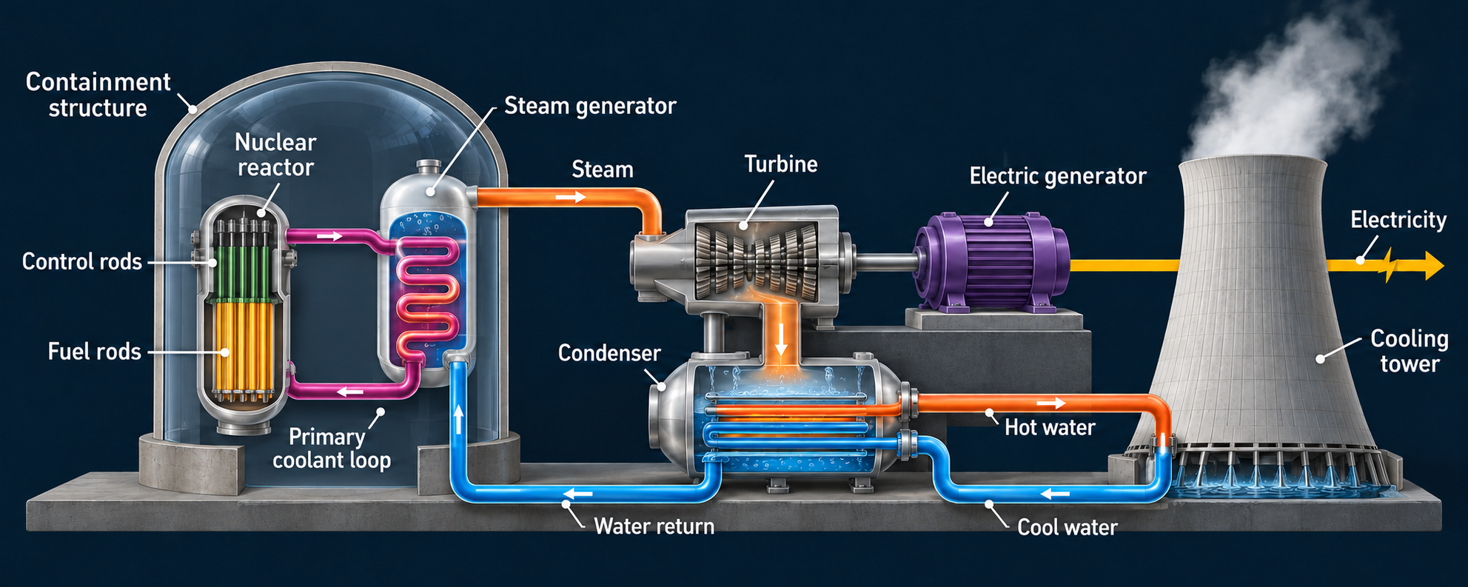
CHAPTER 9 / SCIENCE
23 / 64
Electricity Generation – Using Nuclear Power
Fig. 9.17, reconstructed. Fission supplies heat. Three separate water circuits transfer heat without mixing.
Nuclear Energy ---------------------→ Electrical Energy

Slide 24
CHAPTER 9 / SCIENCE
24 / 64
Electricity Generation – Using Nuclear Power
NUCLEAR ENERGY
THERMAL ENERGY
MECHANICAL
Reactor core
Steam
generator
Steam
turbine
Generator
Fission releases heat
Steam expands
and turns the shaft
Magnetic induction
produces current
Primary coolant loop
transfers heat; water stays separate
Condenser
Cooling system
Liquid water returns
Fig. 9.17, redrawn: controlled fission supplies heat for steam-driven electricity generation. The cooling loop removes waste heat.

Slide 25
CHAPTER 9 / SCIENCE
25 / 64
Nuclear Energy
Nuclear Reactions
Nuclear Fission
Nuclear Fusion

Slide 26
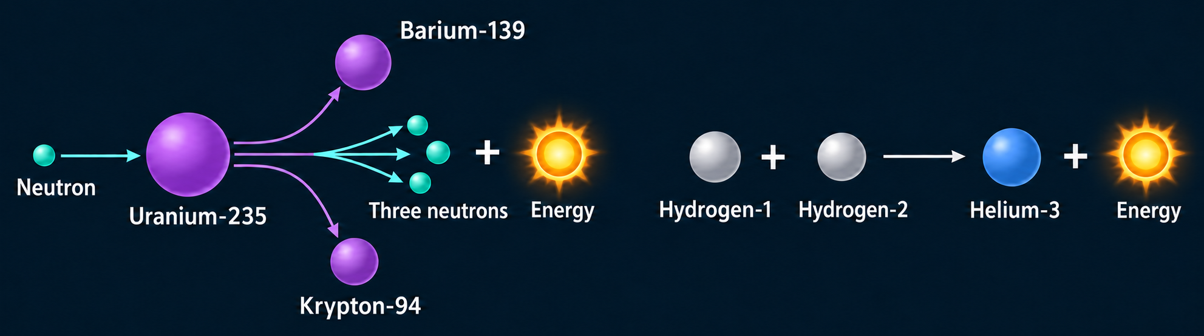
CHAPTER 9 / SCIENCE
26 / 64
Nuclear Reactions
Nuclear Fission
Nuclear Fusion
Nuclear Energy
Fig. 9.15, reconstructed with full isotope names. Fission splits nuclei. Fusion combines nuclei.

Slide 27
CHAPTER 9 / SCIENCE
27 / 64
Uranium is a finite and unevenly distributed fuel
Share of global recoverable uranium (%) · 2012 book data · approximate bar readings
Australia accounts for nearly one-third in this historical inventory.
Fig. 9.16, national panel redrawn: recoverable uranium reserves concentrate in relatively few countries. Bars show the 14 countries plotted in the book.

Slide 28
CHAPTER 9 / SCIENCE
28 / 64
Regional uranium reserves
Regional shares in the book’s 2012 dataset
Asia Pacific has the largest regional share in the book’s distribution.
Fig. 9.16, reconstructed. Approximate slice sizes read from the printed pie; not exact source percentages.

Slide 29
CHAPTER 9 / SCIENCE
29 / 64
Electricity mixes differ among regions
Share of electrical generation (%)
Source | World 2011 | U.S. 2013 | Brazil
Coal | 41% | 39% | 1%
Natural gas | 21% | 27% | 6%
Oil | 5% | 1% | 3%
Nuclear | 13% | 19% | 3%
Biomass | 2% | 1% | 5%
Other renewables | 18% | 12% | 80%
Fig. 9.13, redrawn. Fossil fuels dominate the world/U.S. examples, while renewables dominate Brazil.
Book values retained. Rounded shares total 100%, 99%, and 98%, respectively. Brazil’s year is unspecified.

Slide 30
CHAPTER 9 / SCIENCE
30 / 64
Electricity mixes differ among regions
Share of electrical generation (%)
Fig. 9.13. Printed shares total 100%, 99% and 98%. Pie areas scale to each total; labels retain book values.
Brazil’s year is not specified in the book. These are historical electricity-generation shares.

Slide 31
CHAPTER 9 / SCIENCE
31 / 64
Quick quiz: where does the energy go?
A steam power plant receives 100 units of fuel energy.
At 35% efficiency, how many units become electricity?
A 35 units
B 65 units
C 100 units
Answer: 35 units of electricity; 65 units leave mainly as heat.
Classroom calculation based on the book’s illustrative 35% conversion efficiency. Real plants and technologies differ.

Slide 32
CHAPTER 9 / SCIENCE
32 / 64
Science summary
9.1
Coal, oil, and natural gas store chemical energy.
Their formation takes millions of years.
9.2
Power plants convert heat to motion and electricity.
Vehicle engines convert combustion energy to motion.
9.3
Fission supplies intense heat for electricity generation.
Safe use requires reaction control, cooling, and containment.

Slide 33
CHAPTER 9 / ISSUES
33 / 64
World consumption of energy resources
Million metric tons of oil equivalent (Mtoe)
1998–2014
Coal and natural gas account for much of the growth shown.
Fig. 9.18, redrawn from the book’s graph. Annual values are approximate readings, not raw BP data.
Source: Molles & Borrell, p. 275, citing BP (2009, 2011, 2013, 2015).

Slide 34
CHAPTER 9 / ISSUES
34 / 64
Peak oil forecasts depend on their assumptions
Oil production (billion barrels/year) · approximate redrawing of the book’s model curves
These are historical forecasts—not a prediction for today.
Fig. 9.21, model curves redrawn approximately: assumed total recoverable oil shifts the timing and height of the projected peak. After Maggio & Cacciola (2009).

Slide 35
CHAPTER 9 / SCIENCE
35 / 64
Electricity Generation – Using Nuclear Power
Fig. 9.17, reconstructed. Fission supplies heat. Three separate water circuits transfer heat without mixing.
Nuclear Energy Electrical Energy

Slide 36
CHAPTER 9 / SCIENCE
36 / 64
Electricity Generation – Using Combustible Materials
Fig. 9.14, reconstructed. Burning fuel produces steam that turns a turbine and drives the electric generator.
Chemical Energy Electrical Energy

Slide 37
CHAPTER 9 / SCIENCE
37 / 64
Process of electricity generation from combustible fuels
CHEMICAL ENERGY
THERMAL ENERGY
MECHANICAL
ELECTRICAL
Fuel + oxygen
Boiler
Steam
turbine
Generator
Combustion releases heat
Steam expands
and turns the shaft
Magnetic induction
produces current
Flue gas leaves the stack.
Ash remains after combustion.
Condenser
Cooling system
Liquid water returns
Waste heat → environment
Fig. 9.14, redrawn: burning fuel supplies the heat that produces steam, turns a turbine, and drives an electrical generator.

Slide 38
CHAPTER 9 / ISSUES
38 / 64
Main environmental issues
Finite resources and unequal access
Forest loss, habitat fragmentation, and buried streams
Air pollutants, toxic metals, and climate-warming emissions
Water depletion and contamination
Oil spills, coal sludge, and fly ash waste
Uranium-mine residues and long-lived spent fuel
Major accidents and lasting costs to communities
Expanded issue list from §§9.4–9.6. Impacts occur during extraction, transport, use, and waste management.

Slide 39
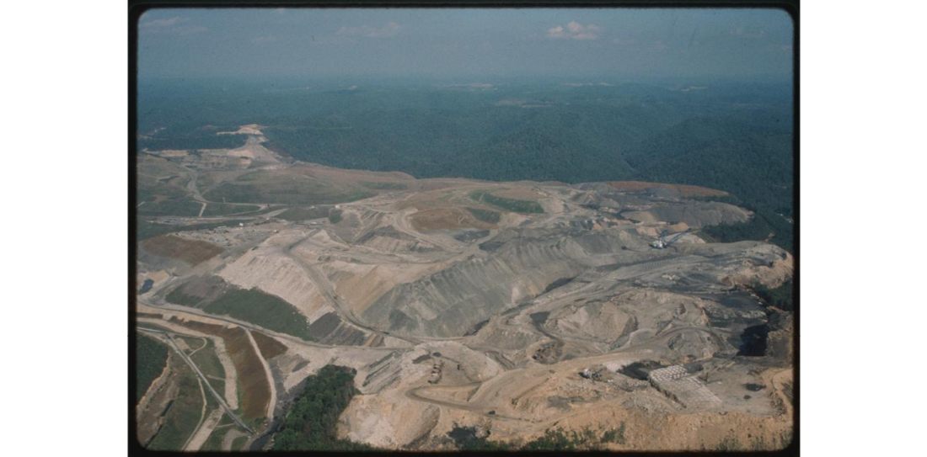
CHAPTER 9 / ISSUES
39 / 64
Mountaintop removal changes entire watersheds
Forests removed
Rock fills bury valleys
and headwater streams.
Dust and polluted runoff
affect ecosystems and
nearby communities.
Mountaintop removal in West Virginia. Photo: Mary Hufford / Library of Congress, via USGS (public domain). Companion to the mechanisms discussed with Fig. 9.23.

Slide 40
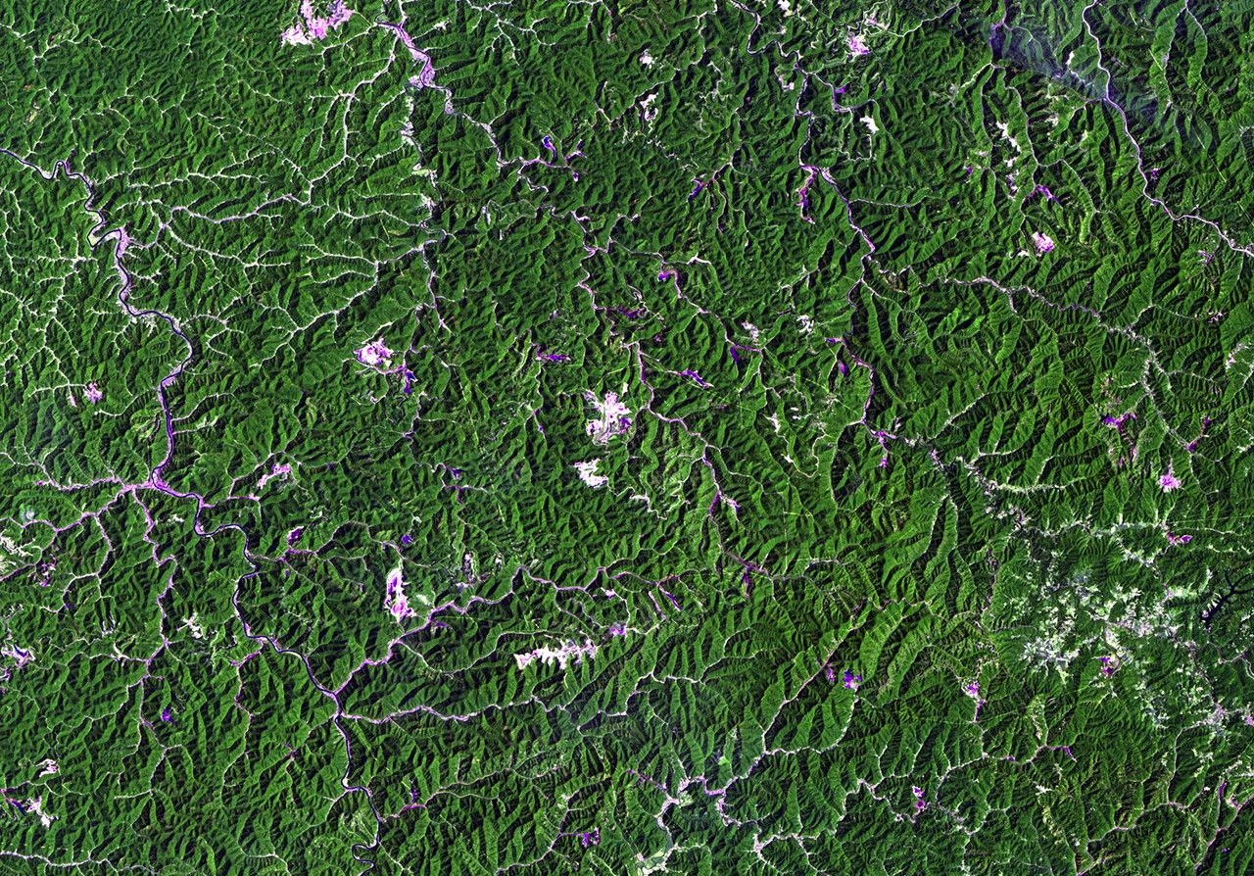
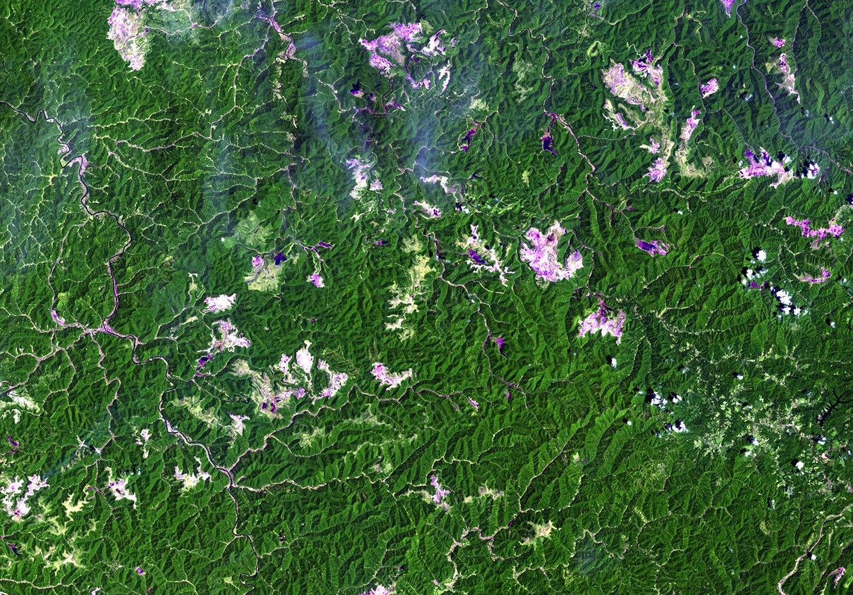
CHAPTER 9 / ISSUES
40 / 64
Satellite images show the mining footprint expanding
1987
2011
Same region, Landsat 5: June 6, 1987 and June 8, 2011. Light disturbed areas expand among forested ridges. NASA / USGS.

Slide 41
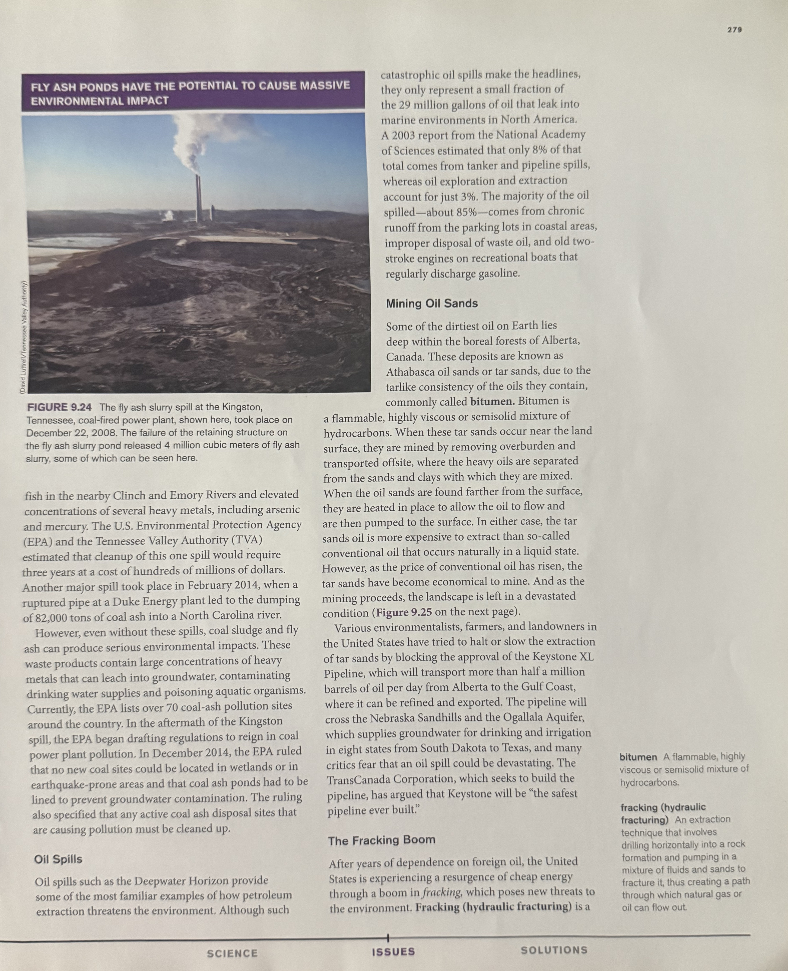
CHAPTER 9 / ISSUES
41 / 64
Coal waste can contaminate land and water
Coal washing produces sludge.
Combustion produces fly ash.
Pond failures spread slurry across land and rivers.
Metals can also leach without a major spill.
Fig. 9.24: the Kingston, Tennessee, ash-pond failure released about 4 million m³ of slurry in December 2008. Book photo: David Luttrell / TVA.

Slide 42

CHAPTER 9 / ISSUES
42 / 64
Oil spills harm wildlife and human livelihoods
Deepwater Horizon, 2010
The rig explosion killed 11 workers.
Oil contaminated wildlife and coastal habitats.
Fishing and tourism communities lost income.
Effects can persist after visible oil disappears.
An oiled brown pelican is captured for cleaning after Deepwater Horizon. Photo: Tom Mackenzie / USFWS (public domain).

Slide 43
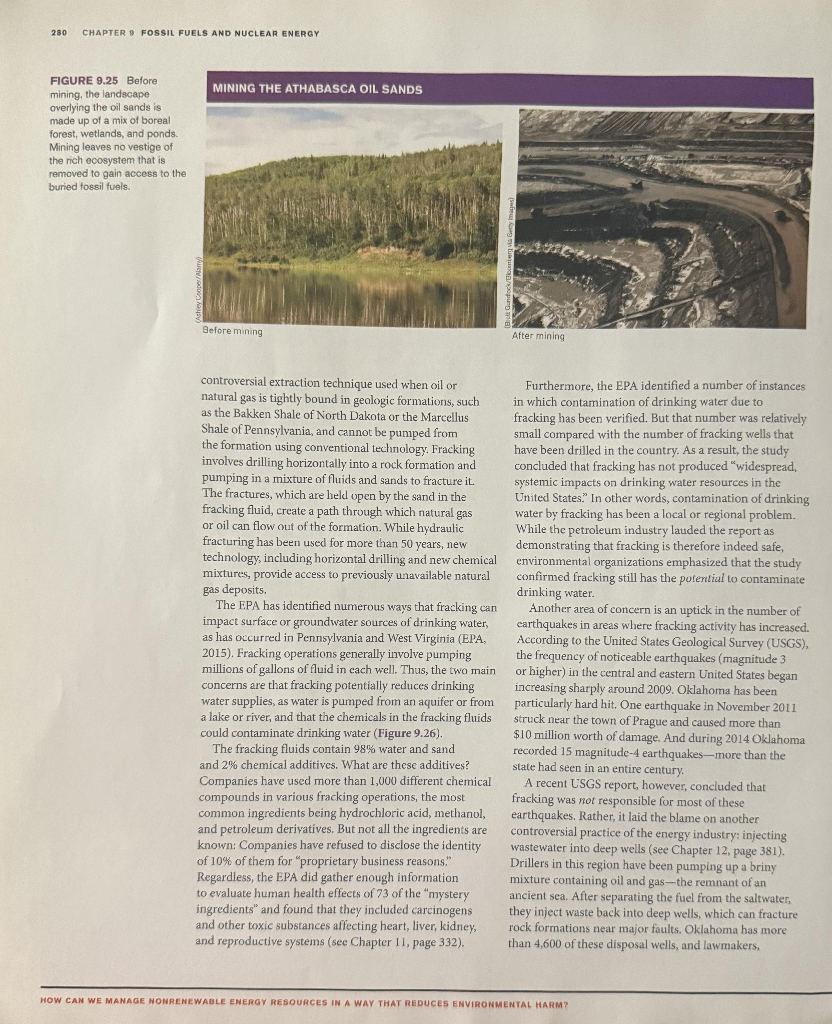
CHAPTER 9 / ISSUES
43 / 64
Oil-sands mining removes a living landscape
Boreal forest and wetlands
Surface mine
Fig. 9.25: oil-sands extraction removes the overlying forest, wetlands, and ponds. Book photos: Ashley Cooper / Alamy and Brett Gundlock / Bloomberg via Getty Images.

Slide 44
CHAPTER 9 / ISSUES
44 / 64
Fracking risks extend through the water cycle
01
02
03
04
05
Acquire water
Mix chemicals
Inject into well
Collect wastewater
Treat / dispose
Competing demand
Surface spills
Well integrity
Leaks and spills
Discharge; disposal
A water-quality risk can arise at every stage—not only deep underground.
Fig. 9.26, redrawn: acquiring, mixing, injecting, recovering, and disposing of water can affect drinking-water resources. EPA’s final assessment (2016) supports this risk framework.

Slide 45
CHAPTER 9 / ISSUES
45 / 64
Nuclear impacts extend beyond the reactor
Mining
Tailings and contaminated sites can expose workers
and communities to radioactive materials.
Spent fuel
High radioactivity and decay heat require shielding,
cooling, secure storage, and long-term isolation.
Accidents
Loss of cooling or containment can damage fuel
and release radioactive material.
Chapter synthesis, §9.6. A reactor’s lack of fossil-fuel combustion does not remove its mining, waste, cooling, or accident obligations.

Slide 46
CHAPTER 9 / ISSUES
46 / 64
Three nuclear accidents had different consequences
Accident | What failed | Environmental significance
Three Mile Island 1979 | Coolant loss and misinterpreted plant conditions | Partial meltdown; containment limited release. NRC found negligible health effects.
Chernobyl 1986 | Unsafe test, reactor-design flaws, and explosion/fire | Large release without robust containment; widespread fallout and long-term exclusion.
Fukushima Daiichi 2011 | Earthquake and tsunami disabled power and cooling | Core damage, hydrogen explosions, releases, evacuations, and prolonged cleanup.
Synthesis accompanying Figs. 9.27–9.29: the initiating events, reactor designs, containment performance, and releases differed.

Slide 47
CHAPTER 9 / ISSUES
47 / 64
Compare complete pathways: extraction
System | Extraction & processing | Land, water & community burdens
Coal | Strip mining; mountaintop removal; coal washing | Forest and stream loss; acid mine drainage; dust; contaminated sludge
Oil | Drilling; oil-sands mining; refining and transport | Spills; forest and peatland loss; water use; contaminated habitats
Natural gas | Drilling; hydraulic fracturing; gathering and transport | Water withdrawals; spills and well leakage; methane loss; wastewater disposal
Nuclear | Uranium mining; milling; enrichment and fuel fabrication | Mine disturbance; radioactive tailings; worker and community exposure
Chapter synthesis, §§9.4–9.6: impacts start before a power plant operates. Wastewater injection can induce earthquakes; it is distinct from fracking.

Slide 48
CHAPTER 9 / ISSUES
48 / 64
Compare complete pathways: use and lasting waste
System | Use / operation | Waste, accidents & continuing duties
Coal | CO₂; air pollutants and toxic metals; cooling demand and waste heat | Ash and sludge containment; acid drainage; mine reclamation and water monitoring
Oil | CO₂ and air pollutants from fuels; refinery and transport impacts | Spill cleanup; contaminated sediments; long recovery of affected ecosystems
Natural gas | CO₂ and nitrogen oxides; methane leakage across the system | Manage flowback and produced water; well integrity; disposal-induced seismicity
Nuclear | No combustion in the reactor; cooling demand and waste heat | Spent fuel and tailings; accident preparedness; secure storage and decommissioning
Expanded chapter synthesis, §§9.4–9.6. This inventory does not imply equal impact magnitudes or equal accident probabilities.

Slide 49
CHAPTER 9 / ISSUES
49 / 64
Issues summary
9.4
Finite supplies and changing demand create pressure.
Forecasts depend on uncertain assumptions.
9.5
Extraction, combustion, spills, and residues damage
land, water, air, and human well-being.
9.6
Nuclear energy carries mining and waste burdens.
Major accidents reveal the importance of cooling and containment.

Slide 50
CHAPTER 9 / SOLUTIONS
50 / 64
Preventing oil-industry harm
Equipment
Double hulls, well integrity, maintenance,
and reliable operating procedures reduce release risk.
Planning
Prevention and response plans establish responsibilities
before a spill and support rapid action afterward.
Location
Avoiding development in sensitive areas prevents
new drilling-related disturbance at those sites.
From §9.7: prevention combines engineering, oversight, preparedness, and decisions about where extraction should occur.

Slide 51
CHAPTER 9 / SOLUTIONS
51 / 64
Oil-spill response has several distinct jobs
PREVENT
CONTAIN
RECOVER
MONITOR
Keep oil from escaping
Limit the affected area
Remove accessible oil
Test ecological recovery
Safer equipment; maintenance;
response plans; double hulls
Booms and barriers
protect sensitive coastlines
Skimmers collect oil;
dispersants redistribute it
Water, sediments, wildlife,
and ecosystem functions
Chapter synthesis, §9.7: spill response combines prevention, physical containment, removal, and long-term follow-up. Dispersal does not remove oil from the ecosystem.

Slide 52
CHAPTER 9 / SOLUTIONS
52 / 64
Response-room challenge: which action fits?
A slick approaches a sensitive shoreline.
Booms help protect the shoreline.
Responders need to remove surface oil.
Skimmers recover accessible oil.
The surface looks clean. Has the ecosystem recovered?
Test water, sediment, organisms, and ecosystem function.
Discuss each scenario, then reveal the response. Conditions such as waves, currents, weather, and oil type affect which methods work.

Slide 53
CHAPTER 9 / SOLUTIONS
53 / 64
Reducing the water risks of oil and gas extraction
Risk point | Matching safeguard
Water withdrawal | Assess local supply and competing water needs.
Chemical mixing / storage | Disclose hazardous ingredients and contain surface spills.
Well injection | Verify casing, cement, and separation from aquifers.
Flowback and produced water | Use secure storage, suitable treatment, and accountable disposal.
Deep wastewater injection | Assess local geology, monitor seismicity, and adjust operations.
Safeguards follow the risk points in Fig. 9.26 and §9.7. They reduce risk; they do not establish zero risk at every site.

Slide 54
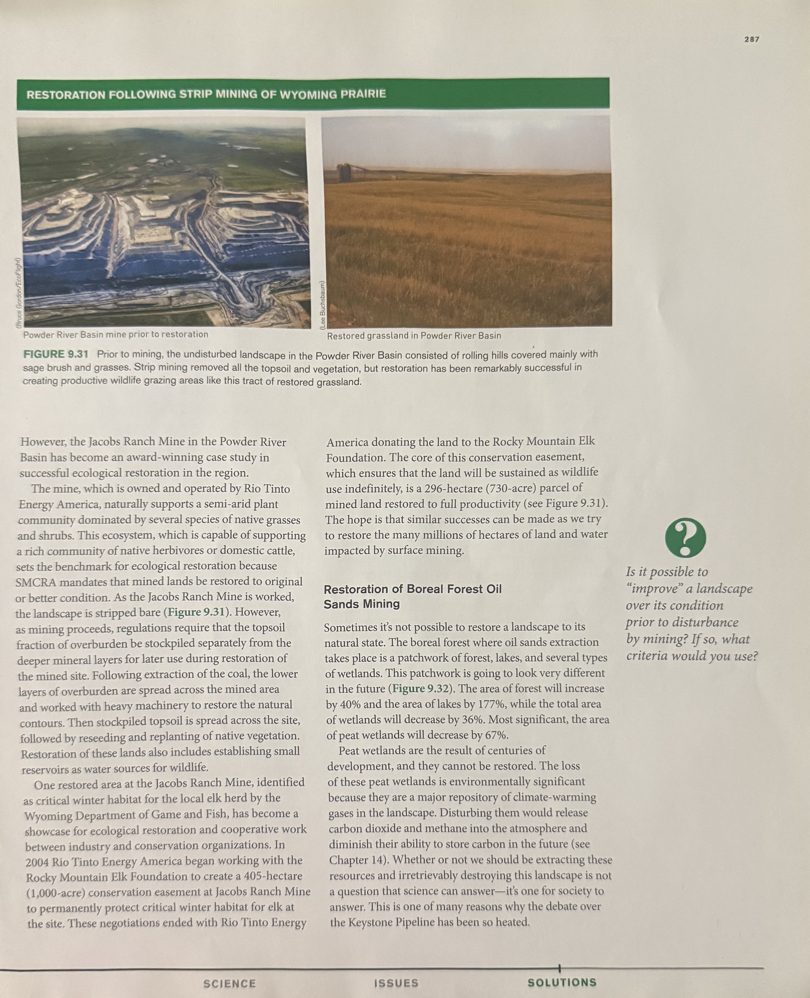
CHAPTER 9 / SOLUTIONS
54 / 64
Prairie restoration rebuilds soil and vegetation
Mined landscape
Restored grassland
Save topsoil → reshape the land → replace soil → replant native vegetation
Fig. 9.31: restoring Wyoming mine land can create productive grazing and wildlife habitat. Book photos: Bruce Gordon / EcoFlight and Lee Bachstam.

Slide 55
CHAPTER 9 / SOLUTIONS
55 / 64
Oil-sands restoration changes the ecosystem mix
Change in area after restoration (%) · values stated in the text
More tree cover can coexist with a large loss of peat wetlands.
Adapted from Fig. 9.32 and the text: projected restoration increases forest/lake area but reduces peatlands. “All wetlands” includes peat wetlands; categories overlap.

Slide 56
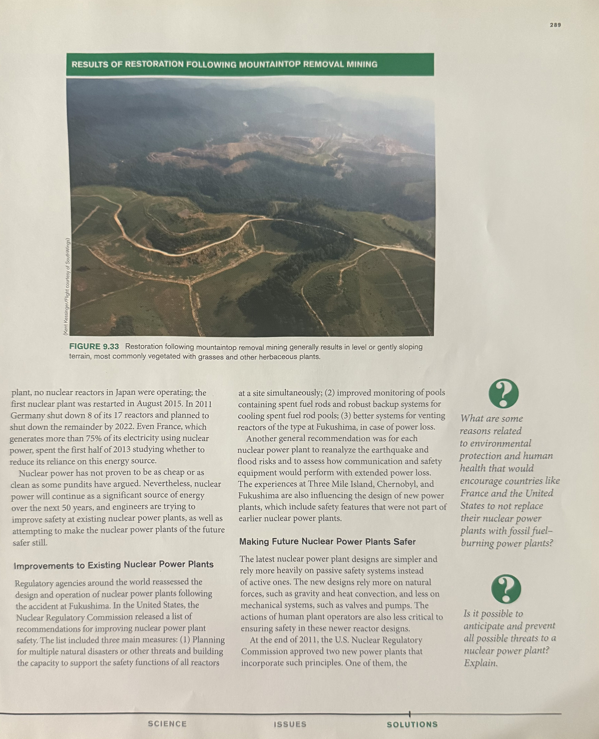
CHAPTER 9 / SOLUTIONS
56 / 64
Reclamation cannot replace a removed mountain
A flatter, greener surface
can support grazing or
economic uses.
Original relief, headwater
streams, soils, and forest
diversity may remain lost.
Fig. 9.33: reclaimed mountaintop mines commonly become level or gently sloping land with grasses and herbs. Photo: Kent Kessinger, flight courtesy of SouthWings.

Slide 57
CHAPTER 9 / SOLUTIONS
57 / 64
Existing nuclear plants need resilient safety systems
Plan for simultaneous failures and multiple hazards.
Protect backup power and long-duration cooling.
Monitor spent-fuel pools and maintain backup water supplies.
Improve reliable venting where the reactor design requires it.
Reassess earthquake, flood, and communication vulnerabilities.
From §9.9: post-Fukushima recommendations address the safety functions that must survive severe external events and extended power loss.

Slide 58
CHAPTER 9 / SOLUTIONS
58 / 64
Passive safety: gravity and natural circulation
Use natural forces to maintain cooling
Elevated water supply
Natural circulation
Warm fluid rises; cooler fluid returns.
Heat transfer can continue without
relying entirely on powered pumps.
Gravity
Reactor / containment cooling
Passive does not mean unlimited.
Stored water moves downward
Design limits, supplies, maintenance, and
long-term heat removal still matter.
Adapted from Fig. 9.34: simpler design and passive safety features reduce dependence on active equipment. This is a principle diagram, not AP1000 piping.

Slide 59
CHAPTER 9 / SOLUTIONS
59 / 64
Further nuclear options carry tradeoffs
Reprocessing spent fuel
Fusion research
Recover uranium and plutonium
for reuse in mixed-oxide fuel.
Potential benefit: more use of
existing nuclear material.
Continuing burdens: waste handling,
security, and proliferation concerns.
Fuse light nuclei at extremely
high temperatures.
Potential benefit: a different
fuel cycle.
Scientific and engineering barriers
separate experiments from power supply.
From §9.9: recycling fuel and researching fusion do not remove the need to manage present-day waste and reactor safety.

Slide 60
CHAPTER 9 / SOLUTIONS
60 / 64
Solutions summary
9.7
Prevent releases, prepare for accidents, and improve
response. Reduce unnecessary resource consumption.
9.8
Restore soil, vegetation, and ecosystem function
where possible. Recognize irreversible losses.
9.9
Strengthen existing reactors’ safety functions.
Use simpler designs and evaluate passive safeguards.

Slide 61
CHAPTER 9 / TAKEAWAYS
61 / 64
The whole chapter in three questions
SCIENCE
Where does the energy come from, and how
does a power plant or engine transform it?
ISSUES
Which harms arise across extraction, use, and waste,
and who experiences those harms?
SOLUTIONS
Which safeguards reduce those harms, and which
losses or responsibilities remain afterward?

Slide 62
CHAPTER 9 / TAKEAWAYS
62 / 64
Fossil fuels, nuclear energy, and you
Stay informed about energy sources and their full costs.
Participate in local decisions and ask who bears the risks.
Use energy efficiently in buildings and daily activities.
Choose lower-energy transportation when safe and practical.
Adapted from “Fossil Fuels, Nuclear Energy, and You.” Personal choices complement the engineering and policy changes discussed in the chapter.

Slide 63
CHAPTER 9 / CENTRAL QUESTION
63 / 64
Returning to the central question
A synthesis answer
Use less energy for the services we need. Prevent pollution
and accidents across the full fuel cycle. Restore damaged
ecosystems where possible, and maintain long-term care
for waste and contamination. Evaluate the remaining harms
while moving toward more sustainable energy sources.
Proposed answer derived from the chapter. Page 293 asks students to compose an answer; it does not provide a printed answer key.

Slide 64
CHAPTER 9 / DISCUSSION
64 / 64
What would change your energy decision?
Which impact deserves more weight in your community?
What measurement would help you compare the alternatives?
Which safeguard would you require, and how would you test it?

