Slide 1

01 / 49
CHAPTER 10 / ENVIRONMENTAL SCIENCE
Renewable
Energy
What will power the light next?

Slide 2
CHAPTER 10 / CENTRAL QUESTION
02 / 49
The Central question
Can we develop renewable energy resources to help sustain a thriving economy without adversely affecting the environment?
SCIENCE
Can renewable energy systems provide the energy people need?
ISSUES
What happens to people and ecosystems along the way?
SOLUTIONS
What are some ways to reduce those impacts?
SCIENCE → ISSUES → SOLUTIONS → TAKEAWAYS

Slide 3
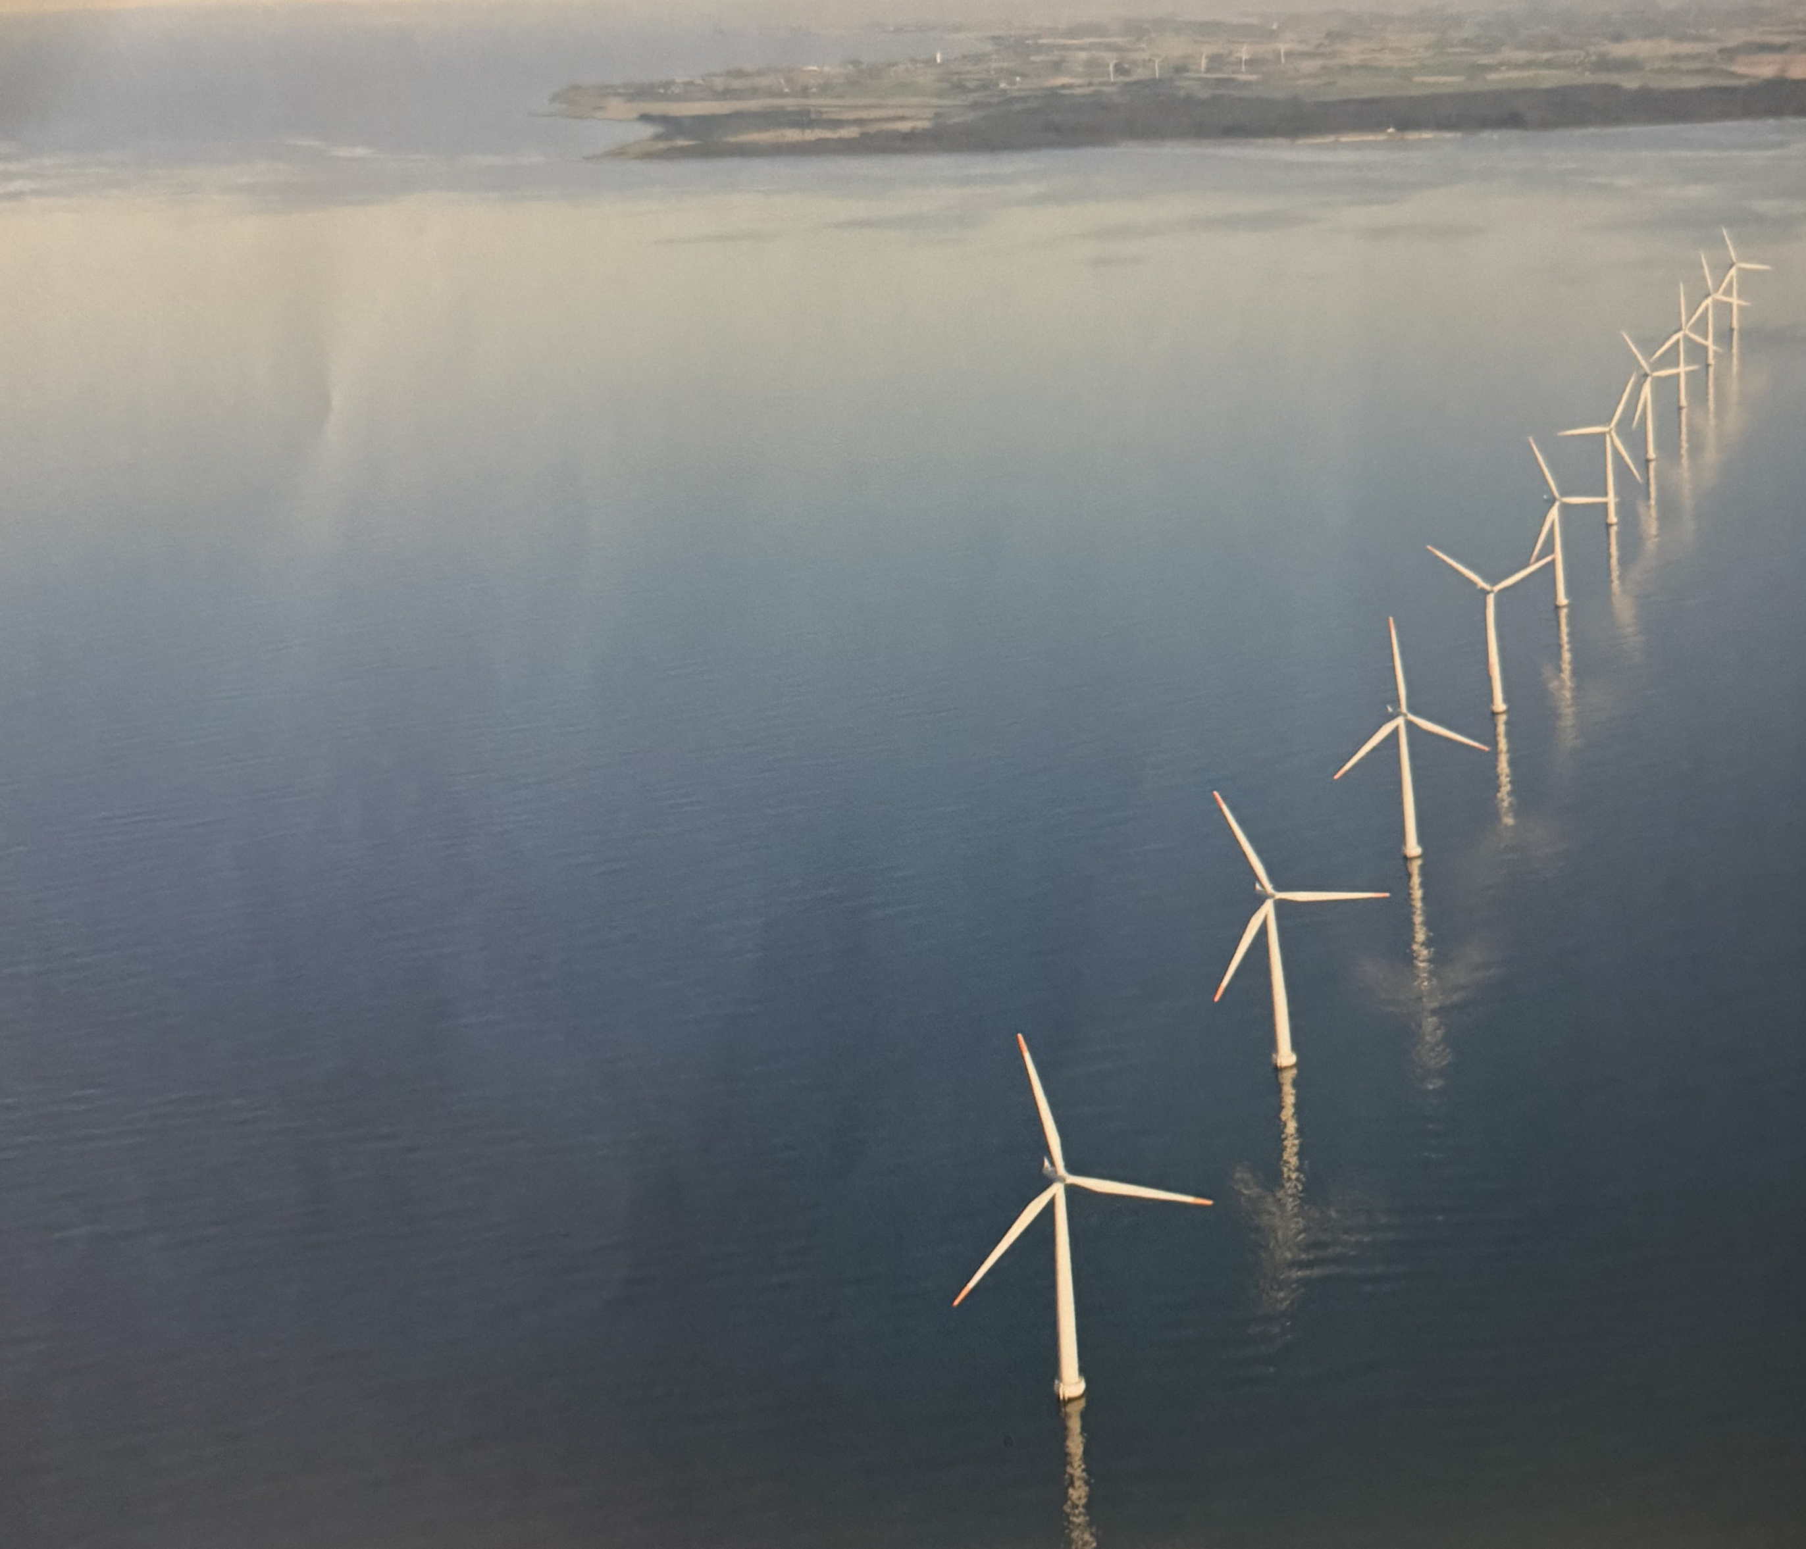
CHAPTER 10 / SCIENCE
03 / 49
Samsø: an energy system, not a single device
Wind supplies electricity
Biomass and solar energy supply heat
Grid connections balance imports and exports
Offshore-wind photograph from the chapter opening.

Slide 4
CHAPTER 10 / SCIENCE
04 / 49
Where renewable energy comes from
Primary source | Renewable pathways | Energy we use
Sunlight | Solar, wind, river flow, waves, biomass | Electricity, heat, fuels
Earth’s internal heat | Geothermal systems | Heat and electricity
Gravitational interactions | Ocean tides | Motion and electricity
Most pathways begin with sunlight. Geothermal energy and tides have different primary sources.

Slide 5
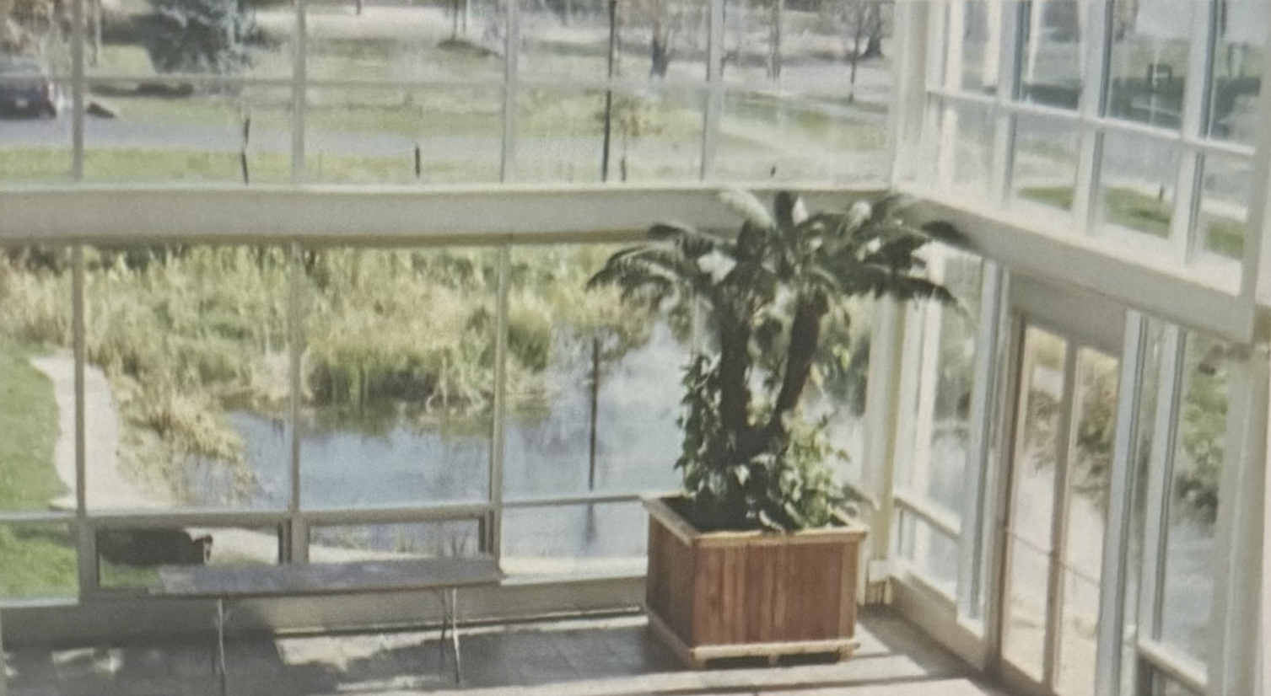
CHAPTER 10 / SCIENCE
05 / 49
Three ways to use sunlight
Direct heating and daylight
Concentrating solar power makes heat
Photovoltaic cells produce electricity directly
Fig. 10.5: the Oberlin atrium uses sunlight for heat and daylight.

Slide 6
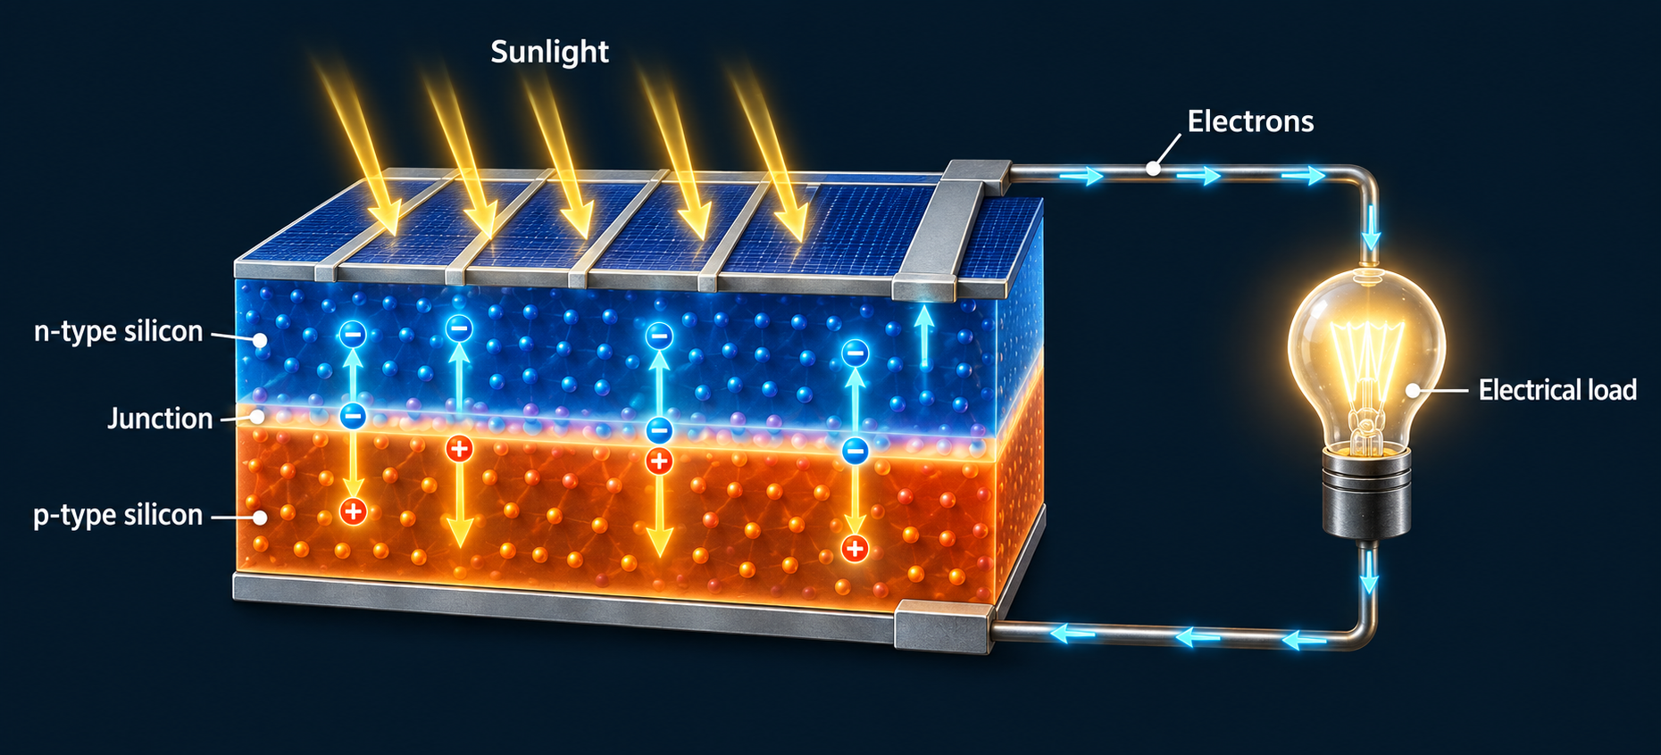
CHAPTER 10 / SCIENCE
06 / 49
How a photovoltaic cell produces electricity
1 Light supplies energy
2 The junction separates charges
3 The external circuit powers a load
Adapted from Fig. 10.7: absorbed light creates mobile charges, and the junction separates them to drive an external circuit.

Slide 7
CHAPTER 10 / SCIENCE
07 / 49
Experiment: does panel angle matter?
Relative direct-beam power (%)
Predict first
The same panel turns away from a fixed beam.
Which angle captures the least power?
% of Direct Beam Power
At 60°, the panel intercepts half the direct-beam power.
Angle of the bean on the panel
Ideal direct-beam model, not measured PV performance. Angle is measured from the panel’s perpendicular direction.

Slide 8
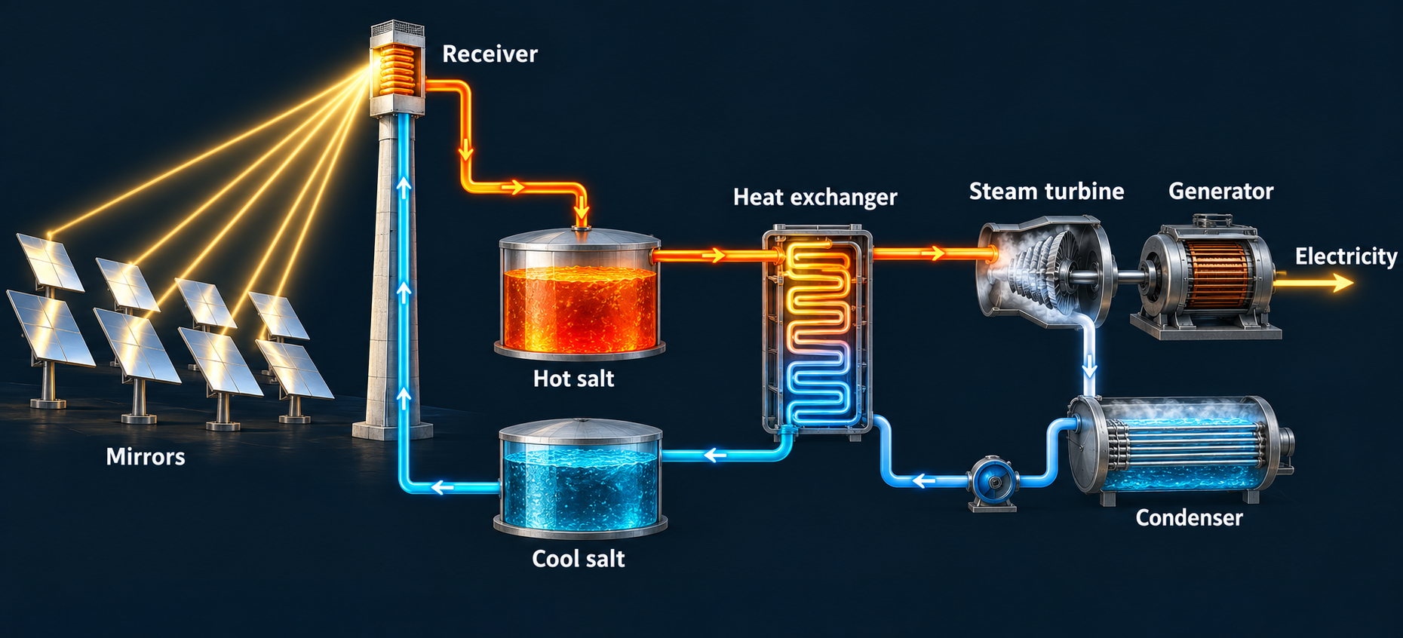
CHAPTER 10 / SCIENCE
08 / 49
Concentrating solar power uses a heat engine
1 Mirrors concentrate sunlight
2 Heat transfers to a steam cycle
3 A turbine drives the generator
Adapted from Fig. 10.6 and §10.8: mirrors supply heat, while a separate steam cycle drives a generator.

Slide 9
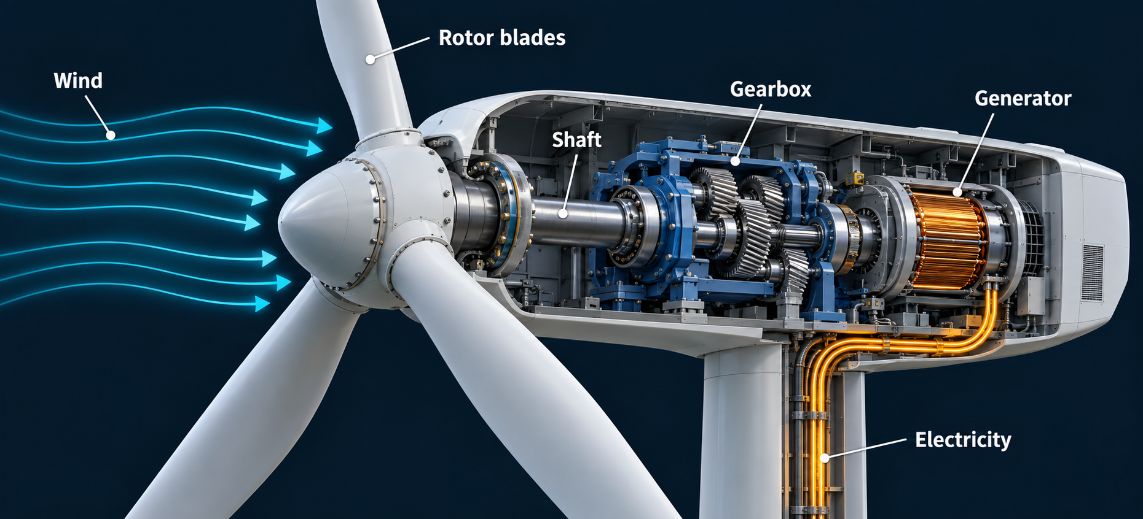
CHAPTER 10 / SCIENCE
09 / 49
A wind turbine converts motion to electricity
1 Aerodynamic forces turn the rotor
2 The shaft transfers mechanical energy
3 The generator produces electricity
Adapted from Fig. 10.8: moving air turns a rotor coupled to an electrical generator.

Slide 10
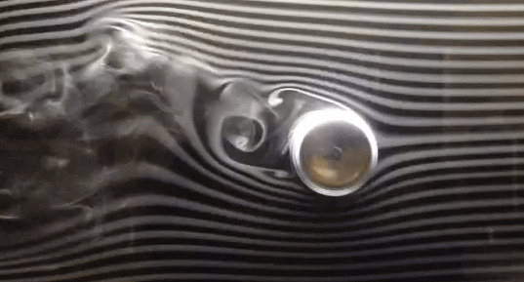
CHAPTER 10 / SCIENCE
10 / 49
Magnus Effect
SPIN CHANGES THE FLOW. THE FLOW EXERTS A SIDEWAYS FORCE.
REAL SMOKE-TUNNEL EXPERIMENT
Watch the smoke
Air enters from the right.
When the cylinder spins,
the wake bends upward.
Air up. Force down.
The sideways force is
the Magnus effect.
Animation: MatSouffNC858s · Wikimedia Commons · CC BY-SA 4.0

Slide 11
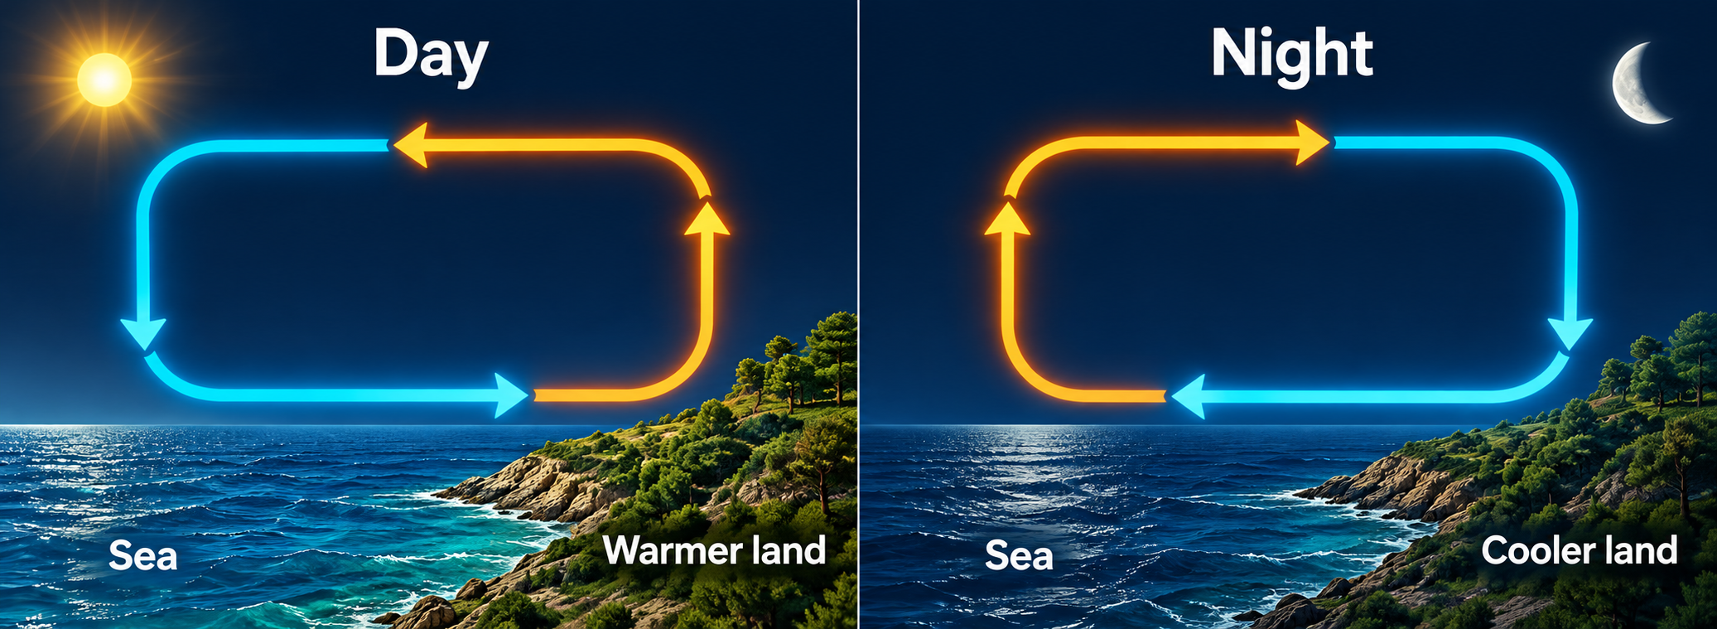
CHAPTER 10 / SCIENCE
11 / 49
Sea breezes reverse as land heats and cools
DAY • Near-surface air moves from sea to land.
NIGHT • Near-surface flow can reverse toward the sea.
Adapted from Fig. 10.9: different heating and cooling rates produce daily changes in coastal air circulation.

Slide 12
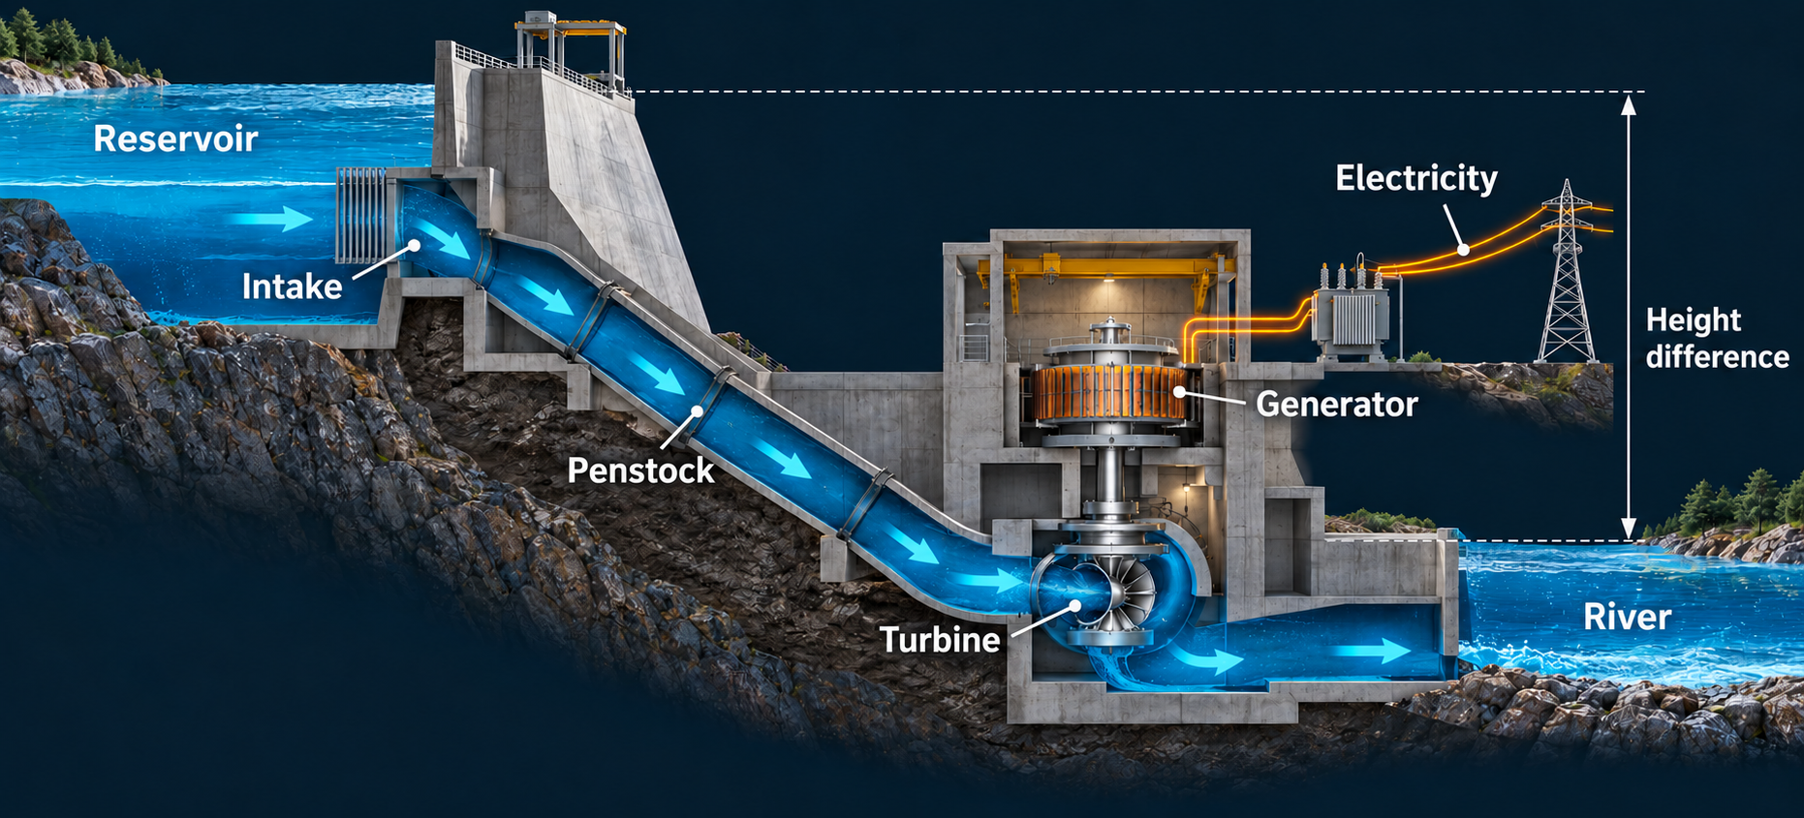
CHAPTER 10 / SCIENCE
12 / 49
Hydropower uses a height difference
1 Water enters the penstock
2 Flow turns the turbine
3 Water returns to the downstream river
Adapted from Fig. 10.12: water loses gravitational potential energy as it passes through a turbine.

Slide 13
CHAPTER 10 / SCIENCE
13 / 49
Experiment: doubling the water drop
Calculated electrical power (kW)
Hold flow constant
What happens to power when the height difference doubles?
Twice the head gives twice the power, if flow and efficiency stay constant.
Calculated classroom example: flow = 1 m³/s, efficiency = 80%, water density = 1,000 kg/m³.

Slide 14
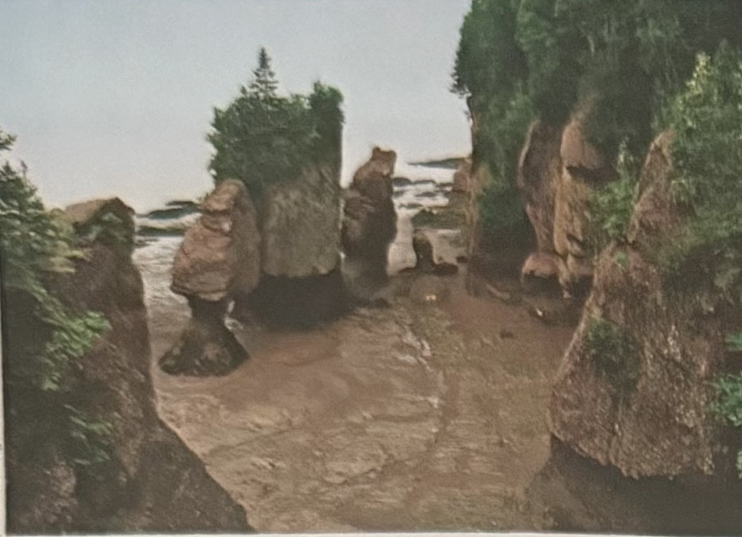
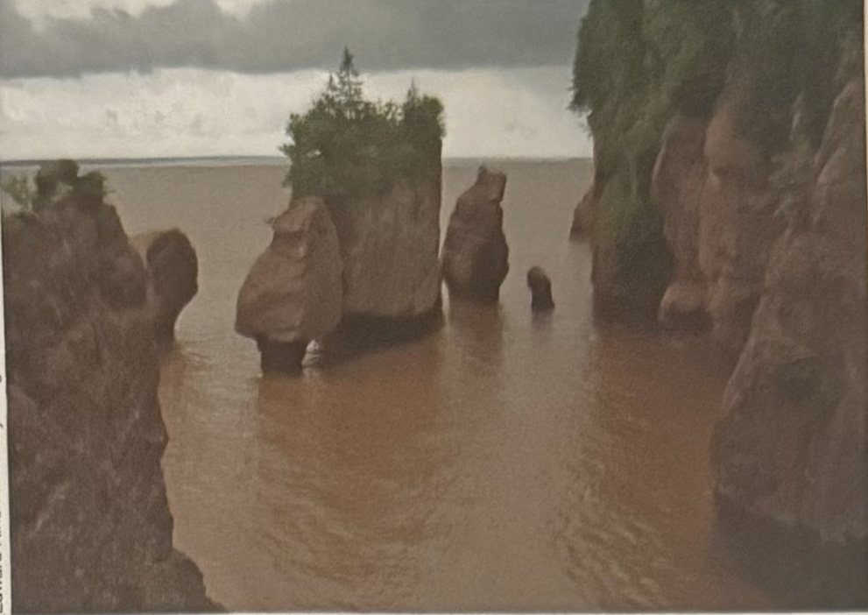
CHAPTER 10 / SCIENCE
14 / 49
Tides and waves have different energy sources
Low tide
High tide
Tides follow gravitational cycles. Most surface waves gain energy from wind.
Fig. 10.14: low and high tide at Hopewell Rocks, Bay of Fundy.

Slide 15
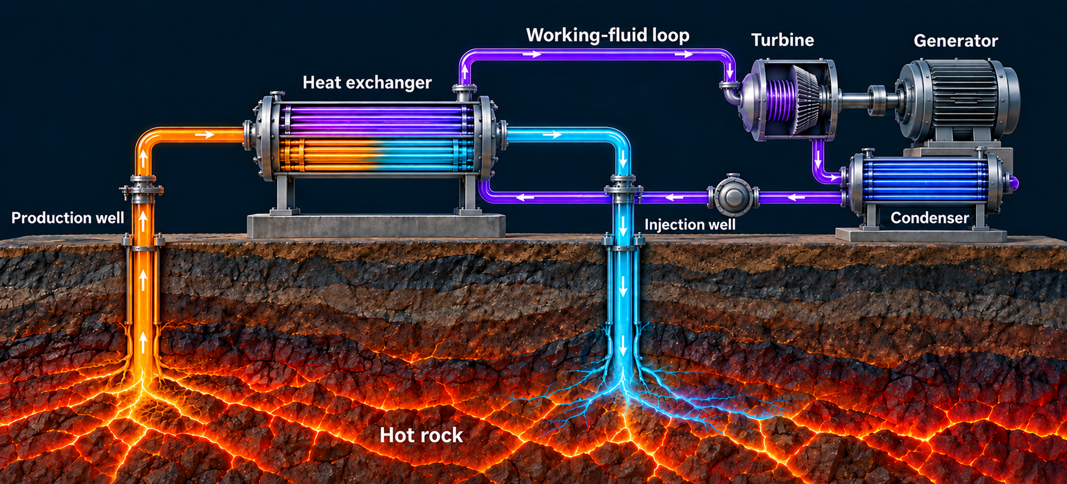
CHAPTER 10 / SCIENCE
15 / 49
Geothermal energy transfers Earth’s heat
1 Hot water brings heat to the surface
2 A second fluid vaporizes and drives a turbine
3 Cooled geothermal water returns underground
Adapted from Fig. 10.19: a binary-cycle plant transfers geothermal heat to a separate working fluid.

Slide 16
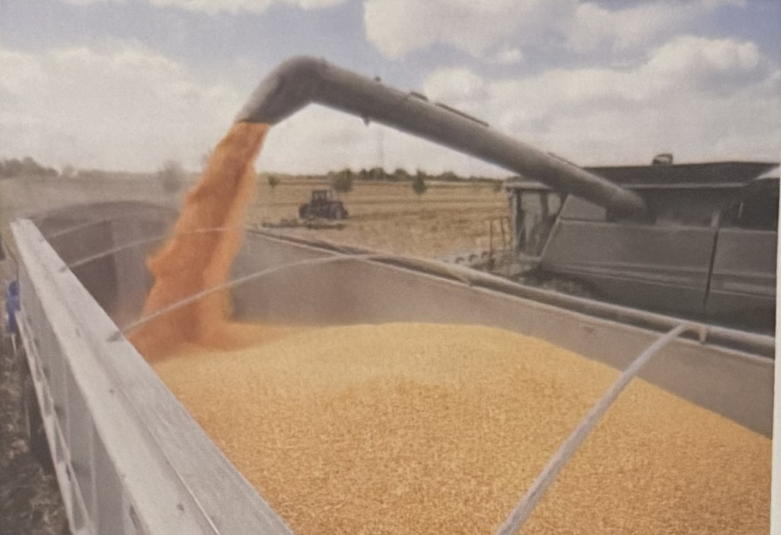
CHAPTER 10 / SCIENCE
16 / 49
Biomass stores energy in chemical bonds
Wood and other biomass can burn directly
Sugars and starches can become ethanol
Oils and fats can become biodiesel
Fig. 10.35, excerpt: harvested corn is one possible biofuel feedstock.

Slide 17
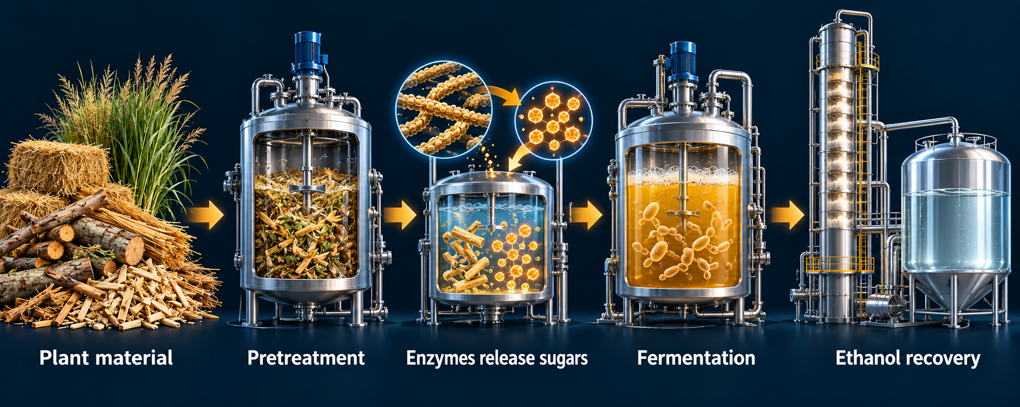
CHAPTER 10 / SCIENCE
17 / 49
Cellulosic ethanol requires an extra breakdown step
1 Cellulose contains linked sugar units
2 Enzymes make sugars accessible
3 Microbes ferment the sugars
Adapted from Fig. 10.23: pretreatment and enzymes release sugars before fermentation and ethanol recovery.

Slide 18
CHAPTER 10 / SCIENCE
18 / 49
Quick quiz: which examples use a turbine?
01
Photovoltaic solar electricity
No. A semiconductor converts light directly.
02
Concentrating solar electricity
Yes. In our example, a steam turbine drives a generator.
03
Hydroelectric power
Yes. Moving water turns the turbine.
Discuss each pathway before revealing its answer.

Slide 19
CHAPTER 10 / SCIENCE
19 / 49
Science summary
10.1
Solar energy can provide heat or generate electricity.
Photovoltaics and concentrating solar use different mechanisms.
10.2
Wind and water supply mechanical energy.
Geothermal systems use Earth’s internal heat.
10.3
Biomass stores chemical energy.
Fuel production requires processing and energy input.

Slide 20
CHAPTER 10 / ISSUES
20 / 49
Main environmental and social issues
Habitat loss, fragmentation, and new transmission corridors
Water demand and competition with other uses
Bird and bat mortality near turbines and power lines
Changed river flows, sediments, water quality, and fish migration
Displacement of communities and loss of livelihoods
Competition for agricultural land, food, and water
Impacts depend on the technology, location, scale, and operating practices.

Slide 21
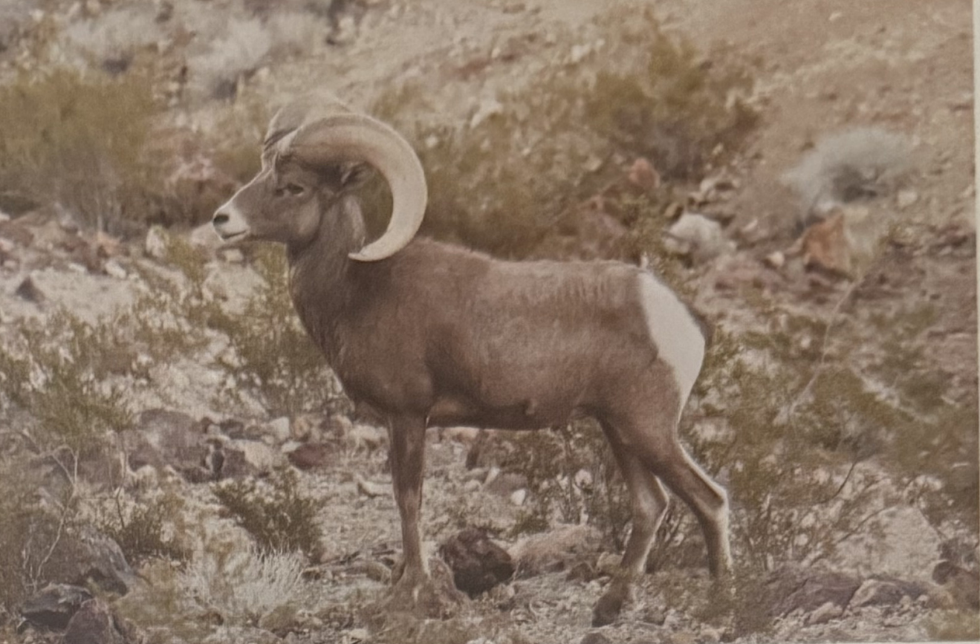
CHAPTER 10 / ISSUES
21 / 49
A sunny landscape is also a habitat
Land clearing removes habitat
Roads and fences interrupt movement
Construction can damage burrows and drainage
Fig. 10.25: roads can fragment desert bighorn sheep habitat.

Slide 22
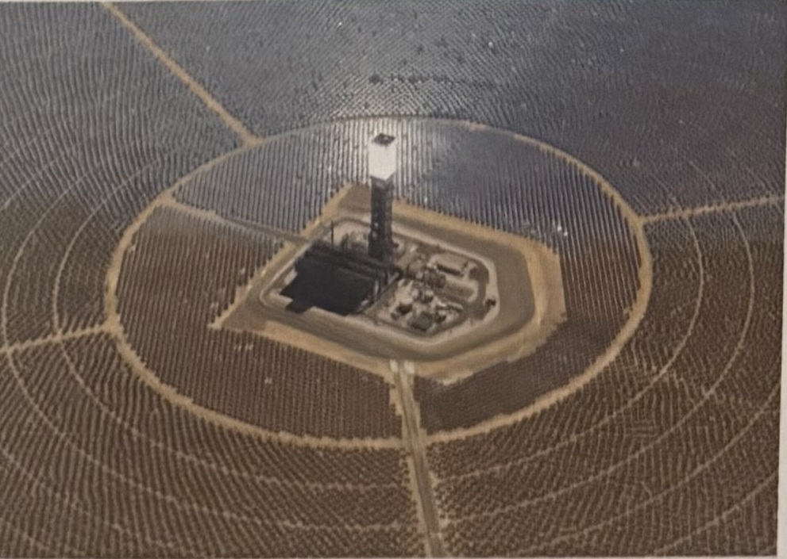
CHAPTER 10 / ISSUES
22 / 49
Concentrating solar power can compete for water
Steam-cycle cooling can consume water
Strong solar resources often occur in dry regions
Cooling design changes the water requirement
Fig. 10.6a: a tower-based solar plant. Cooling requirements differ from those of photovoltaic panels.

Slide 23
CHAPTER 10 / ISSUES
23 / 49
Energy return on energy investment
Useful energy obtained
Energy invested
200 units
40 units
EROEI = energy out ÷ energy in
200 ÷ 40 = 5 | Net energy = 160 units
Illustrative calculation, not a measured value for a particular fuel or technology.

Slide 24
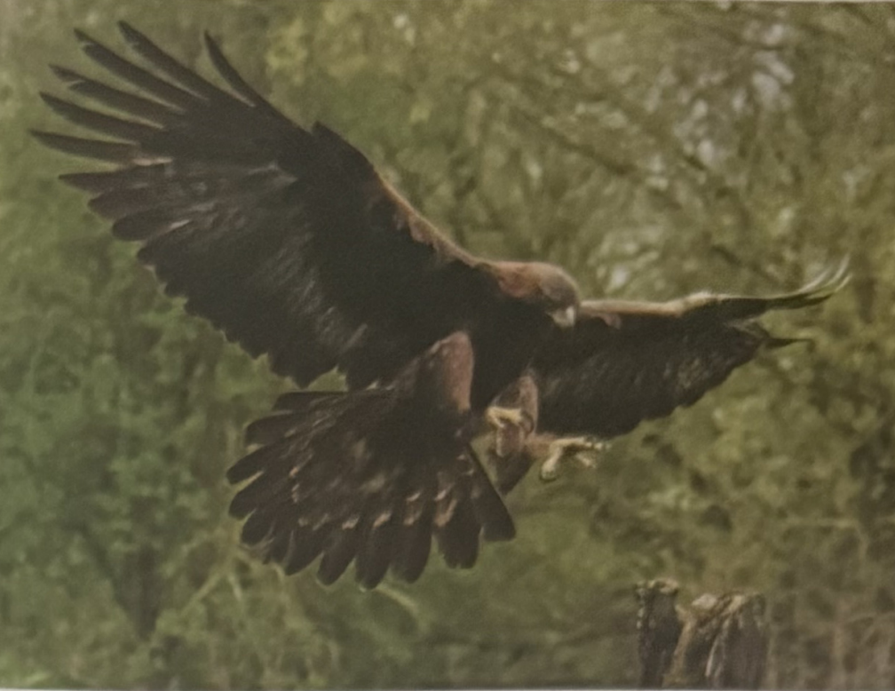
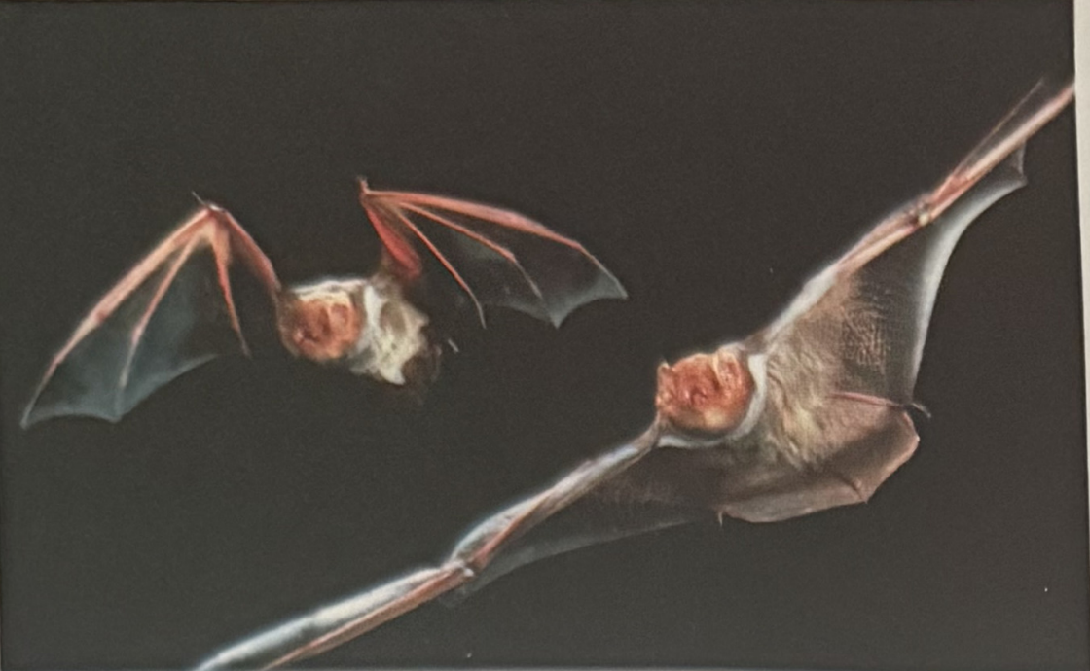
CHAPTER 10 / ISSUES
24 / 49
Wind development affects birds and bats
Bird collisions
Bat fatalities
Risk depends on species, location, migration, and turbine operation.
Figs. 10.28 and 10.30: a golden eagle and eastern red bats illustrate vulnerable wildlife.

Slide 25
CHAPTER 10 / ISSUES
25 / 49
Transmission corridors extend the footprint
Birds may collide with power lines
New roads and corridors can divide habitats
Some grassland birds avoid tall structures
Risk extends beyond the turbine or solar-panel boundary
A project assessment must include the connections that deliver its electricity.

Slide 26
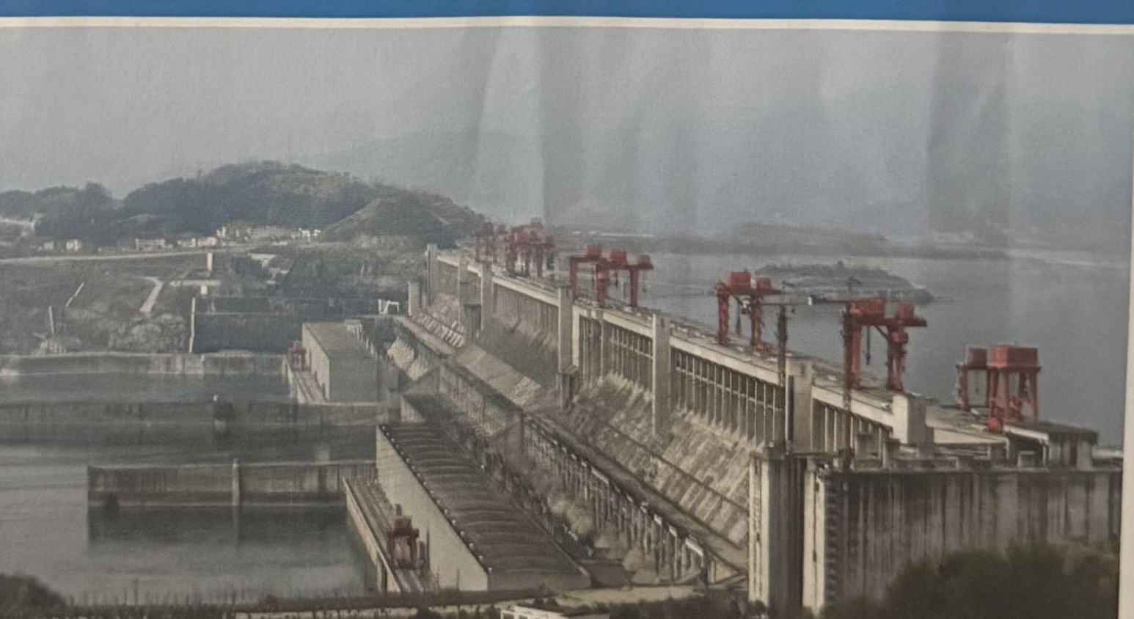
CHAPTER 10 / ISSUES
26 / 49
A dam changes an entire river system
Reservoirs trap sediments
Dams interrupt fish migration
Water temperature and oxygen can change
Flooded organic matter can produce greenhouse gases
Fig. 10.13: the Three Gorges project illustrates the scale of large hydroelectric development.

Slide 27
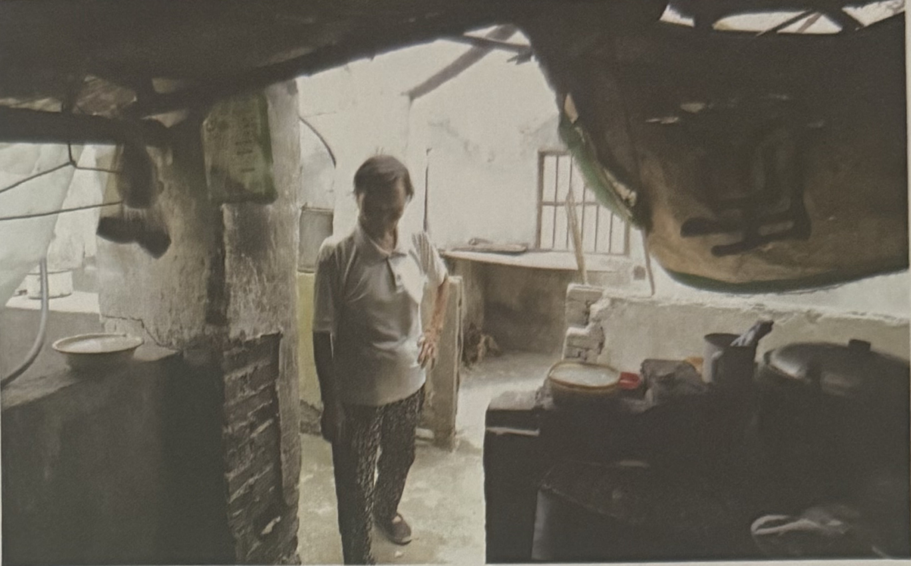
CHAPTER 10 / ISSUES
27 / 49
Hydropower benefits and costs reach different people
Electricity may serve distant cities
Flooding can displace households
Fishing, farming, and cultural sites can be lost
Affected communities need a meaningful voice
Fig. 10.34: a resident in a partly demolished home before inundation by the Three Gorges reservoir.

Slide 28
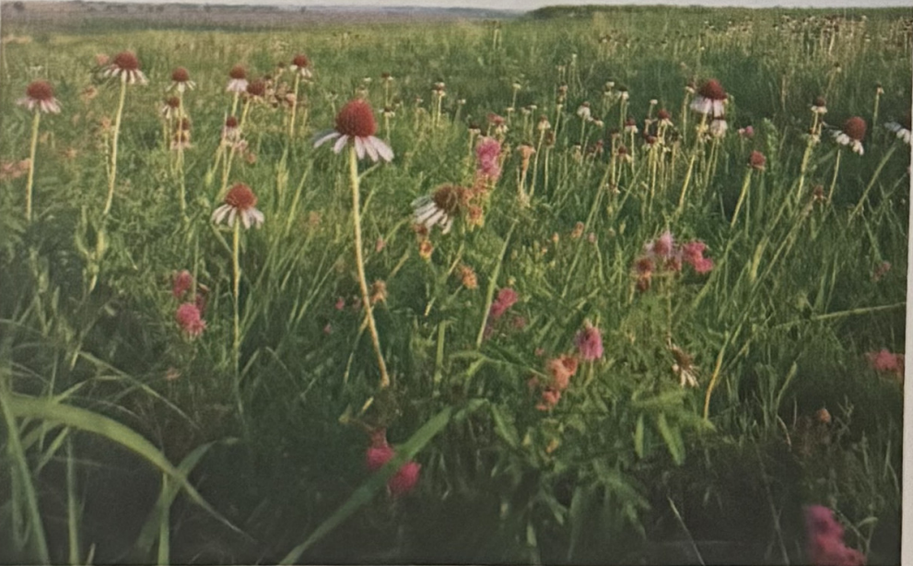
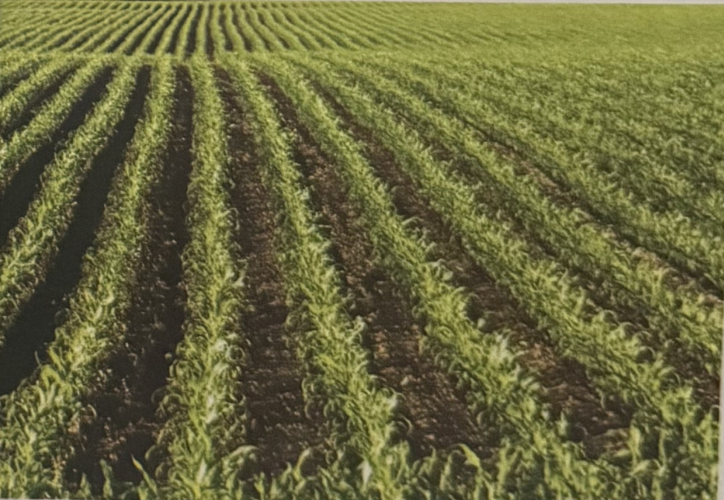
CHAPTER 10 / ISSUES
28 / 49
Biofuel demand can change food and land systems
Diverse prairie
Intensive crop production
Food competition, fertilizer runoff, soil loss, and habitat conversion can occur along the fuel pathway.
Fig. 10.36: contrasting ecosystems illustrate the consequences of converting land to intensive agriculture.

Slide 29
CHAPTER 10 / ISSUES
29 / 49
Comparing complete renewable-energy pathways
Pathway | Main pressures | Questions before development
Solar | Land, materials, cooling water for thermal systems | Which site and cooling design?
Wind | Wildlife, roads, transmission corridors | Which species, seasons, and routes?
Hydropower | River change, flooded land, displacement | What happens upstream and downstream?
Biofuels | Food and land competition, runoff, soil loss | Which feedstock and production boundary?
A chapter synthesis. Local conditions determine the importance of each pressure.

Slide 30
CHAPTER 10 / ISSUES
30 / 49
Issues summary
10.4
Solar development can affect habitats and water supplies.
10.5
Wind turbines and transmission lines can harm wildlife.
10.6
Dams alter rivers and can displace communities.
10.7
Biofuel expansion can compete with food and damage ecosystems.

Slide 31
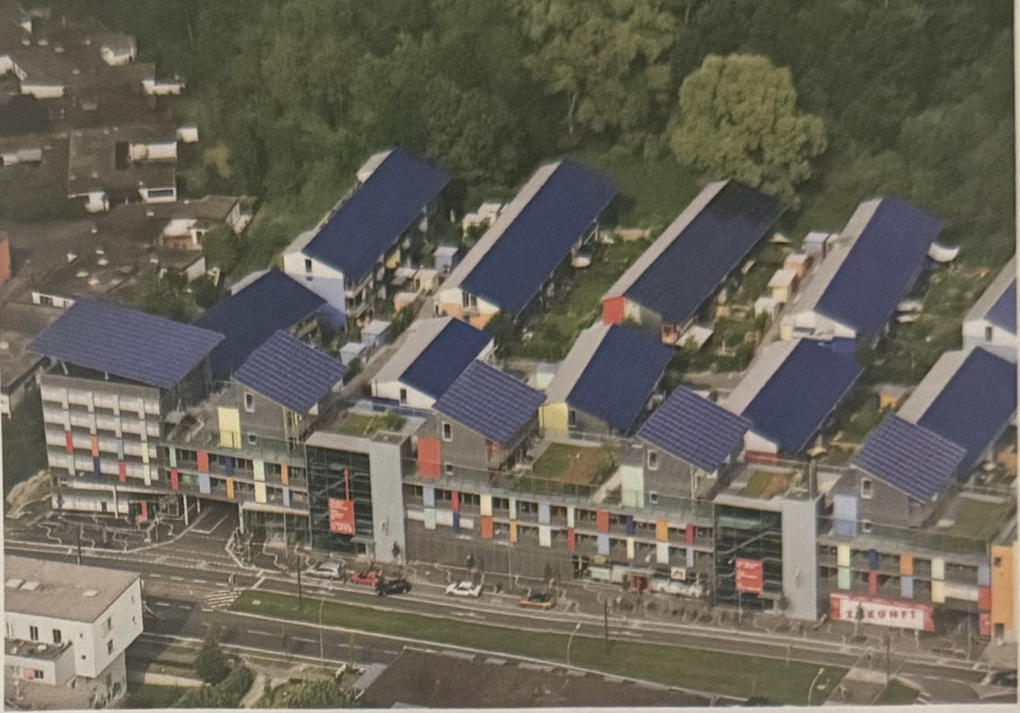
CHAPTER 10 / SOLUTIONS
31 / 49
Solar siting can reduce habitat damage
Use suitable rooftops and developed sites
Check structural, shading, and grid constraints
Reduce pressure on intact habitats
Fig. 10.40: rooftop photovoltaic systems in Freiburg, Germany.

Slide 32
CHAPTER 10 / SOLUTIONS
32 / 49
Storage shifts energy in time
Storage approach | What is stored? | What must be checked?
Thermal storage | Heat, for example in molten salt | Heat loss and usable temperature
Batteries | Electrochemical energy | Power, usable capacity, and losses
Pumped storage | Water at higher elevation | Reservoirs, water, and terrain
Stored energy can serve later demand, but every storage system has limits and losses.

Slide 33
CHAPTER 10 / SOLUTIONS
33 / 49
Storage challenge: is the evening covered?
Energy (MWh)
Efficiency = 80%
2.0 MWh goes in.
Can storage supply the whole evening?
1.6 MWh delivered. Another 0.4 MWh must come from elsewhere.
Classroom assumptions: 2.0 MWh charged, 80% round-trip efficiency, 2.0 MWh evening demand.

Slide 34
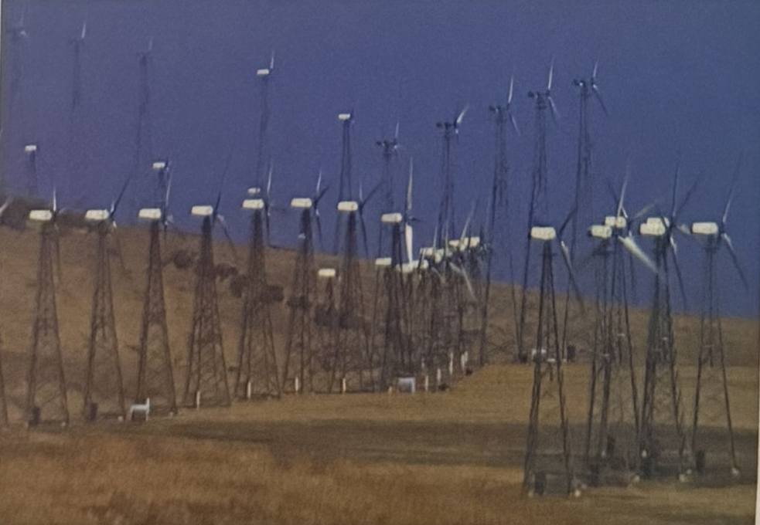
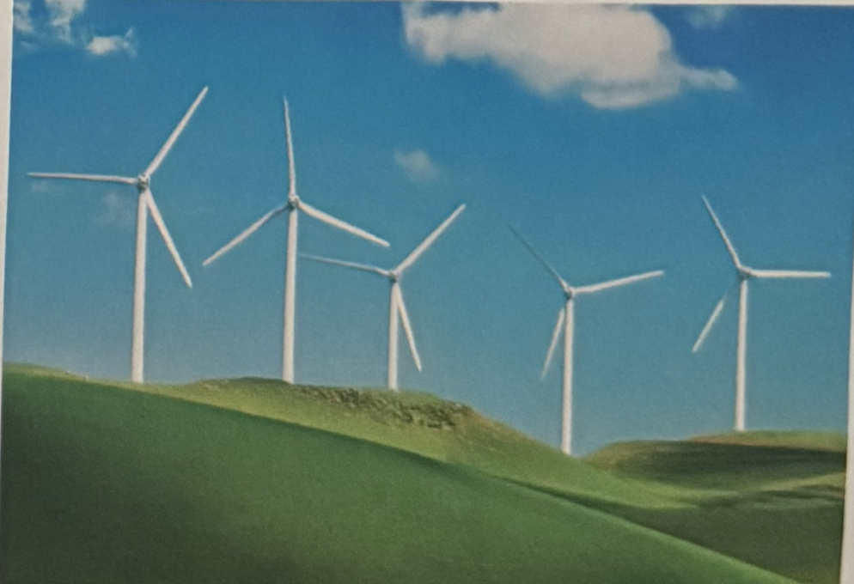
CHAPTER 10 / SOLUTIONS
34 / 49
Wind design and siting can reduce harm
Older lattice towers
Newer tubular towers
Repowering can reduce some bird risks. Careful siting and monitoring remain essential.
Fig. 10.42: turbine designs differ in perch availability and operating characteristics.

Slide 35
CHAPTER 10 / SOLUTIONS
35 / 49
Experiment: changing turbine operation protects bats
Reduction in bat fatalities (%)
Tested on 21 turbines
Reduce rotor motion during low-wind periods when bats are at risk.
Fewer fatalities—not zero risk. Site-specific evidence matters.
Baerwald et al. (2009): reductions relative to normal operation at one Alberta site during the peak fatality period.

Slide 36
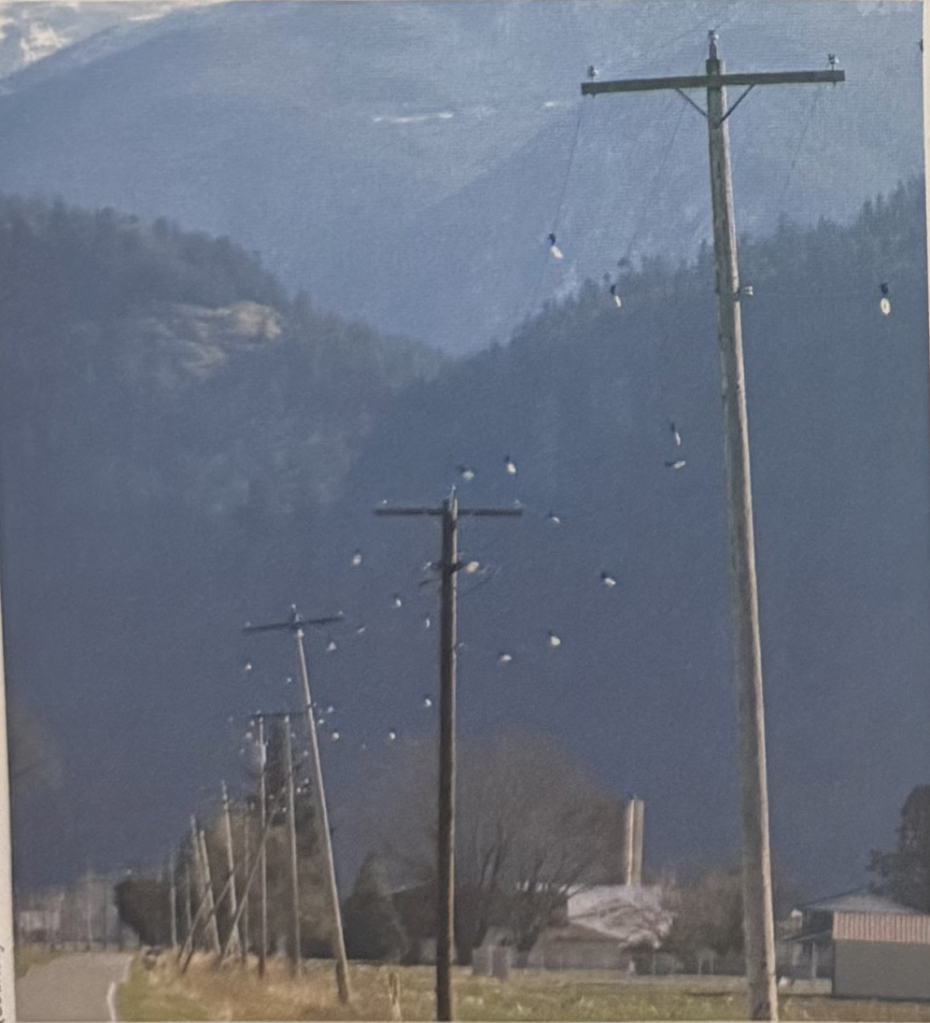
CHAPTER 10 / SOLUTIONS
36 / 49
Safer transmission routes and visible lines
Avoid important flight, feeding, and roosting areas
Use suitable existing rights of way
Mark high-risk spans and measure the outcome
Fig. 10.44: markers make electrical lines more visible to birds.

Slide 37
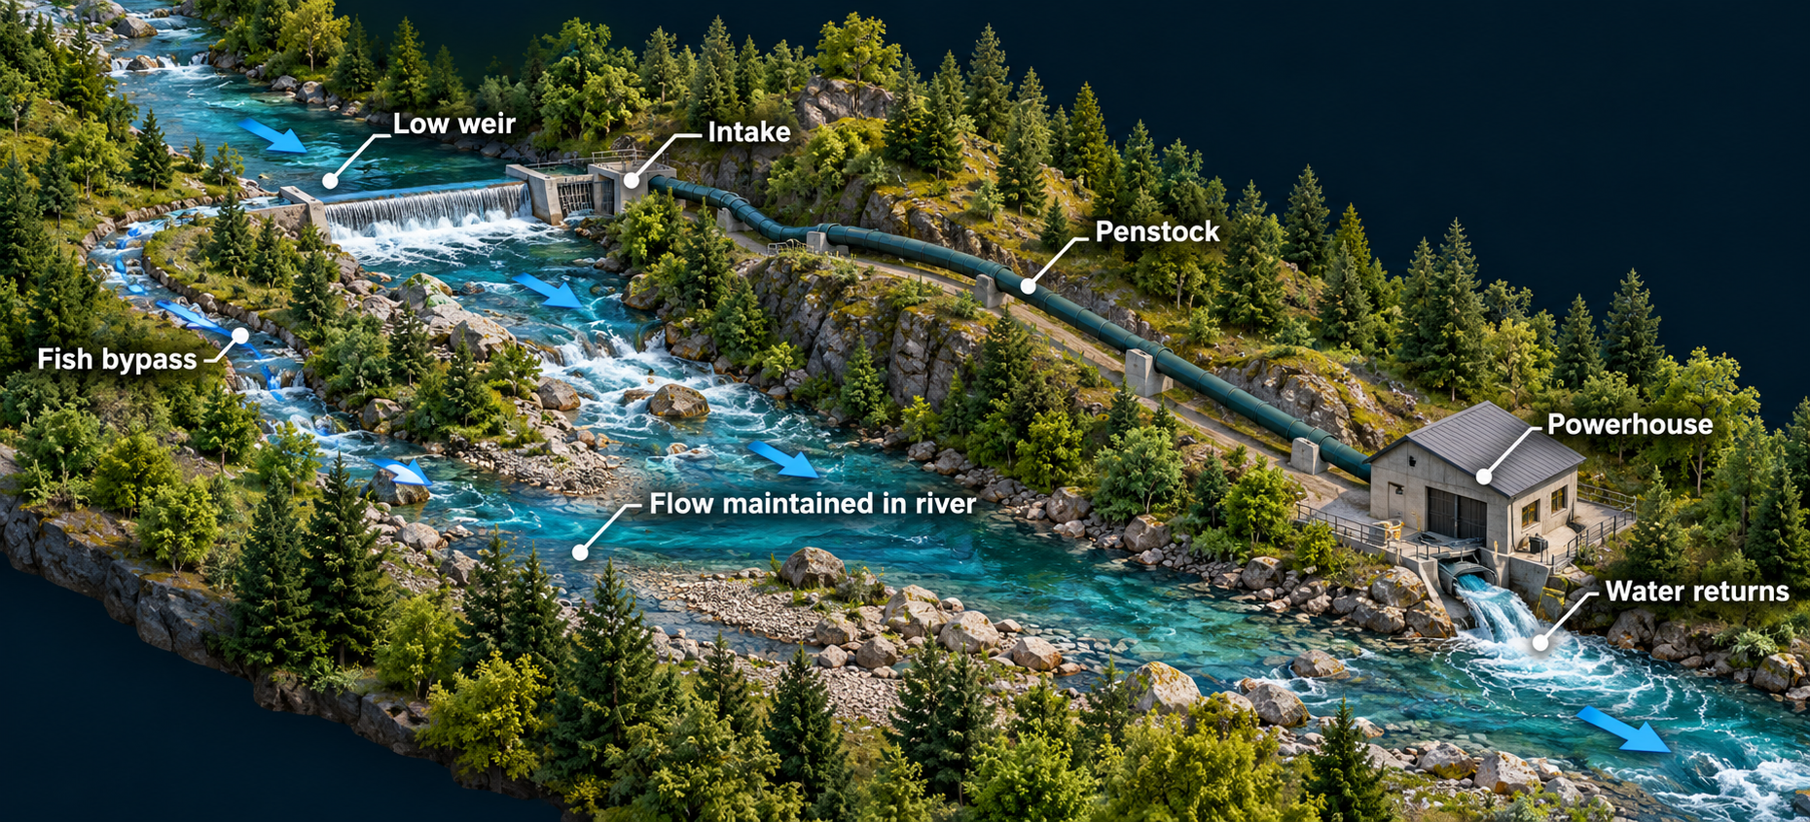
CHAPTER 10 / SOLUTIONS
37 / 49
Run-of-the-river hydropower preserves some flow
1 Divert only part of the river
2 Maintain ecological flow
3 Provide fish passage and monitor impacts
Adapted from Figs. 10.45–10.46: a diversion supplies a powerhouse while the main channel retains flow and fish passage.

Slide 38
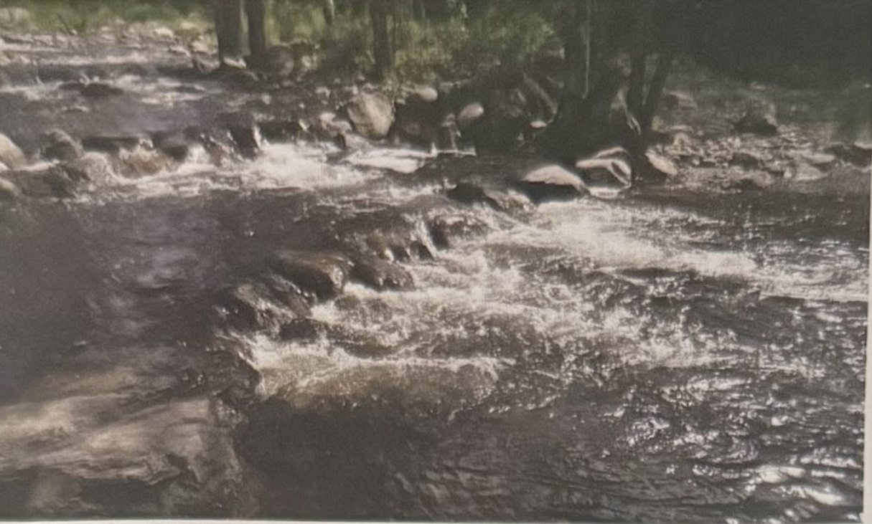
CHAPTER 10 / SOLUTIONS
38 / 49
Existing dams can offer alternatives to new barriers
Assess suitable existing unpowered dams
Improve fish passage and operating rules
Compare refurbishment with removal and other options
Fig. 10.46: a fish bypass at a low dam illustrates one approach to maintaining passage.

Slide 39
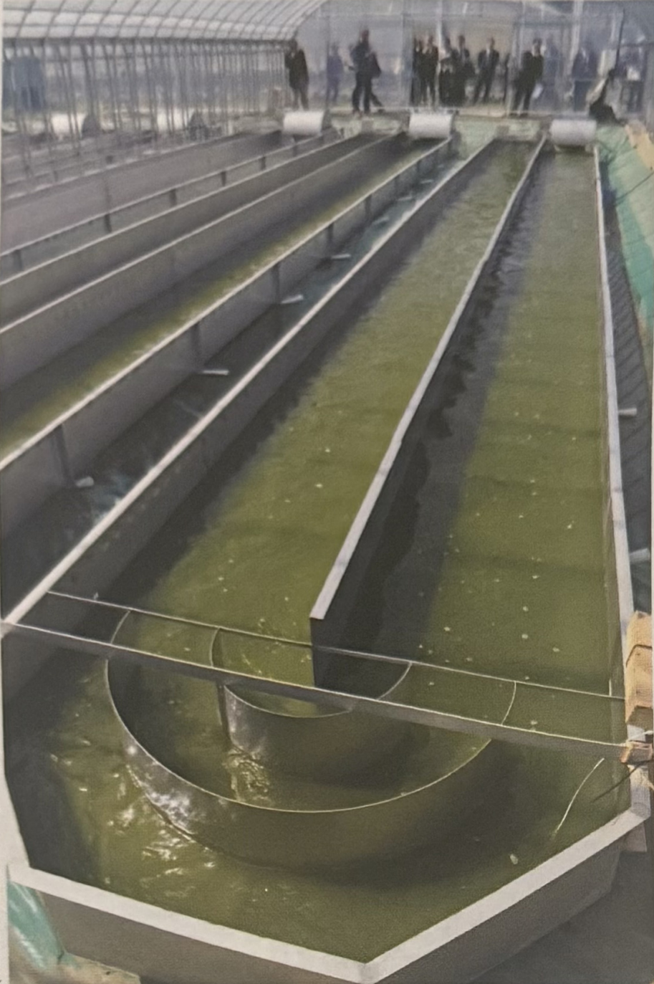
CHAPTER 10 / SOLUTIONS
39 / 49
Lower-impact biofuels start with the feedstock
Use appropriate residues and waste streams
Protect forests, soils, and food production
Evaluate algae and cellulosic pathways over their full life cycle
Fig. 10.50: algae cultivation is a potential biofuel pathway, with its own resource and processing requirements.

Slide 40
CHAPTER 10 / SOLUTIONS
40 / 49
Policy and community participation shape deployment
Clear permitting and grid-connection processes
Financing and incentives aligned with environmental goals
Enforceable habitat and land-use protections
Meaningful community participation and fair distribution of benefits
Technical design and social decisions jointly determine the outcome.

Slide 41
CHAPTER 10 / SOLUTIONS
41 / 49
Solutions summary
10.8
Solar: improve siting, cooling design, and storage.
10.9
Wind: reduce wildlife exposure through siting and operation.
10.10
Hydropower: maintain river function and assess existing barriers.
10.11
Biofuels: protect ecosystems and choose suitable feedstocks.

Slide 42
CHAPTER 10 / APPLICATION
42 / 49
Grid challenge: four hours after sunset
DEMAND
WIND
HYDRO
SOLAR (Photovoltaic)
10 MW
3 MW
4 MW
0 MW
BATTERY
3 MW maximum • 12 MWh usable
Can the lights stay on for all four hours?
Gap = 3 MW × 4 hours = 12 MWh. Yes—exactly enough in this model.
Hypothetical isolated system. Battery starts full with 12 MWh usable output and a 3 MW discharge limit.

Slide 43
CHAPTER 10 / APPLICATION
43 / 49
Grid challenge: the wind drops
DEMAND
WIND
HYDRO
SOLAR (Photovoltaic)
10 MW
1 MW
4 MW
0 MW
BATTERY
3 MW maximum • 12 MWh usable
Is the battery enough now? Propose a response.
Gap: 5 MW for 4 hours = 20 MWh. Reduce demand by 2 MW, or add 2 MW of reliable supply.
Same four-hour scenario, but wind now supplies 1 MW throughout the period. No automatic grid imports are available.

Slide 44
CHAPTER 10 / TAKEAWAYS
44 / 49
What students should take away
Mechanism
Trace energy from its primary source to useful output.
Consequences
Include land, water, wildlife, and affected communities.
Design
Match the solution to the specific impact and location.
Reliability
Check both the rate of supply and how long it can last.

Slide 45
CHAPTER 10 / CENTRAL QUESTION
45 / 49
Returning to the central question
Can we develop renewable energy resources to help sustain a thriving economy without adversely affecting the environment?
Renewables can support a thriving economy while reducing many harms. Their environmental performance depends on where and how we build and operate the system.
Zero impact is not a realistic promise
Lower demand, careful siting, and verified safeguards improve the outcome

Slide 46
CHAPTER 10 / TAKEAWAYS
46 / 49
Renewable energy and you
Reduce avoidable energy use
Choose efficient buildings, appliances, and transport where feasible
Evaluate energy proposals using evidence
Participate in local decisions and ask who benefits
Individual choices matter alongside action by institutions, industry, and government.

Slide 47
CHAPTER 10 / DISCUSSION
47 / 49
Exit questions
01
Why can a renewable energy project still harm an ecosystem?
Infrastructure, resource use, and operation can change habitats and communities.
02
Which change could reduce bat fatalities at a wind farm?
Reduce rotor motion during high-risk low-wind periods, then monitor results.
03
Why is a 3 MW battery rating insufficient to describe its usefulness?
We also need usable MWh capacity to know how long it can supply power.
Explain a mechanism, a mitigation, and one limitation.

Slide 48
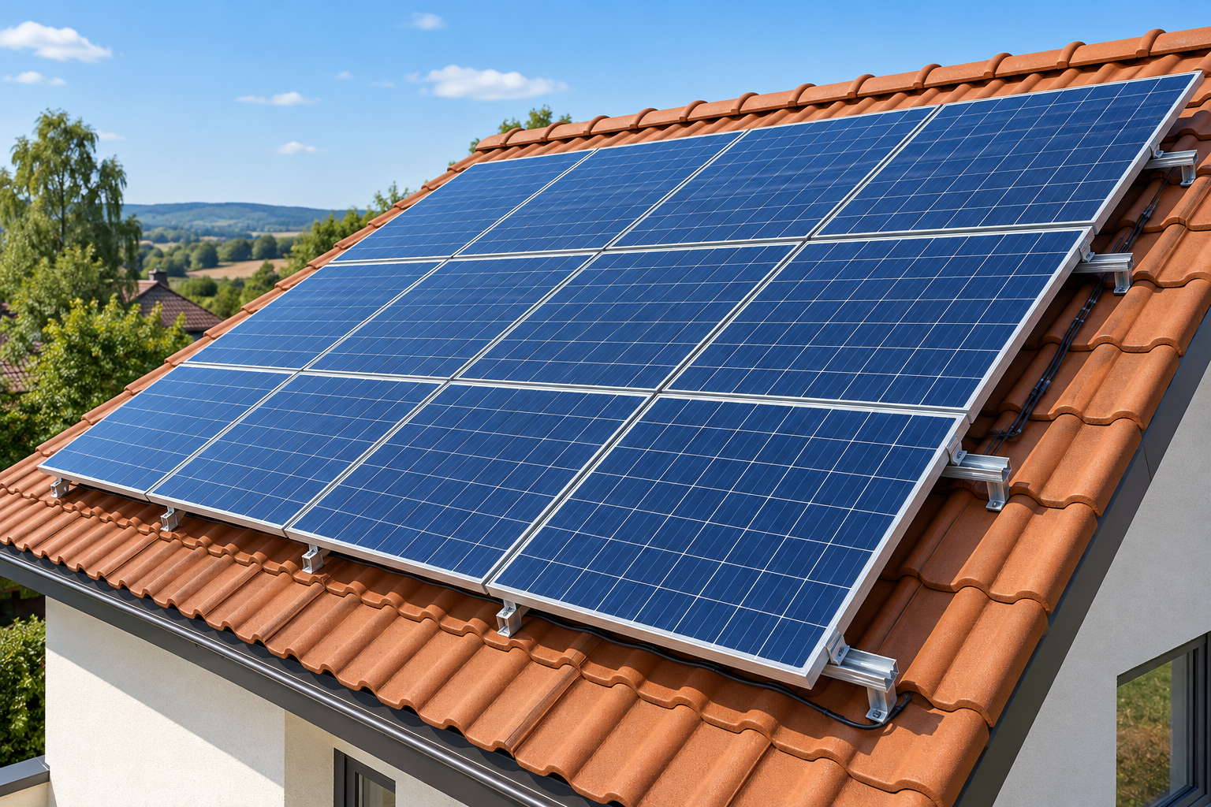
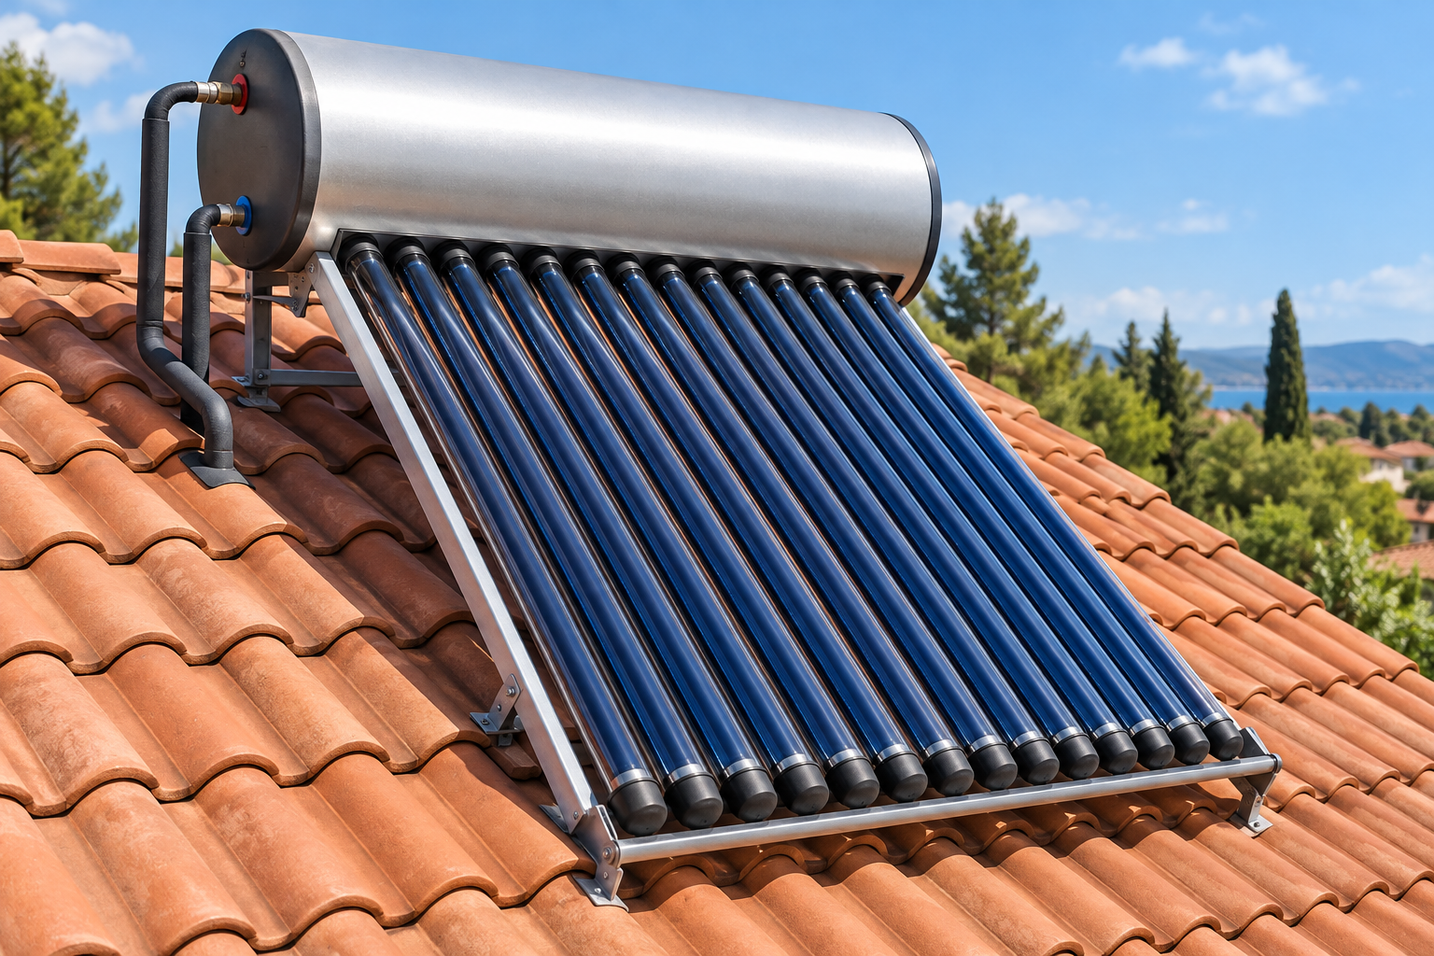
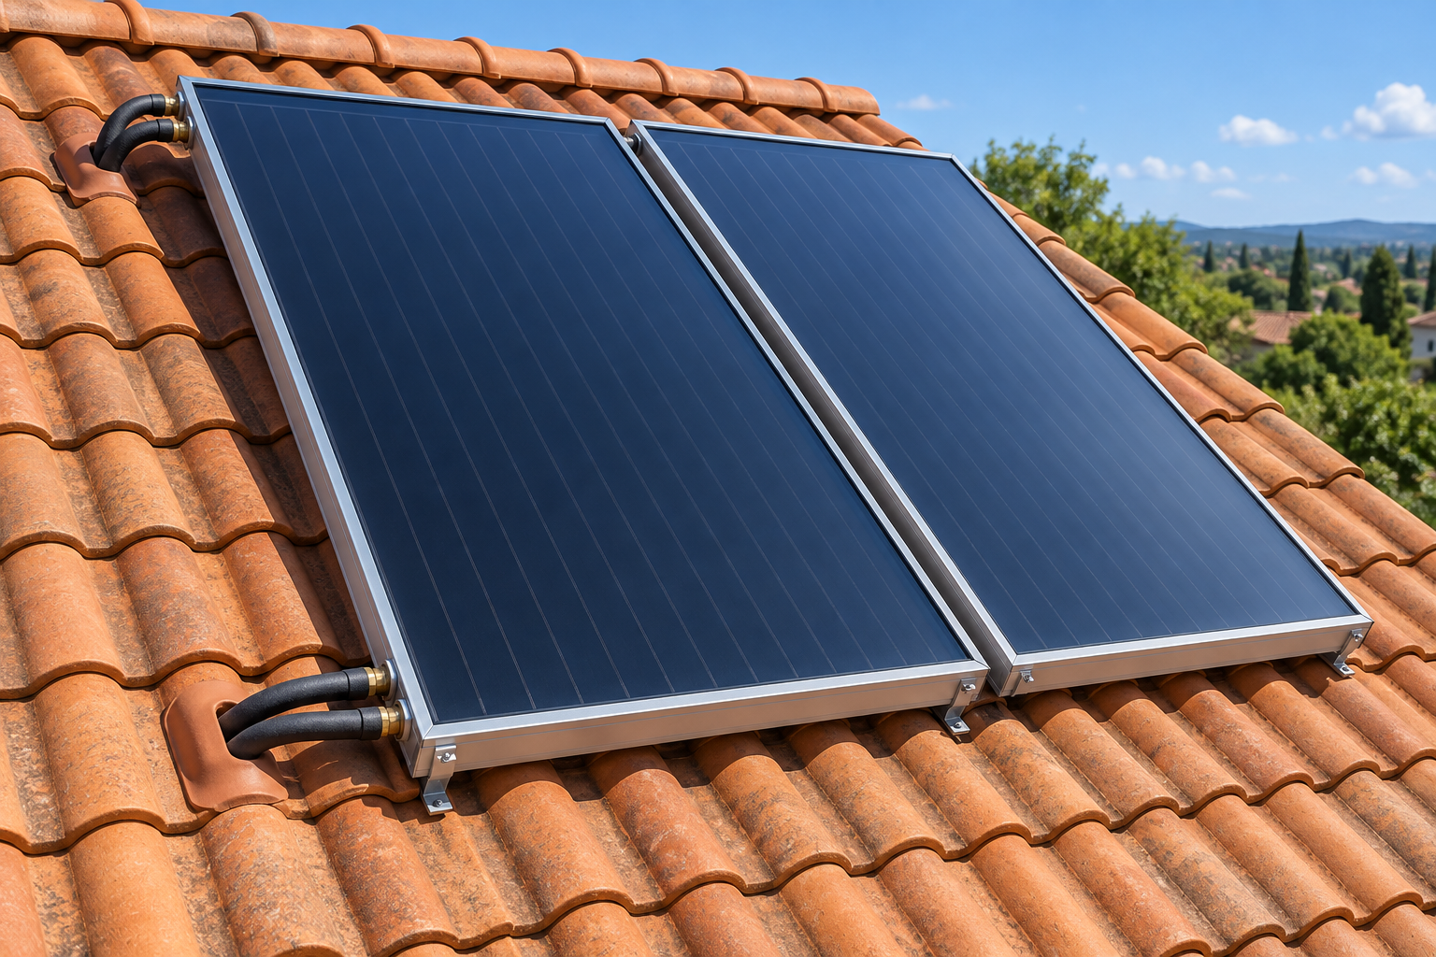
CHAPTER 10 / DISCUSSION
48 / 49
Exit question 4
What is the difference between these systems, if any?
A
B
C
Photovoltaic panels
Solar water heater
Solar water heater
Solar electricity
Tank on the roof
Tank inside the building
Converts sunlight
into electricity
Uses solar heat
to warm water
Uses solar heat
to warm water
Illustrations

Slide 49
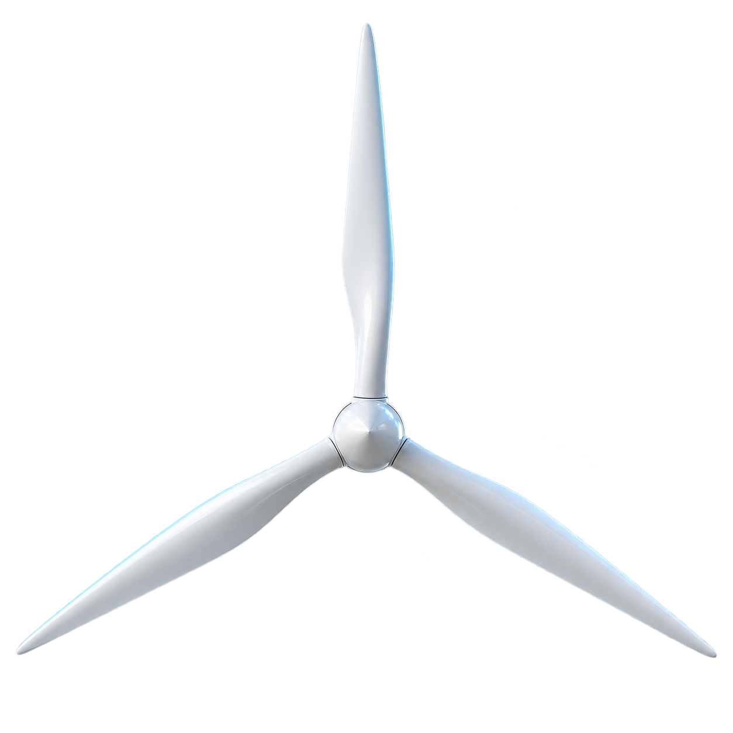
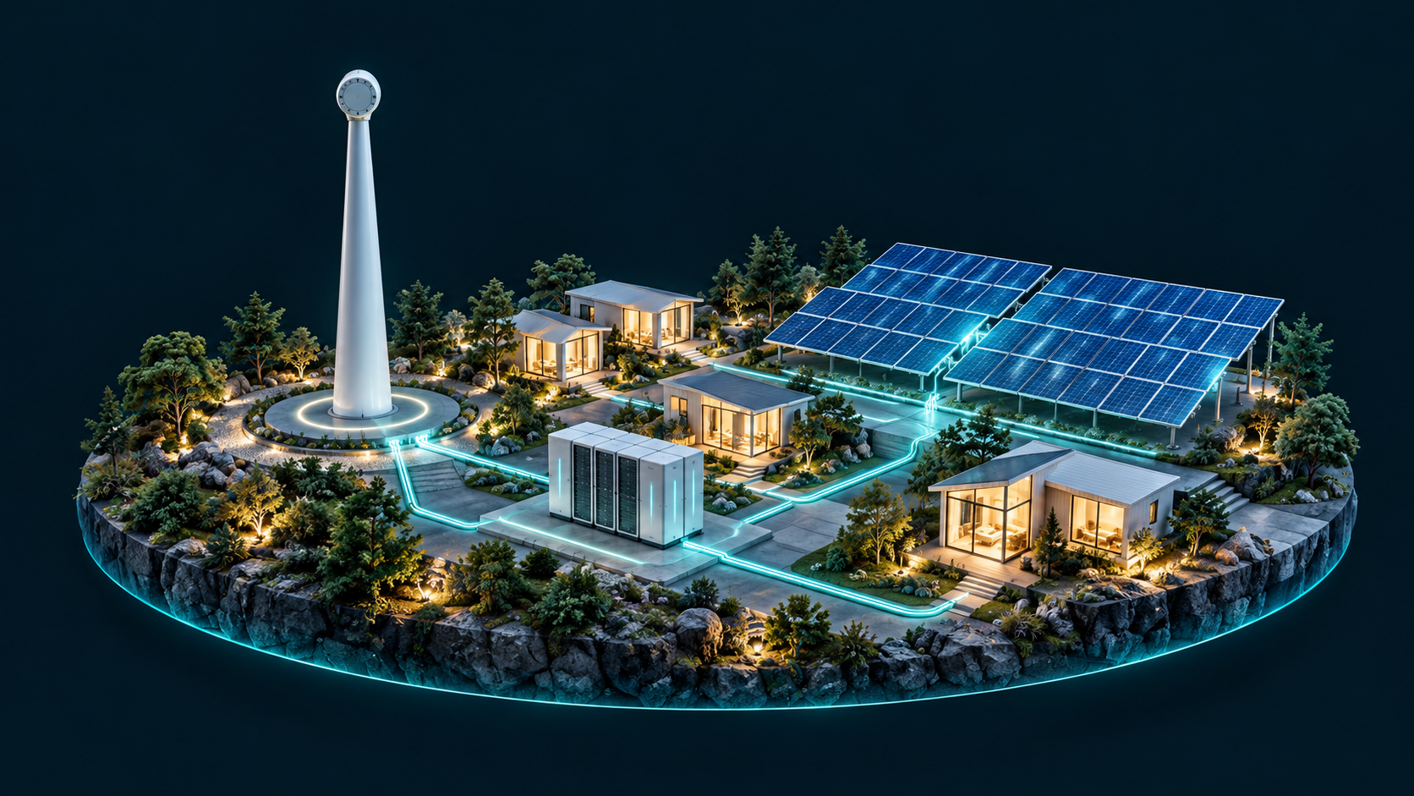
CHAPTER 10 / REFERENCES
49 / 49
Sources and further reading
PRIMARY COURSE SOURCE
Molles & Borrell (2016)
Environment: Science, Issues, Solutions
Chapter 10: Renewable Energy
MECHANISMS AND EMPIRICAL EVIDENCE
U.S. Department of Energy
Solar, wind, geothermal, and storage
Baerwald et al. (2009)
Turbine operation and bat fatalities
The Journal of Wildlife Management
doi:10.2193/2008-233
Thank you for your attention
Practice Chapters 9 and 10 in the Exam Center
https://emohellebi.github.io/teaching/courses/environmental-science/exam-center/

