Slide 1
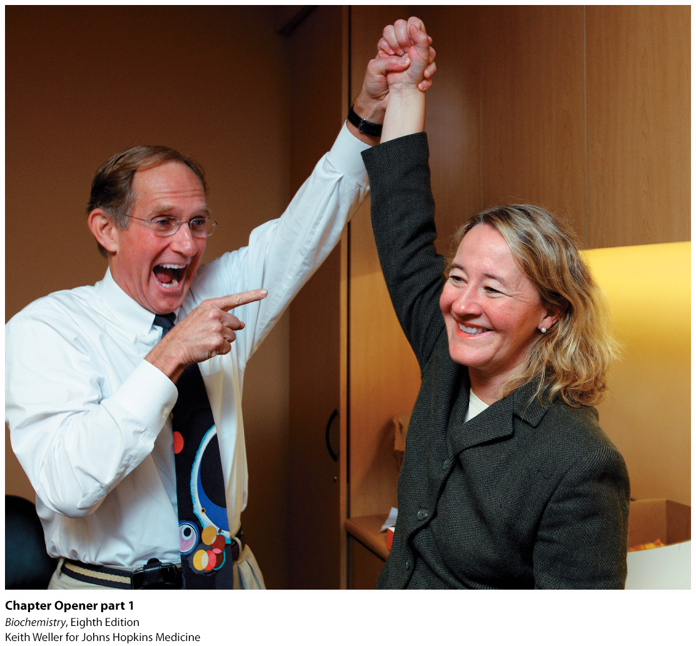
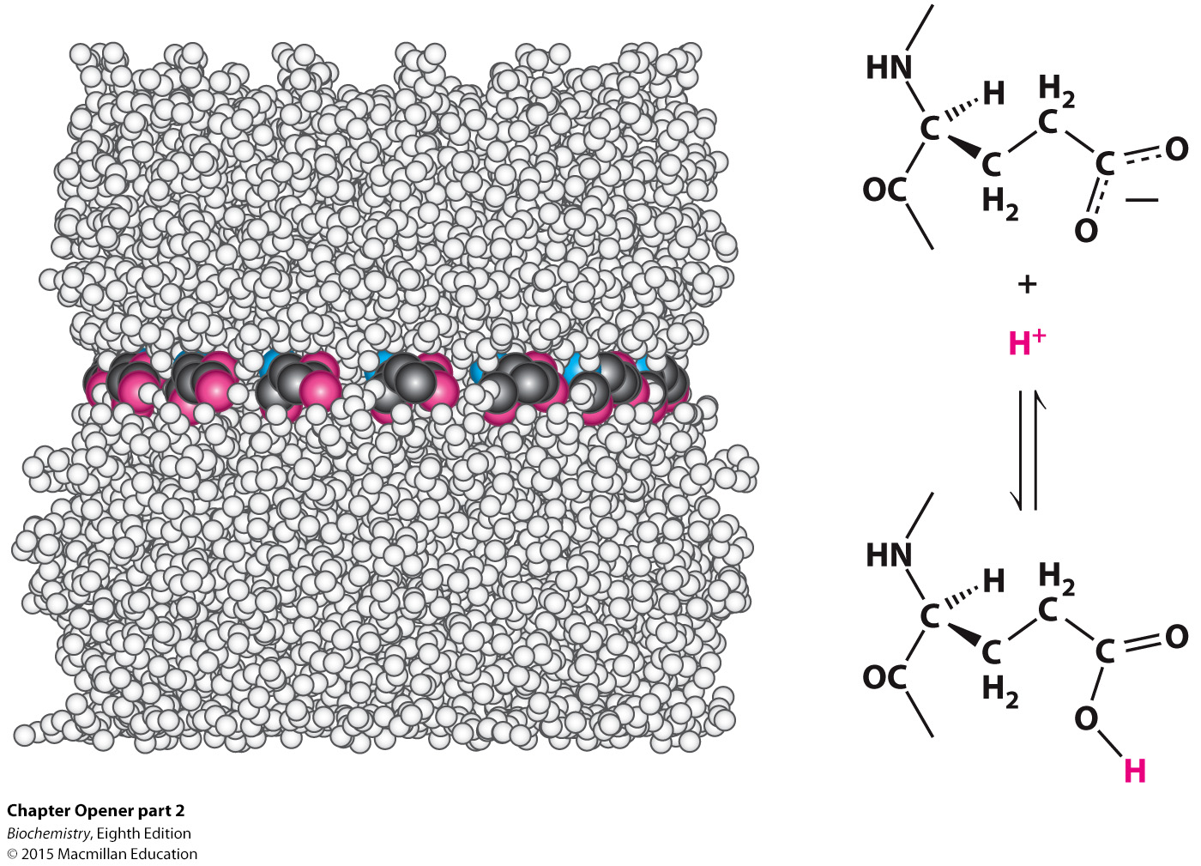
Notes:
Chemistry in action. Human activities require energy. The interconversion of different forms of energy requires large biochemical machines comprising many thousands of atoms such as the complex shown above. Yet, the functions of these elaborate assemblies depend on simple chemical processes such as the protonation and deprotonation of the carboxylic acid groups shown on the right. The photograph is of Nobel Prize winners Peter Agre, M.D., and Carol Greider, Ph.D., who used biochemical techniques to study the structure and function of proteins. [Keith Weller for Johns Hopkins Medicine.]

Slide 2
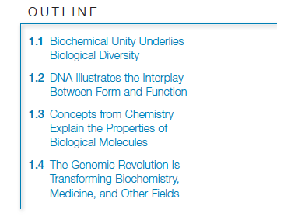

Slide 3
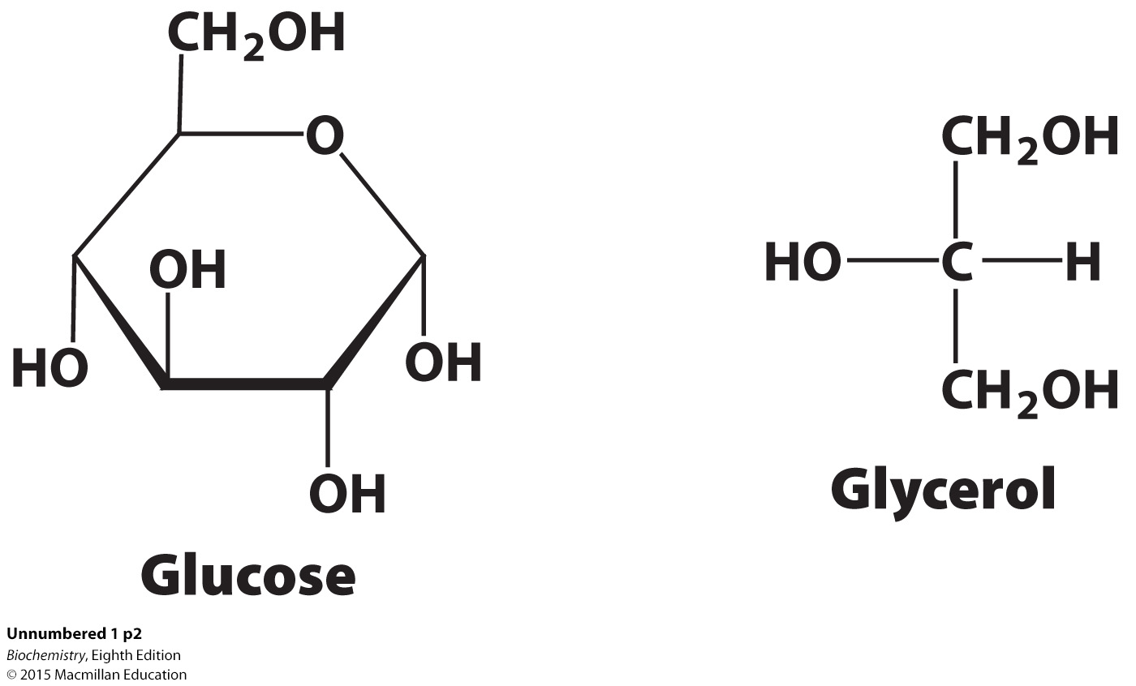
Biochemistry is the study of the chemistry of life processes.
Two classes of biochemically important molecules are macromolecules and small molecules called metabolites, such as glucose and glycerol.
Macromolecules, such as proteins, that play similar roles in different organisms have similar structures.

Slide 4
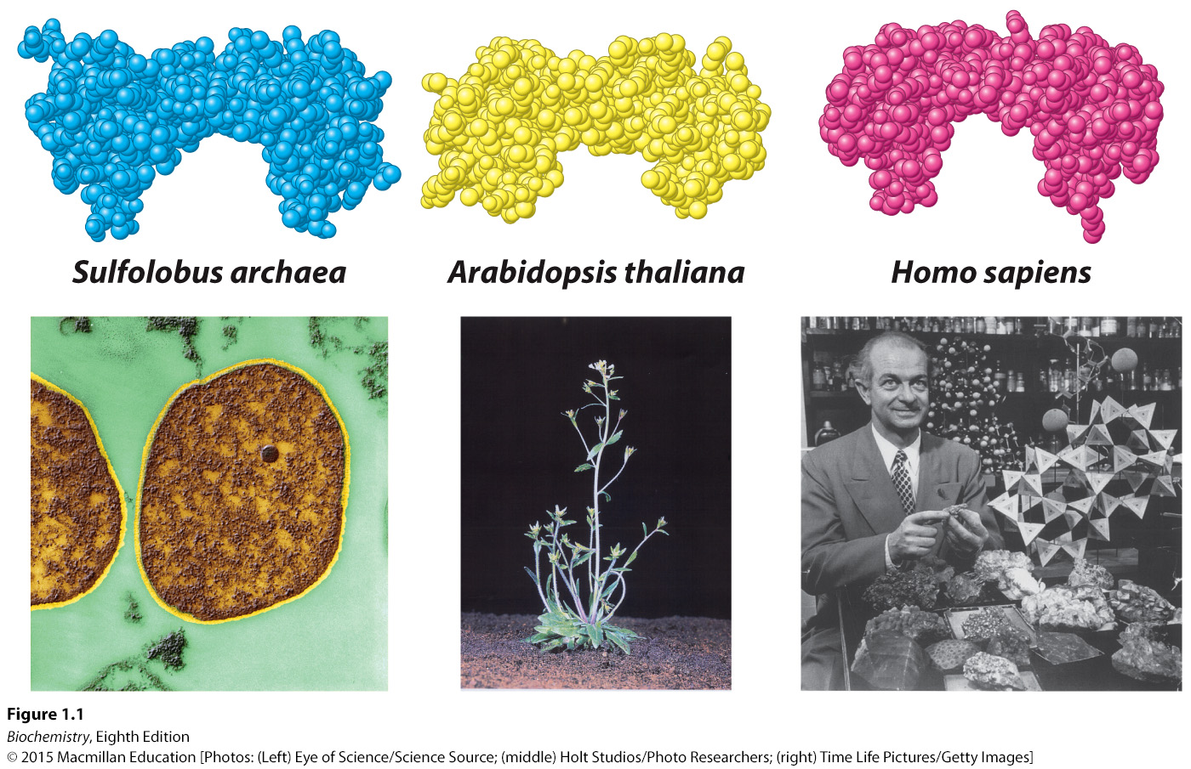
Notes:
FIGURE 1.1 Biological diversity and similarity. The shape of a key molecule in gene regulation
(the TATA-box-binding protein) is similar in three very different organisms that are separated from
one another by billions of years of evolution. [(Left) Eye of Science/Science Source; (middle)
Holt Studios/Photo Researchers; (right) Time Life Pictures/Getty Images.]

Slide 5
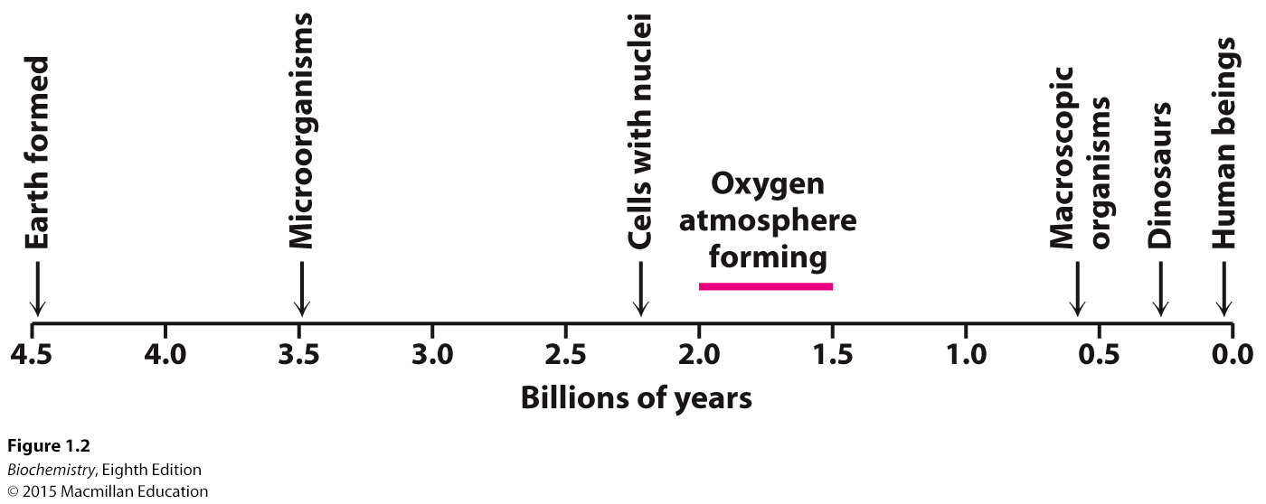
Key metabolic processes are common to many organisms.
The fact that different organisms have macromolecules of similar structure and common biochemical processes suggest that all organisms evolved from a common ancestor.
Notes:
FIGURE 1.2 A possible time line for biochemical evolution. Selected key events are indicated. Note that life on Earth began approximately 3.5 billion years ago, whereas human beings emerged quite recently.

Slide 6
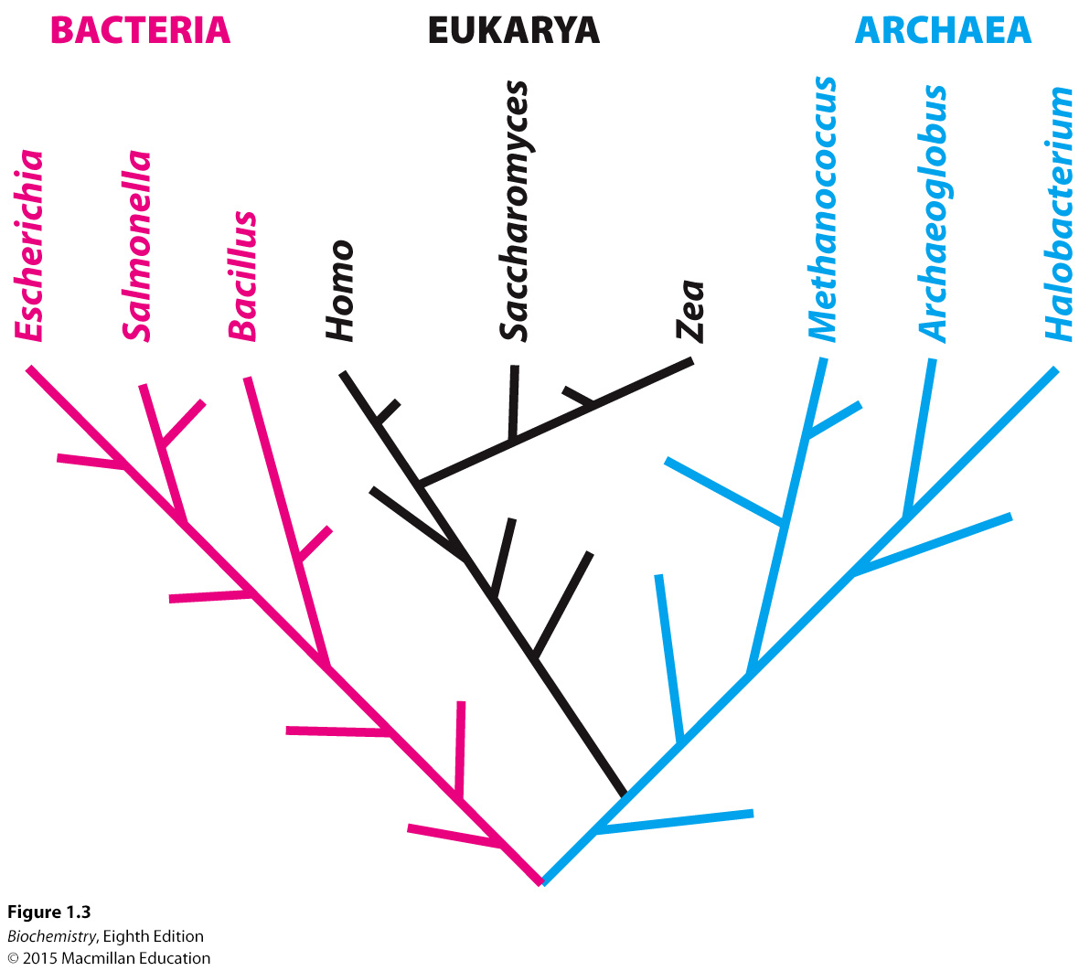
On the basis of biochemical characteristics, all organisms can be placed in one of three domains:
Notes:
FIGURE 1.3 The tree of life. A possible evolutionary path from a common ancestor approximately 3.5 billion years ago at the bottom of the tree to organisms found in the modern world at the top.

Slide 7

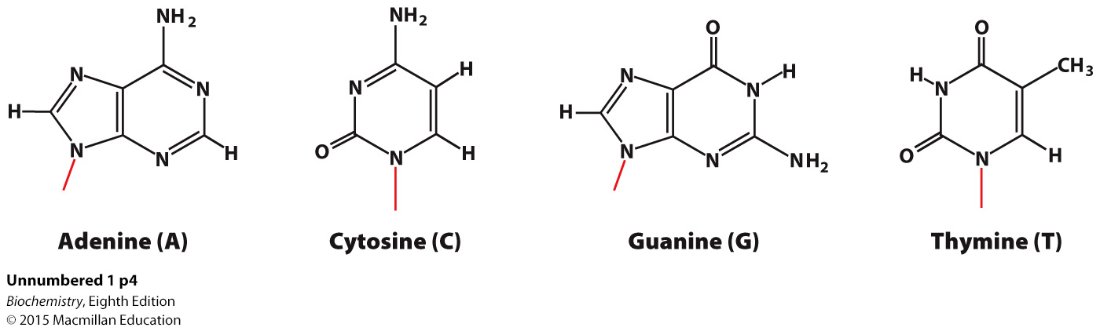
DNA is a linear polymer composed of monomers consisting of deoxyribose sugar, a phosphate and one of four bases.

Slide 8
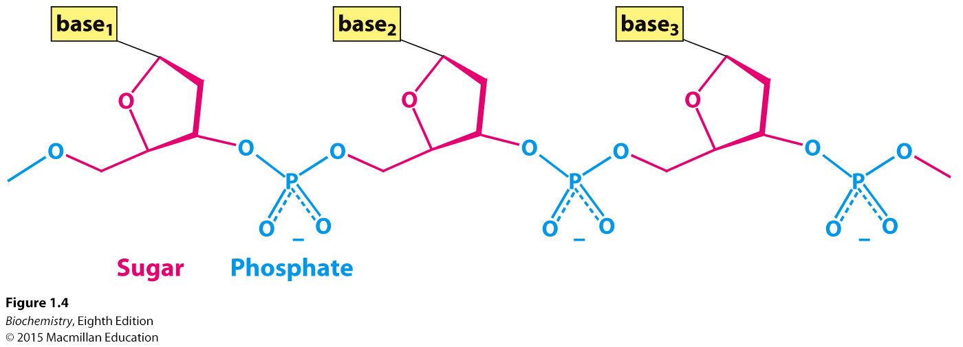
The linked sugar and phosphate compose the backbone of the DNA.
Notes:
FIGURE 1.4 Covalent structure of DNA. Each unit of the polymeric structure is composed of a sugar (deoxyribose), a phosphate, and a variable base that protrudes from the sugar–phosphate backbone.

Slide 9
The two strands of a DNA double helix are formed by hydrogen bonds between specific base pairs in the different strands:
A binds to T
G binds to C

Slide 10
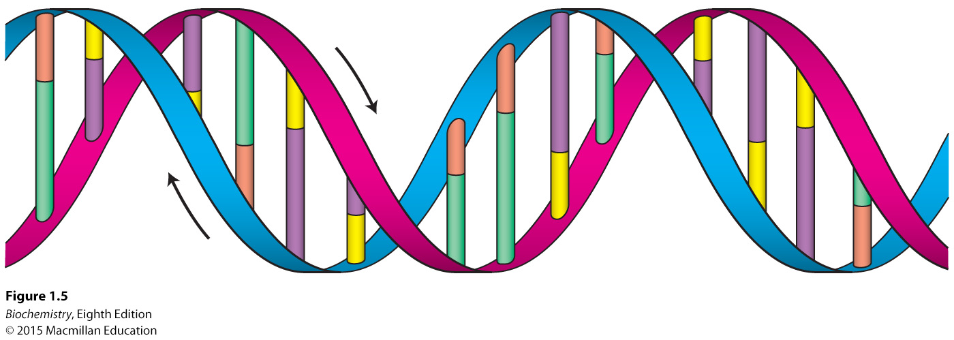
Notes:
FIGURE 1.5 The double helix. The double-helical structure of DNA proposed by Watson and Crick. The sugar–phosphate backbones of the two chains are shown in red and blue, and the bases are shown in green, purple, orange, and yellow. The two strands are antiparallel, running in opposite directions with respect to the axis of the double helix, as indicated by the arrows.

Slide 11
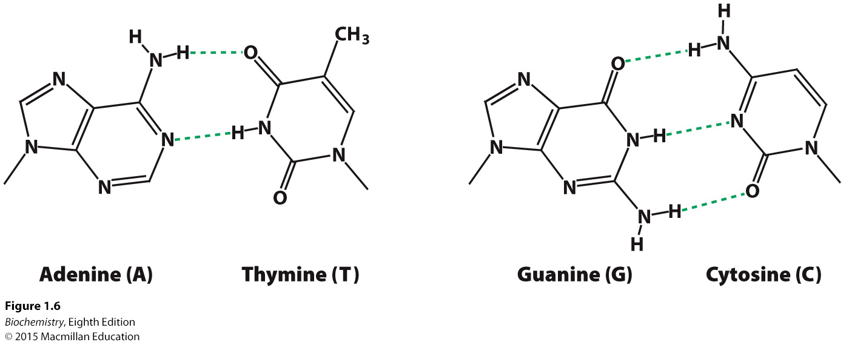
Notes:
FIGURE 1.6 Watson–Crick base pairs. Adenine pairs with thymine (A–T), and guanine with cytosine (G–C). The dashed green lines represent hydrogen bonds.

Slide 12
Because of specific-base pairing, each strand can serve as a template for a new partner, allowing the generation of two identical daughter double helices from one parent strand.

Slide 13
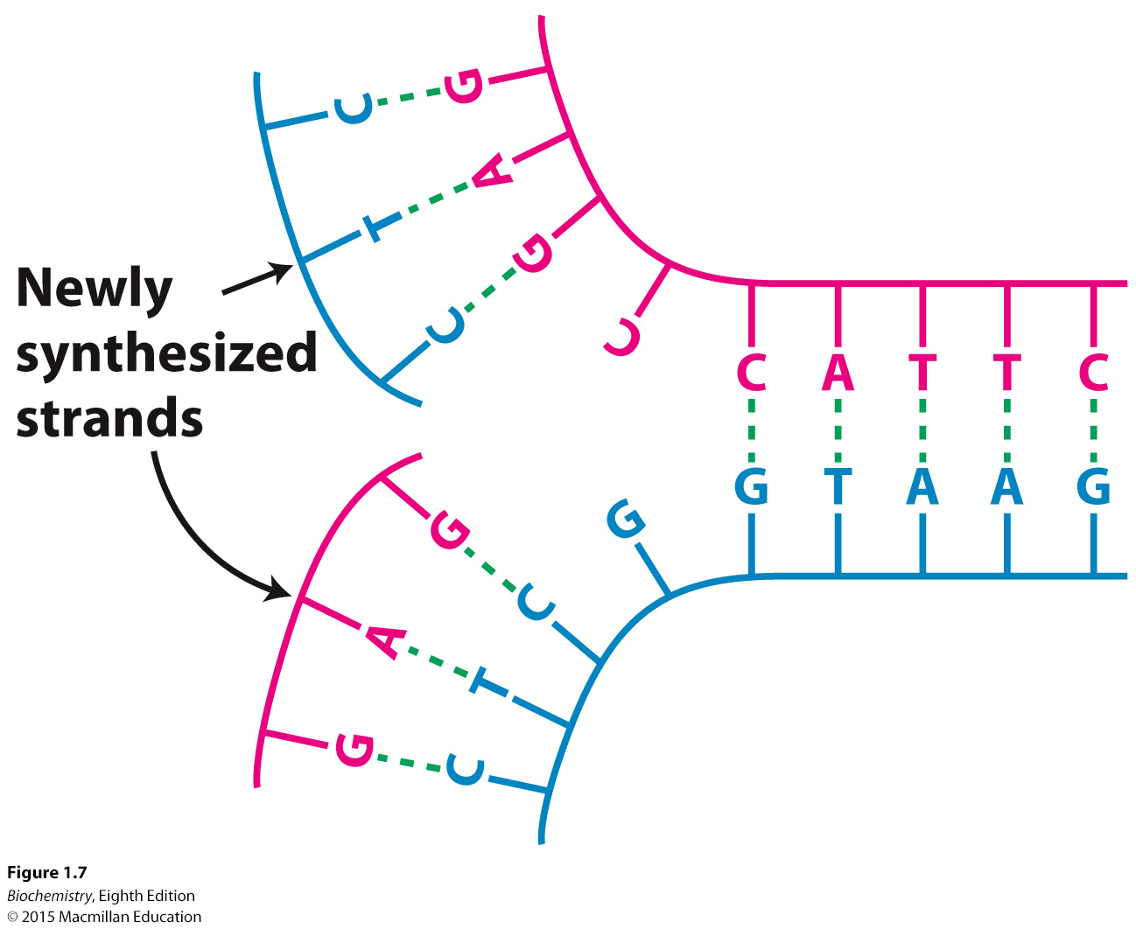
Notes:
FIGURE 1.7 DNA replication. If a DNA molecule is separated into two strands, each strand can act as the template for the generation of its partner strand.

Slide 14

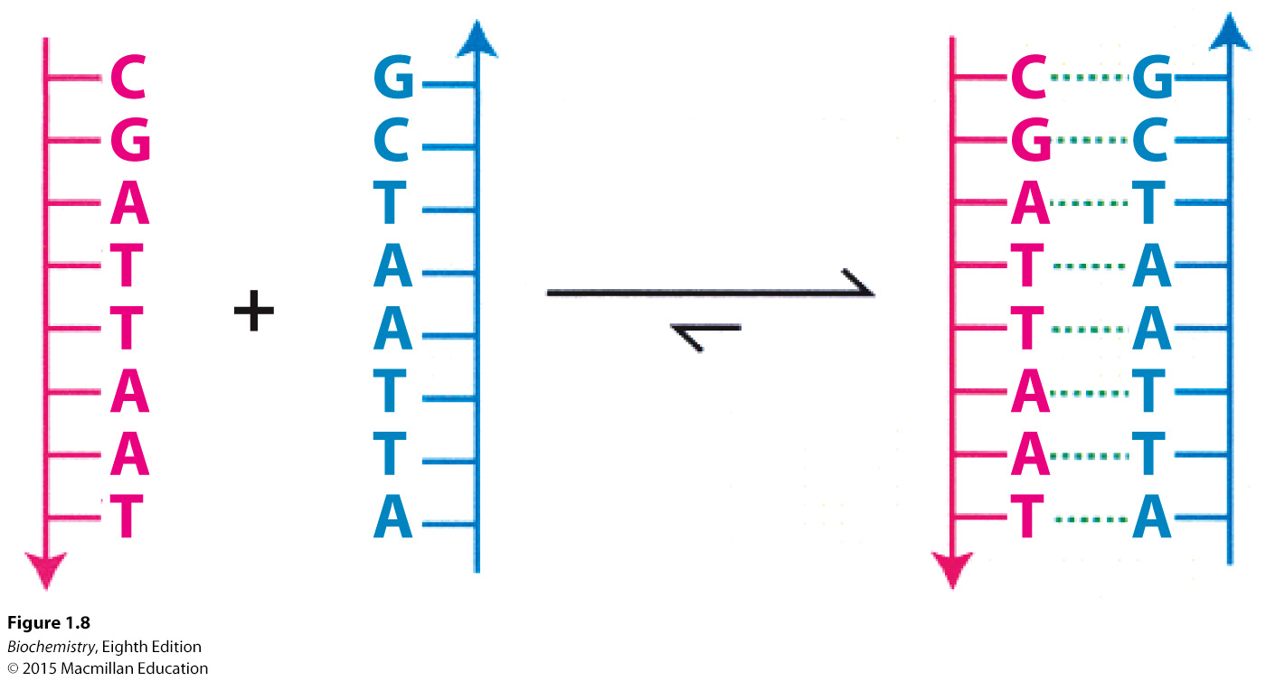
The structure of the DNA double helix illustrates key chemical principles fundamental to living systems.
Notes:
FIGURE 1.8 Formation of a double helix. When two DNA strands with appropriate, complementary sequences are mixed, they spontaneously assemble to form a double helix.

Slide 15
Covalent bonds, formed by electron sharing between two adjacent atoms, are the strongest bonds.
A typical C-C covalent bond has a distance of 1.54 Å and a bond energy of 355 kJ mol⁻¹ (85 kcal mol⁻¹).
Some molecules exhibit multiple covalent structures called resonance structures.

Slide 16
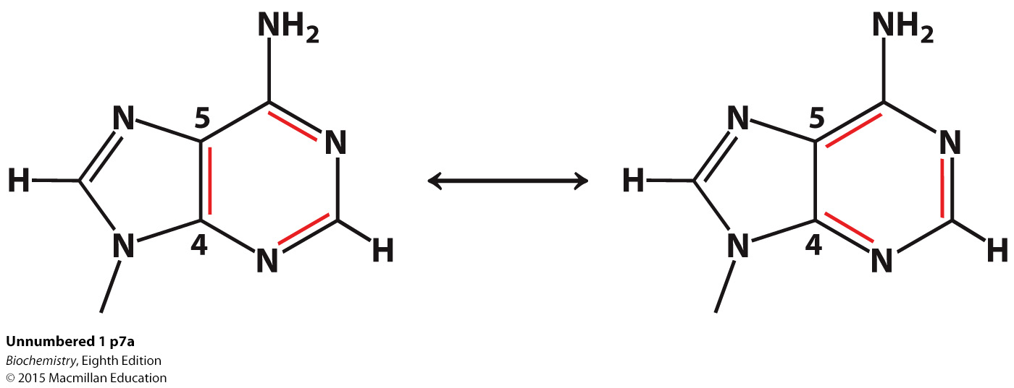
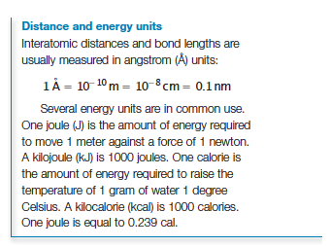
Covalent bonds
Resonance structures of adenine

Slide 17
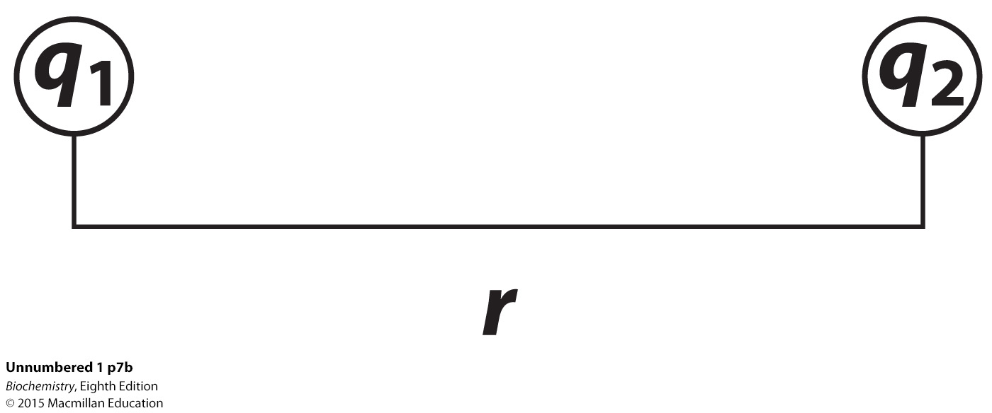

Noncovalent bonds
Ionic interactions.
Ionic interactions, also called electrostatic interactions, occur between oppositely charged molecules.
Electrostatic interactions in water have a bond distance of ≈3 Å and a bond energy, given by Coulomb energy, of 5.86 kJ mol⁻¹ (1.4 kcal mol⁻¹)

Slide 18
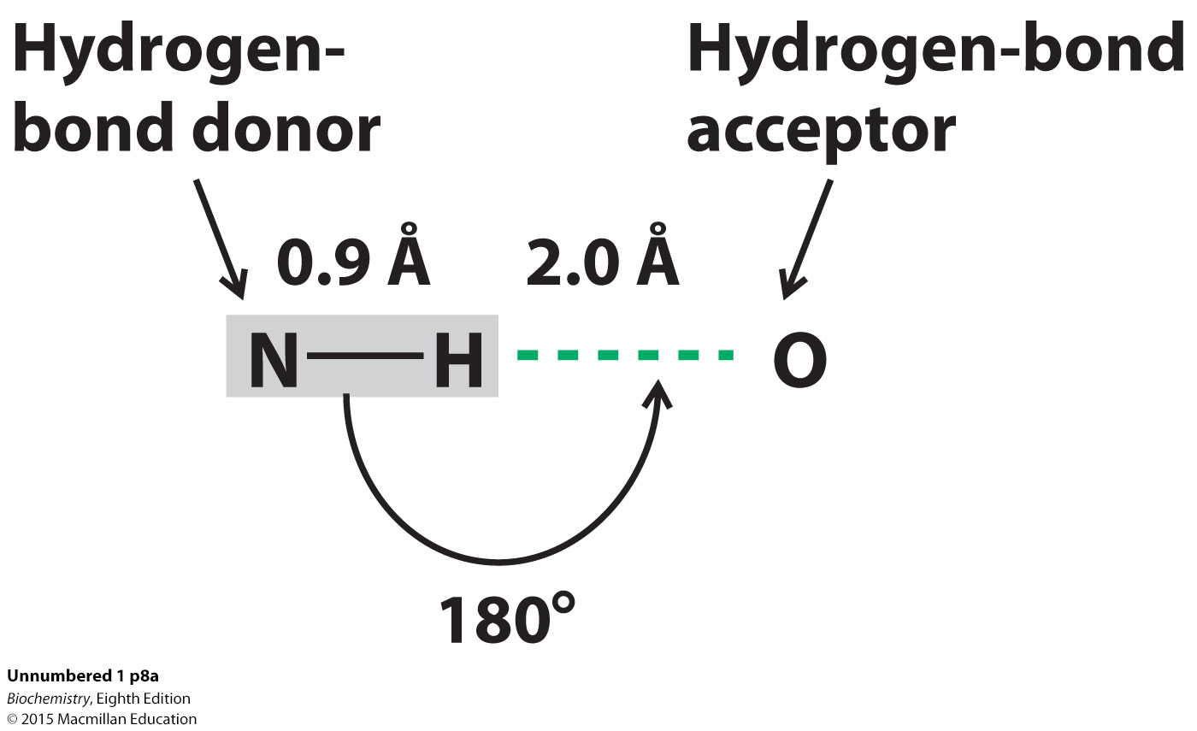
Noncovalent bonds
Hydrogen bonds.
Hydrogen bonds occur between an electronegative atom and a hydrogen covalently bonded to another electronegative atom.
Hydrogen bonds vary in bond distance from 1.5 Å to 2.6 Å with bond energies from 4-20 kJ mol⁻¹ (1-5 kcal mol⁻¹)

Slide 19
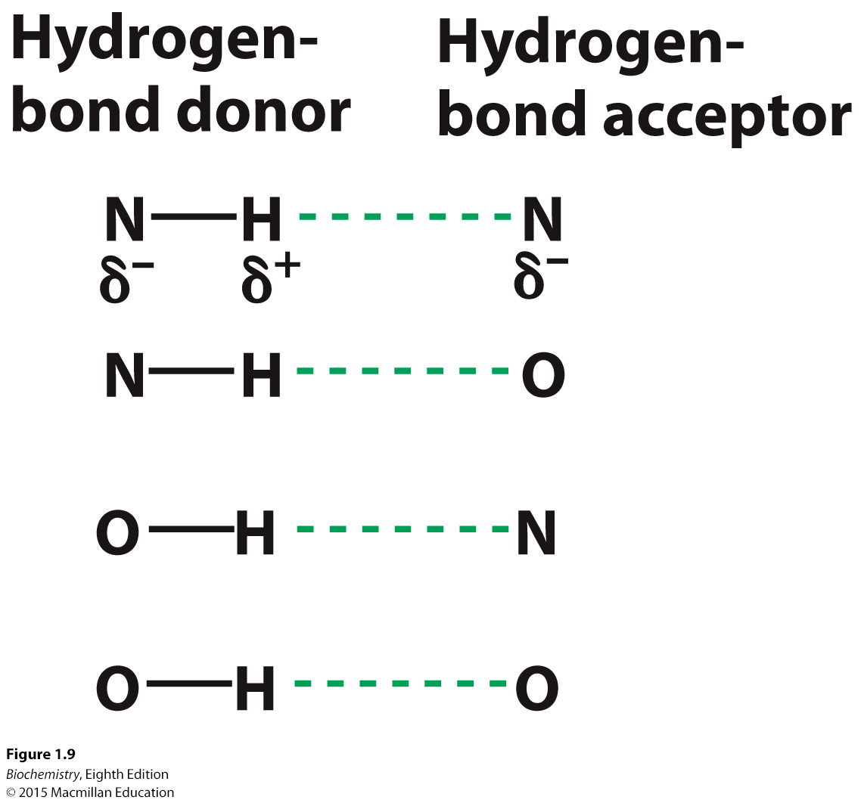
Notes:
Figure 1.9 Hydrogen bonds. Hydrogen bonds are depicted by dashed green lines. The positions of the partial charges (δ⁺ and δ⁻) are shown.

Slide 20
Noncovalent bonds
van der Waal interactions.
Van der Waals interactions occur between two molecules sufficiently close (the van der Walls contact distance) such that transient electronic asymmetries in one molecule induce complementary interaction in the partner molecule.
Van der Waals interactions have bond energies from 2-4 kJ mol⁻¹ ( 0.5-1.0 kcal mol⁻¹)

Slide 21
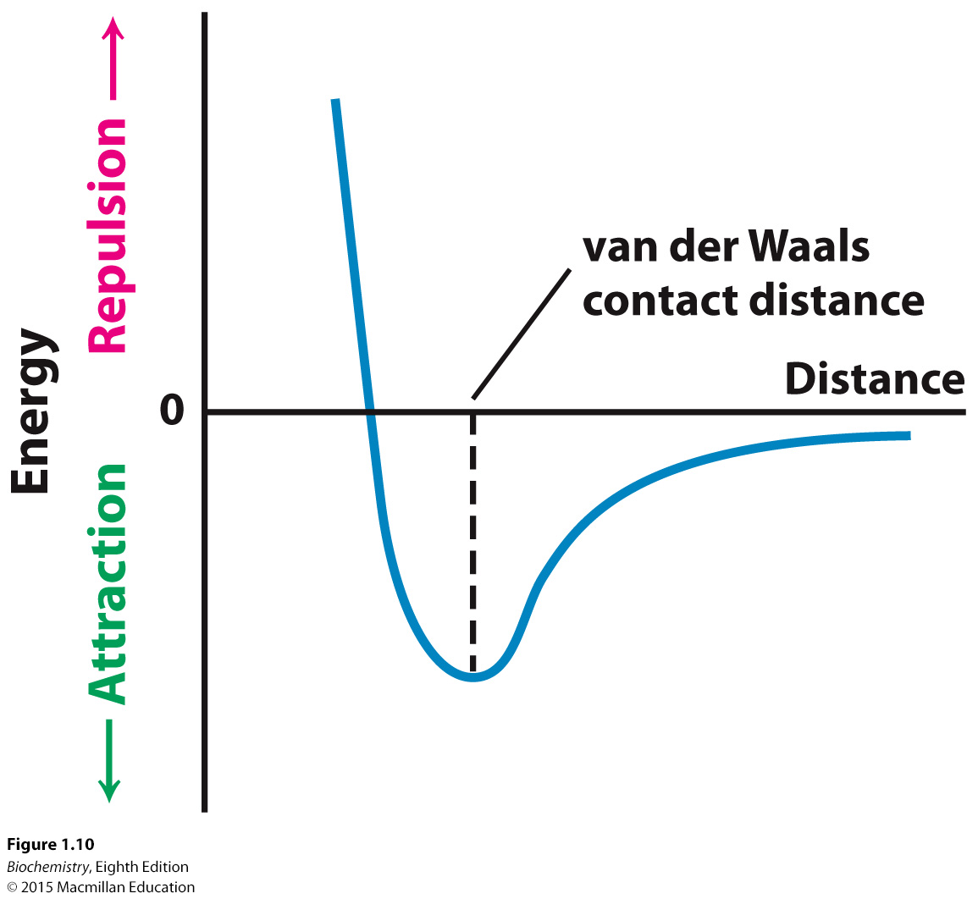
Notes:
FIGURE 1.10 Energy of a van der Waals interaction as two atoms approach each other. The energy is most favorable at the van der Waals contact distance. Owing to electron–electron repulsion, the energy rises rapidly as the distance between the atoms becomes shorter than the contact distance.

Slide 22
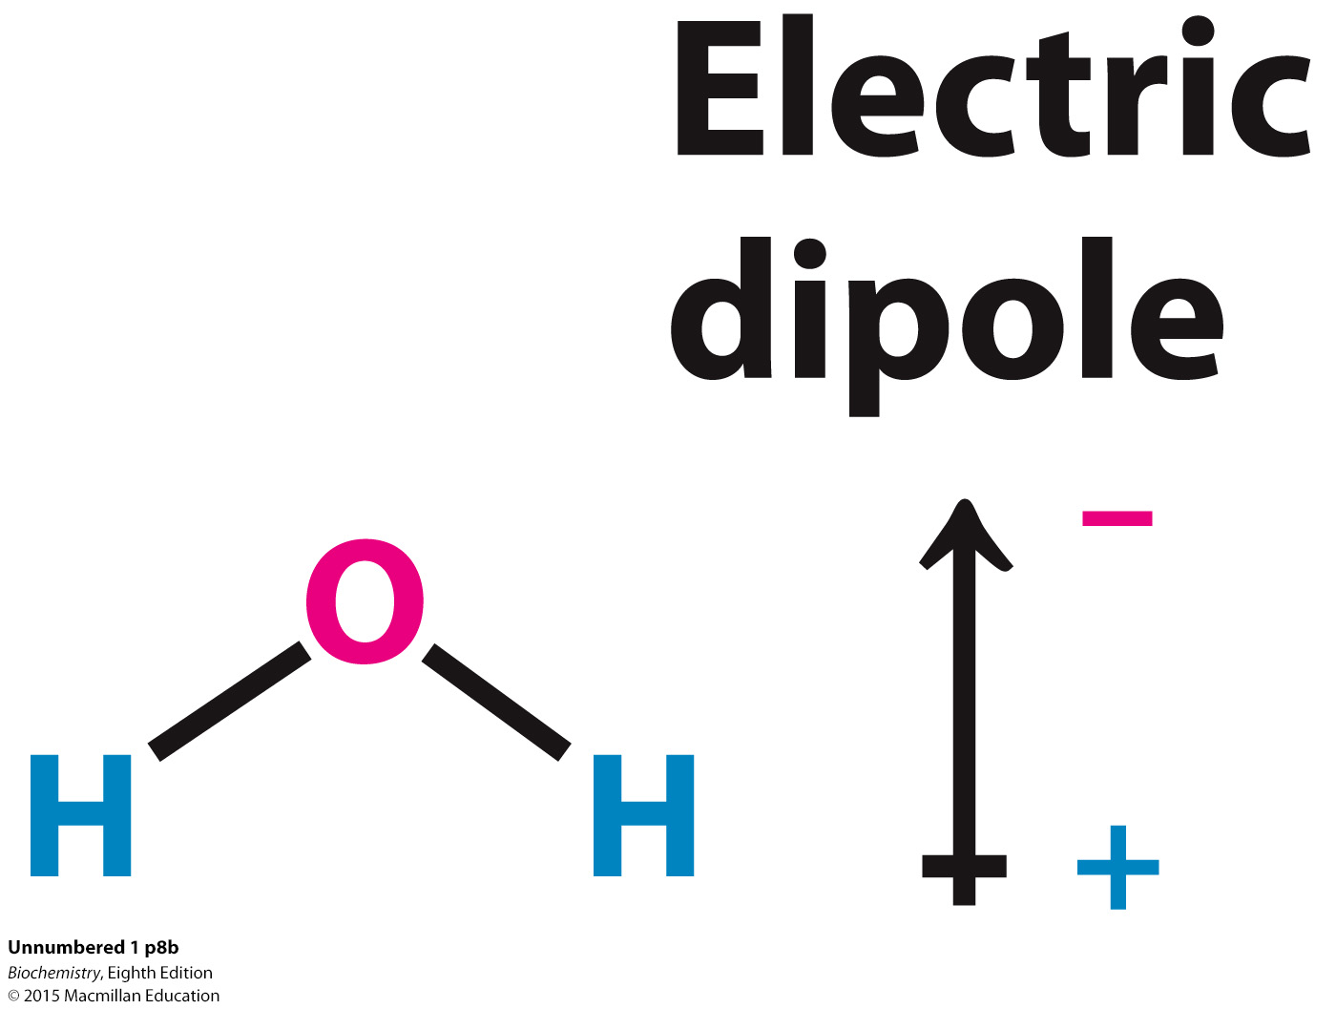
Properties of water.
Water is a polar molecule. The charges on the molecule are not evenly distributed.

Slide 23
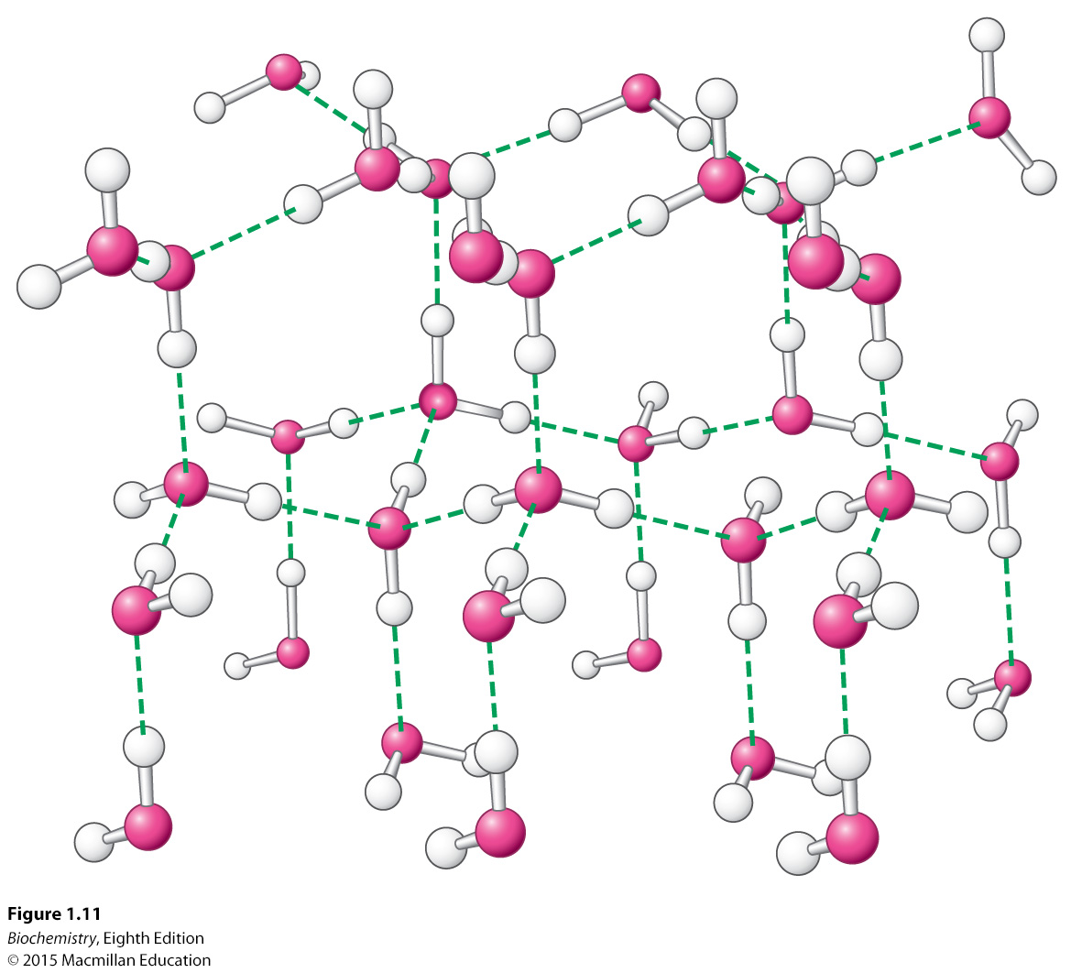
Properties of water.
Water is highly cohesive. Water molecules interact with one another through hydrogen bonds.
Notes:
FIGURE 1.11 Structure of ice. Hydrogen bonds (shown as dashed green lines) are formed between water molecules to produce a highly ordered and open structure.

Slide 24
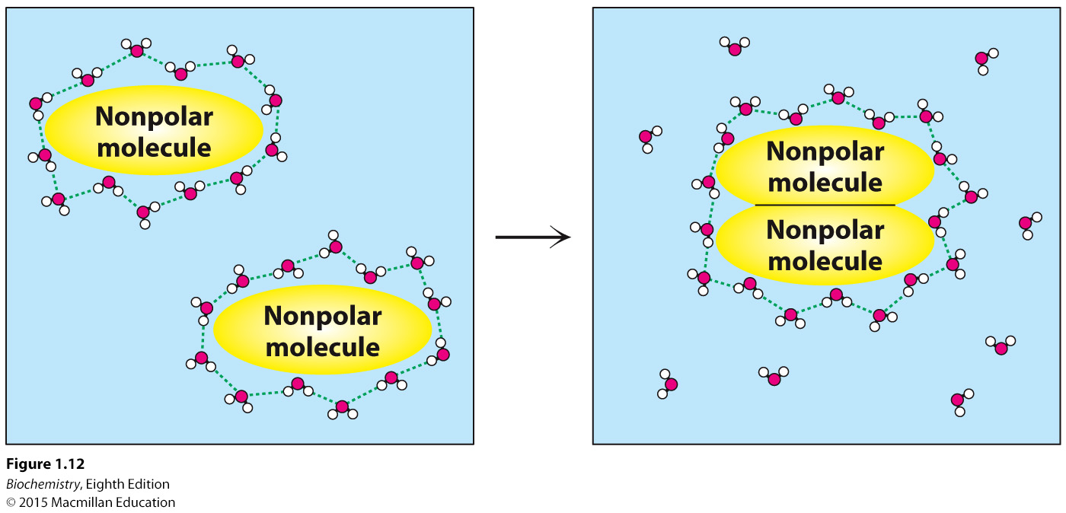
The hydrophobic effect.
Nonpolar molecules in water can be driven together by the hydrophobic effect which is powered by the increase in entropy of water. The associated interactions are called hydrophobic interaction.
Notes:
FIGURE 1.12 The hydrophobic effect. The aggregation of nonpolar groups in water leads to the release of water molecules, initially interacting with the nonpolar surface, into bulk water. The release of water molecules into solution makes the aggregation of nonpolar groups favorable.

Slide 25
When a double helix forms, charge repulsion occurs between the negatively charged phosphates of the backbone.
These repulsive forces are reduced by the high dielectric constant of water and interaction of positively charged ions with the phosphate groups.

Slide 26
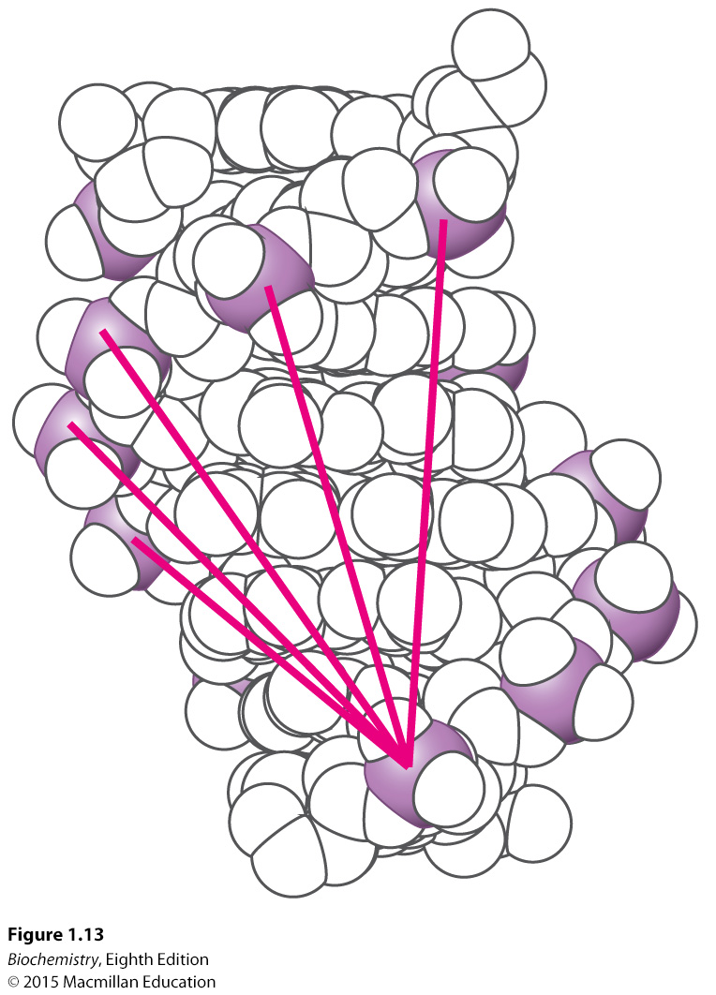
Notes:
FIGURE 1.13 Electrostatic interactions in DNA. Each unit within the double helix includes a phosphate group (the phosphorus atom being shown in purple) that bears a negative charge. The unfavorable interactions of one phosphate with several others are shown by red lines. These repulsive interactions oppose the formation of a double helix.

Slide 27
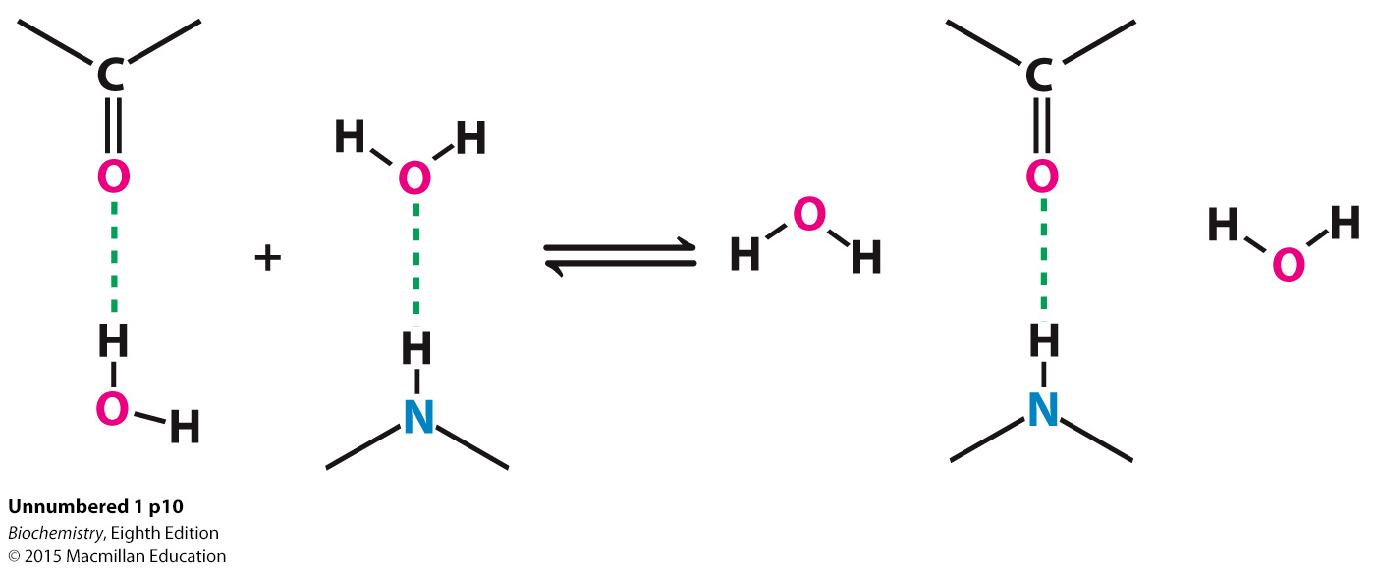
Hydrogen bonds form between bases, which are in the hydrophobic interior away from the disrupting effects of water.

Slide 28
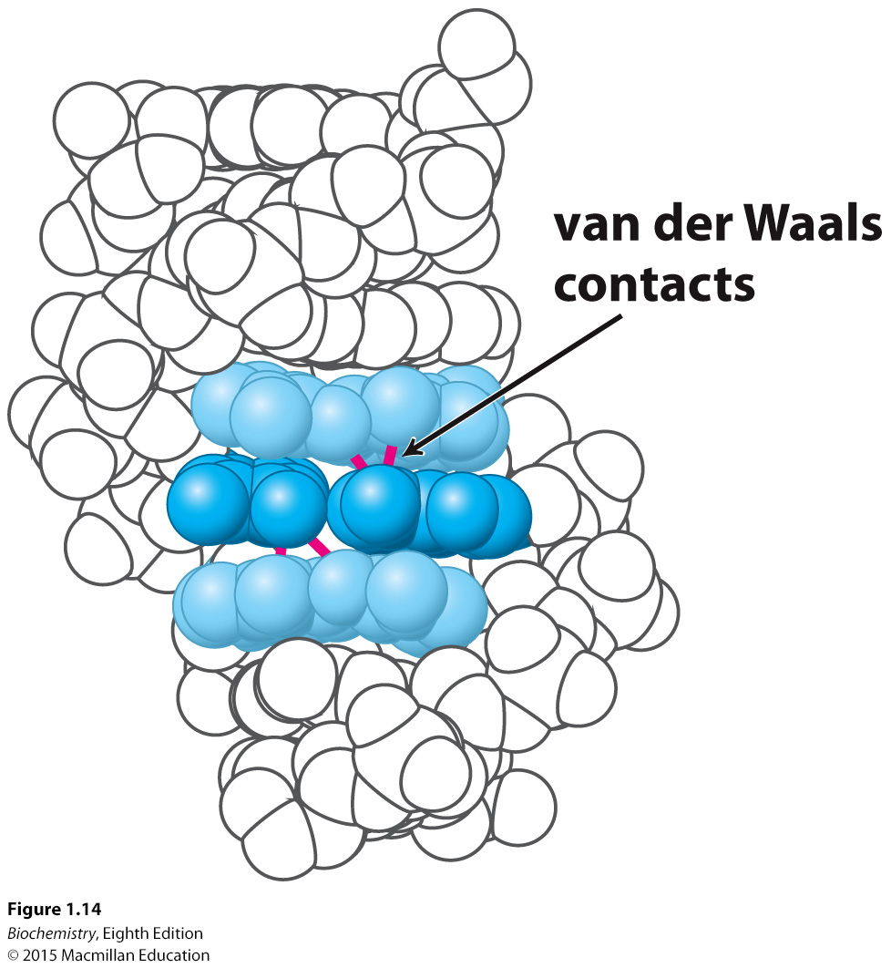
In the interior of the helix, bases are stacked and interact with one another through van der Waals interactions.
Notes:
FIGURE 1.14 Base stacking. In the DNA double helix, adjacent base pairs are stacked nearly on top of one another, and so many atoms in each base pair are separated by their van der Waals contact distance. The central base pair is shown in dark blue and the two adjacent base pairs in light blue. Several van der Waals contacts are shown in red.

Slide 29
The First Law of Thermodynamics states the the total energy of a system and its environment is constant.
The Second Law of Thermodynamics states the total entropy of a system plus that of its surroundings always increases.
Entropy can decrease locally in the system if there is a corresponding increase in entropy in the surroundings.

Slide 30
The change in entropy (ΔS) of the surroundings is proportional to the heat (enthalpy) transferred from the system to the surroundings (ΔH) and inversely proportional the the temperature (T, in kelvins (K)).

Slide 31

The total entropy change is described by the following equation.
Substituting equation 1 into equation 2 yields
Multiplying by −T yields

Slide 32
The term –TΔS_{total} is the free energy or Gibb’s free energy.

Slide 33
The Second Law states that a biochemical reaction can occur only if the entropy of the Universe increases. This is possible only if
or
TΔS_{system}>ΔH_{system}

Slide 34
In other words, entropy will increase only if
A biochemical reaction will occur only if the ΔG is negative, and ΔG is negative only if the entropy of the Universe increases.

Slide 35
The spontaneous formation of a double helix from two strands of DNA appears to violate the Second Law of Thermodynamics since the entropy of the DNA molecules is reduced.
However, the heat released by helix formation increases the entropy of the surroundings.

Slide 36
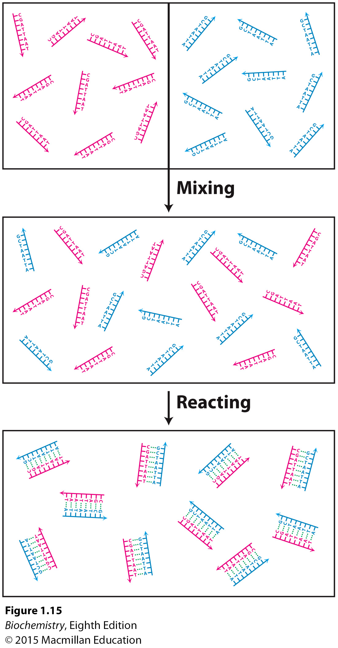
Notes:
FIGURE 1.15 Double-helix formation and entropy. When solutions containing DNA strands with complementary sequences are mixed, the strands react to form double helices. This process results in a loss of entropy from the system, indicating that heat must be released to the surroundings to prevent a violation of the Second Law of Thermodynamics.

Slide 37



Acid-base reactions involve the addition or removal of a H⁺ ion.
Such reactions are important in biochemistry.
pH is a measure of the H⁺ concentration and is defined by
H⁺ and OH⁻ ions are formed upon the dissociation of H₂O.

Slide 38


The equilibrium constant K_{eq} for the dissociation of water is given by
K_{w}, the ion constant of water is given by
This can be simplified to

Slide 39
From this, we can calculate
At pH 7, [H⁺] = [OH⁻] = 10⁻⁷

Slide 40
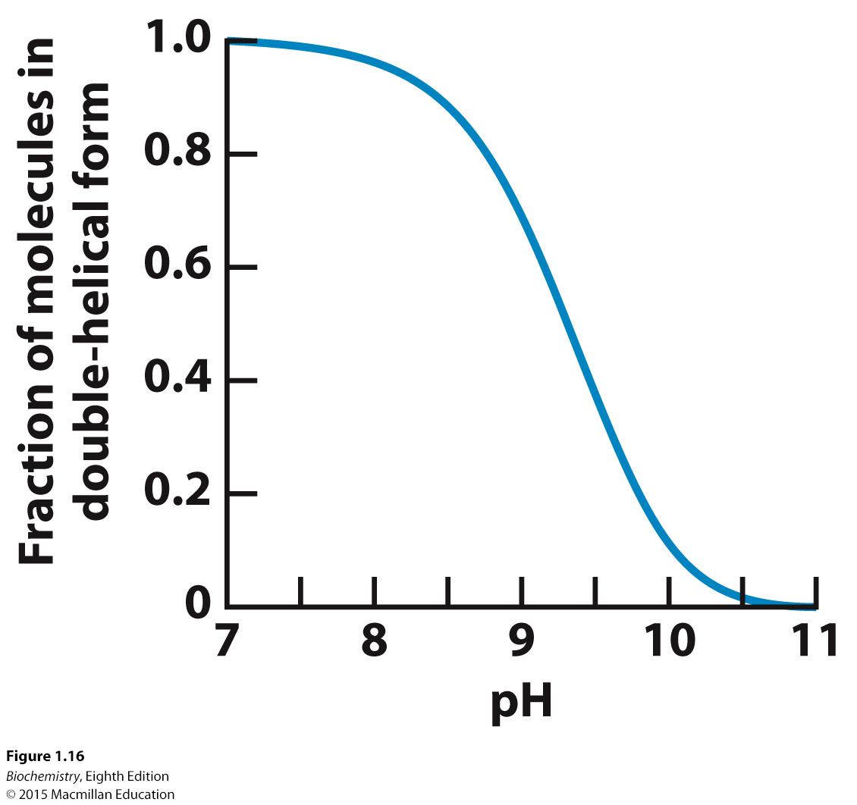
As base is added to a solution of double helical DNA, the helix is disrupted or denatured.
Notes:
FIGURE 1.16 DNA denaturation by the addition of a base. The addition of a base to a solution of double-helical DNA initially at pH 7 causes the double helix to separate into single strands. The process is half complete at slightly above pH 9.

Slide 41
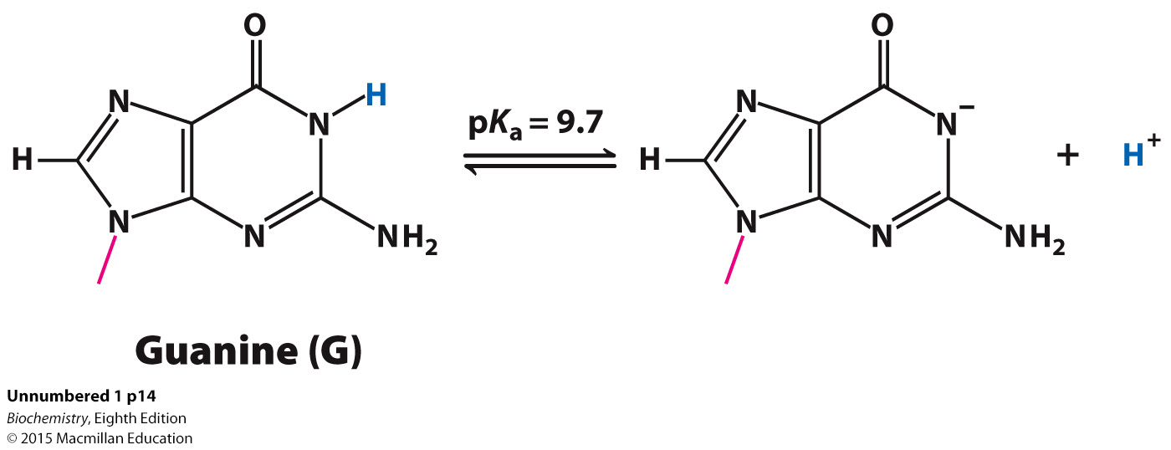
The chemical basis of the denaturation is the disruption of base-pairing. For example, the loss of a proton by the base guanine prevents base pairing with cytosine.

Slide 42




More generally, proton removal from any molecule HA is described by
The pK_{a} value indicates the susceptibility of proton removal.
When pH = pK_{a}
and

Slide 43


Dividing by H⁺ yields
or
Thus, when the pH is equal to the pK_{a}, the concentration of the protonated form of HA (the acid) is equal to the deprotonated form A⁻ (the base).
The N-1 proton of guanine has a pK_{a} of 9.7. When the pH is near or exceeds this value, the proton is lost, base pairing is disrupted and the helix is denatured.

Slide 44
An acid-base conjugate pair resists changes in the pH of a solution.
In other words, it acts as a buffer. A buffer is most effective at a pH near its pK_{a}.

Slide 45
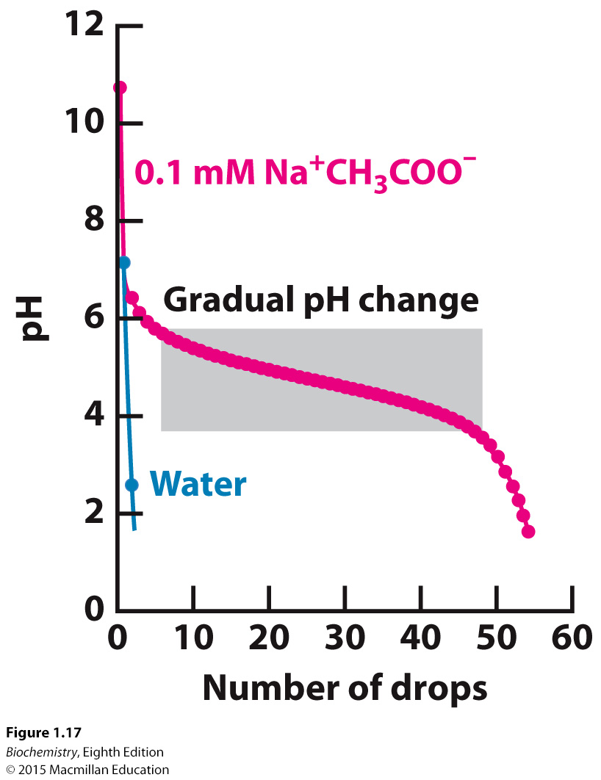
Notes:
FIGURE 1.17 Buffer action. The addition of a strong acid, 1 M HCl, to pure water results in an immediate drop in pH to near 2. In contrast, the addition of the acid to a 0.1 M sodium acetate (Na⁺ CH₃COO⁻) solution results in a much more gradual change in pH until the pH drops below 3.5.

Slide 46

We can understand the effects of a buffer in quantitative terms.
The ionization reaction of a weak acid is given by
The equilibrium constant for this reaction is
Taking the logarithms of both sides yields

Slide 47

Substituting pK_{a} and pH and rearranging yield the Henderson-Hasselbalch equation
Consideration of this equation reveals that weak acids are most effective as buffers at pH near their pK_{a}.

Slide 48
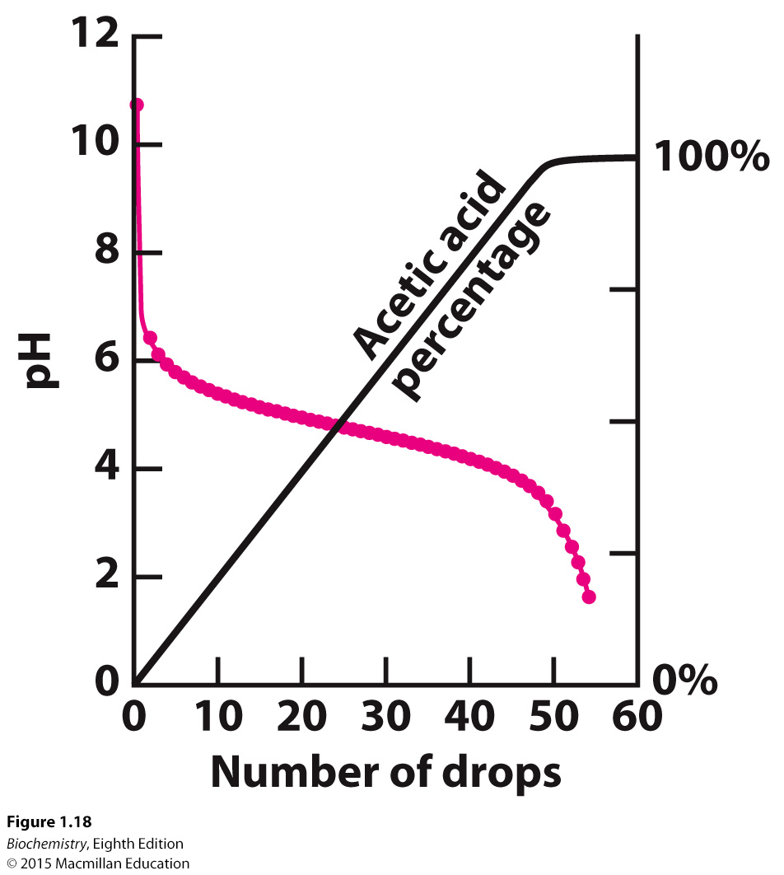
Notes:
FIGURE 1.18 Buffer protonation. When acid is added to sodium acetate, the added hydrogen ions are used to convert acetate ion into acetic acid. Because the proton concentration does not increase significantly, the pH remains relatively constant until all of the acetate has been converted into acetic acid.

Slide 49
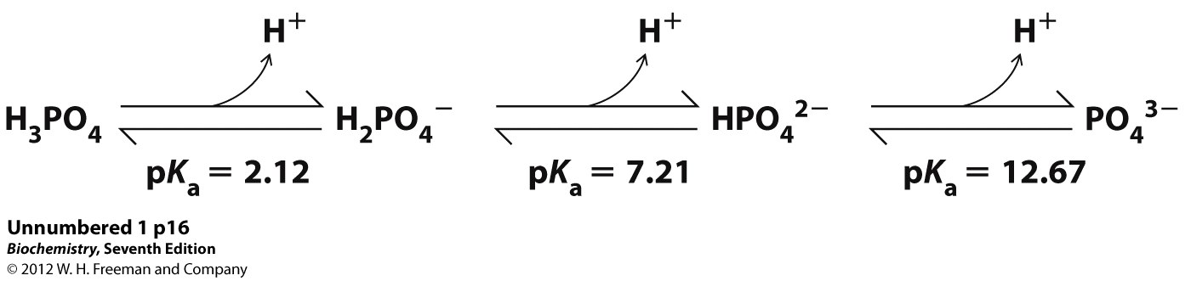
Physiological pH is typically 7.4. Phosphoric acid is an important buffer in biological systems.

Slide 50


Sequencing of the human genome was a landmark in human history. Since the initial sequencing of the human genome, sequence determination has become much cheaper and faster, transforming many fields of biological research.
Identifying sequence variation among individuals may be used to understand the predisposition to various diseases.

Slide 51
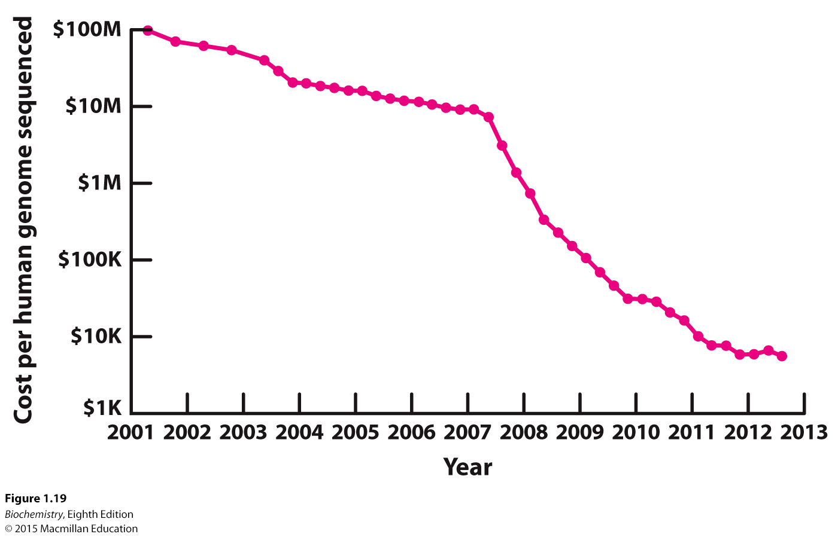
Notes:
FIGURE 1.19 Decreasing costs of DNA sequencing. Through the Human Genome Project, the cost of DNA sequencing dropped steadily. With the advent of new methods, these costs dropped dramatically and are now approaching $1000 for a complete human genome sequence. [National Human Genome Research Institute. www.genome.gov/sequencingcosts]

Slide 52
Complex bacterial communities, in total called the microbiome, live in and on human bodies. Indeed, there are 10 fold more microbial cells than there are human cells in a individual.
The microbiome appears to play a roles in maintaining health and in the occurrence of disease.

Slide 53
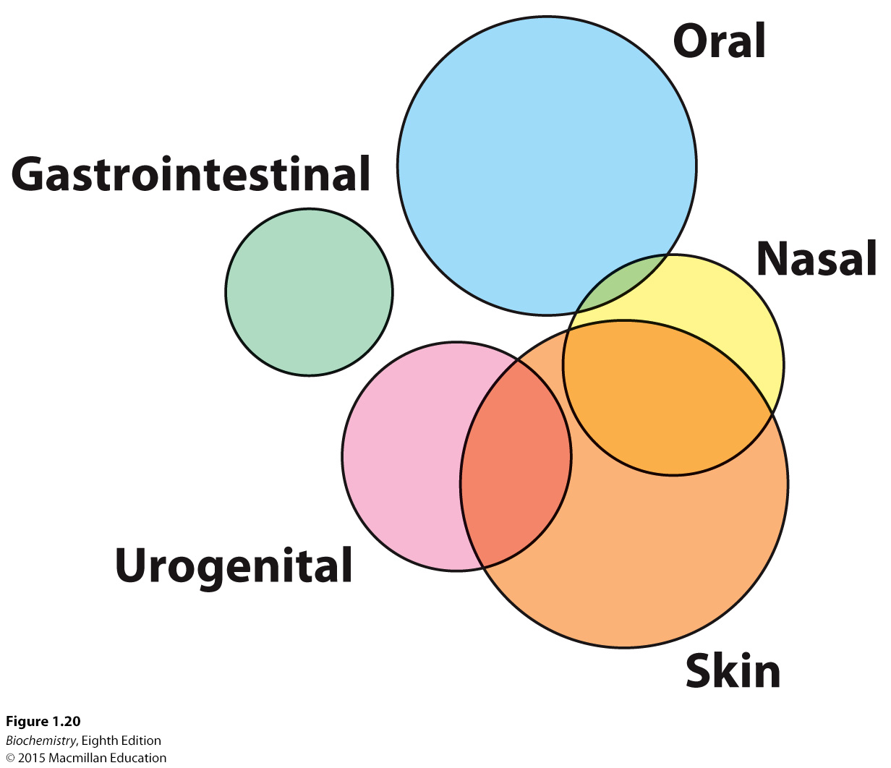
Notes:
FIGURE 1.20 The human microbiome. Microorganisms cover the human body. Examination of the microbial communities using DNA sequencing methods revealed many previously uncharacterized species. The Venn diagrams represent populations of related species as determined by DNA sequence comparisons. The populations present on different body surfaces are largely distinct. [Adapted from www.nature. com/nature/journal/v486/n7402/fig_tab/ nature11234_F1.html]

Slide 54
In addition to facilitating our understanding of health and disease, sequencing studies can be used to understand other aspects of human culture, such as migrations.
Comparative genomics amply demonstrates the unity of life.

Slide 55
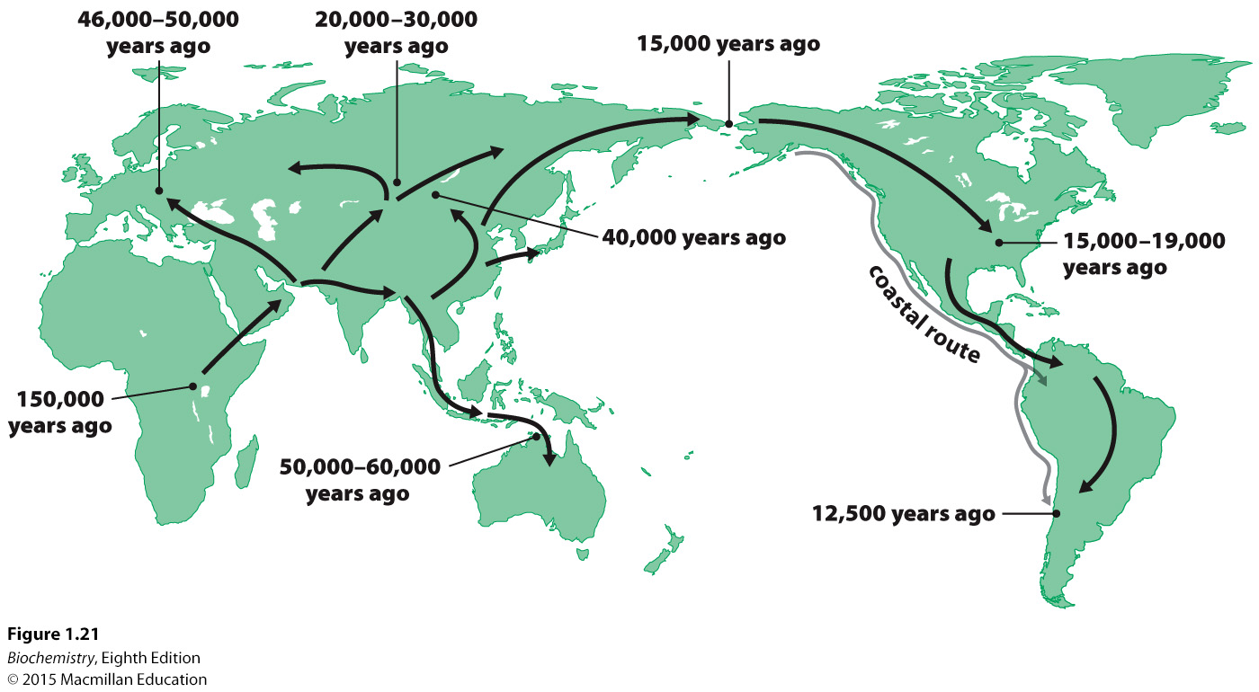
Notes:
FIGURE 1.21 Human migrations supported by DNA sequence comparisons. Modern human beings originated in Africa, migrated first to Asia, and then to Europe, Australia, and North and South America. [Adapted from S. Oppenheimer, “Out-of-Africa, the peopling of continents and islands: tracing uniparental gene trees across the map.” Philos. Trans. R. Soc. Lond. B. Biol. Sci. 367(1590):770–784]

Slide 56
Important environmental factors that influence human biochemistry include diet and exercise.
Inappropriate use of environmental resources, such as poor nutrition, can result in pathological conditions.

Slide 57
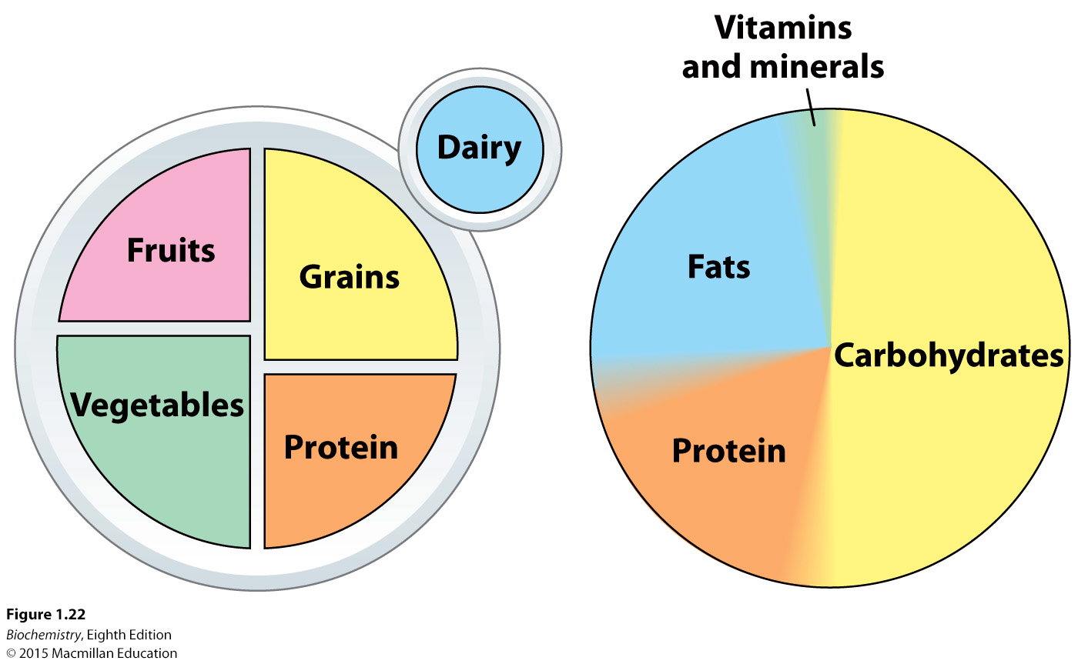
Notes:
FIGURE 1.22 Nutrition. Proper health depends on an appropriate combination of food groups (fruits, vegetables, protein, grains, dairy) (left) to provide an optimal mix of biochemicals (carbohydrates, proteins, fats, vitamins, and minerals) (right). [Adapted from www. choosemyplate.gov]

Slide 58
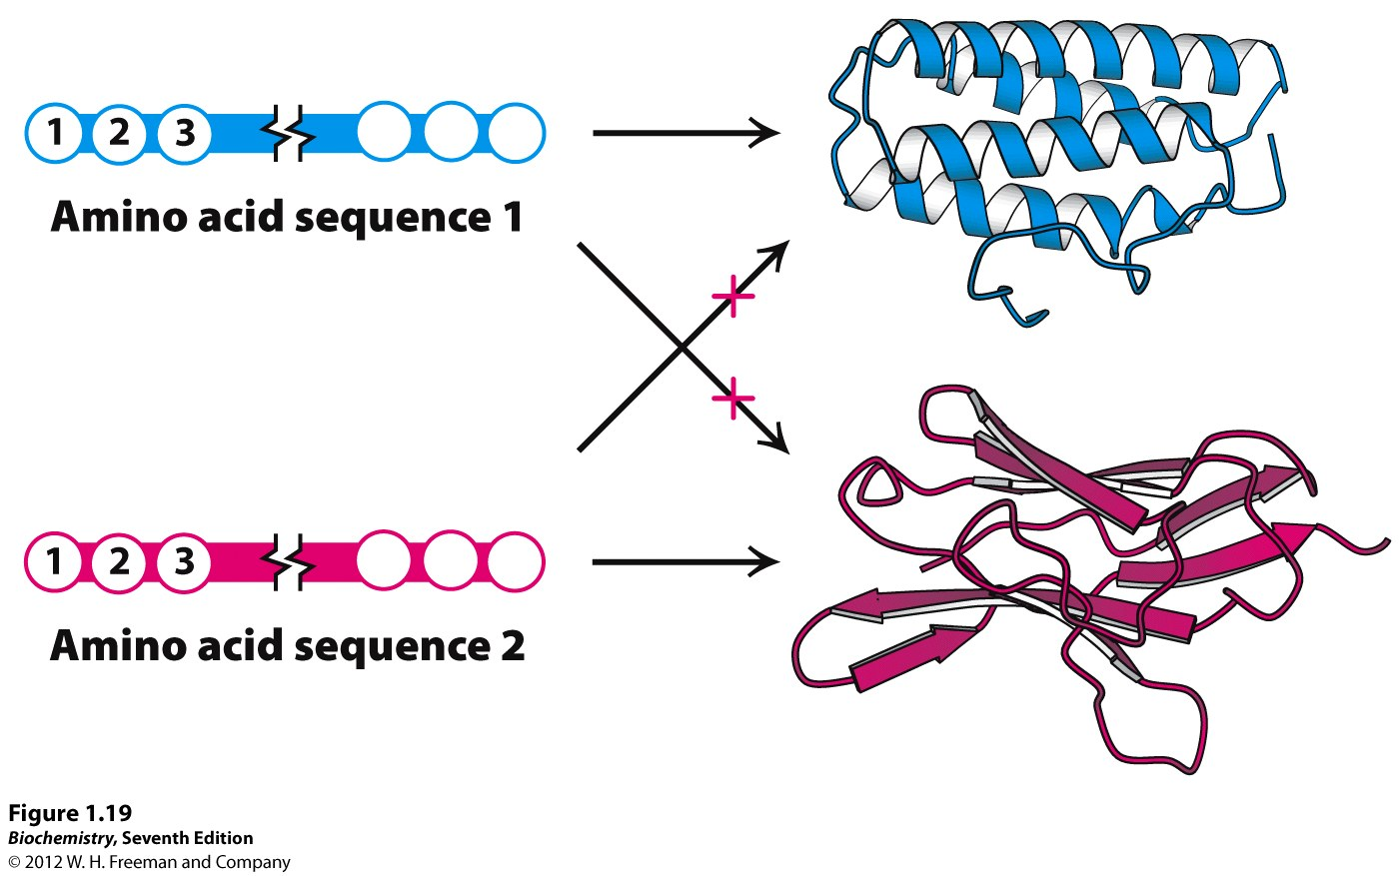
Notes:
Figure 1.19 Protein folding. Proteins are linear polymers of amino acids that fold into elaborate structures. The sequence of amino acids determines the three-dimensional structure. Thus amino acid sequence 1 gives rise only to a protein with the shape depicted in blue, not the shape depicted in red.

