Slide 1
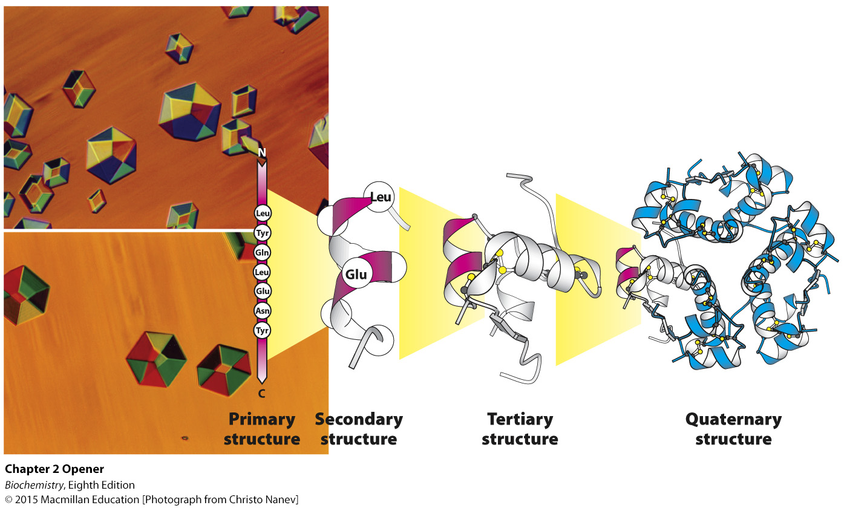
Notes:
Insulin is a protein hormone, crucial for maintaining blood sugar at appropriate levels. Chains of amino acids in a specific sequence (the primary structure) define a protein such as insulin. Amino acids close to one another within this sequence can fold into regular structures (the secondary structure), such as the α-helix. Entire chains fold into well-defined structures (the tertiary structure)—in this case, a single insulin molecule. Such structures assemble with other chains to form arrays such as the complex of six insulin molecules shown at the far right (the quaternary structure). These arrays can often be induced to form well-defined crystals (photograph at left), which allows a determination of these structures in detail. [Photograph from Christo Nanev.]

Slide 2
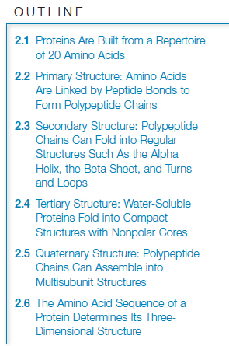

Slide 3
Key properties of proteins include:
Proteins are linear polymers composed of amino acids.
Proteins have a wide variety of functional groups.
Proteins can interact with one another and other macromolecules to form complexes.
Some proteins are rigid while others are flexible.

Slide 4
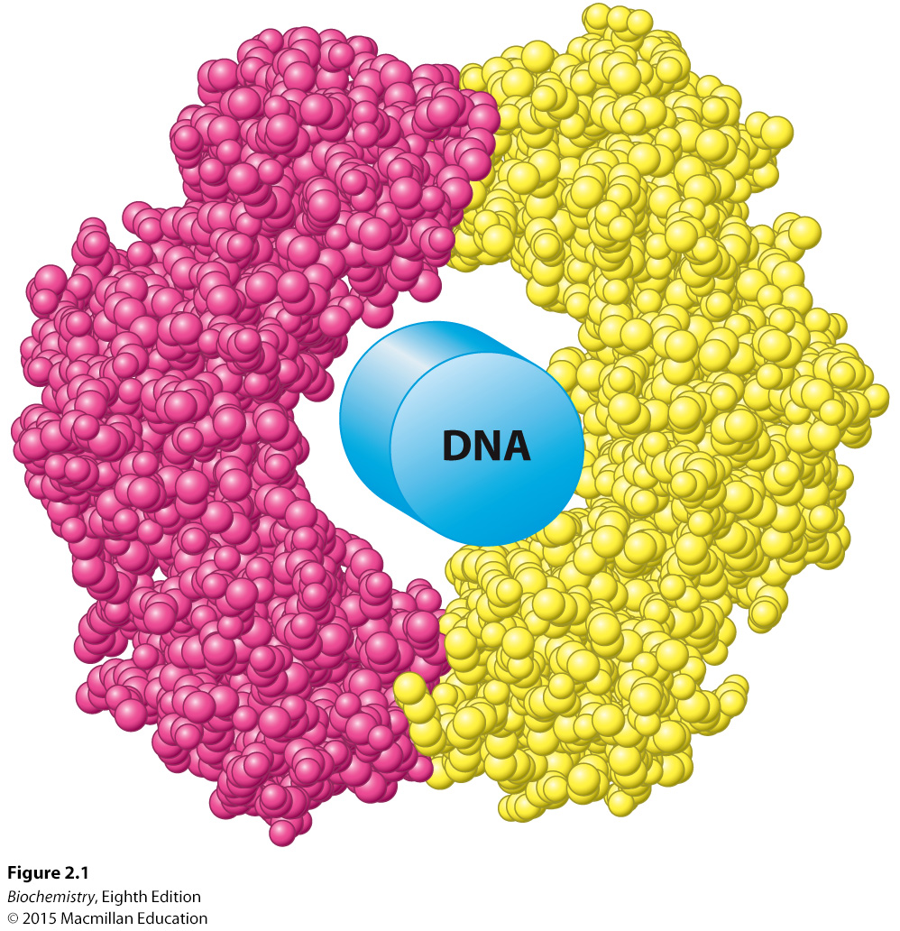
Notes:
FIGURE 2.1 Structure dictates function. A protein component of the DNA replication machinery surrounds a section of DNA double helix depicted as a cylinder. The protein, which consists of two identical subunits (shown in red and yellow), acts as a clamp that allows large segments of DNA to be copied without the replication machinery dissociating from the DNA. [Drawn from 2POL.pdb.]

Slide 5
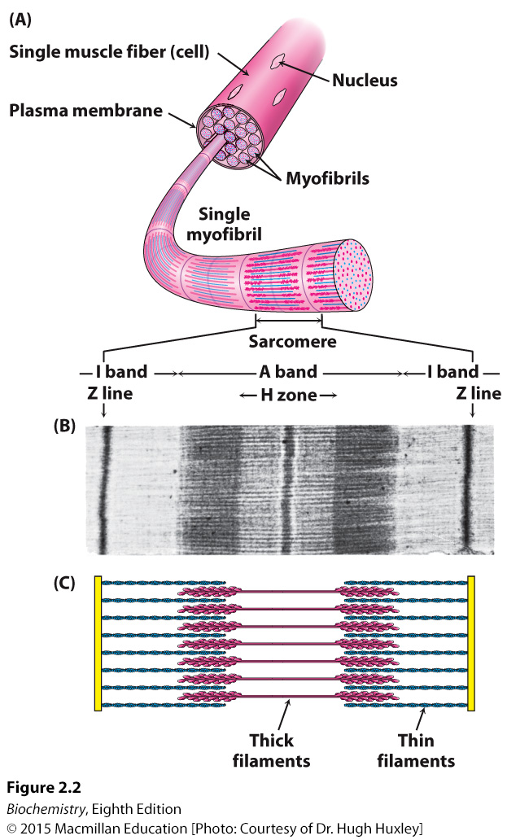
Notes:
FIGURE 2.2 A complex protein assembly. (A) A single muscle cell contains multiple myofibrils, each of which is comprised of numerous repeats of a
complex protein assembly known as the sarcomere. (B) The banding pattern of a sarcomere, evident by electron microscopy, is caused by (C) the interdigitation of filaments made up of many individual proteins. [(B) Courtesy of Dr. Hugh Huxley.]

Slide 6
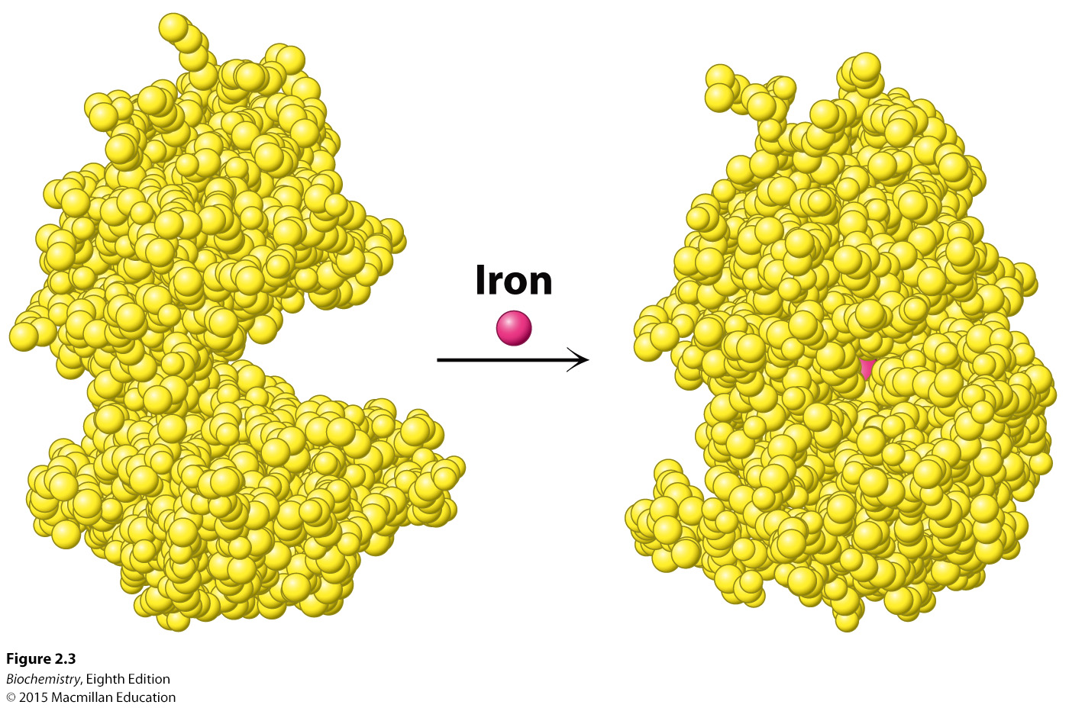
Notes:
FIGURE 2.3 Flexibility and function. On binding iron, the protein lactoferrin undergoes a substantial change in conformation that allows other molecules to distinguish between the iron-free and the iron-bound forms. [Drawn from 1 LFH.pdb and 1 LFG.pdb.]

Slide 7
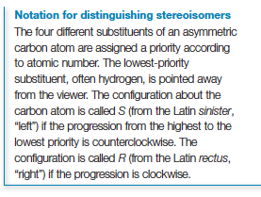
When four different groups are bonded to the α-carbon, the amino acids are chiral, which means that they exist as two mirror-image forms called the L isomer and the D isomer.
Only the L isomers are found in proteins.

Slide 8
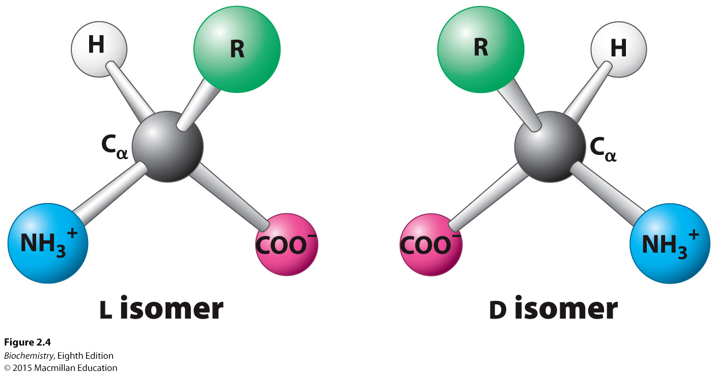
Notes:
FIGURE 2.4 The L and D isomers of amino acids. The letter R refers to the side chain. The L and D isomers are mirror images of each other.

Slide 9
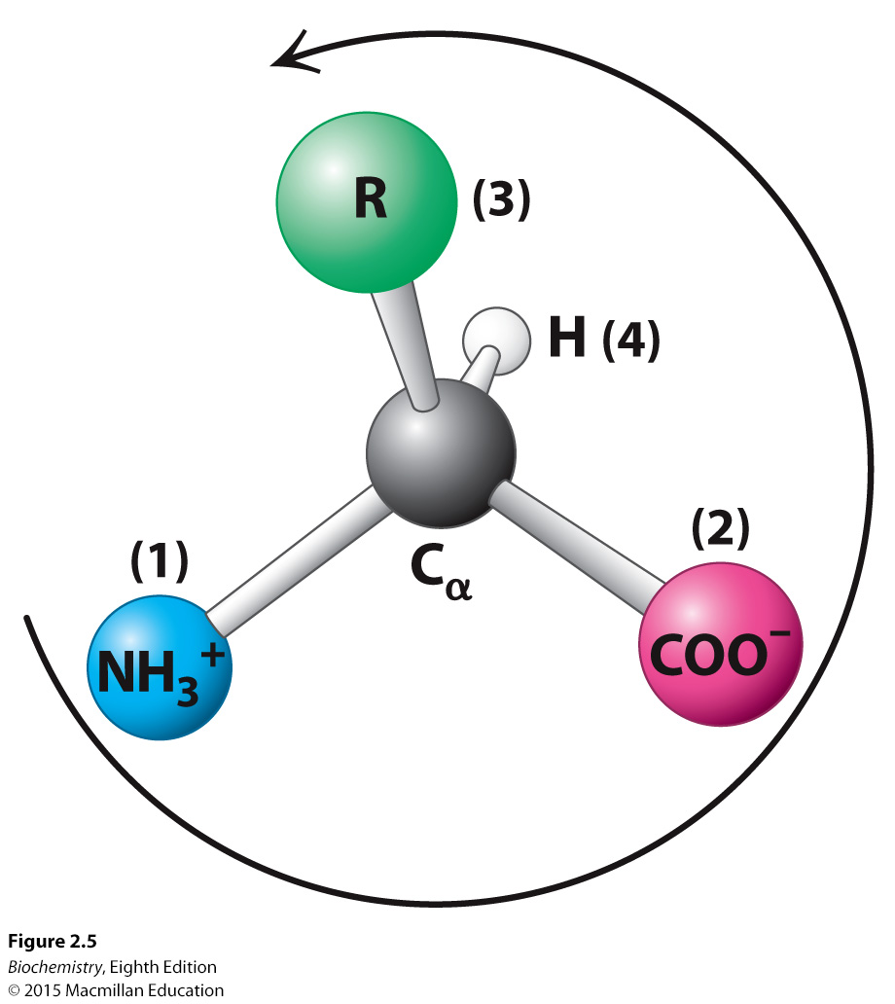
Notes:
FIGURE 2.5 Only L amino acids are found in proteins. Almost all L amino acids have an S absolute configuration. The counterclockwise direction of the arrow from highest- to lowest priority substituents indicates that the chiral center is of the S configuration.

Slide 10
Free amino acids in solution at neutral pH exist as dipolar ions.
The amino group (NH₃⁺) and the carboxyl group (COO⁻) are charged.

Slide 11
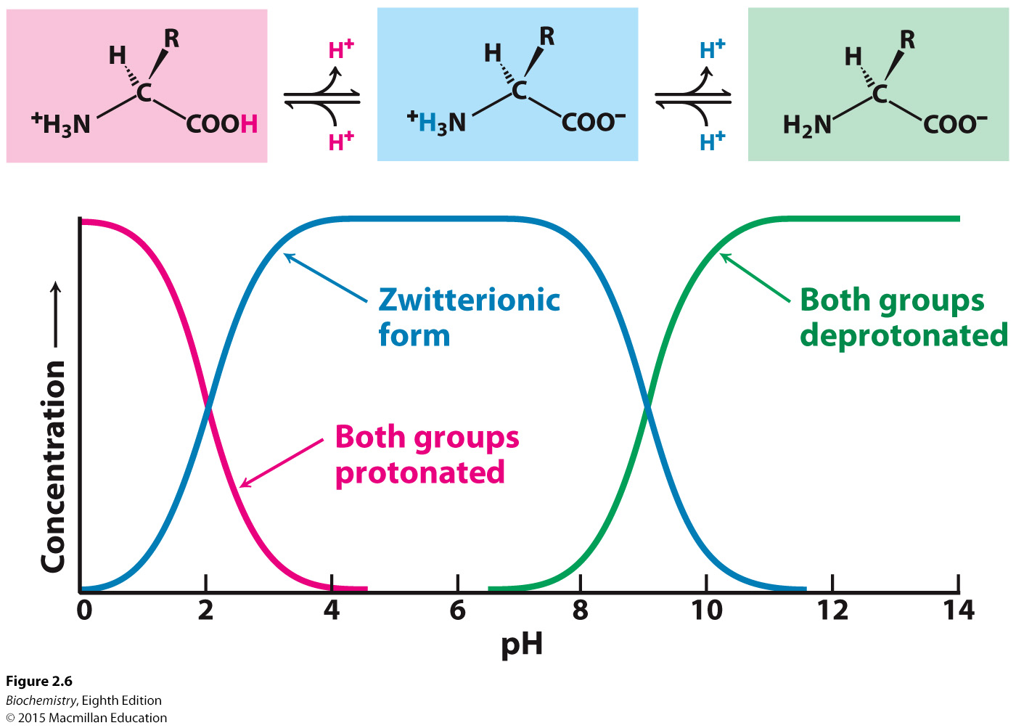
Notes:
FIGURE 2.6 Ionization state as a function of pH. The ionization state of amino acids is altered by a change in pH. The zwitterionic form predominates near physiological pH.

Slide 12
The twenty amino acids found in proteins contain unique side-chains that vary in size, shape, charge, hydrogen-bonding capacity, hydrophobic character, and chemical reactivity.
We will identify four classes of amino acids: hydrophobic, polar, positively charged, and negatively charged.
Amino acids have three-letter abbreviations and one-letter symbols.

Slide 13
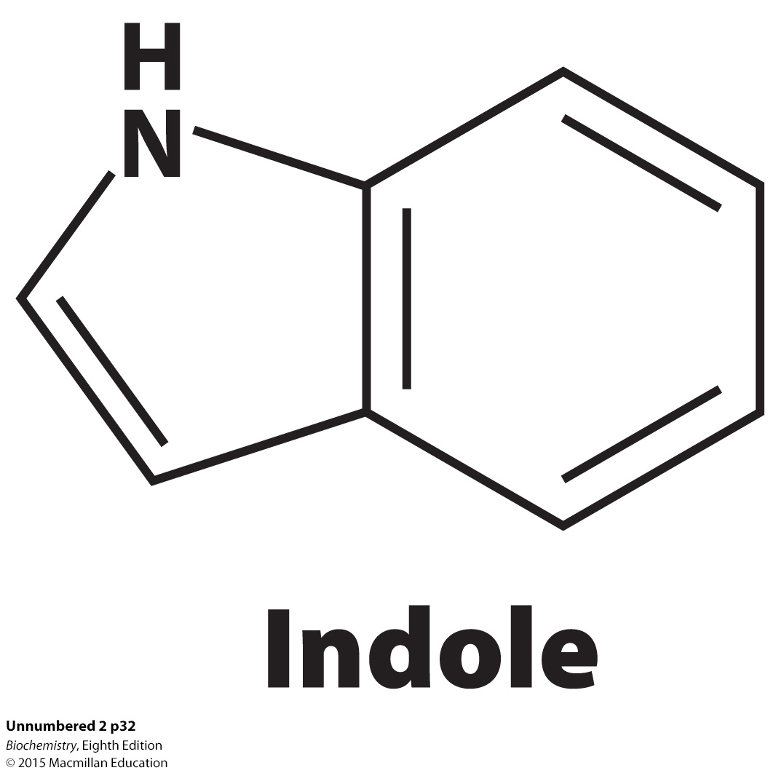
Hydrophobic amino acids with nonpolar side chains.
Tryptophan, a hydrophobic amino acid, contains an indole group.

Slide 14
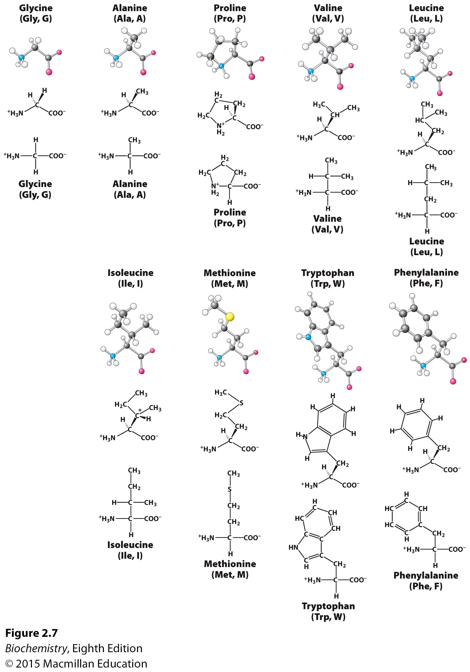
Notes:
FIGURE 2.7 Structures of hydrophobic amino acids. For each amino acid, a ball-and stick model (top) shows the arrangement of atoms and bonds in space. A stereochemically realistic formula (middle) shows the geometric arrangement of bonds around atoms, and a Fischer projection (bottom) shows all bonds as being perpendicular for a simplified representation (see the Appendix to Chapter 1). The additional chiral center of isoleucine is indicated by an asterisk.

Slide 15
Polar amino acids with neutral side chains but the charge is not evenly distributed.

Slide 16
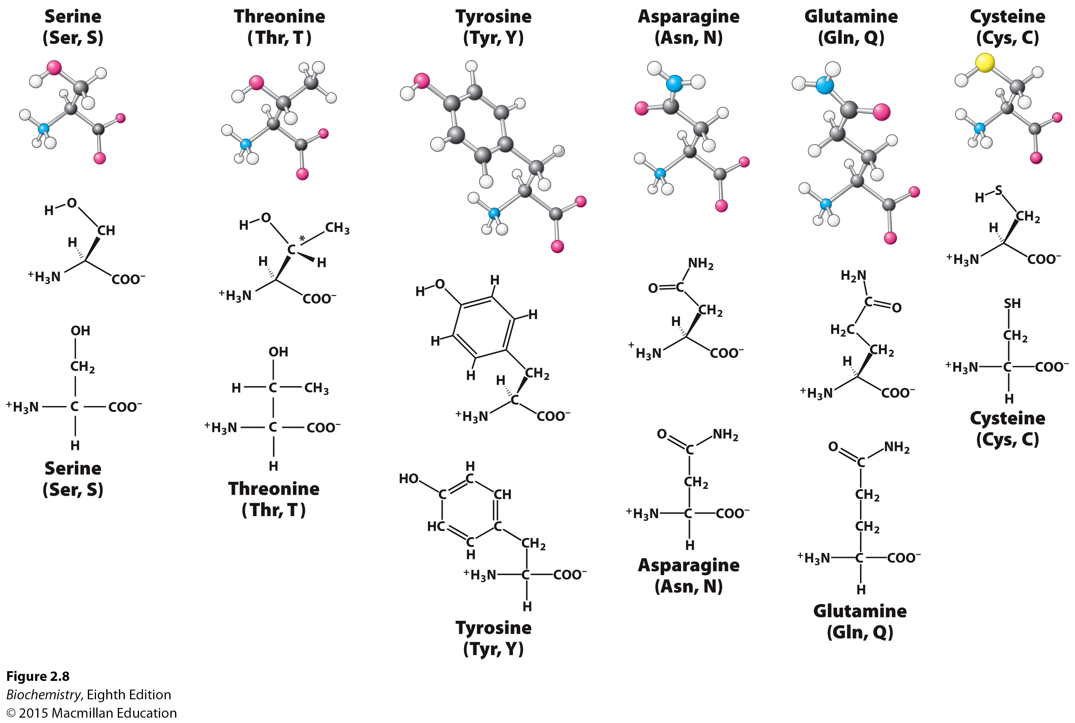
Notes:
FIGURE 2.8 Structures of the polar amino acids. The additional chiral center in threonine is indicated by an asterisk.

Slide 17
Positively charged amino acids with R groups that have a positive charge at physiological pH.

Slide 18
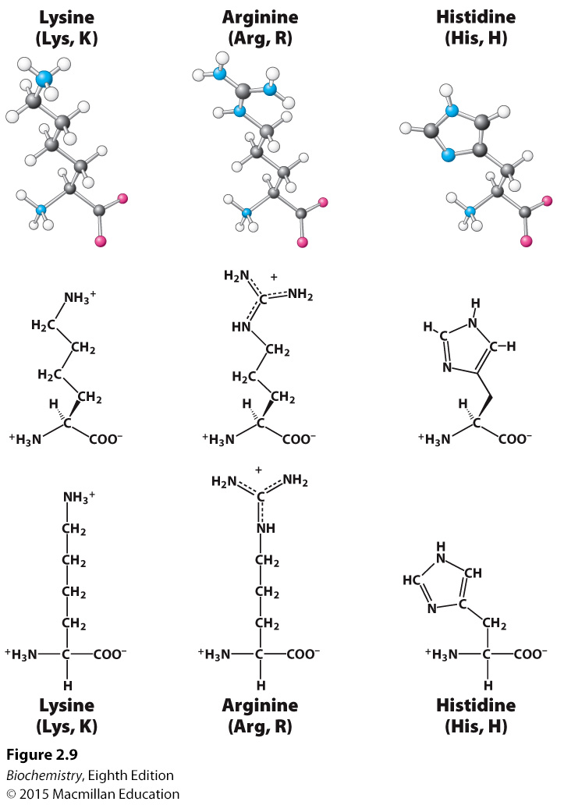
Notes:
FIGURE 2.9 Positively charged amino acids lysine, arginine, and histidine.

Slide 19
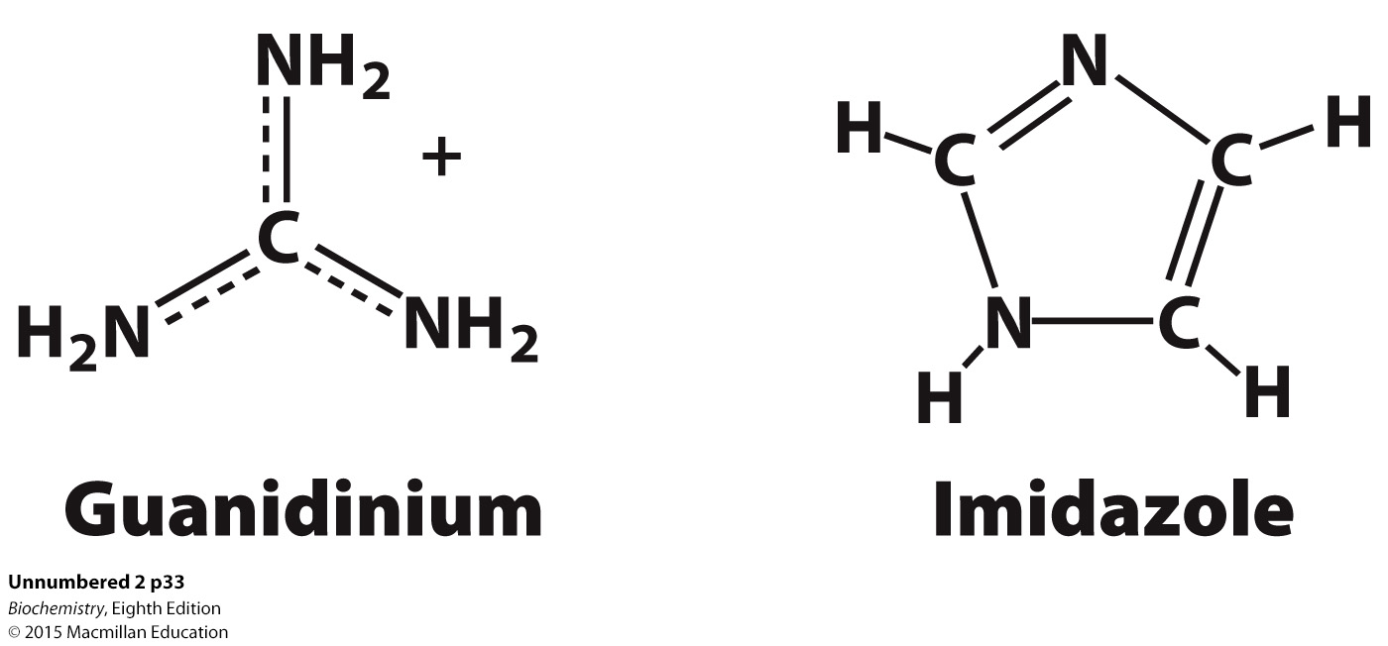
Positively charged amino acids with R groups that have a positive charge at physiological pH.
Arginine contains a guanidinium group while histidine contains an imidazole group.

Slide 20
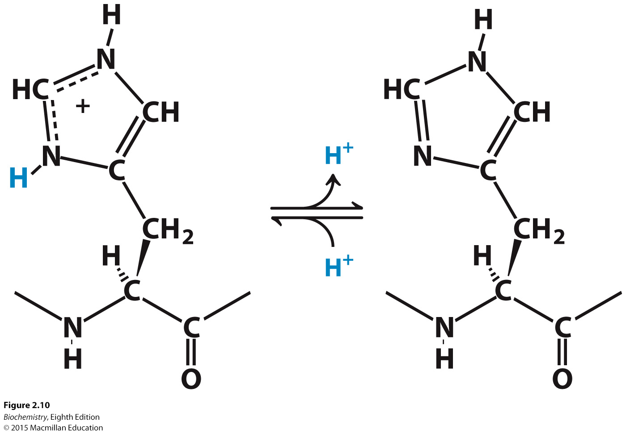
Positively charged amino acids with R groups that have a positive charge at physiological pH.
Histidine can accept or donate protons at physiological pH.
Notes:
FIGURE 2.10 Histidine ionization. Histidine can bind or release protons near physiological pH.

Slide 21
Negatively charged amino acids with R groups that have a negative charge at physiological pH.

Slide 22
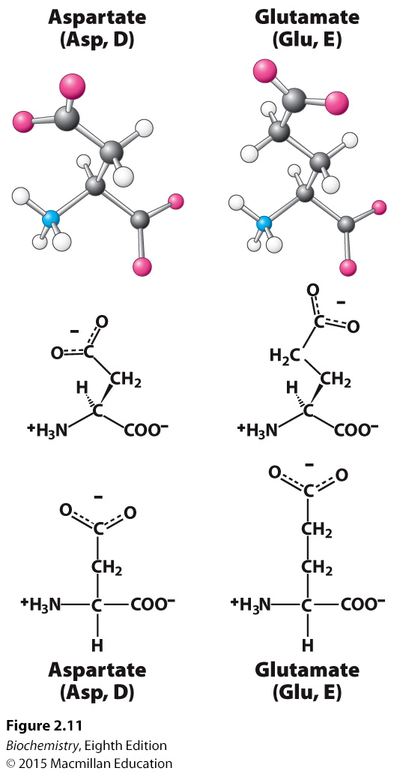
Notes:
FIGURE 2.11 Negatively charged amino acids.

Slide 23
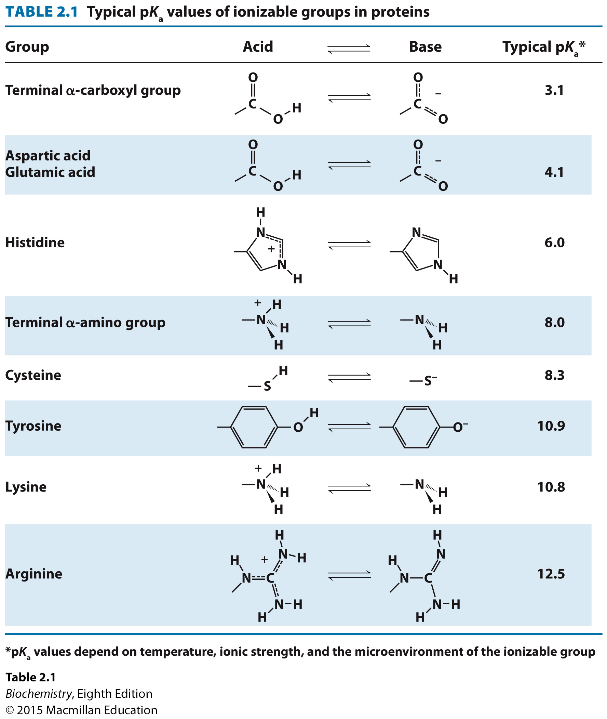
Seven of the 20 amino acids have readily ionizable side chains.

Slide 24
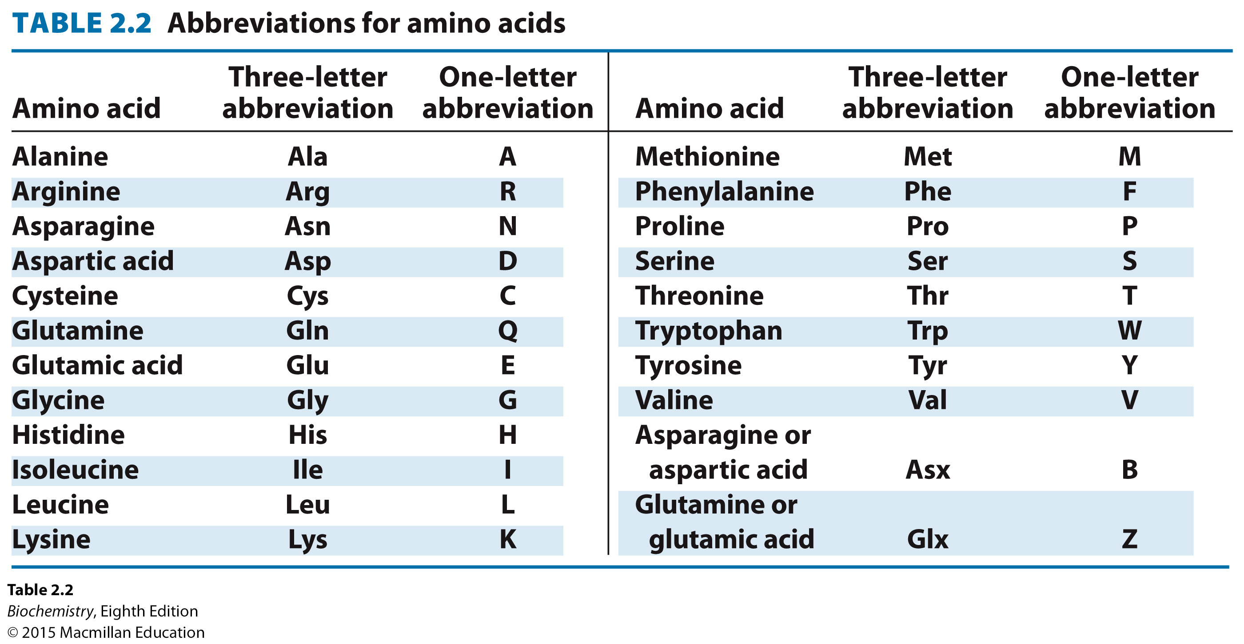

Slide 25
The reason that these particular 20 amino acids became the protein alphabet is not known. Possible reasons include:
These amino acids provide chemical versatility.
They may have been available for prebiotic reactions.
Larger amino acids may be too reactive.

Slide 26
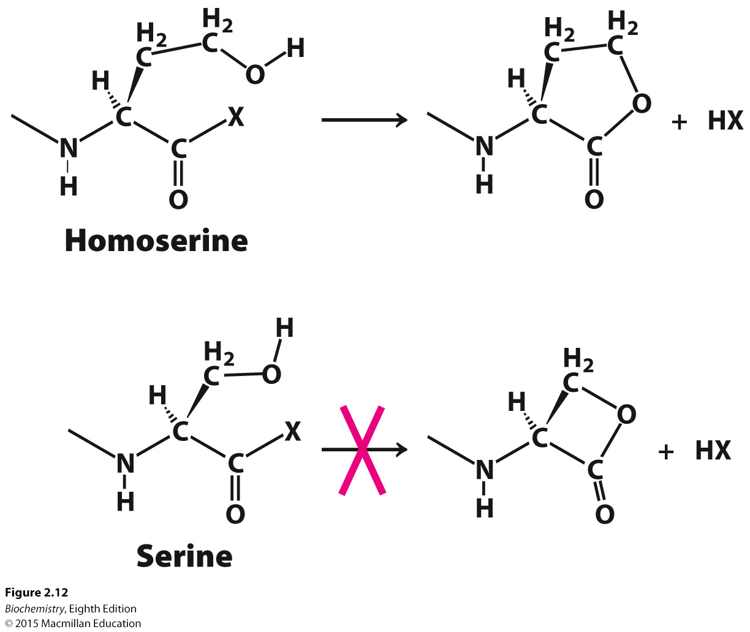
Notes:
FIGURE 2.12 Undesirable reactivity in amino acids. Some amino acids are unsuitable for proteins because of undesirable cyclization. Homoserine can cyclize to form a stable, five-membered ring, potentially resulting in peptide-bond cleavage. The cyclization of serine would form a strained, four membered ring and is thus disfavored. X can be an amino group from a neighboring amino acid or another potential leaving group.

Slide 27

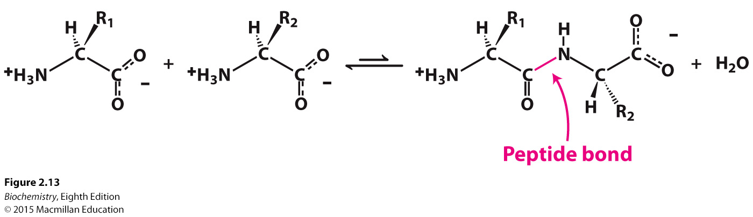
Notes:
FIGURE 2.13 Peptide-bond formation. The linking of two amino acids is accompanied by the loss of a molecule of water.

Slide 28
A polypeptide bond has directionality, sometimes called polarity. The amino terminal end is taken as the beginning of the polypeptide chain.

Slide 29
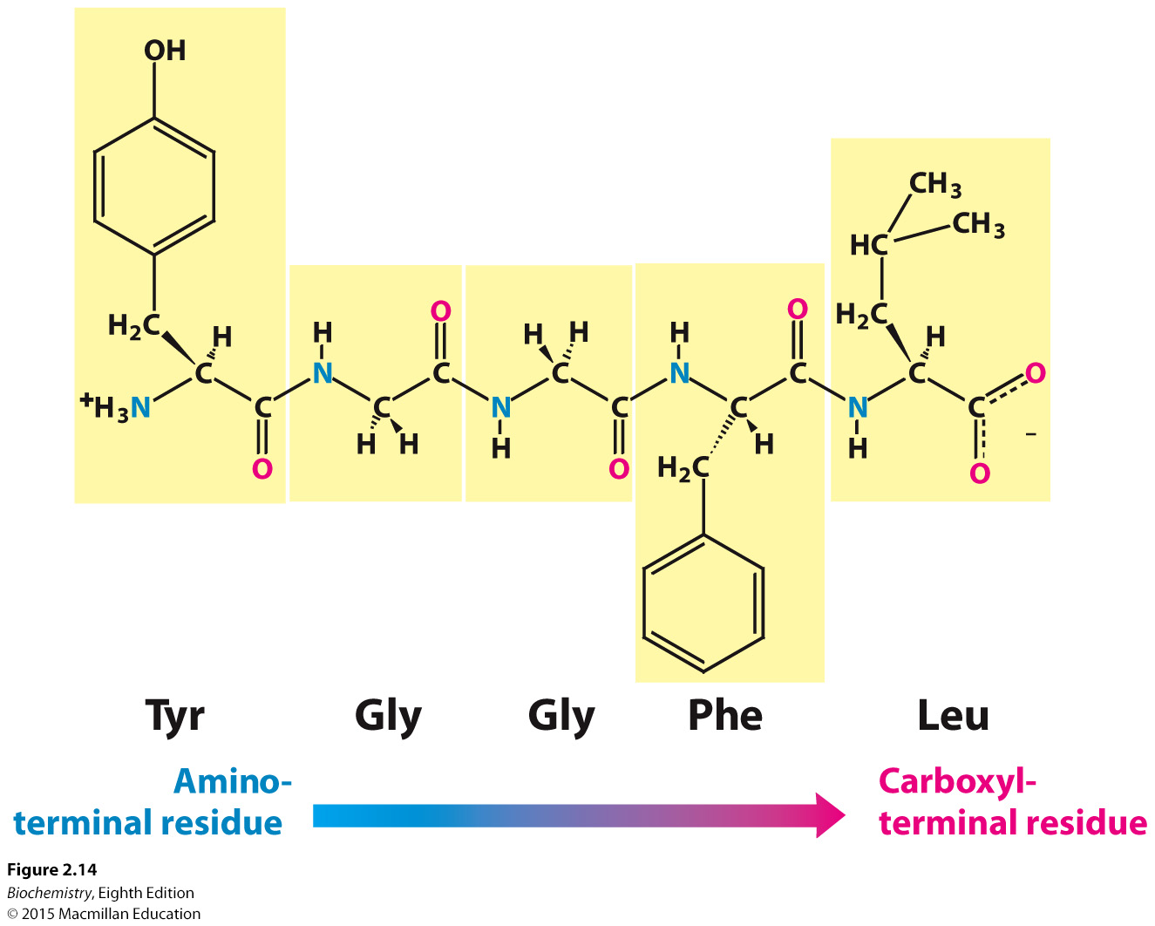
Notes:
FIGURE 2.14 Amino acid sequences have direction. This illustration of the pentapeptide Try-Gly-Gly-Phe-Leu (YGGFL) shows the sequence from the amino terminus to the carboxyl terminus. This pentapeptide, Leu-enkephalin, is an opioid peptide that modulates the perception of pain. The reverse pentapeptide, Leu-Phe-Gly-Gly-Tyr (LFGGY), is a different molecule and has no such effects.

Slide 30
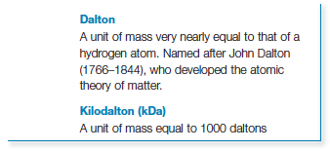
The polypeptide consists of a repeating part called the main chain or backbone and a variable part consisting of the distinctive amino acid side chains.
The backbone has hydrogen bonding potential because of the carbonyl groups and hydrogen atoms that are bonded to the nitrogen of the amine group.
Most proteins consist of 50 to 2000 amino acids.
The mean molecular weight for an amino acid is 110 g mol⁻¹. Protein mass can also be referred to as Daltons.

Slide 31
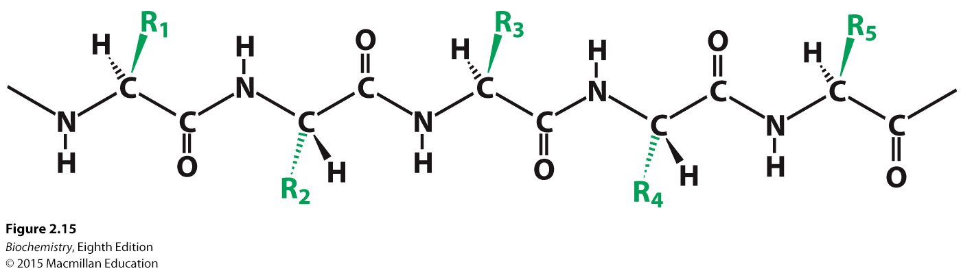
Notes:
FIGURE 2.15 Components of a polypeptide chain. A polypeptide chain consists of a constant backbone (shown in black) and variable side chains (shown in green).

Slide 32
In some proteins, the polypeptide chain can be cross-linked by disulfide bonds.
Disulfide bonds form by the oxidation of two cysteines.
The cross-linked cysteines are called cystine.

Slide 33
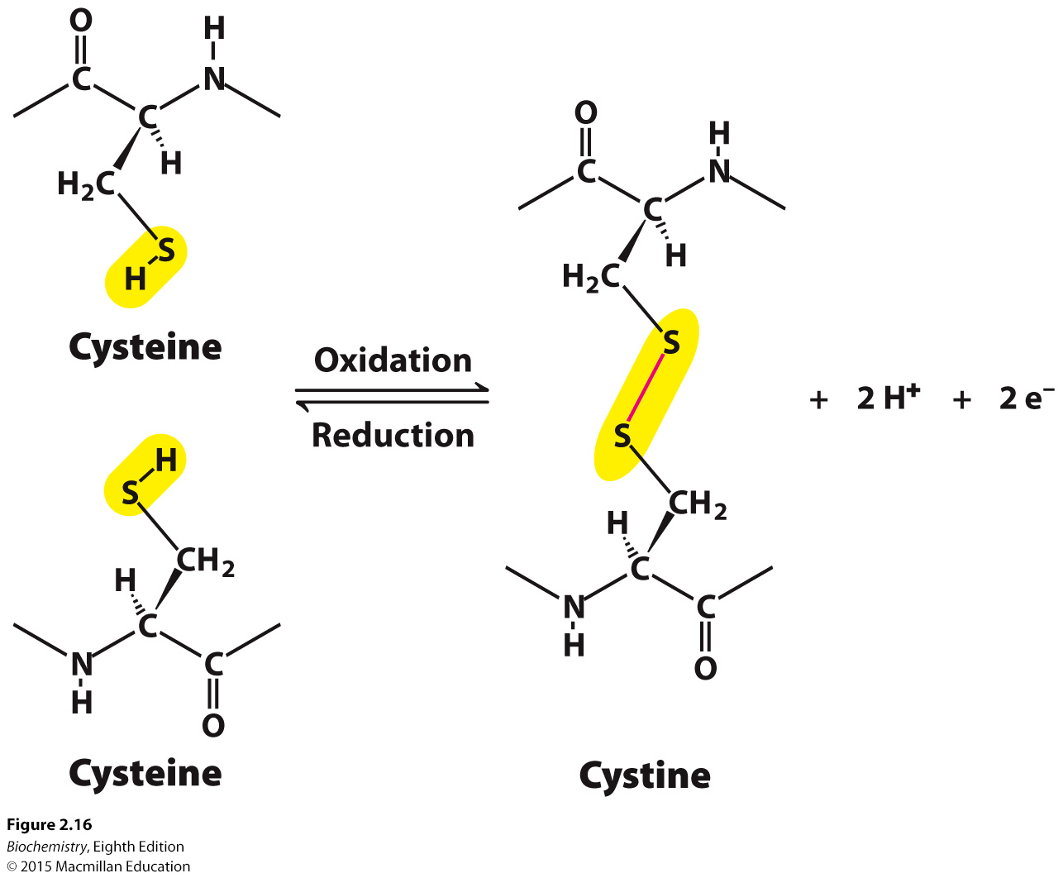
Notes:
FIGURE 2.16 Cross-links. The formation of a disulfide bond from two cysteine residues is an oxidation reaction.

Slide 34

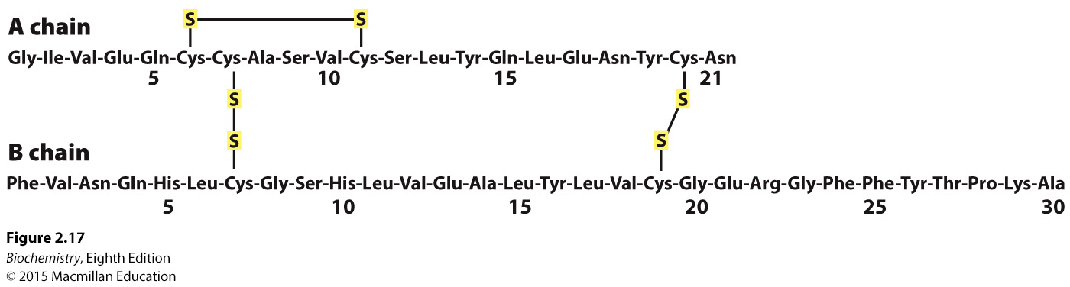
Notes:
FIGURE 2.17 Amino acid sequence of bovine insulin.

Slide 35

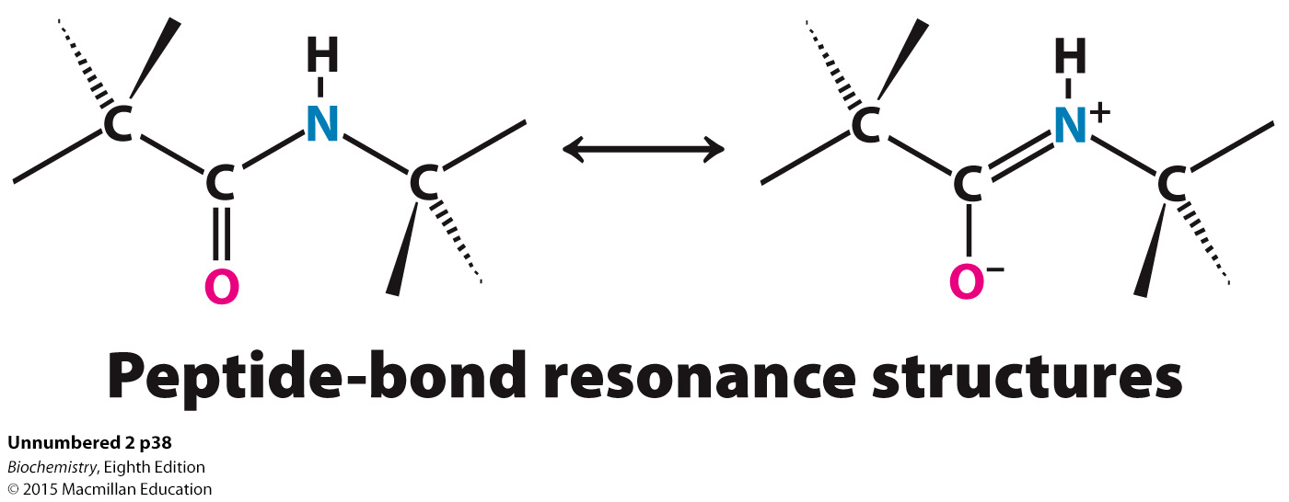
The peptide bond is essentially planar. Six atoms (C_{α}, C, O, N, H, and C_{α}) lie in a plane.
The peptide bond has partial double bond character because of resonance, and thus rotation about the bond is prohibited.
The peptide bond is uncharged.

Slide 36
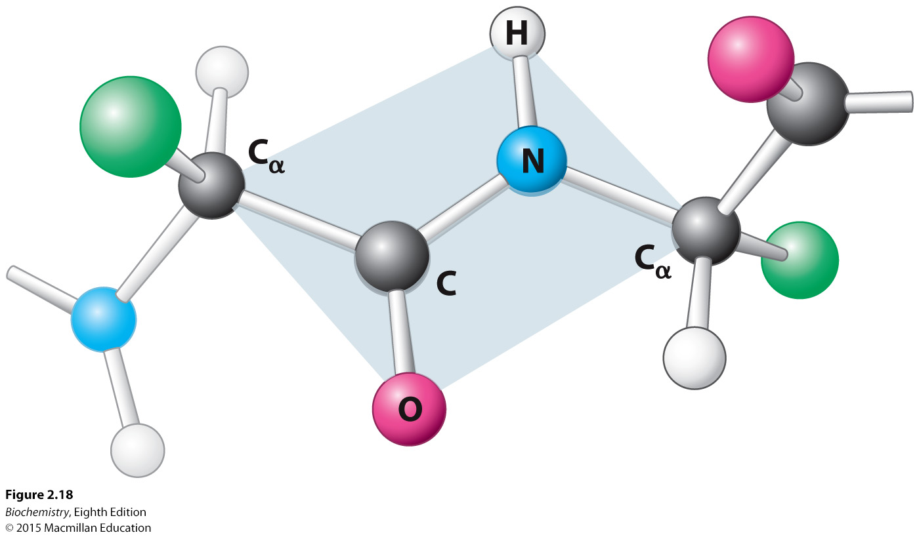
Notes:
FIGURE 2.18 Peptide bonds are planar. In a pair of linked amino acids, six atoms (C_{α,} C, O, N, H, and C_{α}) lie in a plane. Side chains are shown as green balls.

Slide 37
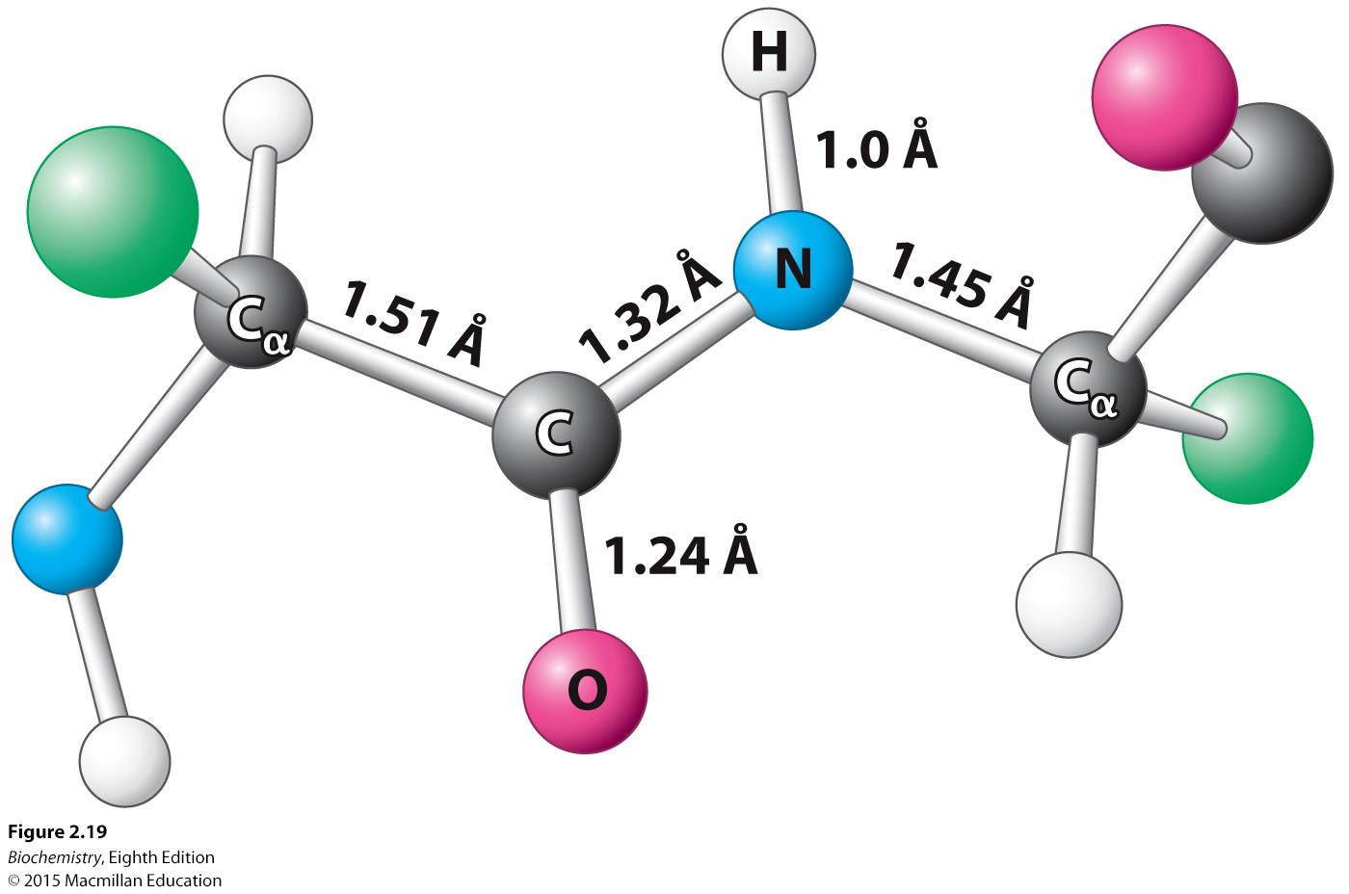
Notes:
FIGURE 2.19 Typical bond lengths within a peptide unit. The peptide unit is shown in the trans configuration.

Slide 38
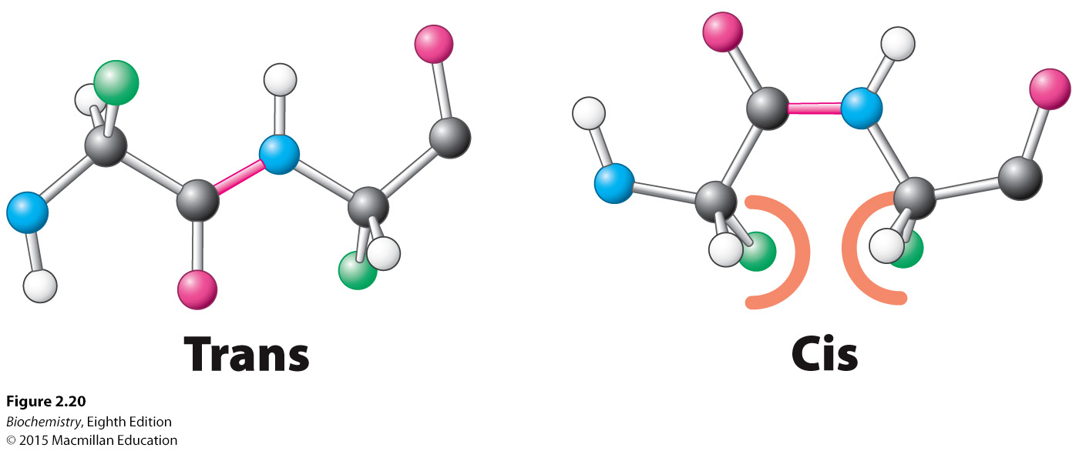
Notes:
FIGURE 2.20 Trans and cis peptide bonds. The trans form is strongly favored because of steric clashes, indicated by the orange semicircles, that arise in the cis form.

Slide 39
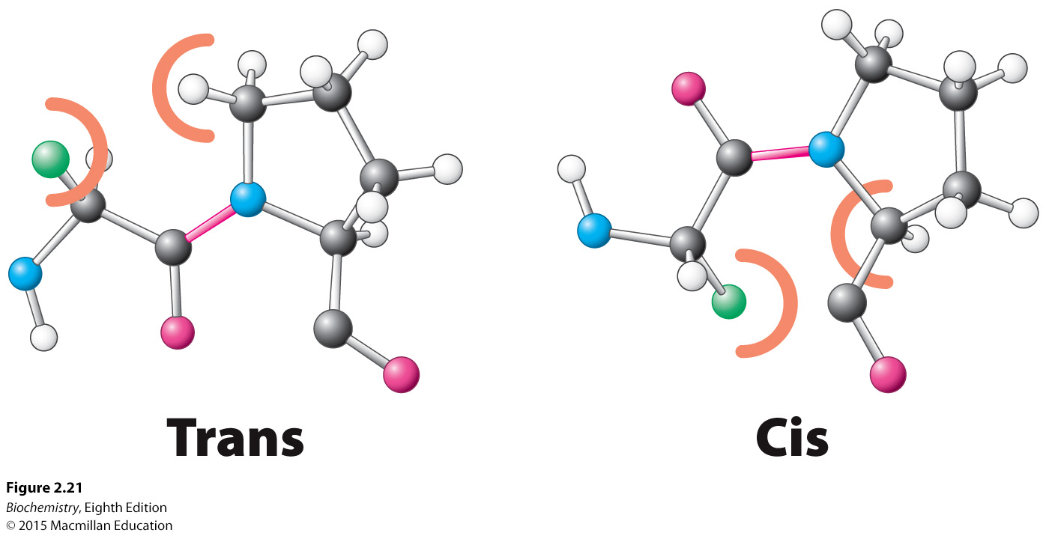
Notes:
FIGURE 2.21 Trans and cis X–Pro bonds. The energies of these forms are similar to one another because steric clashes, indicated by the orange semicircles, arise in both forms.

Slide 40
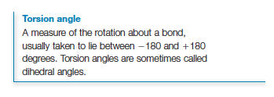
Rotation is permitted about the N-C_{α} bond (the phi (Φ )bond) and about the C_{α}-carbonyl bond (the psi ( ψ) bond.)
The rotation about the Φ and ψ bonds, called the torsion angle, determines the path of the polypeptide chain. Not all torsion angles are permitted.

Slide 41
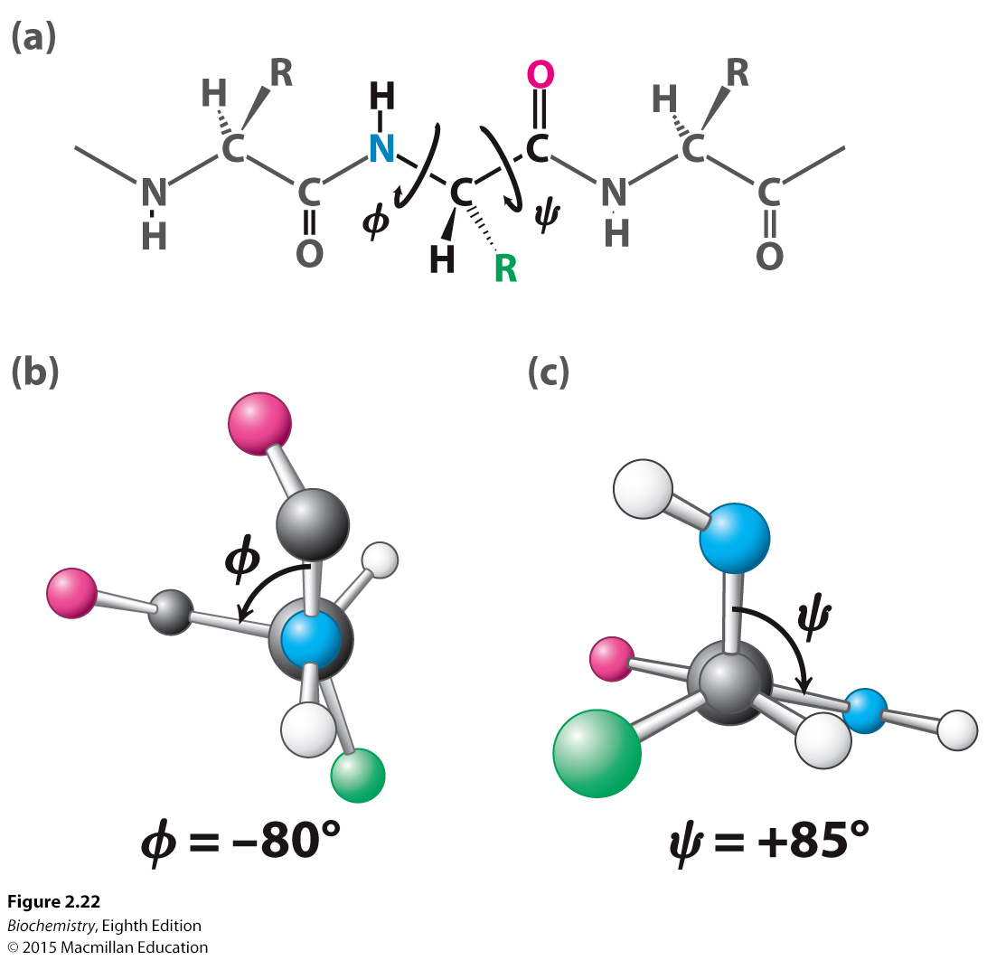
Notes:
FIGURE 2.22 Rotation about bonds in a polypeptide. The structure of each amino acid in a polypeptide can be adjusted by rotation about two single bonds. (A) Phi (Φ) is the angle of rotation about the bond between the nitrogen and the α-carbon atoms, whereas psi (ψ) is the angle of rotation about the bond between the α-carbon and the carbonyl carbon atoms. (B) A view down the bond between the nitrogen and the α-carbon atoms, showing how is measured. (C) A view down the bond between the α-carbon and the carbonyl carbon atoms, showing how ψ is measured.

Slide 42
The Ramachandran plot illustrates the φ and ψ angles that are favorable because there is no steric hindrance.

Slide 43
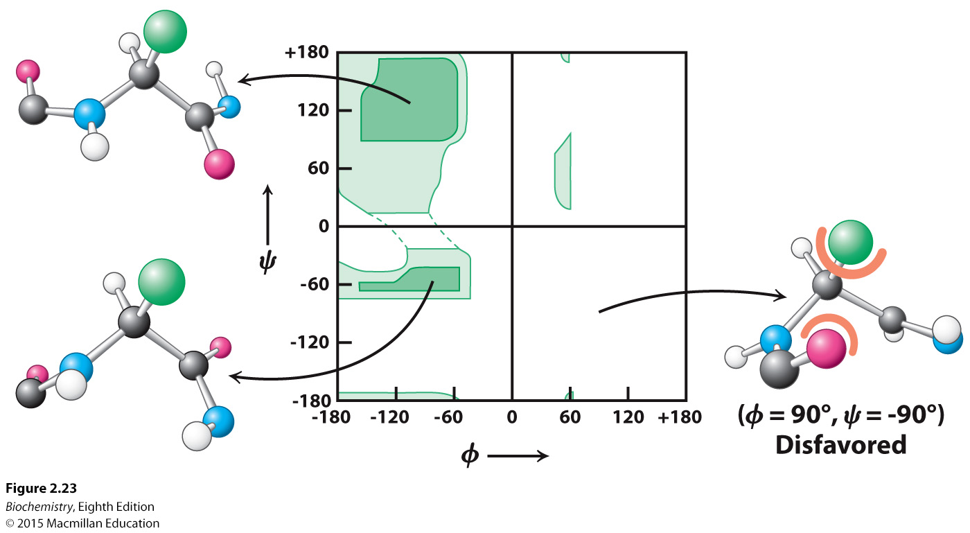
Notes:
FIGURE 2.23 A Ramachandran plot showing the values of Φ and ψ . Not all Φ and ψ values are possible without collisions between atoms. The most favorable regions are shown in dark green; borderline regions are shown in light green. The structure on the right is disfavored because of steric clashes.

Slide 44

Secondary structure is the three-dimensional structure formed by hydrogen bonds between peptide NH and CO groups of amino acids that are near one another in the primary structure.
The α-helix, β-sheets and turns are prominent examples of secondary structure.

Slide 45
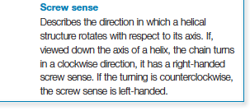
The α-helix is a tightly-coiled rod-like structure, with the R groups bristling out from the axis of the helix.
All of the backbone CO and NH groups form hydrogen bonds except those at the end of the helix.
Essentially all α-helices found in proteins are right-handed.

Slide 46
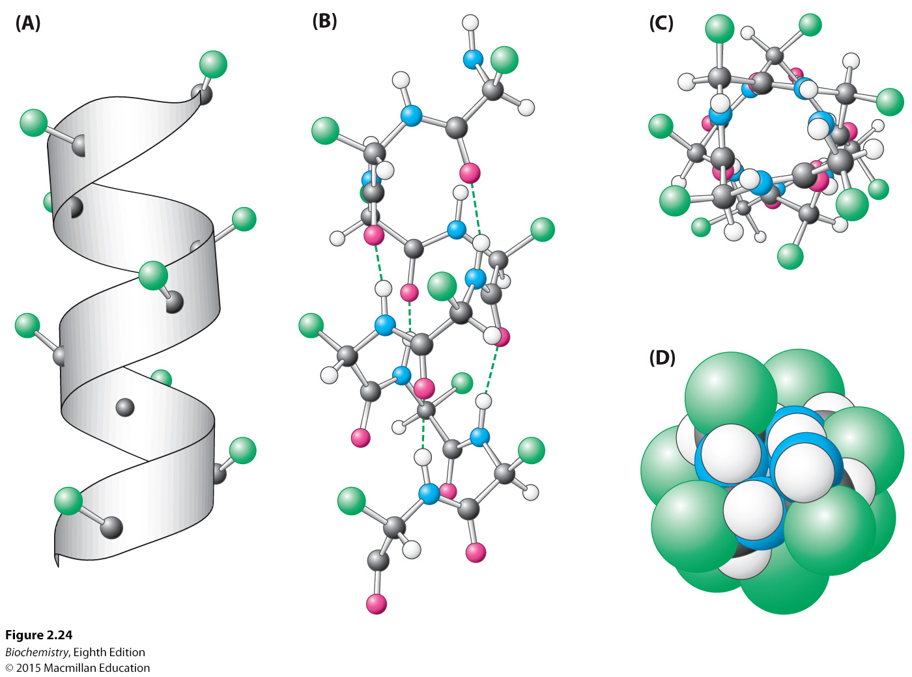
Notes:
FIGURE 2.24 Structure of the α helix. (A) A ribbon depiction shows the α-carbon atoms and side chains (green). (B) A side view of a ball-and-stick version depicts the hydrogen bonds (dashed lines) between NH and CO groups. (C) An end view shows the coiled backbone as the inside of the helix and the side chains (green) projecting outward. (D) A space-filling view of part C shows the tightly packed interior core of the helix.

Slide 47
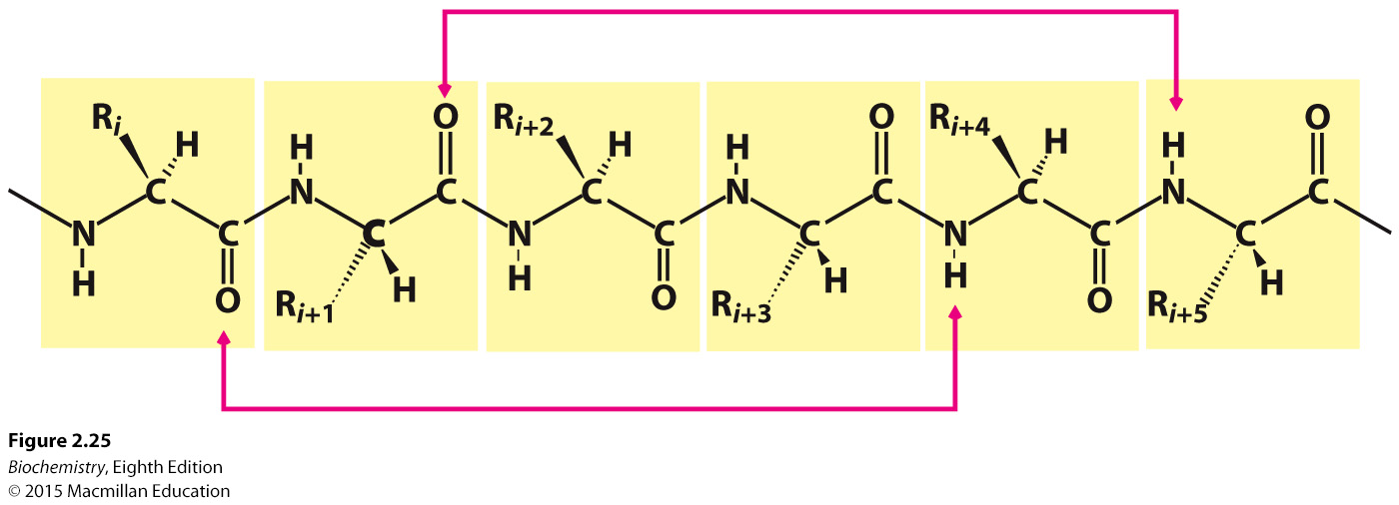
Notes:
FIGURE 2.25 Hydrogen-bonding scheme for an α helix. In the α helix, the CO group of residue i forms a hydrogen bond with the NH group of residue I + 4.

Slide 48
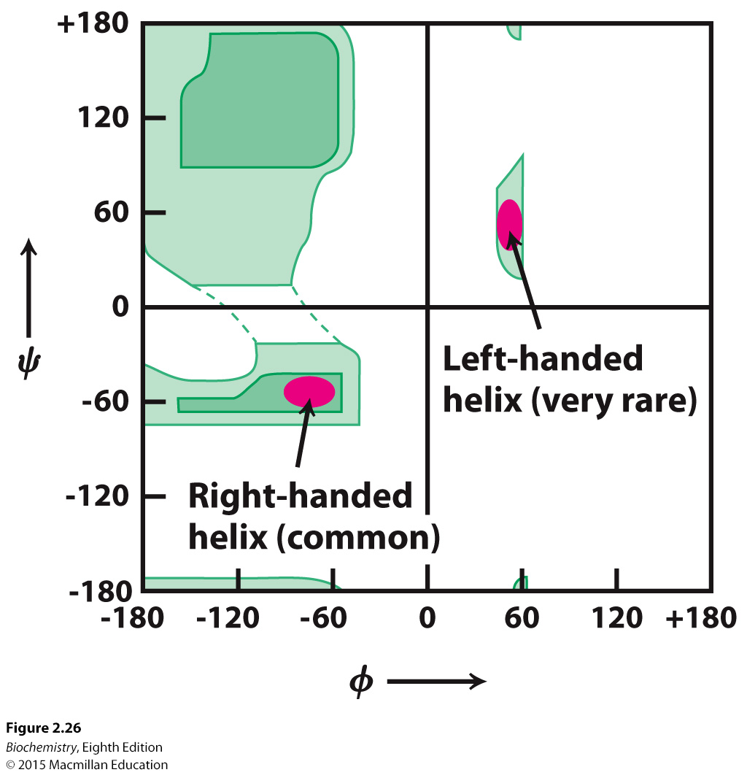
Notes:
FIGURE 2.26 Ramachandran plot for helices. Both right- and left-handed helices lie in regions of allowed conformations in the Ramachandran plot. However, essentially all α helices in proteins are right-handed.

Slide 49
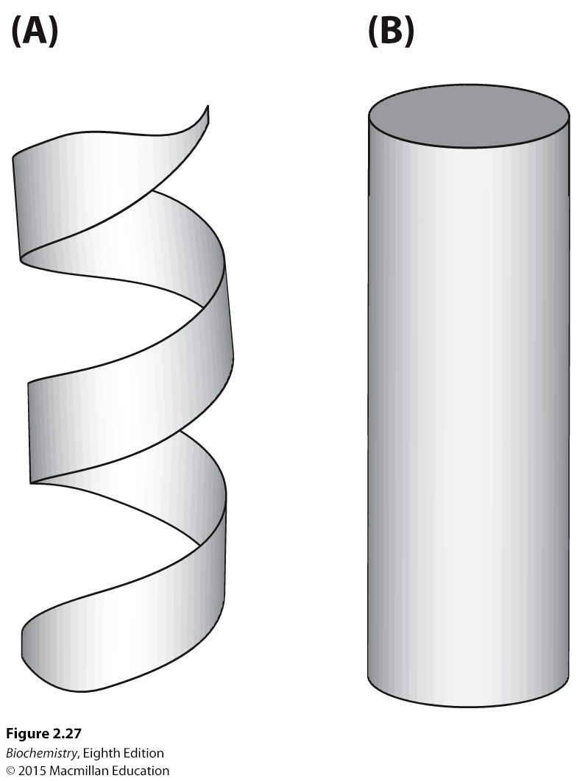
Notes:
FIGURE 2.27 Schematic views of α helices. (A) A ribbon depiction. (B) A cylindrical depiction.

Slide 50
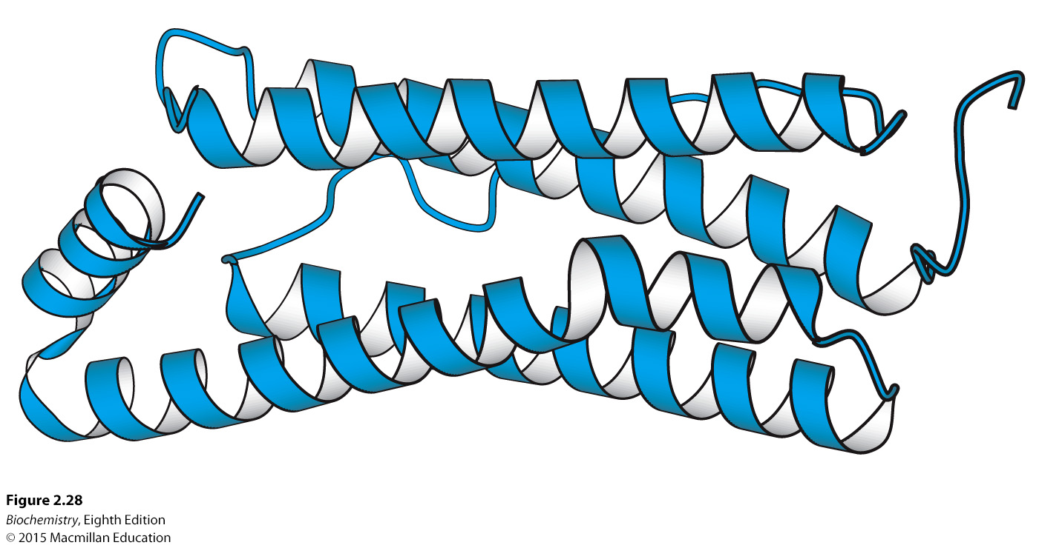
Notes:
FIGURE 2.28 A largely α-helical protein. Ferritin, an iron-storage protein, is built from a bundle of α helices. [Drawn from1AEW.pdb.]

Slide 51

The β-strand is another common form of secondary structure.
Beta sheets are formed by adjacent β-strands.
In contrast to an α-helix, the polypeptide in a β-strand is fully extended.

Slide 52
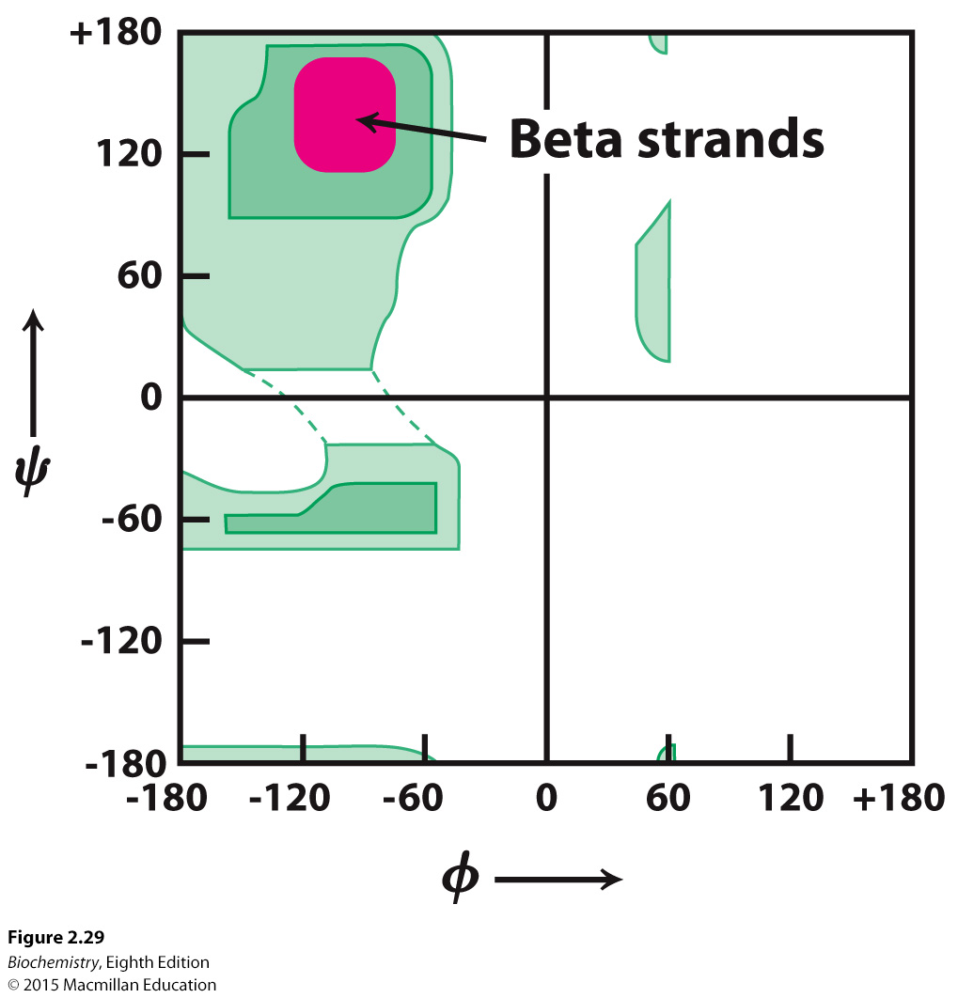
Notes:
FIGURE 2.29 Ramachandran plot for β strands. The red area shows the sterically allowed conformations of extended, α-strand-like structures.

Slide 53
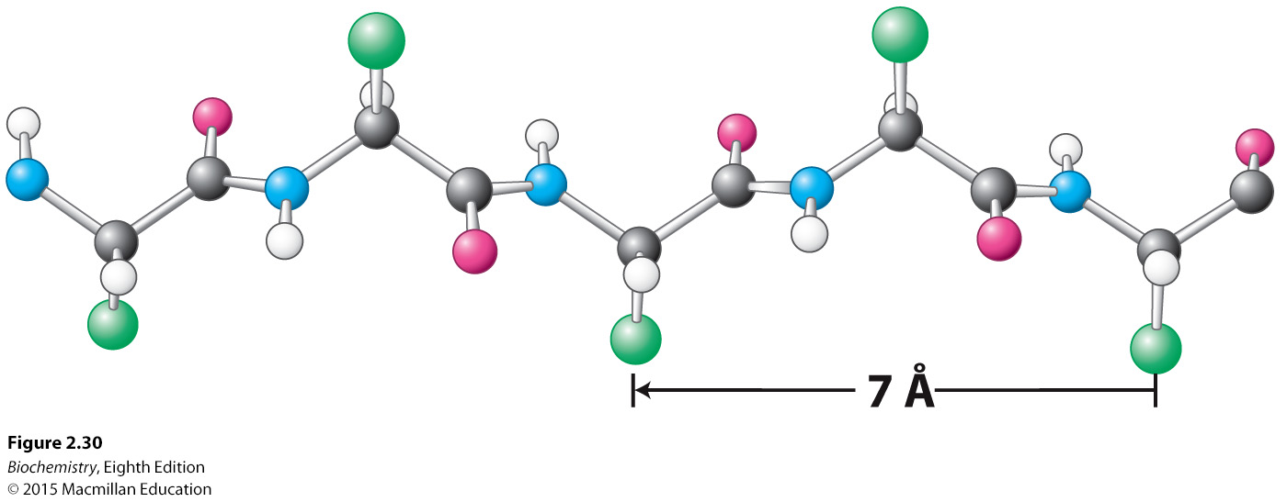
Notes:
FIGURE 2.30 Structure of a β strand. The side chains (green) are alternately above and below the plane of the strand.

Slide 54
Hydrogen bonds link the strands in a β-sheet.
The strands of a β-sheet may be parallel, antiparallel, or mixed.
β-sheets may be flat or adopt a twisted conformation.

Slide 55
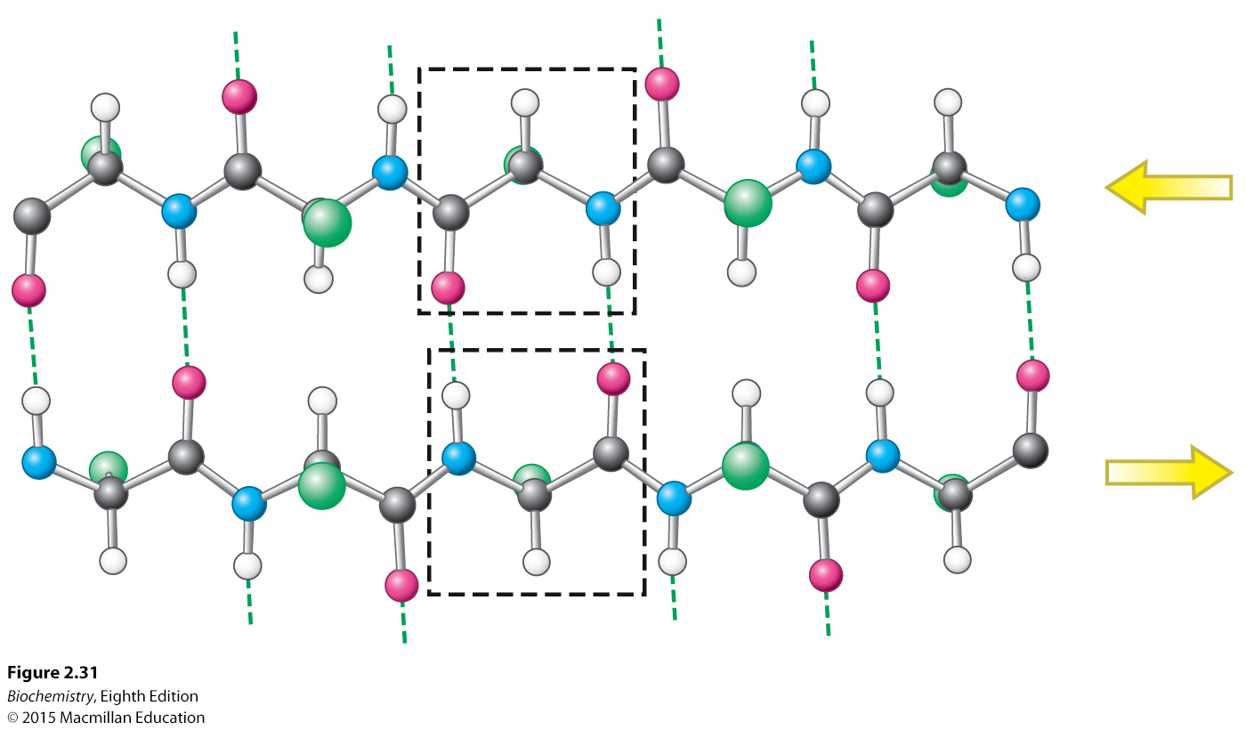
Notes:
FIGURE 2.31 An antiparallel β sheet. Adjacent β strands run in opposite directions. Hydrogen bonds between NH and CO groups connect each amino acid to a single amino acid on an adjacent strand, stabilizing the structure.

Slide 56
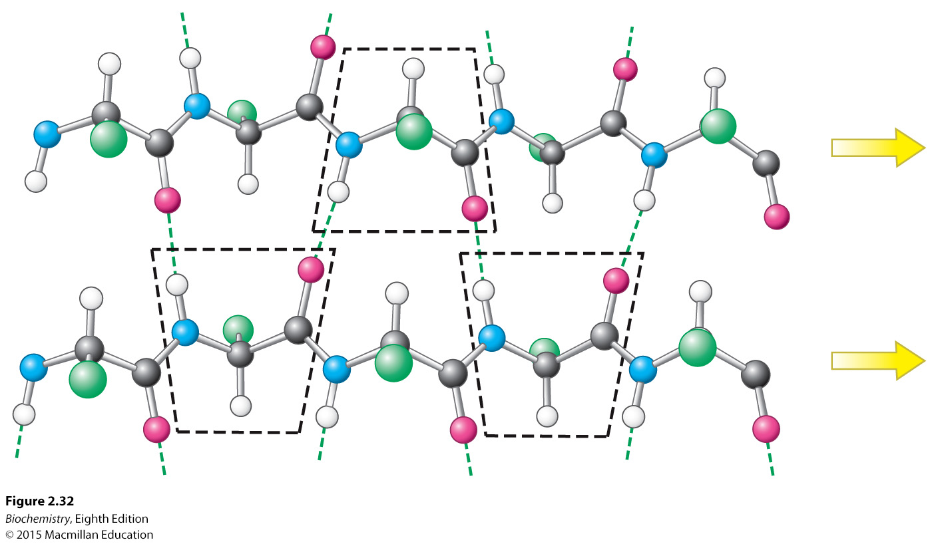
Notes:
FIGURE 2.32 A parallel β sheet. Adjacent β strands run in the same direction, as indicated by the arrows. Hydrogen bonds connect each amino acid on one strand with two different amino acids on the adjacent strand.

Slide 57
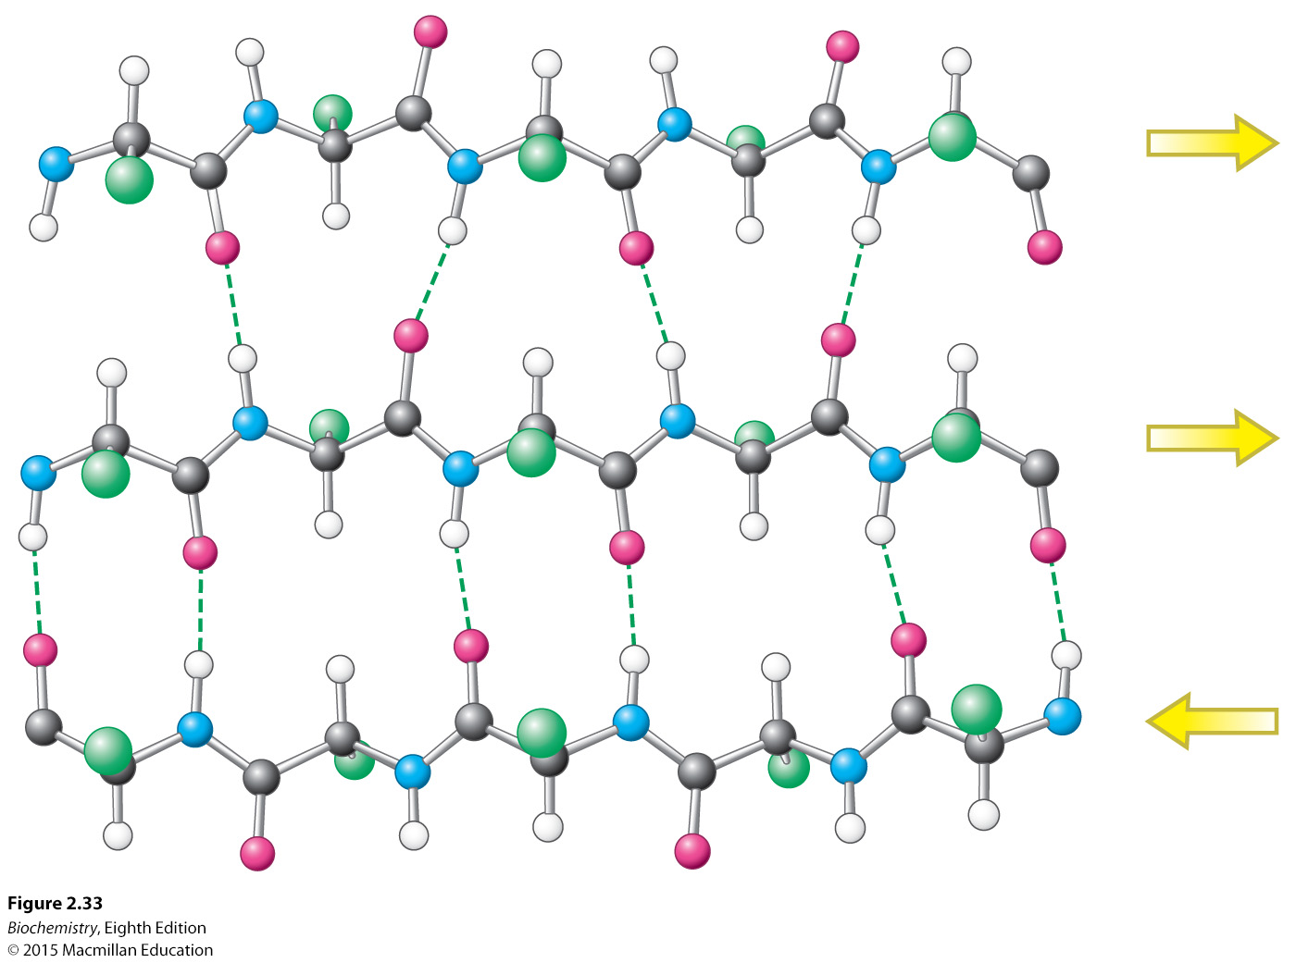
Notes:
FIGURE 2.33 Structure of a mixed β sheet. The arrows indicate the direction of each strand.

Slide 58
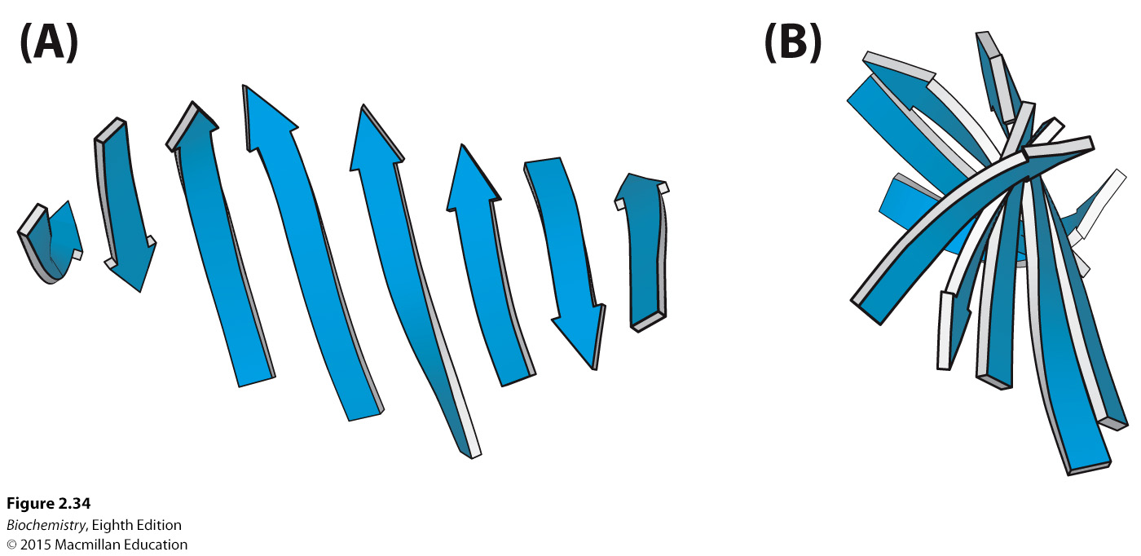
Notes:
FIGURE 2.34 A schematic twisted β sheet. (A) A schematic model. (B) The schematic view rotated by 90 degrees to illustrate the twist more clearly.

Slide 59
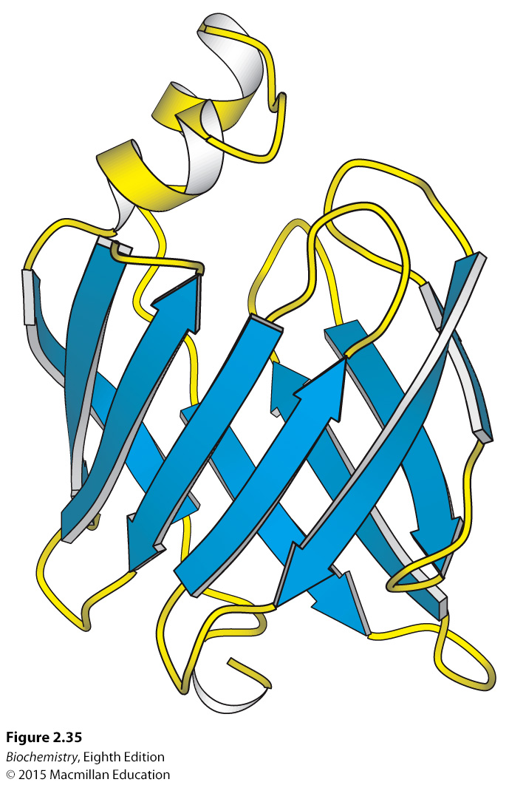
Notes:
Figure 2.35 A protein rich in β sheets. The structure of a fatty acid-binding protein. [Drawn from 1FTP.pdb.]

Slide 60

Polypeptide chains can change directions with β turns (hairpin turns) or omega (Ω) loops.

Slide 61
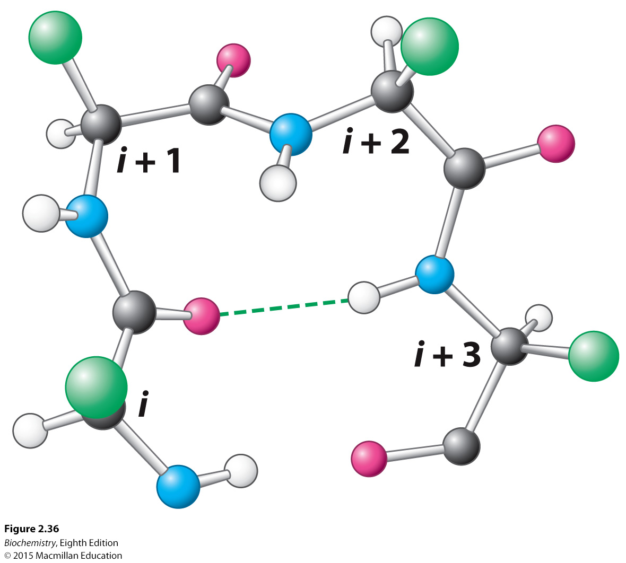
Notes:
FIGURE 2.36 Structure of a reverse turn. The CO group of residue i of the polypeptide chain is hydrogen bonded to the NH group of residue I + 3 to stabilize
the turn.

Slide 62
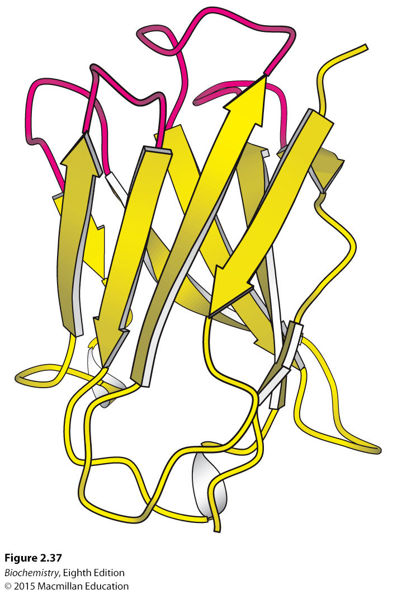
Notes:
FIGURE 2.37 Loops on a protein surface. A part of an antibody molecule has surface loops (shown in red) that mediate interactions with other molecules. [Drawn from 7FAB.pdb.]

Slide 63
α-Keratin, a structural protein found in wool and hair, is composed of two right-handed α-helices intertwined to form a left-handed super helix called a coiled-coil. The helices interact with ionic bonds or van der Waals interactions.
α-Keratin is a member of a superfamily of structural proteins called coiled-coil proteins.
Other members of the family include some cytoskeleton proteins and muscle proteins.

Slide 64
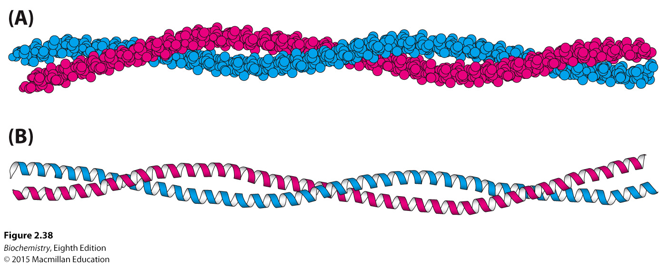
Notes:
FIGURE 2.38 An α-helical coiled coil. (A) Space-filling model. (B) Ribbon diagram. The two helices wind around one another to form a superhelix. Such structures are found in many proteins, including keratin in hair, quills, claws, and horns. [Drawn from 1CIG.pdb.]

Slide 65
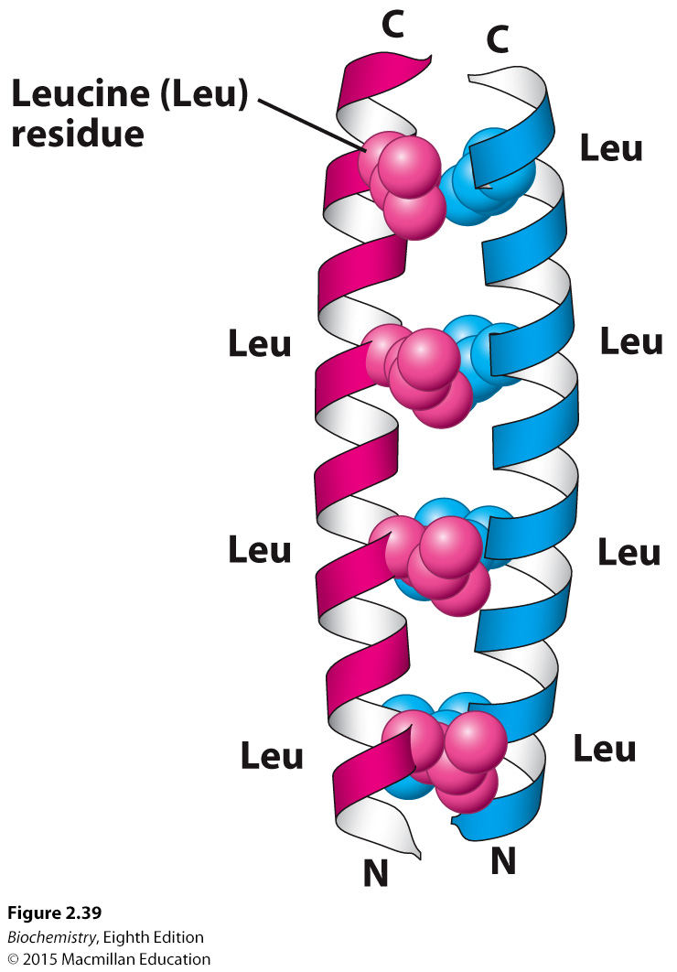
Notes:
FIGURE 2.39 Heptad repeats in a coiled-coil protein. Every seventh residue in each helix is leucine. The two helices are held together by van der Waals interactions primarily between the leucine residues. [Drawn from 2ZTA.pdb.]

Slide 66
Collagen is a structural protein that is a component of skin, bone, tendons, cartilage and teeth.
Collagen consists of three intertwined helical polypeptide chains that form a superhelical cable. The helical polypeptide chains of collagen are not α-helices.
Glycine appears at every third residue and the sequences Gly-Pro-Hyp and Gly-Pro-Pro are common.

Slide 67

Notes:
FIGURE 2.40 Amino acid sequence of a part of a collagen chain. Every third residue is a glycine. Proline and hydroxyproline (Hyp) also are abundant.

Slide 68
The helices in collagen are not stabilized by hydrogen bonds. Rather, they are stabilized by steric repulsion of the pyrrolidine rings of proline and hydroxyproline. The three intertwined chains interact with one another with hydrogen bonds.
The interior of the superhelical cable is crowded, and only glycine can fit in the interior.

Slide 69

Notes:
FIGURE 2.41 Conformation of a single strand of a collagen triple helix.

Slide 70

Notes:
FIGURE 2.42 Structure of the protein collagen. (A) Space-filling model of collagen. Each strand is shown in a different color. (B) Cross section of a model of collagen. Each strand is hydrogen bonded to the other two strands. The α-carbon atom of a glycine residue is identified by the letter G. Every third residue must be glycine because there is no space in the center of the helix. Notice that the pyrrolidine rings are on the outside.

Slide 71
Defects in collagen structure result in pathological conditions.
Osteogenesis imperfecta, or brittle bone disease, occurs if a mutation results in the substitution of another amino acid in place of glycine.

Slide 72

Tertiary structure refers to the spatial arrangement of amino acids that are far apart in the primary structure and to the pattern of disulfide bond formation.
Globular proteins, such as myoglobin, form complicated three-dimensional structures.
Globular proteins are very compact. There is little or no empty space in the interior of globular proteins.
The interior of globular proteins consists mainly of hydrophobic amino acids.
The exterior of globular proteins consists of charged and polar amino acids.
Membrane proteins have the reverse distribution of hydrophilic and hydrophobic amino acids.

Slide 73

Notes:
FIGURE 2.43 Three-dimensional structure of myoglobin. (A) A ribbon diagram shows that the protein consists largely of α helices. (B) A space-filling model in the same orientation shows how tightly packed the folded protein is. Notice that the heme group is nestled into a crevice in the compact protein with only an edge exposed. One helix is blue to allow comparison of the two structural depictions. [Drawn from 1A6N.pdb.]

Slide 74

Notes:
FIGURE 2.44 Distribution of amino acids in myoglobin. (A) A space-filling model of myoglobin with hydrophobic amino acids shown in yellow, charged amino acids shown in blue, and others shown in white. Notice that the surface of the molecule has many charged amino acids, as well as some hydrophobic amino acids. (B) In this cross-sectional view, notice that mostly hydrophobic amino acids are found on the inside of the structure, whereas the charged amino acids are found on the protein surface. [Drawn from 1MBD.pdb.]

Slide 75

Notes:
FIGURE 2.45 “Inside out” amino acid distribution in porin. The outside of porin (which contacts hydrophobic groups in membranes) is covered largely with hydrophobic residues, whereas the center includes a water-filled channel lined with charged and polar amino acids. [Drawn from 1PRN.pdb.]

Slide 76
Motifs, or supersecondary structures, are combinations of secondary structure that are found in many proteins.
Some proteins have two or more similar or identical compact structures called domains.

Slide 77

Notes:
FIGURE 2.46 The helix-turn-helix motif, a supersecondary structural element. Helix-turn-helix motifs are found in many DNA-binding proteins. [Drawn from 1LMB.pdb.]

Slide 78

Notes:
FIGURE 2.47 Protein domains. The cell-surface protein CD4 consists of four similar domains. [Drawn from 1WIO.pdb.]

Slide 79

Many proteins are composed of multiple polypeptide chains called subunits. Such proteins are said to display quaternary structure.
Quaternary structure can be as simple as two identical polypeptide chains or as complex as dozens of different polypeptide chains.

Slide 80

Notes:
FIGURE 2.48 Quaternary structure. The Cro protein of bacteriophage λ is a dimer of identical subunits. [Drawn from 5CRO.pdb.]

Slide 81

Notes:
FIGURE 2.49 The α₂β₂ tetramer of human hemoglobin. The structure of the two identical α subunits (red) is similar to but not identical with that of the two identical β subunits (yellow). The molecule contains four heme groups (gray with the iron atom shown in purple). (A) The ribbon diagram highlights the similarity of the subunits and shows that they are composed mainly of α helices. (B) The space-filling model illustrates how the heme groups occupy crevices in the protein. [Drawn from 1A3N.pdb.]

Slide 82

Notes:
FIGURE 2.50 Complex quaternary structure. The coat of human rhinovirus, the cause of the common cold, comprises 60 copies of each of four subunits. The three most prominent subunits are shown as different colors.

Slide 83


Christian Anfinsen placed the enzyme ribonuclease, which degrades RNA, in a solution containing urea or guanidinium chloride and β-mercaptoethanol. Urea or guanidinium chloride destroyed all noncovalent bonds, while the β-mercaptoethanol destroyed the disulfide bonds. The enzyme displayed no enzymatic activity and existed only as a random coil. The ribonuclease was denatured.
When the urea and β-mercaptoethanol were slowly removed, the enzyme regained its structure and its activity. Ribonuclease was renatured and attained its normal or native state.
These results demonstrated that the information required for a polypeptide chain to fold into a functional protein with a defined three-dimensional is inherent in the primary structure.

Slide 84

Notes:
FIGURE 2.51 Amino acid sequence of bovine ribonuclease. The four disulfide bonds are shown in color. [After C. H. W. Hirs, S. Moore, and W. H. Stein, J. Biol. Chem. 235:633–647, 1960.]

Slide 85

Notes:
FIGURE 2.52 Role of β-mercaptoethanol in reducing disulfide bonds. Note that, as the disulfides are reduced, the β-mercaptoethanol is oxidized and forms dimers.

Slide 86

Notes:
FIGURE 2.53 Reduction and denaturation of ribonuclease.

Slide 87

Notes:
FIGURE 2.54 Reestablishing correct disulfide pairing. Native ribonuclease can be re-formed from scrambled ribonuclease in the presence of a trace of β-mercaptoethanol.

Slide 88

Conformational preferences of amino acids are not strong, suggesting that the majority of amino acids will be found in helices, strands or turns.

Slide 89


Slide 90

Notes:
FIGURE 2.55 Alternative conformations of a peptide sequence. Many sequences can adopt alternative conformations in different proteins. Here the sequence VDLLKN shown in red assumes an α helix in one protein context (left) and a β strand in another (right). [Drawn from (left) 3WRP.pdb and (right) 2HLA.pdb.]

Slide 91

Notes:
FIGURE 2.56 Transition from folded to unfolded state. Most proteins show a sharp transition from the folded to the unfolded form on treatment with increasing concentrations of denaturants.

Slide 92

Notes:
FIGURE 2.57 Components of a partly denatured protein solution. In a half-unfolded protein solution, half the molecules are fully folded and half are fully unfolded.

Slide 93
A monkey randomly poking at a keyboard could type a sentence from Shakespeare in a few thousand keystrokes if the correct letters are retained, a process called cumulative selection.
Protein folding also occurs by cumulative selection. Partly correct folding intermediates are retained because they are slightly more stable than unfolded regions.

Slide 94

Notes:
FIGURE 2.58 Typing-monkey analogy. A monkey randomly poking a typewriter could write a line from Shakespeare’s Hamlet, provided that correct keystrokes were retained. In the two computer simulations shown, the cumulative number of keystrokes is given at the left of each line.

Slide 95

Notes:
FIGURE 2.59 Proposed folding pathway of chymotrypsin inhibitor. Local regions with sufficient structural preference tend to adopt their favored structures initially (1). These structures come together to form a nucleus with a native-like, but still mobile, structure (4). This structure then fully condenses to form the native, more rigid structure (5). [From A. R. Fersht and V. Daggett. Cell 108:573–582, 2002; with permission from Elsevier.]

Slide 96
Protein folding is often represented as a folding funnel. The protein has maximum entropy and minimal structure at the top of the funnel. The folded protein exists at the bottom of the funnel.

Slide 97

Notes:
FIGURE 2.60 Folding funnel. The folding funnel depicts the thermodynamics of protein folding. The top of the funnel represents all possible denatured conformations—that is, maximal conformational entropy. Depressions on the sides of the funnel represent semi-stable intermediates that can facilitate or hinder the formation of the native structure, depending on their depth. Secondary structures, such as helices, form and collapse onto one another to initiate folding. [After D. L. Nelson and M. M. Cox, Lehninger Principles of Biochemistry, 5th ed. ( W. H. Freeman and Company, 2008), p. 143.]

Slide 98
Intrinsically unstructured proteins (IUP) do not have a defined structure under physiological conditions until they interact with other molecules.
Metamorphic proteins exist in an ensemble of structures of approximately equal energies that are in equilibrium.

Slide 99

Notes:
FIGURE 2.61 Lymphotactin exists in two conformations, which are in equilibrium. [R. L. Tuinstra, F. C. Peterson, S. Kutlesa, E. S. Elgin, M. A. Kron, and B. F. Volkman. Proc. Natl. Sci. U.S.A. 105:5057–5062, 2008, Fig. 2A.]

Slide 100

Amyloidoses are diseases that result from the formation of protein aggregates, called amyloid fibrils or plaques.
Alzheimer disease is an example of an amyloidosis.
Normal protein conformations can exist in forms rich in β sheet, which are prone to aggregate.
An abnormally folded aggregate serves as a nucleus to recruit more proteins.

Slide 101

Notes:
FIGURE 2.62 A model of the human prion protein amyloid. A detailed model of a human prion amyloid fibril deduced from spin labeling and electron paramagnetic resonance (EPR) spectroscopy studies shows that protein aggregation is due to the formation of large parallel β sheets. The black arrow indicates the long axis of the fibril. [N. J. Cobb, F. D. Sönnichsen,H. Mchaourab, and W. K. Surewicz. Proc. Natl. Acad. Sci. U.S.A. 104:18946–18951, 2007, Fig. 4E.]

Slide 102

Notes:
FIGURE 2.63 The protein-only model for prion-disease transmission. A nucleus consisting of proteins in an abnormal conformation grows by the addition of proteins from the normal pool.

Slide 103
Lack of appropriate protein modification can result in pathological conditions.
Lack of vitamin C prevents hydroxylation of proline in collagen, which results in scurvy.
If vitamin K is missing, clotting proteins are not carboxylated and hemorrhaging results.
Green fluorescent protein (GFP), from the jellyfish Aequorea victoria, can be attached to cellular proteins. GFP fluoresces green when exposed to blue light, allowing the determination of the cellular location of the attached protein.

Slide 104

Notes:
FIGURE 2.64 Finishing touches. Some common and important covalent modifications of amino acid side chains are shown.

Slide 105

Notes:
FIGURE 2.65 Chemical rearrangement in GFP. (A) The structure of green fluorescent protein (GFP). The rearrangement and oxidation of the sequence Ser-Tyr-Gly is the source of fluorescence. (B) Mutants of GFP emit light across the visible spectrum. (C) A melanoma cell line engineered to express one of these GFP mutants, red fluorescent protein (RFP), was then injected into a mouse whose blood vessels express GFP. In this fluorescence micrograph, the formation of new blood vessels (green) in the tumor (red) is readily apparent. [(A) Drawn from 1GFL.pdb; (B) R.Y. Tsien. Integr. Biol. 2:77–93, 2010, Fig. 12; (C) M. Yang, et al. Proc. Natl. Acad. Sci. U.S.A. 100:14259–14262, 2003, Fig. 2B]

