Slide 1
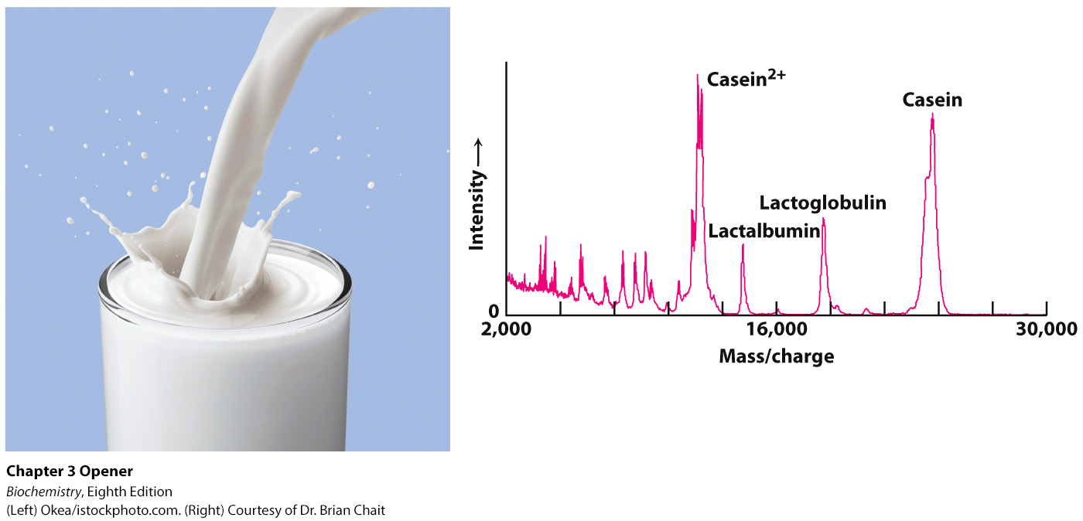
Notes:
Milk, a source of nourishment for all mammals, is composed, in part, of a variety of proteins. The protein components of milk are revealed by the technique of MALDI–TOF mass spectrometry, which separates molecules on the basis of their mass-to-charge ratio. [(Left) Okea/istockphoto.com. (Right) Courtesy of Dr. Brian Chait.]

Slide 2
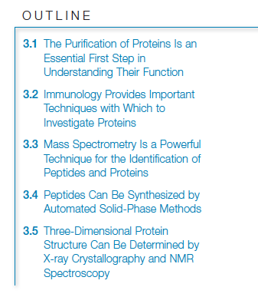

Slide 3
The proteome is the entire set of proteins expressed and modified by a cell under a particular set of biochemical conditions.
Unlike the genome, the proteome is not an unvarying characteristic of the cell.

Slide 4

Proteins can be purified on the basis of differences in their chemical properties.
Protein purification requires a test, or assay, that determines whether the protein of interest is present.

Slide 5
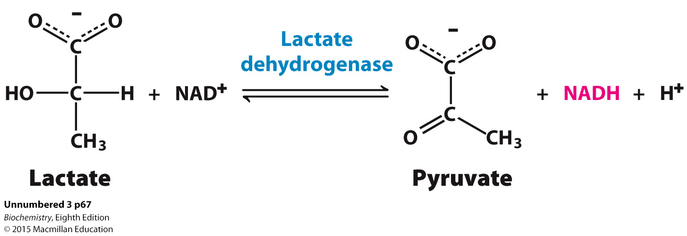
An assay for the enzyme lactate dehydrogenase is based on the fact that a product of the reaction, NADH, can be detected spectrophotometrically.

Slide 6
Cells are disrupted to form a homogenate, which is a mixture of all of the components of the cell, but no intact cells.
The homogenate is then centrifuged at low speed to yield a pellet consisting of nuclei and a supernatant. This supernatant is then centrifuged at a higher centrifugal force to yield another pellet and supernatant. This process, called differential centrifugation, is repeated several more times to yield a series of pellets enriched in various cellular materials and a final supernatant, the soluble portion of the cytoplasm.

Slide 7
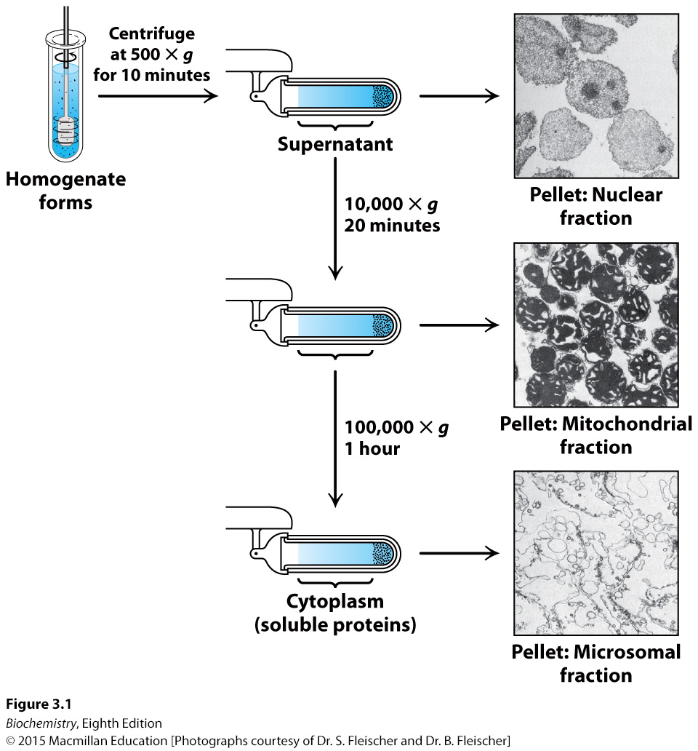
Notes:
FIGURE 3.1 Differential centrifugation. Cells are disrupted in a homogenizer and the resulting mixture, called the homogenate, is centrifuged in a step-by-step fashion of increasing centrifugal force. The denser material will form a pellet at lower centrifugal force than will the less-dense material. The isolated fractions can be used for further purification. [Photographs courtesy of Dr. S. Fleischer and Dr. B. Fleischer.]

Slide 8
Salting out takes advantage of the fact that the solubility of proteins varies with the salt concentration. Most proteins require some salt to dissolve in water, a process called salting in. As the salt concentration is increased, different proteins will precipitate at different salt concentrations, a process called salting out.
The salt can be removed from a protein solution by dialysis. The protein solution is placed in a cellophane bag with pores too small to allow the protein to diffuse, but big enough to allow the salt to equilibrate with the solution surround the dialysis bag.

Slide 9
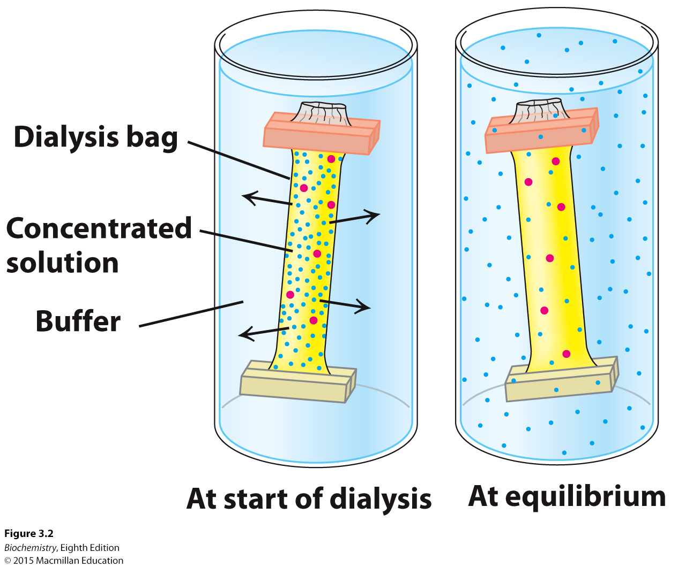
Notes:
FIGURE 3.2 Dialysis. Protein molecules (red) are retained within the dialysis bag, whereas small molecules (blue) diffuse down their concentration gradient into the surrounding medium.

Slide 10
Gel filtration chromatography, also known as molecular exclusion chromatography, allows the separation of proteins on the basis of size. A glass column is filled with porous beads. When a protein solution is passed over the beads, large proteins cannot enter the beads and exit the column first. Small proteins can enter the beads and thus have a longer path and exit the column last.

Slide 11
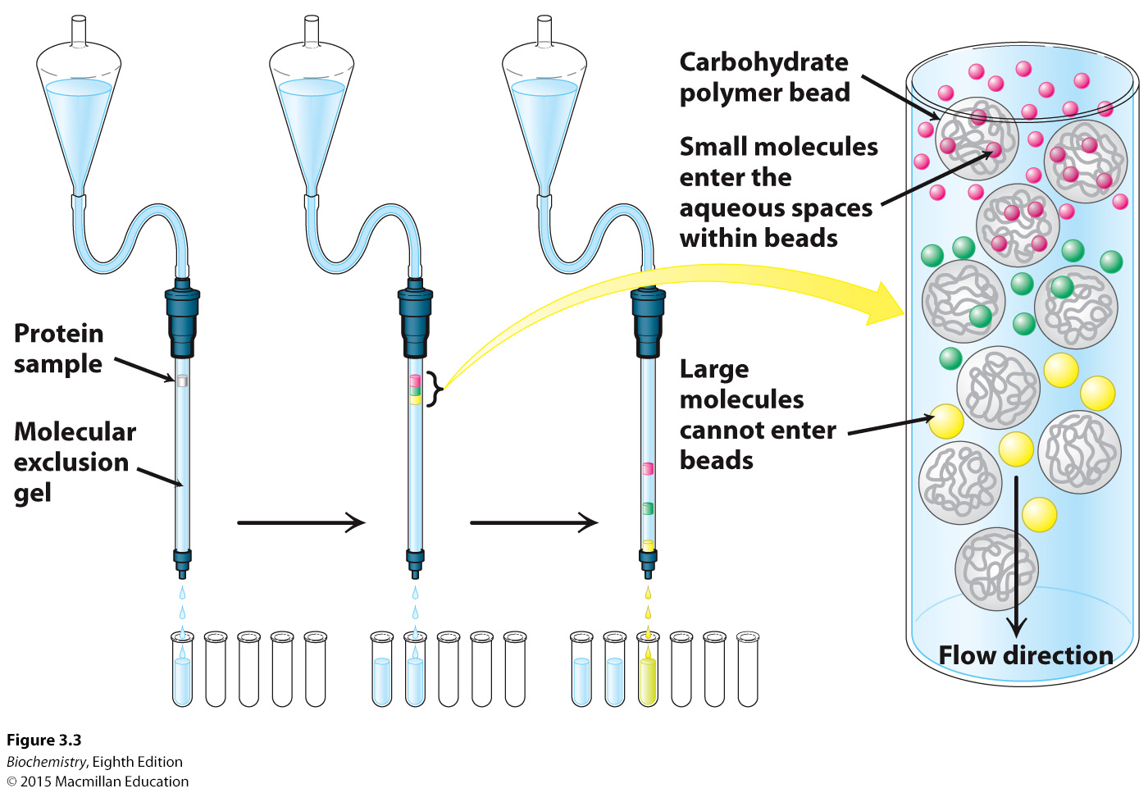
Notes:
FIGURE 3.3 Gel-filtration chromatography. A mixture of proteins in a small volume is applied to a column filled with porous beads. Because large proteins cannot enter the internal volume of the beads, they emerge sooner than do small ones.

Slide 12
Ion exchange chromatography allows separation of proteins on the basis of charge. The beads in the column are made so as to have a charge. When a mixture of proteins is passed through the column, proteins with the same charge as on the column will exit the column quickly. Proteins with the opposite charge will bind to the beads, and are subsequently released by increasing the salt concentration or adjusting the pH of the buffer that is passed through the column.

Slide 13
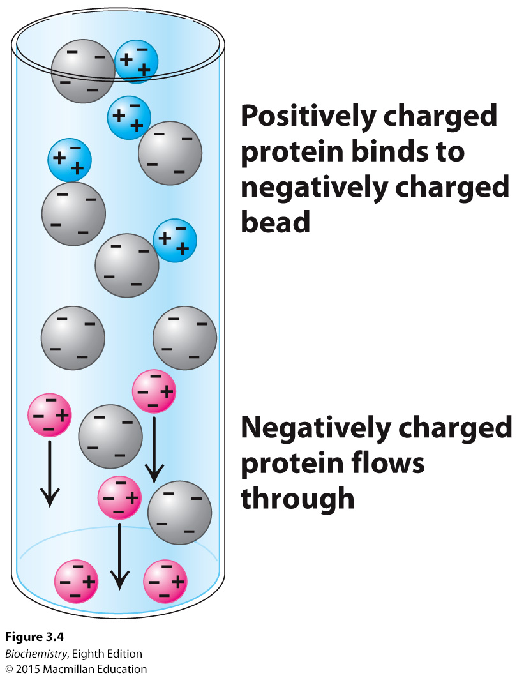
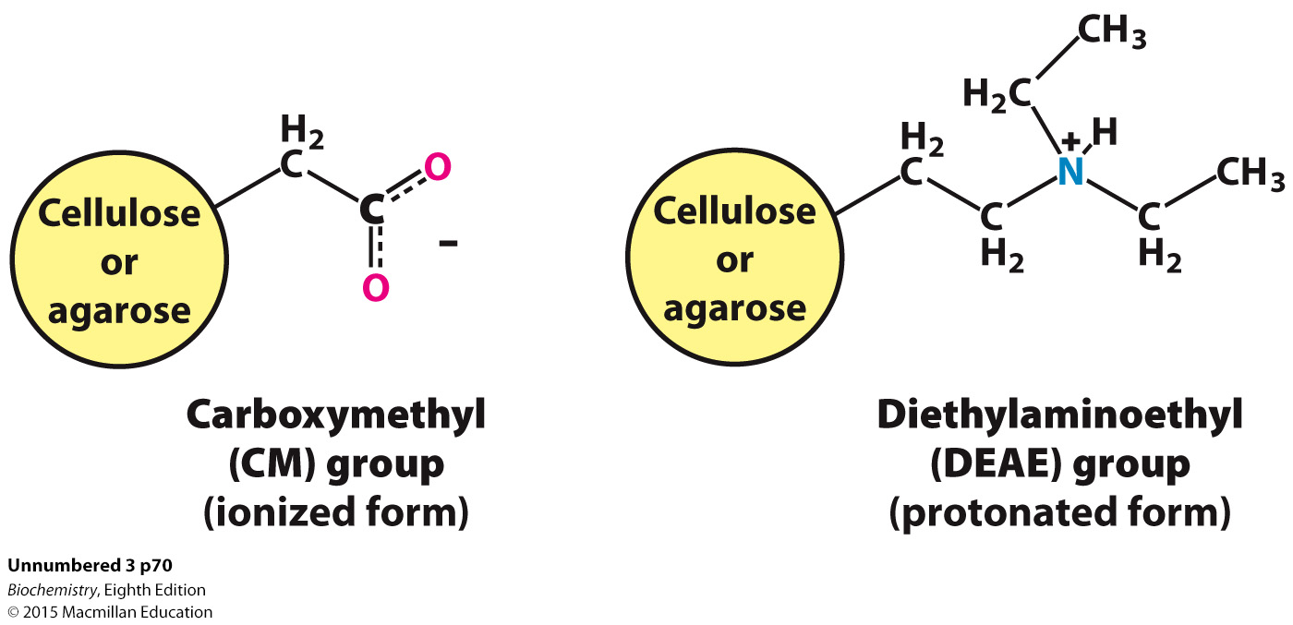
Notes:
FIGURE 3.4 Ion-exchange chromatography. This technique separates proteins mainly according to their net charge.

Slide 14
Affinity chromatography takes advantage of the fact that some proteins have a high affinity for specific chemicals or chemical groups. Beads are made with the specific chemical attached. A protein mixture is passed through the column. Only proteins with affinity for the attached group will be retained. The bound protein is then released by passing a solution enriched in the chemical to which the protein is bound through the column.

Slide 15
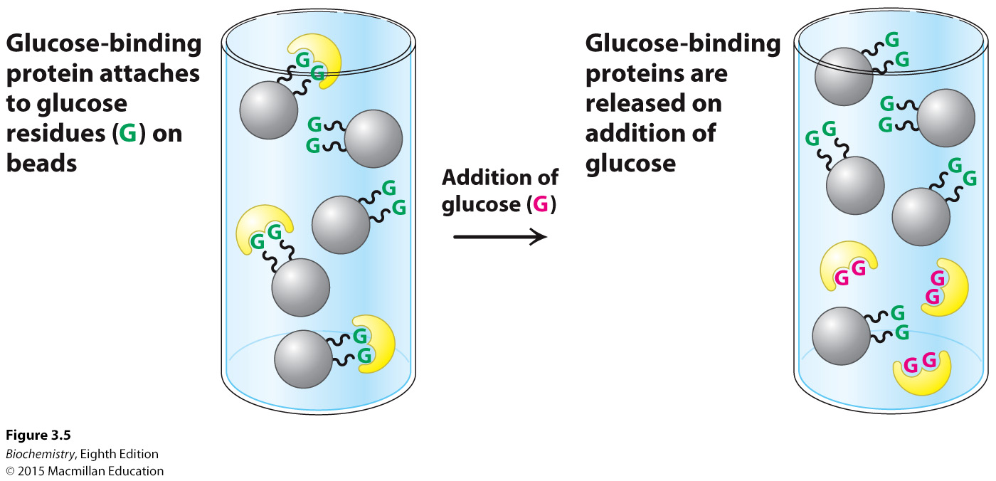
Notes:
FIGURE 3.5 Affinity chromatography. Affinity chromatography of concanavalin A (shown in yellow) on a solid support containing covalently attached glucose residues (G).

Slide 16
The resolving power of any chromatographic technique is related to the number of potential sites of interaction between the protein and the column beads. Very fine beads allow more interactions and thus greater resolving power, but flow rates through such columns are too slow.
High-performance liquid chromatography (HPLC) uses very fine beads in metal columns and high pressure pumps to move the liquid through the column. Because of the increased number of interaction sites, the resolving power of HPLC is greater than normal columns.

Slide 17
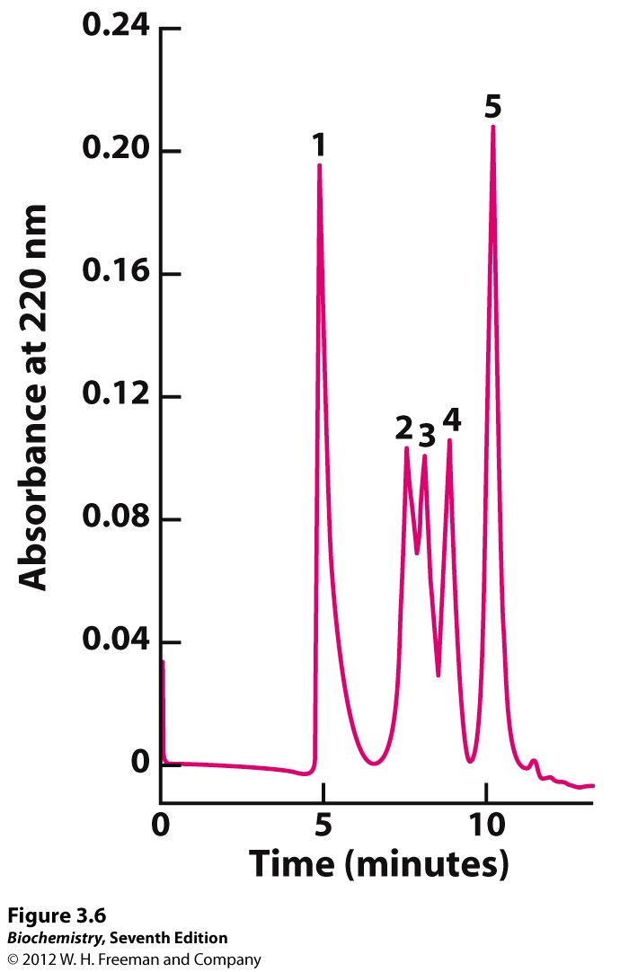
Notes:
FIGURE 3.6 High-performance liquid chromatography (HPLC) . Gel filtration by HPLC clearly defines the individual proteins because of its greater resolving power: (1) thyroglobulin (669 kDa ), (2) catalase (232 kDa ), (3) bovine serum albumin (67 kDa ), (4) ovalbumin (43 kDa ), and (5) ribonuclease (13.4 kDa ). [Data from K. J. Wilson and T. D. Schlabach. In Current Protocols in Molecular Biology, vol. 2, suppl. 41, F. M. Ausubel, R. Brent, R. E. Kingston, D. D. Moore, J. G. Seidman, J. A. Smith, and K. Struhl, Eds. (Wiley, 1998), p. 10.14.1.]

Slide 18


Proteins will migrate in an electrical field with a velocity (v) directly proportional to electric field strength (E), the charge on the protein (z), and inversely proportional to the frictional coefficient ( ).
The frictional coefficient is a function of the protein mass, shape, radius (r) and the density of the medium ( η ).
When the migration occurs in a gel, it is called gel electrophoresis.

Slide 19
Sodium dodecyl sulfate-polyacrylamide gel electrophoresis (SDS-PAGE) allows accurate determination of mass. SDS denatures proteins, and for most proteins, 1 molecule of SDS binds for every two amino acids. Thus, proteins have the same charge to mass ratio and migrate in the gel on the basis of mass only.

Slide 20
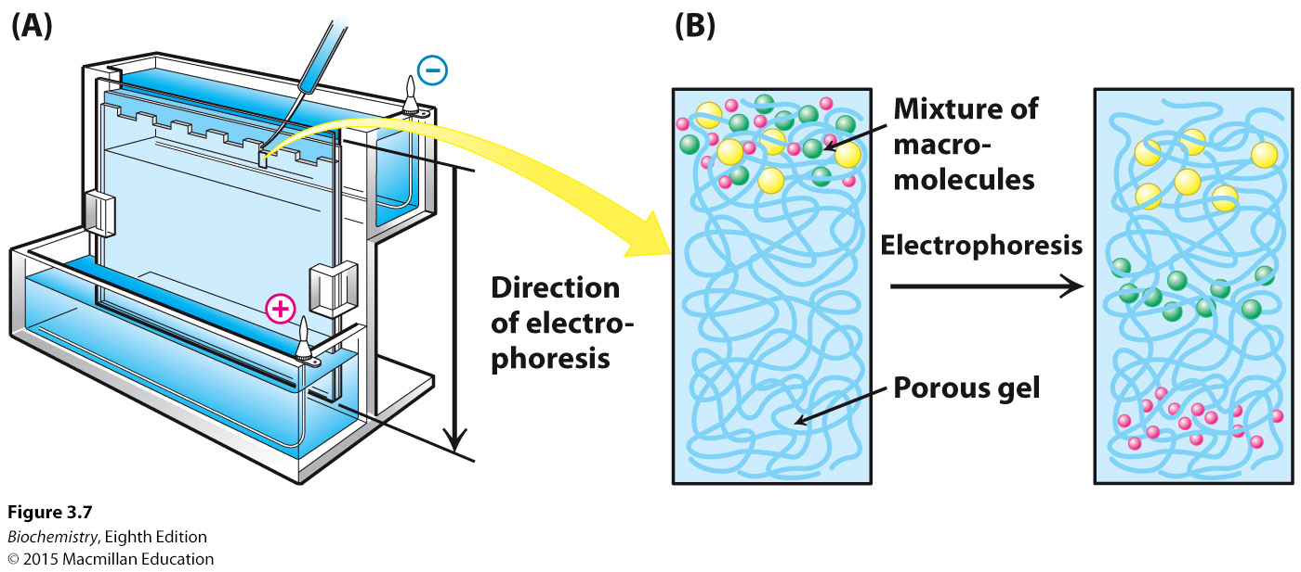
Notes:
FIGURE 3.7 Polyacrylamide gel electrophoresis. (A) Gel electrophoresis apparatus. Typically, several samples undergo electrophoresis on one flat polyacrylamide gel. A microliter pipette is used to place solutions of proteins in the wells of the slab. A cover is then placed over the gel chamber and voltage is applied. The negatively charged SDS (sodium dodecyl sulfate)–protein complexes migrate in the direction of the anode, at the bottom of the gel. (B) The sieving action of a porous polyacrylamide gel separates proteins according to size, with the smallest moving most rapidly.

Slide 21
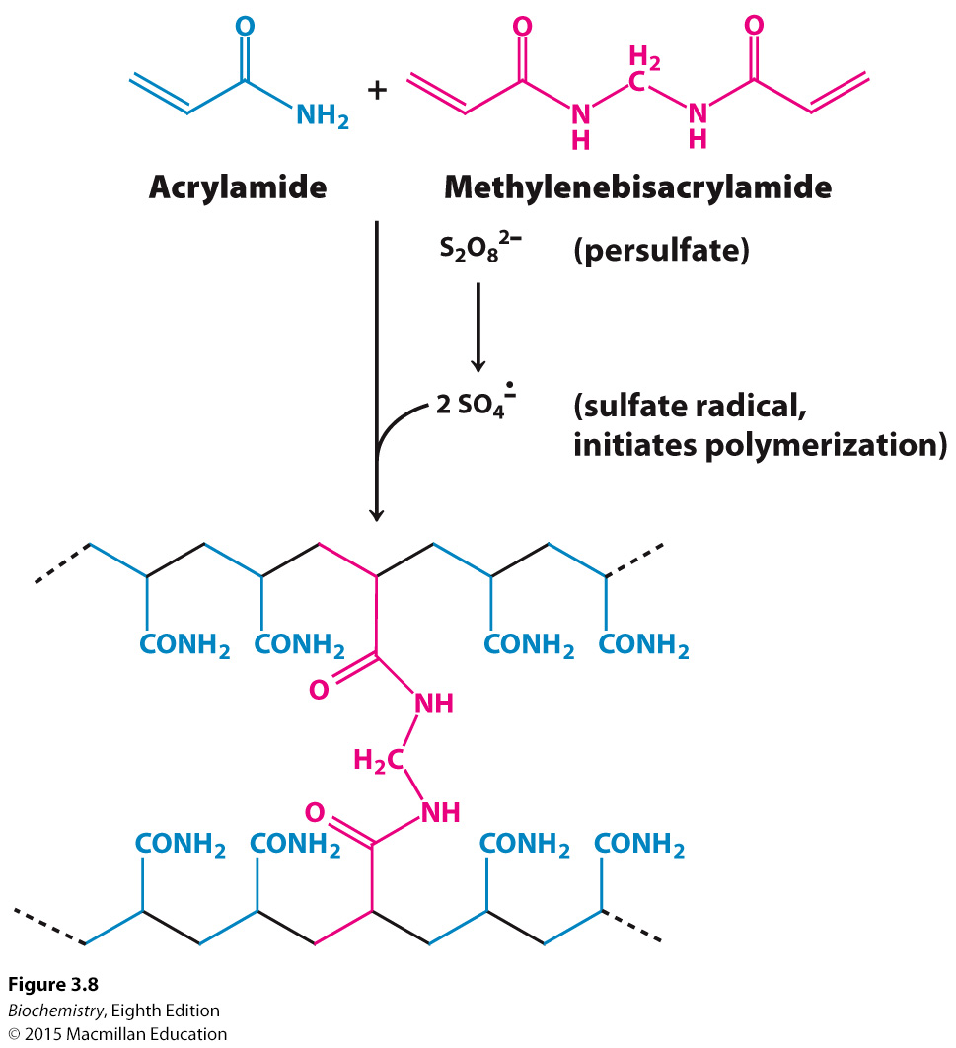
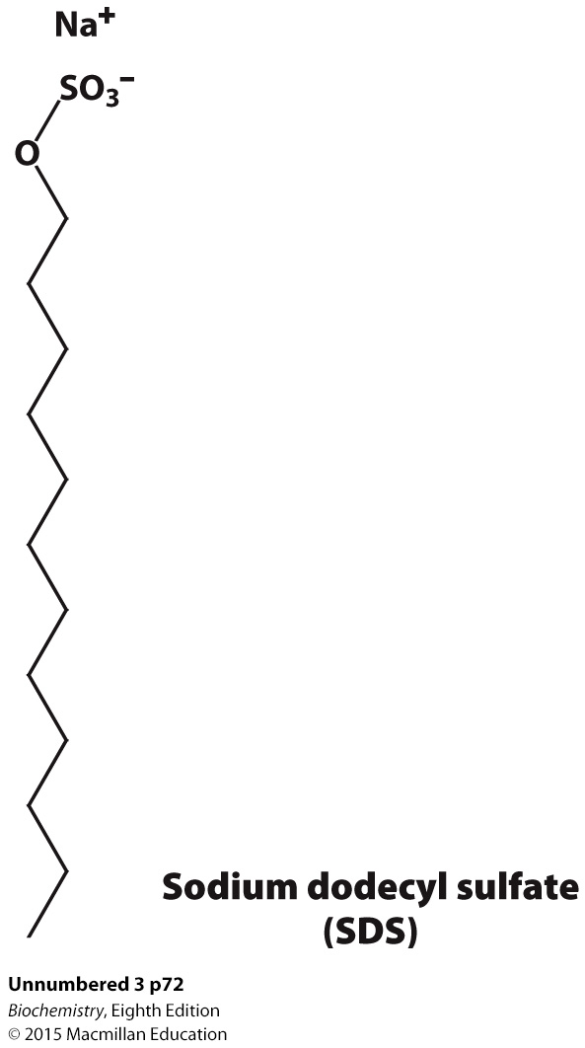
Notes:
FIGURE 3.8 Formation of a polyacrylamide gel. A three-dimensional mesh is formed by copolymerizing activated monomer (blue) and cross-linker (red).

Slide 22
Proteins separated by SDS-PAGE are visualized by staining the gel with dyes such as Coomassie blue.

Slide 23
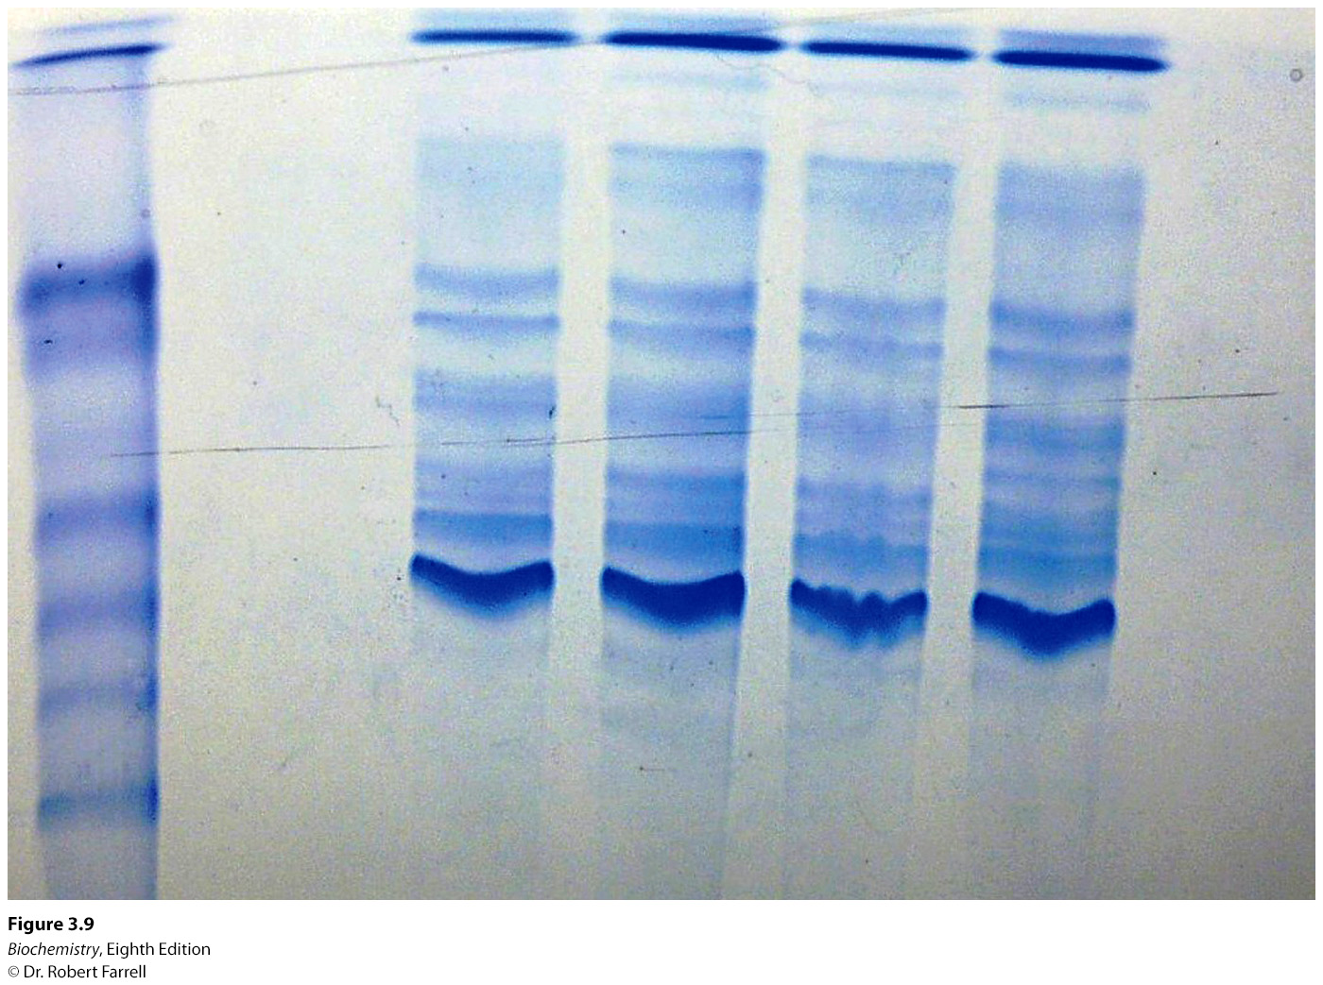
Notes:
FIGURE 3.9 Staining of proteins after electrophoresis. Mixtures of proteins from cellular extracts subjected to electrophoresis on an SDS– polyacrylamide gel can be visualized by staining with Coomassie blue. The first lane contains a mixture of proteins of known molecular weights, which can be used to estimate the sizes of the bands in the samples. [©Dr. Robert Farrell.]

Slide 24
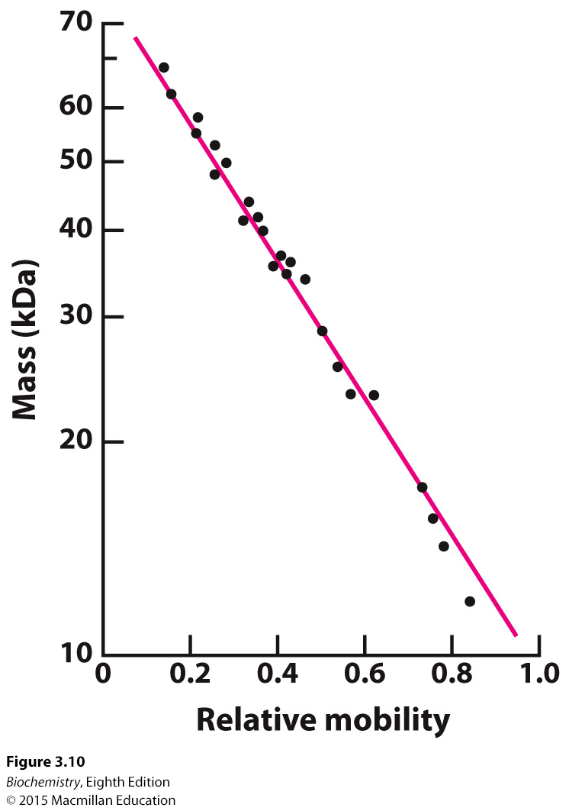
Notes:
FIGURE 3.10 Electrophoresis can determine mass. The electrophoretic mobility of many proteins in SDS–polyacrylamide gels is inversely proportional to the logarithm of their mass. [Data from K. Weber and M. Osborn, The Proteins, vol. 1, 3d ed. (Academic Press, 1975), p. 179.]

Slide 25
Isoelectric focusing allows separation of proteins in a gel on the basis of their relative amounts of acidic and basic amino acids. If a mixture of proteins is placed in a gel with a pH gradient and an electrical field is applied, proteins will migrate to their isoelectric point, the pH at which they have no net charge.

Slide 26
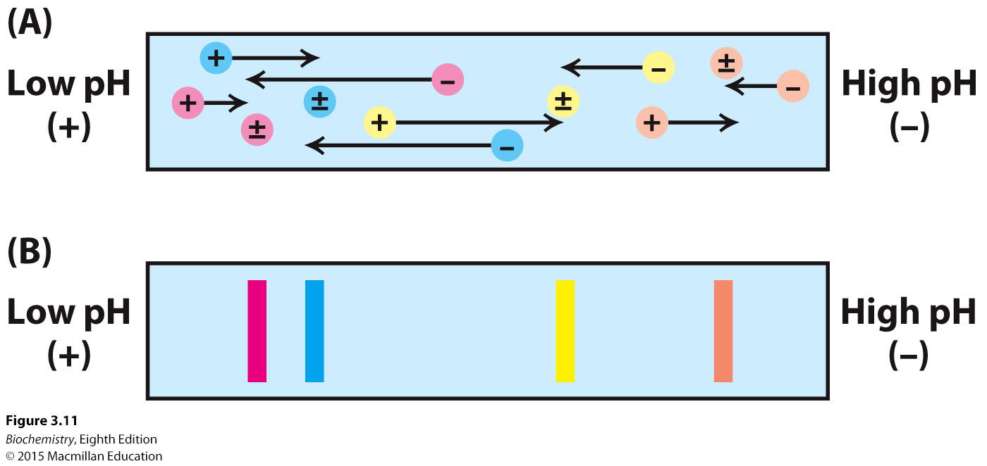
Notes:
FIGURE 3.11 The principle of isoelectric focusing. A pH gradient is established in a gel before loading the sample. (A) Each protein, represented by the different colored circles, will possess a net positive charge in the regions of the gel where the pH is lower than its respective pI value and a net negative charge where the pH is greater than its pI. When voltage is applied to the gel, each protein will migrate to its pI, the location at which it has no net charge.
(B) The proteins form bands that can be excised and used for further experimentation.

Slide 27
In two-dimensional gel electrophoresis, proteins are separated in one direction by isoelectric focusing. This gel is then attached to an SDS-PAGE gel and electrophoresis is performed at a 90º angle to the direction of the isoelectric focusing separation.

Slide 28
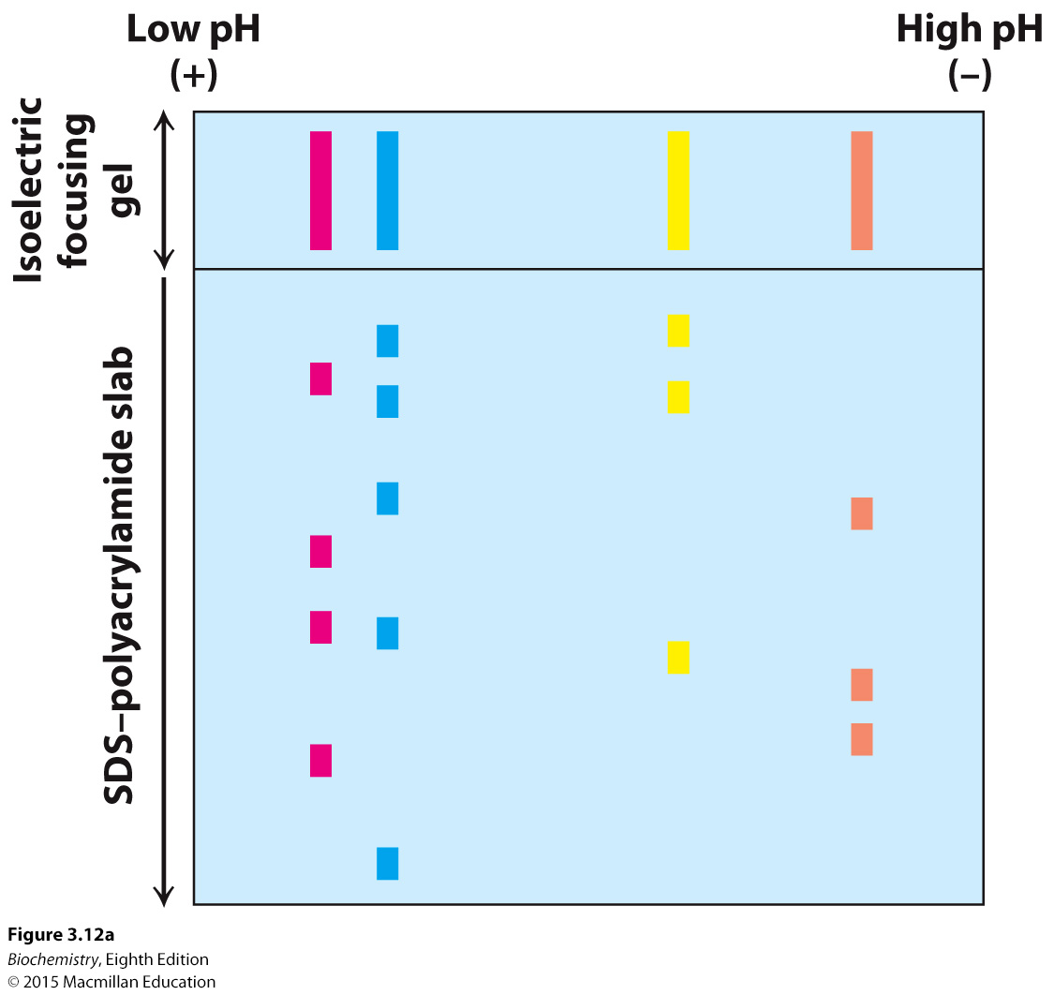
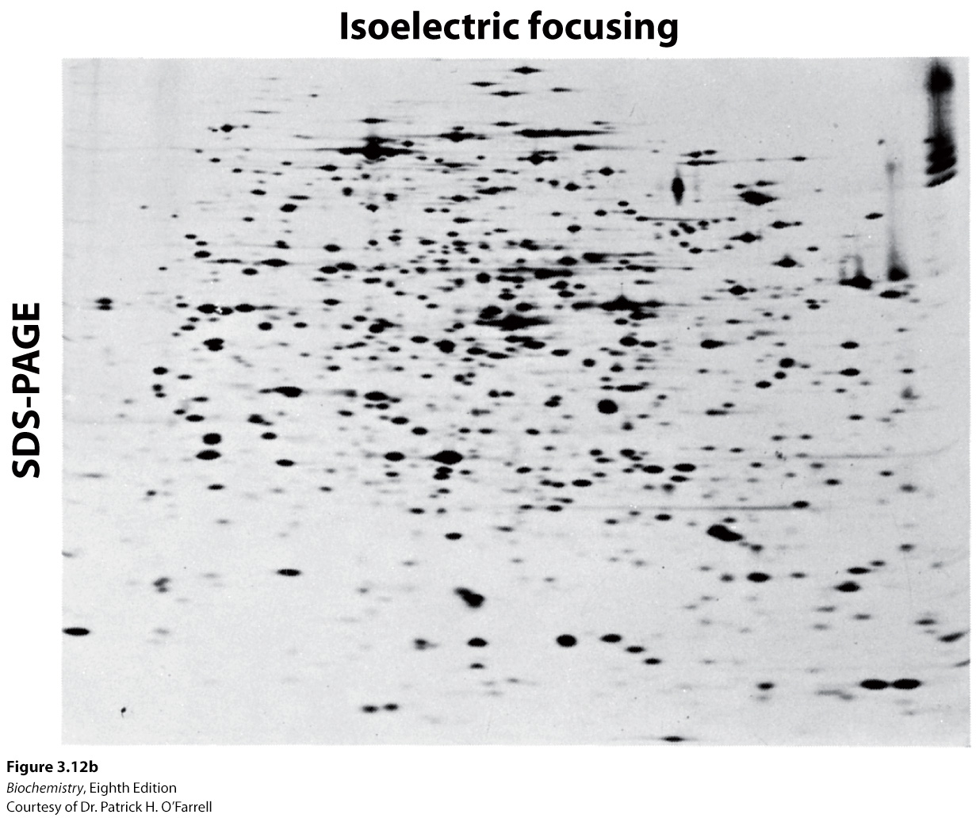
Notes:
FIGURE 3.12 Two-dimensional gel electrophoresis. (A) A protein sample is initially fractionated in one dimension by isoelectric focusing as described in Figure 3.11. The isoelectric focusing gel is then attached to an SDS–polyacrylamide gel, and electrophoresis is performed in the second dimension, perpendicular to the original separation. Proteins with the same pI are now separated on the basis of mass. (B) Proteins from E. coli were separated by two-dimensional gel electrophoresis, resolving more than a thousand different proteins. The proteins were first separated according to their isoelectric pH in the horizontal direction and then by their apparent mass in the vertical direction. [(B) Courtesy of Dr. Patrick H. O’Farrell.]

Slide 29
Two-dimensional electrophoresis can be used to detect differences in protein expression under different physiological circumstances.

Slide 30
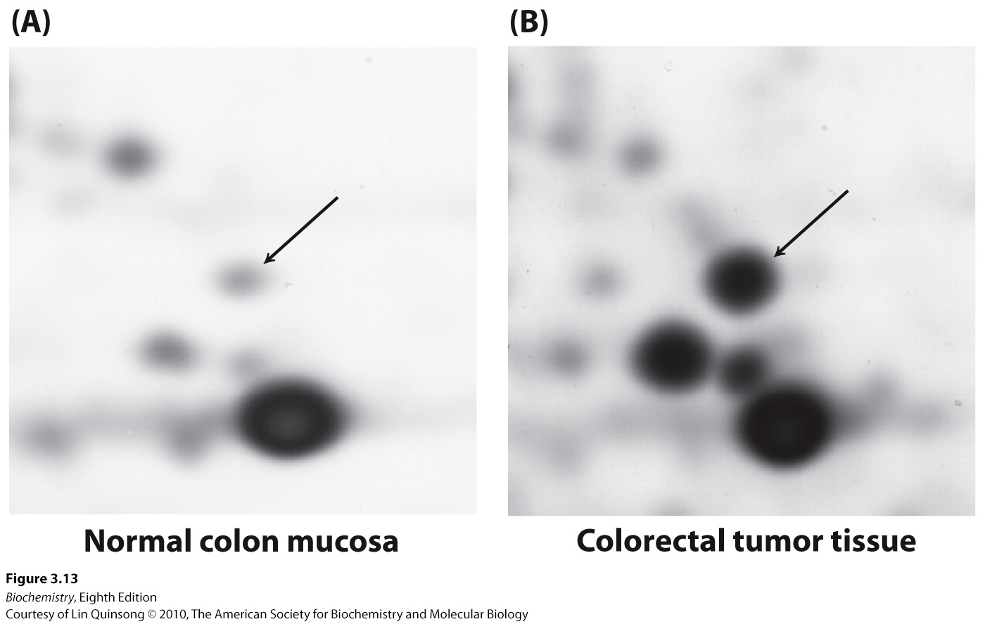
Notes:
FIGURE 3.13 Alterations in protein levels detected by two-dimensional gel electrophoresis. Samples of normal colon mucosa and colorectal tumor tissue from the same person were analyzed by two-dimensional gel electrophoresis. In the gel section shown, changes in the intensity of several spots are evident, including a dramatic increase in levels of the protein indicated by the arrow, corresponding to the enzyme glyceraldehyde-3-phosphate dehydrogenase. [Courtesy of Lin Quinsong © 2010, The American Society for Biochemistry and Molecular Biology.]

Slide 31

The effectiveness of a purification scheme is measured by calculating the specific activity after each separation technique.
Specific activity is the ratio of enzyme activity to protein concentration. Specific activity should increase with each step of the purification procedure.
SDS-PAGE allows a visual evaluation of the purification scheme.

Slide 32
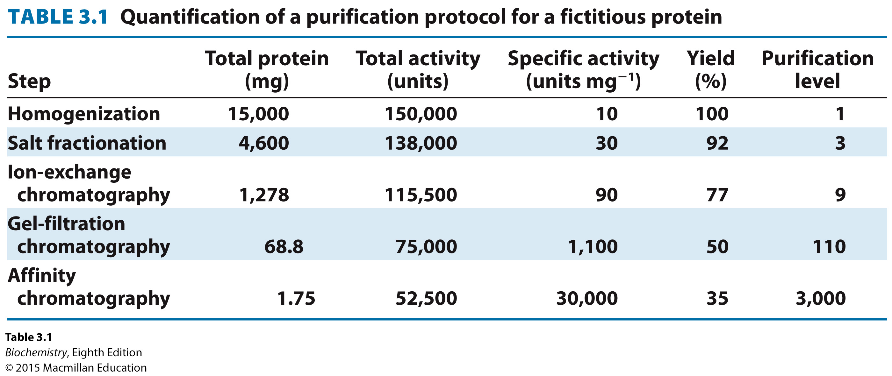

Slide 33
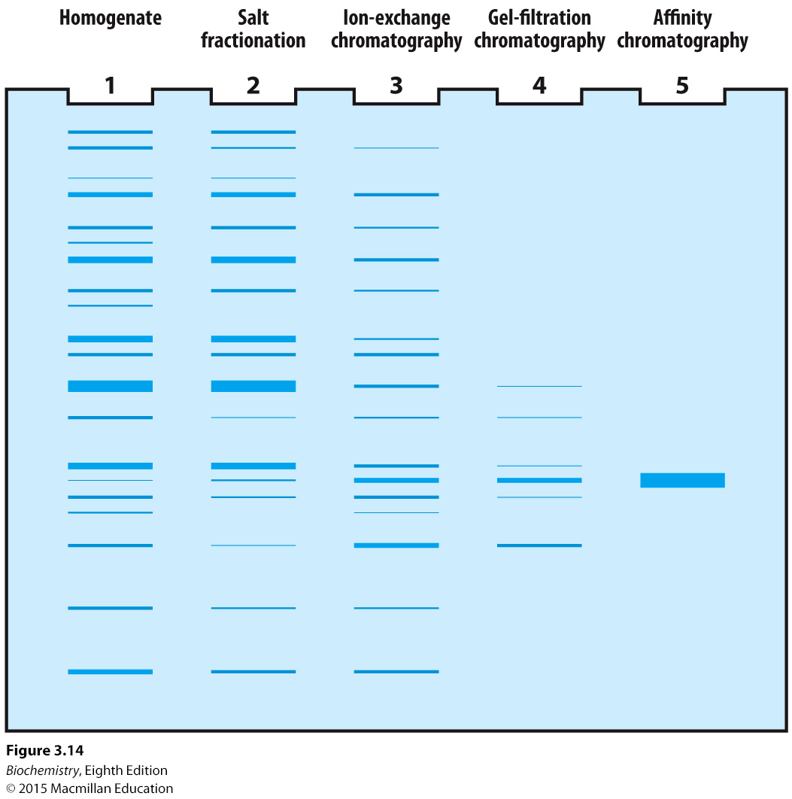
Notes:
FIGURE 3.14 Electrophoretic analysis of a protein purification. The purification scheme in Table 3.1 was analyzed by SDS-PAGE. Each lane contained 50 μg of sample. The effectiveness of the purification can be seen as the band for the protein of interest becomes more prominent relative to other bands.

Slide 34


Ultracentrifugation can be used to examine proteins. When subjected to a centrifugal force, the rate of movement of a particle is defined by the sedimentation coefficient, s
Where m=mass, = the partial specific volume (or one over the mass of the particle, ρ=density of the medium, and ƒ =the frictional coefficient of the particle.

Slide 35
Sedimentation coefficients are usually expressed as Svedberg units (S), equal to 10⁻¹³ s.
The smaller the S value, the slower the protein moves in a centrifugal field.

Slide 36
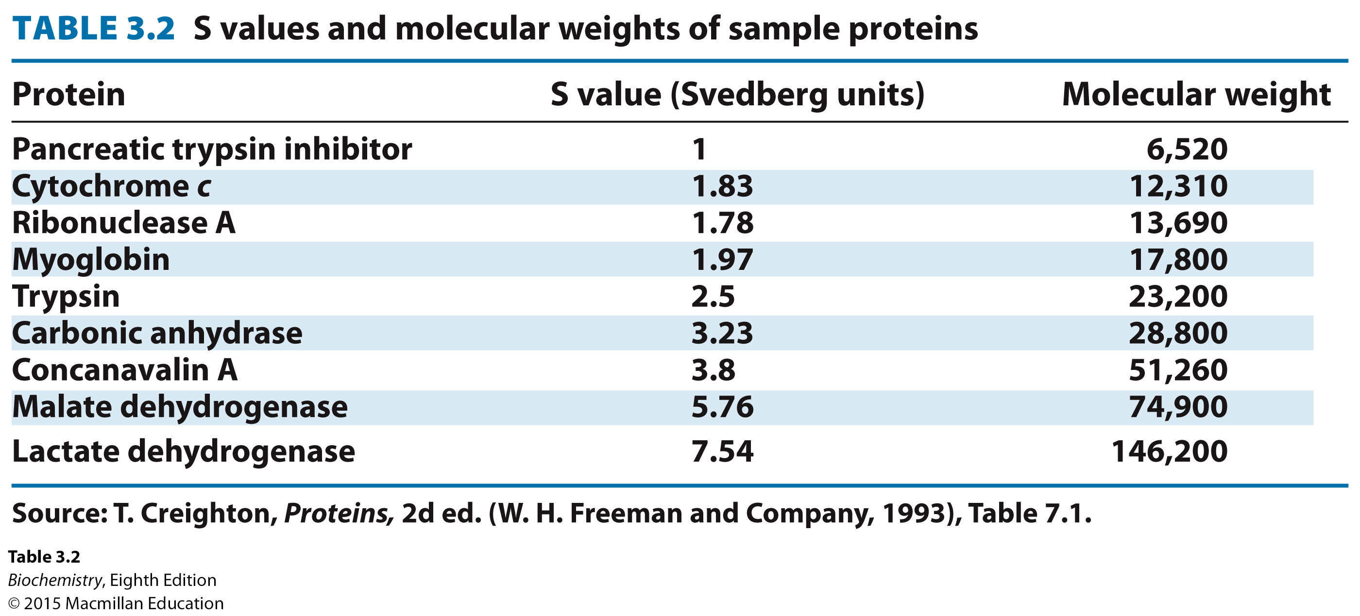

Slide 37
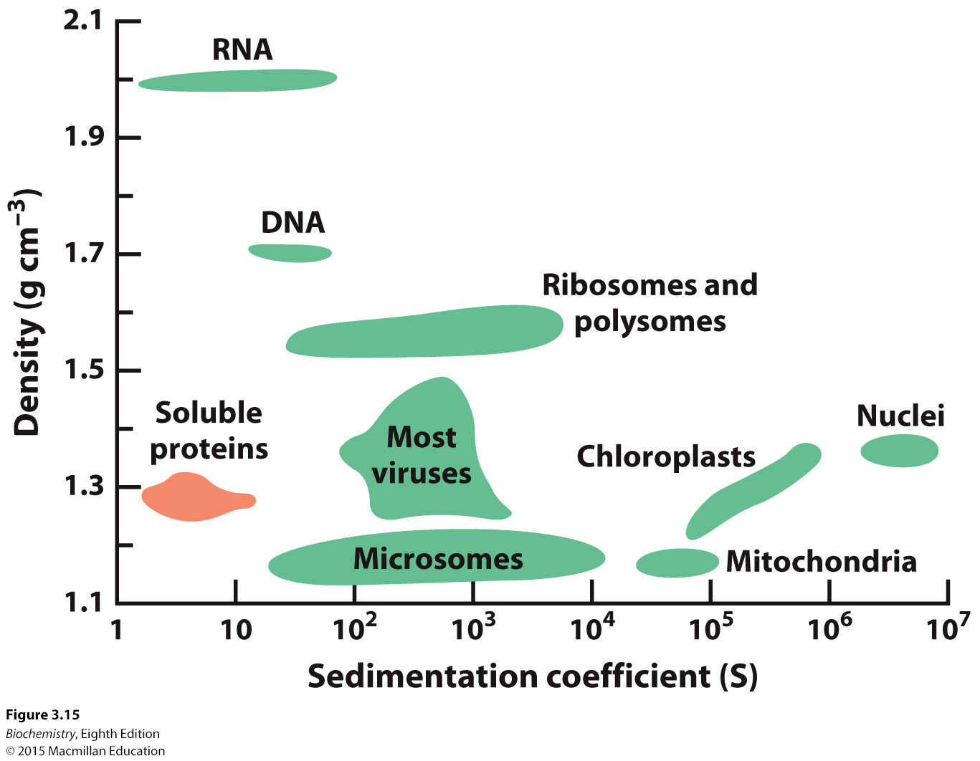
Notes:
FIGURE 3.15 Density and sedimentation coefficients of cellular components. [Data from L. J. Kleinsmith and V. M. Kish, Principles of Cell and Molecular Biology, 2d ed. (HarperCollins, 1995),p. 138.]

Slide 38
A density gradient is formed in a centrifuge tube, and a mixture of proteins in solution is placed on top of the gradient.
After the centrifugation is complete, a small hole is made in the bottom of the tube and portions of the gradient are collected. These portions are analyzed for protein concentration, enzyme activity or other biochemical characteristics.

Slide 39
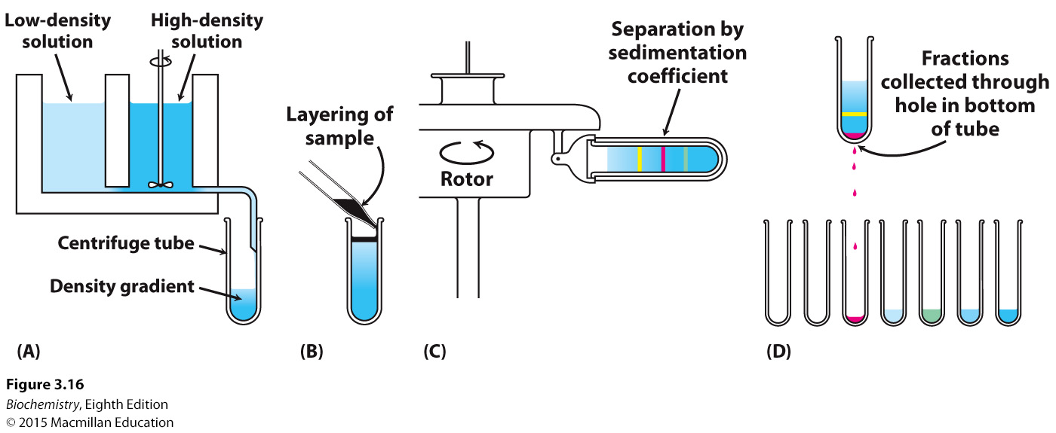
Notes:
FIGURE 3.16 Zonal centrifugation. The steps are as follows: (A) form a density gradient, (B) layer the sample on top of the gradient, (C) place the tube in a swinging bucket rotor and centrifuge it, and (D) collect the samples. [Information from D. Freifelder, Physical Biochemistry, 2d ed. (W. H. Freeman and Company, 1982), p. 397.]

Slide 40
Large quantities of proteins can be obtained.
Proteins can be modified with affinity tags that allow purification of the protein or visualization of the protein in the cell.
Proteins with modified primary structure can be generated.

Slide 41

An antibody is a protein synthesized in response to the presence of a foreign substance called an antigen.
The antibody recognizes a particular structural feature on the antigen called the antigenic determinant or epitope.

Slide 42
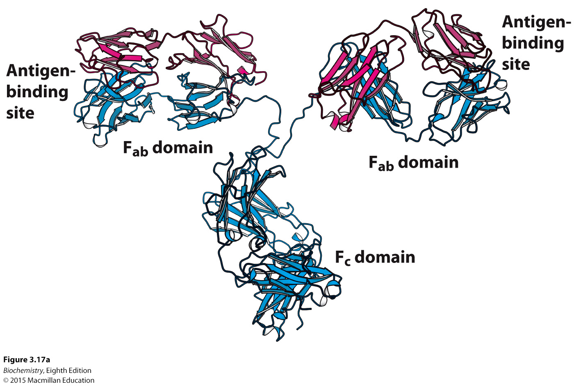
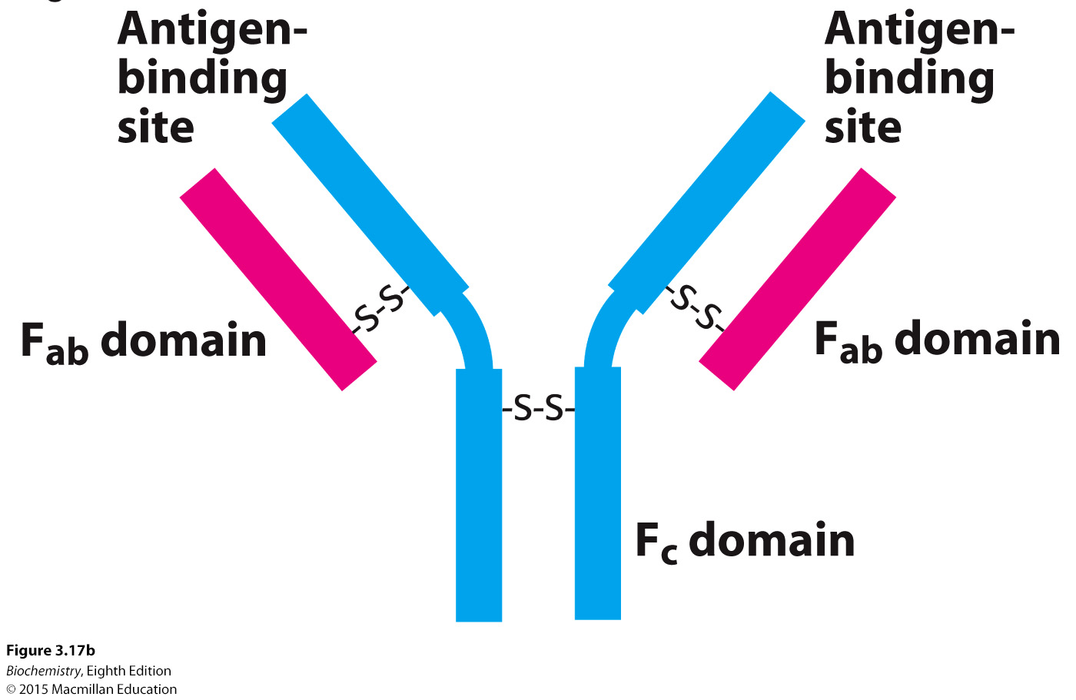
Notes:
FIGURE 3.17 Antibody structure. (A) Immunoglobulin G (IgG) consists of four chains, two heavy chains (blue) and two light chains (red), linked by disulfide bonds. The heavy and light chains come together to form F_{ab} domains, which have the antigen-binding sites at the ends. The two heavy chains form the F_{c} domain. Notice that the F_{ab} domains are linked to the F_{c} domain by flexible linkers. (B) A more schematic representation of an IgG molecule. [Drawn from 1IGT.pdb.]

Slide 43
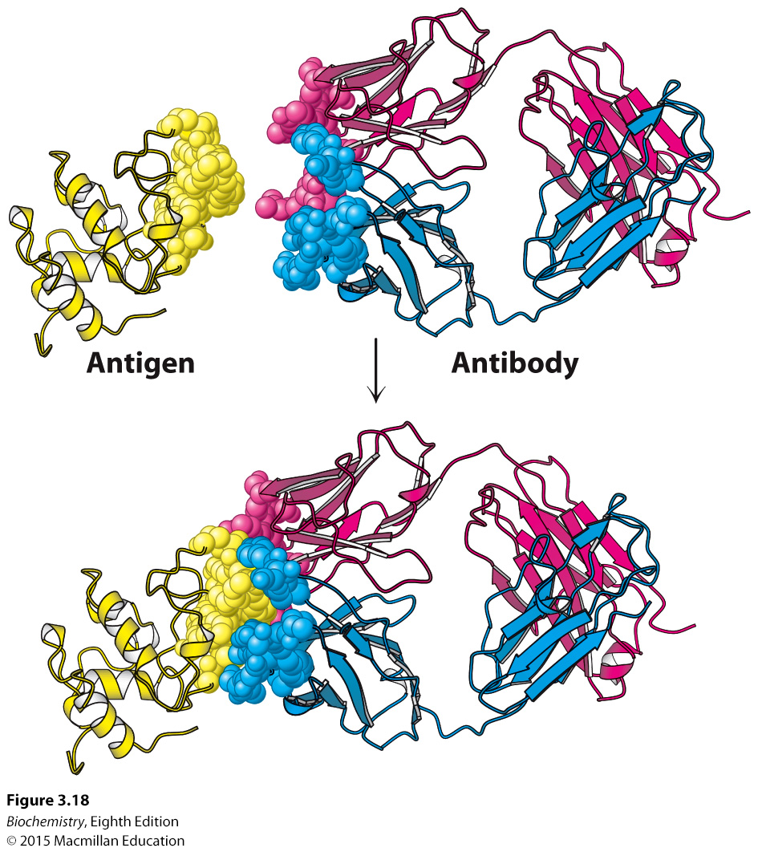
Notes:
FIGURE 3.18 Antigen–antibody interactions. A protein antigen, in this case lysozyme, binds to the end of an F_{ab} domain of an antibody. Notice that the end of the antibody and the antigen have complementary shapes, allowing a large amount of surface to be buried on binding. [Drawn from 1YQV.pdb.]

Slide 44
Any antibody-producing cell synthesizes antibodies that recognize only one epitope. Each antibody-producing cell thus synthesizes a monoclonal antibody.
Any antigen may have multiple epitopes. The antibodies produced to the antigen by different cells are said to be polyclonal.

Slide 45
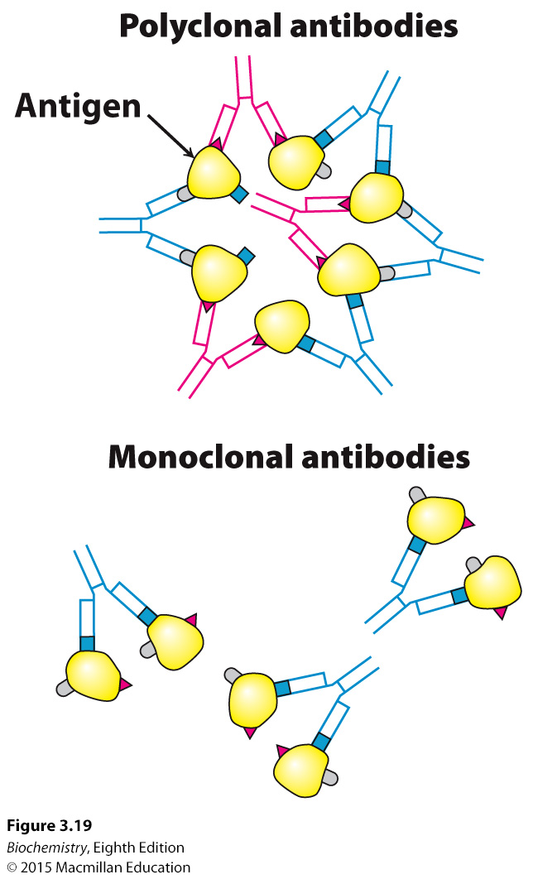
Notes:
FIGURE 3.19 Polyclonal and monoclonal antibodies. Most antigens have several epitopes. Polyclonal antibodies are heterogeneous mixtures of antibodies, each specific for one of the various epitopes on an antigen. Monoclonal antibodies are all identical, produced by clones of a single antibody-producing cell. They recognize one specific epitope. [Information from R. A. Goldsby, T. J. Kindt, and B. A. Osborne, Kuby Immunology, 4th ed. (W. H. Freeman and Company, 2000), p. 154.]

Slide 46

Immortal cell lines producing monoclonal antibodies can be generated by fusing normal antibody-producing cells with cells from a type of cancer called multiple myeloma.
A monoclonal cell line is isolated by screening for the antibody of interest.

Slide 47
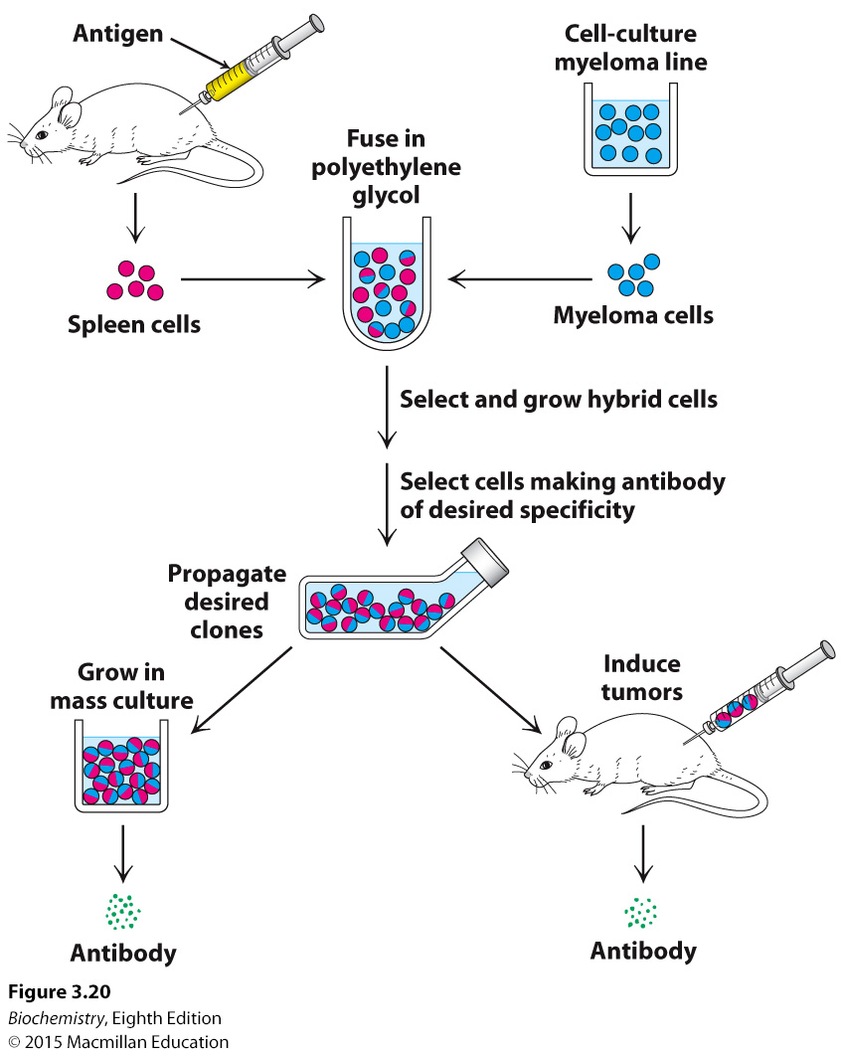
Notes:
FIGURE 3.20 Preparation of monoclonal antibodies. Hybridoma cells are formed by the fusion of antibody-producing cells and myeloma cells. The hybrid cells are allowed to proliferate by growing them in selective medium. They are then screened to determine which ones produce antibody of the desired specificity. [Information from C. Milstein. Monoclonal antibodies. Copyright © 1980 by Scientific American, Inc. All rights reserved.]

Slide 48
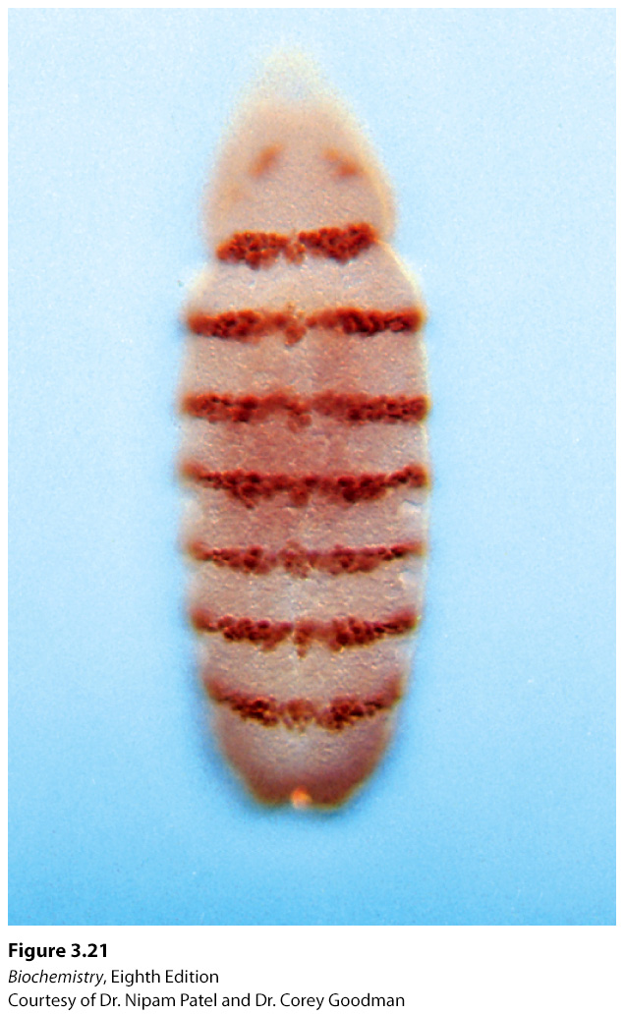
Notes:
FIGURE 3.21 Fluorescence micrograph of a developing Drosophila embryo. The embryo was stained with a fluorescence labeled monoclonal antibody for the DNA binding protein encoded by engrailed, an essential gene in specifying the body plan. [Courtesy of Dr. Nipam Patel and Dr. Corey Goodman.]

Slide 49
Antibodies are used as a reagent to quantify the amount of a protein or other antigen. Enzyme-linked immunosorbent assay (ELISA) quantifies the amount of protein present because the antibody is linked to an enzyme whose reaction yields a readily identified colored product.

Slide 50
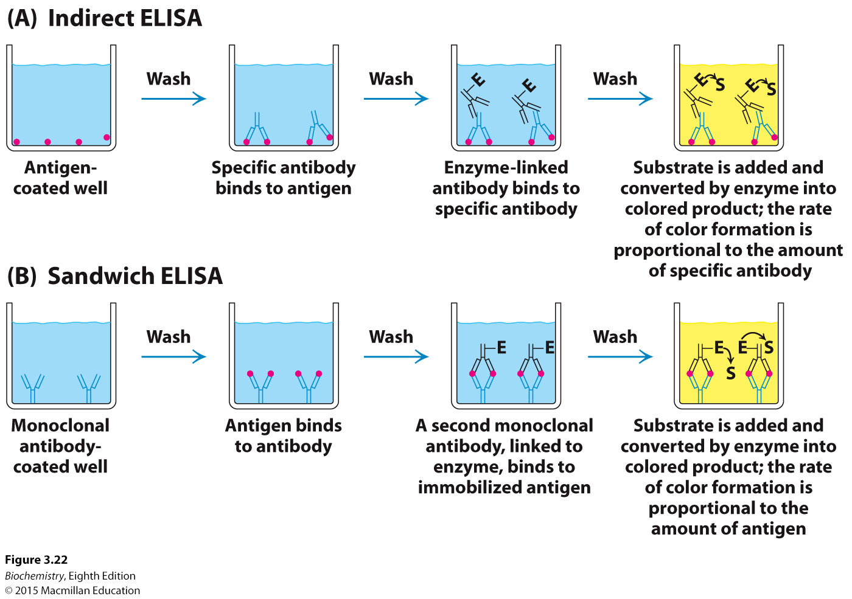
Notes:
FIGURE 3.22 Indirect ELISA and sandwich ELISA. (A) In indirect ELISA, the production of color indicates the amount of an antibody to a specific antigen. (B) In sandwich ELISA, the production of color indicates the quantity of antigen. [Information from R. A. Goldsby, T. J. Kindt, and B. A. Osborne, Kuby Immunology, 4th ed. (W. H. Freeman and Company, 2000), p. 162.]

Slide 51
In western blotting or immuonoblotting, proteins are separated in an SDS-PAGE gel, transferred to a polymer, and then stained with an antibody specific for the protein, called the primary antibody. A second antibody, the secondary antibody, specific for the first antibody is then added. The secondary antibody is attached to an enzyme that generates a chemiluminescent product or contains a fluorescently labeled tag, thereby allowing the detection of the primary antibody.

Slide 52
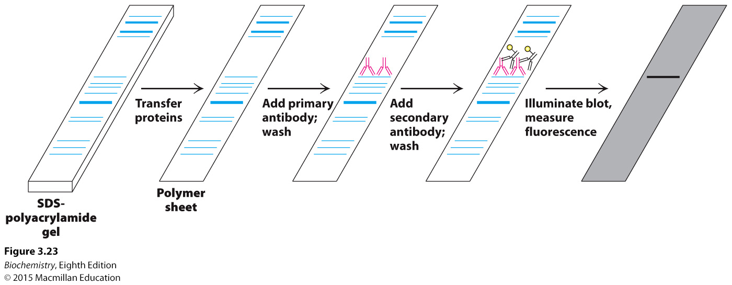
Notes:
FIGURE 3.23 Western blotting. Proteins on an SDS–polyacrylamide gel are transferred to a polymer sheet. The sheet is first treated with a primary antibody, which is specific for the protein of interest, and then washed to remove unbound antibody. Next, the sheet is treated with a secondary antibody, which recognizes the primary antibody, and washed again. Since the secondary antibody is labeled (here, with a fluorescent tag indicated by the yellow circle), the band containing the protein of interest can be identified.

Slide 53
Fluorescently labeled antibodies to particular proteins, coupled with fluorescence microscopy, allows the cellular location of proteins to be determined.
Green fluorescent protein can also be used to tag cellular proteins and to followed their movement in the cell.
Antibodies labeled with clusters of electron dense metal can be used in electron microscopy.

Slide 54
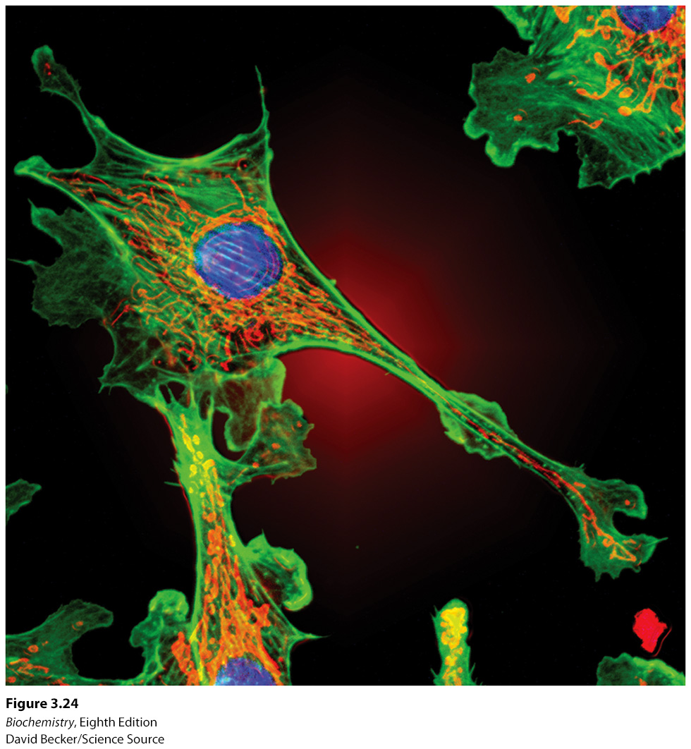
Notes:
FIGURE 3.24 Actin filaments. Fluorescence micrograph of a cell shows actin filaments stained green using an antibody specific to actin. [David Becker/Science Source.]

Slide 55
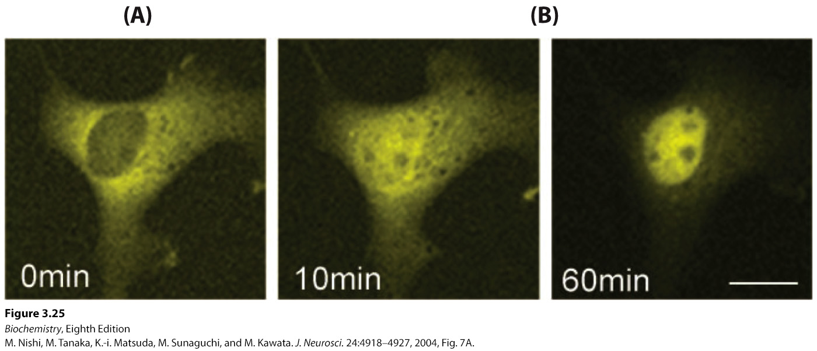
Notes:
FIGURE 3.25 Nuclear localization of a steroid receptor. (A) The mineralocorticoid receptor, made visible by attachment to a yellow variant of GFP, is located predominantly in the cytoplasm of the cultured cell. (B) Subsequent to the addition of corticosterone (a glucocorticoid steroid that also binds to the mineralocorticoid receptor), the receptor moves into the nucleus. [M. Nishi, M. Tanaka, K.-i. Matsuda, M. Sunaguchi, and M. Kawata. J. Neurosci. 24:4918–4927, 2004, Fig. 7A.]

Slide 56
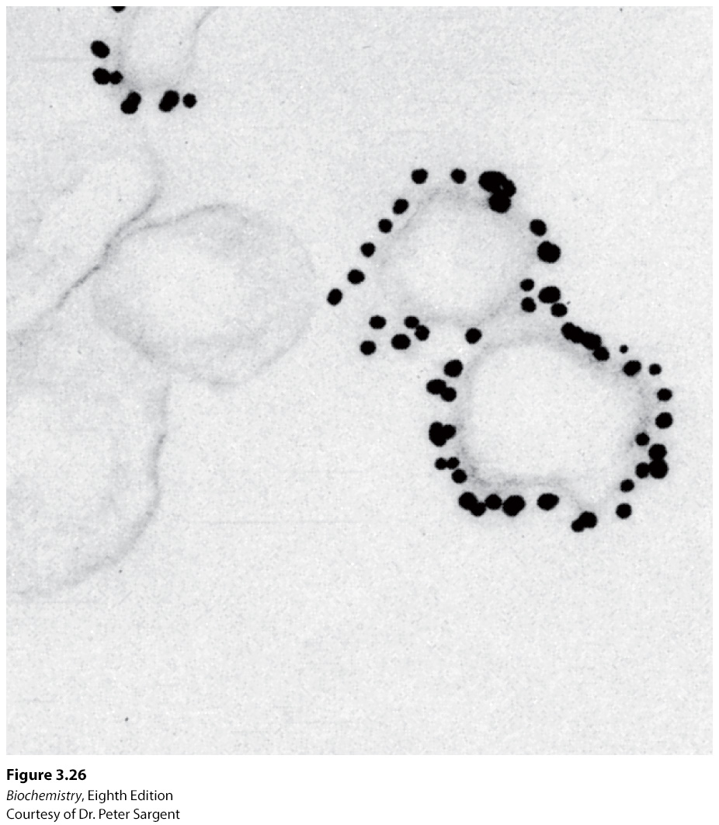
Notes:
FIGURE 3.26 Immunoelectron microscopy. The opaque particles (150-Å, or 15-nm, diameter) in this electron micrograph are clusters of gold atoms bound to antibody molecules. A gold-labeled antibody against a channel protein (Section 13.4) identifies membrane vesicles at the termini of neurons that contain this protein. [Courtesy of Dr. Peter Sargent.]

Slide 57

Mass spectrometry allows the highly accurate and sensitive detection of the mass of the molecule of interest, or analyte.
Mass spectrometers convert the analyte into gas-phase ions. The mass-to-charge ratio (m/z) can be determined.
Mass spectrometers consist of three components: an ion source, a mass analyzer and a detector.
Matrix-assisted laser desorption/ionization (MALDI) is often combined with a time-of-flight (TOF) detector.

Slide 58
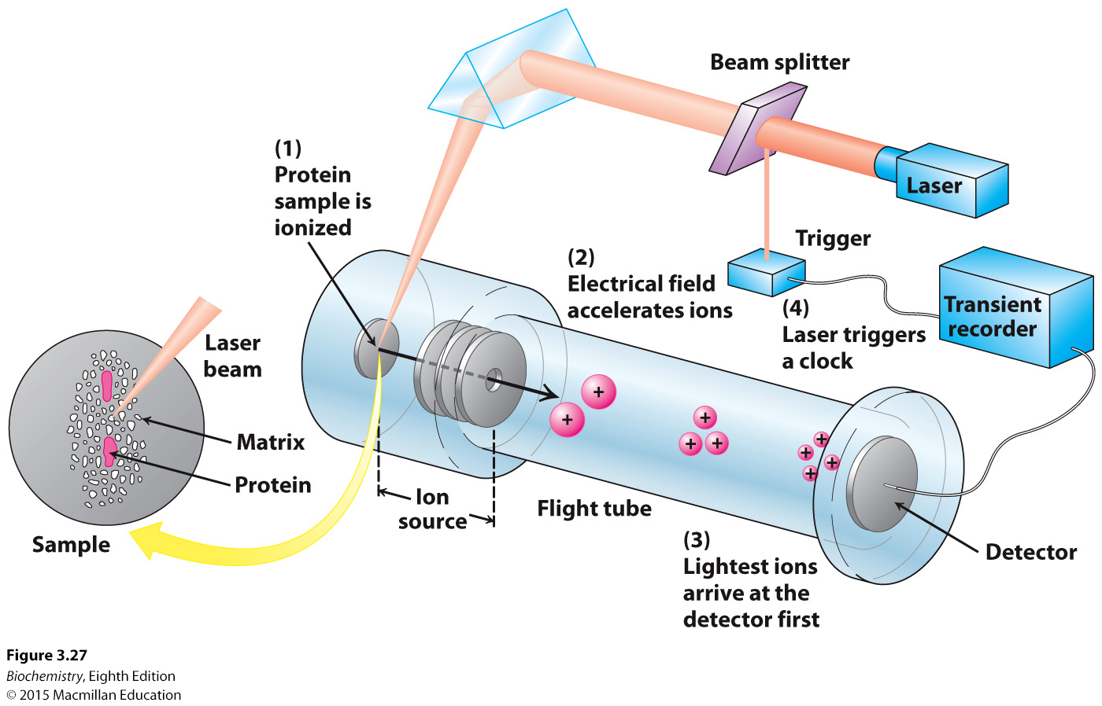
Notes:
Figure 3.27 MALDI-TOF mass spectrometry. (1) The protein sample, embedded in an appropriate matrix, is ionized by the application of a laser beam. (2) An electric field accelerates the ions through the flight tube toward the detector. (3) The lightest ions arrive first. (4) The ionizing laser pulse also triggers a clock that measures the time of flight (TOF) for the ions. [Information from J. T. Watson, Introduction to Mass Spectrometry, 3d ed. (Lippincott-Raven, 1997), p. 279.]

Slide 59
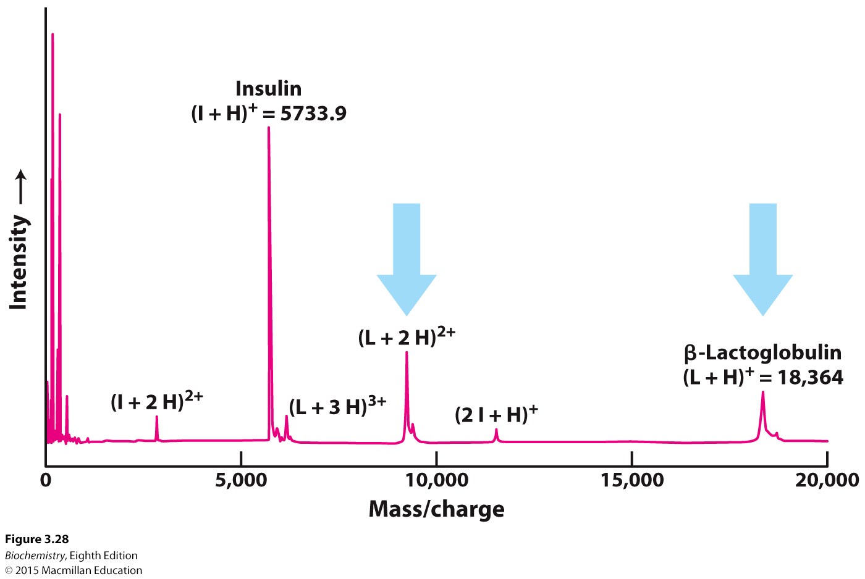
Notes:
FIGURE 3.28 MALDI-TOF mass spectrum of insulin and β-lactoglobulin. A mixture of 5 pmol each of insulin (I) and β-lactoglobulin (L) was ionized by MALDI, which produces predominantly singly charged molecular ions from peptides and proteins—the insulin ion (I+H)⁺ and the lactoglobulin ion (L+H)⁺. Molecules with multiple charges, such as those for β-lactoglobulin indicated by the blue arrows, as well as small quantities of a singly charged dimer of insulin (2 I+H)⁺ also are produced. [Data from J. T. Watson, Introduction to Mass Spectrometry, 3d ed. (Lippincott-Raven, 1997), p. 282.]

Slide 60
Although mass spectrometry has supplanted most chemical methods for determining amino acid sequence, it is illustrative to examine a once popular chemical method, the Edman degradation.
The amino acid sequence can be determined by Edman degradation. The protein is exposed to phenyl isothiocyanate (PTH), which reacts with the N-terminal amino acid to form a PTH-derivative. The PTH-amino acid can be released without cleaving the remainder of the protein, and the degradation is subsequently repeated.
High-performance liquid chromatography is used to identify the amino acids.

Slide 61
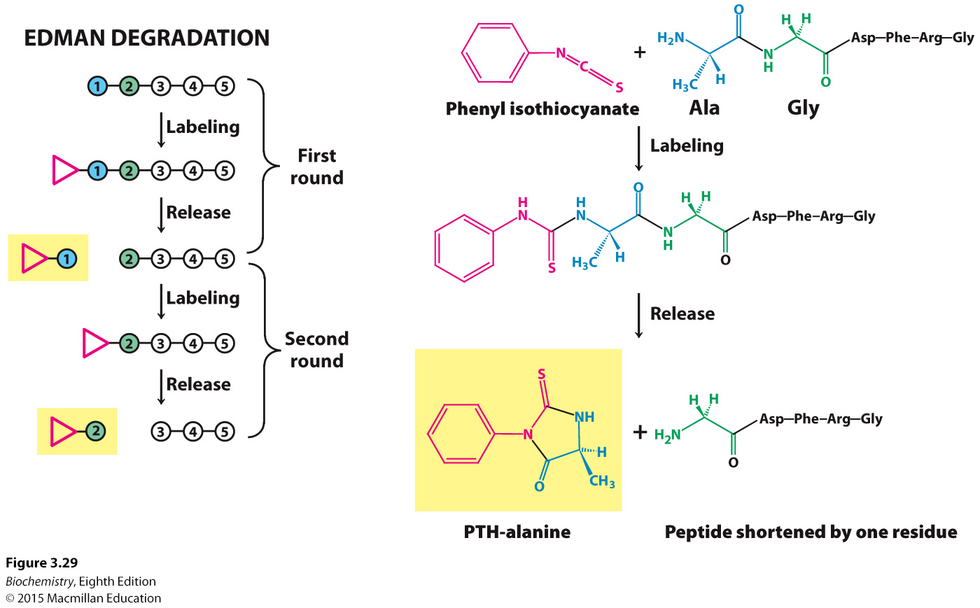
Notes:
FIGURE 3.29 The Edman degradation. The labeled amino-terminal residue (PTH–alanine in the first round) can be released without hydrolyzing the rest of the peptide. Hence, the amino-terminal residue of the shortened peptide (Gly-Asp-Phe-Arg-Gly) can be determined in the second round. Three more rounds of the Edman degradation reveal the complete sequence of the original peptide.

Slide 62
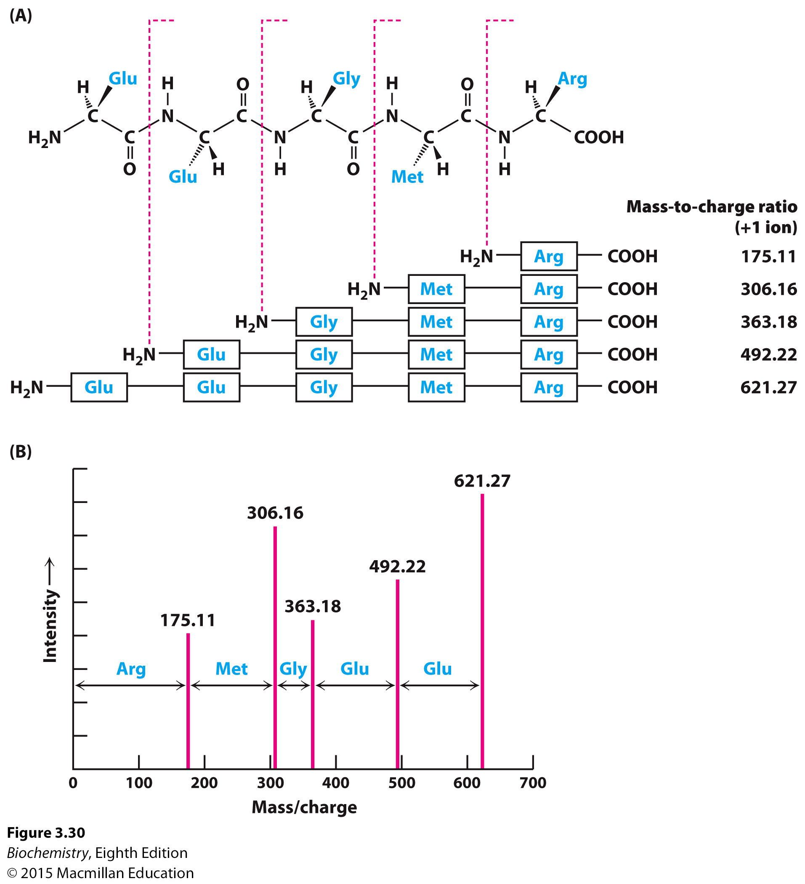
Tandem mass spectrometry facilitates protein sequence determination
Notes:
FIGURE 3.30 Peptide sequencing by tandem mass spectrometry. (A) Within the mass spectrometer, peptides can be fragmented by bombardment with inert gaseous ions to generate a family of product ions in which individual amino acids have been removed from one end. In this example, the carboxyl fragment of the cleaved peptide bond is ionized. (B) The product ions are detected in the second mass analyzer. The mass differences between the peaks indicate the sequence of amino acids in the precursor ion. [Data from H. Steen and M. Mann. Nat. Rev. Mol. Cell Biol. 5:699–711, 2004.]

Slide 63
Because the reactions of the Edman degradation and mass spectrometry procedure are not 100% effective, it is not possible to sequence polypeptides longer than 50 amino acids.
In order to sequence the entire protein, the protein is chemically or enzymatically cleaved to yield peptides of fewer than 50 amino acids.
The peptides are then ordered by performing a different cleavage procedure in order to generate overlap peptides.

Slide 64
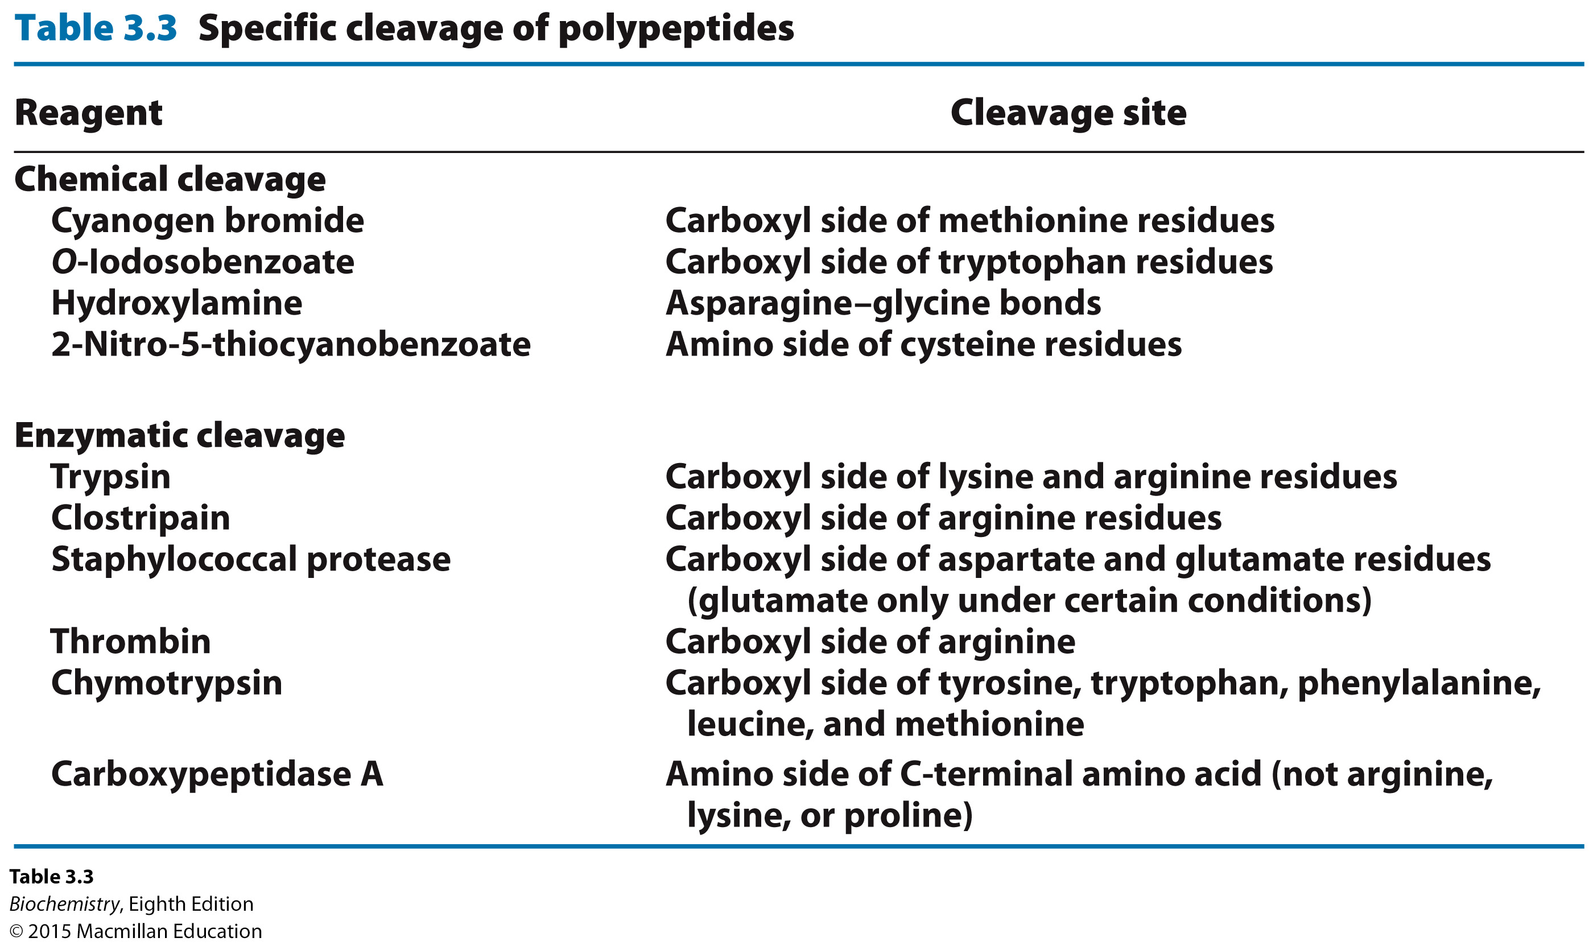

Slide 65
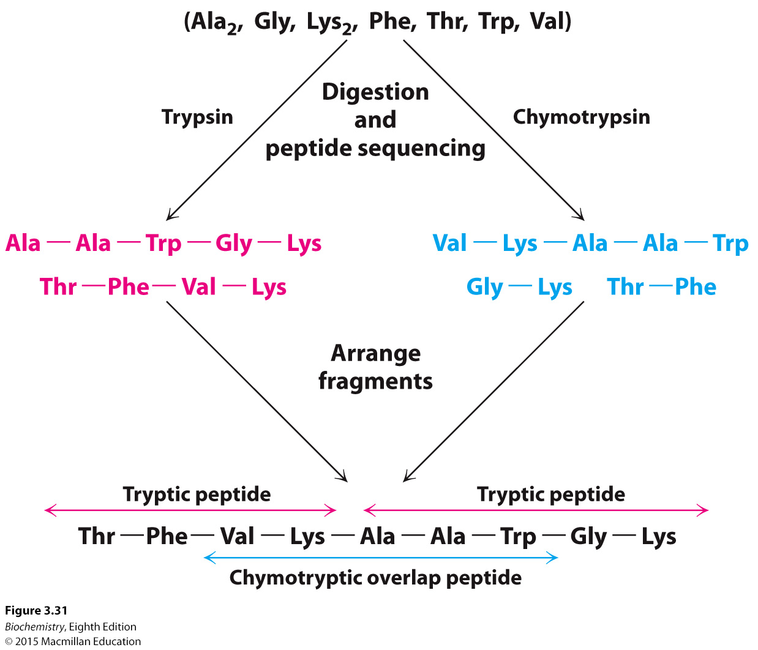
Notes:
FIGURE 3.31 Overlap peptides. The peptide obtained by chymotryptic digestion overlaps two tryptic peptides, establishing their order.

Slide 66
Extra steps are required for the determination of the disulfide bonds.
Disulfide bonds are cleaved by the addition of a reducing agent.
Disulfide bond reformation is prevented by the alkylation of the cysteine residues.

Slide 67
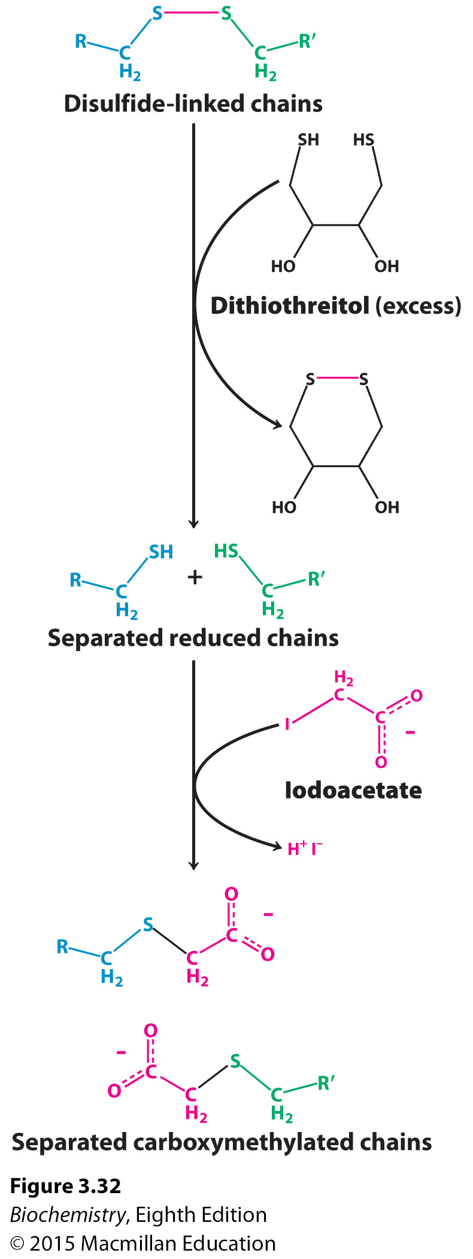
Notes:
FIGURE 3.32 Disulfide-bond reduction. Polypeptides linked by disulfide bonds can be separated by reduction with dithiothreitol followed by alkylation to prevent them from re-forming.

Slide 68
Even with today’s techniques, determining the amino acid sequence of a protein is sometimes a challenge.
Genomic techniques that reveal the DNA sequence of the gene encoding a protein also allow determination of the amino acid sequence.

Slide 69
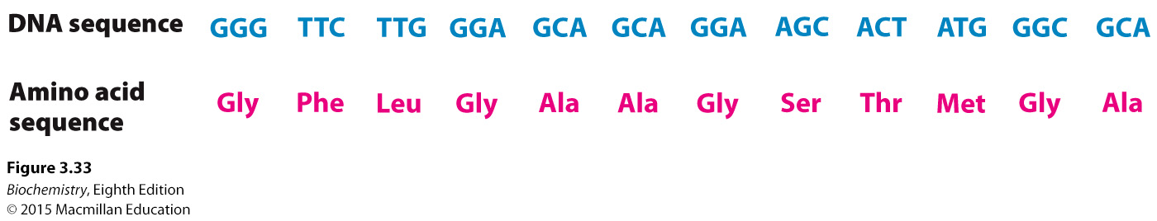
Notes:
FIGURE 3.33 DNA sequence yields the amino acid sequence. The complete nucleotide sequence of HIV-1 (human immunodeficiency virus), the cause of AIDS (acquired immune deficiency syndrome), was determined within a year after the isolation of the virus. A part of the DNA sequence specified by the RNA genome of the virus is shown here with the corresponding amino acid sequence (deduced from a knowledge of the genetic code).

Slide 70
Amino acid sequences of proteins can be compared to identify similarities.
Comparison of the sequence of the same protein from different species yields evolutionary information.
Amino acid sequence searches can reveal the presence of internal repeats.
Sequencing information can identify signals that determine the location of the protein or processing signals.
Sequence information can be used to generate antibodies for the protein.
Amino acid sequence can be used to generate DNA probes specific for the gene encoding the protein.

Slide 71
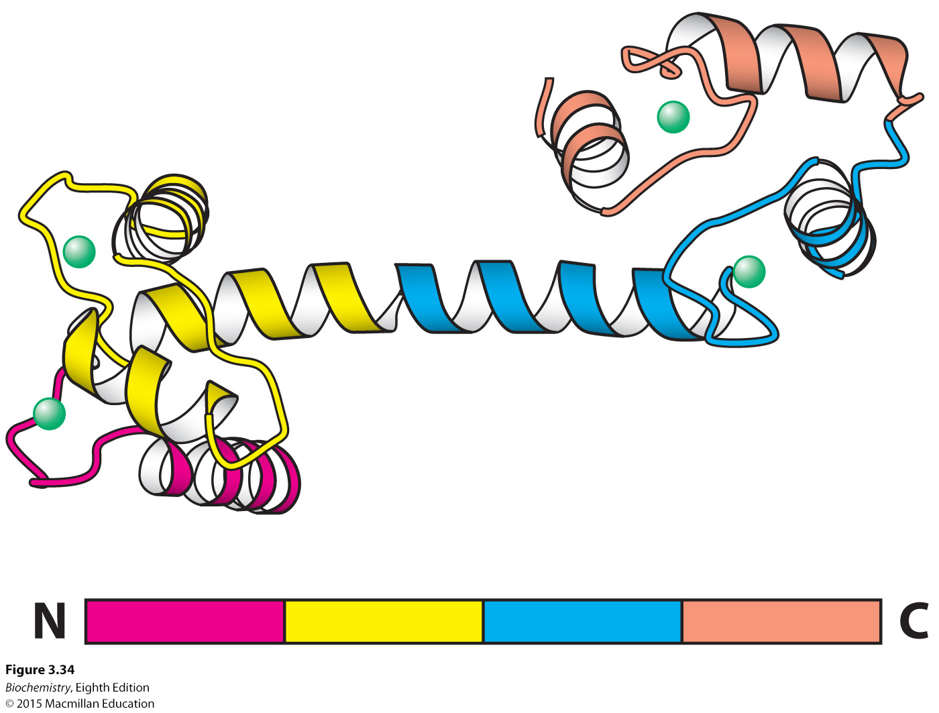
Notes:
FIGURE 3.34 Repeating motifs in a protein chain. Calmodulin, a calcium sensor, contains four similar units (shown in red, yellow, blue, and orange) in a single polypeptide chain. Notice that each unit binds a calcium ion (shown in green). [Drawn from 1CLL.pdb.]

Slide 72
Specific protein cleavage, followed by separation of of the resulting peptides and mass spectrometry, allows the identification of individual proteins.
This technique for protein identification is called peptide mass fingerprinting.

Slide 73
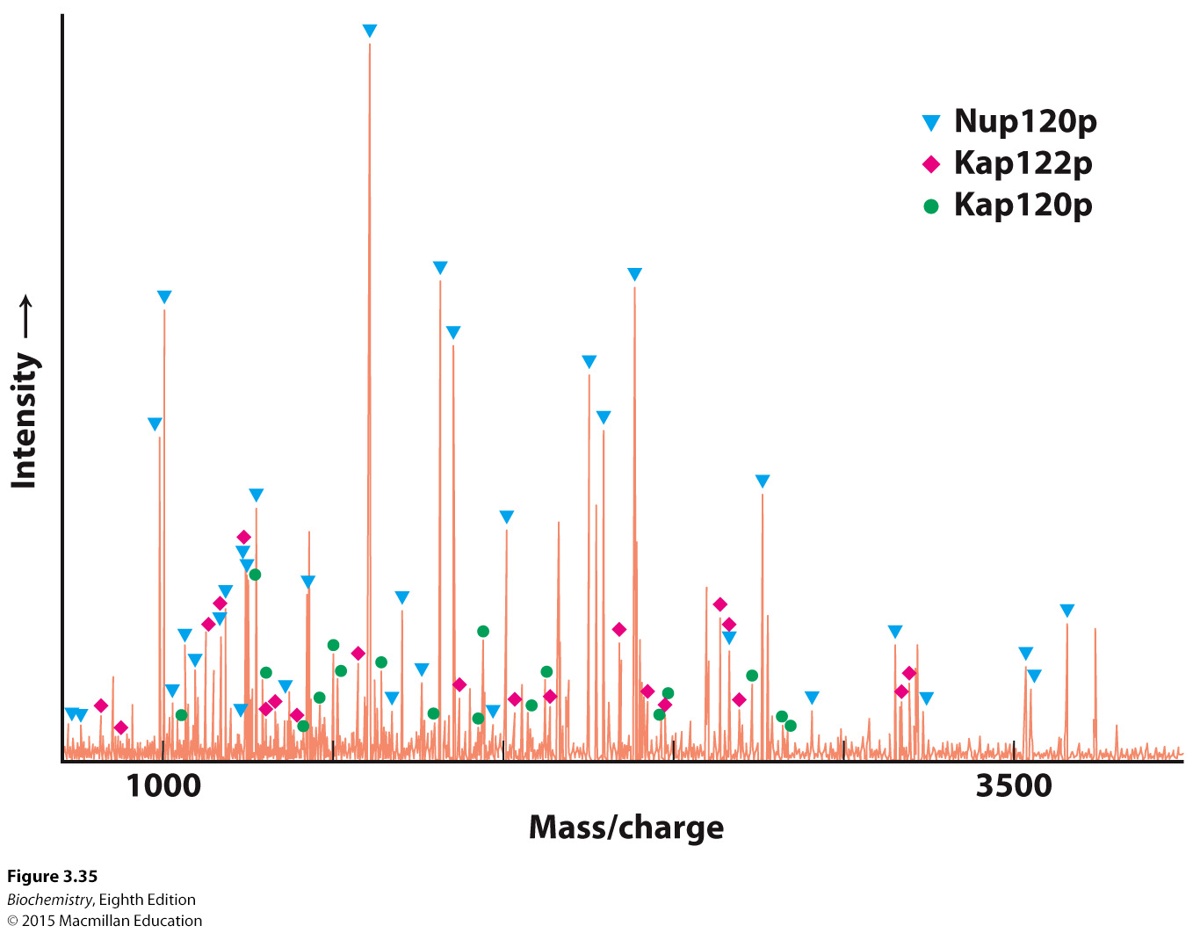
Notes:
FIGURE 3.35 Proteomic analysis by mass spectrometry. This mass spectrum was obtained by analyzing a trypsin-treated band in a gel derived from a yeast nuclear-pore sample. Many of the peaks were found to match the masses predicted for peptide fragments from three proteins (Nup120p, Kap122p, and Kap120p) within the yeast genome. The band corresponded to an apparent molecular mass of 100 kDa. [Data from M. P. Rout, J. D. Aitchison, A. Suprapto, K. Hjertaas, Y. Zhao, and B. T. Chait. J. Cell Biol. 148:635–651, 2000.]

Slide 74

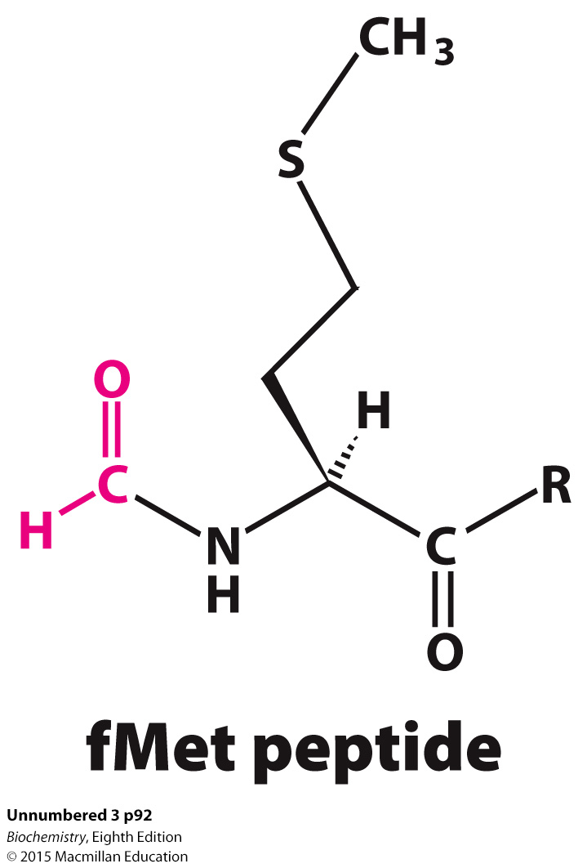
Synthetic peptides can be used as antigens to produce antibodies.
Synthetic peptides can be used to isolate receptors. Synthetic peptides containing formylmethionine (fMet) have been used to identify receptors on white blood cells.

Slide 75
3. Synthetic peptides can be drugs.
4. Synthetic peptides can be used to understand protein folding.

Slide 76
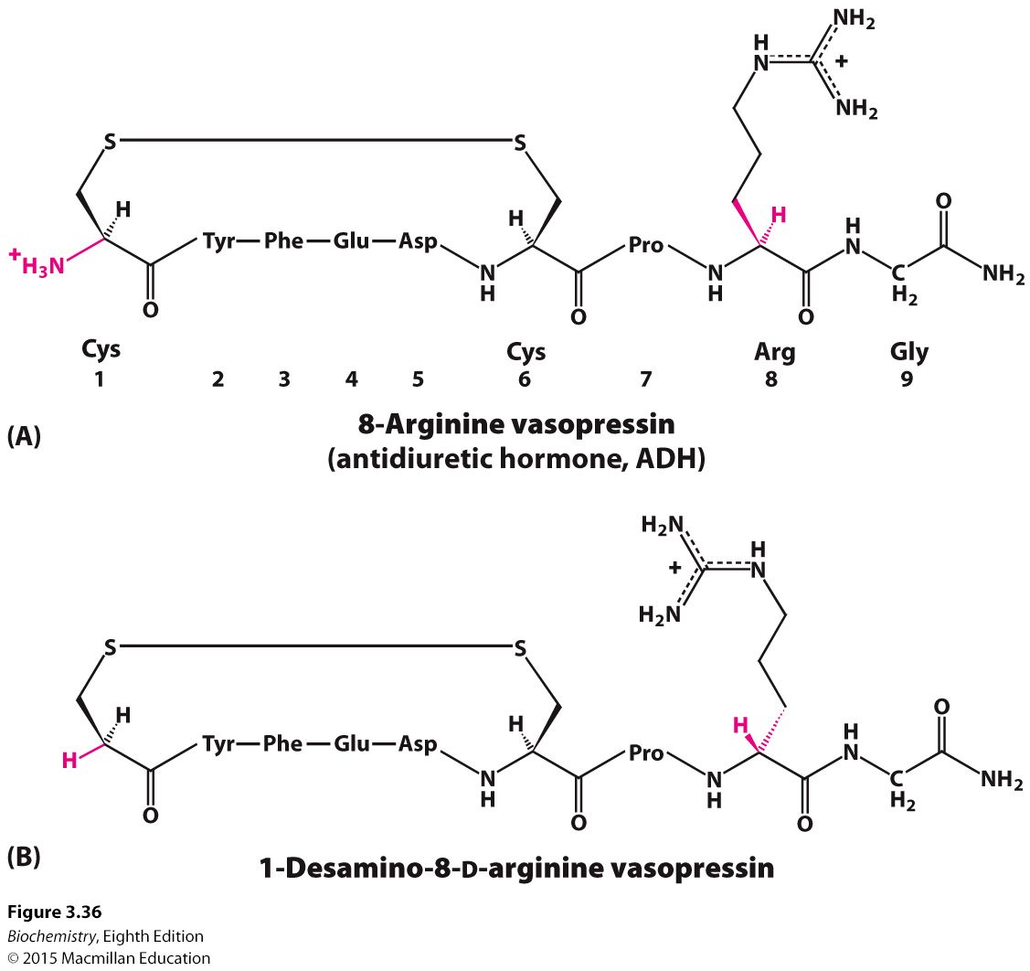
Notes:
FIGURE 3.36 Vasopressin and a synthetic vasopressin analog. Structural formulas of (A) vasopressin, a peptide hormone that stimulates water resorption, and (B) 1-desamino-8-D-arginine vasopressin, a more stable synthetic analog of this antidiuretic hormone.

Slide 77
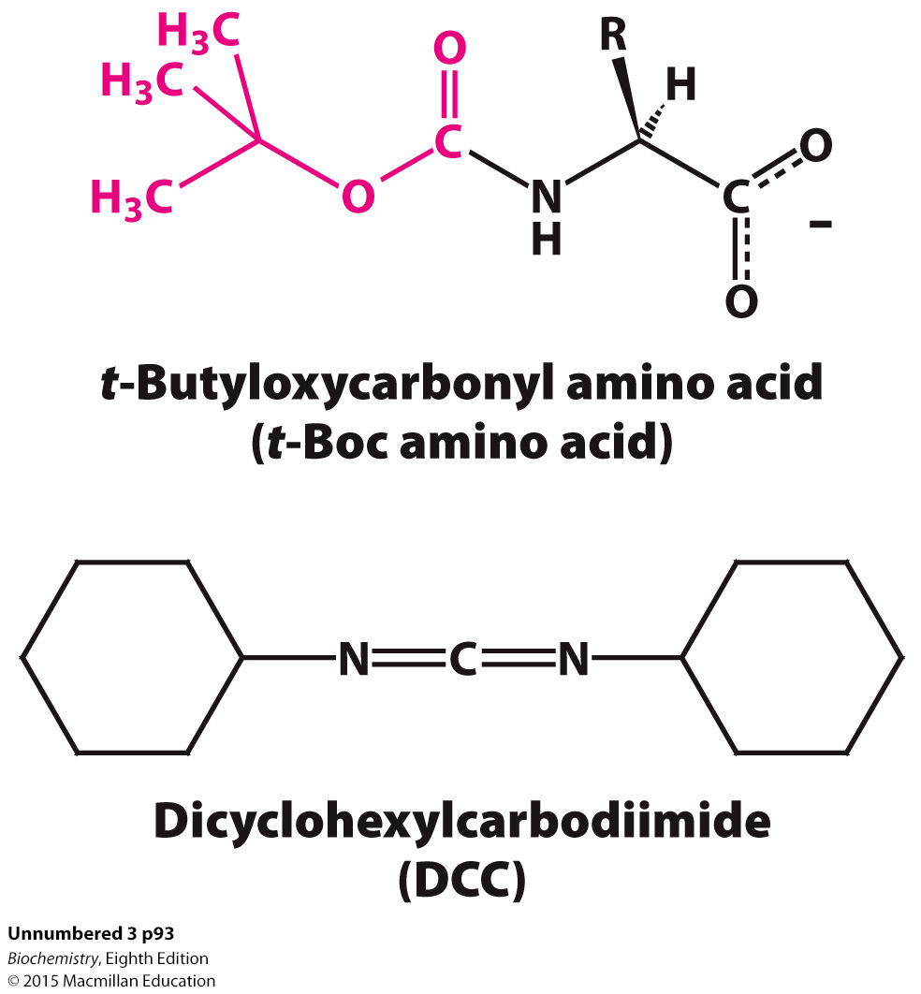
Synthetic peptide are synthesized in a step-wise fashion with the carboxyl terminus of the growing chain attached to an inert matrix.
t-Boc blocks the amino group of the incoming amino acid and DCC facilitates peptide bond formation.

Slide 78
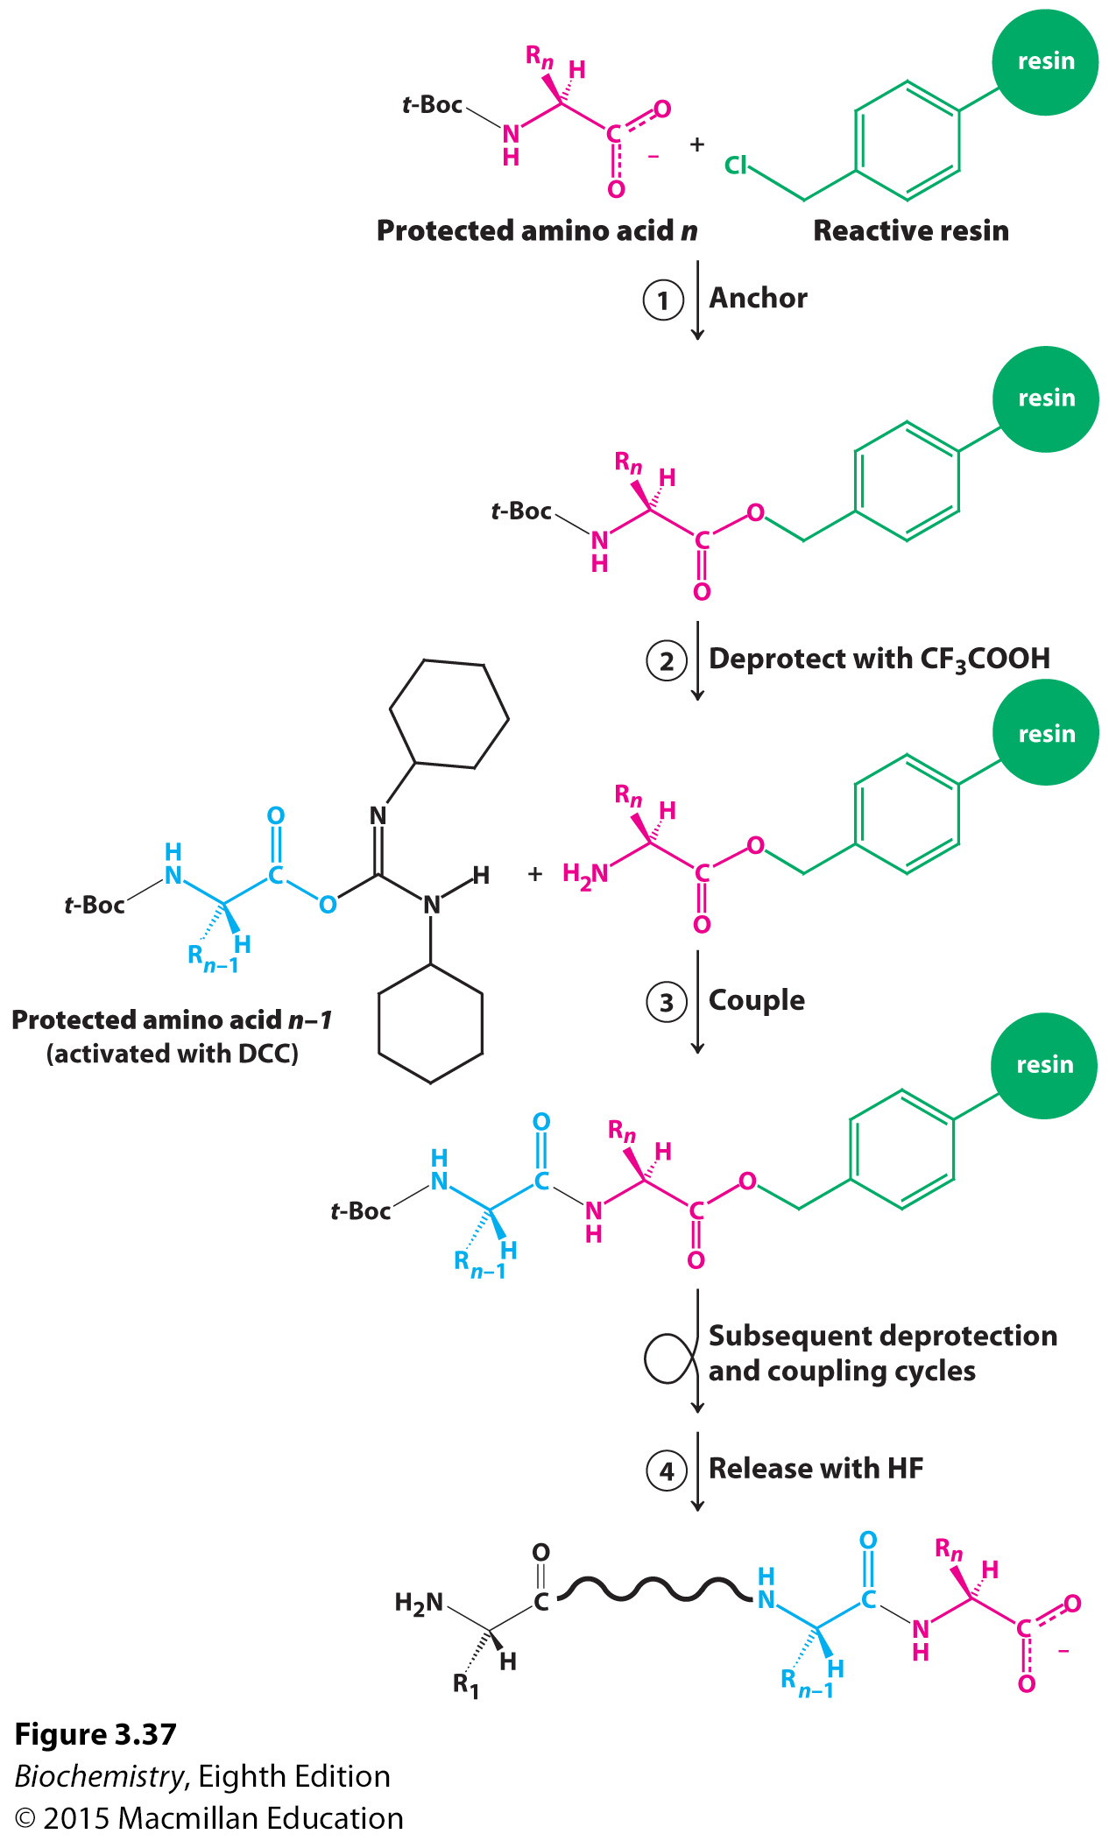
Notes:
FIGURE 3.37 Solid-phase peptide synthesis. The sequence of steps in solid phase synthesis is: (1) anchoring of the C-terminal amino acid to a solid resin, (2) deprotection of the amino terminus, and (3) coupling of the free amino terminus with the DCC-activated carboxyl group of the next amino acid. Steps 2 and 3 are repeated for each added amino acid. Finally, in step 4, the completed peptide is released from the resin.

Slide 79

Crystals of proteins are irradiated with x-rays.
Electrons of the atoms scatter x-rays.
The scattered waves recombine.
The way in which the scattered x-rays recombine reveals the atomic arrangement.

Slide 80
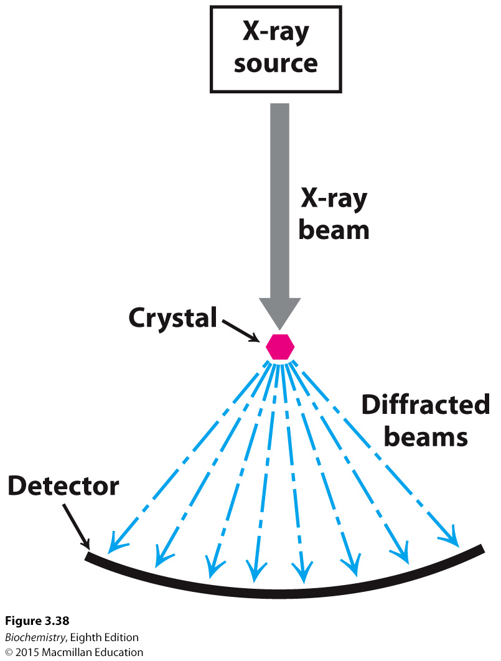
Notes:
FIGURE 3.38 An x-ray crystallographic experiment. An x-ray source generates a beam, which is diffracted by a crystal. The resulting diffraction pattern is collected on a detector.

Slide 81

Notes:
FIGURE 3.39 An x-ray diffraction pattern. A protein crystal diffracts x-rays to produce a pattern of spots, or reflections, on the detector surface. The white silhouette in the center of the image is from a beam stop which protects the detector from the intense, undiffracted x-rays. [S. Lansky, O. Alalouf, V. Solomon, A. Alhassid, L. Govada, N. E. Chayan, H. Belrhali, Y. Shoham, and G. Shoham. Acta Cryst. F69:430–434, 2013, Fig. 2.]

Slide 82

Notes:
FIGURE 3.40 Interpretation of an electron-density map. (A) A segment of an electron-density map is drawn as a three-dimensional contour plot, in which the regions inside the “cage” represent the regions of highest electron density. (B) A model of the protein is built into this map so as to maximize the placement of atoms within this density. [Drawn from 1FCH.pdb.]

Slide 83

Notes:
FIGURE 3.41 Resolution affects the quality of an image. The effect of resolution on the quality of a reconstructed image is shown by an optical analog of x-ray diffraction: (A) a photograph of the Parthenon; (B) an optical diffraction pattern of the Parthenon; (C and D) images reconstructed from the pattern in part B. More data were used to obtain image D than image C, which accounts for the higher quality of image D. [Courtesy of Dr. Thomas Steitz (part A) and Dr. David DeRosier (part B).]

Slide 84

Notes:
FIGURE 3.42 Resolution affects the quality of the electron density map. The electron density maps of a tyrosine residue at four different resolution levels (1.0 Å, 2.0 Å, 2.7 Å, and 3.0 Å) are shown. At the lower resolution levels (2.7 Å and 3.0 Å), only a group of atoms corresponding to the side chain is visible, whereas at the highest resolution (1.0 Å), individual atoms within the side chain are distinguishable. [Data from www.rcsb.org/pdb/101/static101.
do?p=education_discussion/Looking-at- Structures/resolution.html]

Slide 85

NMR is based on the fact that certain atomic nuclei are intrinsically magnetic and can exist in two spin states when an external magnetic field is applied.
The nuclei of the sample absorb electromagnetic radiation at different frequencies termed chemical shifts.
The chemical shifts depend on the environment of the nuclei, and the environment depends on protein structure.
One-dimensional NMR reveals changes to a particular chemical group under different conditions.
Two-dimensional NMR (NOSEY) displays groups that are in close proximity.

Slide 86


Slide 87

Notes:
FIGURE 3.43 Basis of NMR spectroscopy. The energies of the two orientations of a nucleus of spin 1/2 (such as ³¹P and ¹H) depend on the strength of the applied magnetic field. Absorption of electromagnetic radiation of appropriate frequency induces a transition from the lower to the upper level.

Slide 88


Notes:
FIGURE 3.44 One-dimensional NMR spectra. (A) ¹H-NMR spectrum of ethanol (CH₃CH₂OH) shows that the chemical shifts for the hydrogen are clearly resolved. (B) ¹H-NMR spectrum of a 55 amino acid fragment of a protein having a role in RNA splicing shows a greater degree of complexity. A large number of peaks are present and many overlap. [(A) Data from C. Branden and J. Tooze, Introduction to Protein Structure (Garland, 1991), p. 280; (B) courtesy of Dr. Barbara Amann and Dr. Wesley McDermott.]

Slide 89

Notes:
FIGURE 3.45 The nuclear Overhauser effect. The nuclear Overhauser effect (NOE) identifies pairs of protons that are in close proximity. (A) Schematic representation of a polypeptide chain highlighting five particular protons. Protons 2 and 5 are in close proximity (~4 Å apart), whereas other pairs are farther apart. (B) A highly simplified NOESY spectrum. The diagonal shows five peaks corresponding to the five protons in part A. The peak above the diagonal and the symmetrically related one below reveal that proton 2 is close to proton 5.

Slide 90

Notes:
FIGURE 3.46 Detecting short proton–proton distances. A NOESY spectrum for a 55 amino acid domain from a protein having a role in RNA splicing. Each off-diagonal peak corresponds to a short proton–proton separation. This spectrum reveals hundreds of such short proton–proton distances, which
can be used to determine the three-dimensional structure of this domain. [Courtesy of Dr. Barbara Amann and Dr. Wesley McDermott.]

Slide 91

Notes:
FIGURE 3.47 Structures calculated on the basis of NMR constraints. (A) NOESY observations show that protons (connected by dotted red lines) are close to one another in space. (B) A three-dimensional structure calculated with these proton pairs constrained to be close together.

Slide 92

Notes:
FIGURE 3.48 A family of structures. A set of 25 structures for a 28 amino acid domain from a zinc-finger-DNA-binding protein. The red line traces the average course of the protein backbone. Each of these structures is consistent with hundreds of constraints derived from NMR experiments. The differences between the individual structures are due to a combination of imperfections in the experimental data and the dynamic nature of proteins in solution. [Courtesy of Dr. Barbara Amann.]

