Slide 1
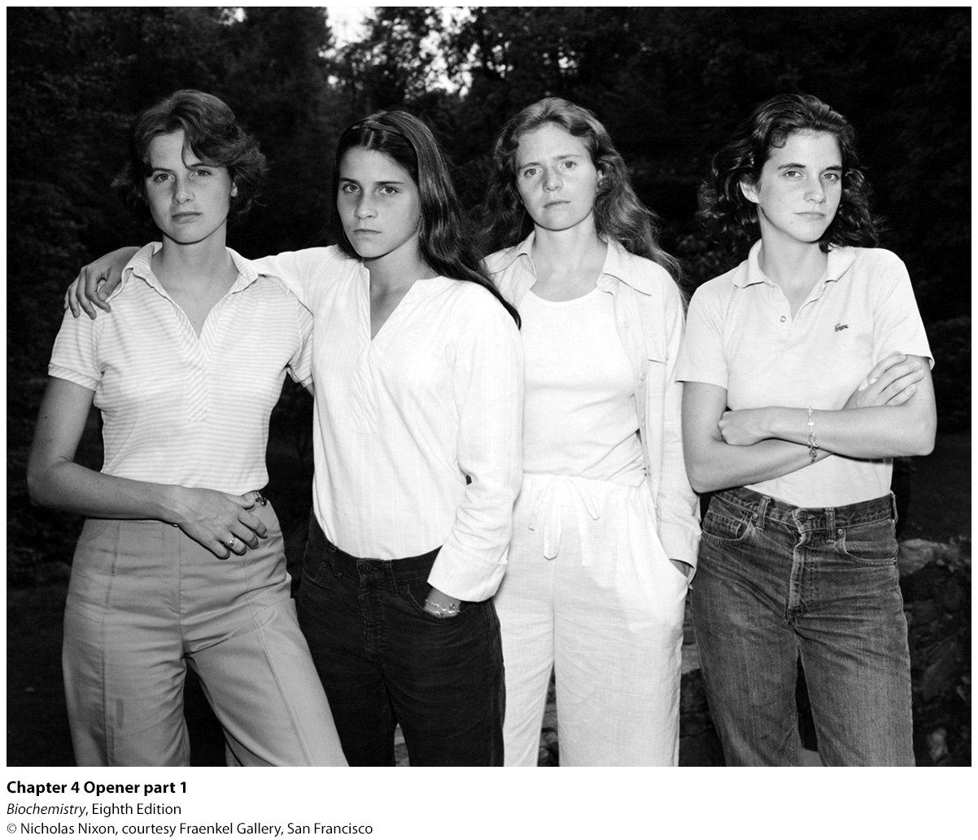
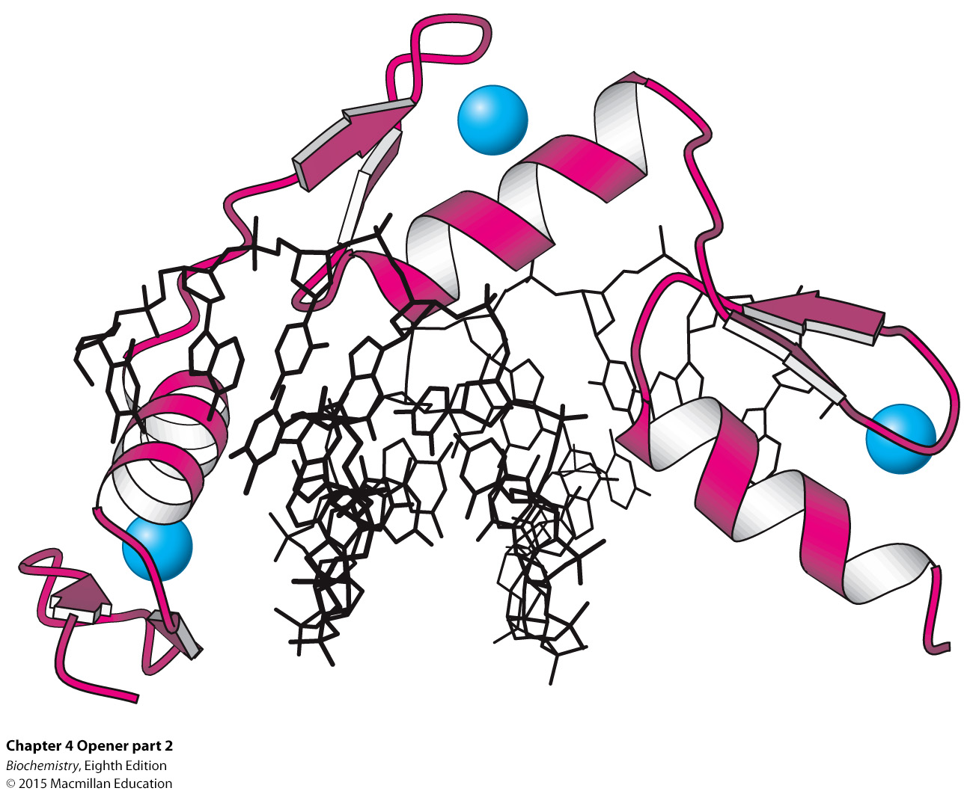
Notes:
Family resemblance, very evident in this photograph of four sisters, results from having genes in common. Genes must be expressed to exert an effect, and proteins regulate such expression. One such regulatory protein, a zinc-finger protein (zinc ion is blue, protein is red), is shown bound to a control region of DNA (black). [(Left) © Nicholas Nixon, courtesy Fraenkel Gallery, San Francisco. (Right) Drawn from 1AAY.pdb.]

Slide 2
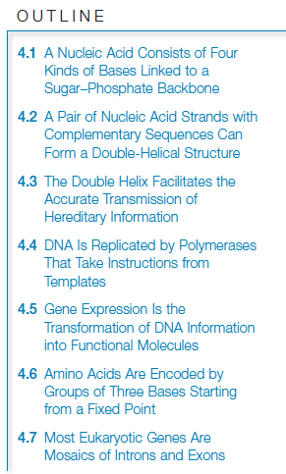

Slide 3
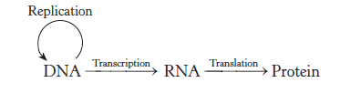
The flow of genetic information is from DNA to RNA to proteins, a scheme called the central dogma.

Slide 4

Nucleic acids are long, linear polymers constructed from 4 types of monomers.
Each monomer consists of a sugar, a phosphate and a base.
The sequence of the bases is the information content of the nucleic acid.

Slide 5
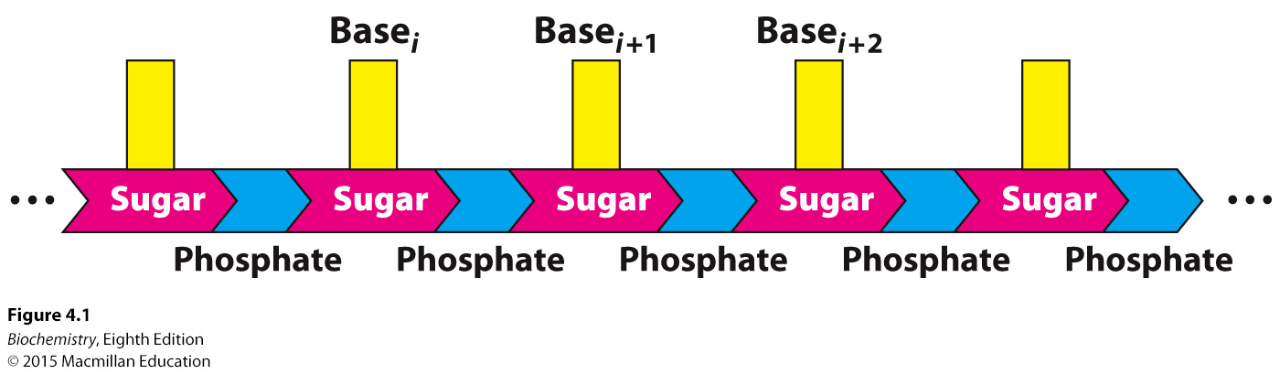
Notes:
FIGURE 4.1 Polymeric structure of nucleic acids.

Slide 6
The sugar component of deoxyribonucleic acid (DNA) is deoxyribose, a ribose in which the 2′-hydroxyl is replaced with a hydrogen.
Ribonucleic acid (RNA) contains the sugar ribose.
The backbones of DNA and RNA consist of sugars linked by phosphodiester bridges between the 3′-hydroxyl of one sugar and the 5′-hydroxyl of an adjacent sugar.
Bases are attached to carbon atom 1′ in the sugar.
Two of the bases are purines (adenine and guanine) and two are pyrimidines (cytosine and thymine (DNA) or uracil (RNA)).

Slide 7
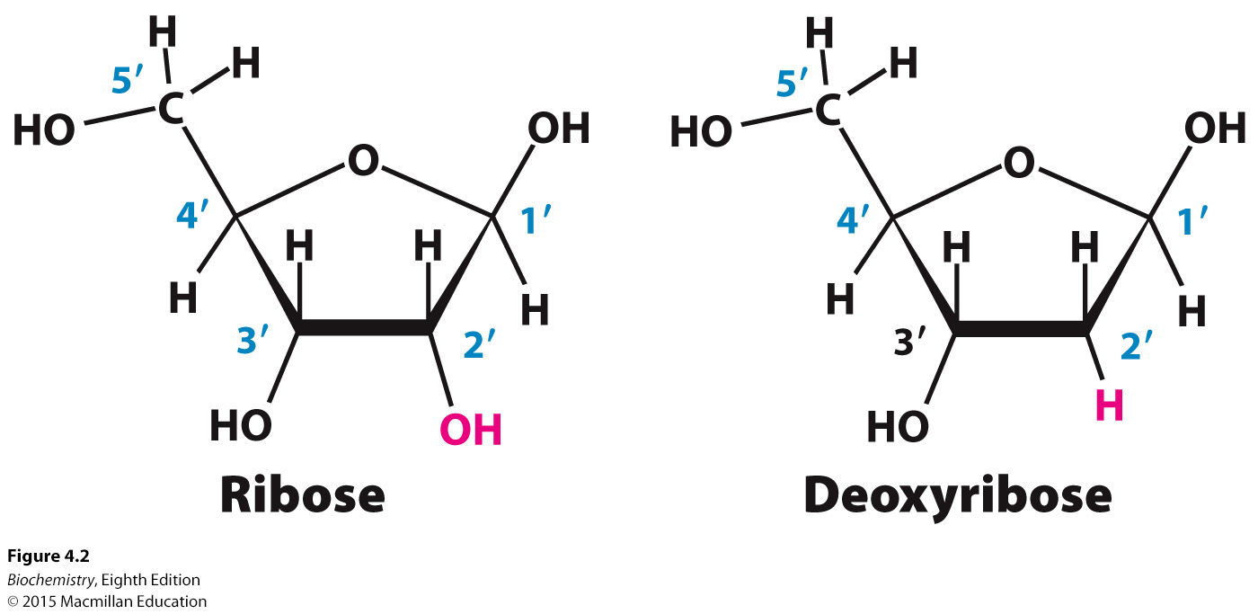
Notes:
FIGURE 4.2 Ribose and deoxyribose. Atoms in sugar units are numbered with primes to distinguish them from atoms in bases (see Figure 4.4).

Slide 8
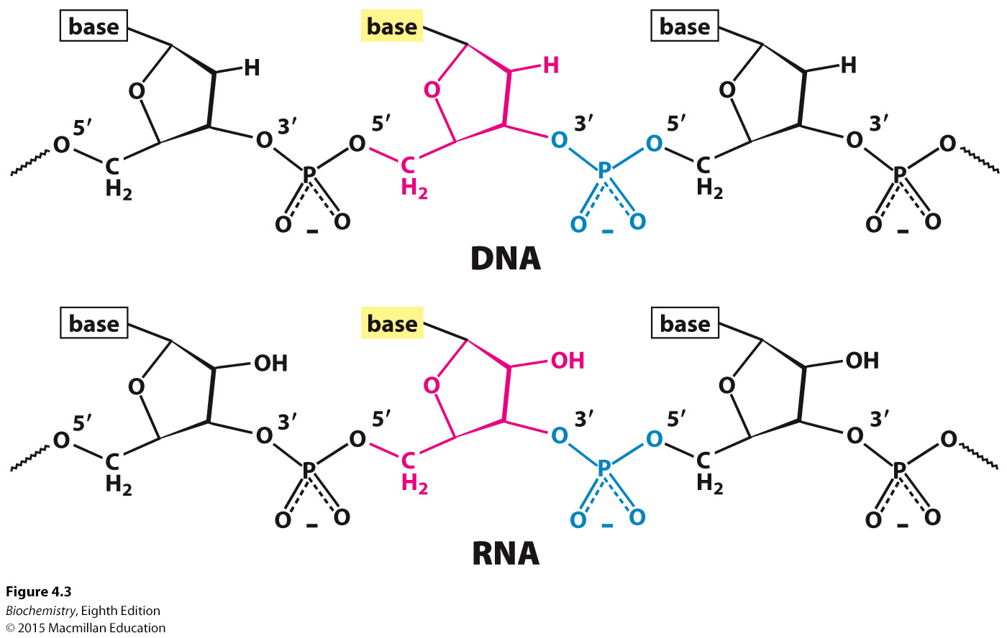
Notes:
FIGURE 4.3 Backbones of DNA and RNA. The backbones of these nucleic acids are formed by 3′-to-5′ phosphodiester linkages. A sugar unit is highlighted in red and a phosphate group in blue.

Slide 9
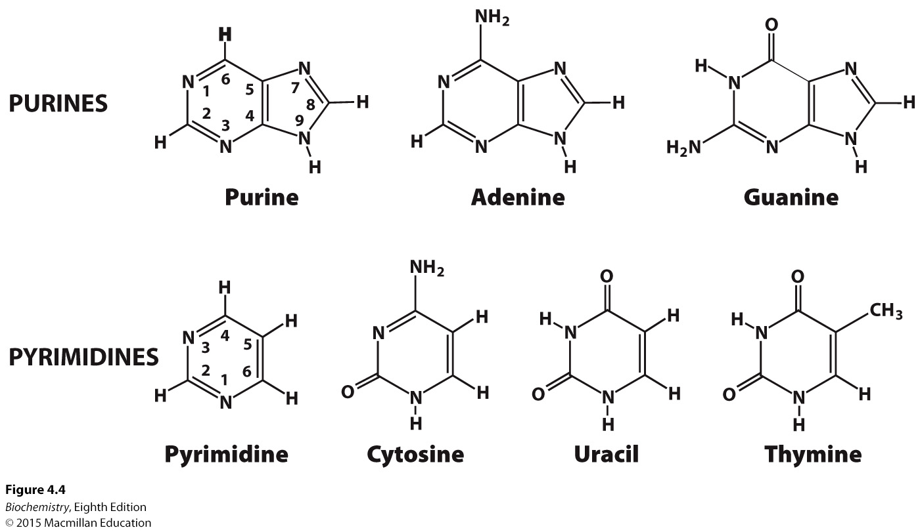
Notes:
FIGURE 4.4 Purines and pyrimidines. Atoms within bases are numbered without primes. Uracil is present in RNA instead of thymine.

Slide 10
A base bound to a sugar is called a nucleoside. The nucleosides of DNA are deoxyadenosine, deoxyguanosine, deoxycytidine and deoxythymidine. By convention, deoxythymidine, which rarely occurs in RNA, is simply called thymidine.
The nucleosides of RNA are adenosine, guanosine, cytidine and uridine.
In all cases, the C-1′ of the sugar is attached to the N-9 of the purine or the N-1 of the pyrimidine by a β-glycosidic bond.
A nucleotide is a nucleoside with one or more phosphoryl groups attached.
Nucleotide triphosphates are the building blocks of DNA and RNA.

Slide 11
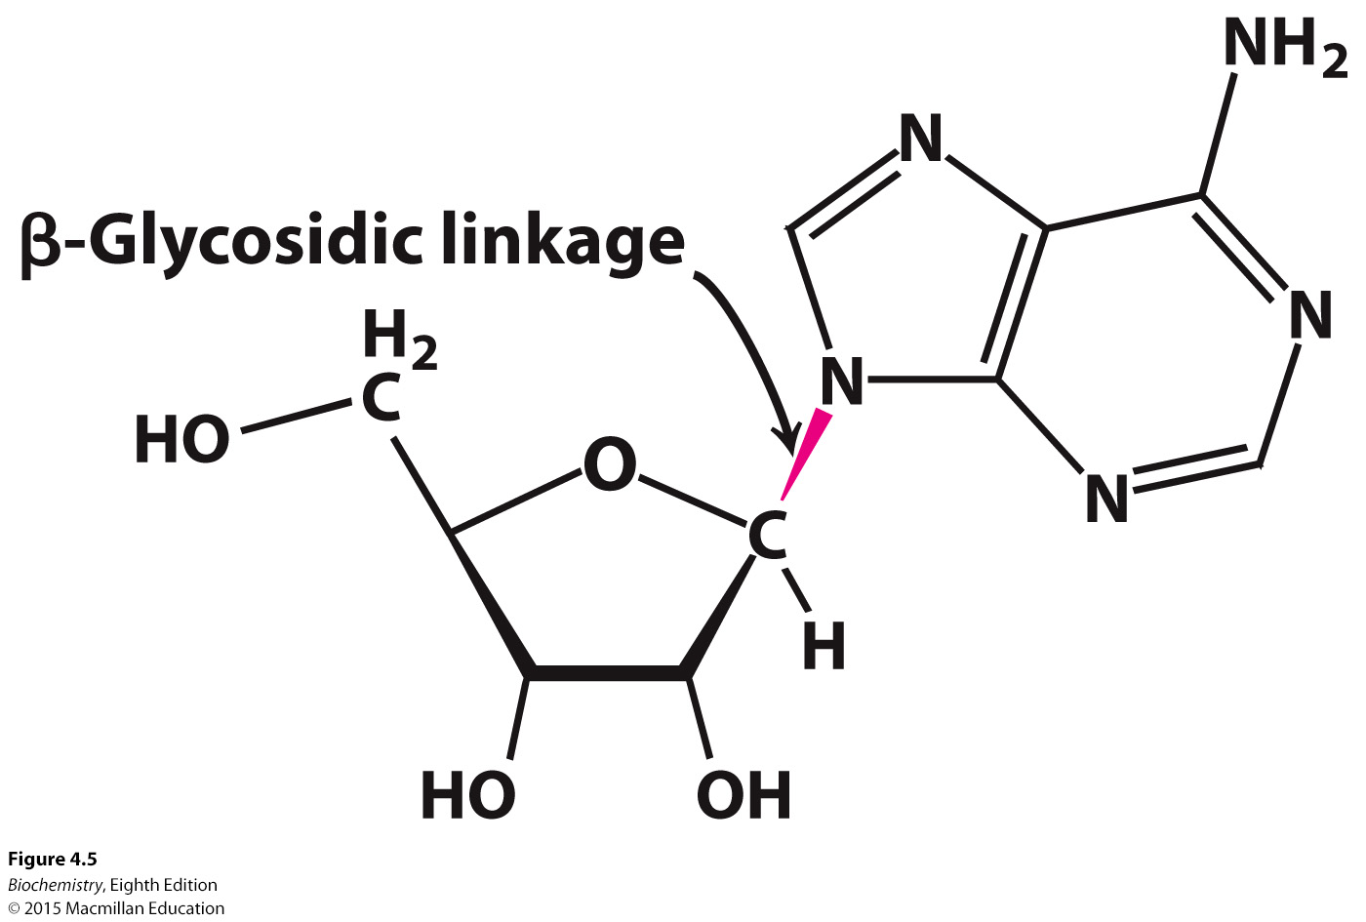
Notes:
FIGURE 4.5 β-Glycosidic linkage in a nucleoside.

Slide 12
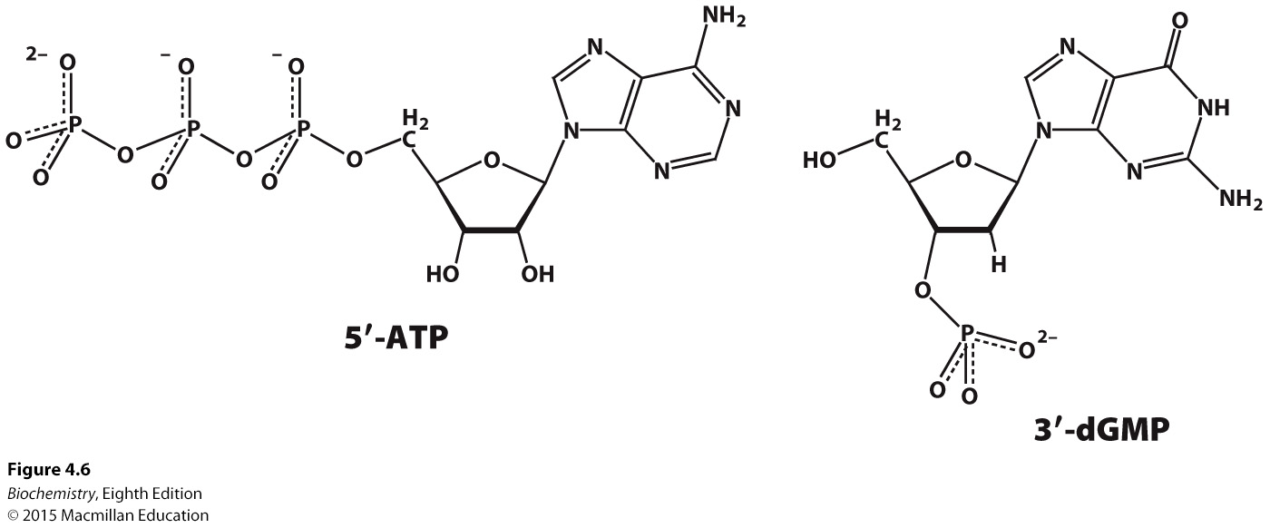
Notes:
FIGURE 4.6 Nucleotides adenosine 5′-triphosphate (5′-ATP) and deoxyguanosine 3′-monophosphate (3′-dGMP).

Slide 13
Nucleic acid chains are represented by abbreviations such as pApGpCpT, pAGCT or more simply AGCT.
Nucleic acid chains have directionality in that the two ends are different. One end has a phosphoryl group attached to the 5′ carbon atom of the sugar and one end has a free hydroxyl attached to the 3′ carbon of the sugar.
Nucleic acid sequences are written in the 5′ to 3′ direction.

Slide 14
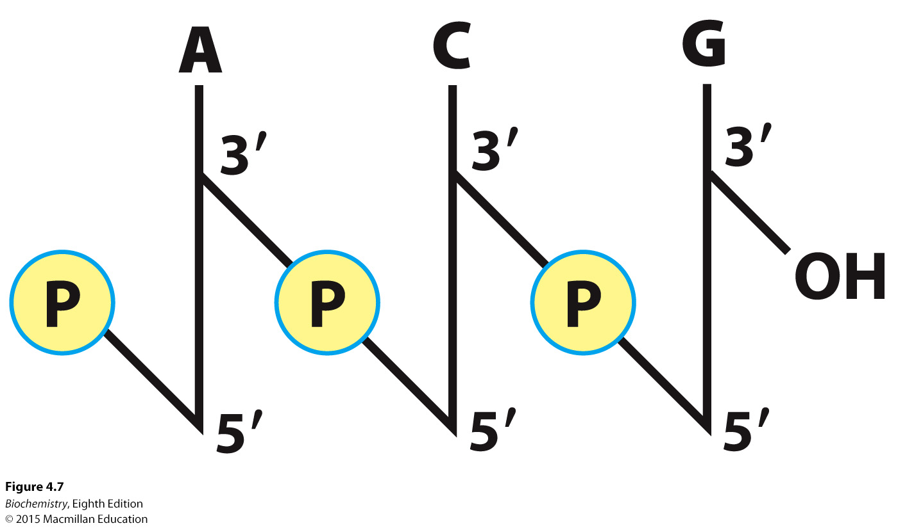
Notes:
FIGURE 4.7 Structure of a DNA chain. The chain has a 5′ end, which is usually attached to a phosphoryl group, and a 3′ end, which is usually a free hydroxyl group.

Slide 15

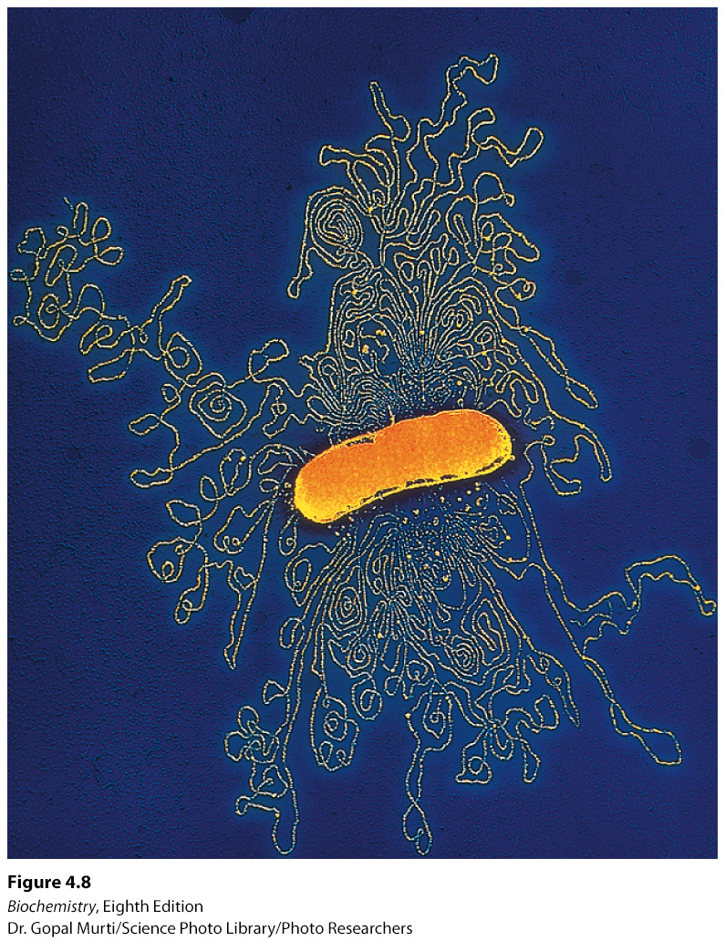
DNA molecules can be extremely long, some consisting of more than 1 billion nucleotides.
Notes:
FIGURE 4.8 Electron micrograph of part of the E. coli genome. [Dr. Gopal Murti/Science Photo Library/Photo Researchers.]

Slide 16
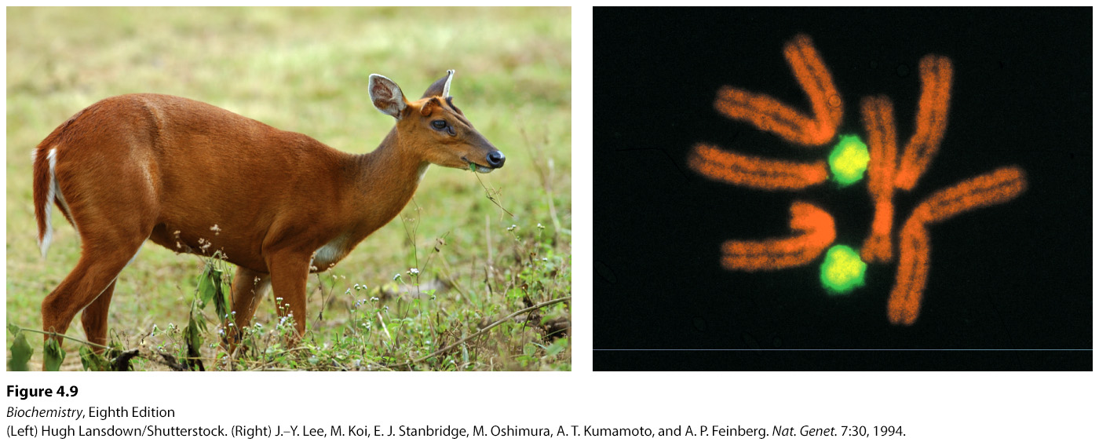
Notes:
FIGURE 4.9 The Indian muntjac and its chromosomes. Cells from a female Indian muntjac (right) contain three pairs of very large chromosomes (stained orange). The cell shown is a hybrid containing a pair of human chromosomes (stained green) for comparison. [(Left) Hugh Lansdown/Shutterstock. (Right) J.–Y. Lee, M. Koi, E. J. Stanbridge, M. Oshimura, A. T. Kumamoto, and A. P. Feinberg. Nat. Genet. 7:30, 1994.]

Slide 17


Adenine always forms hydrogen bonds with thymine while guanine forms hydrogen bonds with cytosine.
The helix is stabilized by hydrogen bonds between base pairs as well as by hydrophobic interactions, called stacking forces, between adjacent bases.
Because of the base pairing rules, the sequence of one strand determines the sequence of the partner strand.
The two strands can be separated and complementary sequences synthesized to generate two identical daughter strands.
Because the two daughter helices have one parent strand and one newly synthesized strand, the replication process is called semiconservative replication.

Slide 18
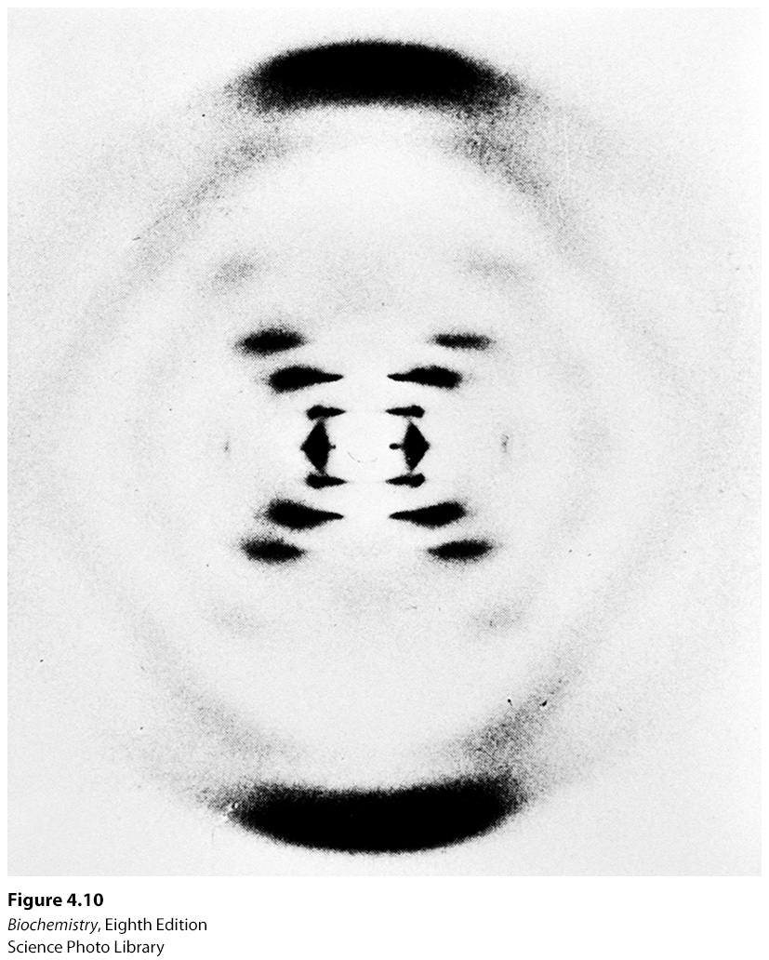
Notes:
FIGURE 4.10 X-ray diffraction photograph of a hydrated DNA fiber. When crystals of a biomolecule are irradiated with x-rays, the x-rays are diffracted and these diffracted x-rays are seen as a series of spots, called reflections, on a screen behind the crystal. The structure of the molecule can be determined by the pattern of the reflections (Section 3.5). In regard to DNA crystals, the central cross is diagnostic of a helical structure. The strong arcs on the meridian arise from the stack of nucleotide bases, which are 3.4 Å apart. [Science Photo Library.]

Slide 19
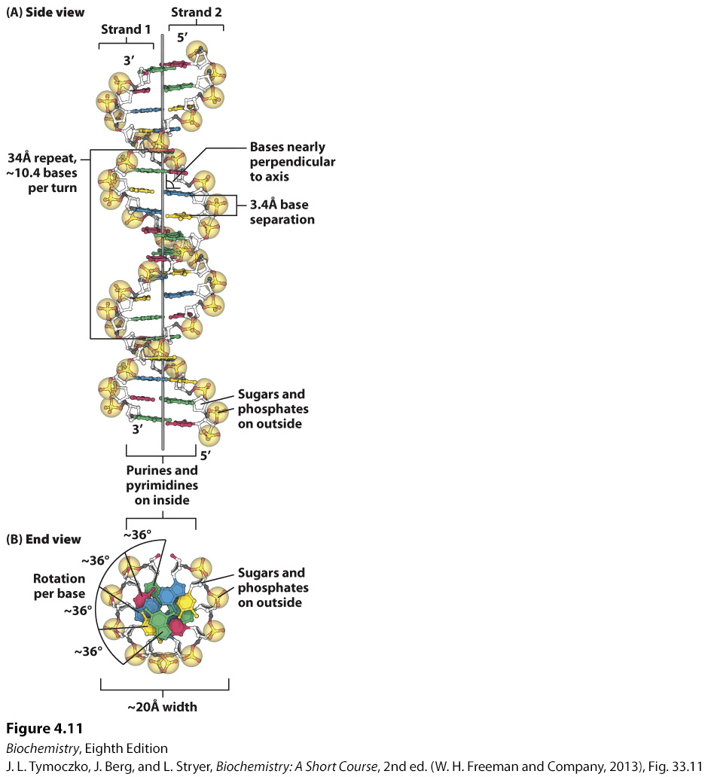
Notes:
FIGURE 4.11 Watson–Crick model of double-helical DNA. (A) Side view. Adjacent bases are separated by 3.4 Å. The structure repeats along the helical axis (vertical) at intervals of 34 Å, which corresponds to approximately 10 nucleotides on each chain. (B) Axial view, looking down the helix axis, reveals a rotation of 36° per base and shows that the bases are stacked on top of one another [Source: J. L. Tymoczko, J. Berg, and L. Stryer, Biochemistry: A Short Course, 2nd ed. (W. H. Freeman and Company, 2013), Fig. 33.11.].

Slide 20
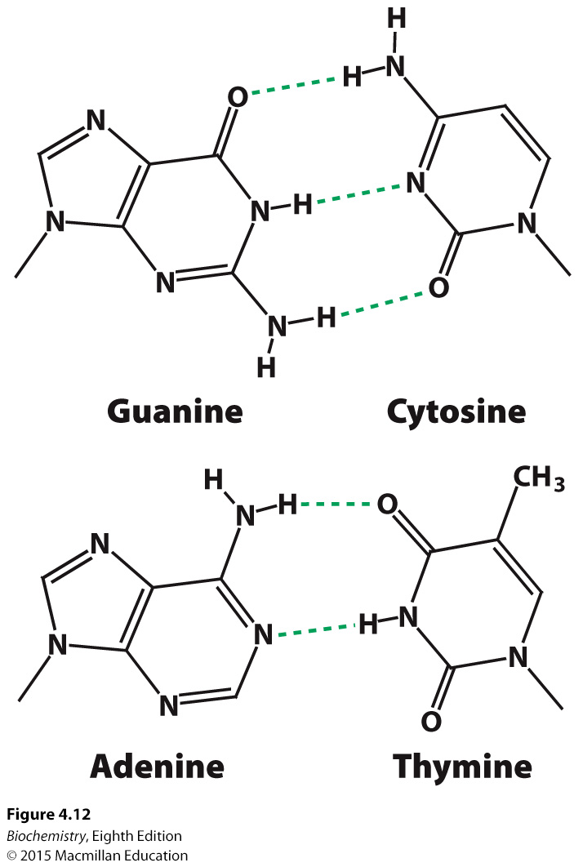
Notes:
FIGURE 4.12 Structures of the base pairs proposed by Watson and Crick.

Slide 21
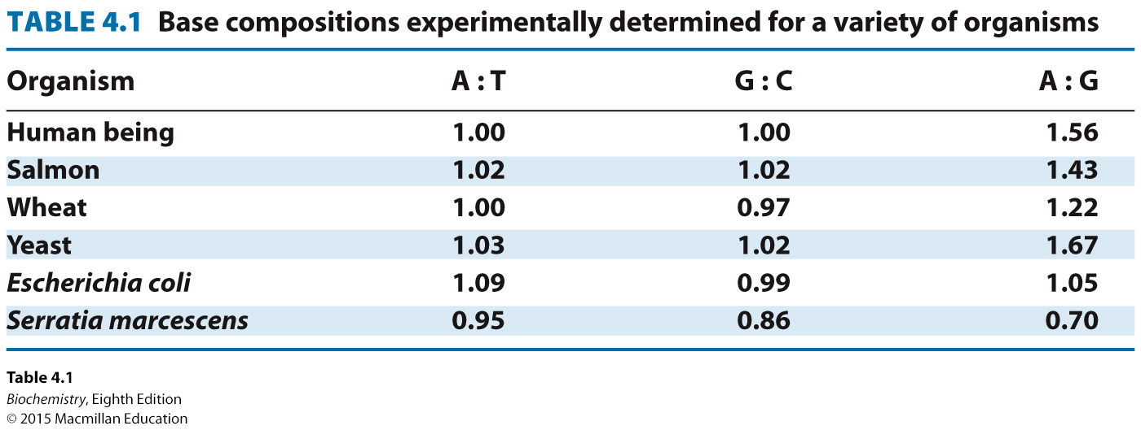

Slide 22
Van der Waals interactions between stacked bases, called stacking forces, help to stabilize the double helix.

Slide 23
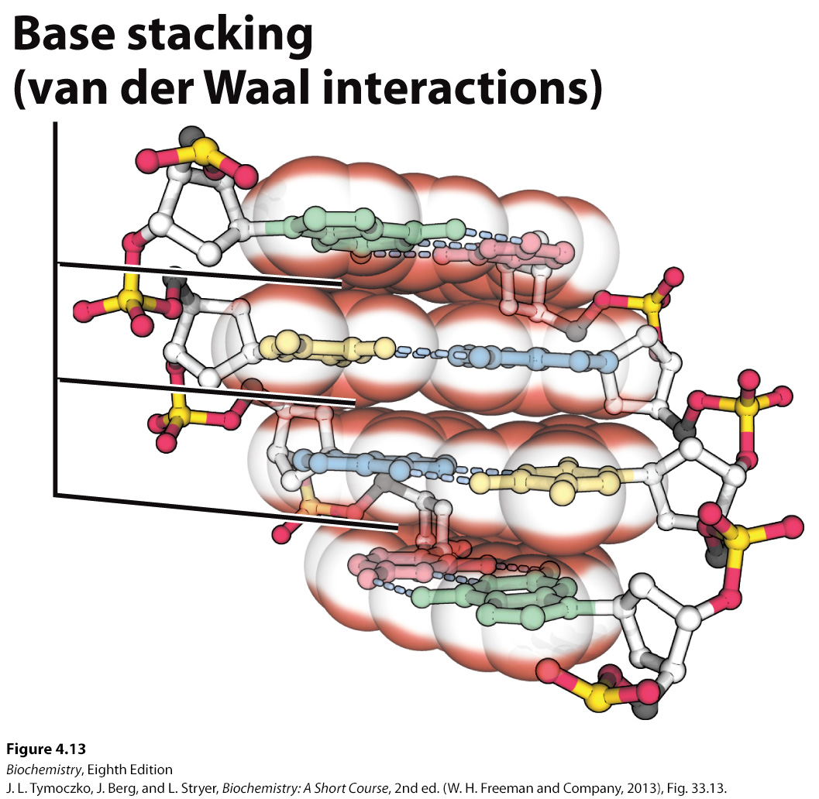
Notes:
FIGURE 4.13 A side view of DNA. Base pairs are stacked nearly one on top of another in the double helix. The stacked bases interact with van der Waals forces. Such stacking forces help stabilize the double helix. [Source: J. L. Tymoczko, J. Berg, and L. Stryer, Biochemistry: A Short Course, 2nd ed. (W. H. Freeman and Company, 2013), Fig. 33.13.].

Slide 24
In the cell, the most commonly seen form of DNA double helix is called the B form or the Watson-Crick helix.
The double helix can also exist in an A form, which is shorter and wider than the B form with the bases at an angle rather than perpendicular to the helix axis. In the A forms, the sugar is in the C-3′-endo conformation, while the sugar is in C-2′-endo configuration in the B form.
The A form is seen in RNA double helices and in RNA-DNA hybrid helices, structures observed in transcription and RNA processing.

Slide 25
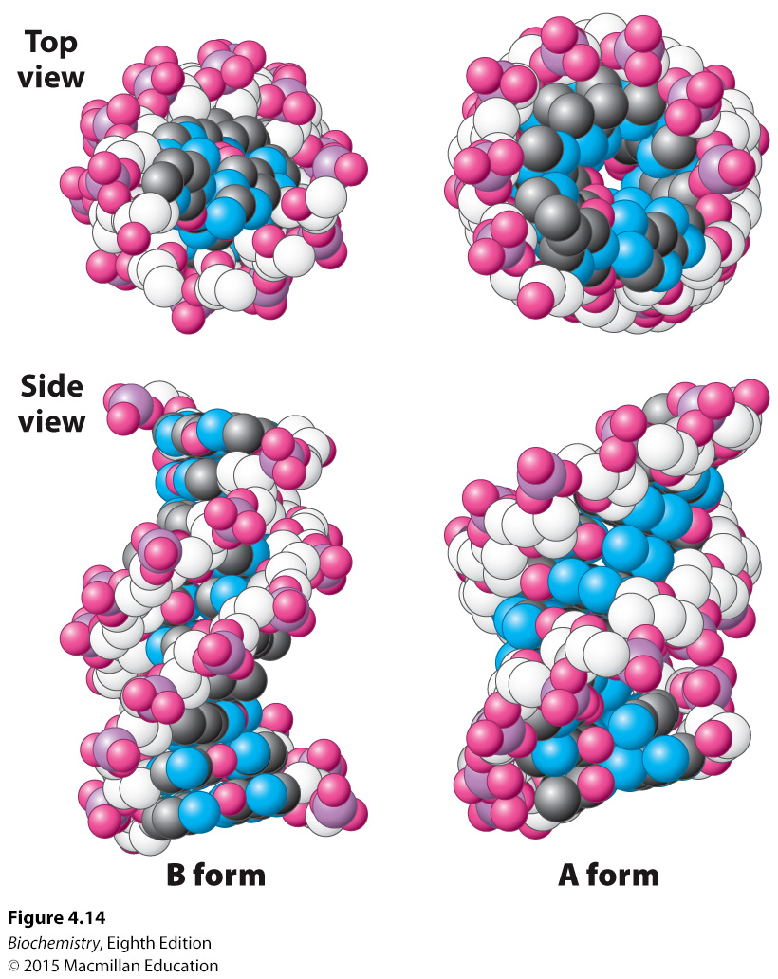
Notes:
FIGURE 4.14 B-form and A-form DNA. Space-filling models of 10 base pairs of B-form and A-form DNA depict their right-handed helical structures. Notice that the B-form helix is longer and narrower than the A-form helix. The carbon atoms of the backbone are shown in white. [Drawn from 1BNA.pdb and 1DNZ.pdb.]

Slide 26
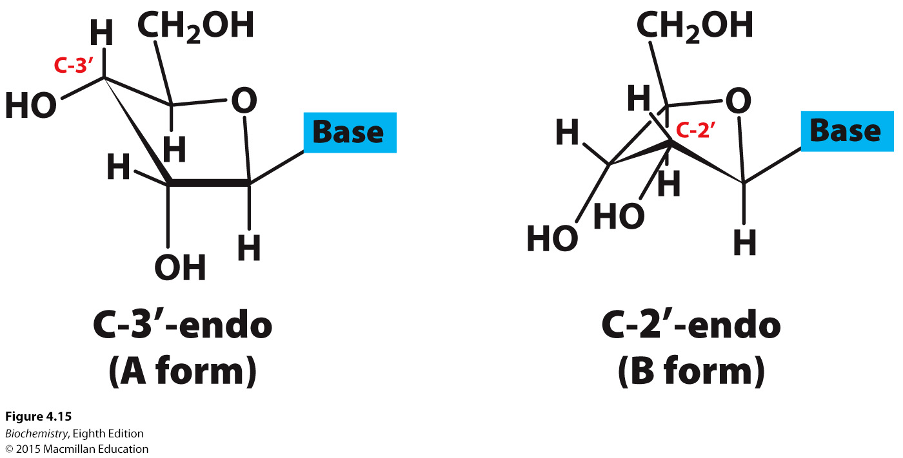
Notes:
FIGURE 4.15 Sugar pucker. In A-form DNA, the C-3′ carbon atom lies above the approximate plane defined by the four other sugar nonhydrogen atoms (called C-3′-endo). In B-form DNA, each deoxyribose is in a C-2′- endo conformation, in which C-2′ lies out of the plane.

Slide 27

The double helix can also form Z-DNA. Z-DNA is left-handed and the backbone is zigzagged, accounting for the name “Z-DNA”.

Slide 28
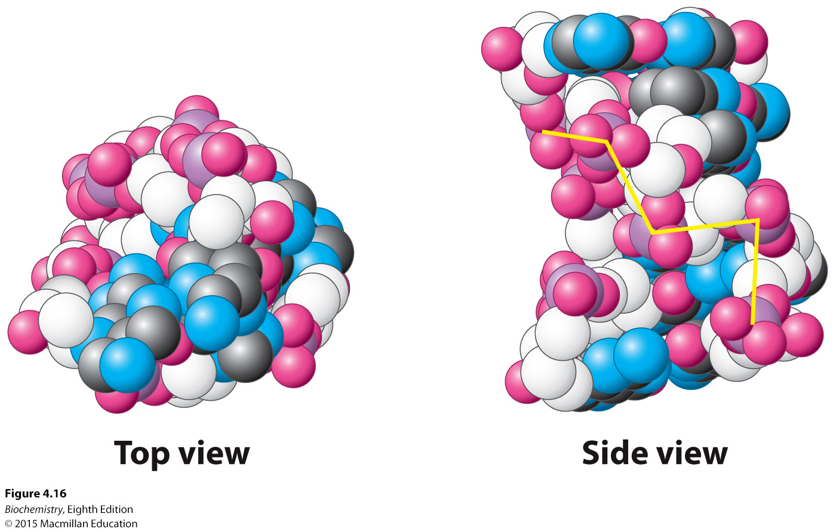
Notes:
FIGURE 4.16 Z-DNA. DNA oligomers such as CGCGCG adopt an alternative conformation under some conditions. This conformation is called Z-DNA because the phosphoryl groups zigzag along the backbone. [Drawn from 131D.pdb.]

Slide 29
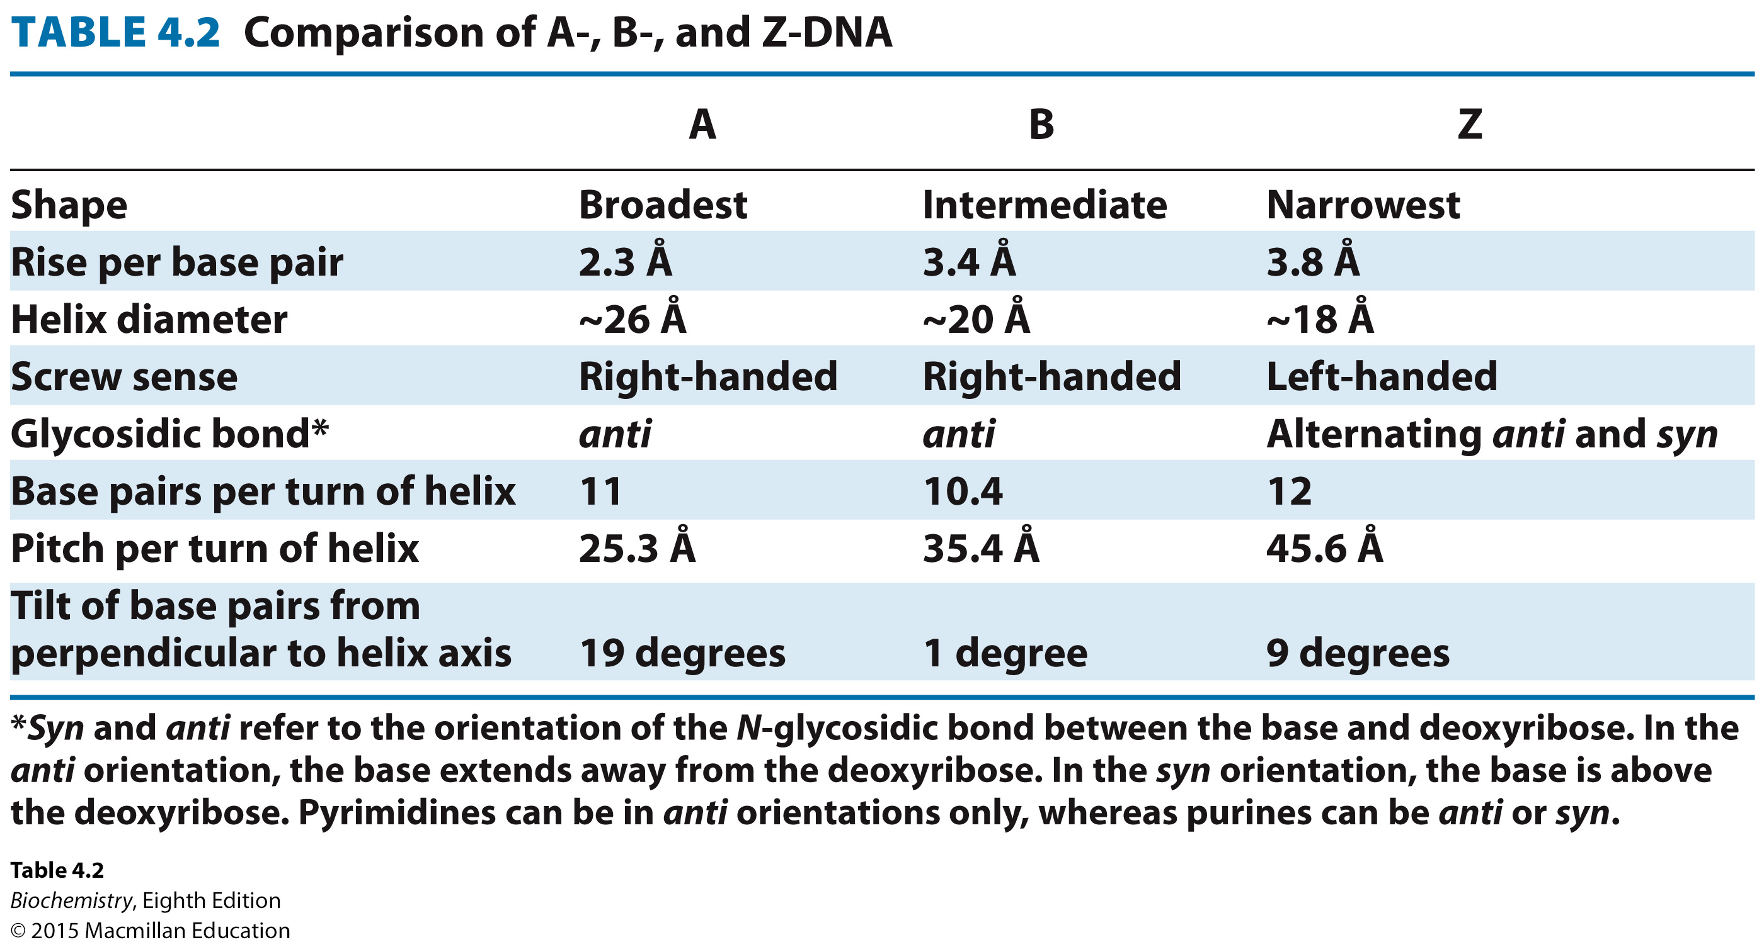

Slide 30
In order to fit inside a cell, the DNA molecule must be compacted. In E. coli, the DNA double helix is a circular molecule that is twisted into a superhelix by the process of supercoiling.
The relaxed circular DNA and the superhelix form are topological isomers of each other.

Slide 31
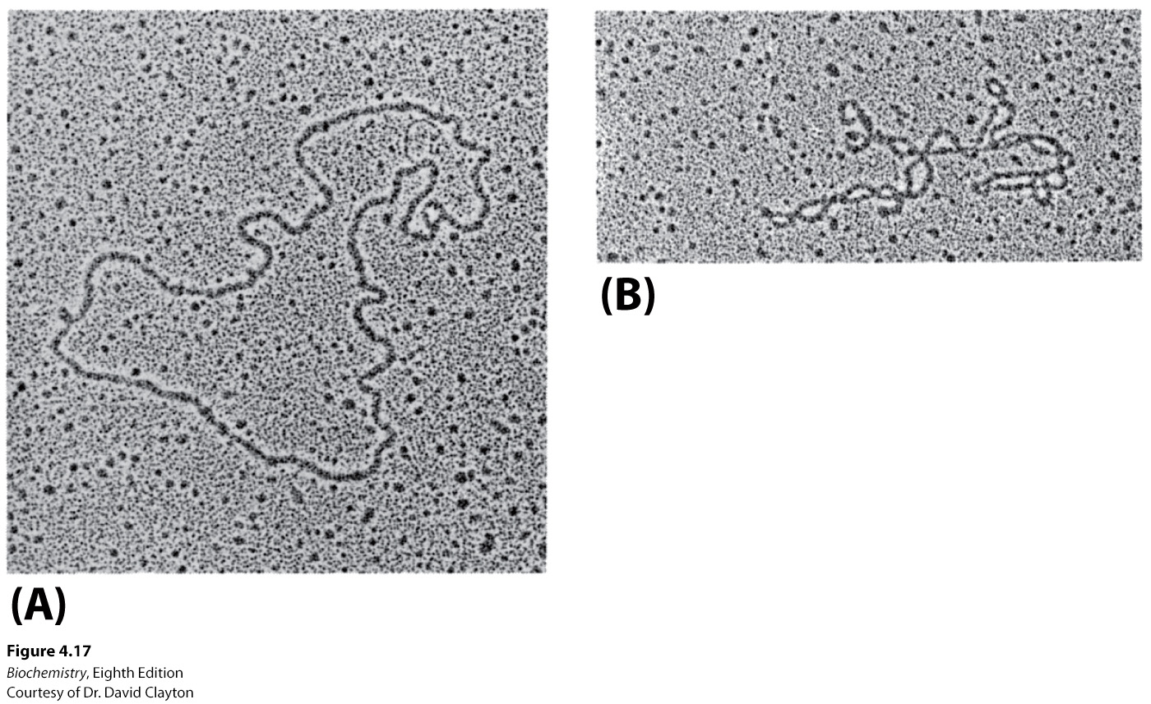
Notes:
FIGURE 4.17 Electron micrographs of circular DNA from mitochondria. (A) Relaxed form. (B) Supercoiled form. [Courtesy of Dr. David Clayton.]

Slide 32
A common structural motif seen in nucleic acids, most notably RNA, is the stem-loop, which occurs when complementary sequences in the same strand form a double helix.
Non-Watson-Crick base pairs occur frequently in RNA.
More elaborate structures may form, often stabilized by Mg²⁺ ions.

Slide 33
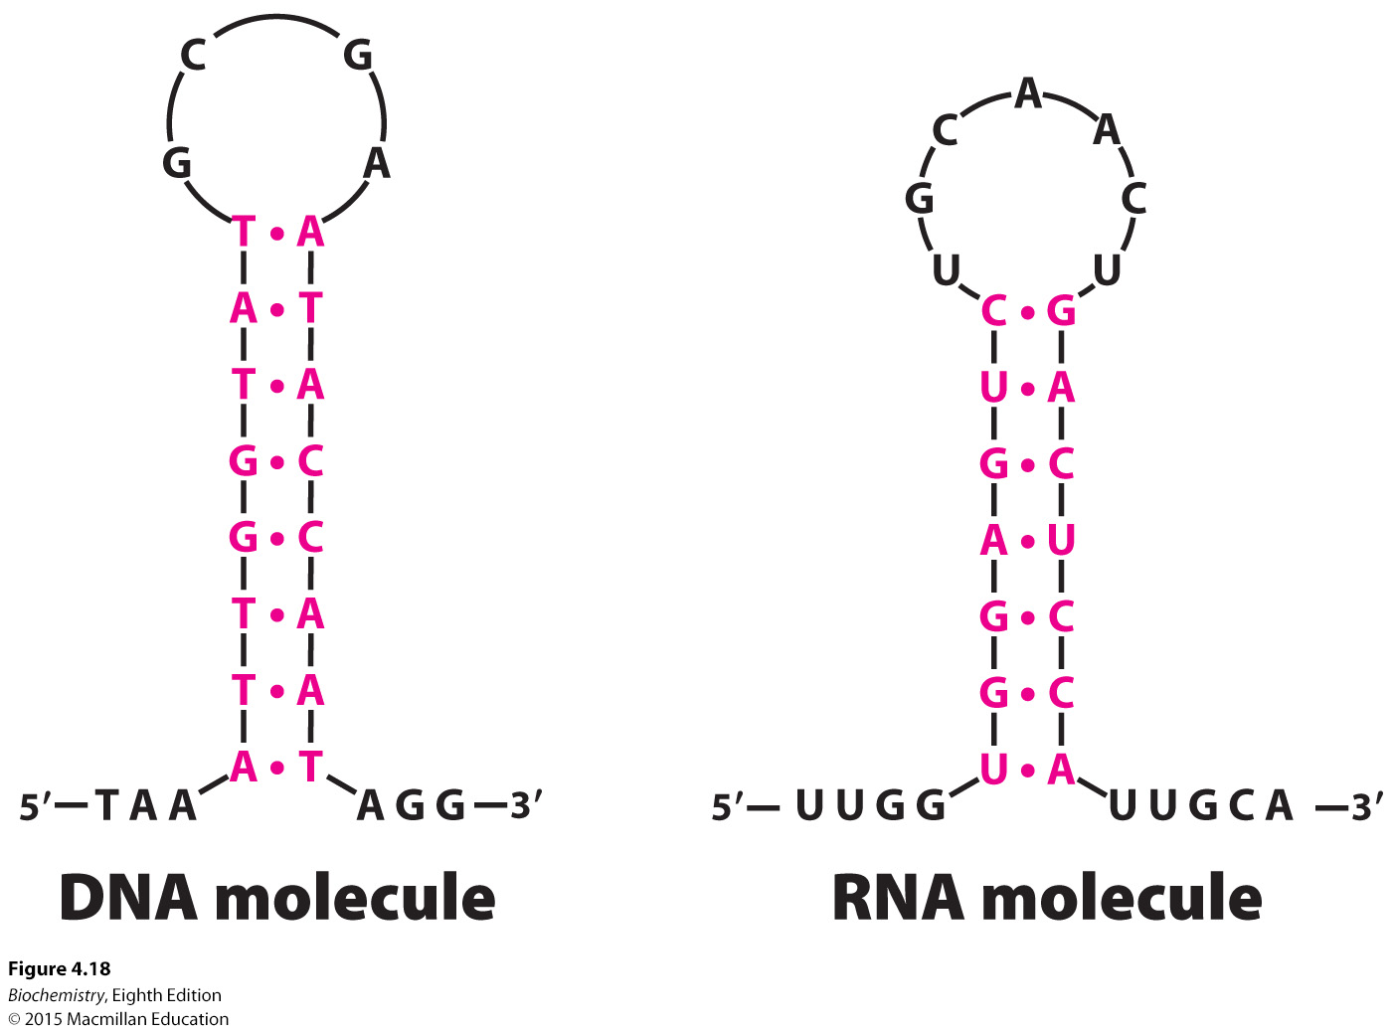
Notes:
FIGURE 4.18 Stem-loop structures. Stem-loop structures can be formed from single-stranded DNA and RNA molecules.

Slide 34
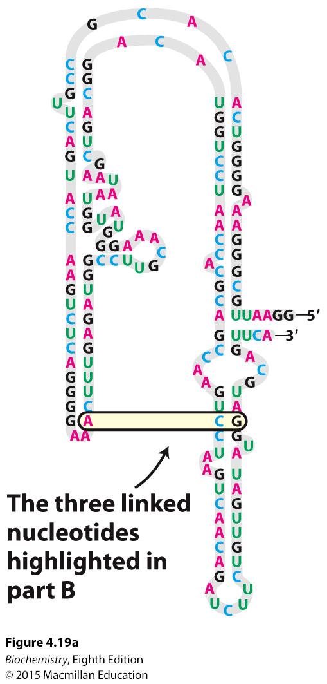
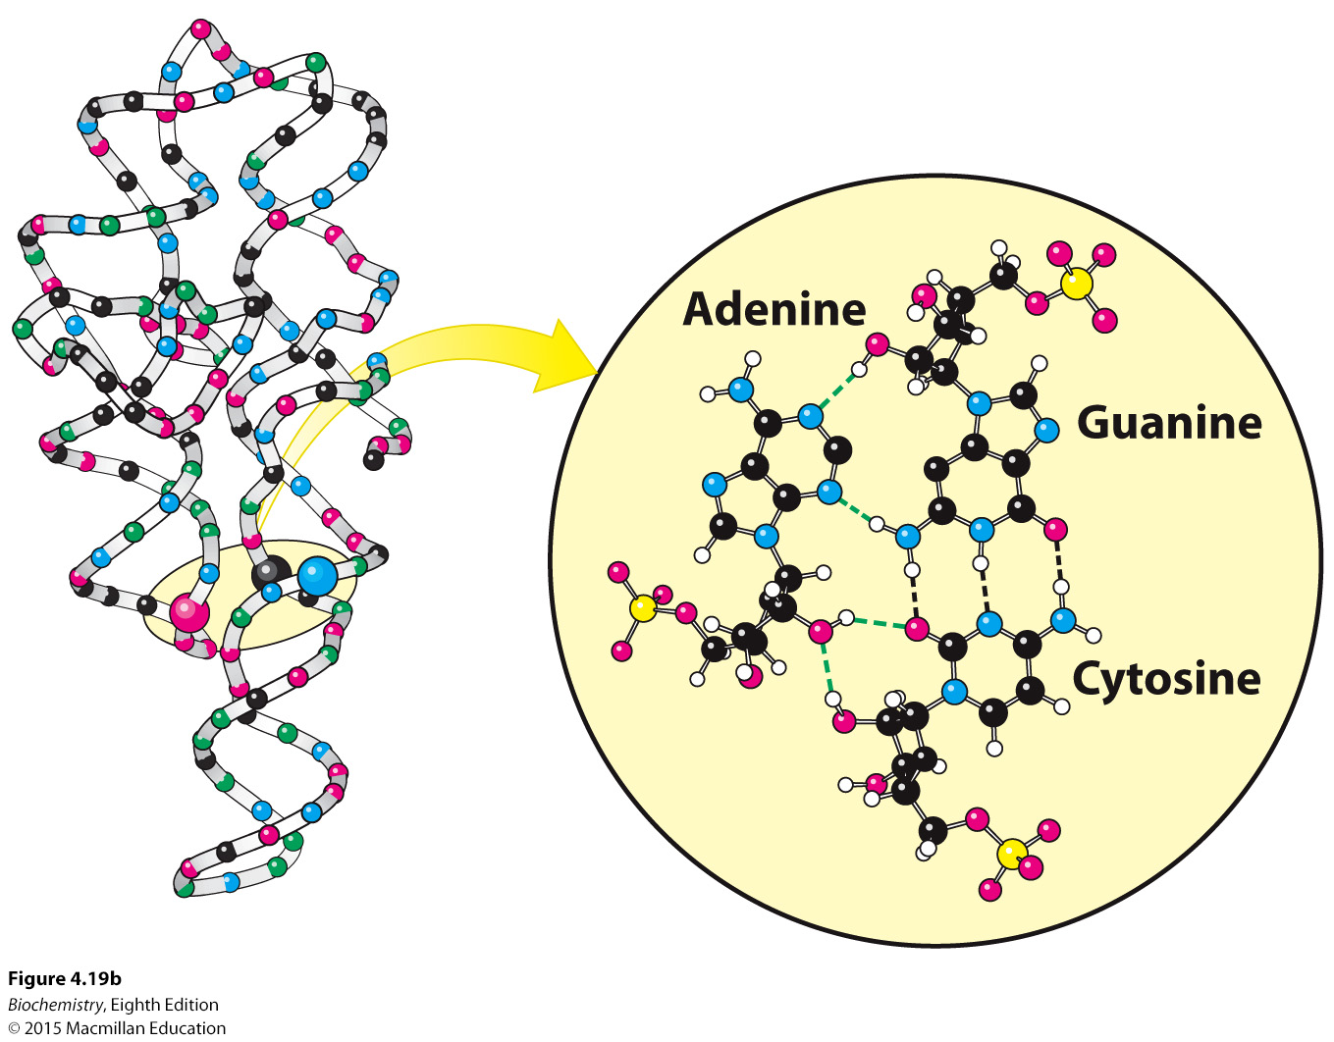
Notes:
FIGURE 4.19 Complex structure of an RNA molecule. A single-stranded RNA molecule can fold back on itself to form a complex structure. (A) The nucleotide sequence showing Watson–Crick base pairs and other nonstandard base pairings in stem-loop structures. (B) The three-dimensional structure and one important long-range interaction between three bases. In the three-dimensional structure at the left, cytidine nucleotides are shown in blue, adenosine in red, guanosine in black, and uridine in green. In the detailed projection, hydrogen bonds within the Watson–Crick base pair are shown as dashed black lines; additional hydrogen bonds are shown as dashed green lines.

Slide 35

Because of the base pairing rules, the sequence of one strand determines the sequence of the partner strand.
The two strands can be separated and complementary sequences synthesized to generate two identical daughter strands.
Because the two daughter helices have one parent strand and one newly synthesized strand, the replication process is called semiconservative replication.

Slide 36

Meselson and Stahl elegantly demonstrated that replication is semiconservative by growing bacteria in growth media supplemented with ¹⁵N. The bacteria were then shifted to growth media with ¹⁴N as the nitrogen source.
Density gradient centrifugation established that upon the shift to ¹⁴N medium, newly synthesized DNA consisted of DNA with equal parts ¹⁵N-DNA and ¹⁴N-DNA, a result consistent with semiconservative replication.

Slide 37
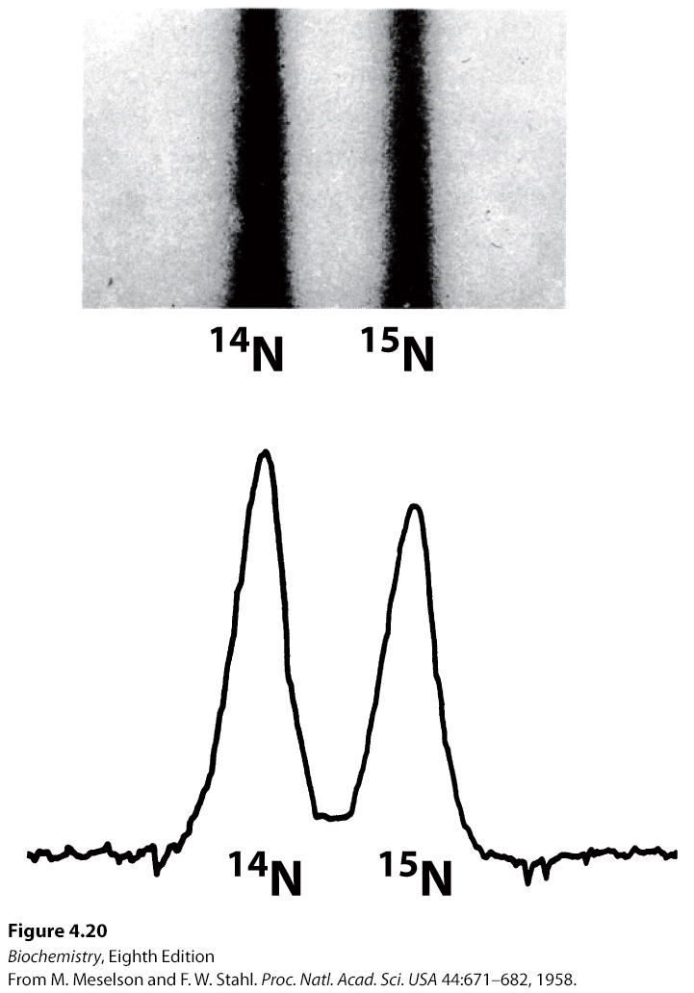
Notes:
FIGURE 4.20 Resolution of ¹⁴N DNA and ¹⁵N DNA by density-gradient centrifugation. (A) Ultraviolet-absorption photograph of a centrifuged cell showing the two distinct bands of DNA. (B) Densitometric tracing of the absorption photograph. [Data from M. Meselson and F. W. Stahl. Proc. Natl. Acad. Sci. U. S. A. 44:671–682, 1958.]

Slide 38
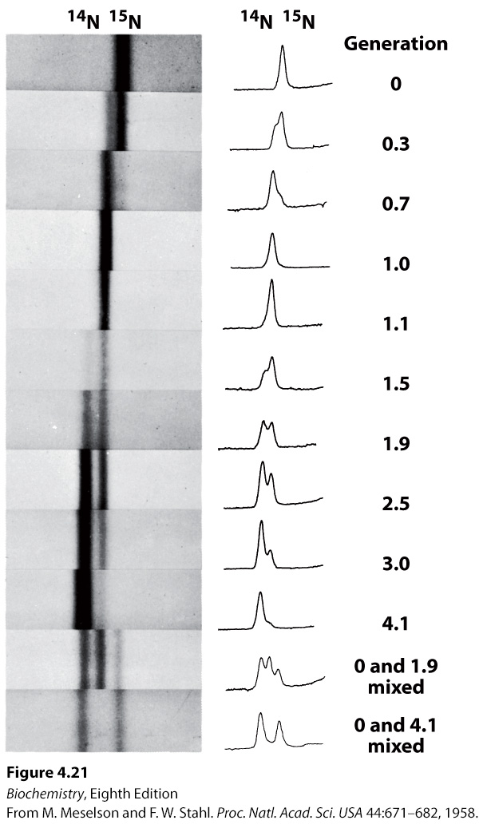
Notes:
FIGURE 4.21 Detection of semiconservative replication of E. coli DNA by density-gradient centrifugation. The position of a band of DNA depends on its content of ¹⁴N and ¹⁵N. After 1.0 generation, all of the DNA molecules were hybrids containing equal amounts of ¹⁴N and ¹⁵N. [Data from M. Meselson and F. W. Stahl. Proc. Natl. Acad. Sci. U. S. A. 44:671–682, 1958.]

Slide 39
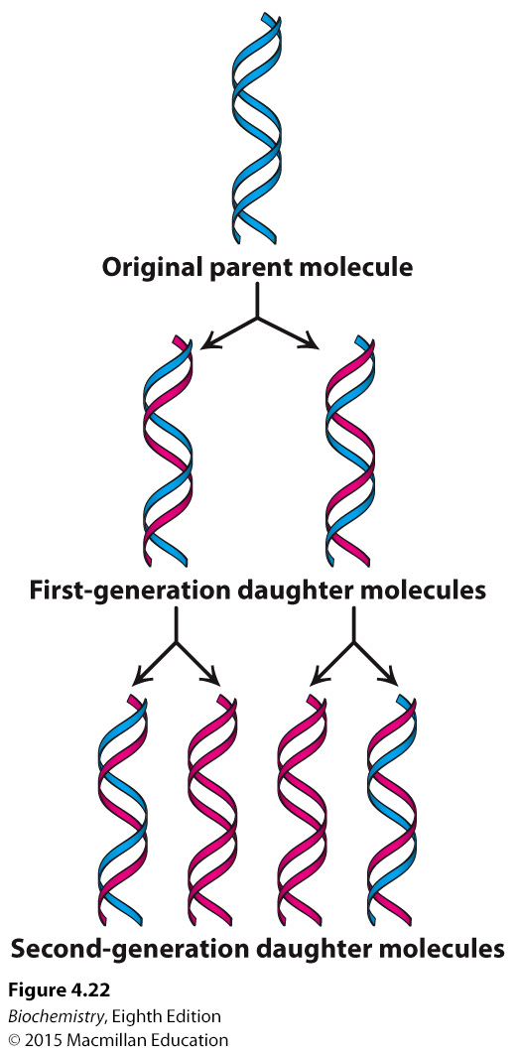
Notes:
FIGURE 4.22 Diagram of semiconservative replication. Parental DNA is shown in blue and newly synthesized DNA in red. [Information from M. Meselson and F. W. Stahl. Proc. Natl. Acad. Sci. U. S. A. 44:671–682, 1958.]

Slide 40

During replication or transcription, the two strands of the DNA double helix must be separated.
In the laboratory, DNA strands can be separated by heating a solution of DNA, a process called denaturation or melting. The temperature at which half of the DNA molecules are denatured is called the melting temperature (T_{m}).
Melting can be observed because bases stacked in a double helix absorb less ultraviolet light than bases in a single-stranded molecule, a phenomenon called hypochromism.
Upon cooling, the two strands can bind to one another to reform the double helix, a process called reannealing.

Slide 41
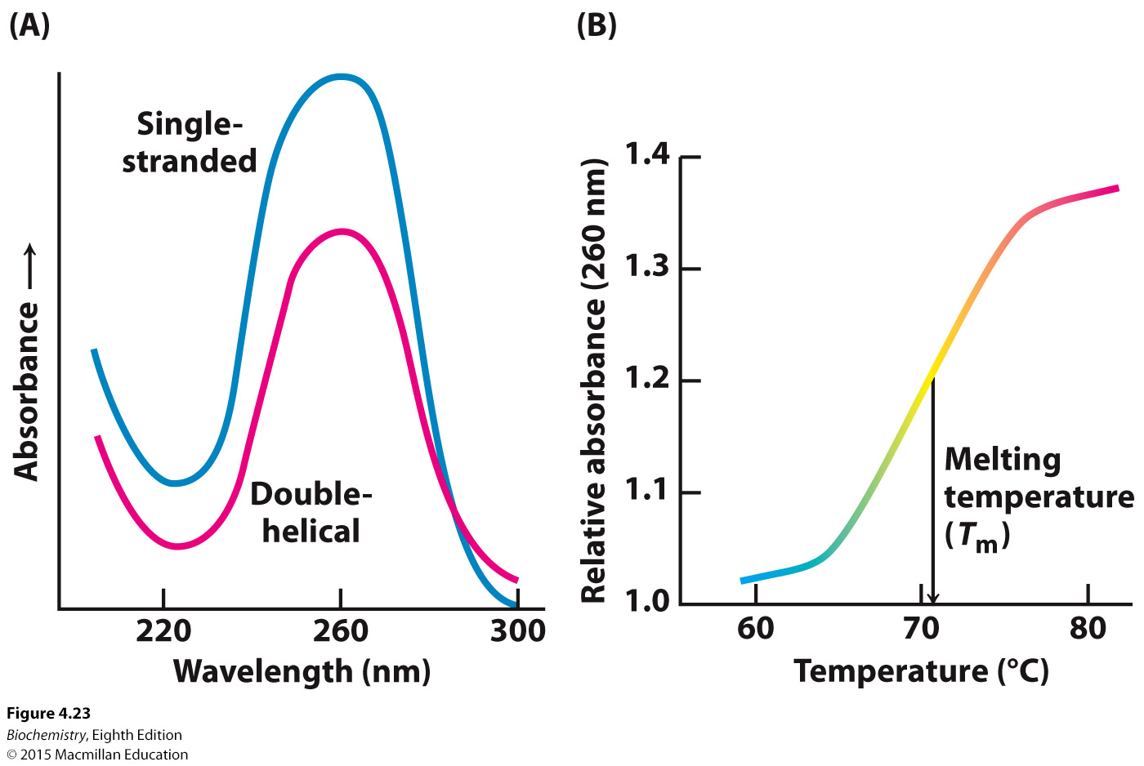
Notes:
FIGURE 4.23 Hypochromism. (A) Single-stranded DNA absorbs light more effectively than does double-helical DNA. (B) The absorbance of a DNA solution at a wavelength of 260 nm increases when the double helix is melted into single strands.

Slide 42

DNA replication in E. coli requires more than 20 proteins, five of which, called DNA polymerases, catalyze the synthesis of new DNA.

Slide 43

The reaction catalyzed by DNA polymerase is:
Key characteristics of DNA synthesis are:
Four deoxynucleoside triphosphates and Mg²⁺ are required.
A template strand is used to direct DNA synthesis.
A primer from which the new strand grows must be present.
Many DNA polymerases have nuclease activity that allows for the removal of mismatched bases.

Slide 44
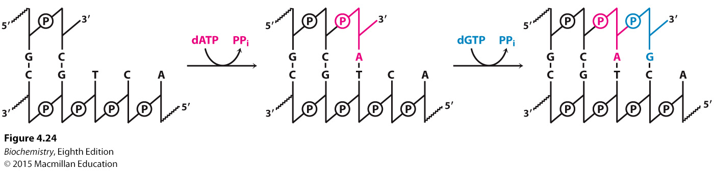
Notes:
FIGURE 4.24 Polymerization reaction catalyzed by DNA polymerases.

Slide 45
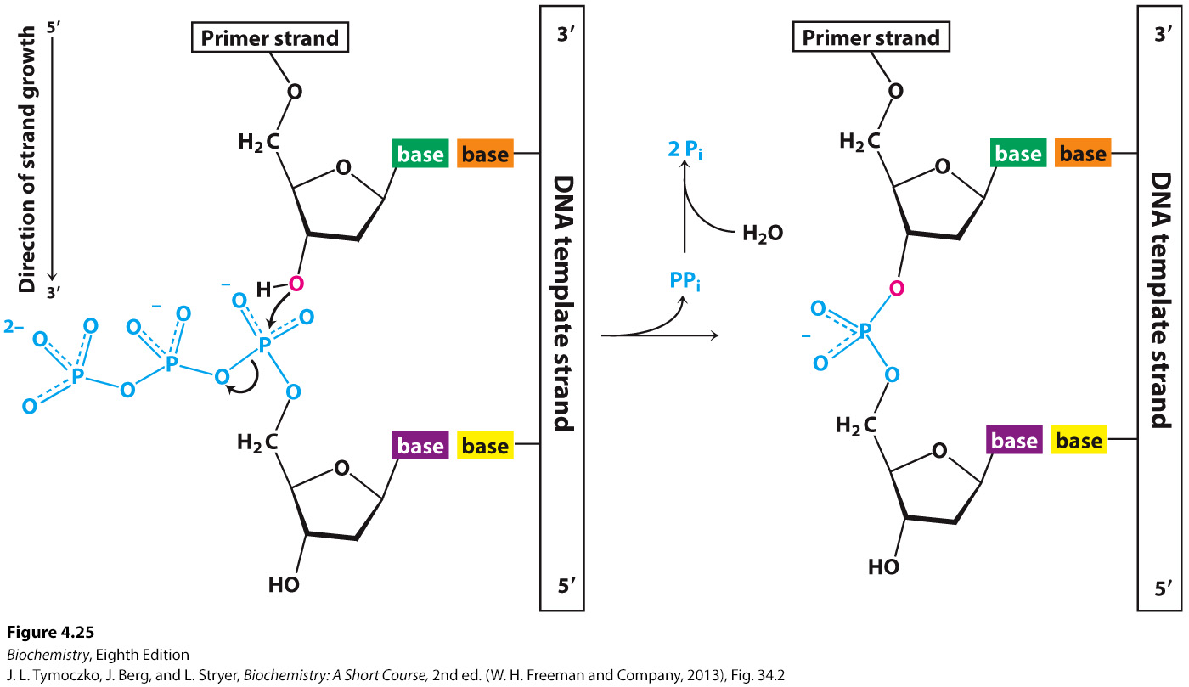
Notes:
FIGURE 4.25 Strand-elongation reaction. DNA polymerases catalyze the formation of a phosphodiester bridge. [Source: J. L. Tymoczko, J. Berg, and L. Stryer, Biochemistry: A Short Course, 2nd ed. (W. H. Freeman and Company, 2013), Fig. 34.2.].

Slide 46
Some viruses, such as the tobacco mosaic virus, have RNA genomes that are replicated by RNA-directed RNA polymerases.
Retroviruses, such as HIV-1, have single-stranded RNA genomes that are converted into DNA double helices by the action of reverse transcriptase.

Slide 47
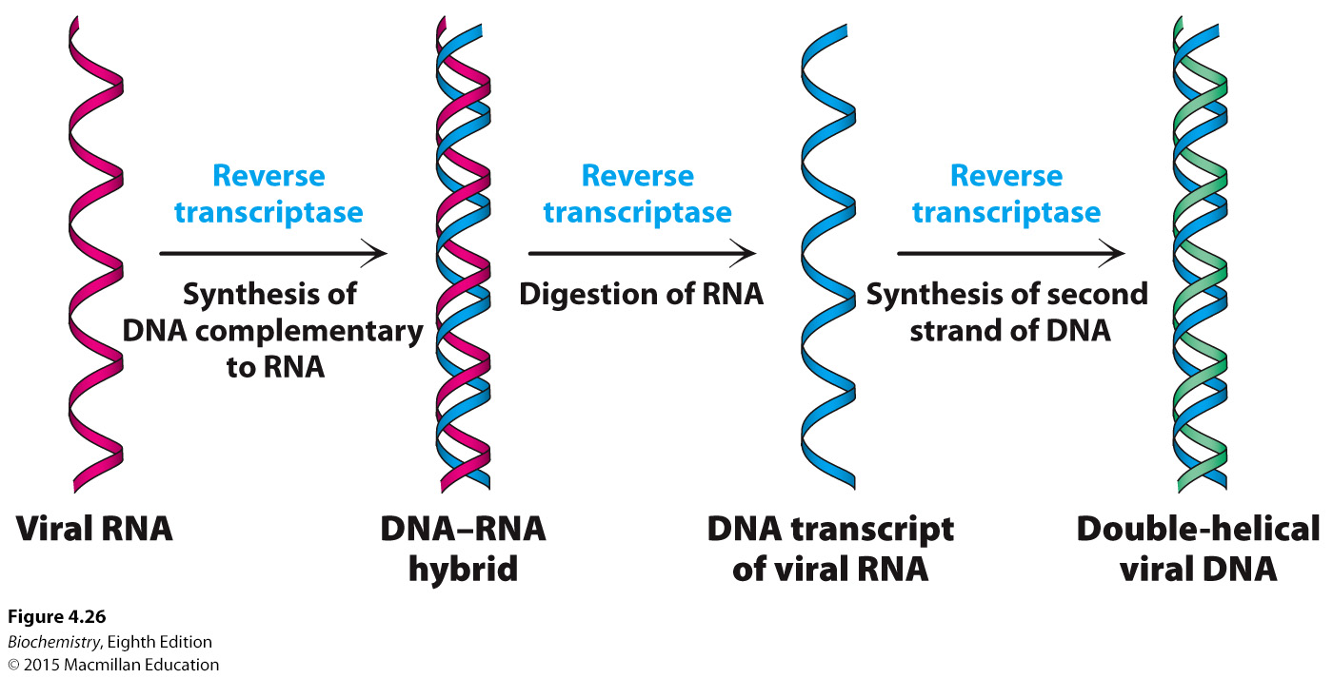
Notes:
FIGURE 4.26 Flow of information from RNA to DNA in retroviruses. The RNA genome of a retrovirus is converted into DNA by reverse transcriptase, an enzyme brought into the cell by the infecting virus particle. Reverse transcriptase possesses several activities and catalyzes the synthesis of a complementary DNA strand, the digestion of the RNA, and the subsequent synthesis of the DNA strand.

Slide 48

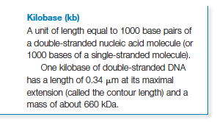
There are many species of RNA that perform a variety of functions. However, the three most abundant classes of RNA are ribosomal RNA (rRNA), messenger RNA (mRNA) and transfer RNA (tRNA).

Slide 49
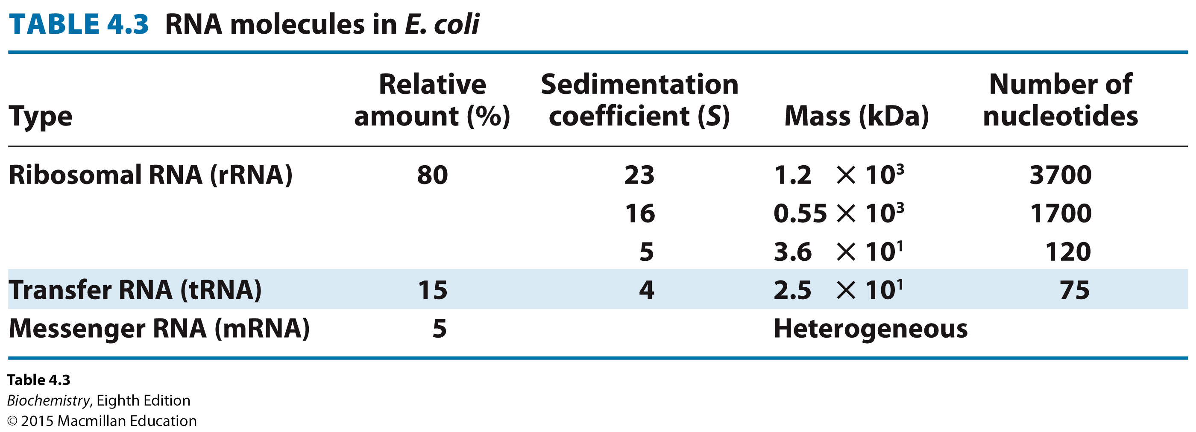

Slide 50
The synthesis of RNA from a DNA template is called transcription, a process catalyzed by RNA polymerase. RNA polymerase has the following requirements:
A template. The sequence of the newly-synthesized RNA is complementary to the DNA template. The DNA strand that has the same sequence as the RNA product (with T instead of U) is called the coding strand.
Activated precursors in the form of the four ribonucleoside triphosphates.
Divalent metal ions, usually Mg²⁺ or Mn²⁺
RNA polymerase initiates and elongates the RNA product, with the chain growing in the 5′ to 3′ direction. The 3′ OH of the growing chain attacks the inner most phosphoryl (α) group of the incoming ribonucleoside triphosphate.

Slide 51
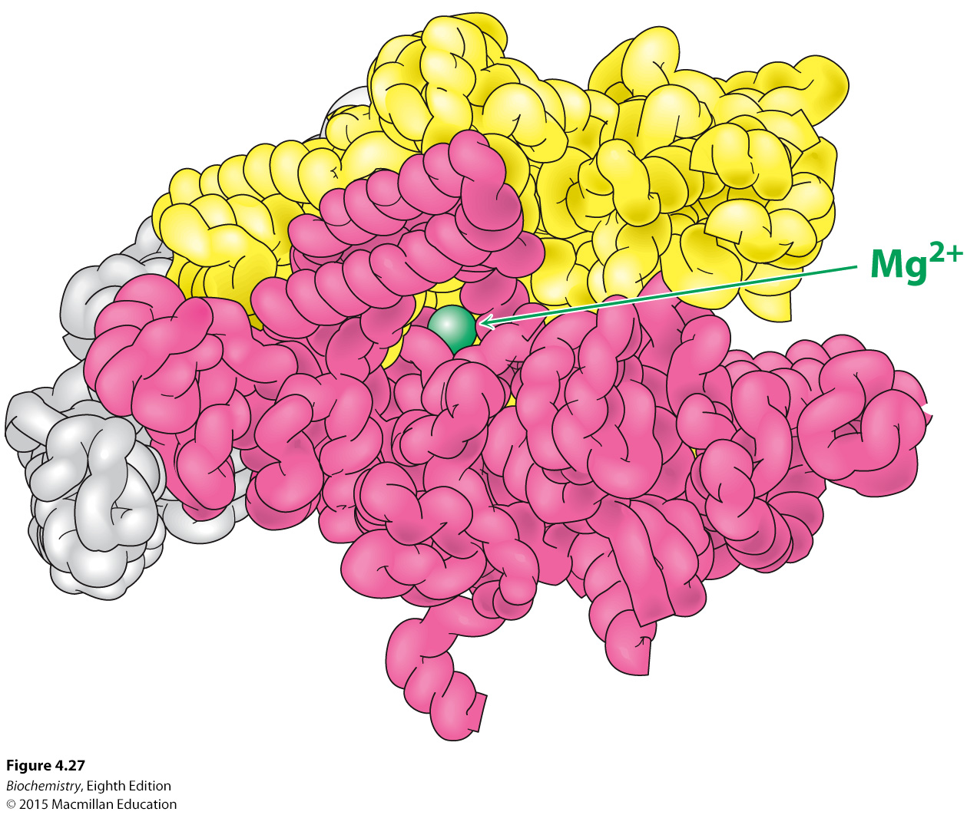
Notes:
FIGURE 4.27 RNA Polymerase. This large enzyme comprises many subunits, including β (red) and β’ (yellow), which form a “claw” that holds the DNA to be transcribed. Notice that the active site includes a Mg²⁺ion (green) at the center of the structure. The curved tubes making up the protein in the image represent the backbone of the polypeptide chain. [Drawn from 1L9Z. pdb.]

Slide 52
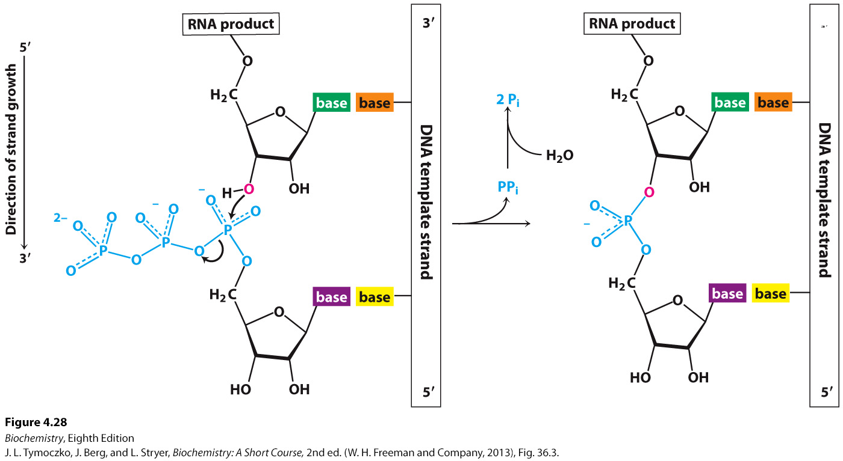
Notes:
FIGURE 4.28 Transcription mechanism of the chain-elongation reaction catalyzed by RNA polymerase. [Source: J. L. Tymoczko, J. Berg, and L. Stryer, Biochemistry: A Short Course, 2nd ed. (W. H. Freeman and Company, 2013), Fig. 36.3.]

Slide 53
Newly synthesized RNA has a base sequence complementary to that of the template strand of the DNA.

Slide 54
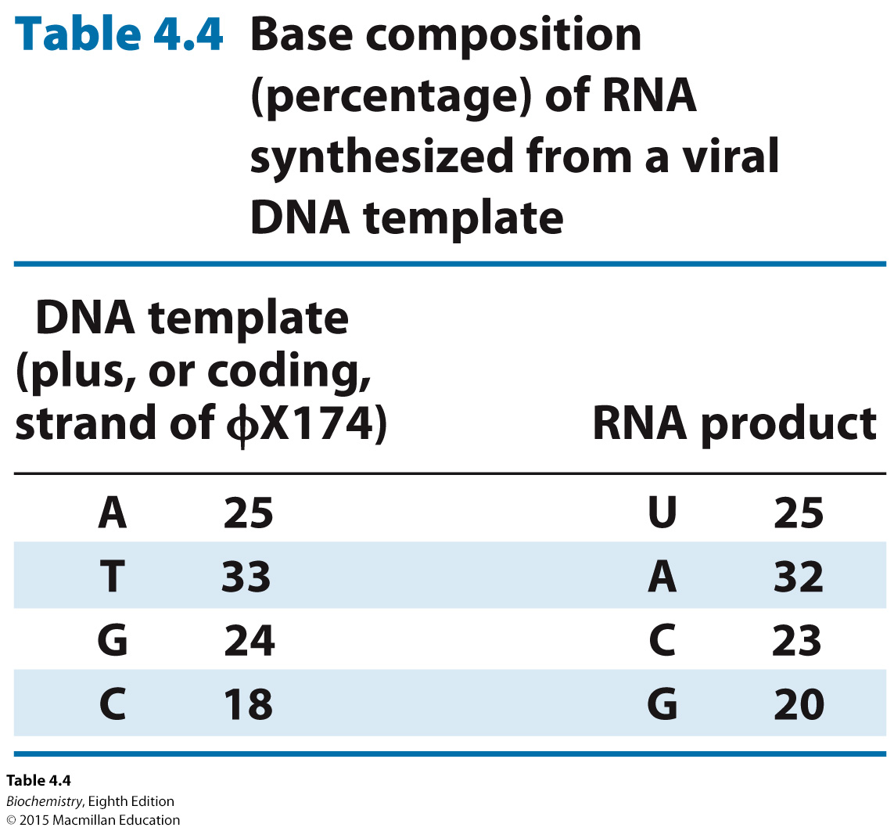

Slide 55
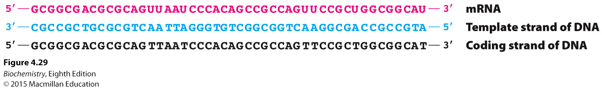
Notes:
FIGURE 4.29 Complementarity between mRNA and DNA. The base sequence of mRNA (red) is the complement of that of the DNA template strand (blue). The sequence shown here is from the tryptophan operon, a segment of DNA containing the genes for five enzymes that catalyze the synthesis of tryptophan. The other strand of DNA (black) is called the coding strand because it has the same sequence as the RNA transcript except for thymine (T) in place of uracil (U).

Slide 56
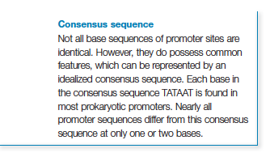
Promoters are specific DNA sequences that direct RNA polymerase to the proper initiation site.
There are often variations in the sequence of a promoter for different genes. The average of such variation is called the consensus sequence.

Slide 57
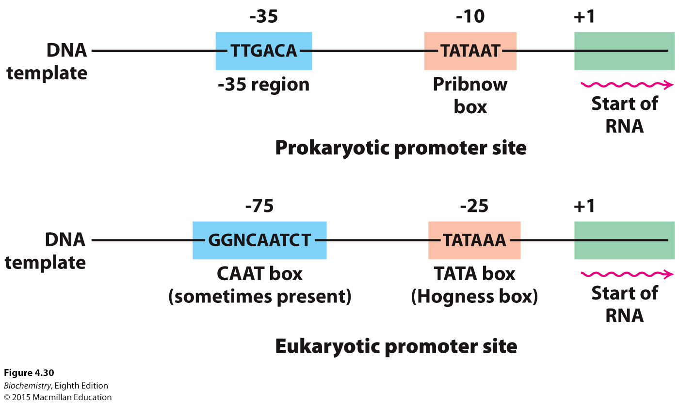
Notes:
FIGURE 4.30 Promoter sites for transcription in (A) prokaryotes and (B) eukaryotes. Consensus sequences are shown. The first nucleotide to be transcribed is numbered +1. The adjacent nucleotide on the 5′ side is numbered -1. The sequences shown are those of the coding strand of DNA.

Slide 58
Elongation continues until a termination signal is detected.
The simplest stop signal is the transcribed product of a segment of palindromic DNA.
The RNA complement of the DNA stop signal forms a hairpin structure, followed by several uracil residues.
Upon synthesis of the hairpin, the polymerase stalls, the RNA product is released and the DNA double helix reforms.
In other cases, the protein rho is required for transcription termination.

Slide 59
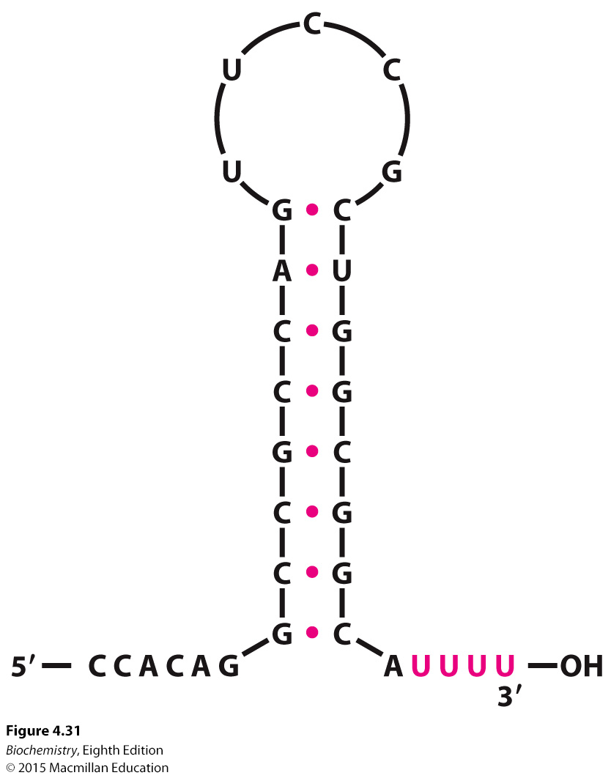
Notes:
FIGURE 4.31 Base sequence of the 3’ end of an mRNA transcript in E. coli. A stable hairpin structure is followed by a sequence of uridine (U) residues.

Slide 60
In eukaryotes, the 5′ end of mRNA is modified by the attachment of a cap structure while the 3′ end acquires a poly(A) tail.

Slide 61
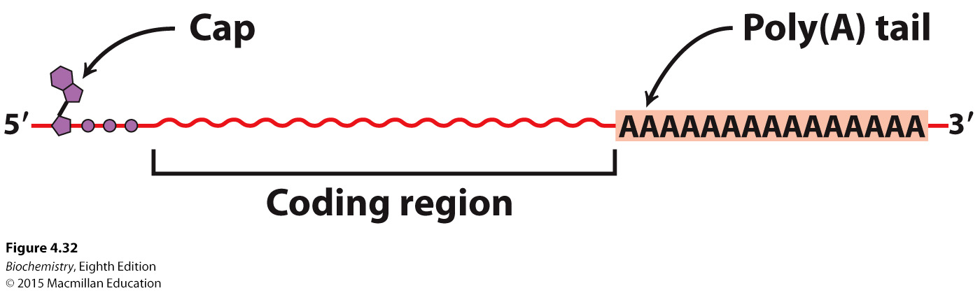
Notes:
FIGURE 4.32 Modification of mRNA. Messenger RNA in eukaryotes is modified after transcription. A nucleotide “cap” structure is added to the 5′ end, and a poly(A) tail is added at the 3′ end.

Slide 62
Transfer RNA molecules react with specific amino acids in a reaction catalyzed by aminoacyl-tRNA synthetases.
Transfer RNA molecules also contain a template recognition site, called the anticodon. The anticodon, which consists of three bases, recognizes a complementary 3 base sequence in the mRNA called the codon.

Slide 63
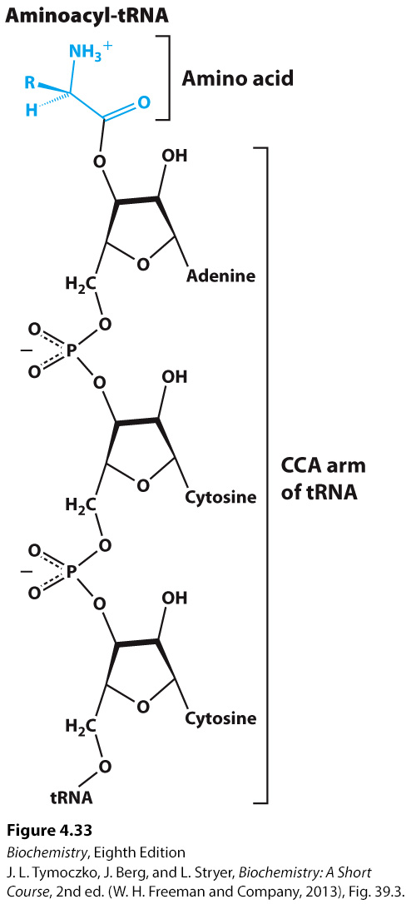
Notes:
FIGURE 4.33 Attachment of an amino acid to a tRNA molecule. The amino acid (shown in blue) is esterified to the 3′-hydroxyl group of the terminal adenylate of tRNA. [Source: J. L. Tymoczko, J. Berg, and L. Stryer, Biochemistry: A Short Course, 2nd ed. (W. H. Freeman and Company, 2013), Fig. 39.3.]

Slide 64
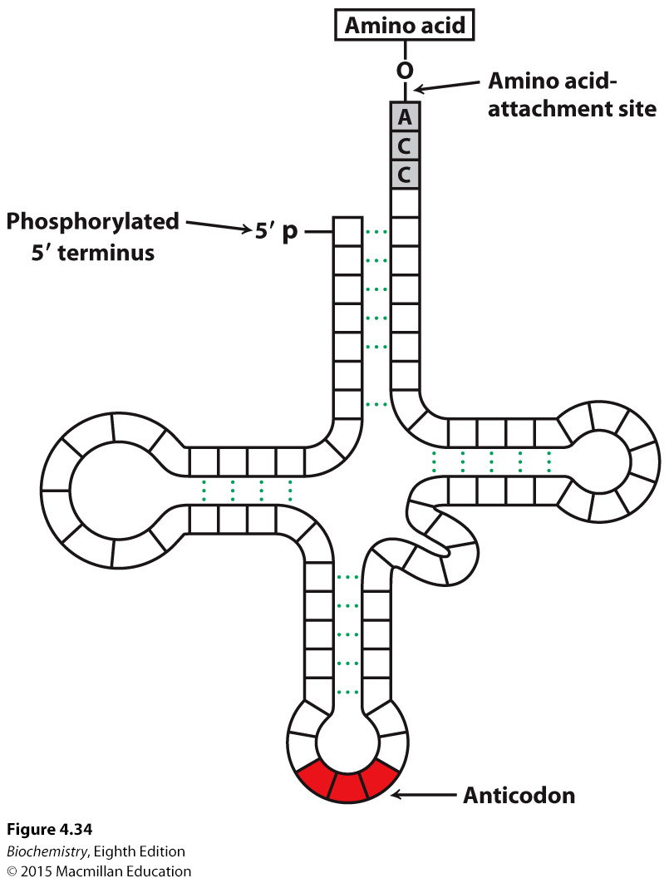
Notes:
FIGURE 4.34 General structure of an aminoacyl-tRNA. The amino acid is attached at the 3′ end of the RNA. The anticodon is the template-recognition site. Notice that the tRNA has a cloverleaf structure with many hydrogen bonds (green dots) between bases.

Slide 65

Protein synthesis is a process of translation. Nucleic acid sequence information is translated into amino acid sequence information. The genetic code links these two types of information.
Characteristics of the genetic code are:
Three nucleotides, called a codon, encode an amino acid.
The code is nonoverlapping.
The code has no punctuation.
The code has directionality. It is read from the 5′ end of the mRNA to the 3′ end.
The code is degenerate in that some amino acids are encoded by more than one codon.

Slide 66
Most amino acids are encoded by more than one codon, a property called degeneracy.
Degeneracy minimizes the deleterious effects of mutations.

Slide 67
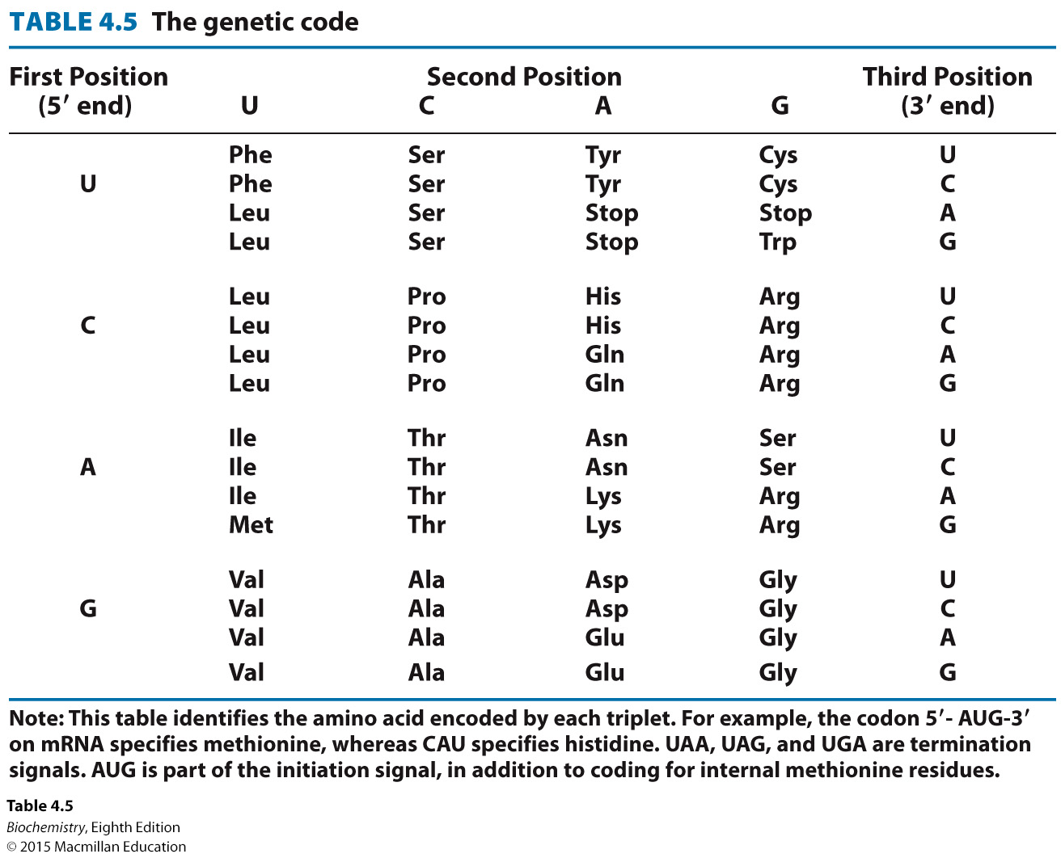

Slide 68
Messenger RNA is translated on ribosomes. The first codon is almost always AUG, which codes for methionine. In prokaryotes, the AUG is preceded by a purine rich sequence called the Shine-Dalgarno sequence. Formyl-Met-tRNA binds to the initiator codon.
In eukaryotes, the AUG nearest the 5′ end is the initiator codon.
Location of the initiator codon establishes the reading frame.

Slide 69
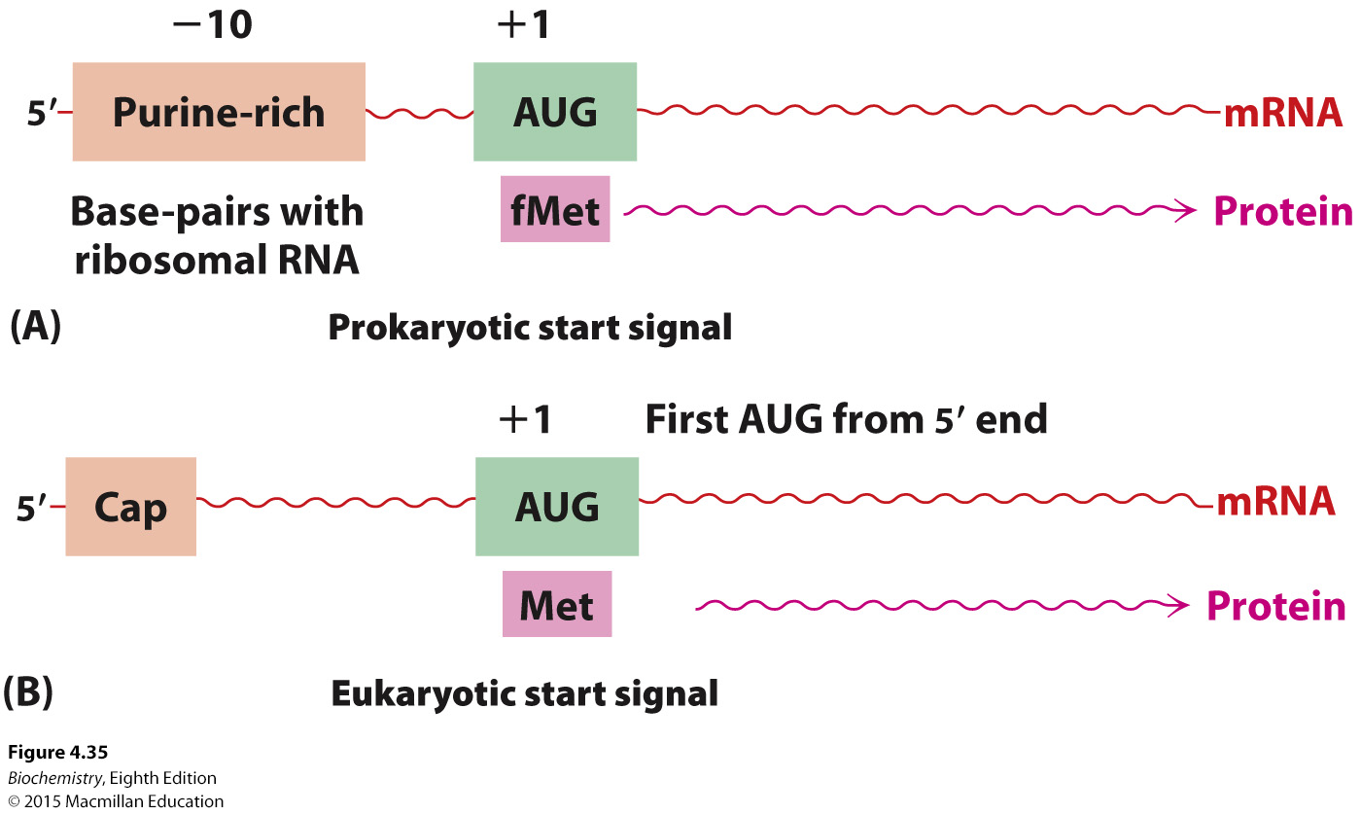
Notes:
FIGURE 4.35 Initiation of protein synthesis. Start signals are required for the initiation of protein synthesis in (A) prokaryotes and (B) eukaryotes.

Slide 70

Most organisms use the same genetic code. However, some organisms have slight modifications.
For instance, in ciliated protozoa, codons that are stop signals in most organisms encode amino acids.
Mitochondria also use variations of the genetic code.

Slide 71
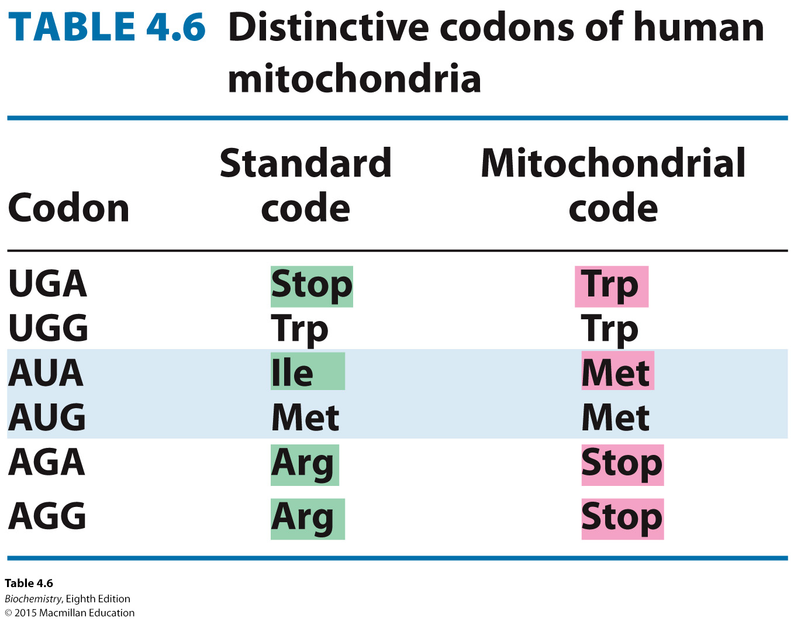

Slide 72

Eukaryotic genes are discontinuous, with coding regions called exons, interrupted by noncoding regions called introns.
Introns were initially detected by electron microscopy studies.
The gene for the β-chain of human hemoglobin has 3 exons and two introns.

Slide 73
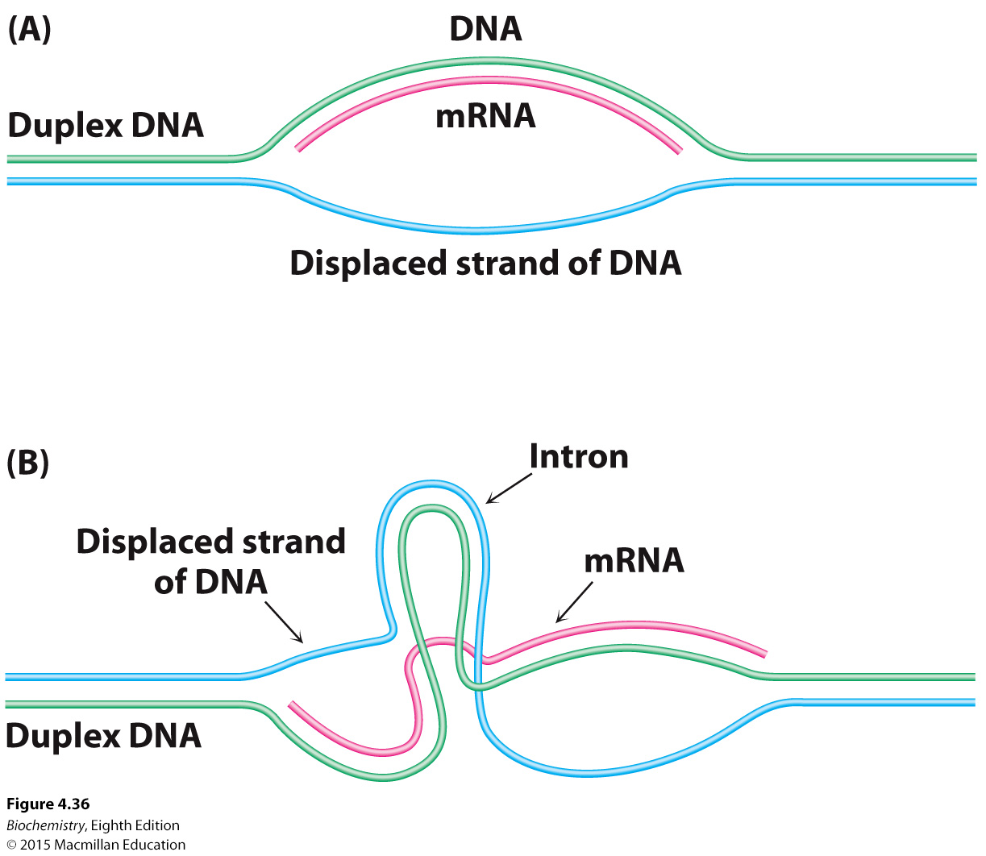
Notes:
FIGURE 4.36 Detection of introns by electron microscopy. An mRNA molecule (shown in red) is hybridized to genomic DNA containing the corresponding gene. (A) A single loop of single-stranded DNA (shown in blue) is seen if the gene is continuous. (B) Two loops of single-stranded
DNA (blue) and a loop of double-stranded DNA (blue and green) are seen if the gene contains an intron. Additional loops are evident if more than one intron is present.

Slide 74
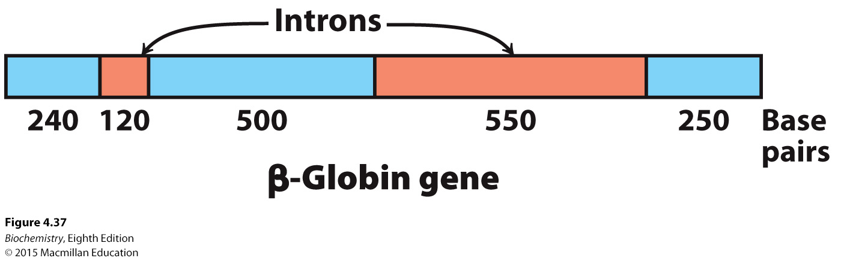
Notes:
FIGURE 4.37 Structure of the β-globin gene.

Slide 75

Pre-messenger RNA contains exons and intron. It is first modified by the addition of a 5′ cap and a poly A tail at the 3′ end. The introns are spliced out to generate mature mRNA by large complexes called spliceosomes.
Introns almost always begin with a GU and end with an AG.

Slide 76

Notes:
FIGURE 4.38 Transcription and processing of the β-globin gene. The gene is transcribed to yield the primary transcript, which is modified by cap and poly(A) addition. The introns in the primary RNA transcript are removed to form the mRNA.

Slide 77

Notes:
FIGURE 4.39 Consensus sequence for the splicing of mRNA precursors.

Slide 78

Many exons encode discrete structural and functional units of proteins.
Some new proteins have evolved by exon shuffling.
Alternative splicing allows the generation of multiple proteins from a single gene.

Slide 79

Notes:
FIGURE 4.40 Exon shuffling. Exons can be readily shuffled by recombination of DNA to expand the genetic repertoire.

Slide 80

Notes:
FIGURE 4.41 The tissue plasminogen activator (TPA) gene was generated by exon shuffling. The gene for TPA encodes an enzyme that functions in hemostasis (Section 10.4). This gene consists of 4 exons, one (F) derived from the fibronectin gene which encodes an extracellular matrix protein, one from the epidermal growth factor gene (EGF), and two from the plasminogen gene (K, Section 10.4), the substrate of the TPA protein. The K domain appears to have arrived by exon shuffling and then been duplicated to generate the TPA gene that exists today. [Information from: www.ehu.es/ehusfera/genetica/2012/10/02/demostracion-molecular-de-microevolucion/]

Slide 81

Notes:
FIGURE 4.41 Alternative splicing. Alternative splicing generates mRNAs that are templates for different forms of a protein: (A) a membrane-bound antibody on the surface of a lymphocyte and (B) its soluble counterpart, exported from the cell. The membrane-bound antibody is anchored to the plasma membrane by a helical segment (highlighted in yellow) that is encoded by its own exon.

