Slide 1
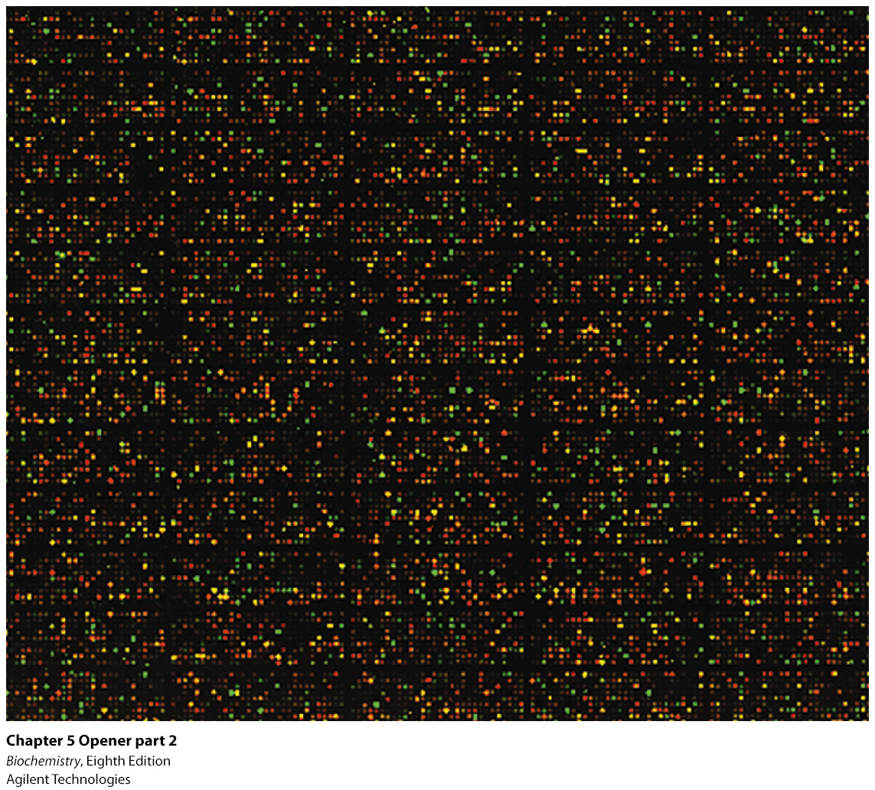
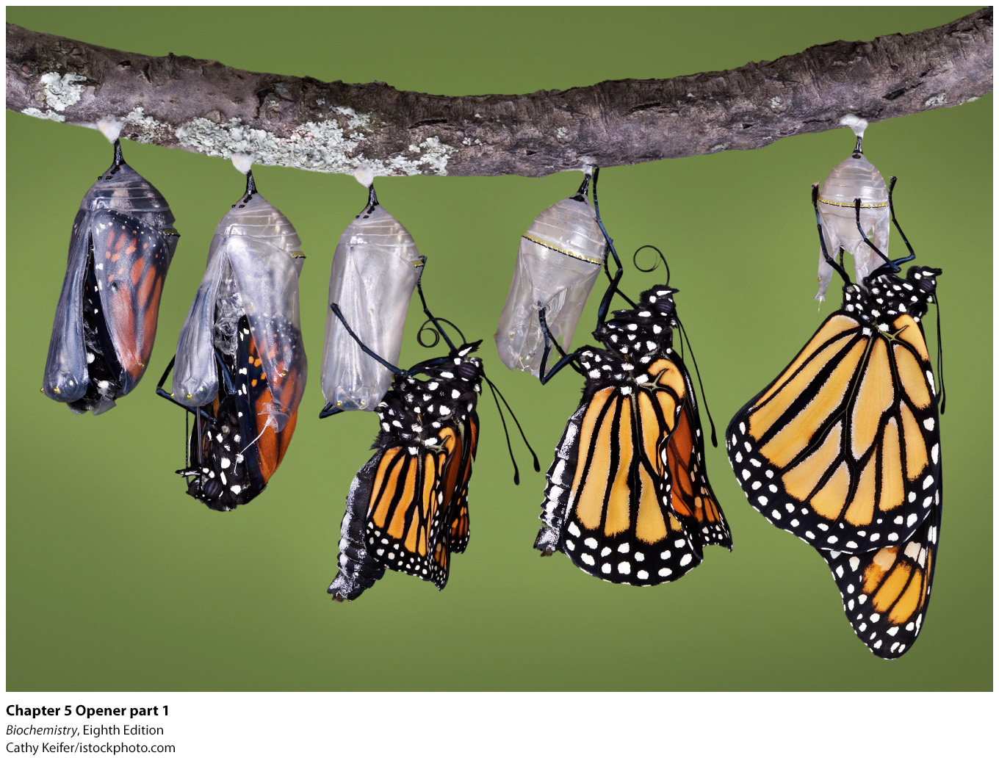
Notes:
Processes such as the development from a caterpillar into a butterfly entail dramatic changes in patterns of gene expression. The expression levels of thousands of genes can be monitored through the use of DNA arrays. At the right, a DNA microarray reveals the expression levels of more than 12,000 human genes; the brightness and color of each spot indicates a change in the expression level of the corresponding gene. [(Left) Cathy Keifer/istockphoto. com. (Right) Agilent Technologies.]

Slide 2
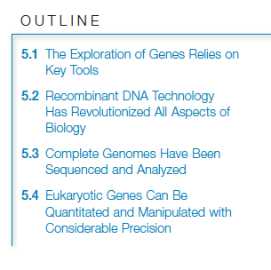

Slide 3

Advances in biotechnology are possible because of key techniques:
Restriction enzyme analysis.
Blotting techniques.
DNA sequencing.
Solid-phase synthesis of nucleic acids.
The polymerase chain reaction.

Slide 4
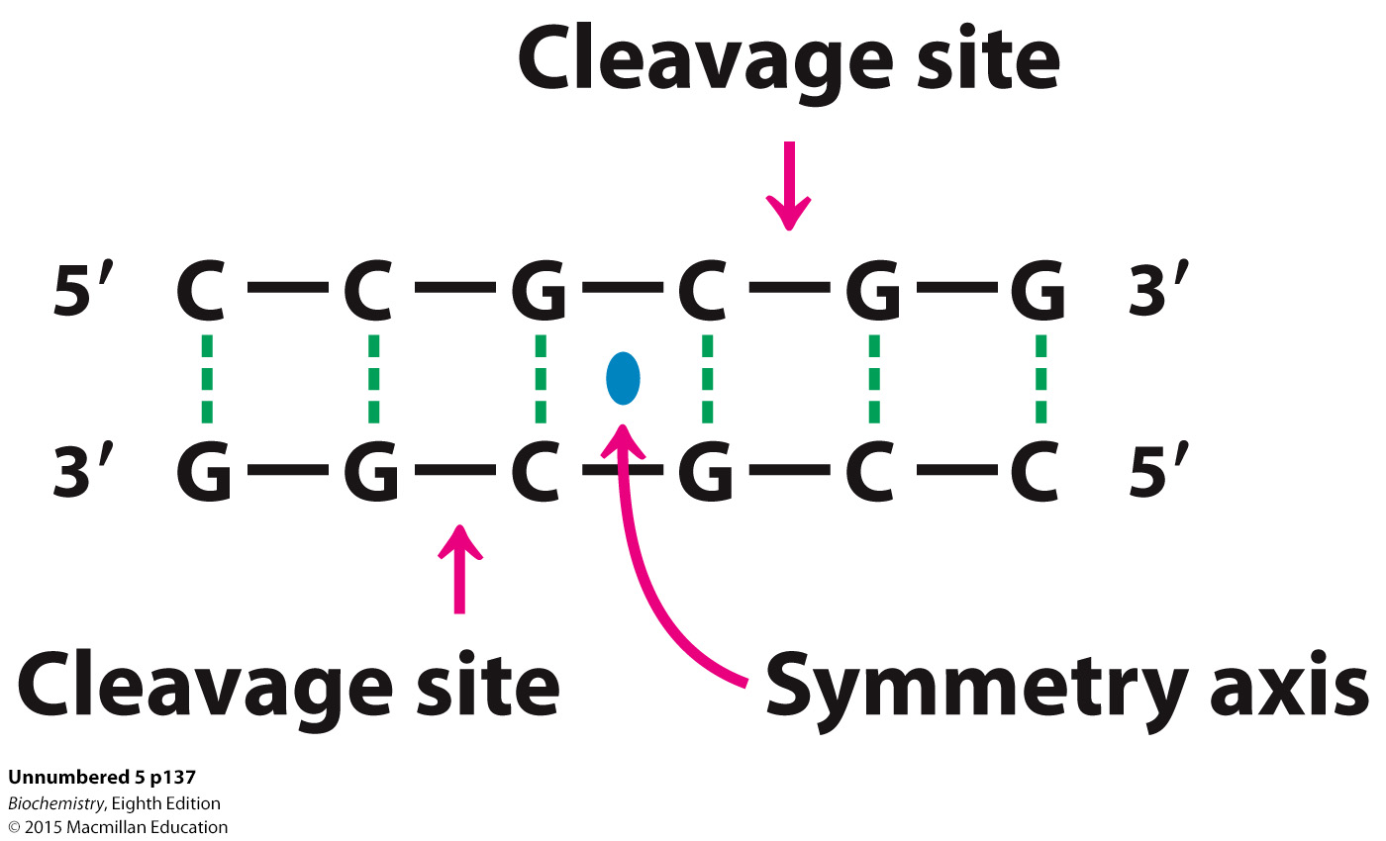
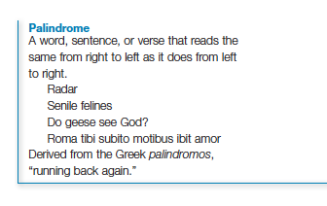
Restriction enzymes are bacterial enzymes that cleave DNA in a highly specific manner. The enzymes recognize cleavage sites of four to eight nucleotides in length that are palindromic and then cleave each strand of the DNA.

Slide 5
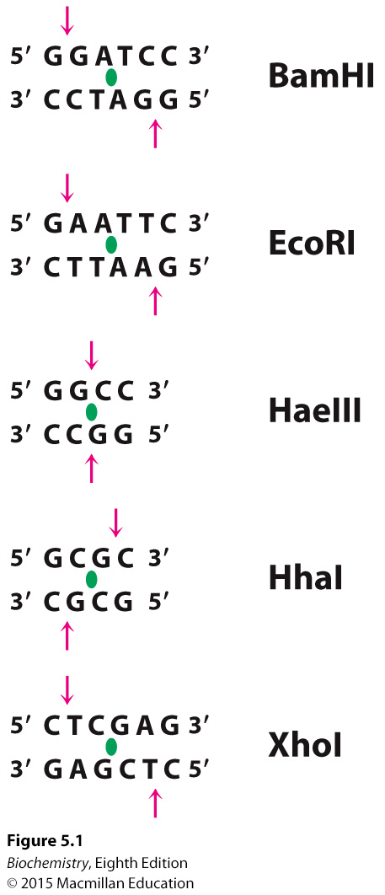
Notes:
Figure 5.1 Specificities of some restriction endonucleases. The sequences that are recognized by these enzymes contain a twofold axis of symmetry. The two strands in these regions are related by a 180-degree rotation about the axis marked by the green symbol. The cleavage sites are denoted by red arrows. The abbreviated name of each restriction enzyme is given at the right of the sequence that it recognizes. Note that the cuts may be staggered or even.

Slide 6
DNA fragments generated by restriction enzyme digestion can be separated by gel electrophoresis in agarose or polyacrylamide gels.
The fragments can be visualized by staining with ethidium bromide.
A restriction fragment containing a specific sequence can be identified following electrophoresis. The separated fragments are transferred to a sheet of nitrocellulose paper, a process called Southern blotting, and then exposed to a radioactively labeled probe complementary to the sequence of interest.
Autoradiography identifies the fragment binding to the probe.

Slide 7
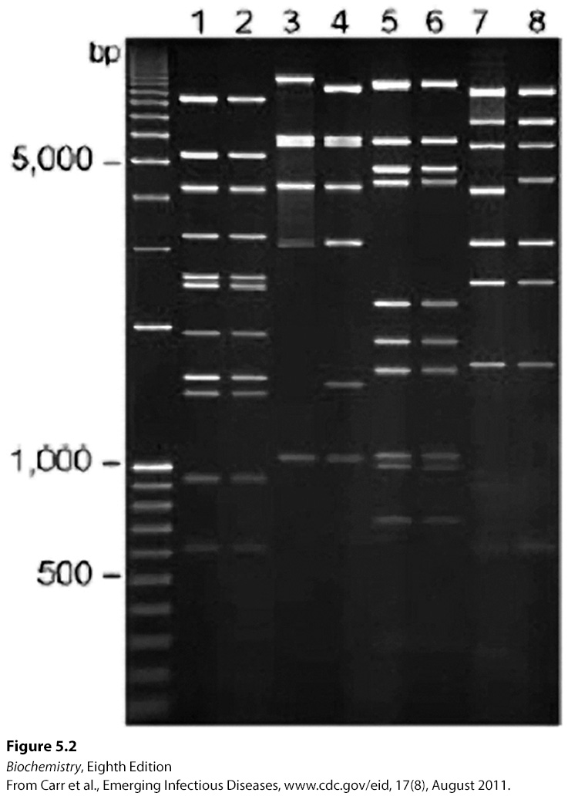
Notes:
FIGURE 5.2 Gel-electrophoresis pattern of a restriction digest. This gel shows the fragments produced by cleaving DNA from two viral strains (odd- vs. even-numbered lanes) with each of four restriction enzymes. These fragments were made fluorescent by staining the gel with ethidium bromide. [Data from Carr et al., Emerging Infectious Diseases, www.cdc.gov/eid, 17(8), August 2011.]

Slide 8
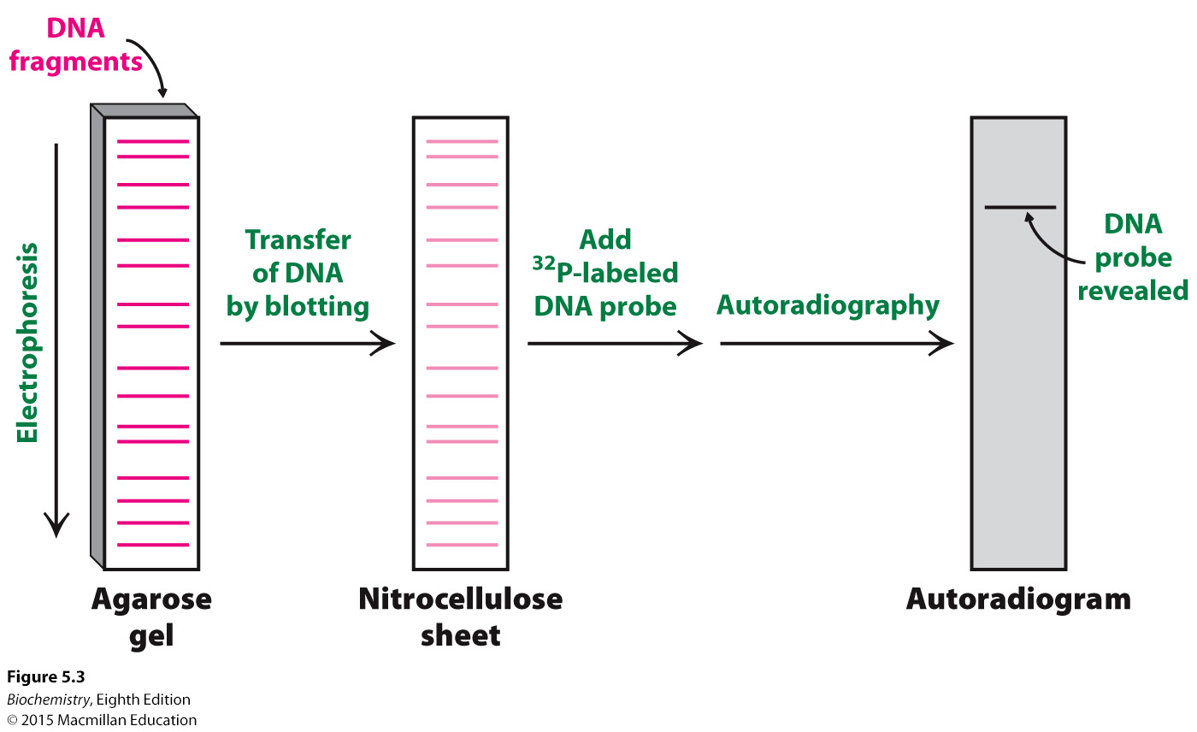
Notes:
FIGURE 5.3 Southern blotting. A DNA fragment containing a specific sequence can be identified by separating a mixture of fragments by electrophoresis, transferring them to nitrocellulose, and hybridizing with a ³²P-labeled probe complementary to the sequence. The fragment containing the sequence is then visualized by autoradiography.

Slide 9
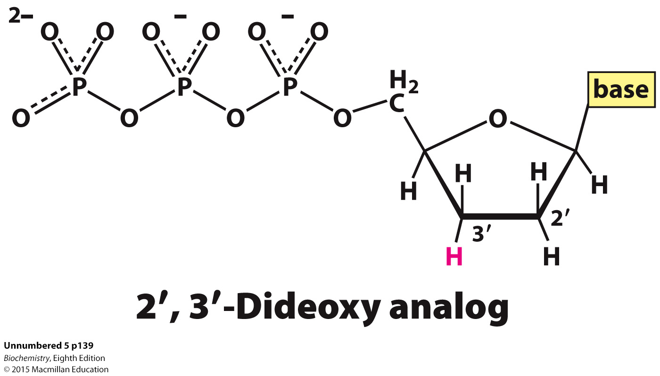
DNA can be sequenced by performing four polymerization reactions using as a template, the DNA to be sequenced. Each of the four reactions has a small amount of the 2′ , 3′ -dideoxy analog of one of the deoxynucleoside triphosphates. Polymerization sometimes halts with incorporation of the analog.
The fragments synthesized by the four reactions are then separated by polyacrylamide gel electrophoresis.
Strands of different lengths will result. The fragment lengths of the four reactions will correspond to the position in the template of the base complementary to the dideoxy analog.
Fluorescent detection of fragment length is possible if each dideoxy analog has a distinct fluorescent label.

Slide 10
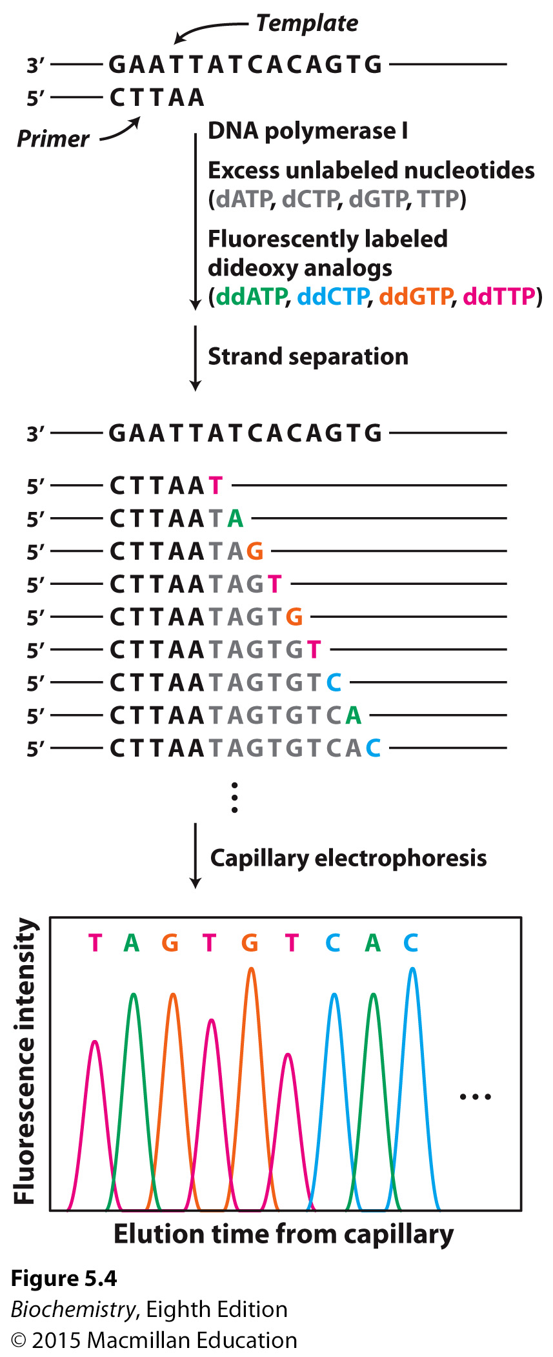
Notes:
FIGURE 5.4 Fluorescence detection of oligonucleotide fragments produced by the dideoxy method. A sequencing reaction is performed with four chain terminating dideoxy nucleotides, each labeled with a tag that fluoresces at a different wavelength. The color of each fragment indicates the identity of the last base in the chain. The fragments are separated by size using capillary electrophoresis and the fluorescence at each of the four wavelengths indicates the sequence of the complement of the original DNA template.

Slide 11

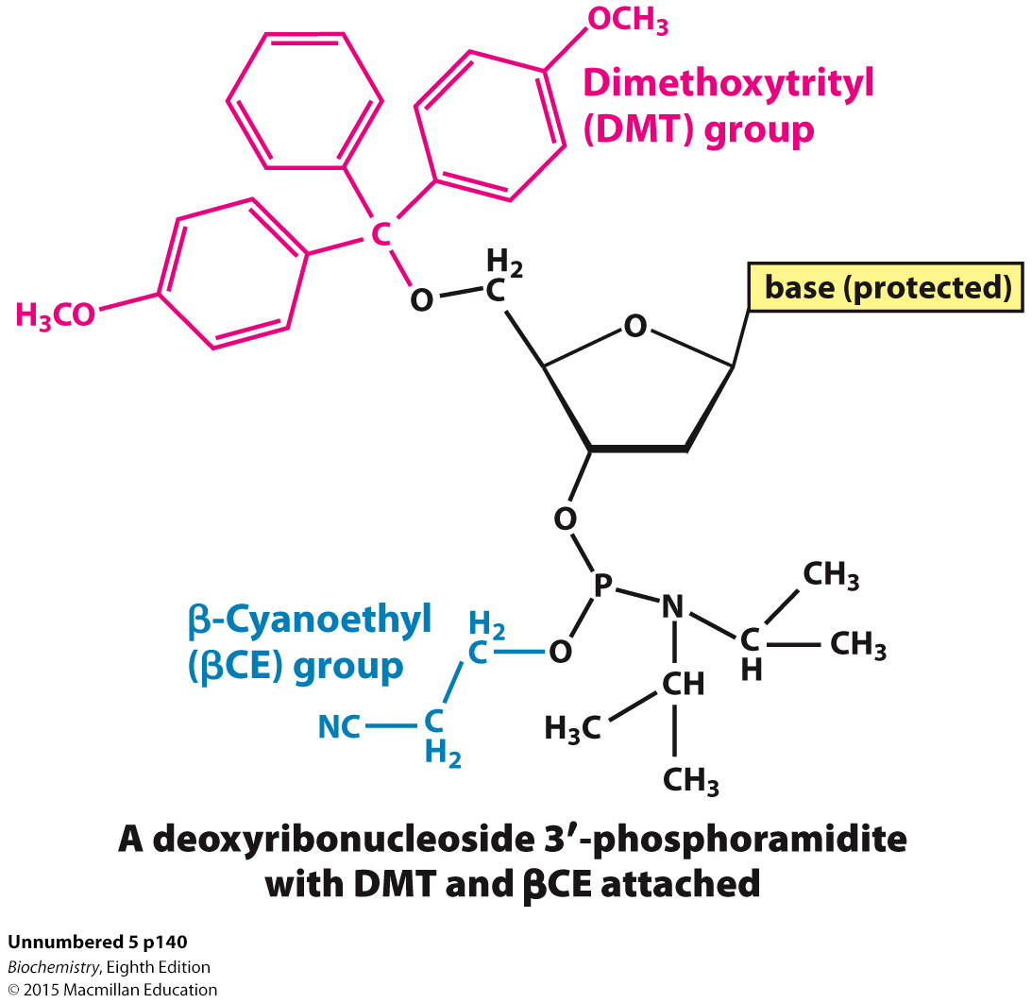
Deoxyribonucleoside 3′-phosphoramidites, in which all but one reactive groups are temporarily blocked by DMT or βCE, are activated monomers that can be sequentially linked to a strand attached to an insoluble support.
The newly synthesized DNA can be tagged with ³²P or a fluorescent marker and used as a probe.

Slide 12
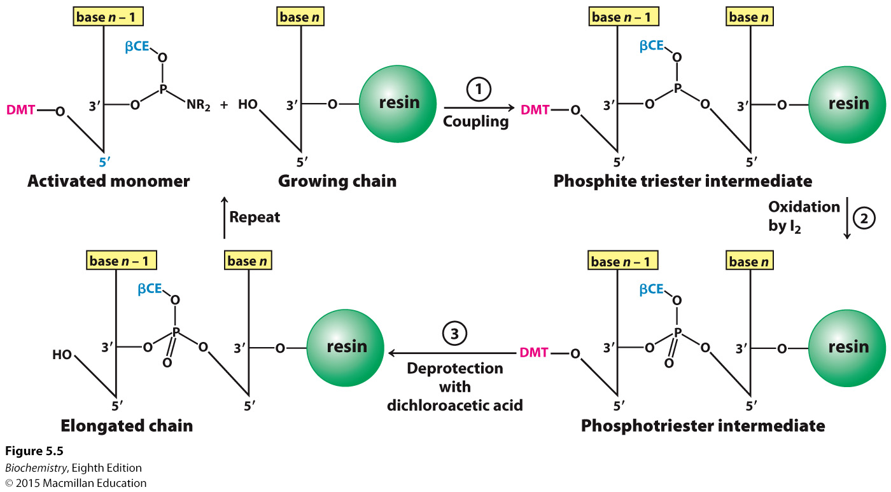
Notes:
FIGURE 5.5 Solid-phase synthesis of a DNA chain by the phosphite triester method. The activated monomer added to the growing chain is a deoxyribonucleoside 3′-phosphoramidite containing a dimethoxytrityl (DMT) protecting group on its 5′-oxygen atom, a β-cyanoethyl (βCE) protecting group on its 3′-phosphoryl oxygen atom, and a protecting group on the base.

Slide 13
The polymerase chain reaction (PCR) allows the amplification of any DNA sequence provided some sequence information about the DNA on either side of the DNA to be amplified (the target DNA) is known.
A PCR reaction consists of the target DNA, the flanking regions, which will serve as primers, and a heat stable DNA polymerase. PCR consists of three steps that are repeated until the desired degree of amplification is achieved.
The duplex containing the target sequence and the flanking regions (primers) is heated to 80ºC to generate single strands.
The mixture is cooled to a temperature determined by the experimenter (≈55ºC), to allow the primers to anneal to the DNA.
The mixture is heated to 72ºC, allowing the polymerase to synthesize DNA.
The three steps are repeated 20 to 30 times.

Slide 14
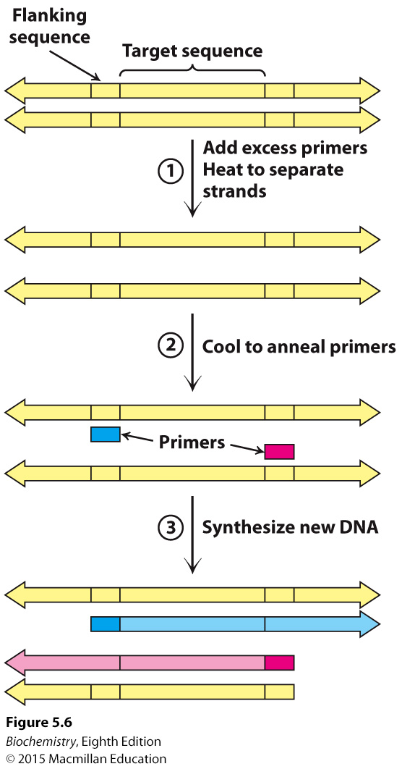
Notes:
FIGURE 5.6 The first cycle in the polymerase chain reaction (PCR). A cycle consists of three steps: strand separation, the hybridization of primers, and the extension of primers by DNA synthesis.

Slide 15
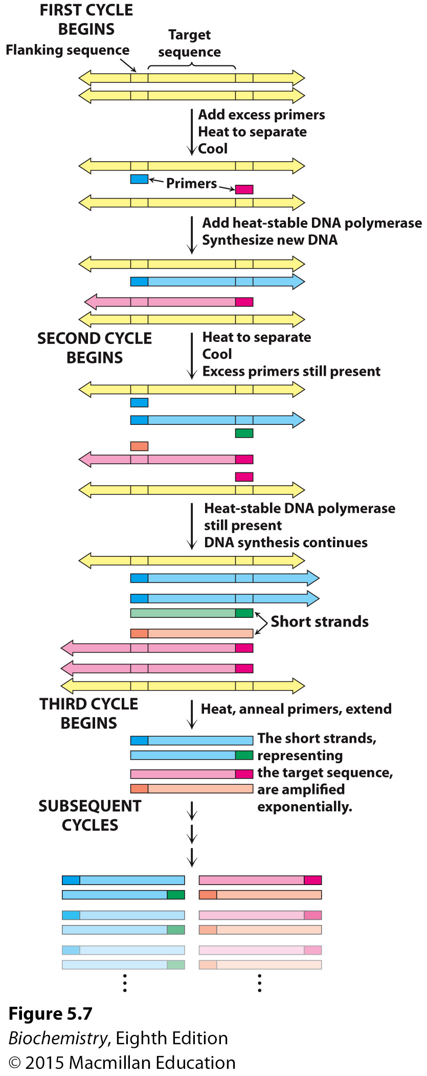
Notes:
FIGURE 5.7 Multiple cycles of the polymerase chain reaction. The two short strands produced at the end of the third cycle (along with longer stands not shown) represent the target sequence. Subsequent cycles will amplify the target sequence exponentially and the parent sequence arithmetically.

Slide 16

PCR is capable of amplifying a single molecule of DNA that can then be visualized in a gel or sequenced.
PCR is used to detect mutations in genes that cause cancer, verify the presence of infectious agents in cells, and determine the guilt or innocence of crime suspects.

Slide 17
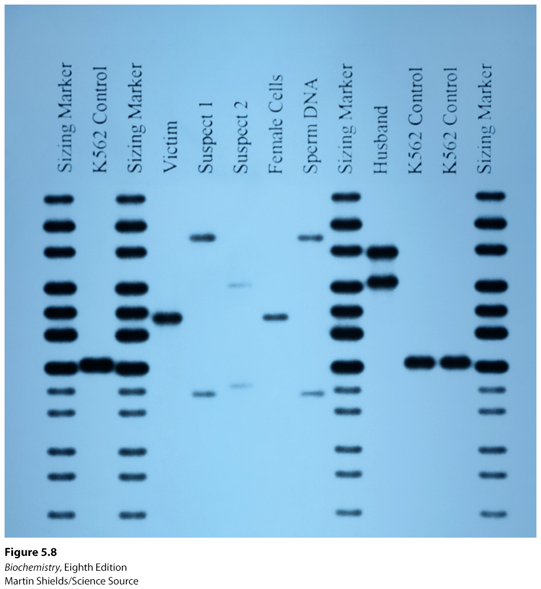
Notes:
FIGURE 5.8 DNA and forensics. DNA isolated from sperm obtained during the examination of a rape victim was amplified by PCR, then compared with DNA from the victim and three potential suspects—the victim’s husband and two additional individuals—using gel electrophoresis and autoradiography. Sperm DNA matched the pattern of Suspect 1, but not that of Suspect 2 or the victim’s husband. Sizing marker and K562 lanes refer to control DNA samples. [Martin Shields/Science Source.]

Slide 18
Instances of genetic variation, called polymorphisms, sometimes correlate with the emergence of a disease.
Examination of restriction fragment length polymorphisms (RFLP) is an especially powerful means of correlating a mutation with the occurrence of a disease.

Slide 19


Digestion of DNA by restriction enzymes often generates staggered or sticky ends.
A vector, a piece of DNA readily taken up and replicated by bacteria, is cleaved by the same restriction enzyme used to generate the fragment. When the fragment and the cleaved vector are mixed together, the sticky ends anneal.
DNA ligase is then used to covalently join the fragment and the vector, generating recombinant DNA.
Common vectors are bacterial plasmids and bacteriophage lambda (λ).

Slide 20
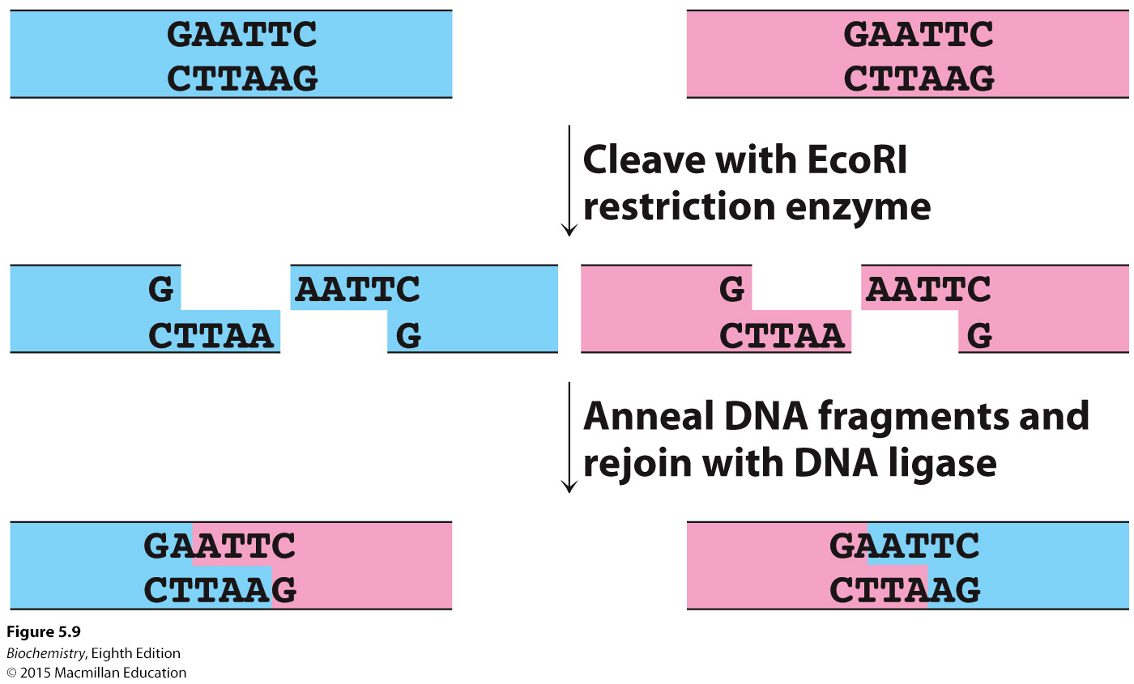
Notes:
FIGURE 5.9 Joining of DNA molecules by the cohesive-end method. Two DNA molecules, cleaved with a common restriction enzyme such as EcoRI, can be ligated to form recombinant molecules.

Slide 21
If the DNA fragment of interest does not contain appropriate restriction sites for vector insertion, a chemically synthesized linker DNA with the required restriction site is added to the fragment.

Slide 22
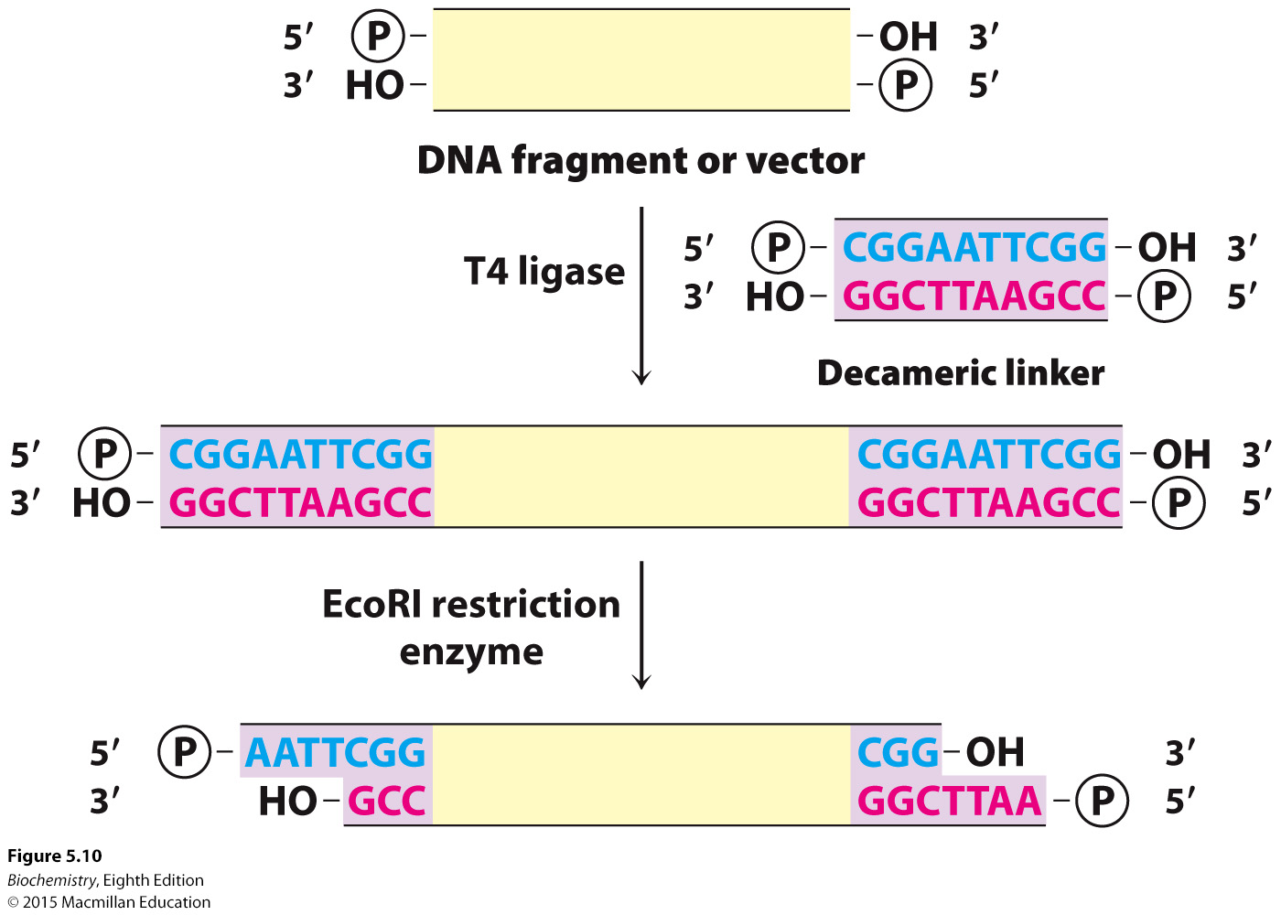
Notes:
FIGURE 5.10 Formation of cohesive ends. Cohesive ends can be formed by the addition and cleavage of a chemically synthesized linker.

Slide 23
Specially designed plasmids called cloning vectors allow for efficient insertion of DNA as well as replication.
Cloning vectors may have polylinker regions that allow the use of many restriction sites for DNA insertion.
Reporter genes, such as antibiotic-resistance genes, in the vector make identification of vectors with the inserted DNA simple.
Insertional inactivation also allows detection of plasmids that harbor insertions.
Cloning vectors contain promoters that facilitate transcription of the insert and sequences that allow translation.

Slide 24
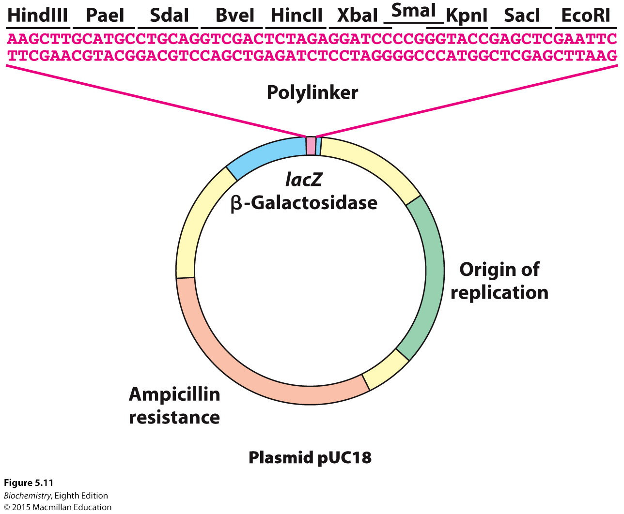
Notes:
FIGURE 5.11 A polylinker in the plasmid pUC18. The plasmid pUC18 includes a polylinker within an essential fragment of the β-galactosidase gene (often called the lacZ gene). Insertion of a DNA fragment into one of the many restriction sites within this polylinker can be detected by the absence of β-galactosidase activity.

Slide 25
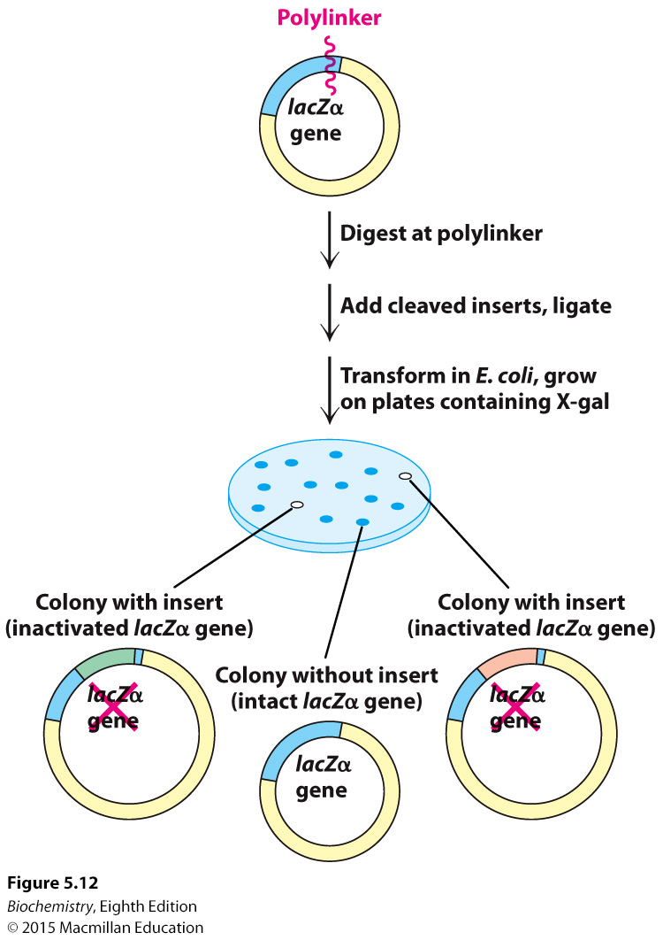
Notes:
FIGURE 5.12 Insertional inactivation. Successful insertion of DNA fragments into the polylinker region of pUC18 will result in the disruption of the β–galactosidase gene. Bacterial colonies that harbor such plasmids will no longer convert X-gal into a colored product, and will appear white on the plate.

Slide 26
Bacteriophage lambda (λ) is a commonly used cloning vector.
λ phage can infect a cell and cause cell lysis (lytic pathway) or become stably integrated into the host DNA (lysogenic pathway) and be replicated indefinitely. Environmental changes can cause the switch from lysogenic to lytic pathway.
Mutant λ phage have missing DNA that can be replaced with DNA to be cloned.
A cosmid is a hybrid of λ phage and a plasmid that is used to clone large pieces of DNA.

Slide 27
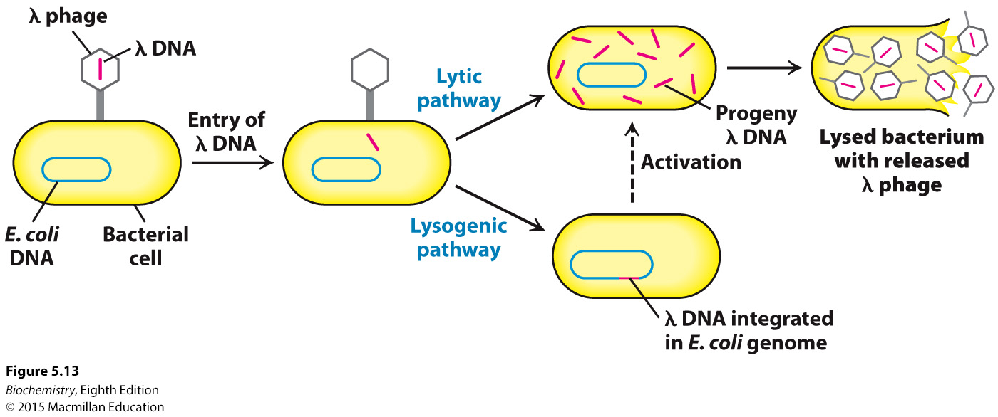
Notes:
FIGURE 5.13 Alternative infection modes for λ phage. Lambda phage can multiply within a host and lyse it (lytic pathway) or its DNA can become integrated into the host genome (lysogenic pathway), where it is dormant until activated.

Slide 28
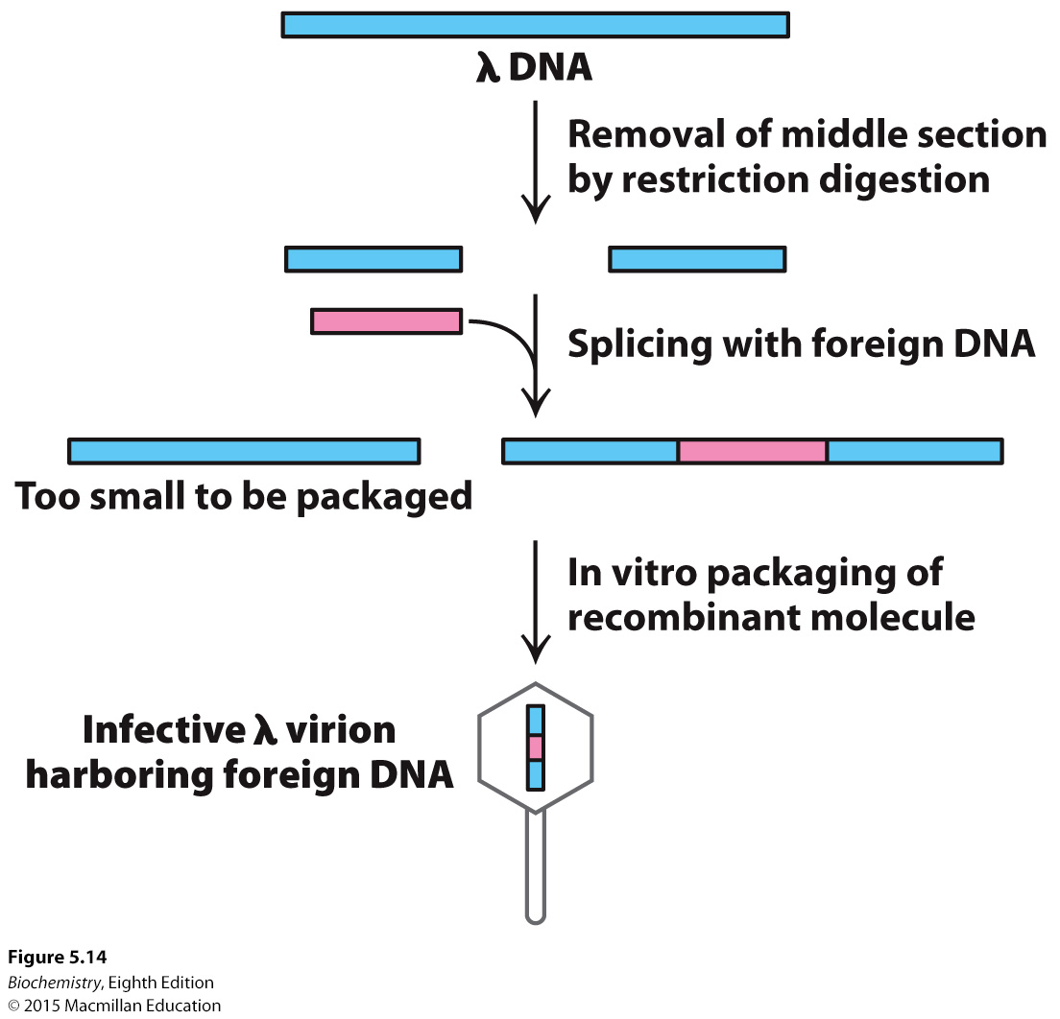
Notes:
FIGURE 5.14 Mutant l phage as a cloning vector. The packaging process selects DNA molecules that contain an insert (colored red). DNA molecules that have resealed without an insert are too small to be efficiently packaged.

Slide 29
Bacterial artificial chromosomes (BACs) and yeast artificial chromosomes (YACs) are especially useful for cloning large fragments of DNA.
YACs contain an autonomously replicating sequence (ARS) where replication begins.

Slide 30
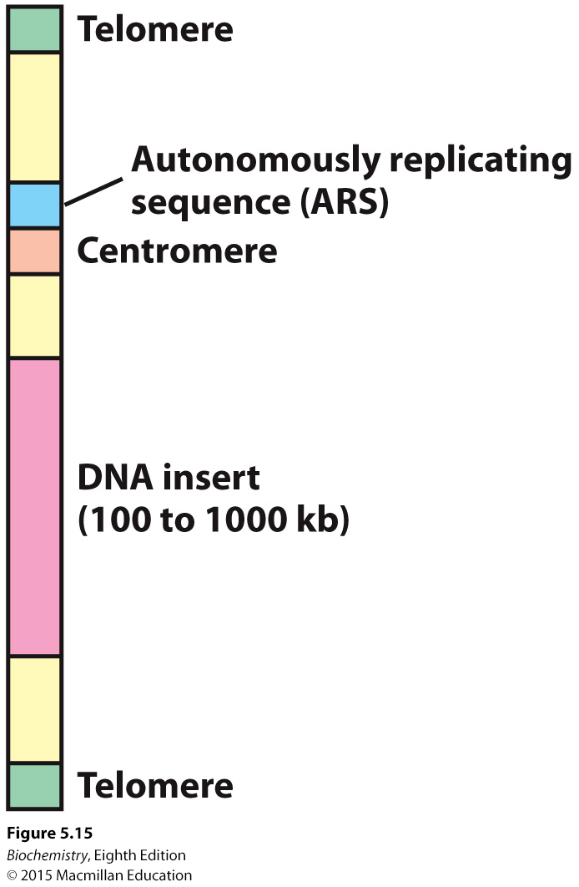
Notes:
Figure 5.15 Diagram of a yeast artificial chromosome (YAC). These vectors include features necessary for replication and stability in yeast cells.

Slide 31
Probes are used to screen a cDNA library for a particular DNA sequence.
Probes can be synthesized from knowledge of the protein sequence of the gene of interest.
Probes can also be generated from mRNA of the corresponding protein.

Slide 32
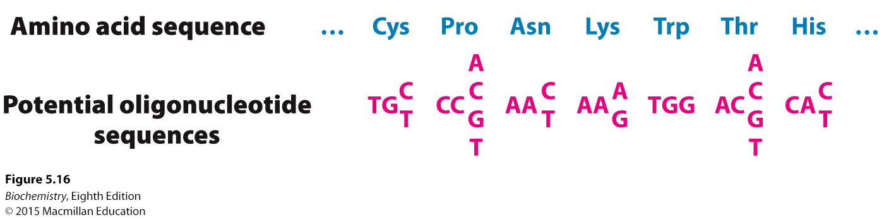
Notes:
FIGURE 5.16 Probes generated from a protein sequence. A probe can be generated by synthesizing all possible oligonucleotides encoding a particular sequence of amino acids. Because of the degeneracy of the genetic code, 256 distinct oligonucleotides must be synthesized to ensure that the probe matching the sequence of seven amino acids in this example is present.

Slide 33
A genomic library is made by fragmenting the entire genome of an organism and inserting the fragments into a vector such as λ phage.
Bacteria are infected with the λ phage, replicas appear and are then screened using radioactive probes for the gene of interest.

Slide 34
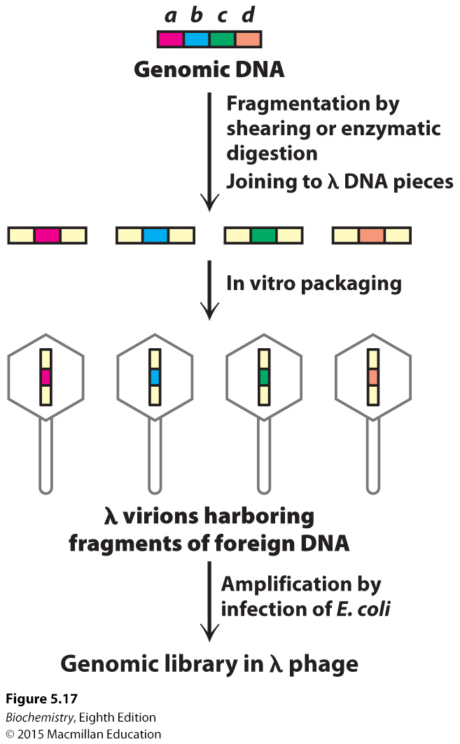
Notes:
FIGURE 5.17 Creation of a genomic library. A genomic library can be created from a digest of a whole complex genome. On fragmentation of the genomic DNA into overlapping segments, the DNA is inserted into the λ phage vector (shown in yellow). Packaging into virions and amplification
by infection in E. coli yields a genomic library.

Slide 35
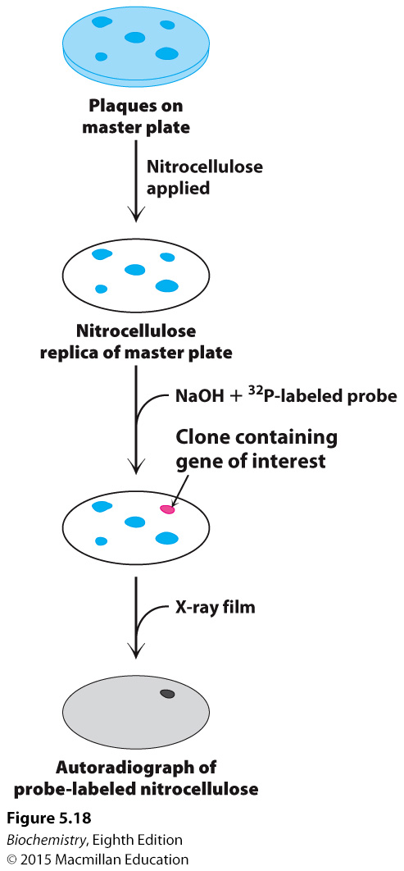
Notes:
FIGURE 5.18 Screening a genomic library for a specific gene. Here, a plate is tested for plaques containing gene a of Figure 5.17.

Slide 36

Complementary DNA (cDNA) is a double-stranded DNA molecule generated from an mRNA template by the enzyme reverse transcriptase, a retroviral enzyme.
Complementary DNA can be synthesized from all of the mRNA that a cell contains and inserted into a cloning vector to generate a cDNA library.
Clones containing cDNA from eukaryotes can be expressed in bacteria.

Slide 37
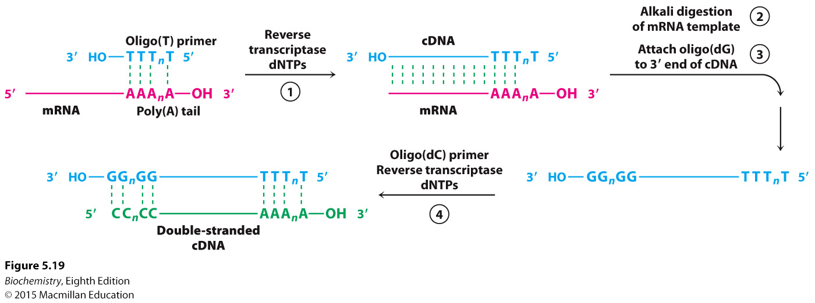
Notes:
FIGURE 5.19 Formation of a cDNA duplex. A complementary DNA (cDNA) duplex is created from mRNA by (1) use of reverse transcriptase to synthesize a cDNA strand, (2)digestion of the original RNA strand, (3) addition of several G bases to the DNA by terminal transferase, and (4) synthesis of a complementary DNA strand using the newly synthesized cDNA strand as a template.

Slide 38
Complementary DNA can also be inserted into expression vectors.
Expression vectors are plasmids or λ phage that have powerful promoters for transcription as well as a segment of DNA that encodes a ribosome-binding site that is expressed with the mRNA encoded by the cDNA.
Expression vectors allow for not only transcription but also translation of the cDNA library.
Replica plates are made of a λ phage containing an expression vector, and the plaques are probed with an antibody for the protein of interest.

Slide 39
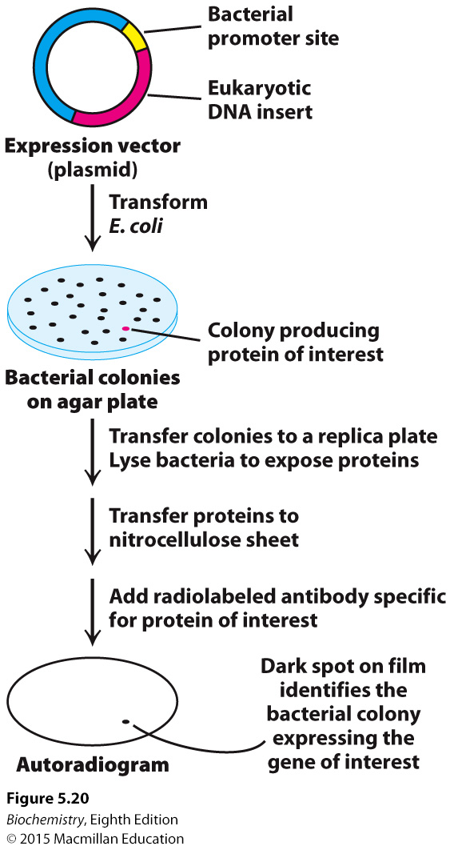
Notes:
FIGURE 5.20 Screening of cDNA clones. A method of screening for cDNA clones is to identify expressed products by staining with specific antibody.

Slide 40
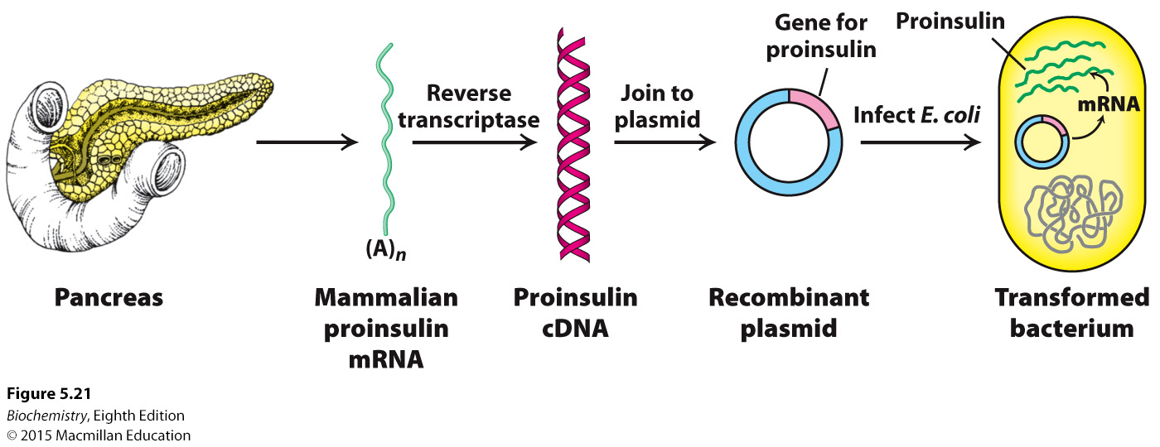
Notes:
FIGURE 5.21 Synthesis of proinsulin by bacteria. Proinsulin, a precursor of insulin, can be synthesized by transformed (genetically altered) clones of E. coli. The clones contain the mammalian proinsulin gene.

Slide 41
Recombinant DNA techniques allows for the introduction of specific mutations in vitro, permitting the investigation of protein structure and functions.
The three main classes of mutations are deletions, insertions and substitutions.

Slide 42
Site-direct mutagenesis allows the generation of mutant proteins with a single amino acid substitution.
Cassette mutagenesis allows more complex sets of mutations. An oligonucleotide—a cassette—containing the mutations is inserted into the gene of interest.
Mutagenesis by PCR uses primers to introduce insertions, deletions, and substitutions.
The various means of altering DNA allow for the development of designer proteins, novel proteins that are not found in nature.

Slide 43
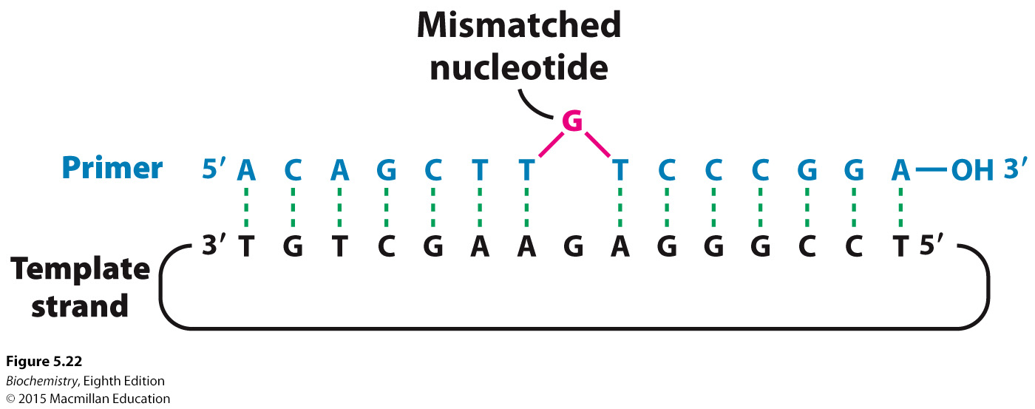
Notes:
FIGURE 5.22 Oligonucleotide-directed mutagenesis. A primer containing a mismatched
nucleotide is used to produce a desired change in the DNA sequence.

Slide 44
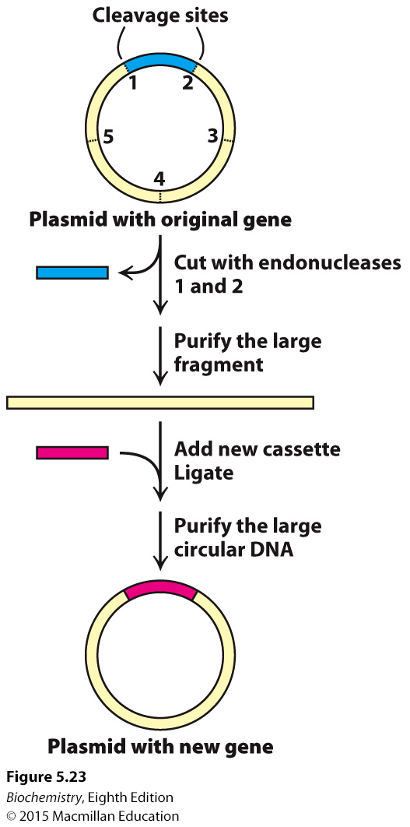
Notes:
FIGURE 5.23 Cassette mutagenesis. DNA is cleaved at a pair of unique restriction sites by two different restriction endonucleases. A synthetic oligonucleotide with ends that are complementary to these sites (the cassette) is then ligated to the cleaved DNA. The method is highly versatile because the inserted DNA can have any desired sequence.

Slide 45
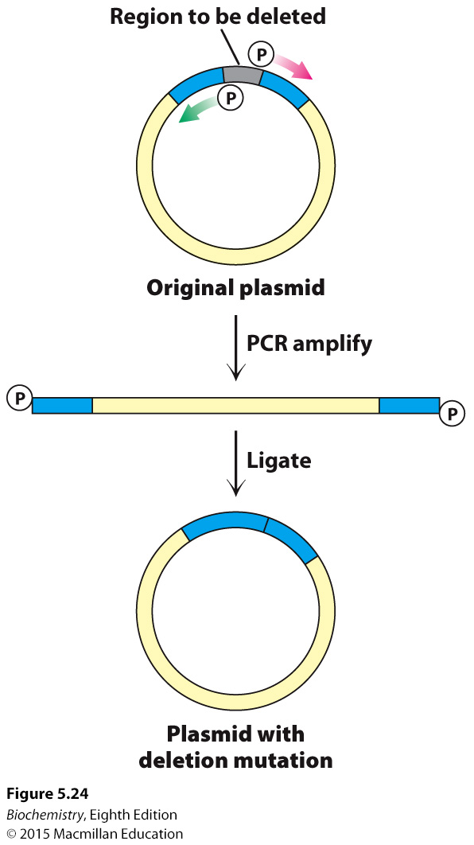
Notes:
FIGURE 5.24 Deletion mutagenesis by inverse PCR. A deletion can be introduced into a plasmid with primers that flank this region but are oriented away from the segment to be removed. PCR amplification yields a linear product that contains the entire plasmid minus the unwanted sequence. If the primers contained a 5' phosphate group, this product can be recircularized using DNA ligase, generating a plasmid with the desired mutation.

Slide 46
Amyotrophic lateral sclerosis may be caused, at least in part, by mutations in the gene encoding superoxide dismutase.
Interestingly, the mutations do not affect the activity of the enzyme.

Slide 47

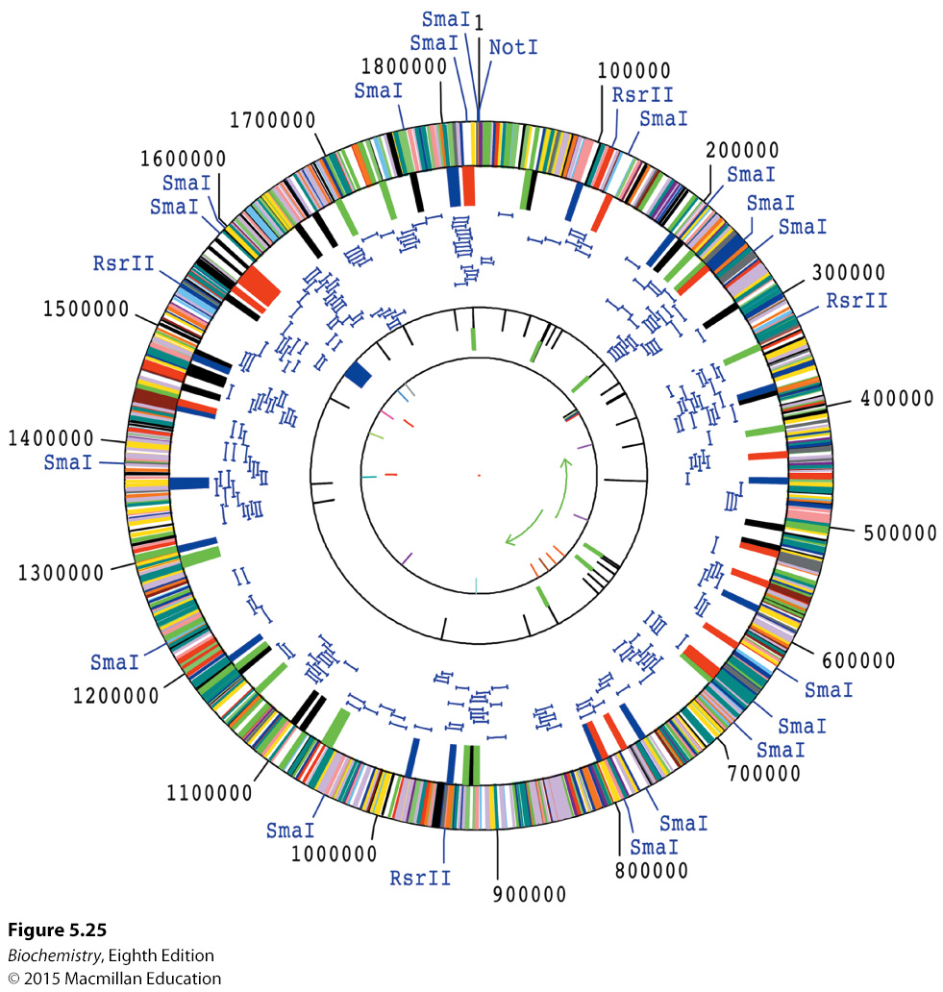
Notes:
FIGURE 5.25 A complete genome. The diagram depicts the genome of Haemophilus influenzae, the first complete genome of a free-living organism to be sequenced. The genome encodes more than 1700 proteins and 70 RNA molecules. The likely function of approximately one-half of the proteins was determined by comparisons with sequences of proteins already characterized in other species. [Data from R. D. Fleischmann et al., Science 269:496–512, 1995; scan courtesy of The Institute for Genomic Research.]

Slide 48
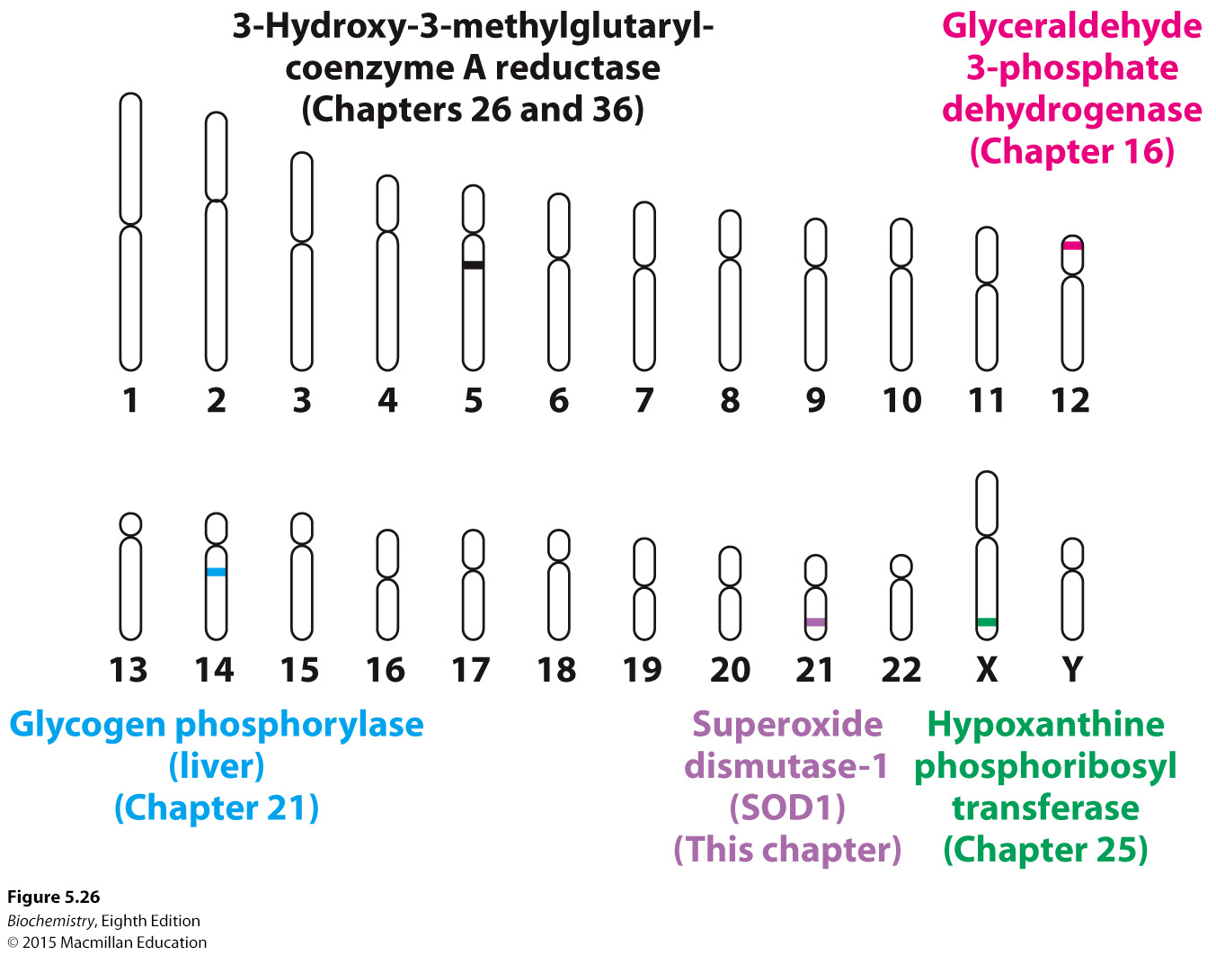
Notes:
FIGURE 5.26 The human genome. The human genome is arrayed on 46 chromosomes—22 pairs of autosomes and the X and Y sex chromosomes. The locations of several genes associated with important pathways in biochemistry are highlighted.

Slide 49

Next-generation sequencing (NGS), using advances in handling of small amounts of liquids, high-resolution optics and computing power, makes sequencing of whole genomes rapid and inexpensive.
In NGS, fragments of DNA serve as a template for DNA polymerase. When a nucleotide is added by the polymerase, a signal is generated that allows the identification of the added nucleotide.
Common types of NGS are the reversible terminator method, which is akin to dideoxy sequencing; pyrosequencing, in which nucleotide addition is detected by a flash of light; and ion semiconductor sequencing, which detects a released proton upon nucleotide addition.

Slide 50
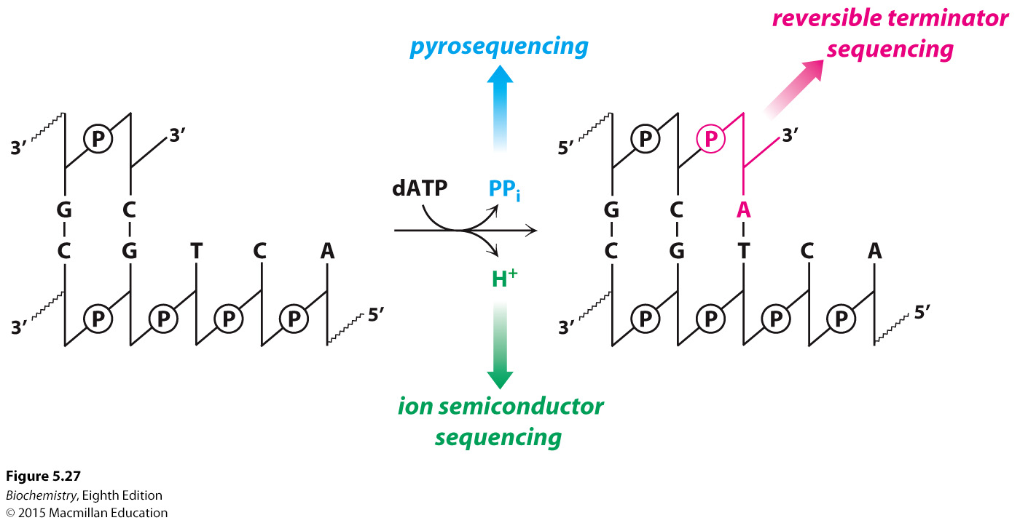
Notes:
FIGURE 5.27 Detection methods in next-generation sequencing. Measurement of base incorporation in next-generation sequencing methods relies on the detection of the various products of the DNA polymerase reaction. Reversible terminator sequencing measures the nucleotide incorporation in a manner similar to Sanger sequencing, while pyrosequencing and ion semiconductor sequencing detect the release of pyrophosphate and protons, respectively.

Slide 51
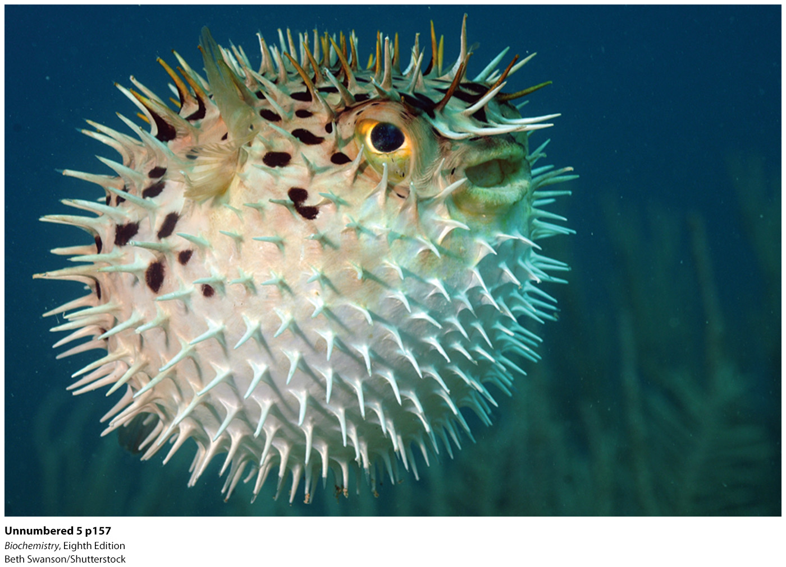
Many genomes have been sequenced, including that of the puffer fish.

Slide 52
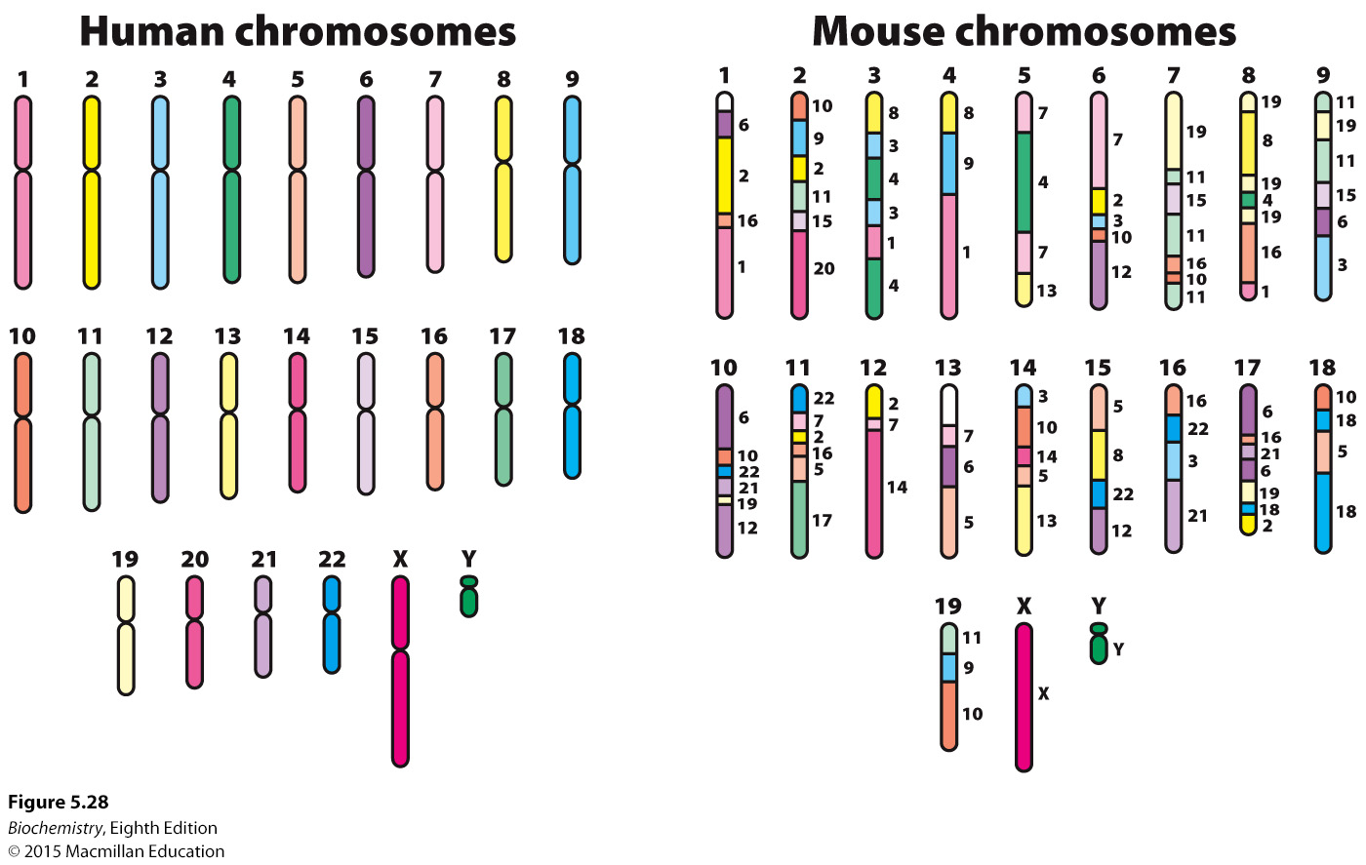
Notes:
FIGURE 5.28 Genome comparison. A schematic comparison of the human genome and the mouse genome shows reassortment of large chromosomal fragments. The small numbers to the right of the mouse chromosomes indicate the human chromosome to which each region is most closely related.

Slide 53

The quantity of individual transcripts in a cell can be determined by quantitative PCR (qPCR), sometimes called real-time PCR.
Messenger RNA is isolated and converted into cDNA, and the cDNA is used as the target DNA in a PCR reaction carried out in the presence of a dye that fluoresces when bound to the duplex DNA. The PCR cycle at which fluorescence's becomes detectable is inversely related to the original number of target templates.
DNA microarrays or gene chips allow the determination of the expression pattern of a large number of genes simultaneously. DNA sequences are attached to a solid support in a defined pattern to generate the microarray. Fluorescently labeled cDNA is then hybridized to the microarray to reveal the expression level of each gene on the chip.
DNA microarrays can be used to detect gene expression changes in cancer cells.

Slide 54
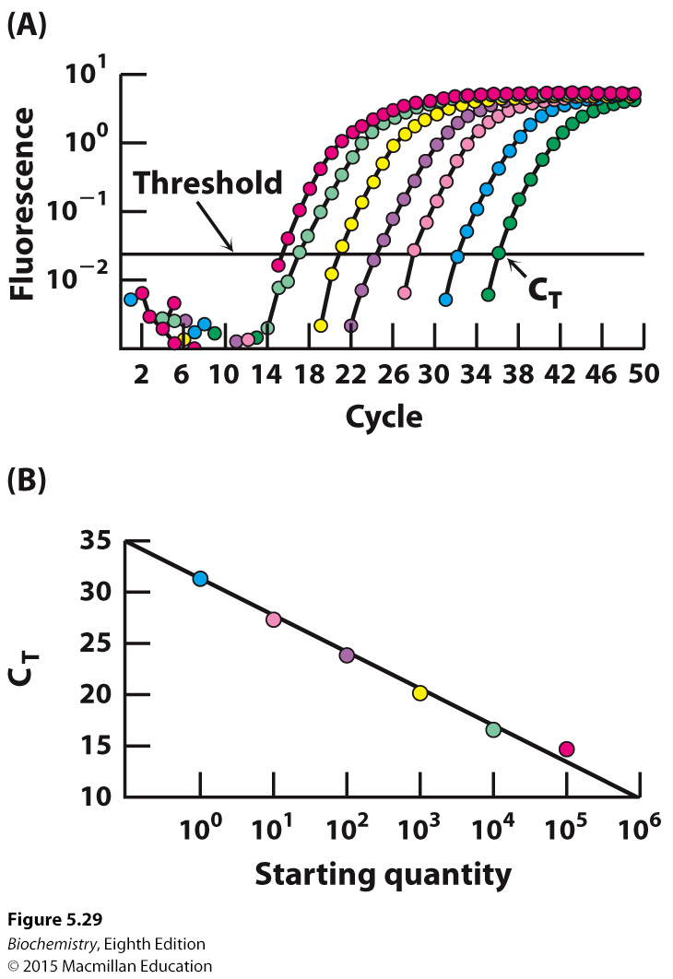
Notes:
FIGURE 5.29 Quantitative PCR. (A) In qPCR, fluorescence is monitored in the course of PCR amplification to determine C_{T}, the cycle at which this signal exceeds a defined threshold. Each color represents a different starting quantity of DNA. (B) C_{T} values are inversely proportional to the number of copies of the original cDNA template. [Data from N. J. Walker, Science 296:557–559, 2002.]

Slide 55
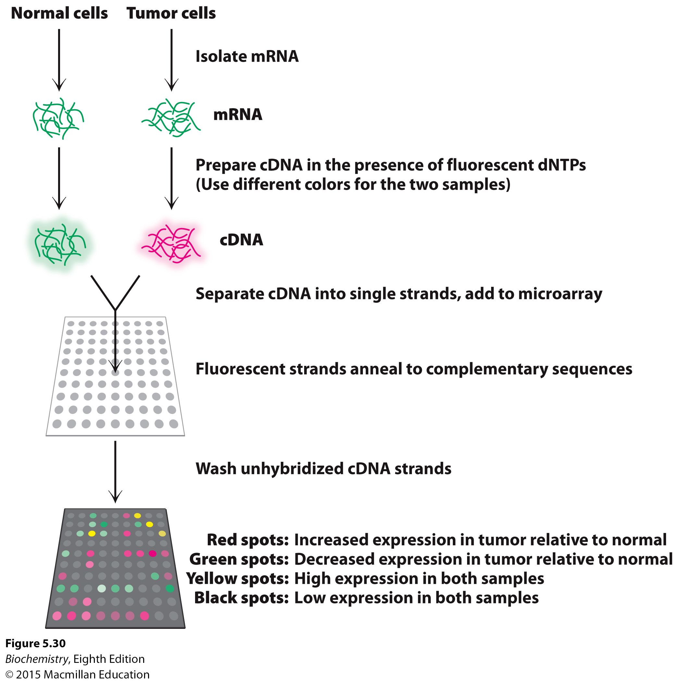
Notes:
FIGURE 5.30 Using DNA microarrays to measure gene expression changes in a tumor. mRNA is isolated from two samples, tumor cells and a control sample. From these transcripts, cDNA is prepared in the presence of a fluorescent nucleotide, with a red label for the tumor sample and a green
label for the control sample. The cDNA strands are separated, hybridized to the microarray, and the unbound DNA is washed away. Spots that are red indicate genes which are expressed more highly in the tumor, while the green spots indicate reduced expression relative to control. Spots that are black or yellow indicate comparable expression at either low or high levels, respectively. [Information from D. L. Nelson and M. M. Cox, Lehninger Principles of Biochemistry 6th ed. (W. H. Freeman and Company, 2013)]

Slide 56
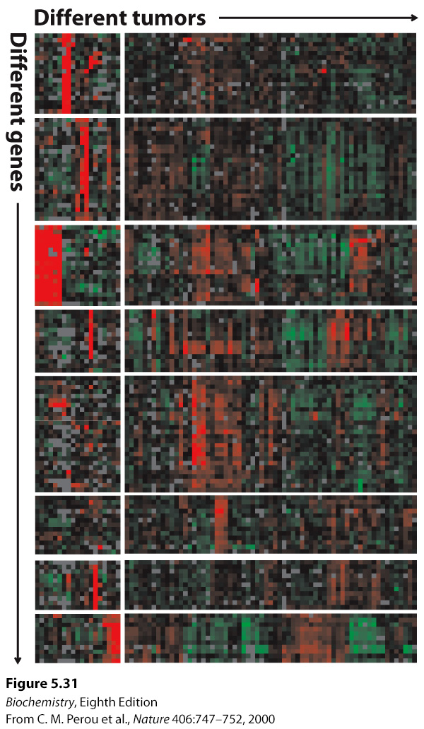
Notes:
FIGURE 5.31 Gene-expression analysis with the use of microarrays. The expression levels of thousands of genes can be simultaneously analyzed with DNA microarrays. Here, an analysis of 1733 genes in 84 breast tumor samples reveals that the tumors can be divided into distinct classes based on their gene-expression patterns. In this “heat map” representation, each row represents a different gene and each column represents a different breast tumor sample (i.e., a separate microarray experiment). Red corresponds to gene induction and green corresponds to gene repression. [Data from C. M. Perou et al., Nature 406:747–752, 2000.]

Slide 57
New genes can be inserted into eukaryotic cells by a variety of methods:
Calcium phosphate mediated uptake
Microinjection into cells
Infection with a retrovirus carrying the gene of interest.

Slide 58
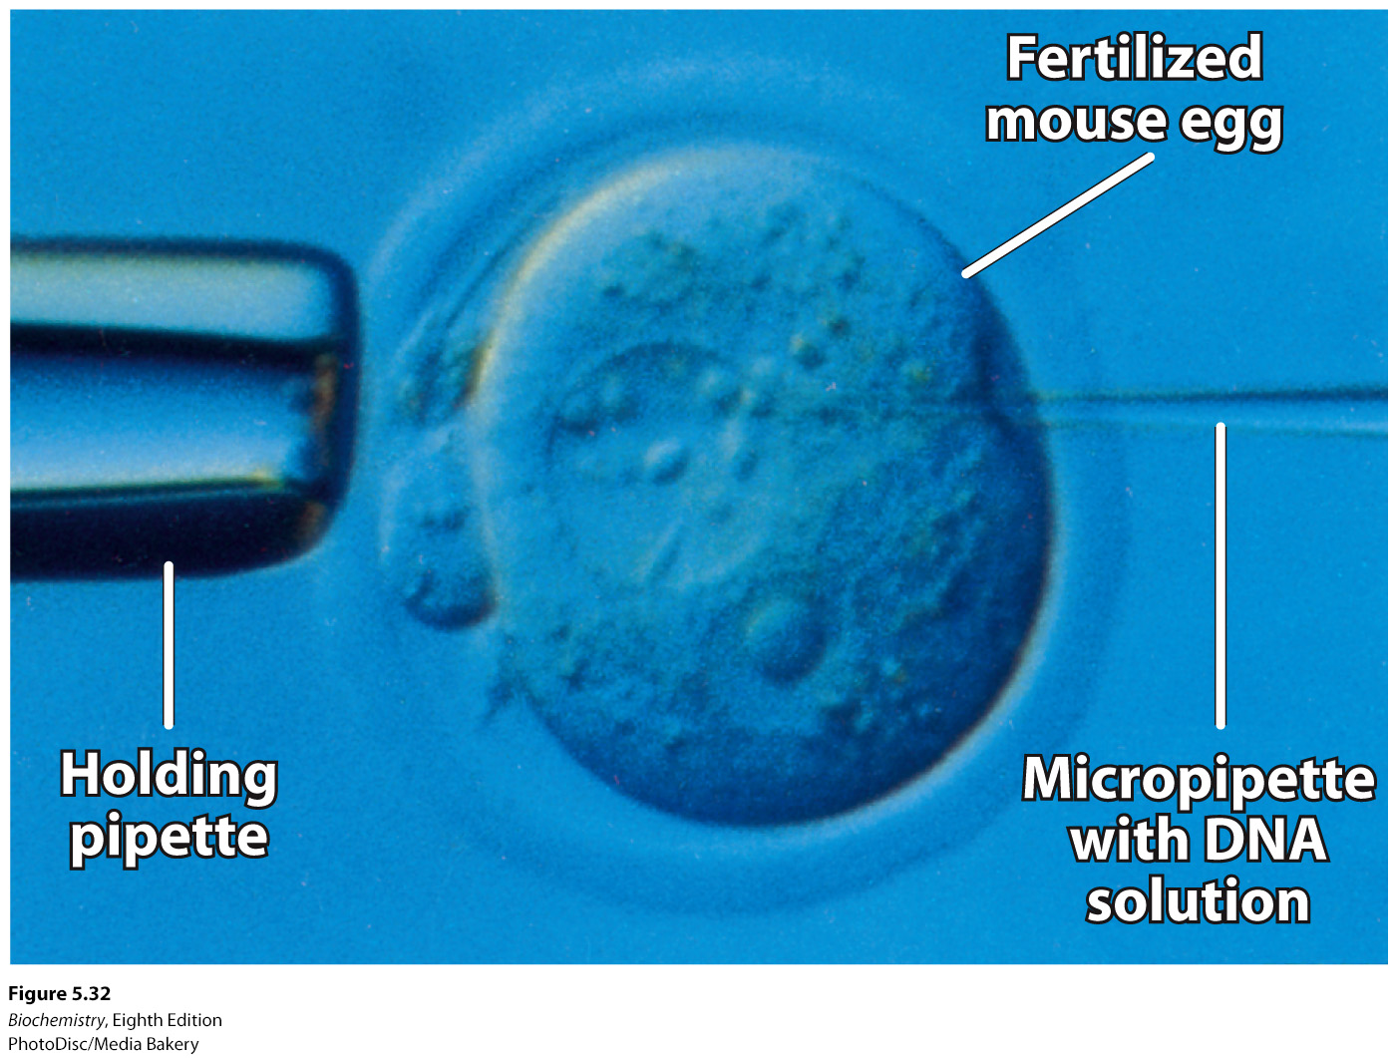
Notes:
FIGURE 5.32 Microinjection of DNA. Cloned plasmid DNA is being microinjected into the male pronucleus of a fertilized mouse egg.

Slide 59
Some of the DNA injected into embryos may be incorporated into the genome, generating transgenic animals.
Transgenic animals are useful tools for investigating a variety of diseases, such as ALS.

Slide 60
Genes can be disrupted (knocked out) when a foreign fragment is inserted by homologous recombination.
Gene editing allows highly specific modification of genomic DNA.
Zinc finger nucleases (ZFN) are engineered nucleases that can target any region of the genome.
In transcription activator-like effector nucleases (TALENS), the DNA binding domain is composed of an array of the amino acid sequence TALE. Mutations in the TALE array allow recognition of a vast number of DNA sequences.

Slide 61
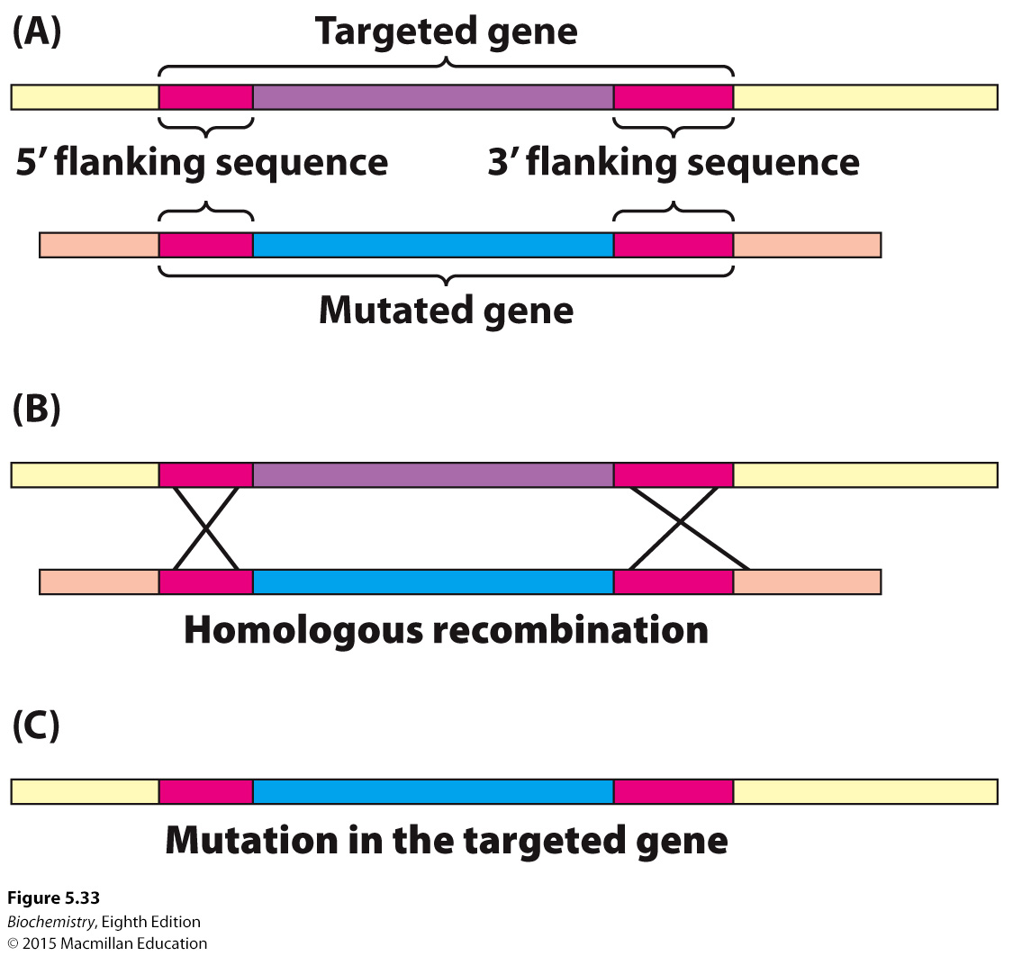
Notes:
FIGURE 5.33 Gene disruption by homologous recombination. (A) A mutated version of the gene to be disrupted is constructed, maintaining some regions of homology with the normal gene (red). When the foreign mutated gene is introduced into an embryonic stem cell, (B) recombination takes place at regions of homology and (C) the normal (targeted) gene is replaced, or “knocked out,” by the foreign gene. The cell is inserted into embryos, and mice lacking the gene (knockout mice) are produced.

Slide 62
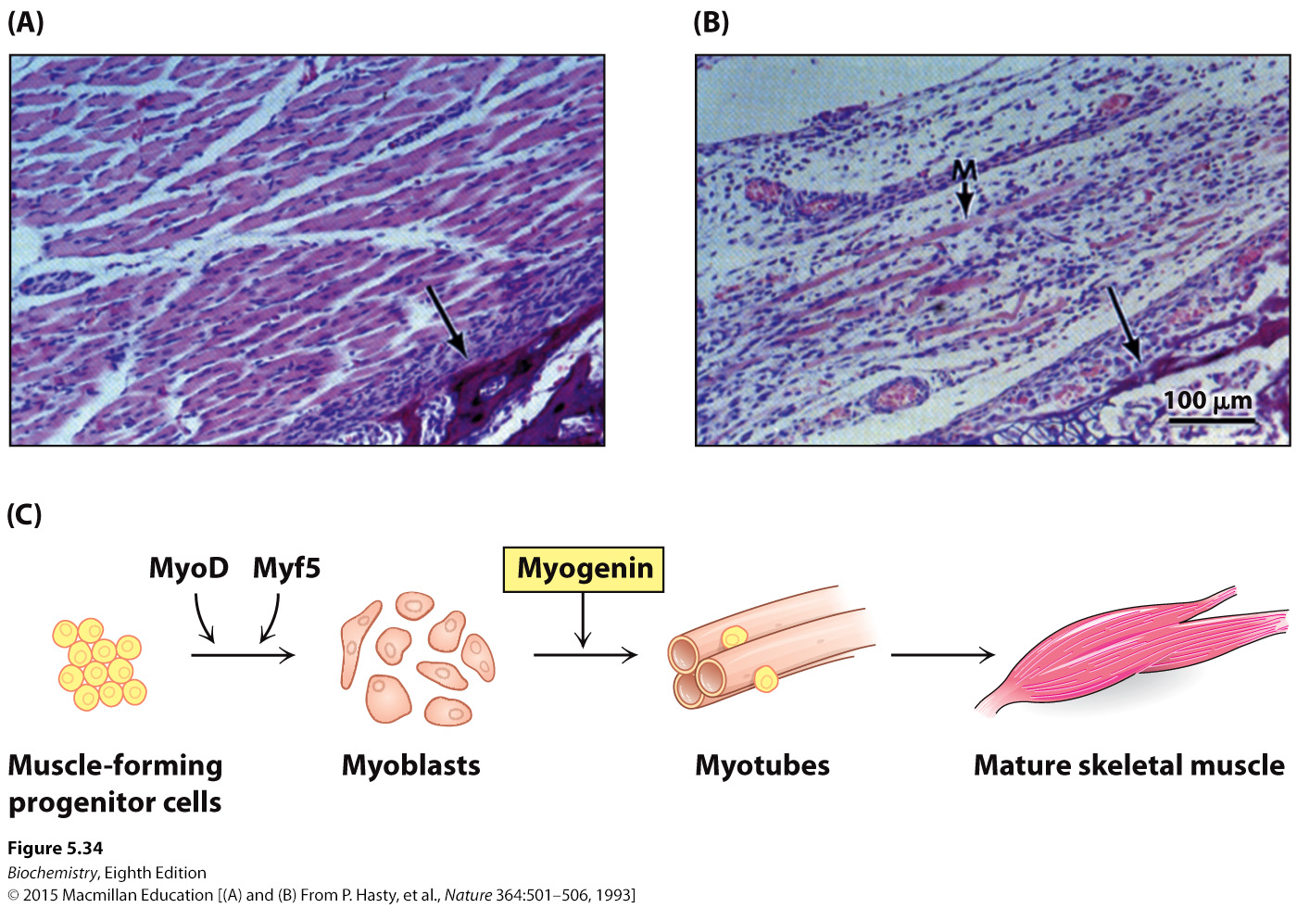
Notes:
FIGURE 5.34 Consequences of gene disruption. Sections of muscle from normal (A) and myogenin-knockout (B) mice, as viewed under the light microscope. The unlabeled arrows in both panels identify comparable sections of the pelvic bone, indicating that similar anatomical regions are depicted. Muscles do not develop properly in mice having both myogenin genes disrupted. A poorly formed muscle fiber in the knockout strain is indicated by the M arrow. (C) The development of mature skeletal muscle from progenitor cells is a highly regulated process involving a number of intermediate cell types and multiple transcription factors. Through the gene-disruption studies in (A) and (B), myogenin was identified as an essential component of this pathway. [(A) and (B) From P. Hasty, et al., Nature 364:501–506, 1993; (C) Information from S. Hettmer and A. J. Wagers, Nat. Med. 16:171–173, 2010, Fig. 1]

Slide 63
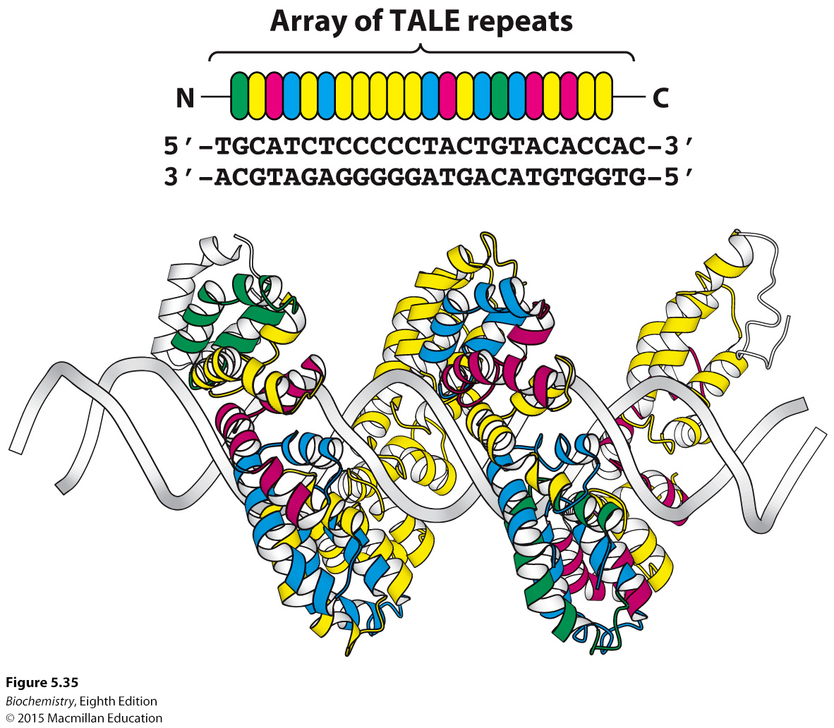
Notes:
FIGURE 5.35 TALE repeats recognize individual bases in DNA. Each TALE repeat contains 34 amino acids, two of which specify its nucleotide binding partner. In this figure, the identity of these residues is indicated by the color of the repeat. TALE proteins can be designed to uniquely recognize extended oligonucleotide sequences. In this example, a 22 base-pair sequence is bound by a single TALE protein, the bacterial effector PthXo1. [Drawn from 3UGM.pdb]

Slide 64
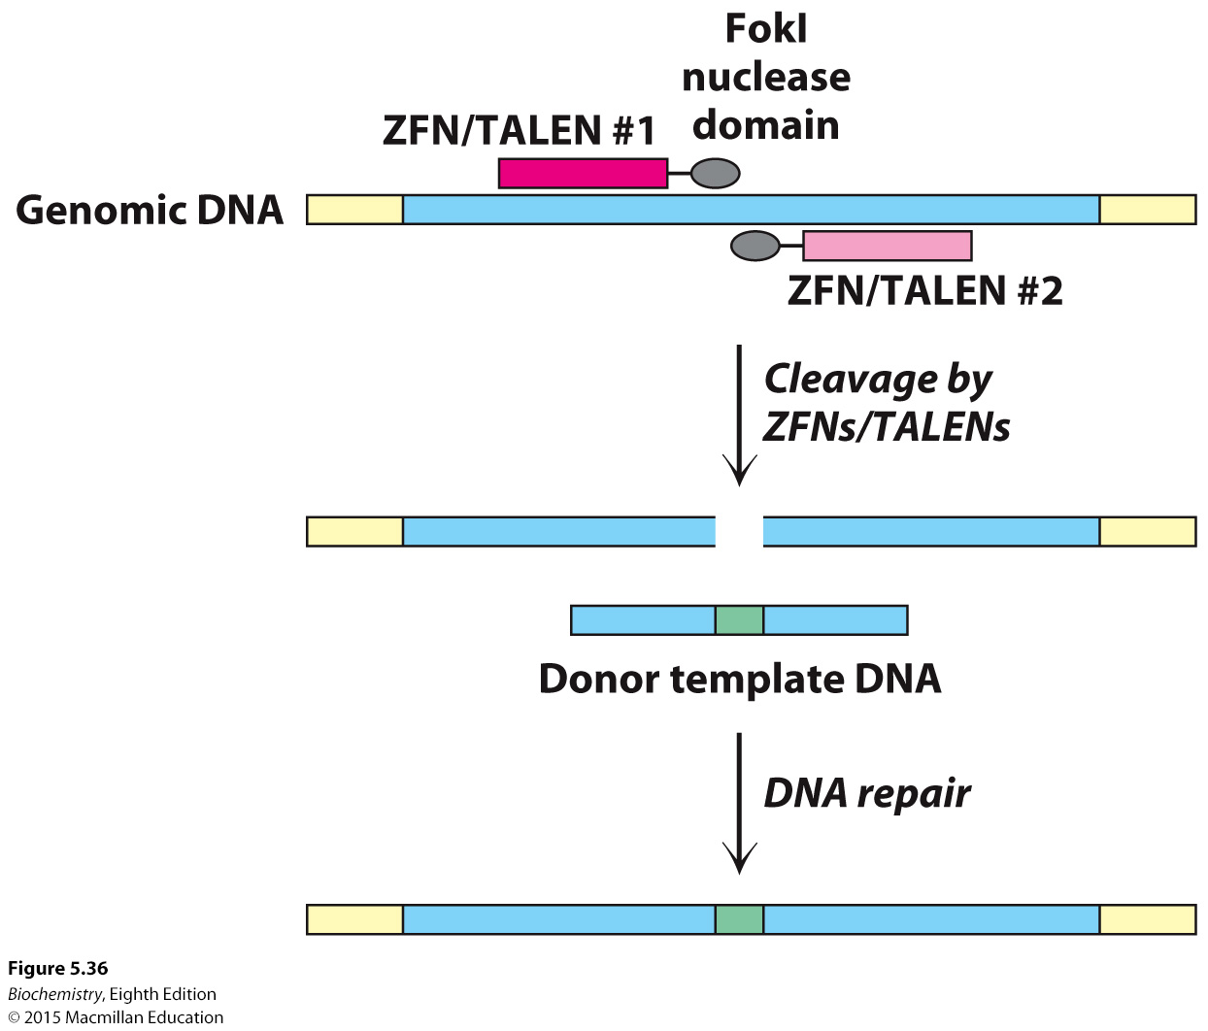
Notes:
FIGURE 5.36 Genome editing by site-specific nucleases. A pair of ZFNs or TALENs cleave opposite strands of a targeted gene (blue) within the genome. The DNA repair machinery of the cell will use a homologous donor template DNA fragment to fix the double-strand break, incorporating the desired modifications (green) into the targeted gene.

Slide 65
Double-stranded RNA containing a strand complementary to a specific mRNA can be introduced into a cell.
The introduced RNA is cleaved into small fragments by the enzyme Dicer.
The fragment that is complementary to the mRNA becomes incorporated into the RNA-induced silencing complex (RISC).
The associated complementary RNA guides the complex to the mRNA, which is then degraded.

Slide 66
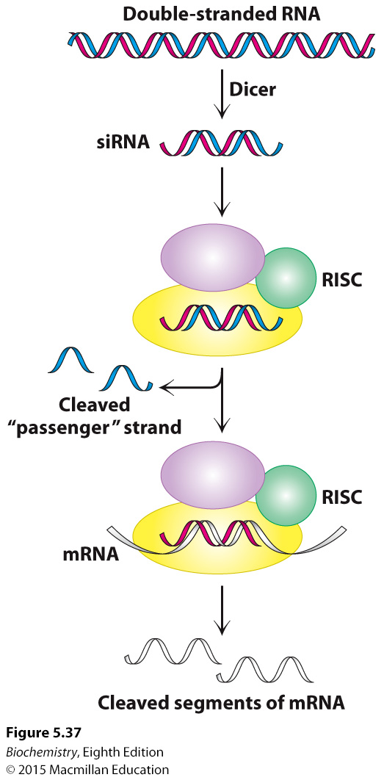
Notes:
FIGURE 5.37 RNA interference mechanism. A double-stranded RNA molecule is cleaved into 21-bp fragments by the enzyme Dicer to produce siRNAs. These siRNAs are incorporated into the RNA-induced silencing complex (RISC), where the single-stranded RNAs guide the cleavage of mRNAs that contain complementary sequences.

Slide 67

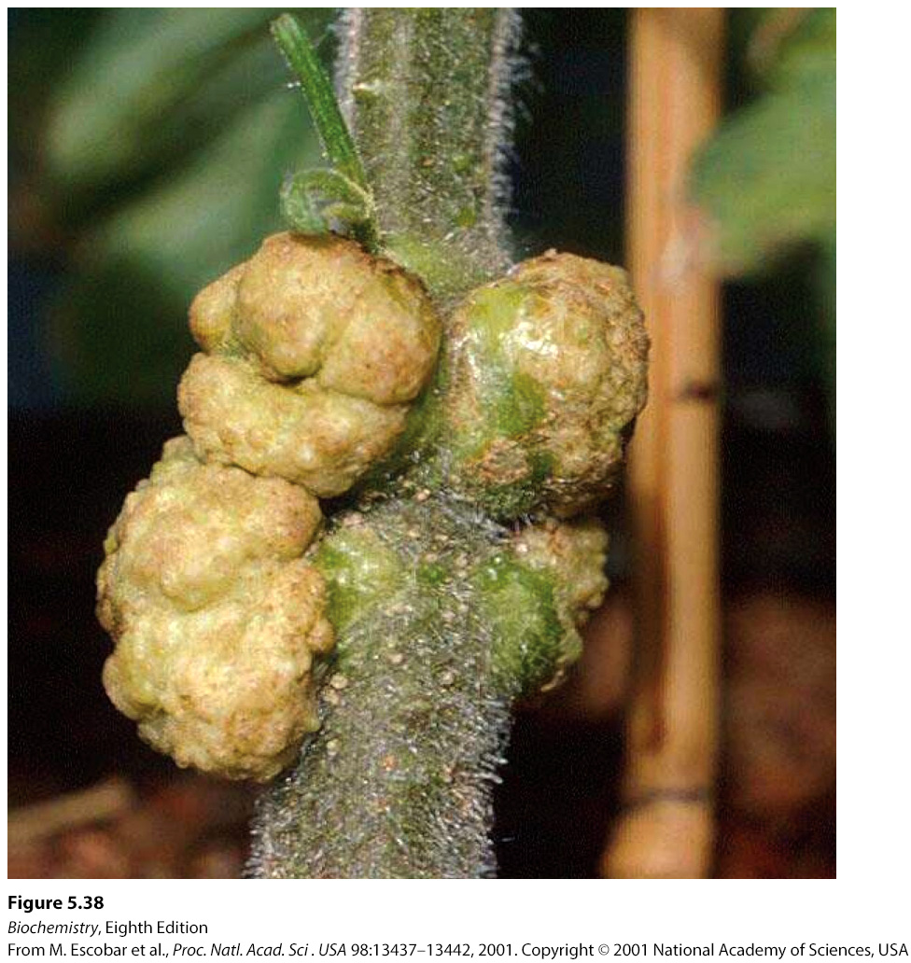
The soil bacterium Agrobacterium tumefaciens infects plant cells to produce a tumor called crown gall.
Notes:
FIGURE 5.38 Tumors in plants. Crown gall, a plant tumor, is caused by a bacterium (Agrobacterium tumefaciens) that carries a tumor-inducing plasmid (Ti plasmid). [From M. Escobar et al., PNAS 98:13437–13442, 2001. Copyright 2001 National Academy of Sciences, U. S. A.]

Slide 68
A. tumefaciens contains tumor-inducing plasmids (Ti plasmids) that are responsible for crown gall formation and the synthesis of amino acid derivatives called opines.
A part of the Ti plasmid is incorporated into cellular DNA.
Modified Ti plasmids are used to incorporate foreign DNA into the plant genome.
The modified plasmids can be introduced into plant cells by electroporation or by bombardment-mediated transformation.

Slide 69
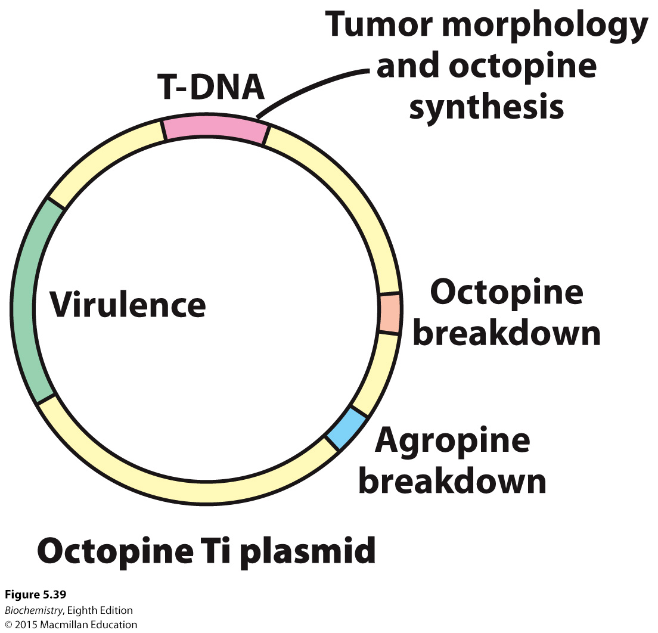
Notes:
FIGURE 5.39 Ti plasmids. Agrobacteria containing Ti plasmids can deliver foreign genes into some plant cells. [Information from M. Chilton. A vector for introducing new genes into plants. Copyright © 1983 by Scientific American, Inc. All rights reserved.]

Slide 70
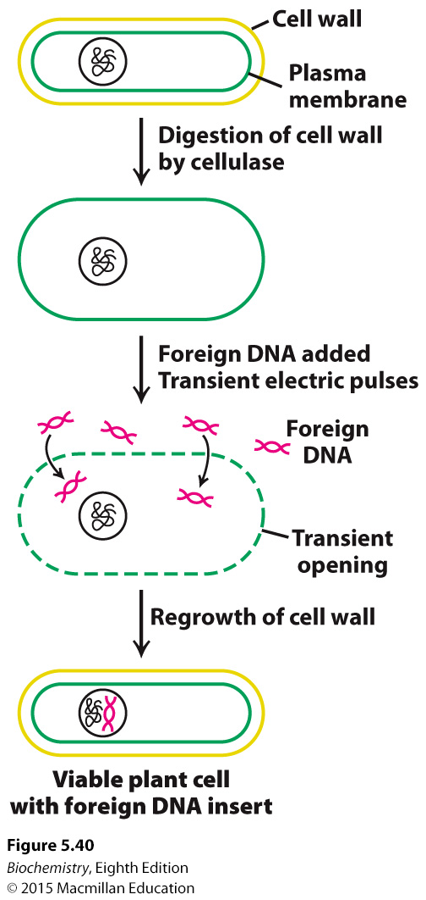
Notes:
FIGURE 5.40 Electroporation. Foreign DNA can be introduced into plant cells by electroporation, the application of intense electric fields to make their plasma membranes transiently permeable.

Slide 71
Gene therapy, the insertion of functional genes into cells to replace mutated genes, may become clinically important.
Severe combined immunodeficiency (SCID) has been treated by infecting cells with a functional version of the mutated enzyme, adenosine deaminase.

