Slide 1
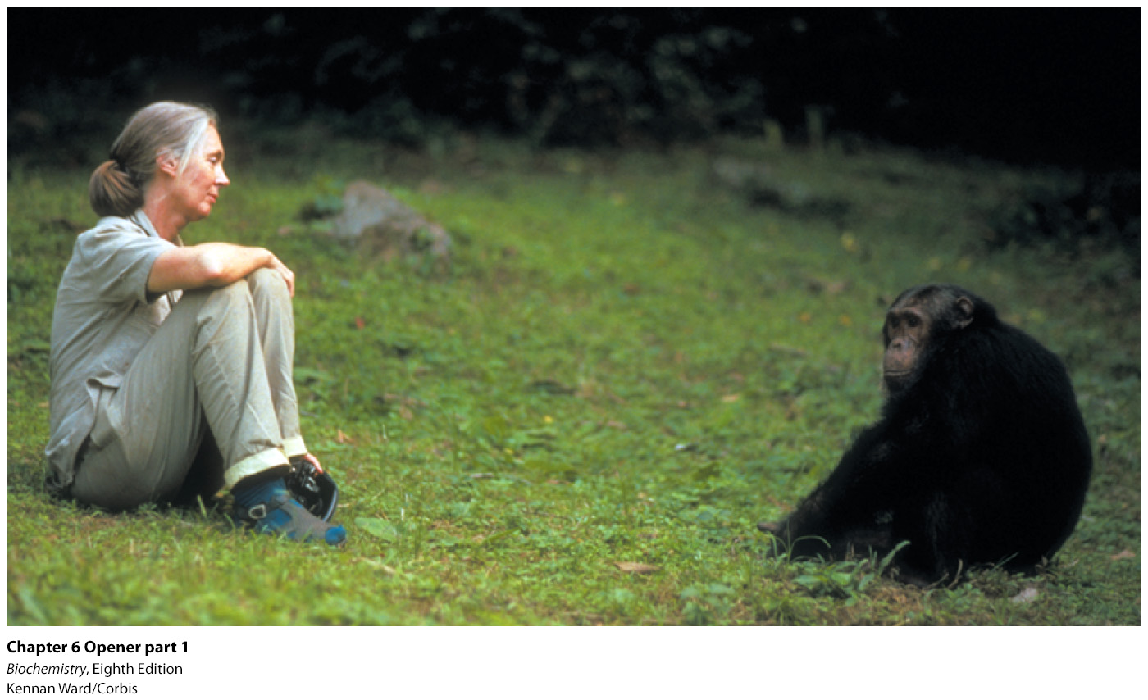
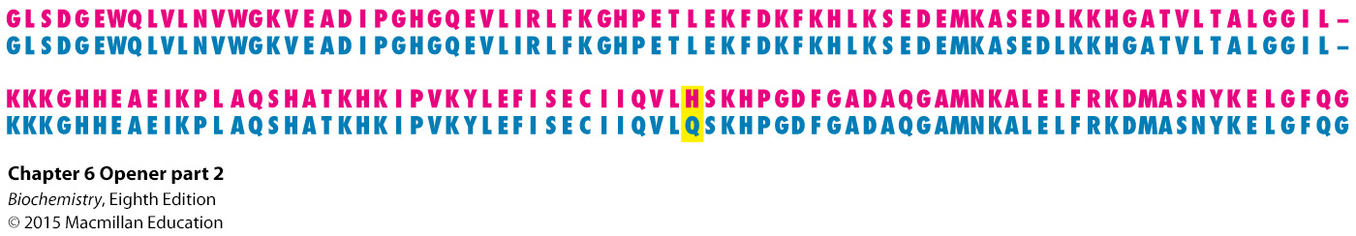
Notes:
Evolutionary relationships are manifest in protein sequences. The close kinship between human beings and chimpanzees, hinted at by the mutual interest shown by Jane Goodall and a chimpanzee in the photograph, is revealed in the amino acid sequences of myoglobin. The human sequence (red) differs from the chimpanzee sequence (blue) in only one amino acid in a protein chain of 153 residues. [(Left) Kennan Ward/Corbis.]

Slide 2
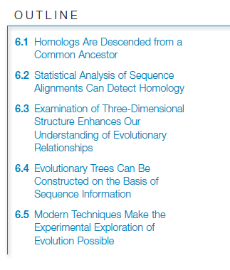

Slide 3
Structural comparisons permit the establishment of evolutionary relationships.
Angiogenin, a signal molecule that stimulates blood vessel growth, is structurally similar to ribonuclease, an enzyme that degrades RNA.
Evolutionary relatedness is also evident in amino acid and nucleotide sequence comparisons.

Slide 4
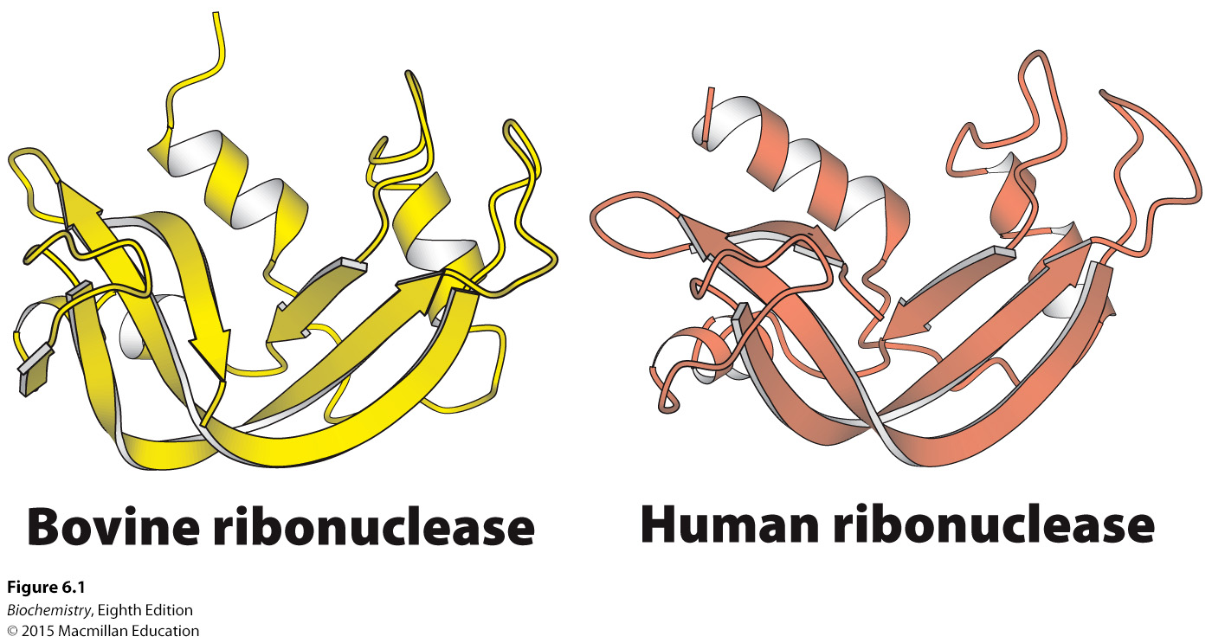
Notes:
Figure 6.1 Structures of ribonucleases from cows and human beings. Structural similarity often follows functional similarity. [Drawn from 8RAT.pdb. and 2RNF.pdb.]

Slide 5
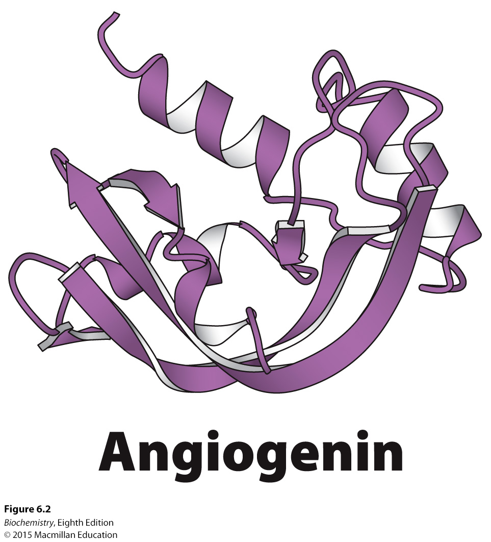
Notes:
FIGURE 6.2 Structure of angiogenin. The protein angiogenin, identified on the basis of its ability to stimulate blood-vessel growth, is highly similar in three-dimensional structure to ribonuclease. [Drawn from 2ANG.pdb.]

Slide 6
Homologs are two molecules that are derived from a common ancestor.
Paralogs are homologs present within one species and may have different functions.
Orthologs are homologs that are present in different species and that have similar functions.

Slide 7
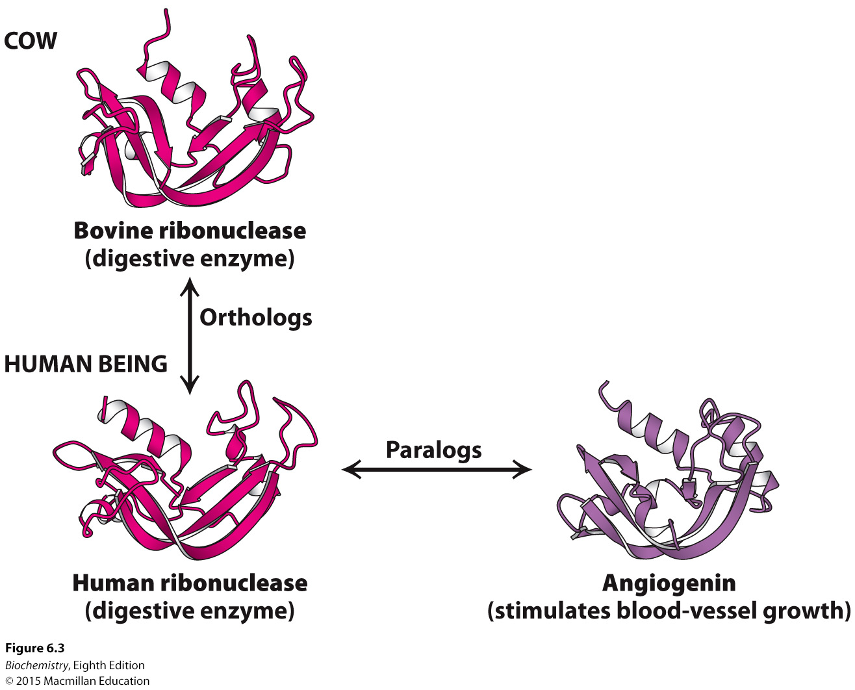
Notes:
FIGURE 6.3 Two classes of homologs. Homologs that perform identical or very similar functions in different species are called orthologs, whereas homologs that perform different functions within one species are called paralogs.

Slide 8

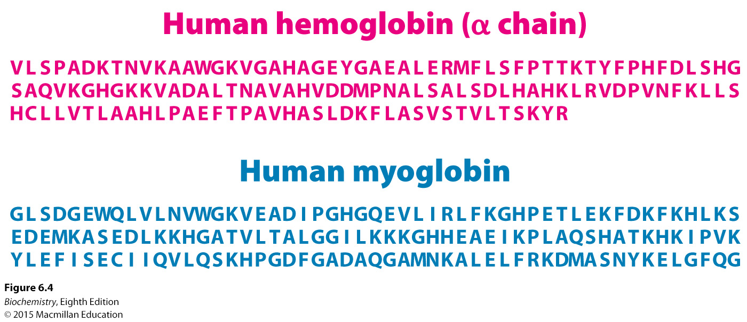
Sequence comparisons must rule out the possibility that the similarities are due to chance.
Sequences are systematically aligned to search for similarities, a process called sequence alignment.
The similarity of α-hemoglobin and myoglobin can be compared.
Notes:
FIGURE 6.4 Amino acid sequences of human hemoglobin (α chain) and human myoglobin. α-Hemoglobin is composed of 141 amino acids; myoglobin consists of 153 amino acids. (One-letter abbreviations designating amino acids are used; see Table 2.2.)

Slide 9
Sequence identities can be established by sliding one sequence past the other and counting the number of matches.

Slide 10
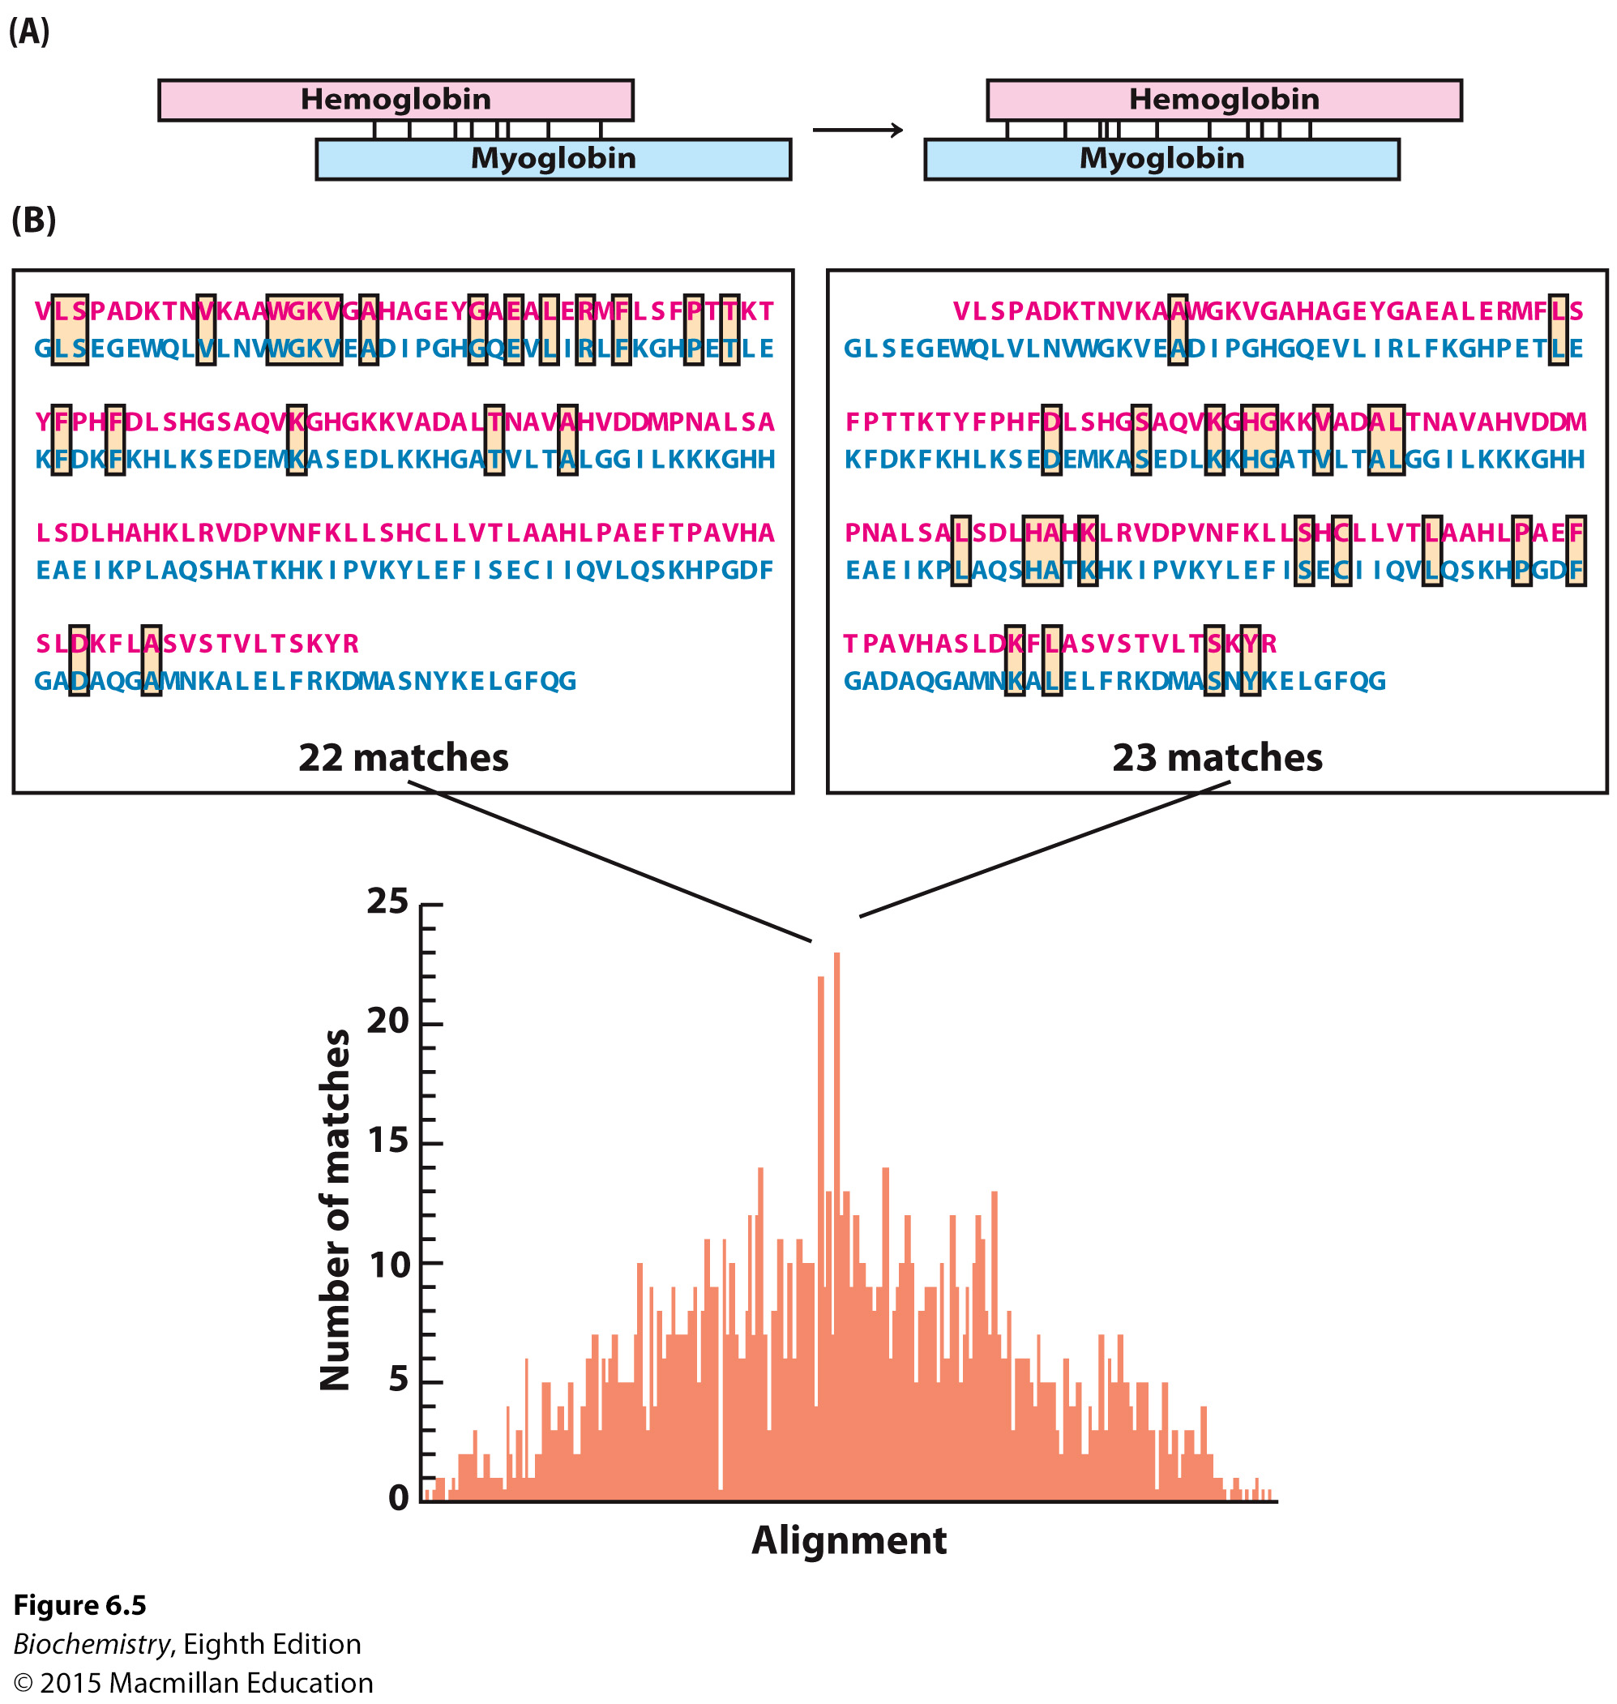
Notes:
FIGURE 6.5 Comparing the amino acid sequences of α-hemoglobin and myoglobin. (A) A comparison is made by sliding the sequences of the two proteins past each other, one amino acid at a time, and counting the number of amino acid identities between the proteins. (B) The two alignments with the largest number of matches are shown above the graph, which plots the matches as a function of alignment.

Slide 11
Searching for sequence identities sometimes yields multiple alignments that display a large number of matches.
Introduction of a gap into one of the sequences may allow identities found in the different alignments to be represented in one alignment.
However, the use of gaps may generate artificial similarities.
Scoring systems facilitate the use of gaps. For instance, 10 points are assigned for a match and 25 points are deducted for a gap.
Myoglobin and α-hemoglobin are 25.9% identical with a score of 355.

Slide 12
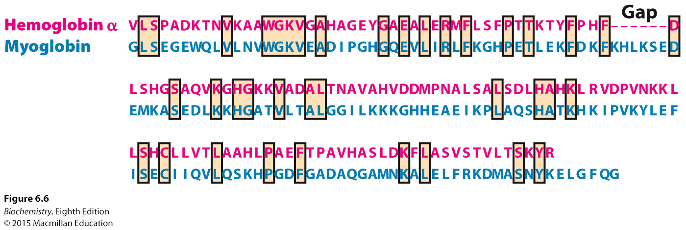
Notes:
FIGURE 6.6 Alignment with gap insertion. The alignment of α-hemoglobin and myoglobin after a gap has been inserted into the hemoglobin α sequence.

Slide 13
The significance of an alignment can be assessed by randomly rearranging the sequence of one of the sequences being compared.
The “shuffled” sequences are used in the sequence alignment process and the alignment scores determined.
If the original score is not sufficiently different from the randomized score, the original alignment could be a result of chance.

Slide 14
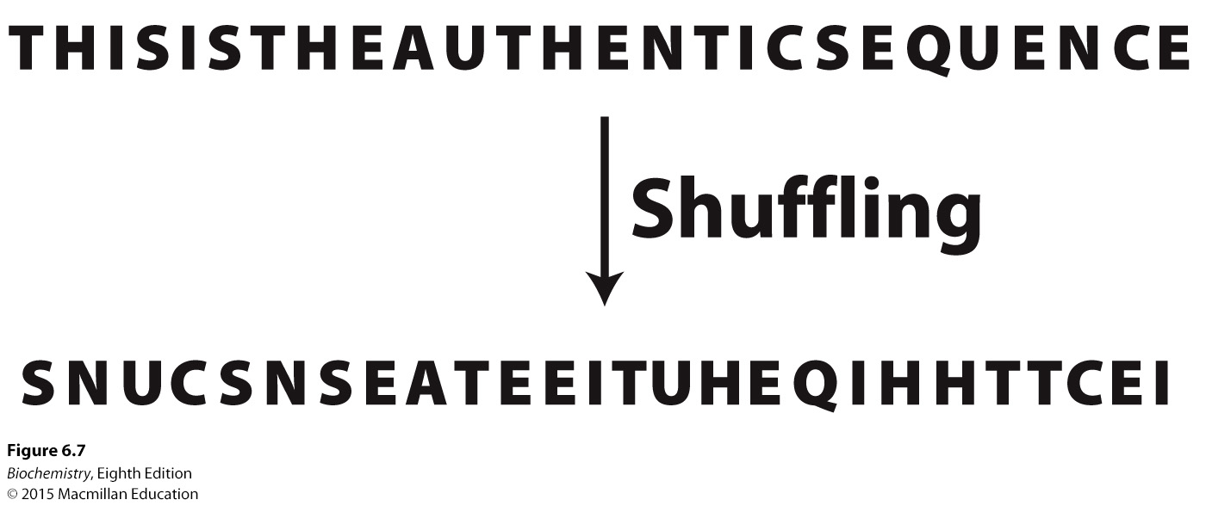
Notes:
FIGURE 6.7 The generation of a shuffled sequence.

Slide 15
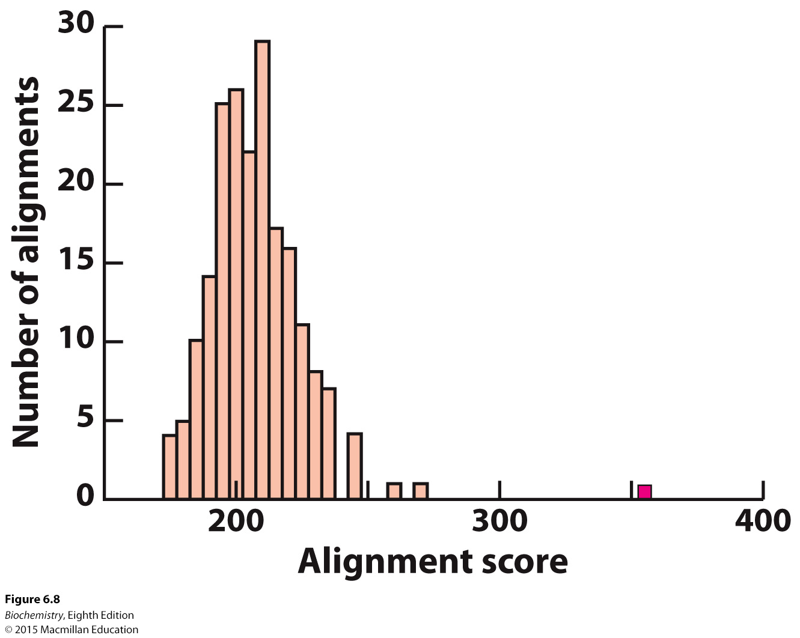
Notes:
FIGURE 6.8 Statistical comparison of alignment scores. Alignment scores are calculated for many shuffled sequences, and the number of sequences generating a particular score is plotted against the score. The resulting plot is a distribution of alignment scores occurring by chance. The alignment score for unshuffled α-hemoglobin and myoglobin (shown in red) is substantially greater than any of these scores, strongly suggesting that the sequence similarity is significant.

Slide 16

A more sensitive scoring system takes into account the degree of similarity of amino acids.
A conservative substitution replaces one amino acid with a similar one.
A nonconservative substitution replaces an amino acid with one with different chemical properties.
Amino acids substitutions can also be classified by the fewest number of nucleotide changes to achieve the amino acid substitution.

Slide 17
A substitution matrix, such as Blosum-62, is a scoring system that awards points for substitutions that are commonly found in nature and subtracts points for substitutions that only rarely occur.
The substitution matrix shows that many of the differences between α-hemoglobin and myoglobin are conservative.
Substitution matrices can reveal homologies not identified by sequence alignments only.

Slide 18
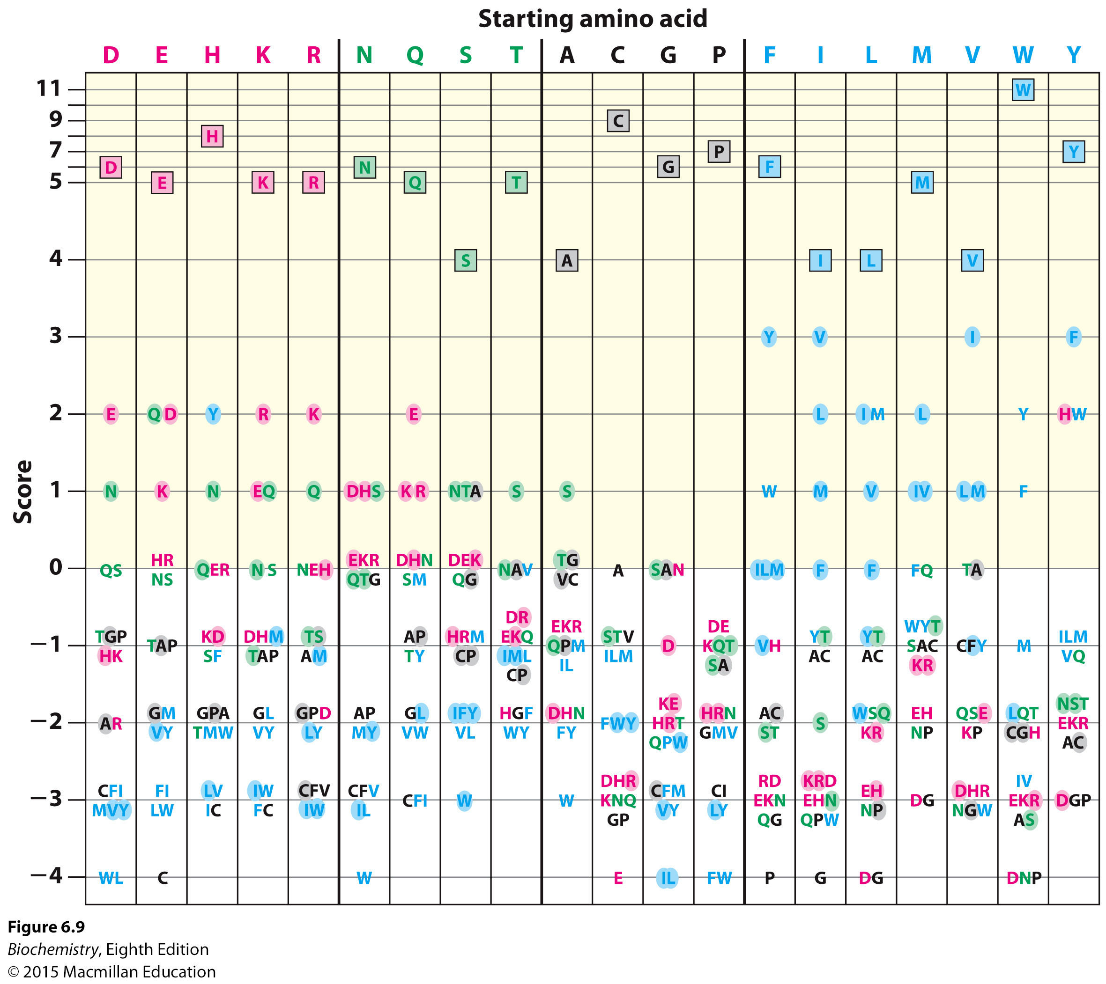
Notes:
FIGURE 6.9 A graphic view of the Blosum-62. This substitution matrix was derived by examining substitutions within aligned sequence blocks in related proteins. Amino acids are classified into four groups (charged, red; polar, green; large and hydrophobic, blue; other, black). Substitutions that require the change of only a single nucleotide are shaded. Identities are boxed. To find the score for a substitution of, for instance, a Y for an H, you find the Y in the column having H at the top and check the number at the left. In this case, the resulting score is 2.

Slide 19
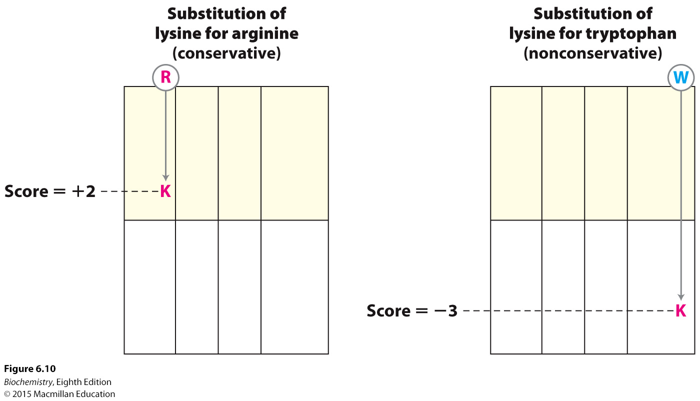
Notes:
FIGURE 6.10 Scoring of conservative and nonconservative substitutions. The Blosum-62 indicates that a conservative substitution (lysine for arginine) receives a positive score, whereas a nonconservative substitution (lysine for tryptophan) is scored negatively. The matrix is depicted as an abbreviated form of Figure 6.9.

Slide 20
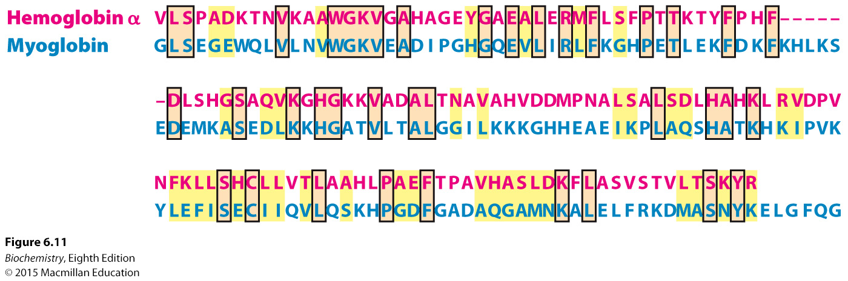
Notes:
FIGURE 6.11 Alignment with conservative substitutions noted. The alignment of α-hemoglobin and myoglobin with conservative substitutions indicated by yellow shading and identities by orange.

Slide 21
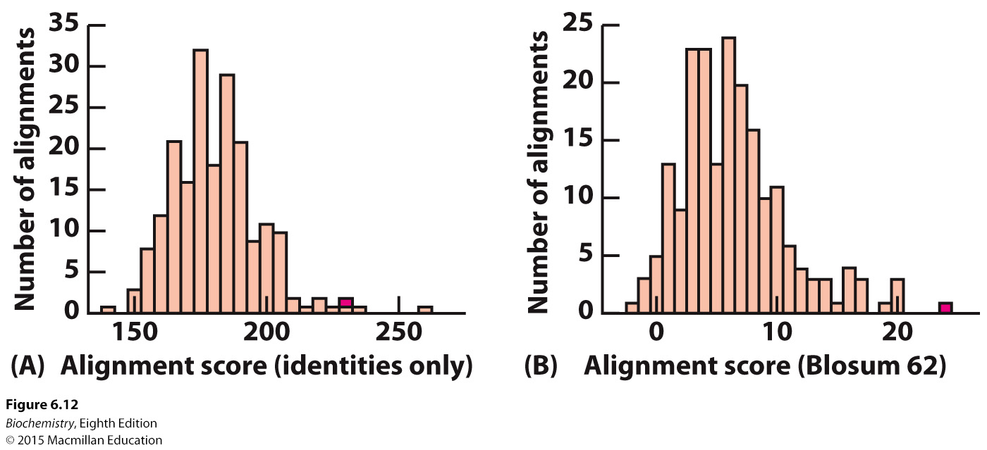
Notes:
FIGURE 6.12 Alignment of identities only versus the Blosum-62. Repeated shuffling and scoring reveal the significance of sequence alignment for human myoglobin versus lupine leghemoglobin with the use of either (A) the simple, identity-based scoring system or (B) the Blosum-62. The scores for the alignment of the authentic sequences are shown in red. Accounting for amino acid similarity in addition to identity reveals a greater separation between the authentic alignment and the population of shuffled alignments.

Slide 22
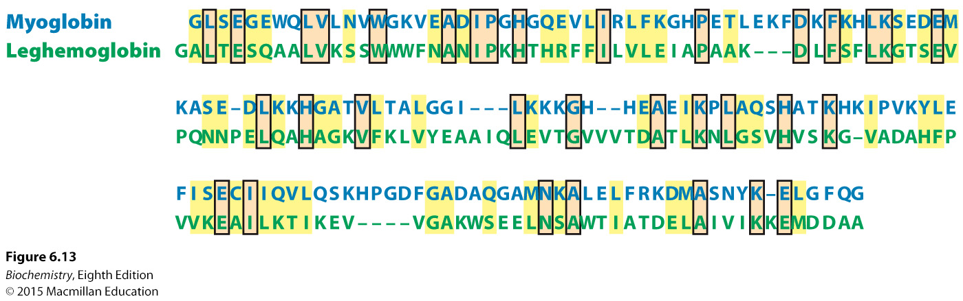
Notes:
FIGURE 6.13 Alignment of human myoglobin and lupine leghemoglobin. The use of Blosum-62 yields the alignment shown between human myoglobin and lupine leghemoglobin, illustrating identities (orange boxes) and conservative substitutions (yellow). These sequences are 23% identical.

Slide 23
In order to detect sequence similarities between proteins, BLAST searches are performed. BLAST stands for Basic Local Alignment Search Tool.
The sequence under investigation is entered into the database, and a BLAST search yields a list of sequence alignments accompanied by an estimate that the alignments occurred by chance.

Slide 24
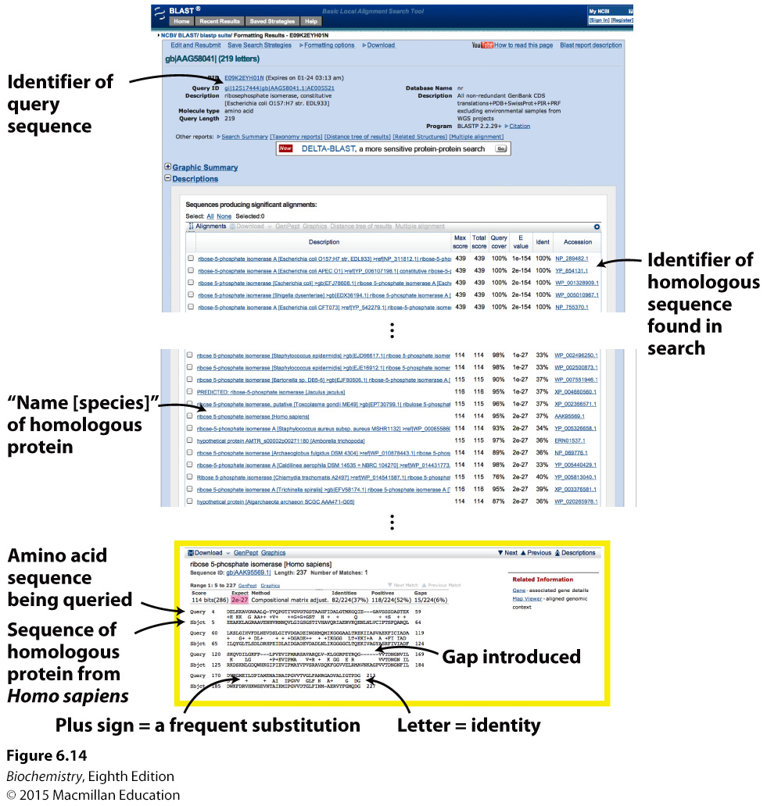
Notes:
FIGURE 6.14 BLAST search results. Part of the results from a BLAST search of the nonredundant (nr) protein sequence database using the sequence of ribose 5-phosphate isomerase (also called phosphopentose isomerase, Chapter 20) from E. coli as a query. Among the thousands of sequences found is the orthologous sequence from humans, and the alignment between these sequences is shown (highlighted in yellow). The number of sequences with this level of similarity expected to be in the database by chance is 2 x 10⁻²⁷ as shown by the E value (highlighted in red). Because this value is much less than 1, the observed sequence alignment is highly significant.

Slide 25

Tertiary structure is more closely associated with function than is primary structure.
Plant leghemoglobin shows little sequence homology with other globins but is remarkably similar in structure.
On the basis of three-dimensional structure, actin and Hsp70, proteins with different biological functions, are paralogs.

Slide 26
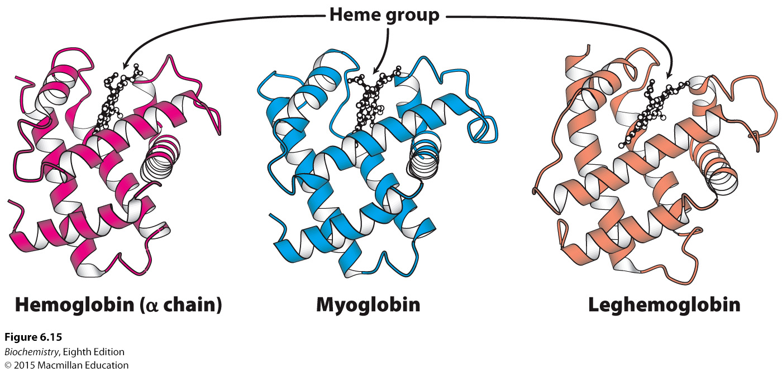
Notes:
FIGURE 6.15 Conservation of three-dimensional structure. The tertiary structures of human hemoglobin (α chain), human myoglobin, and lupine leghemoglobin are conserved. Each heme group contains an iron atom to which oxygen binds. [Drawn from 1HBB.pdb, 1MBD.pdb, and 1GDJ.pdb.]

Slide 27
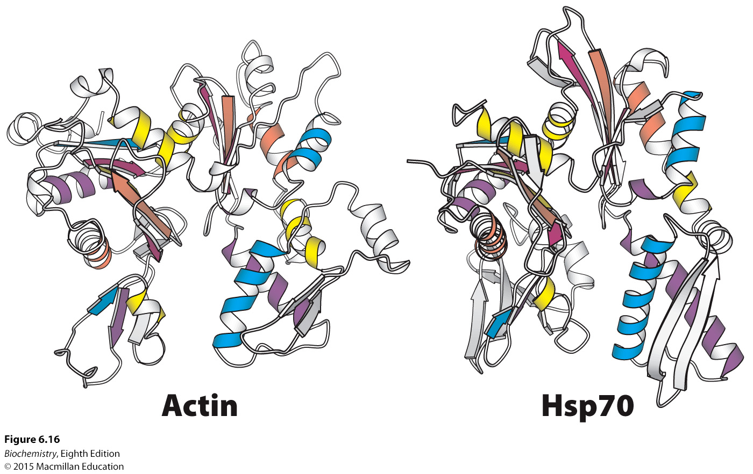
Notes:
FIGURE 6.16 Structures of actin and a large fragment of heat shock protein 70 (Hsp70). A comparison of the identically colored elements of secondary structure reveals the overall similarity in structure despite the difference in biochemical activities. [Drawn from Actin Hsp70 1ATN.pdb and 1ATR.pdb.]

Slide 28
A sequence template, a map of conserved sequences that are structurally and functionally important and are common to a particular family of proteins, allows the detection of homologies that may not be apparent with other techniques.

Slide 29

Many proteins have domains that are similar to one another.
Such repeats are detected by performing sequence alignments with the protein itself.

Slide 30
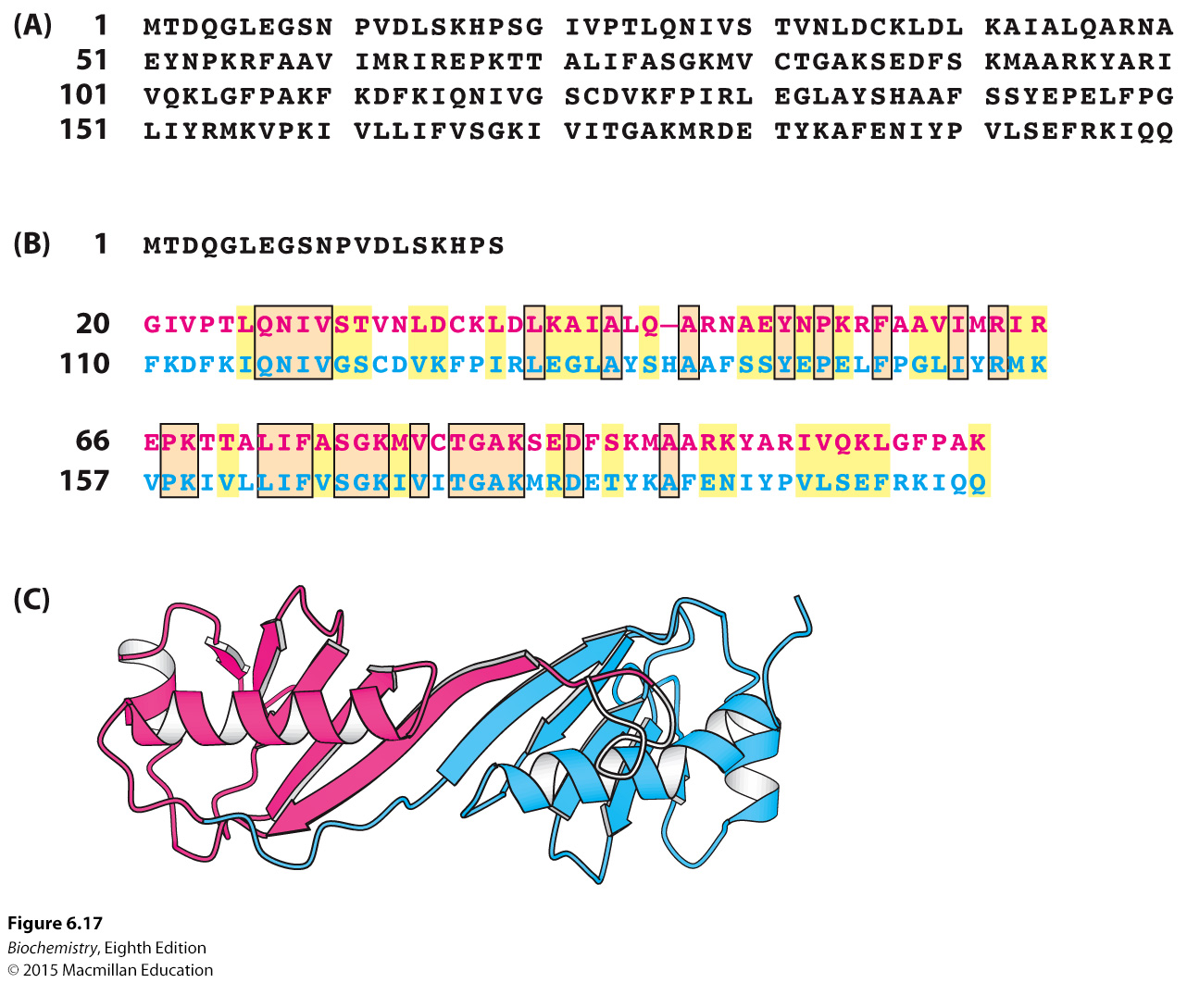
Notes:
FIGURE 6.17 Sequence alignment of internal repeats. (A) The primary structure of the TATA-box-binding protein. (B) An alignment of the sequences of the two repeats of the TATA-box-binding protein. The amino-terminal repeat is shown in red and the carboxyl-terminal repeat in blue. (C) Structure of the TATA-box-binding protein. The amino-terminal domain is shown in red and the carboxyl-terminal domain in blue. [Drawn from 1VOK.pdb.]

Slide 31

Proteins derived from a common ancestor are a result of divergent evolution.
Some proteins have common structural and functional features but do not share a common ancestor, a result of convergent evolution.
Convergent evolution is an example of proteins from different evolutionary pathways arriving at the same solution to a biochemical problem.
Serine proteases are examples of convergent evolution.

Slide 32
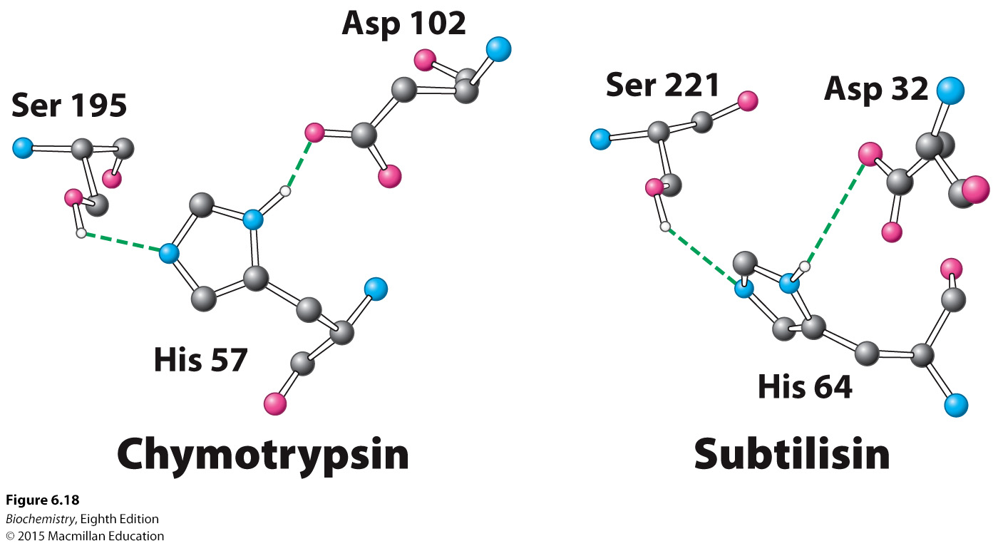
Notes:
FIGURE 6.18 Convergent evolution of protease active sites. The relative positions of the three key residues shown are nearly identical in the active sites of the serine proteases chymotrypsin and subtilisin.

Slide 33
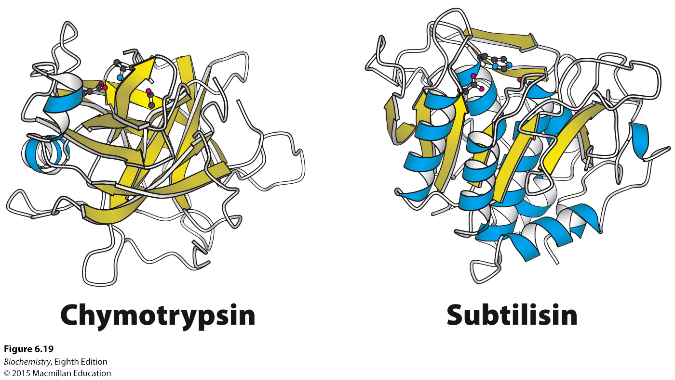
Notes:
FIGURE 6.19 Structures of mammalian chymotrypsin and bacterial subtilisin. The overall structures are quite dissimilar, in stark contrast with the active sites, shown at the top of each structure. The β strands are shown in yellow and the α helices in blue. [Drawn from 1GCT.pdb. and 1SUP.pdb.]

Slide 34
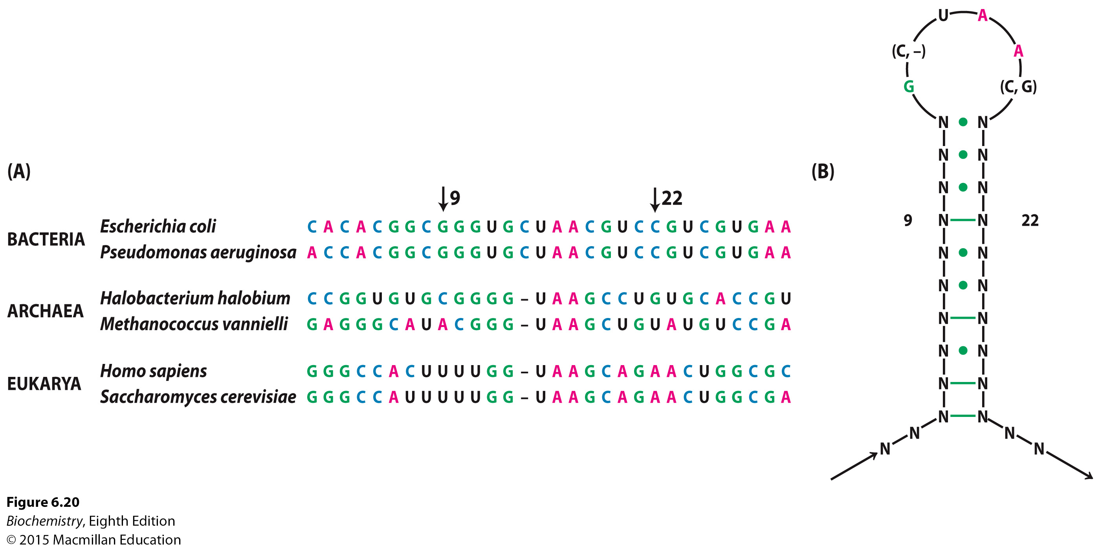
Notes:
FIGURE 6.20 Comparison of RNA sequences. (A) A comparison of sequences in a part of ribosomal RNA taken from a variety of species. (B) The implied secondary structure. Green lines indicate positions at which Watson–Crick base-pairing is completely conserved in the sequences shown, whereas dots indicate positions at which Watson–Crick base-pairing is conserved in most cases.

Slide 35

The lengths of the branches of evolutionary trees connecting two proteins are proportional to the number of differences in the amino acid sequences of the two proteins.
Hemoglobin from lamprey consists of only a single type of subunit.

Slide 36
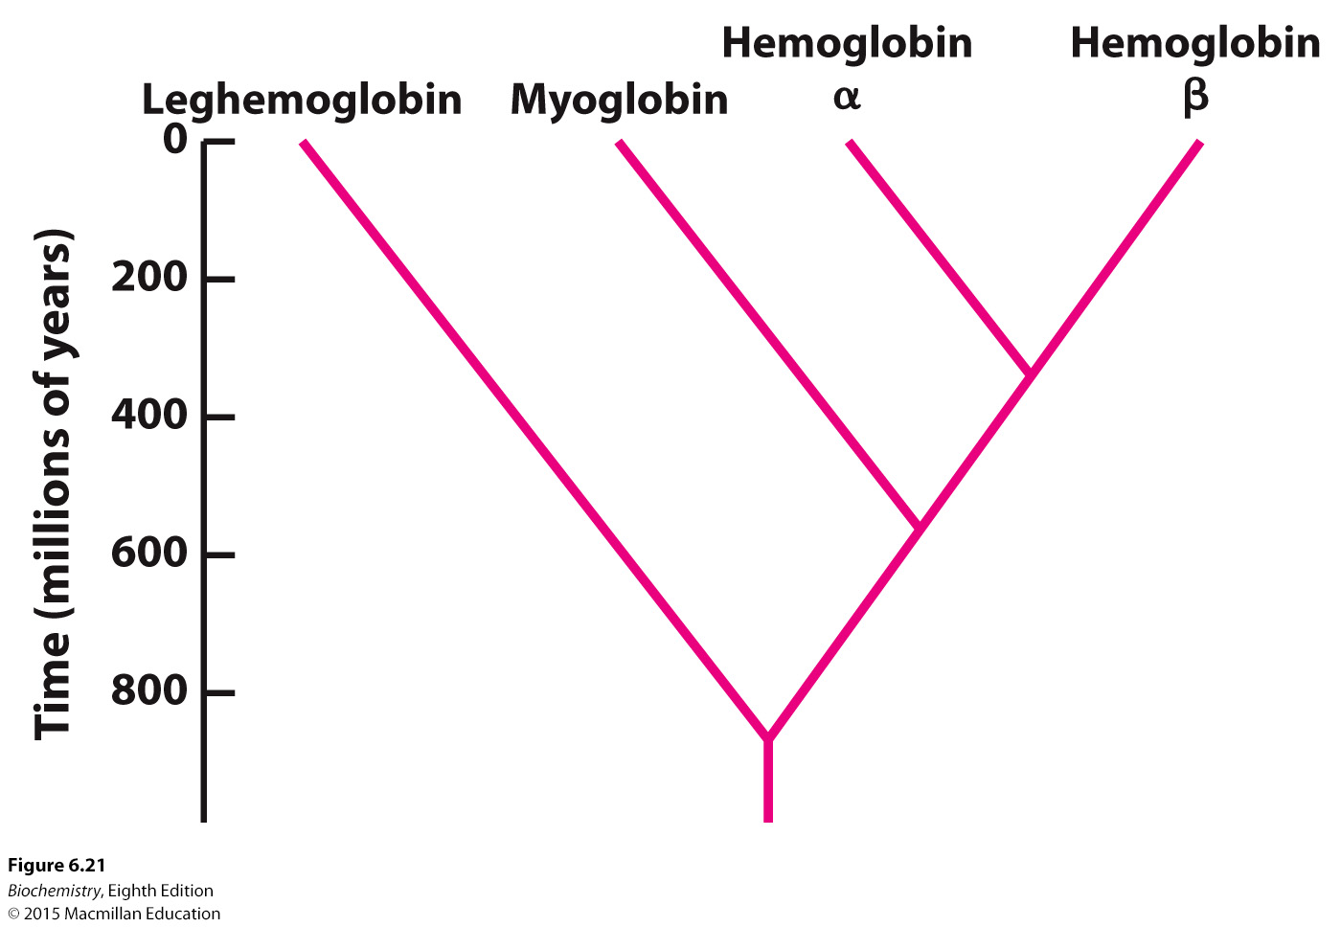
Notes:
FIGURE 6.21 An evolutionary tree for globins. The branching structure was deduced by sequence comparison, whereas the results of fossil studies provided the overall time scale showing when divergence occurred.

Slide 37
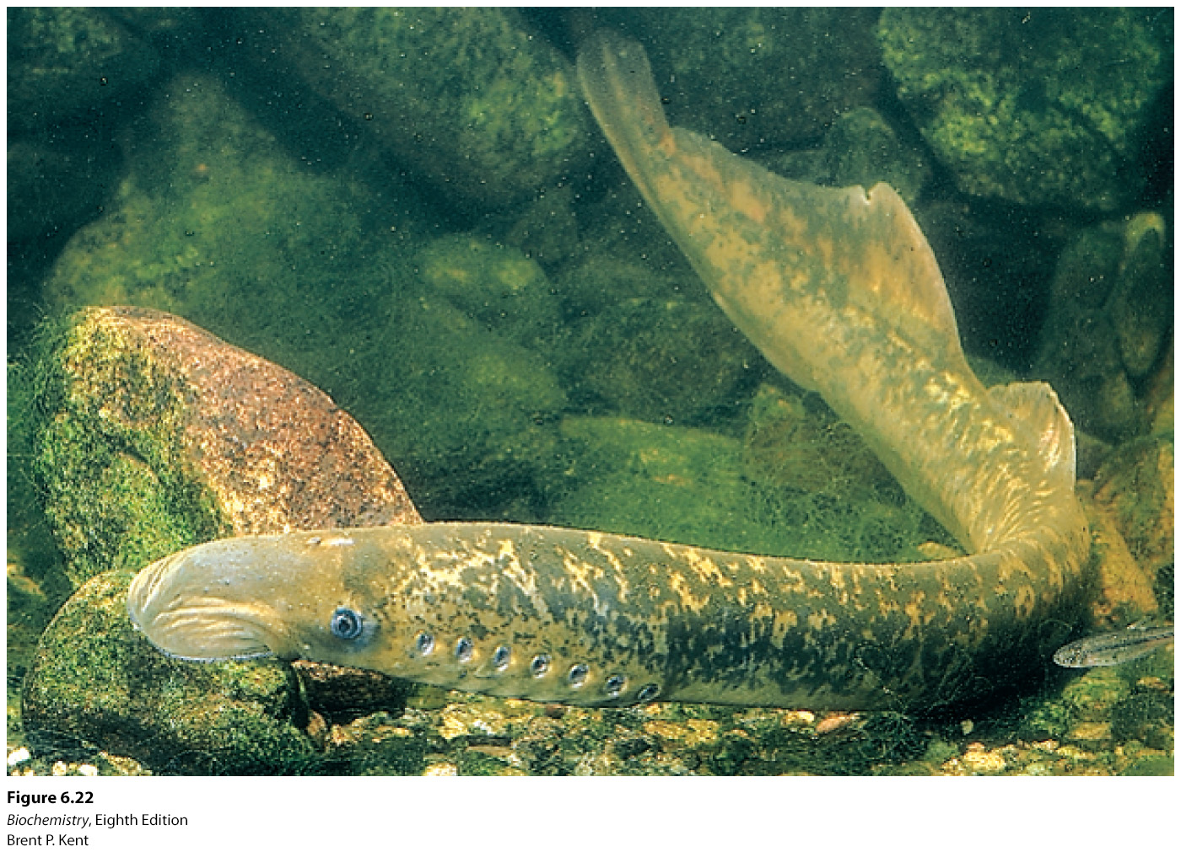
Notes:
FIGURE 6.22 The lamprey. A jawless fish whose ancestors diverged from bony fish approximately 400 million years ago, the lamprey has hemoglobin molecules that contain only a single type of polypeptide chain. [Brent P. Kent.]

Slide 38
Horizontal gene transfer is the exchange of DNA between species that confers selective advantage on the recipient.
Horizontal gene transfer is common among prokaryotes.
The eukaryote Galdieria sulphuraria contains genes more closely related to bacteria and archaea. This subset of genes allows G. sulphuraria to live in hostile environments.

Slide 39
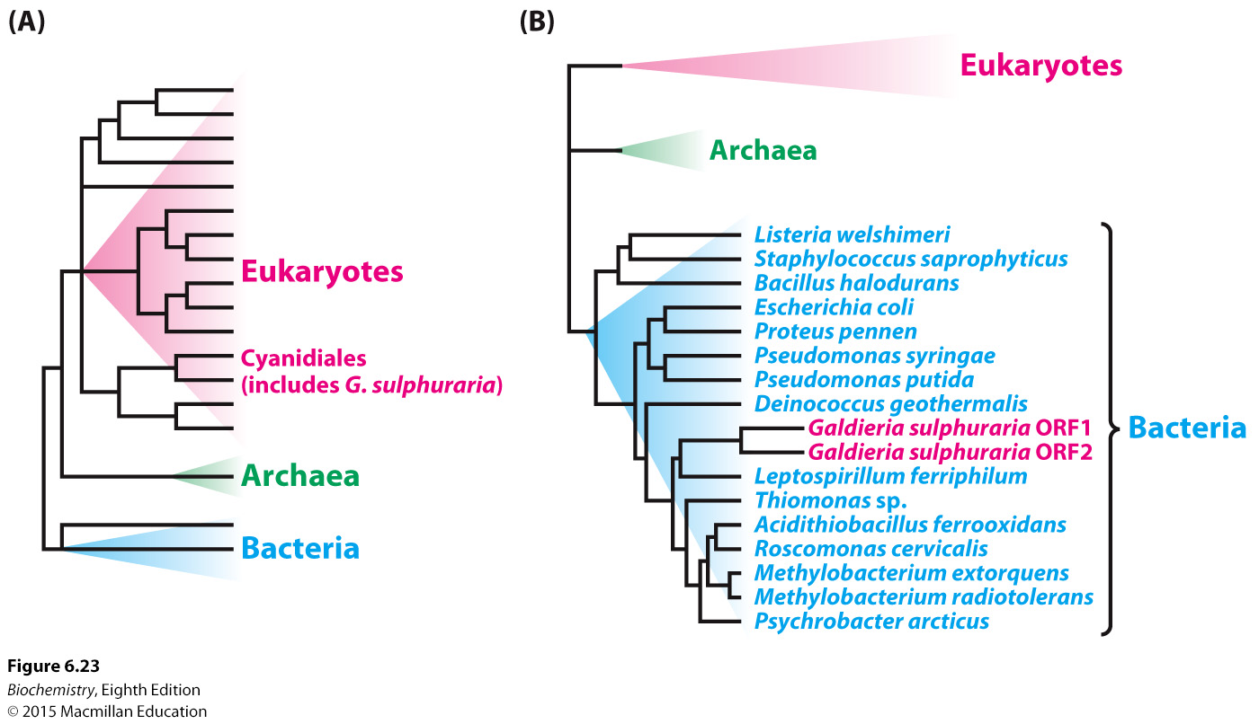
Notes:
FIGURE 6.23 Evidence of horizontal gene transfer. (A) The unicellular red alga Galdieria sulphuraria belongs to the order Cyanidiales, clearly within the eukaryotic branch of the evolutionary tree. (B) Within the completely sequenced G. sulphuraria genome, two ORFs encode proteins involved in transport of arsenate ions across membranes. Alignment of these ORFs against orthologs from a variety of species reveals that these pumps are most closely related to their bacterial counterparts, suggesting that a horizontal gene transfer event occurred during the evolution of this species. [(A) Information from Dr. Gerald Schönknecht; (B) Information from G. Schönknecht et al. Science 339:1207–1210, 2013, Fig. 3.]

Slide 40

The polymerase chain reaction and DNA sequencing technology make it possible to determine the sequence of ancient DNA.

Slide 41
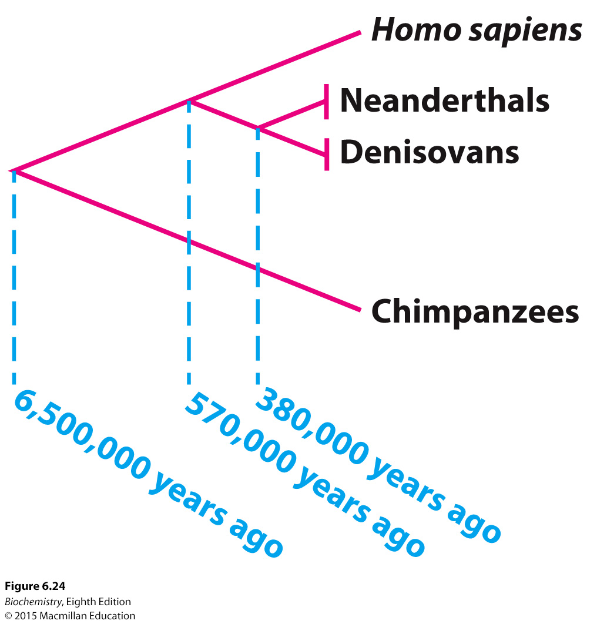
Notes:
FIGURE 6.24 Placing Neanderthals and Denisovans on an evolutionary tree. Comparison of DNA sequences revealed that neither Neanderthals nor the Denisovans are on the line of direct descent leading to Homo sapiens but, instead, branched off earlier and then became extinct.

Slide 42
The use of combinatorial chemistry makes it possible to observe molecular evolution in the laboratory.
Three criteria are required to mimic evolution:
A diverse population.
Selective pressure to allow fitness to be evident.
Reproduction that permits the enrichment of fit individual molecules.

Slide 43
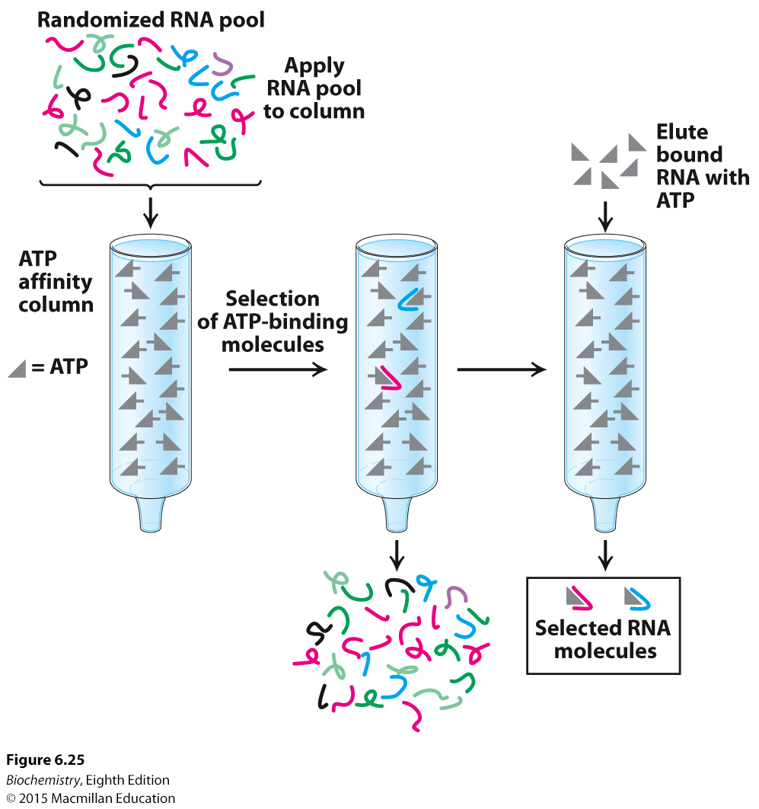
Notes:
FIGURE 6.25 Evolution in the laboratory. A collection of RNA molecules of random sequences is synthesized by combinatorial chemistry. This collection is selected for the ability to bind ATP by passing the RNA through an ATP affinity column (Section 3.1). The ATP-binding RNA molecules are released from the column by washing with excess ATP and then replicated. The process of selection and replication is then repeated several times. The final RNA products with significant ATP-binding ability are isolated and characterized.

Slide 44
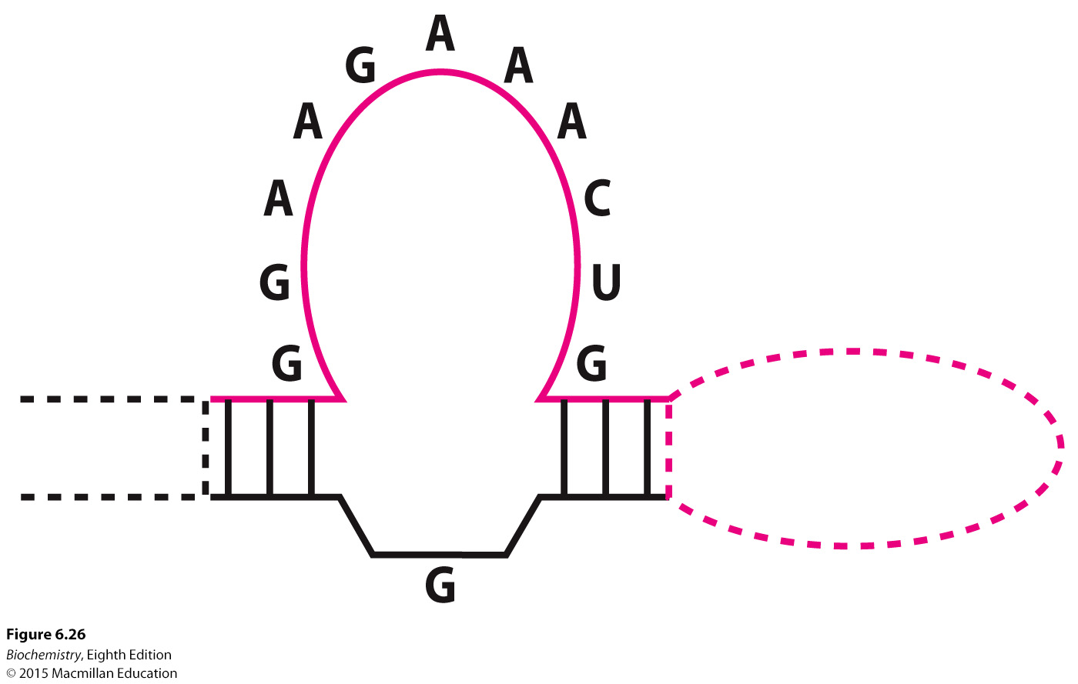
Notes:
FIGURE 6.26 A conserved secondary structure. The secondary structure shown is common to RNA molecules selected for ATP binding.

Slide 45
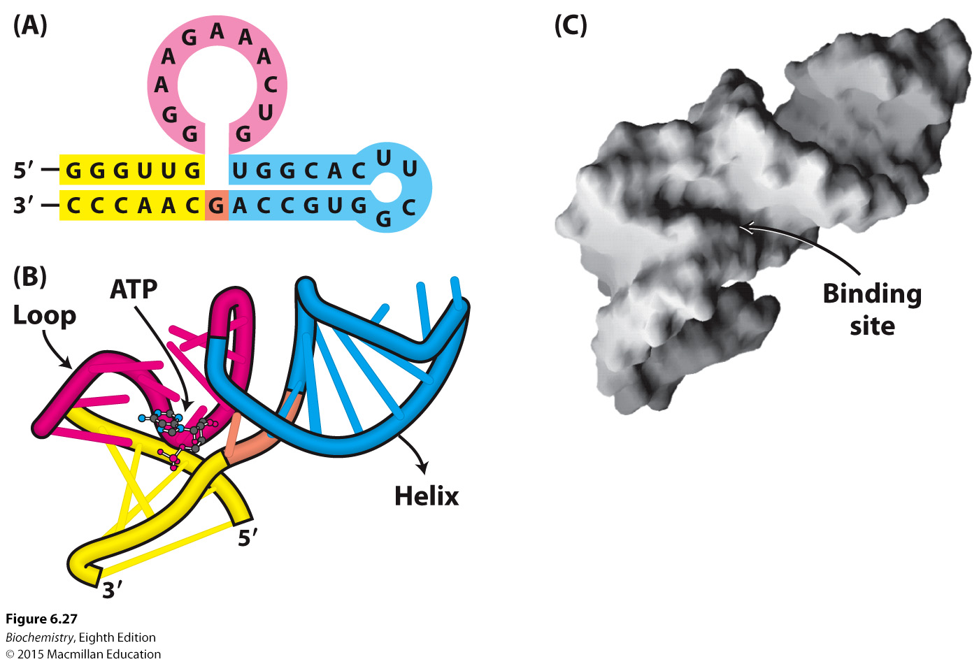
Notes:
FIGURE 6.27 An evolved ATP-binding RNA molecule. (A) The Watson–Crick base-pairing pattern of an RNA molecule selected to bind adenosine nucleotides. (B) The NMR structure of this RNA molecule reveals the deep pocket into which the ATP molecule is bound. (C) In this surface representation, the ATP molecule has been removed to enable visualization of the pocket. [Drawn from 1RAW.pdb.]

