Slide 1

Time Travel to 1 Year Ago
1
Willing to join a Master’s Programs
4
Trying to find an Education Consultant
Multiple meetings to identify the right advisor
2
Navigating University Websites
Browsing fragmented information with no central source
5
Selecting and Starting the Process
Choosing one agency and committing blindly
3
Attending Education Fairs
Limited information from crowded, time-constrained events
6
Errors, Inefficiency, Bias & High Costs
Expensive services with hidden bias and economic pressure
EdFind | IMIE 2026 1.

Slide 2

Your AI-Powered Guide to European Master's Programs
Let us be your compass in education!
Hasan Cenk Salgam — Derin Canözden
IMIE 2026 | POLIMI GSoM

Slide 3
Mission & Purpose
Mission
To democratize access to European higher education for Turkish students by replacing fragmented, biased, and expensive advisory services with a single AI-powered platform that delivers personalized, verified, and neutral guidance.
Vision
To become the go-to education advisory platform for every student applying to master's programs across borders — starting with Turkey-to-Europe, expanding globally.
Purpose
We exist because students deserve more than fragmented websites, biased consultants, and uncertain advice when making one of the most important decisions of their lives. EdFind helps them navigate international education with clarity, trust, and confidence
Cenk EdFind | IMIE 2026 3.

Slide 4
Executive Summary (Düzenleencek)
EdFind is an AI-powered education advisory platform helping Turkish students discover, compare, and apply to European master’s programs with more clarity and confidence.
Our research validated a clear pain point: all 13 interviewees described the process as fragmented, time-consuming, and unreliable. Students currently depend on scattered university websites, inconsistent AI outputs, WhatsApp groups, and costly consultants — yet still risk missing the right programs.
EdFind solves this through three integrated layers: a personalized AI recommendation engine, a country-specific application toolkit, and a verified student community with real reviews, alumni insights, and program-level guidance.
The platform follows a B2B2C model, combining student access fees with university-side visibility and recruitment opportunities. Early validation is positive: 9 out of 13 interviewees preferred full access, with willingness to pay clustering around 2,000–5,000 TL.
Cenk EdFind | IMIE 2026 4.

Slide 5






The Problemv (customer segmentsi burden çıkar yeni slide a koy)
Customer Segments
Main Problems
Students considering education abroad
Time-consuming research process
Students actively applying to master's programs
Lack of personalized guidance
Students seeking personalized guidance
Expensive consultant dependency
Difficulty comparing universities
Fragmented and scattered information
Problem validated through 13 in-depth interviews with students at different stages of the study abroad journey.
Derin EdFind | IMIE 2026 7.

Slide 6



Our Solution
EdFind combines personalized AI guidance, centralized information, and student-driven insights in a single platform.
AI-Powered Matching
Smart Comparison
Process Tracking
Find personalized best-fit programs faster based on your profile and goals
Compare universities more confidently with structured, verified data
Navigate applications efficiently with country-specific checklists
Centralized Hub
Verified Community
Access all guidance in one place — no more scattered information
Learn from .eduverified student experiences and alumni outcomes
Derin EdFind | IMIE 2026 8.

Slide 7


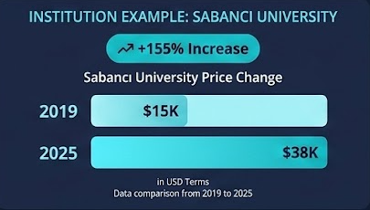
Market Overview & Sizing
A growing number of Turkish students pursue higher education abroad, yet the process remains fragmented and difficult to navigate.
+18%
Growth in student mobility of Turkey
OECD (2018–2023)
7M+
50K+
University students (Turkey)
according to OECD
Turkish students study
abroad every year (OECD 2026)
The demand for international education continues to grow globally and in Türkiye.
Derin EdFind | IMIE 2026 5.

Slide 8
Customer segments

Slide 9
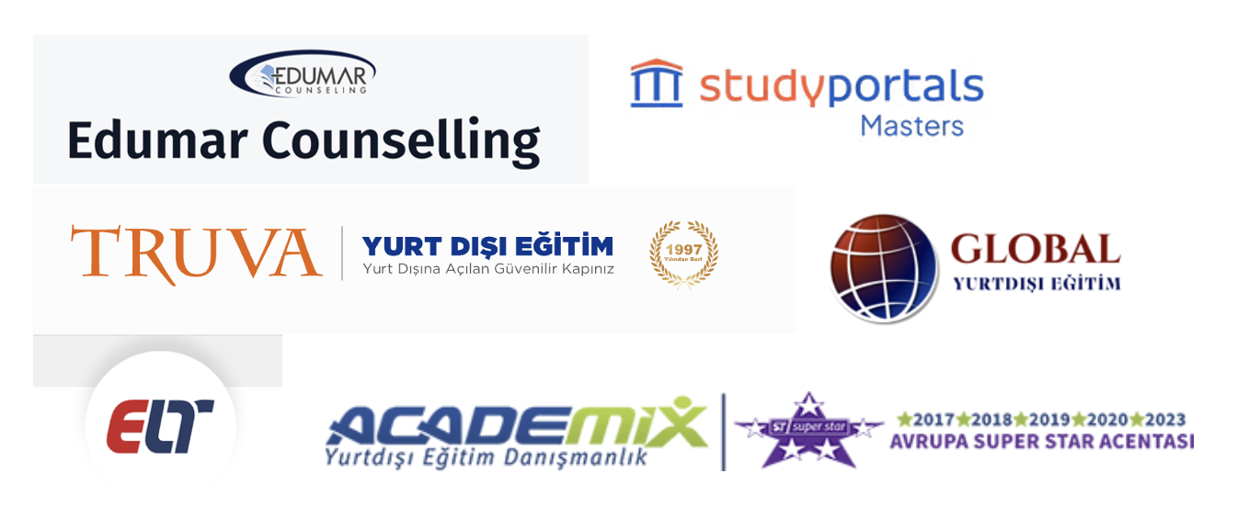
Competitive Landscape
The Turkish study-abroad market is dominated by traditional consulting agencies and generic aggregator platforms.
The Gap: Existing platforms provide information, but personalized guidance still relies heavily on traditional consultants who charge €500–2,000 and often push partner schools for commission. No single platform combines AI matching, verified community, and neutral application support.
Derin EdFind | IMIE 2026 6.

Slide 10
Customer Validation (Survey eklenip güncellenmeli)
Validation based on 13 interviews with students researching, applying to, or enrolled in international programs.
13/13
€40–100
Confirmed research process is fragmented and stressful
Emerging pricing sweet spot
Reacted positively to the EdFind concept
5–15x cheaper than traditional consultants
9/13 chose Full Access over free tier
Found community & verified reviews highly valuable
WTP clusters around 2,000–5,000 TL
"The process is much more exhausting than it should be."
— Ahsen D.
Derin EdFind | IMIE 2026 12.

Slide 11
Business Model Canvas
Designed for EdFind / IMIE Pre-Incubation Lab
Key Partners
Key Activities
Value Propositions
Customer
Relationships
Customer
Segments
Partner universities
Education institutions
Scholarship orgs
Campus representatives
AI/LLM providers
Cloud infrastructure
Student communities
Platform & UX dev
AI recommendation engine
Database curation
Community moderation
Campus rep mgmt
AI-powered recommendations
All info in one place
Profile quiz + search
Application tracker
Community hub
Scholarship discovery
Built by students that lived the process
Self-service onboarding
AI assistant + dashboard
Community peer support
1-on-1 campus rep chat
Deadline notifications
Turkish students → EU master's
Int'l students (long-term)
Free explorers
Partner Uni subscribers
Full Access subscribers
Universities (B2B)
Key Resources
Channels
Structured database
AI/ML stack
Verified student reviews
Founder–market fit
Founder team
Web app
Social media
Influencer partnerships
Student outreach
Email + notifications
Word-of-mouth
Cost Structure
Revenue Streams
Platform dev & maintenance • AI/LLM API • Cloud infra • Database curation • Customer acquisition • Operations
Full Access subscriptions (~€40–100 / 6 mo) • B2B partner-university fees • Lead-generation fees • Affiliate referrals

Slide 12
Business Model — B2B2C (beğendiler ama güncellenecek)
STUDENT
PLATFORM
UNIVERSITY
Package 1
Free access
University sponsored
Partner pool only
Application tools included
EdFind
AI recommendation engine
Application toolkit
Verified community
All universities
No hidden bias
Honest comparison
Partner university
Qualified student pool
Application page & tools
Visibility + analytics
→
fees →
Package 2
Paid access
One-time payment or 6-month sub
All universities
Full toolkit
All universities
No partnership required
Listed in unbiased ranking
Students reach directly
→
→
REVENUE STREAMS
Partner uni fees (B2B)
Funds the free tier
Full access (B2C)
Primary revenue
Affiliate (long-term)
Scholarships, visa, housing
EdFind | IMIE 2026 11.

Slide 13
Go-to-Market Strategy (kalsın ama es geçilebilri)
Core Logic: Start narrow, build trust, then scale across Europe.
01
Beachhead Market
Turkish students applying to master’s programs in Europe
02
Acquisition Channels
Student communities, university clubs, WhatsApp/Telegram groups, LinkedIn, SEO guides, campus ambassadors, Social Media
03
Conversion Strategy
Free guides build trust; AI matching, tracking, and verified insights drive paid access.
04
Expansion Roadmap
Italy-focused MVP, expand to key European destinations, scale via university partnerships.
EdFind | IMIE 2026 13.

Slide 14

Live Product Demo
Launch EdFind →
ed-find.vercel.app
Cenk EdFind | IMIE 2026 9.

Slide 15
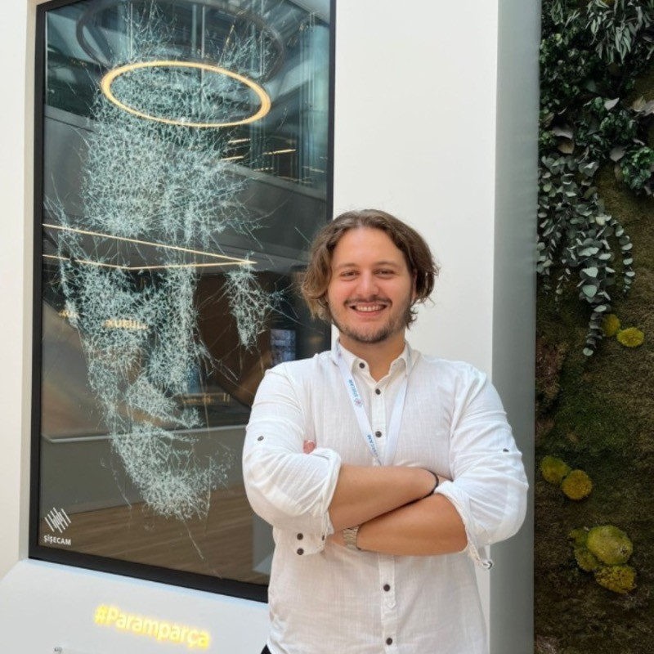

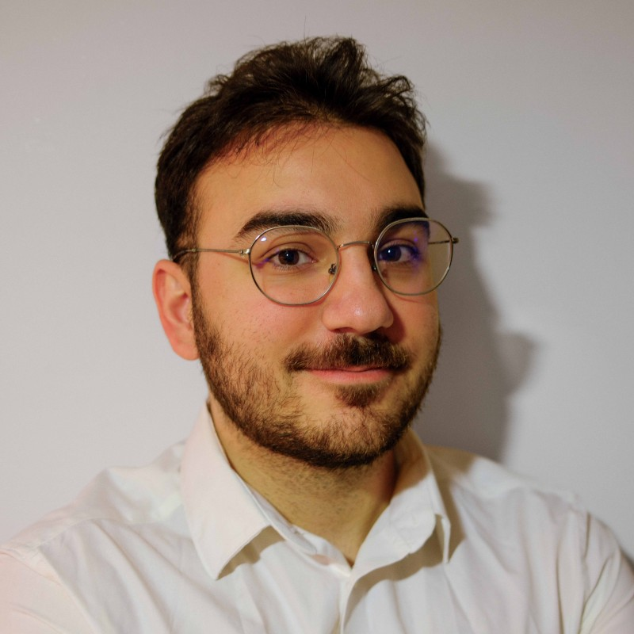
The Team
Hasan Cenk Şalgam
Derin Canözden
Erdoğan Mert Oruntak
CEO & Co-Founder
CMO & Co-Founder
CTO & Co-Founder
BSc Industrial Engineering + Finance Minor
MSc Innovation & Entrepreneurship, POLIMI GSoM
Beko, Sisecam — Digital Process Excellence and Business Transformation
BA International Trade & Business
MSc Innovation & Entrepreneurship, POLIMI GSoM
Deloitte audit
BSc Economics, Bogazici University
Junior Research Analyst — data science, Python, R
Digital media optimization — billions of views
EdFind | IMIE 2026 14.

Slide 16
Thank You
Questions & Discussion
Hasan Cenk Salgam — Derin Canözden
ed-find.vercel.app
EdFind | IMIE 2026 15.

