Slide 1

Roll Number
202311887
202312187
202312188
202312104
202312372
202312192
202311865

Slide 2
Climate Change Indicators – Exploratory Data Analysis
Using R to Analyze Global Temperature Anomalies
Presented by: Group 1
Date: April 5, 2025

Slide 3





Introduction
Objective: Explore global temperature trends from 1961 to 2022
Source: FAOSTAT (Food and Agriculture Organization of the United Nations)
Purpose: Support climate modeling, agriculture planning, and policy-making

Slide 4

Dataset Overview
Yearly temperature anomalies from 1961 to 2022
Categorical: Country, ISO Code, Indicator
Numeric: F1961–F2022 (temperature anomalies)
Relevance to Agricultural and Environmental Sciences

Slide 5

Data Inspection
Code Usages
dim(data) 222 rows, 64 columns
head(data) First 6 rows
tail(data) Last 6 rows
str(data) Structure of the data
summary(data) Summary of each column

Slide 6
Missing Values
Code Usage
colSums(is.na(data)) Count missing values per column
sum(is.na(data)) Total number of missing values

Slide 7

Duplicate Rows
sum(duplicated(data))

Slide 8

Data Cleaning Strategy
Option 1: Remove rows with NA using na.omit()
Option 2: Drop columns with >50% missing values
Option 3: Impute numeric columns with mean
Remove duplicates using unique()

Slide 9

Reshaping for Time Series Analysis
Use pivot_longer() to reshape wide to long format
Extract year from column names: F1961 → 1961
Mutate new Year and TempChange columns

Slide 10

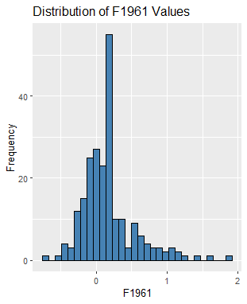
Histogram of F1961 Temperatures

Slide 11
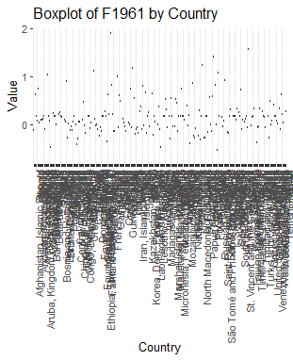
Boxplot of F1961 by Country

Slide 12
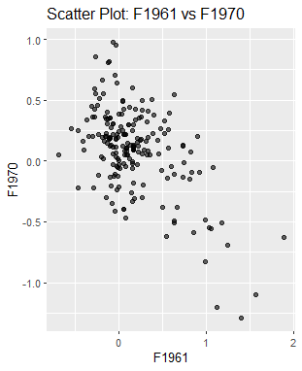
Scatter Plot: F1961 vs F1970

Slide 13
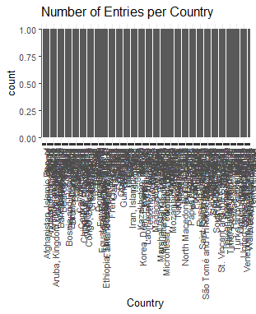
Bar Chart: Countries Represented

Slide 14
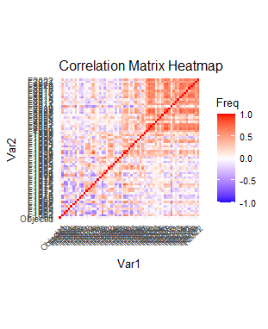
Correlation Matrix Heatmap

Slide 15
Line Plot: Trends Over Time
"Too many numeric columns for pair plot."

Slide 16

Observed Patterns
Rising temperatures globally
Positive year-to-year correlation
Uneven data coverage across countries
Outliers may indicate extreme weather events

Slide 17

Challenges Encountered
Missing values in early years
Wide format complexity for time series
Incomplete country coverage
Outliers required validation

Slide 18
Future Research Ideas
Predictive modeling of future anomalies
Clustering countries by warming trends
Unsupervised learning for anomaly detection
Regression models to understand warming drivers

Slide 19
Machine Learning Opportunities
Time Series Forecasting: ARIMA, LSTM
Unsupervised Learning: K-means, PCA
Supervised Learning: Regression, anomaly detection

Slide 20

GitHub Repository
Link to GitHub repository: https://github.com/emomo81/climate-change-analysis
Includes R code, cleaned dataset, visualizations, and this report

Slide 21

Conclusion & Q&A
Valuable dataset for climate, agriculture, and environmental studies
Clear evidence of rising temperatures
Opportunities for ML and statistical modeling
Questions?

