Slide 1

Voucher Management System
Course Name: DATABASE LAB

Slide 2
Voucher Management System
Motivation:
Every company needs to maintain a voucher management system for their daily expenses. We are trying to solve this problem using our project.
Prospective Client:
Any company who has quite a good number of expenses to maintain in their daily routine, will be helped by this software.
Searching Options:
We can search based on many conditions. Some of them are as follows:
1. The vouchers by the issuer user
2. Total expense of a month by querying all the vouchers
3. Total earning of a month by querying all the credit vouchers
4. View voucher details through searching by voucher id

Slide 3
Voucher Management System
Project Structure:
TABLES:
1.Users
2.Vouchers
3.Expense Type
4.Expense Sector
5.Voucher Details

Slide 4
Voucher Management System
Project Structure:
ATTRIBUTES OF EACH TABLE:
1.User
-User_ID
-User_name
-Password
-email
2.Vouchers
-Voucher_ID
-Expense_type_id
-User_ID

Slide 5
Voucher Management System
Project Structure:
ATTRIBUTES OF EACH TABLE:
3.Expense Types
-Expense_type_name
-Expense_type_id
4.Expense Sectors
-Expense_type_id
-Expense_sector_description
-Expense_sector_name
-Expense_sector_id
5.Voucher Details
-voucher_id
-Expense_sector_id
-issue_Date
-Description
-Voucher_ID
-Amount

Slide 6
Voucher Management System
Project Structure:
PRIMARY KEYS:
1.User
-User_ID
2.Voucher
-Voucher_ID
3.Expense Types
-Expense_type
4.Expense Sectors
-Expense_sector_id
5.Voucher Details
-Voucher_Details_id

Slide 7
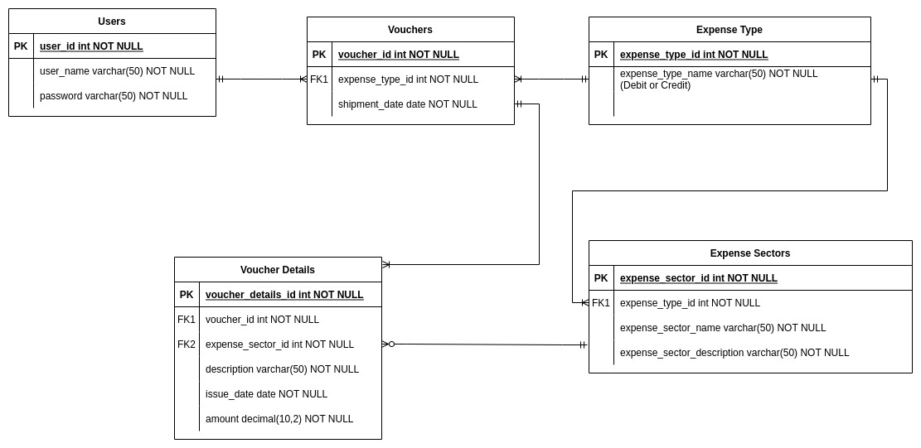
Voucher Management System

Slide 8
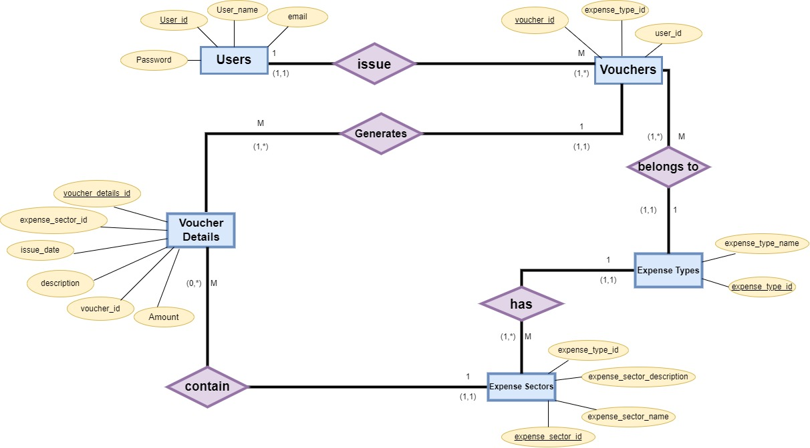
Voucher Management System

