Slide 1

Evaluating BloombergGPT-Style Models for Financial Tool Use and Function Calling
Combining financial-domain LLMs with tool-use capabilities to perform reasoning and decision tasks.
Inspired by BloombergGPT (financial LLM) and Toolformer (tool-using LLM).

Slide 2

Research Motivation
Finance involves vast unstructured data: reports, filings, news.
General LLMs lack domain precision and financial reasoning.
BloombergGPT improved domain specialization.
Toolformer demonstrated autonomous API/tool usage.
This work merges both ideas: financial tool-use simulation.

Slide 3
Main Objective:
Evaluate the performance and capabilities of BloombergGPT-style language models for financial tool use and simulated function calling.
Specific Objectives:
🧩 Simulate a function-calling environment using open-source financial LLMs such as FinGPT and FinBERT.⚙️ Evaluate how accurately these models identify, select, and execute the correct financial functions in realistic scenarios.📊 Compare reasoning performance across financial tasks — including sentiment analysis, stock prediction, and portfolio evaluation.💡 Identify key limitations and propose recommendations for improving tool-augmented financial LLMs.

Slide 4
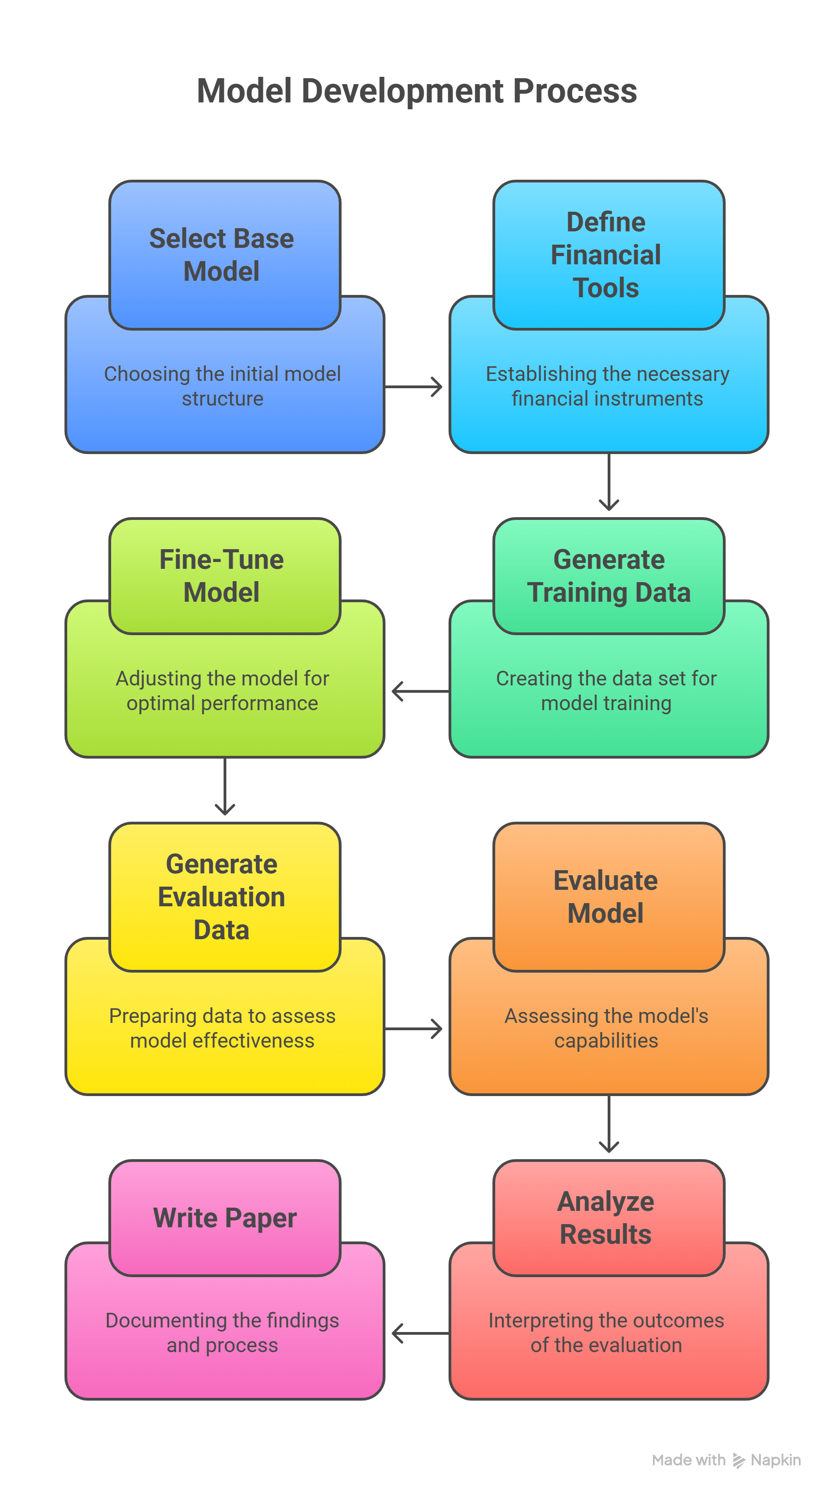

Slide 5
Step 1: Select Base Model
Goal: Choose foundation models resembling BloombergGPT.
Options:
• FinGPT – Open financial LLM with FinPile dataset.
• FinBERT – Sentiment-focused financial model.
• Toolformer-style GPT-J – Learns to call APIs.
BloombergGPT: 50B params, 70 layers, BLOOM architecture.

Slide 6
Step 2: Define Financial Tools
Define local finance-related tools for reasoning tasks.
Examples:
• get_stock_price(symbol)
• calculate_portfolio_risk(weights, returns)
• analyze_sentiment(text)
• summarize_report(document)
Goal: Teach models to identify and call correct functions.

Slide 7
Step 3: Generate Training Data
Use open financial datasets (FiQA, FinancialPhraseBank, FinSum).
Annotate text samples with function call templates (Toolformer-style).
Example:
Input: 'Tesla stock rose after earnings.' → analyze_sentiment('Tesla stock rose after earnings') → positive.
Goal: Teach when and how to call functions.

Slide 8
Step 4: Fine-Tune the Model
Objective: Enable tool-based reasoning recognition.
Approach: Self-supervised fine-tuning using function-labeled text.
Techniques:
• LoRA adapters for efficiency.
• Transforming API-style calls into training text.
Hardware: local GPU or Colab (8–12GB VRAM).

Slide 9
Step 5: Generate Evaluation Data
Purpose: Test model's tool use on new scenarios.
Tasks and Expected Tools:
• Sentiment → analyze_sentiment()
• Risk Analysis → calculate_portfolio_risk()
• Data Query → get_stock_price()
Labels: tool selection, argument accuracy, task success.

Slide 10
Step 6: Evaluate Model
Metrics:
• Tool Selection Accuracy – correct function chosen.
• Parameter Accuracy – correct arguments used.
• Task Completion Rate – correct full results.
• Output Quality – human evaluation or ROUGE score.
Comparison: FinGPT vs FinBERT vs Toolformer-like model.

Slide 11

Step 7: Analyze Results & Write Paper
Expected Findings:
• Domain-specific LLMs excel in financial reasoning.
• Toolformer-style tuning enhances call accuracy.
• Combined approach = BloombergGPT-style performance.
Deliverables: comparative charts, qualitative analysis, limitations.

Slide 12
Key Contributions
✅ Simulated evaluation of BloombergGPT-style LLMs.
✅ Framework for financial tool use and function calling.
✅ Comparative study with open financial models.
✅ Insights for practical AI-driven financial assistants.

Slide 13
References
Wu et al., BloombergGPT: A Large Language Model for Finance, arXiv:2303.17564 (2023).
Schick et al., Toolformer: LLMs Can Teach Themselves to Use Tools, NeurIPS (2023).
Keshri, BloombergGPT: Revolutionizing Finance with LLMs, IJARSCT (2025).

