Slide 1
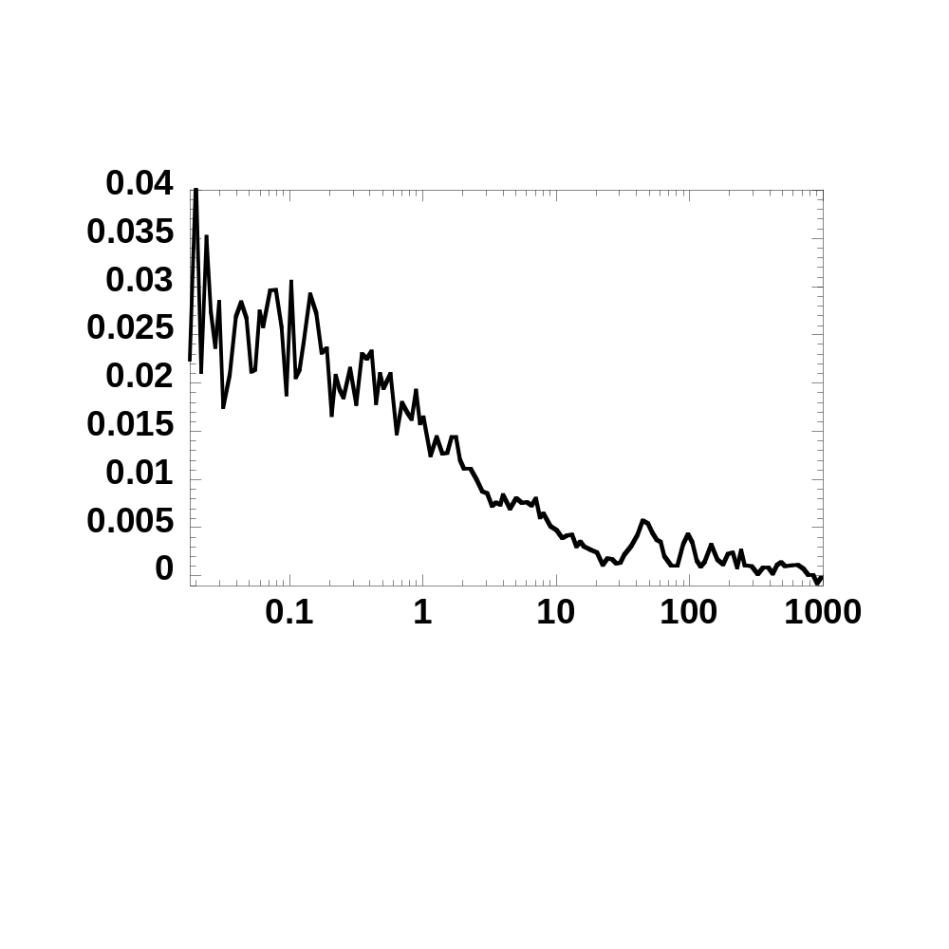
Figure S1
G(τ)
τ(ms)

Slide 2
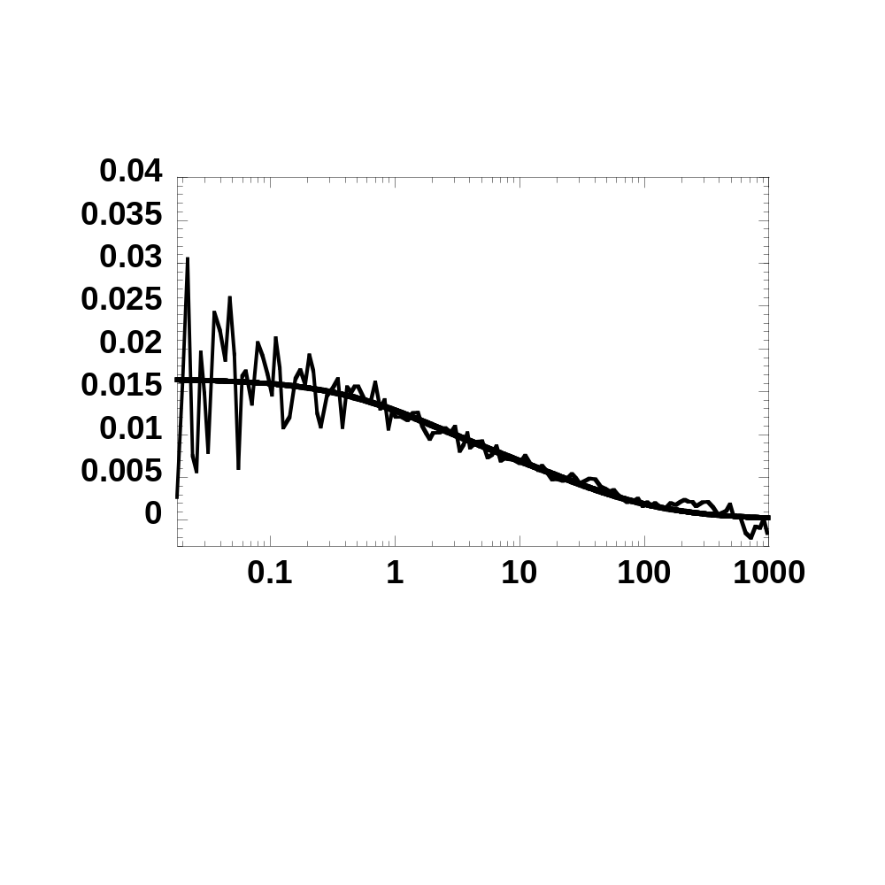
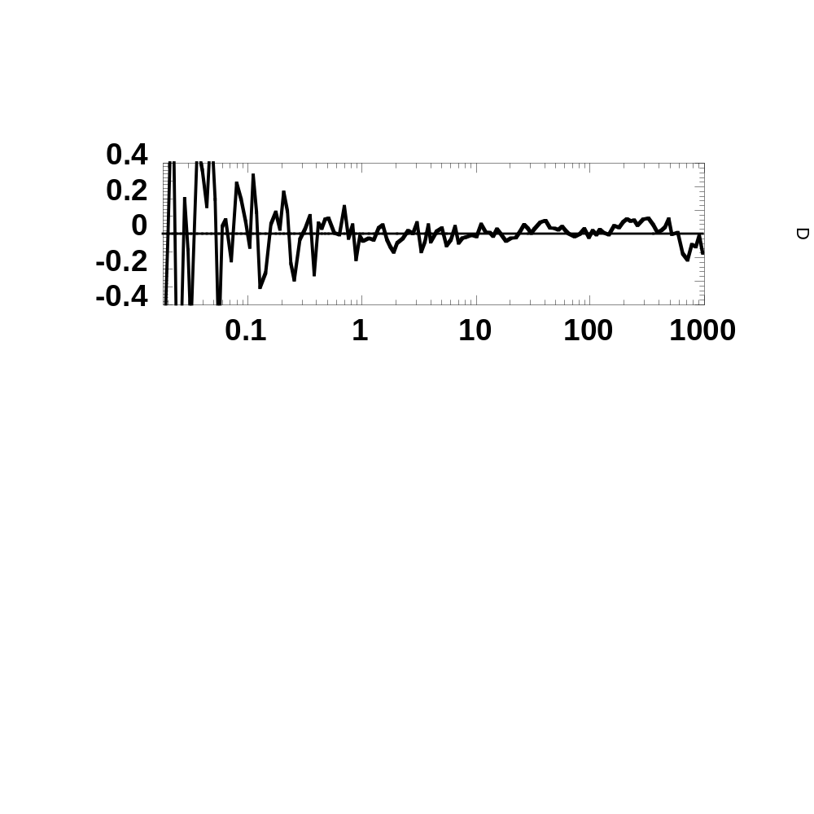
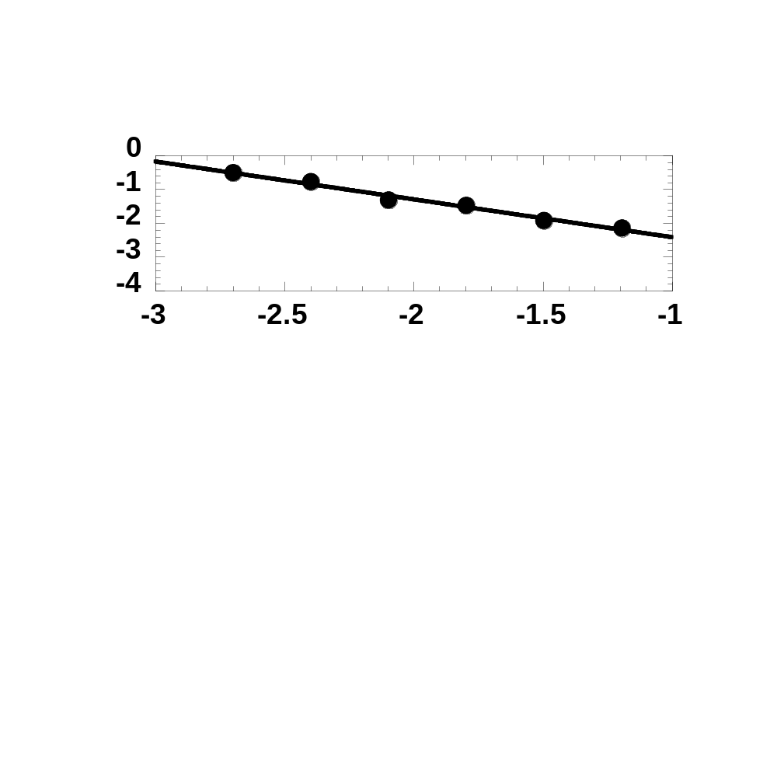
Figure S2A
G(τ)
res
τ(ms)
var
Δτ_{i}

Slide 3
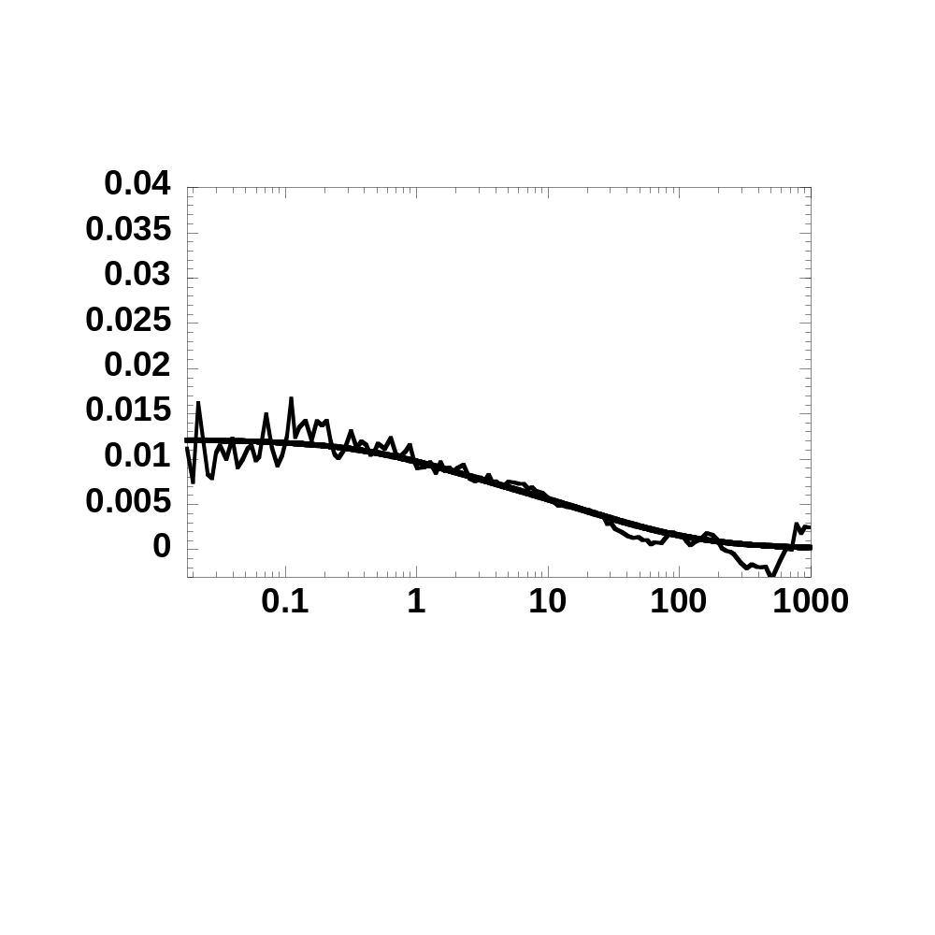
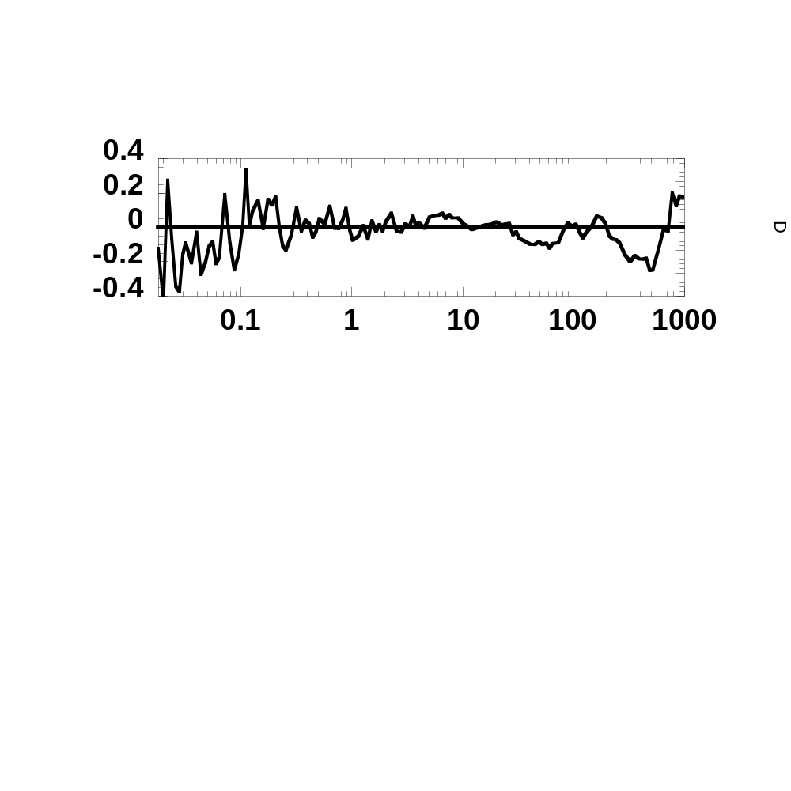
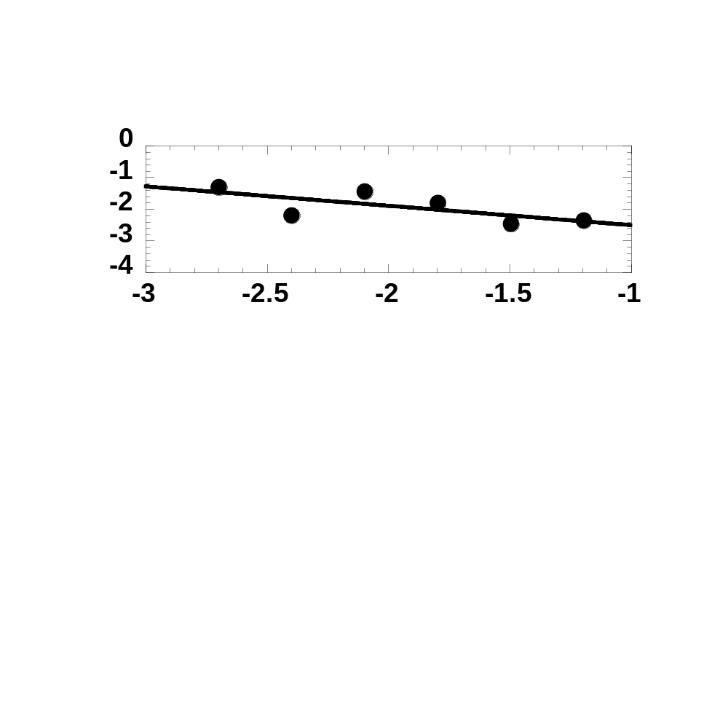
Figure S2B
G(τ)
res
τ(ms)
var
Δτ_{i}

Slide 4
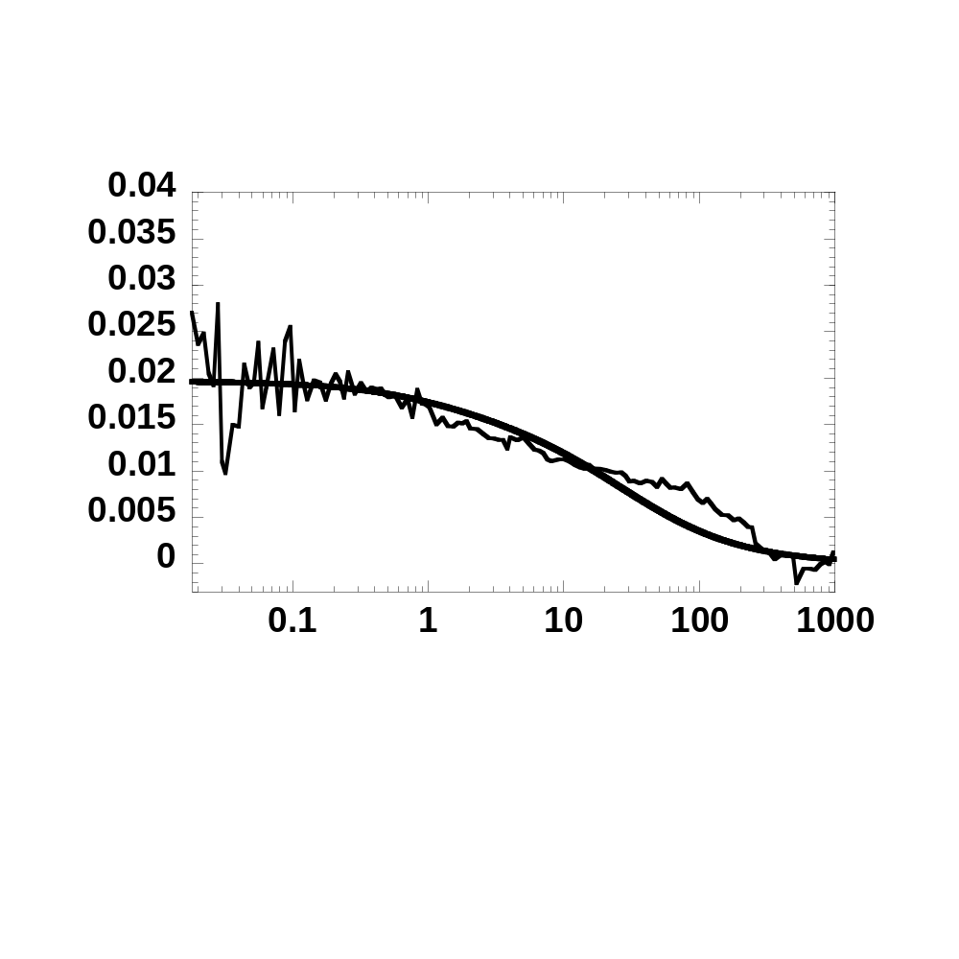
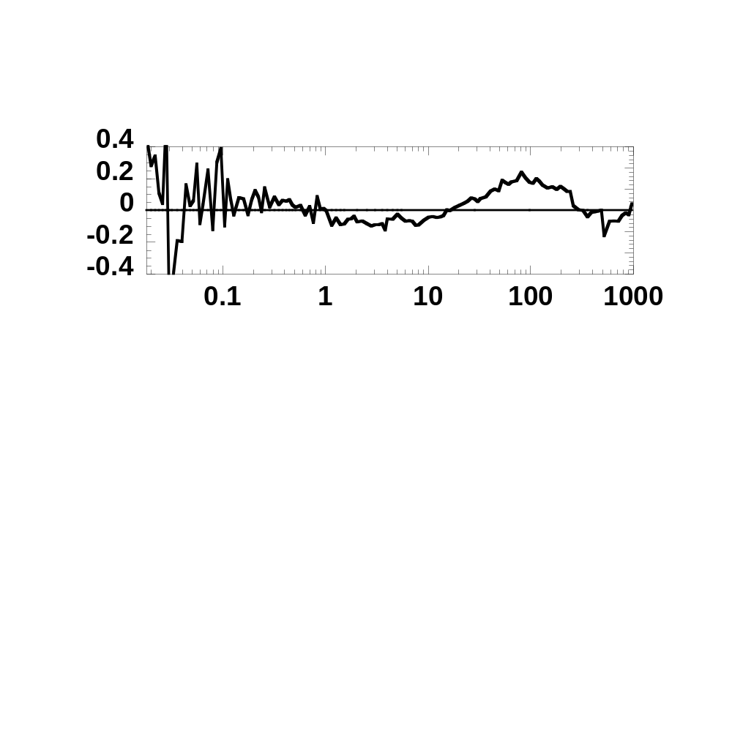
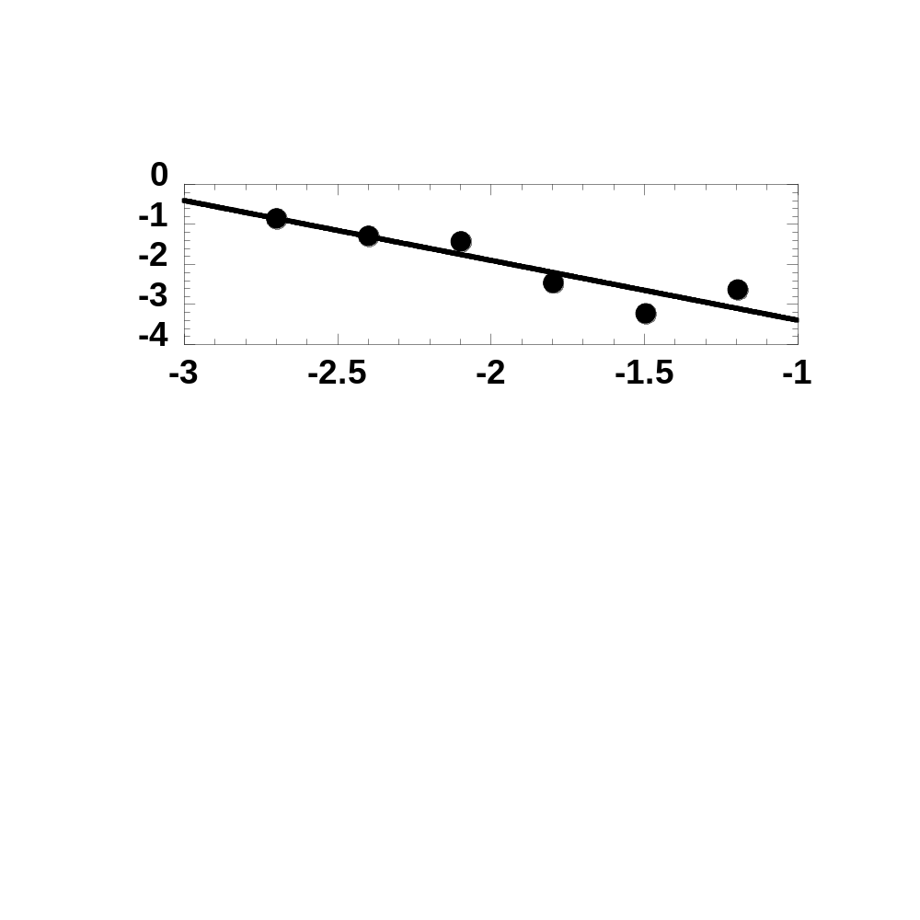
Figure S2C
G(τ)
res
τ(ms)
var
Δτ_{i}

Slide 5
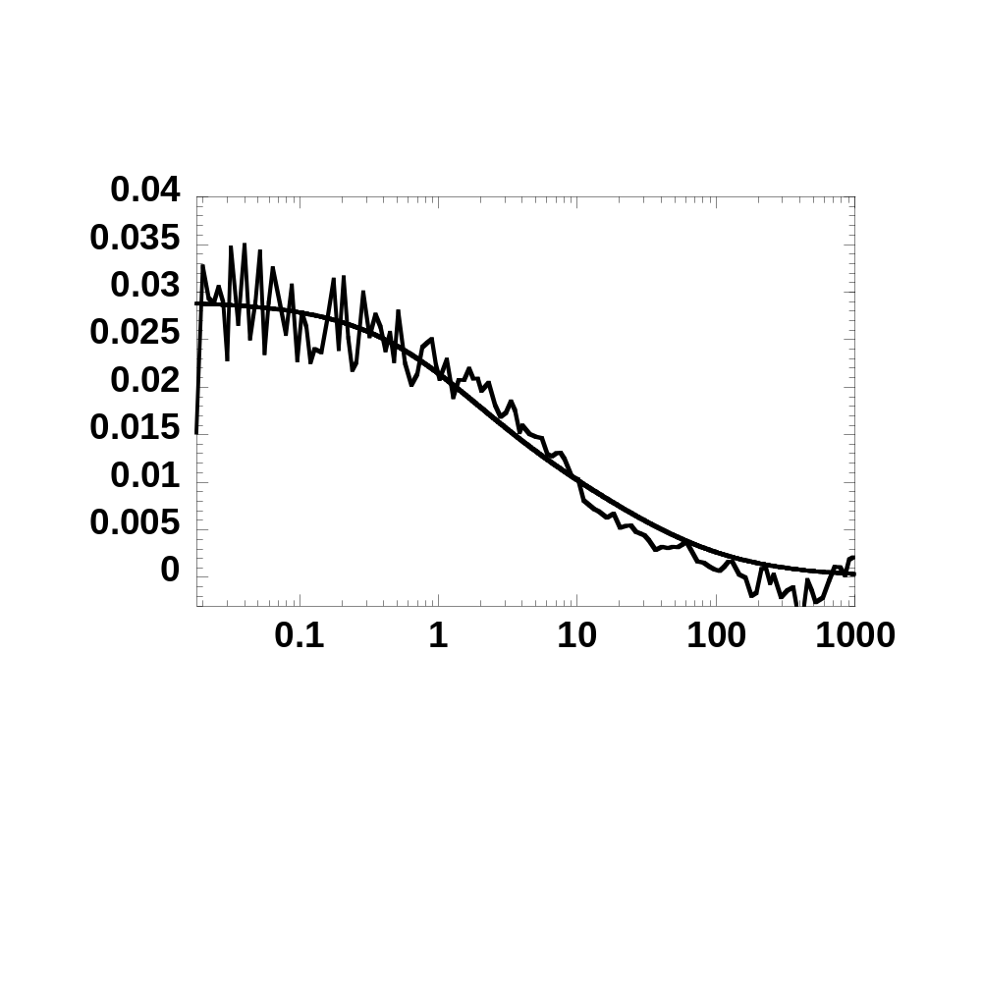
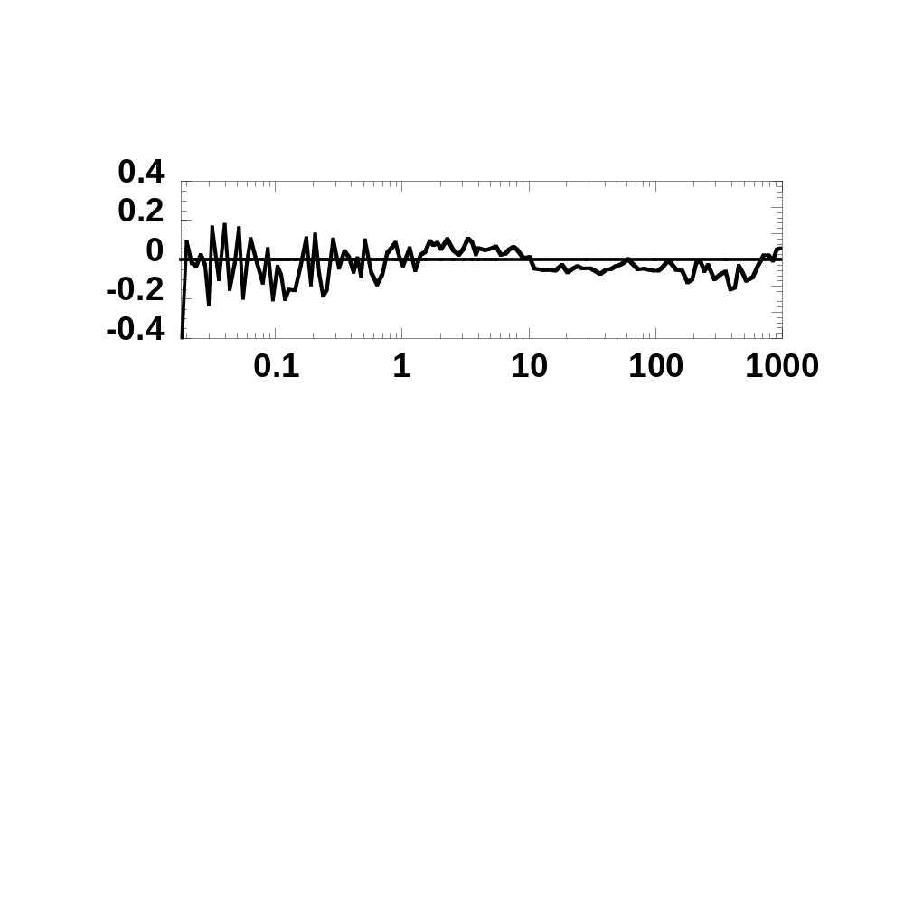

Figure S2D
G(τ)
res
τ(ms)
var
Δτ_{i}

Slide 6
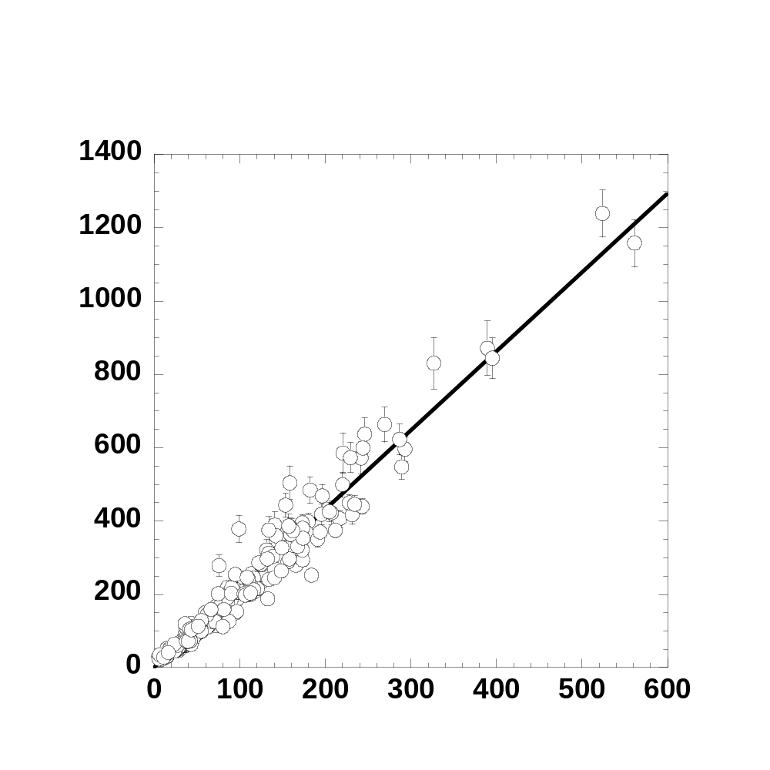
Figure S3
Number of DsRed
Intensity (kHz)

Slide 7
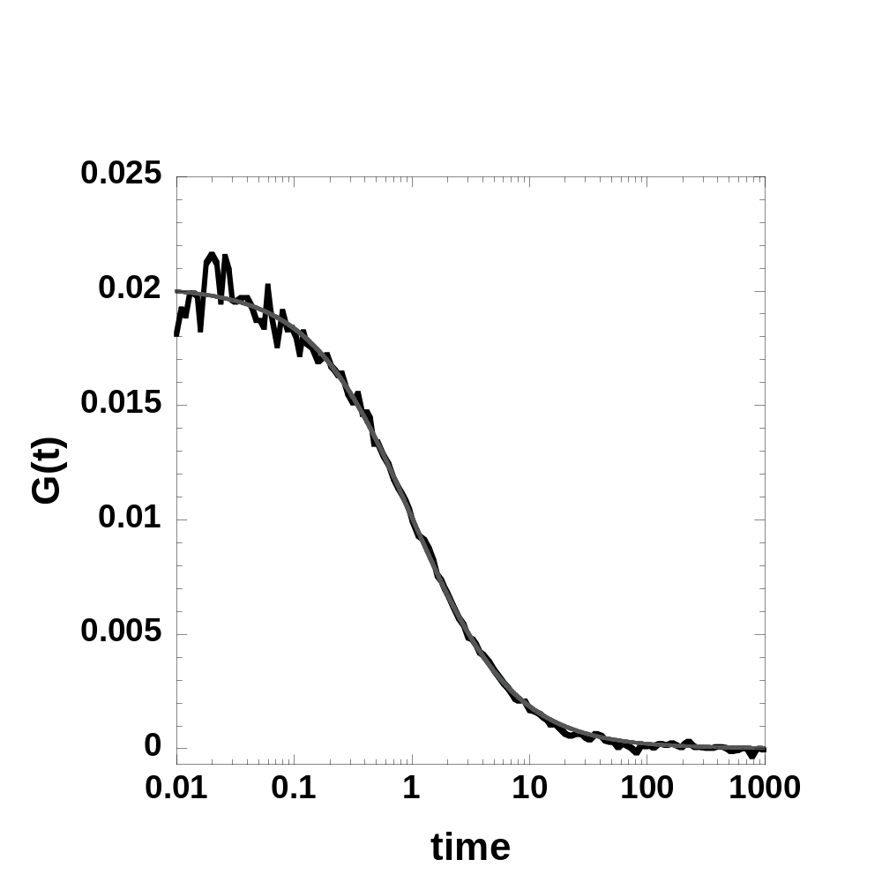
Figure S4

