Slide 1
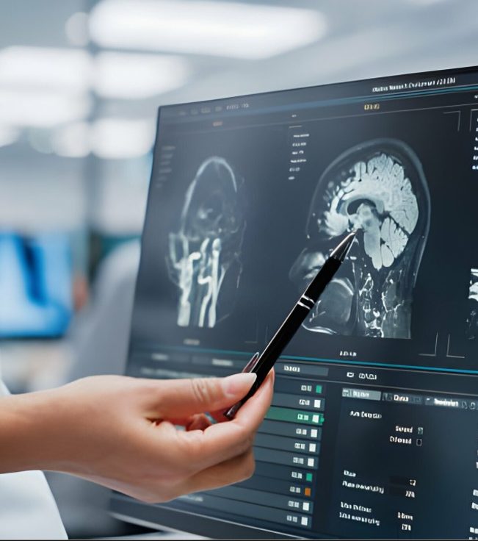
AI in MRI IMAGE SEGMENTAION
Emon Ahmed
ID:0182320012101356
Leading University,Sylhet

Slide 2
Agenda
01
02
03
04
What is Segmentation?
Importance
Fundamental Concepts
Mathematical Concepts
In Applications Significance Limitations
What is it? In simple terms
What does the Visualization Segmentation mean?
What is the mathematics behind it?

Slide 3
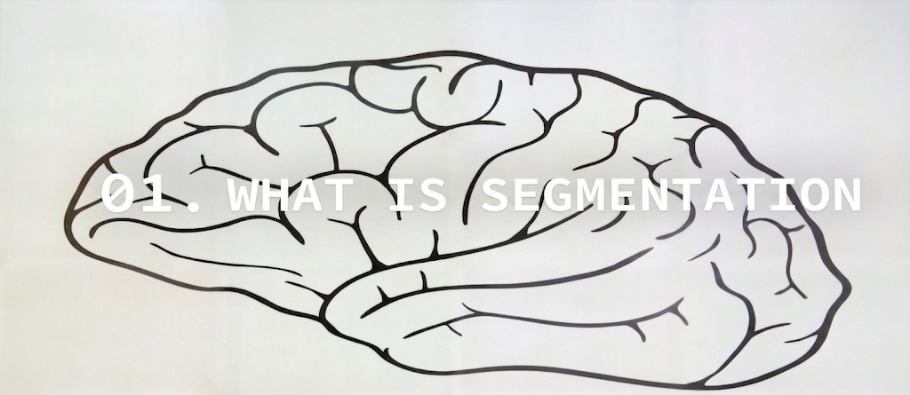

Slide 4
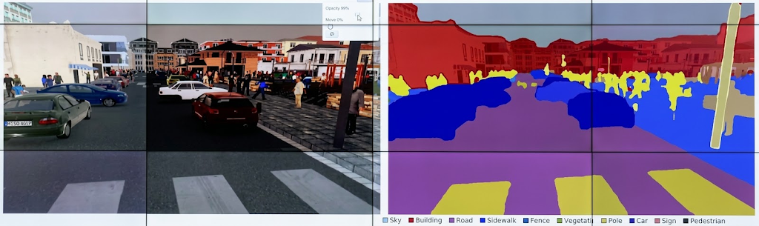
What is image segmentation

Slide 5
“Partitoning image in to meaningful segment”
In the medical image it is identifying the organ, tissue and other biological structure.

Slide 6
Agenda
01
02
03
04
What is Segmentation?
Importance
Fundamental Concepts
Mathematical Concepts
In Applications Significance Limitations
What is it? In simple terms
What does the Visualization Segmentation mean?
What is the mathematics behind it?

Slide 7
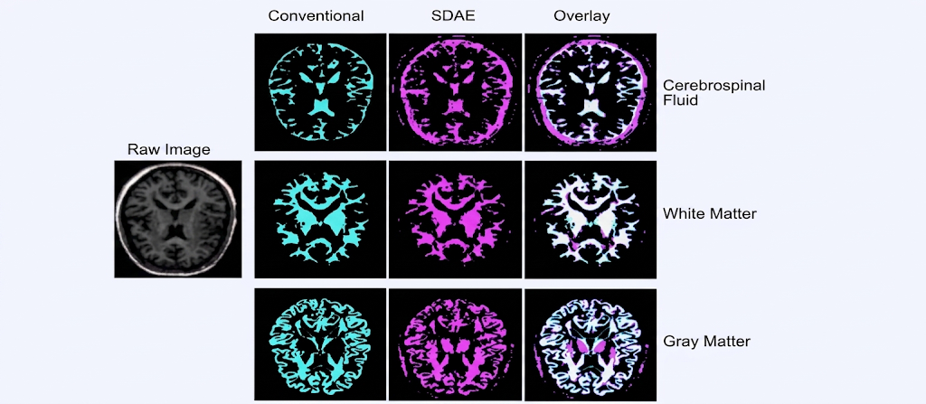
Applying the medical images..

Slide 8
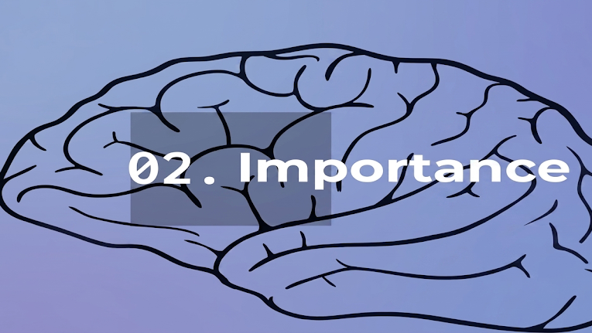

Slide 9
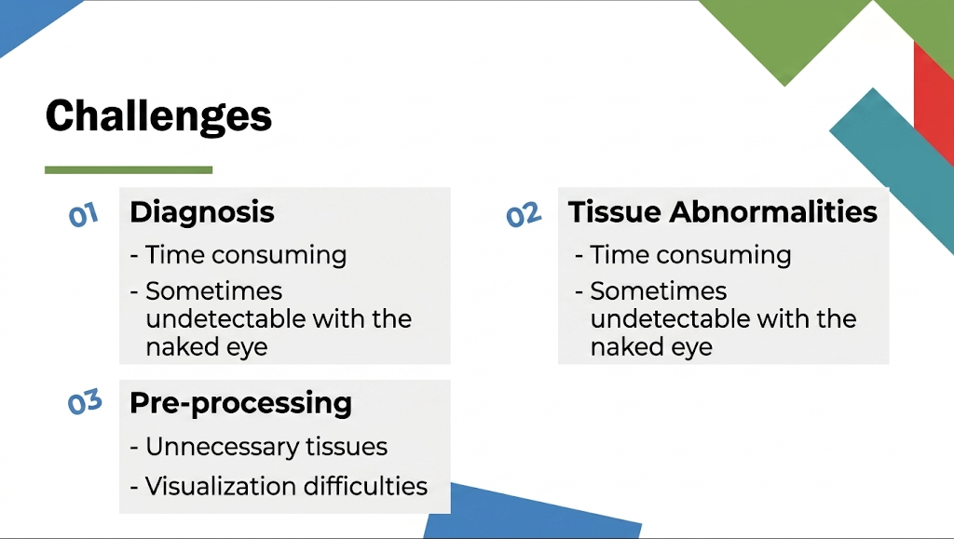

Slide 10
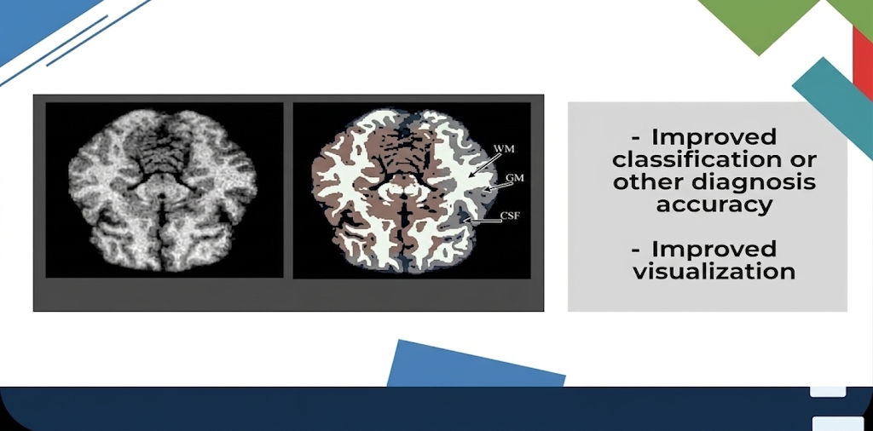

Slide 11
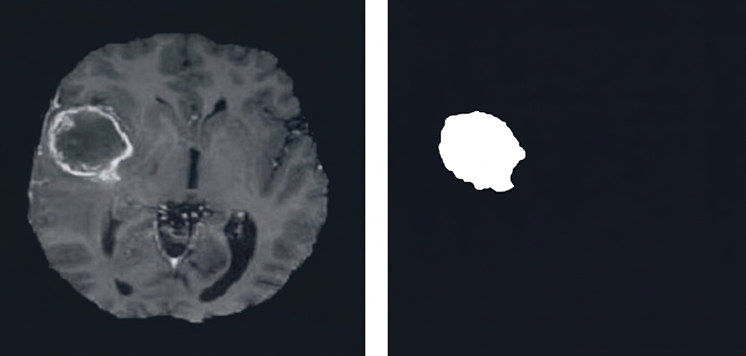
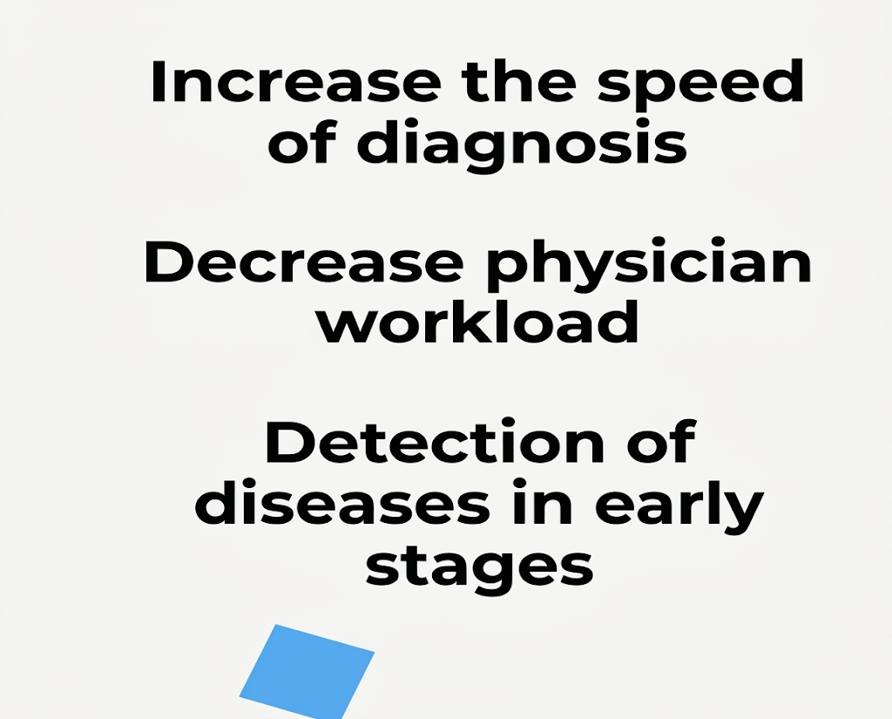
Diagnosis + Tissue Abnormalities

Slide 12
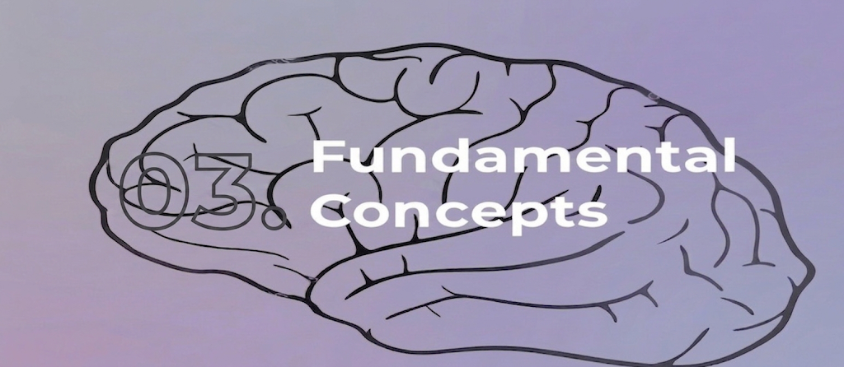

Slide 13
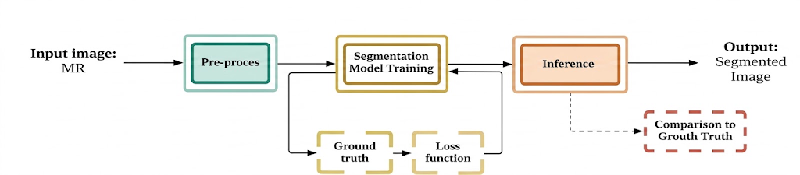
Work Flow

Slide 14
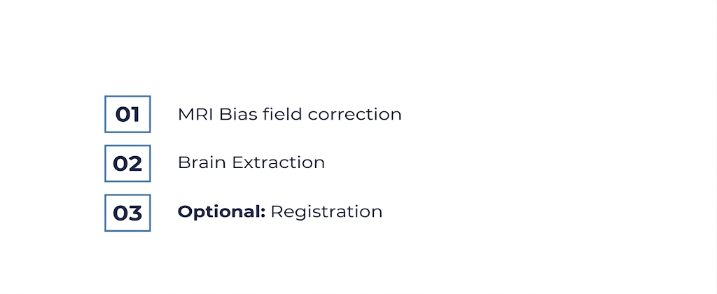
Preprocessing :for MRI

Slide 15
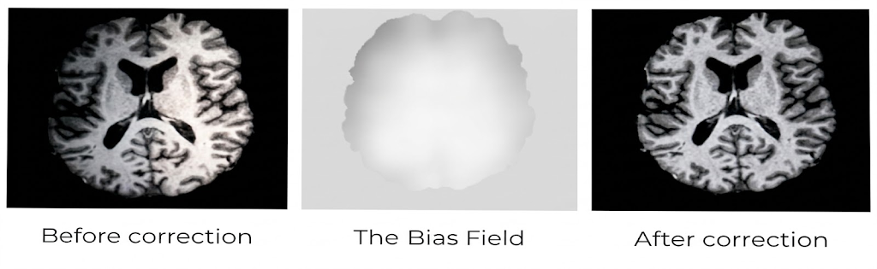
Bias Field Correction

Slide 16
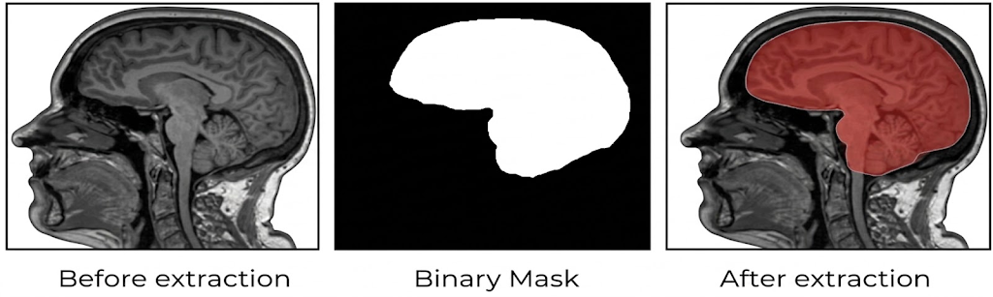
Brain extraction

Slide 17
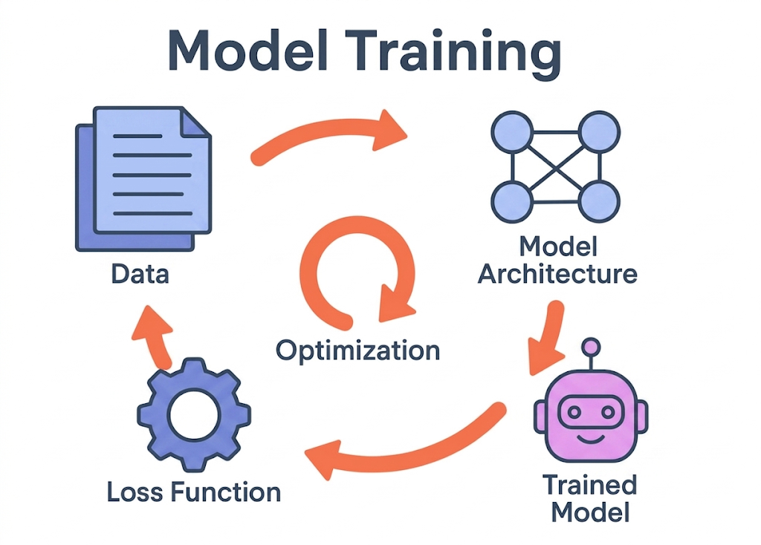
Learning to image segment

Slide 18
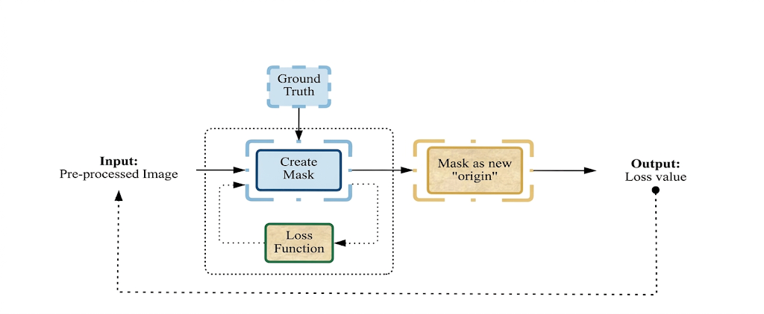
Model Training

Slide 19
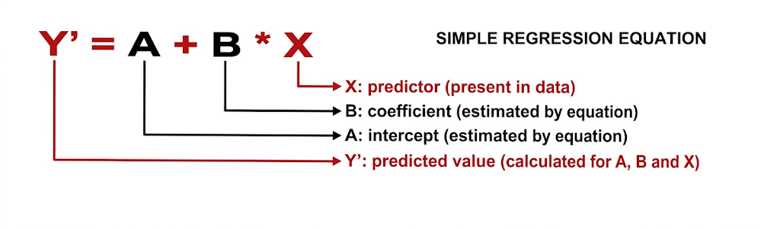
Trained Model

Slide 20
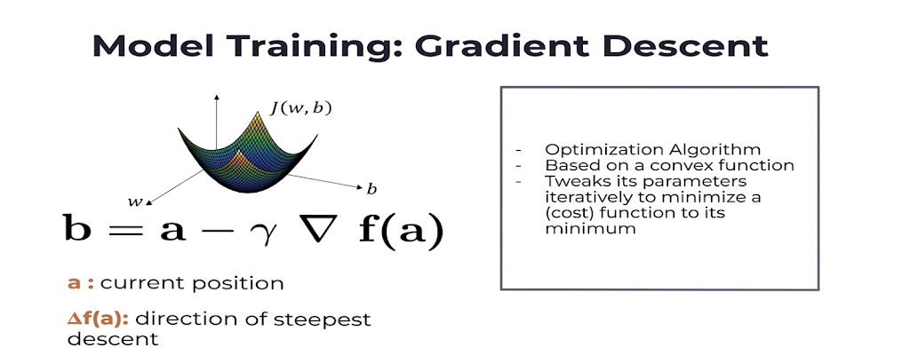
OPTIMIZATION

Slide 21
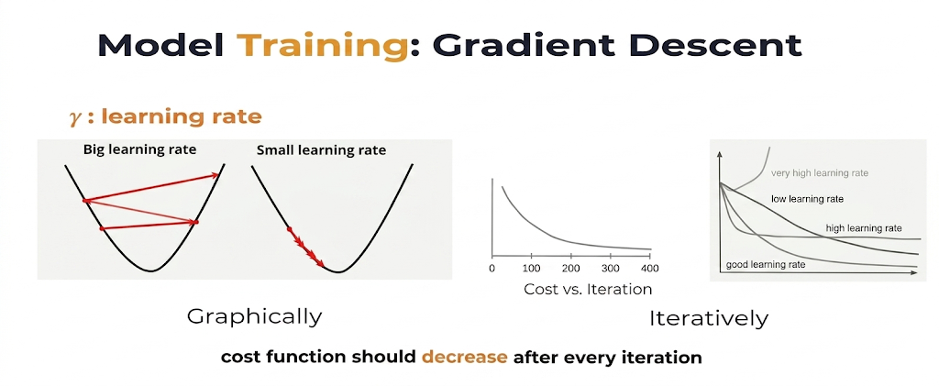
Learning Rate

Slide 22
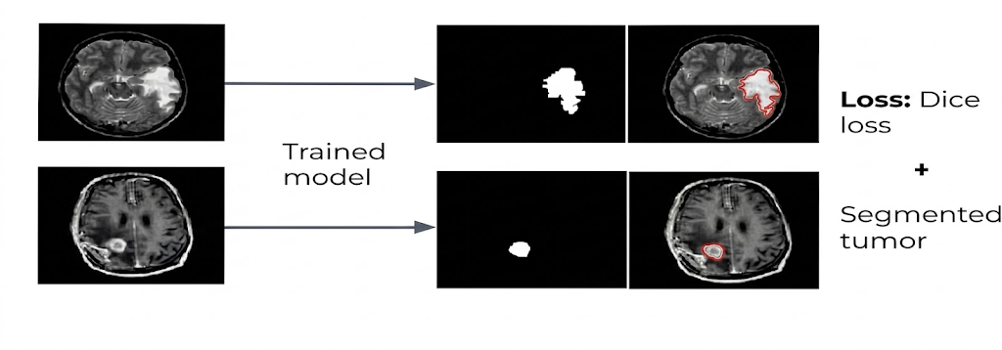
How trained model predict

Slide 23
Thank you

