Slide 1
Theory Of Computation
Pushdown Automata
Presented by
Md. Rashedul Islam
Id: 181-35-293
Sec:- PC-A
Department of Software Engineering
Daffodil International University
Presented to
Bikash kumar Paul
Lecturer,
Department of Software Engineering
Daffodil International University

Slide 2
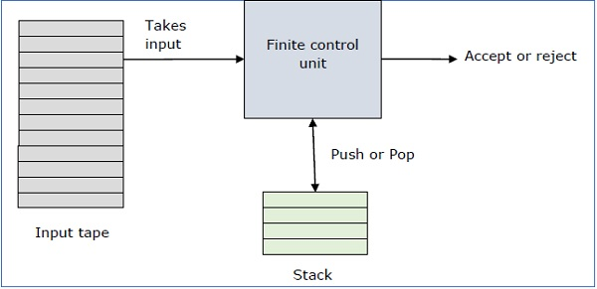
What is pushdown automata?
Finite state machine + Stack memory
More capable than finite state machine
It can recognize context-free language
Page||1

Slide 3
Formal Definition of Pushdown automata
It has 7 tuples
Q = A finite set of state
∑ = A finite set of Input symbol
Γ = A finite stack alphabet
δ = The transition function
q₀ = The start state
Z₀ = The start stack symbol
F = The set of final and accepting state
Page||2

Slide 4
Transition function has 3 argument
It take argument triple δ(q, a, x)
q = q is a state in Q
a = a is an input symbol from ∑ or a=ε
x = top element of stack
Page||3

Slide 5
L={0^{n}1^{n}| n>=0}
0, ε 0
1, 0 ε
q₁
ε, ε z₀
q₂
1, 0 ε
q₃
ε, z₀ ε
q1
q₄
L1= 0011
0
0
z₀
Stack
Page||4

Slide 6
L={0^{n}1^{n}| n>=0}
0, ε 0
1, 0 ε
q₁
ε, ε z₀
q₂
1, 0 ε
q₃
ε, z₀ ε
q1
q₄
L1= 0011
0
0
z₀
Stack
Page||5

Slide 7
L={WW^{R}| W=(A+B)⁺ }
A, ε A
A, A ε
B, ε B
B, B ε
q₁
ε, ε z₀
q₂
ε, ε ε
q₃
ε, z₀ ε
q1
q₄
L1=ABBA
B
A
z₀
Stack
Page||6

Slide 8
L={WW^{R}| W=(A+B)⁺ }
A, ε A
A, A ε
B, ε B
B, B ε
q₁
ε, ε z₀
q₂
ε, ε ε
q₃
ε, z₀ ε
q1
q₄
L1=ABBA
B
A
z₀
Stack
Page||7

Slide 9
Example: ε A ε B ε B ε A ε
ε
q₁ q₂
z₀
q₂
A
q₂
A
B
z₀
B
ε
A
q₂
z₀
q₃
A
ε
B
z₀
ε
B
B
B
q₃
A
B
q₂
B
z₀
A
z₀
A
A
ε
ε
q₃
z₀
A
A
B
B
ε
B
q₃
q₂
q₃
A
B
z₀
z₀
A
z₀
ε
A
ε
ε
A
Final state
q₄
B
B
A
z₀
Page||8

Slide 10
Thank You

