Slide 1
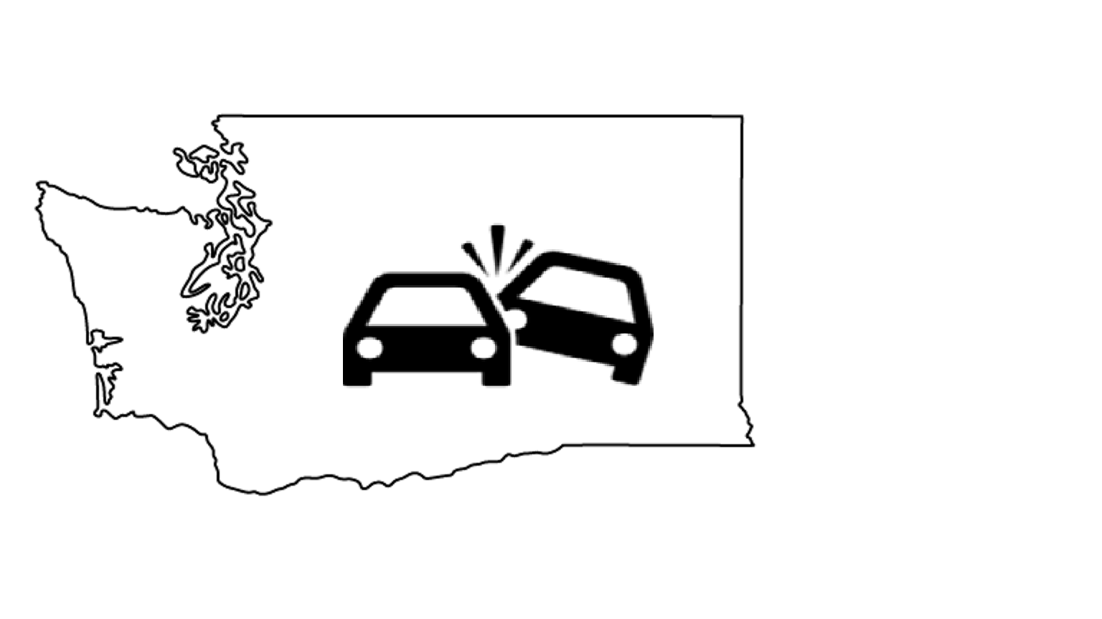
Agenda – from the instructions
Background. Describe the problem or area being addressed.
Data used. What data did you use? How was it obtained? What are its limitations?
Use cases. How users will interact with your system in a way that addresses the problem area.
Demo. Demonstrate your software.
Design. Describe the components and how they interact to accomplish the use cases.
Project Structure. Show the structure of your github repository.
Lessons learned and future work.

Slide 2
Washington Collisions
A deep dive on collisions in Seattle
By: Libby Montague, Fei Wang, Geoff Coyner, Salik Warsi
Notes:
LIbby

Slide 3
Background
Motivations
Visualize relationship between weather, Seattle neighborhoods and collisions.
Develop tools to investigate research questions with this data.
How do collisions vary by neighborhood?
Did a 2016 change in central Seattle speed limits impact the number of collisions or injuries related to collisions?
Audience
Seattle policy makers
Urban planners
Research questions
Neighborhood groups
Is there a relationship between weather and collisions?

Slide 4
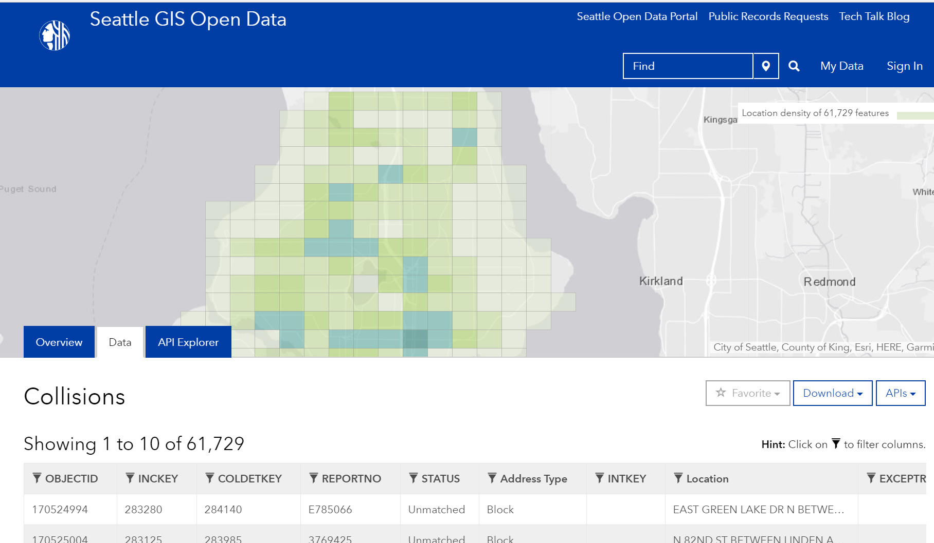
Seattle Collision Data
Downloaded from Seattle GIS open data portal
Provides 48 attributes for Seattle collisions since 2004
Majority of collisions include exact geo-coordinates.
Includes a weather attribute but it’s sparsely populated and qualitative.
Notes:
Data available at this portal here: https://data-seattlecitygis.opendata.arcgis.com/datasets/collisions?geometry=-122.579%2C47.656%2C-122.001%2C47.737

Slide 5
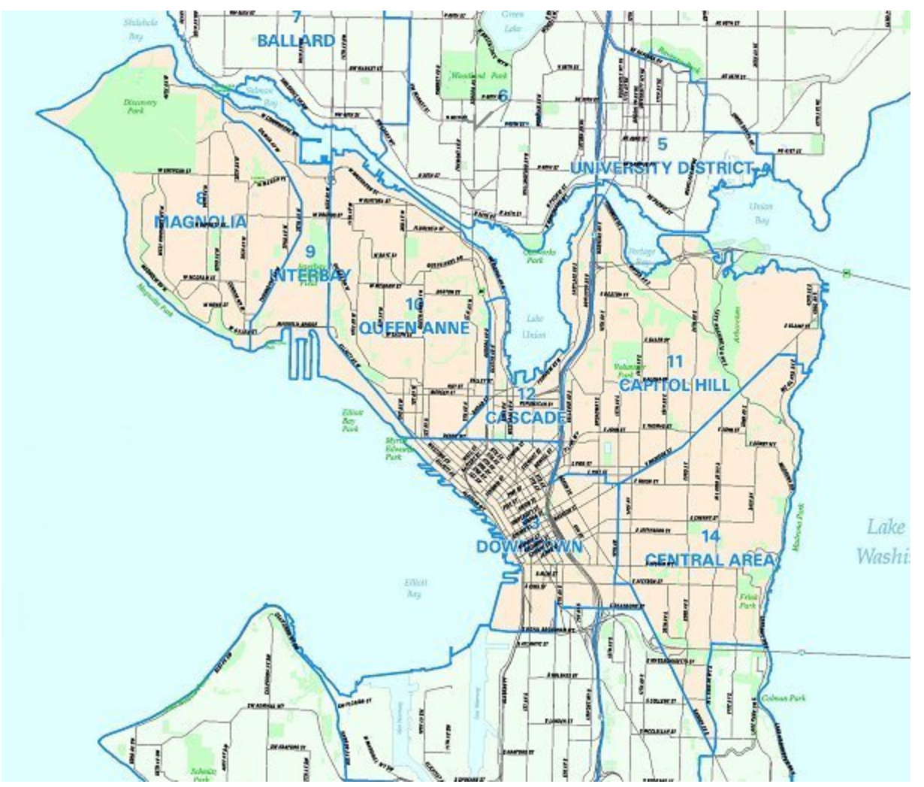
Seattle Neighborhoods Data
Shape File of the boundaries of neighborhoods used by the City Clerks Office
Used to understand collisions at a level useful to neighborhood groups
Helpful in analyzing policy questions that impacted some neighborhoods, like changing speed limits.
Notes:
Data available here: https://data.seattle.gov/dataset/Neighborhoods/2mbt-aqqx
Image from: http://clerk.seattle.gov/~public/nmaps/central.htm

Slide 6
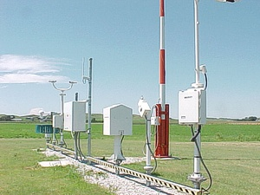
Weather Data
Downloaded from Iowa State University database of hourly airport AWOS/ASOS reports.
We combined data SeaTac, Renton, Boeing Field and other airports to come up with hourly weather information.
Notes:
Data available at this portal here: https://mesonet.agron.iastate.edu/request/download.phtml
Photo from: https://www.weather.gov/asos/

Slide 7
Use Cases
Clean and prepare Seattle area collision data for regression and other machine learning projects.
Create visualizations of Seattle area collision data.
Casual Impact analysis of Seattle area collision data and the change in speed limits.
Notes:
LIbby

Slide 8
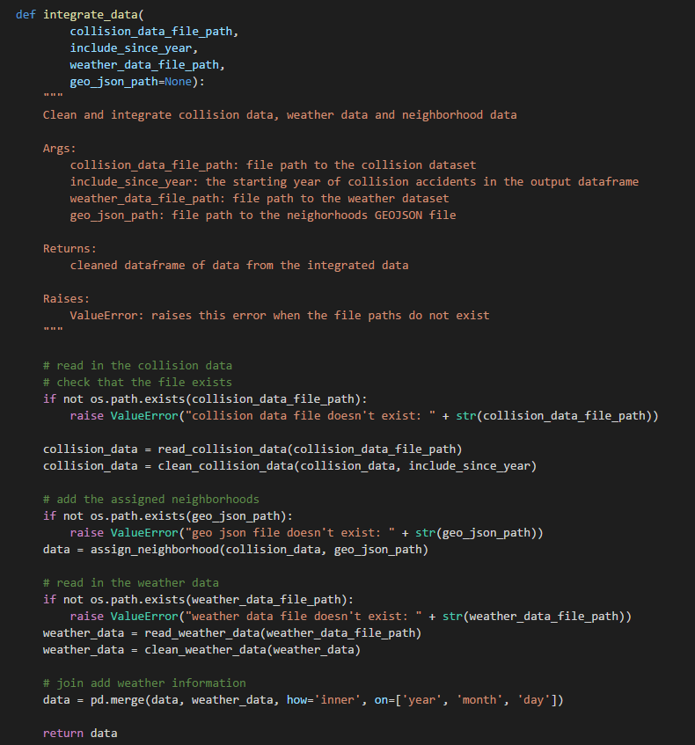
Demo: Prepare Data
Set of modules that creates a cleaned and integrated dataset.
Example jupyter notebook walks the user through downloading the necessary data.
Small subsets of data are on the repo and used for testing.

Slide 9
Demo: Visual – Over Time
Salik/Fei to add content

Slide 10
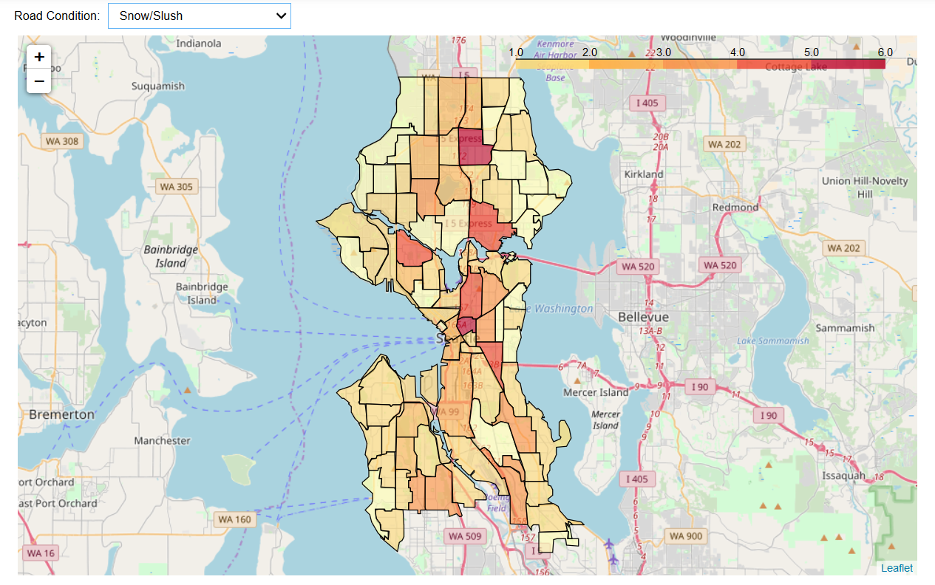
Demo: Visualize Neighborhoods
Assign a neighborhood to each collision based on shape file
Visualize data per neighborhood
Use interactive drop down to analyse data.

Slide 11
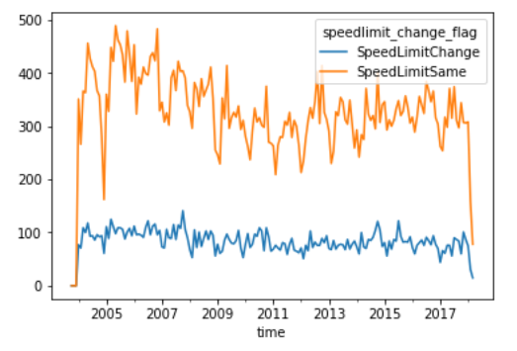
Demo: Casual Impact
Monthly volume of collision injuries (neighborhoods with speed limit change vs. others)
Notebook groups neighborhoods into those where speed limits changed in 2016 and those where they did not.
Used Causal Impact package and Bayesian structural time series models to compare collisions and injuries “control” and “treatment”
Was there an effect?
Notes:
Demo notebook: https://github.com/gdc3000/wa_collisions/blob/master/examples/Example%20-%20CausalImpact%20SpeedLimits.ipynb

Slide 12
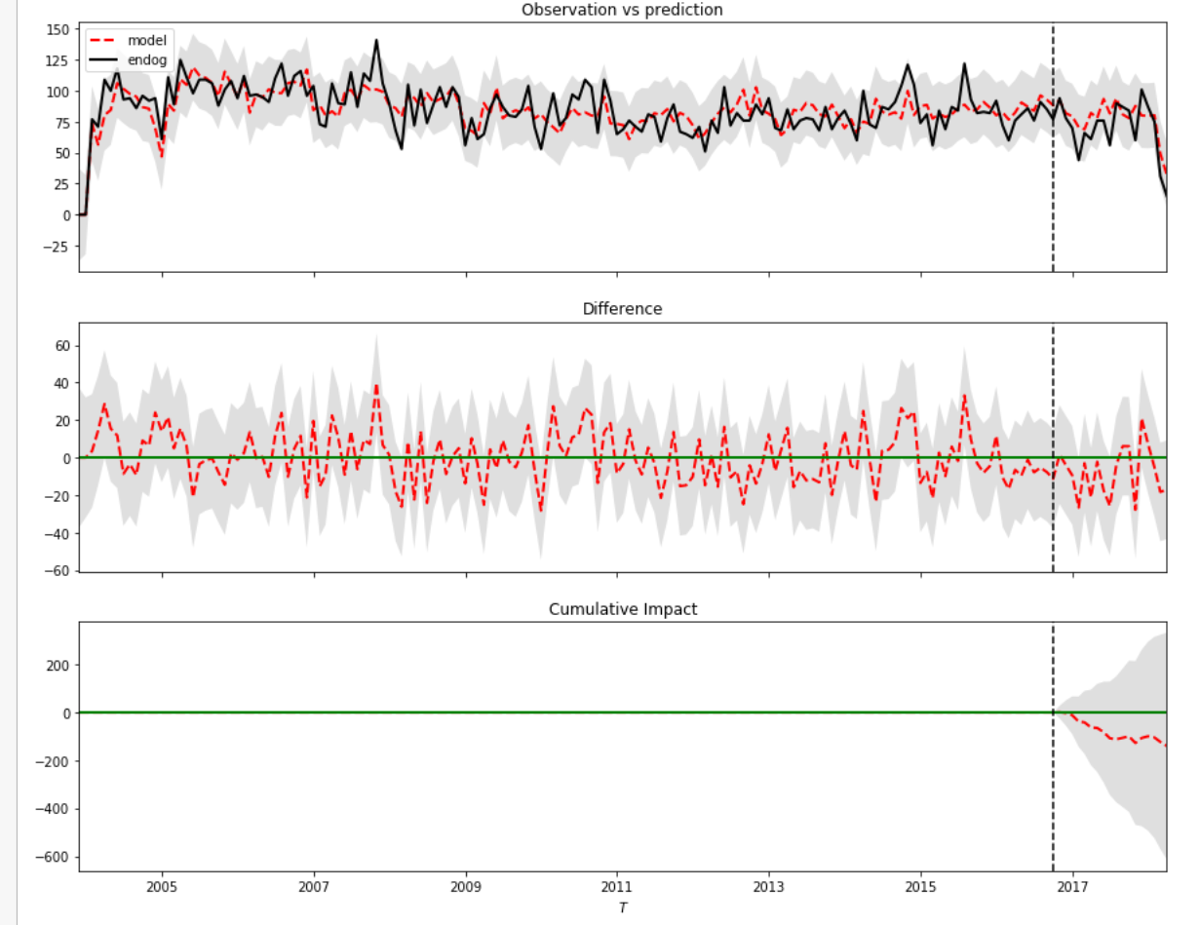
Demo: Casual Impact
Results of Causal Impact Study: volume of collision injuries in neighborhoods with speed limit change
Notebook groups neighborhoods into those where speed limits changed in 2016 and those where they did not.
Used Causal Impact package and Bayesian structural time series models to compare collisions and injuries “control” and “treatment”
We found fewer injuries after the speed limit change than forecast by the model but not a statistically significant change.
Notes:
Monthly # of collision related injuries across Seatle neighborhoods

Slide 13
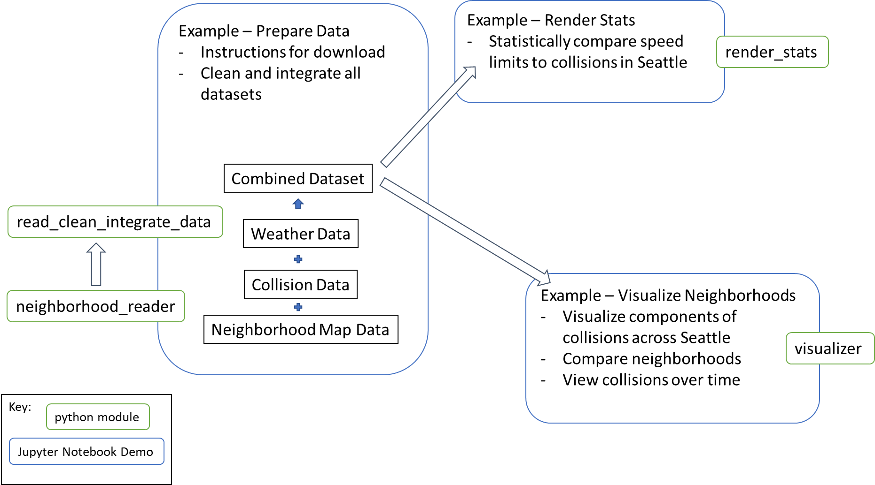
Design
Notes:
Monthly # of collision related injuries across Seatle neighborhoods

Slide 14
Project Structure
wa_collisions/
|- README.md
|- wa_collisions/
|- __init__.py
|- neighborhood_reader.py
|- read_clean_integrate_data.py
|- render_stats.py
|- visualizer.py
|- data/
|- …
|- tests/
|- __init__.py
|- test_neighborhood_reader.py
|- test_read_clean_integrate.py
|- test_render_stats.py
|- test_visualizer.py
|- examples/
|- Example - CausalImpact SpeedLimits.ipynb
|- Example - Prepare Data.ipynb
|- Example - Visualize Data.ipynb
|- doc/
|- Feature_Design_V1.md
|- Feature_Design_V2.md
|- …
|- .coverage
|- .coveragerc
|- .gitignore
|- .pylintrc
|- .travis.yml
|- LICENSE
|- requirements.txt
|- setup.py
Modeled after the sheblona template.
One example jupyter notebook for each use case.
Four modules that are each used in at least one use case.
Test scripts for each of the modules.

Slide 15
Lessons Learned
Salik, Fei, Libby to add content
Code mostly in notebook
Interactions of code - remembering to run the unittests
Try the code in multiple systems - discovered issue with follium (only works with firefox)

Slide 16
Future Work
Test for using other cities’ data
Salik, Fei, Libby to add content

