Slide 1
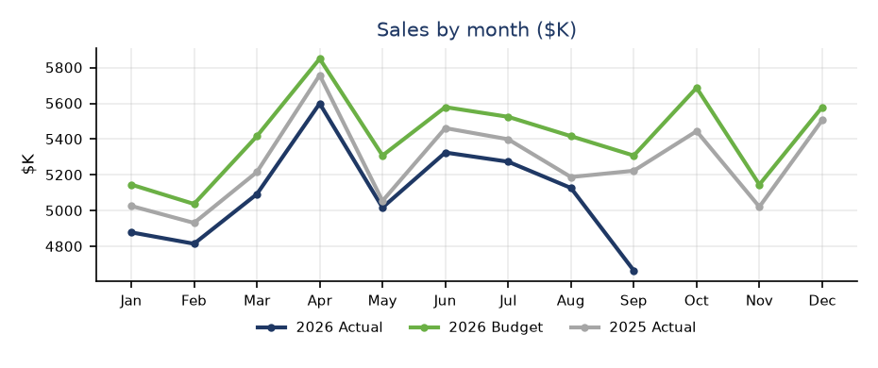
Sales & Margin
Action | Sales | Margin
#1 | [Headline] [Two or three sentences with numbers] | [Headline] [Two or three sentences with numbers]
#2 | [Headline] [Two or three sentences with numbers] | [Headline] [Two or three sentences with numbers]
#3 | [Headline] [Two or three sentences with numbers] | [Headline] [Two or three sentences with numbers]
September YTD
$K except as noted | Actual 2026 | Budget 2026 | Var vs Bud | % | Actual 2025 | Var vs PY | %
Revenue | 45,795 | 48,588 | (2,792) | -5.7% | 47,260 | (1,464) | -3.1%
Gross margin | 12,936 | 14,576 | (1,640) | -11.3% | 14,454 | (1,517) | -10.5%
GM% | 28.2% | 30.0% | -1.8% |  | 30.6% | -2.3%
Selling Costs | 3,227 | 3,304 | (77) | -2.3% | 3,233 | (6) | -0.2%
D&W Costs | 3,777 | 3,887 | (110) | -2.8% | 3,809 | (32) | -0.8%
G&A Costs | 2,945 | 3,013 | (68) | -2.3% | 2,956 | (11) | -0.4%
Operating costs | 9,950 | 10,204 | (254) | -2.5% | 9,998 | (48) | -0.5%
PBIT | 2,987 | 4,372 | (1,385) | -31.7% | 4,456 | (1,469) | -33.0%
PBIT % | 6.5% | 9.0% | -2.5% |  | 9.4% | -2.9%
SPD $'000 | 240 | 254 | -15 |  | 247 | -8
Trading Days | 191 | 191 |  |  | 191
Training data only - Zava Safety and all businesses and numbers are fictitious.

Slide 2
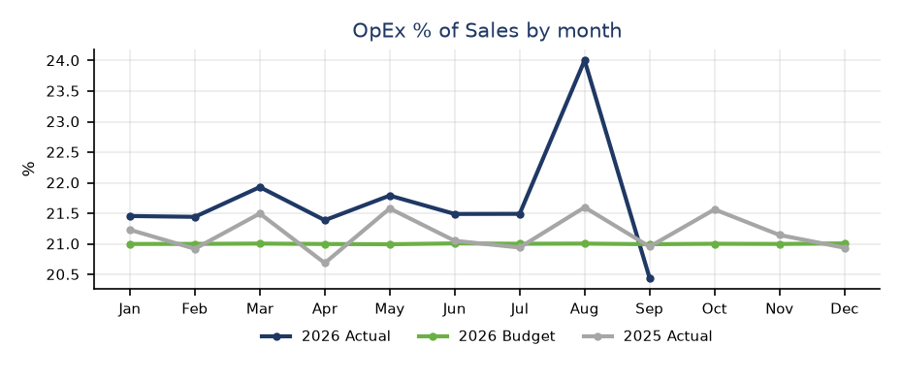
Costs
 | Delivery & Warehouse | Selling & G&A
Issue #1 | [Headline] [Two or three sentences with numbers] | [Headline] [Two or three sentences with numbers]
Action #1 | [Headline] [Two or three sentences with numbers] | [Headline] [Two or three sentences with numbers]
Resolution #1 | [Headline] [Two or three sentences with numbers] | [Headline] [Two or three sentences with numbers]
$K, September YTD | Actual 2026 | Budget 2026 | Var vs Bud | Actual 2025 | Var vs PY
Payroll Exp - Selling | 2,033 | 2,081 | (49) | 2,038 | (5)
Promotional Exp - Selling | 253 | 264 | (11) | 258 | (5)
Selling Costs | 3,227 | 3,304 | (77) | 3,233 | (6)
Payroll Exp - D&W | 1,597 | 1,632 | (36) | 1,598 | (2)
Freight Exp - D&W | 908 | 933 | (25) | 913 | (5)
Occupancy Costs - D&W | 536 | 544 | (9) | 533 | 2
Delivery & Warehouse Costs | 3,777 | 3,887 | (110) | 3,809 | (32)
Payroll Exp - G&A | 1,316 | 1,356 | (39) | 1,324 | (8)
General Office Exp - G&A | 386 | 392 | (6) | 388 | (2)
G&A Costs | 2,945 | 3,013 | (68) | 2,956 | (11)
Operating costs | 9,950 | 10,204 | (254) | 9,998 | (48)
OpEx % of Sales | 21.7% | 21.0% | +0.7% | 21.2% | +0.6%
Training data only - Zava Safety and all businesses and numbers are fictitious.

Slide 3
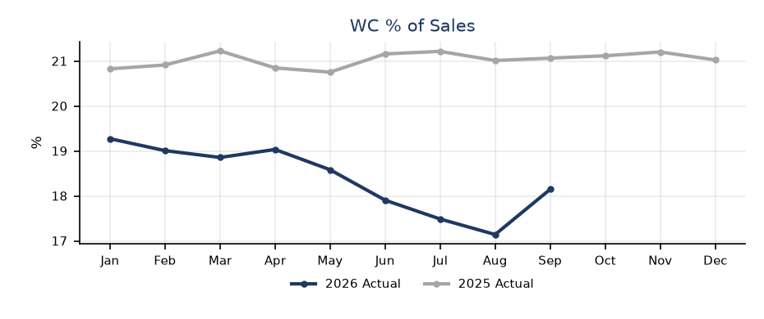
Working Capital
$m, September negative variances are adverse | Actual 2026 | Budget 2026 | Var vs Bud | Actual 2025 | Var vs PY
Net Inventories | 8.1 | 9.4 | 1.3 | 10.3 | 2.1
Total Receivables | 7.1 | 8.0 | 0.9 | 8.1 | 0.9
Total Payables | (5.1) | (5.4) | 0.2 | (5.1) | 0.0
Net working capital | 10.2 | 12.1 | 2.0 | 13.2 | 3.0
AR Days | 45.5 | 45.0 | -0.5 | 46.0 | 0.5
AP Days | 43.0 | 42.0 | 1.0 | 41.0 | 2.0
Inventory Days | 70.2 | 76.3 | 6.1 | 84.4 | 14.2
WC % of Sales | 18.1% | 19.0% | +0.9% | 21.1% | +2.9%
 | AP Days | AR Days | Inventory
Action #1 | [Headline] [Two or three sentences with numbers] | [Headline] [Two or three sentences with numbers] | [Headline] [Two or three sentences with numbers]
Action #2 | [Headline] [Two or three sentences with numbers] | [Headline] [Two or three sentences with numbers] | [Headline] [Two or three sentences with numbers]
Action #3 | [Headline] [Two or three sentences with numbers] | [Headline] [Two or three sentences with numbers] | [Headline] [Two or three sentences with numbers]
Training data only - Zava Safety and all businesses and numbers are fictitious.

Slide 4
Product Development and Marketing Initiatives
 | Product Development | Marketing
#1 | [Initiative] [Status, numbers and next step] | [Initiative] [Status, numbers and next step]
#2 | [Initiative] [Status, numbers and next step] | [Initiative] [Status, numbers and next step]
#3 | [Initiative] [Status, numbers and next step] | [Initiative] [Status, numbers and next step]
#4 | [Initiative] [Status, numbers and next step] | [Initiative] [Status, numbers and next step]
#5 | [Initiative] [Status, numbers and next step] | [Initiative] [Status, numbers and next step]
Training data only - Zava Safety and all businesses and numbers are fictitious.

Slide 5
Digital and Technology Initiatives
 | Digital | Technology
#1 | [Initiative] [Status, numbers and next step] | [Initiative] [Status, numbers and next step]
#2 | [Initiative] [Status, numbers and next step] | [Initiative] [Status, numbers and next step]
#3 | [Initiative] [Status, numbers and next step] | [Initiative] [Status, numbers and next step]
#4 | [Initiative] [Status, numbers and next step] | [Initiative] [Status, numbers and next step]
#5 | [Initiative] [Status, numbers and next step] | [Initiative] [Status, numbers and next step]
#6 | [Initiative] [Status, numbers and next step] | [Initiative] [Status, numbers and next step]
Training data only - Zava Safety and all businesses and numbers are fictitious.

Slide 6
Operations and Inventory Initiatives
 | Operations | Inventory
#1 | [Initiative] [Status, numbers and next step] | [Initiative] [Status, numbers and next step]
#2 | [Initiative] [Status, numbers and next step] | [Initiative] [Status, numbers and next step]
#3 | [Initiative] [Status, numbers and next step] | [Initiative] [Status, numbers and next step]
#4 | [Initiative] [Status, numbers and next step] | [Initiative] [Status, numbers and next step]
Training data only - Zava Safety and all businesses and numbers are fictitious.

Slide 7
Tariff and Diversification of Supply Chain
 | Tariff | Supply Chain
#1 | [Initiative] [Status, numbers and next step] | [Initiative] [Status, numbers and next step]
#2 | [Initiative] [Status, numbers and next step] | [Initiative] [Status, numbers and next step]
#3 | [Initiative] [Status, numbers and next step] | [Initiative] [Status, numbers and next step]
#4 | [Initiative] [Status, numbers and next step] | [Initiative] [Status, numbers and next step]
Training data only - Zava Safety and all businesses and numbers are fictitious.

Slide 8
People and Safety
Recent / Upcoming Leavers | Recent / Upcoming Starters | Internal Moves | Vacancies Expected to Fill in H2-2026 | New Roles Planned for H2-2026
[Business to complete]
Training data only - Zava Safety and all businesses and numbers are fictitious.

