Slide 1

Version control, and what it can do for your project
Ellyn Montgomery
&
Amar Nayegandhi

Slide 2
Organization
Overview
Introduction to version control with Subversion (Svn)
How WHSC uses Svn
How FISC uses Svn
Conclusions and questions

Slide 3
Key aspects of version control
Version control systems allow multiple users simultaneous access to work with files in the repository
The users manage what is under version control
The repository exists on a central site, and access is available via the internet
Reverting to any previous version is possible

Slide 4
Software repository established
Version control implemented with Subversion (svn)
  For PC we use tortoiseSvn: http://subversion.tigris.org
  For linux we use Smartsvn or other client: http://www.syntevo.com/smartsvn/index.html
The repository is hosted at:
http://svn1.hosted-projects.com/cmgsoft
  Includes a Trac site to handle discussions, documentation, bug reports and fixes
  External site, backed up nightly, costs depend on size of storage (< $100/month)

Slide 5
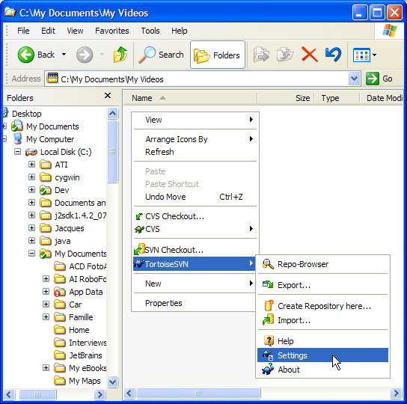
Tortoise svn interface on a PC

Slide 6
Important Terms
Import = send code to the server to establish a new project repository
Checkout = put a new project from the repository on the local machine
Update = get the most recent version of a project from the server
Commit = send your changes to the project repository

Slide 7
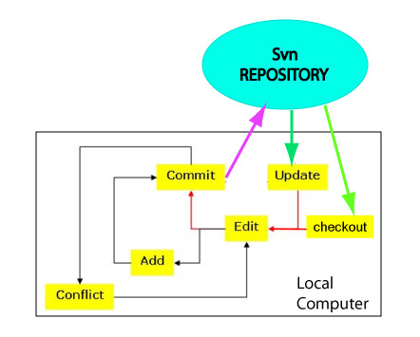
Here’s how it works

Slide 8
To checkout m_cmg
Right click and select SVN checkout
Enter the source repository address
  https://svn1.hostedprojects.com/cmgsoft/m_cmg
Enter the local destination directory root
Keep HEAD revision selected
Click OK
Go for coffee (the first checkout will take awhile) **note adequate disk space required

Slide 9
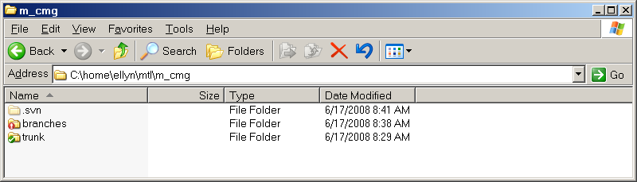
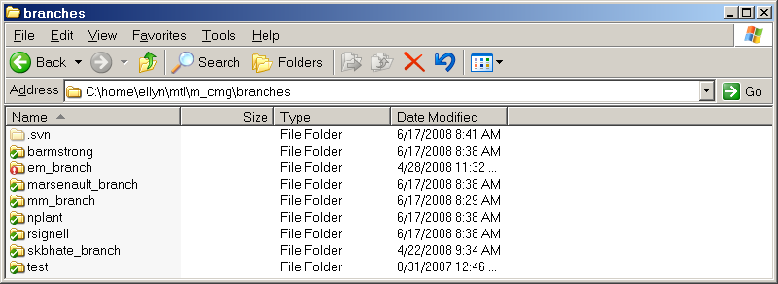
Status indicators

Slide 10
Trac component
Allows web interface to management
Provides space for documentation
Has bug report and resolution tracking
GUI display of differences between program versions
See example at https://www.hosted-projects.com/trac/cmgsoft/m_cmg

Slide 11
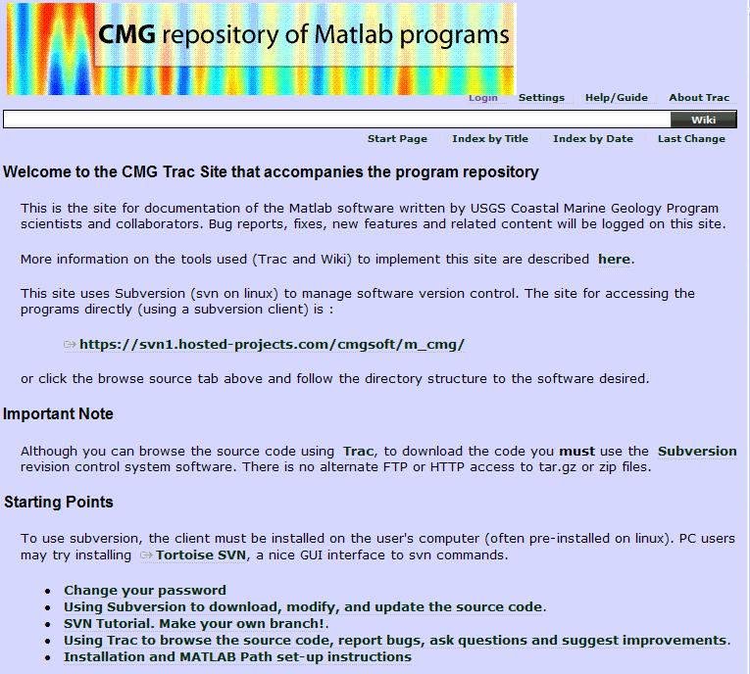
The result

Slide 12
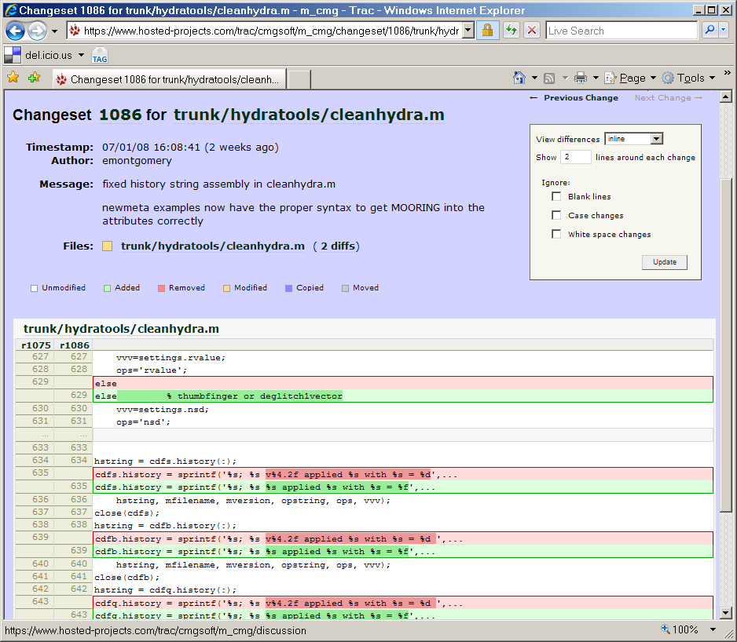

Slide 13
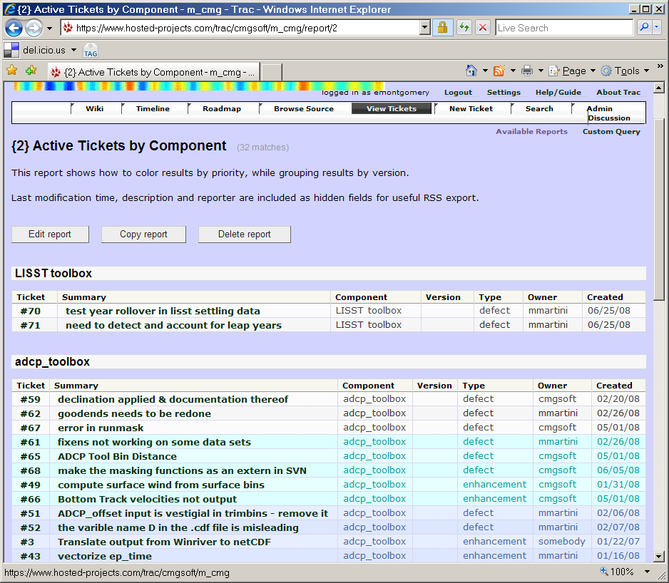

Slide 14
How we use Svn at WHSC
Matlab software including data processing toolboxes
Instrument documentation
Forms for deployment & recovery
Model development all under svn
  https://www.myroms.org/index.php

Slide 15
Conclusions
Having our Matlab® programs under version control has been a tremendous advantage
  Collaborative work is much easier
  A centralized web distribution site allows easy access
  A modification summary is mandatory with commit
  Editing conflicts are easy to find and resolve
Svn does not provide much benefit in working with large MSword documents
We’ll help get you started if you want to implement version control for your group

