Slide 1
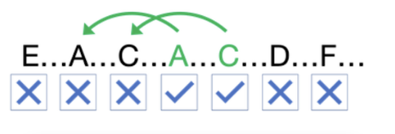
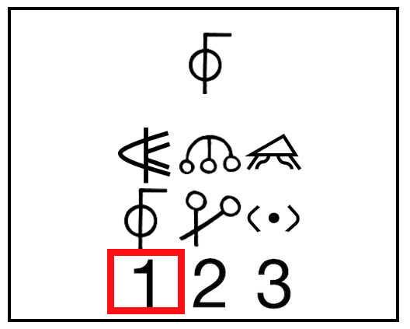
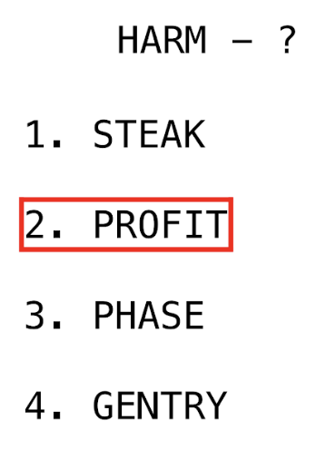
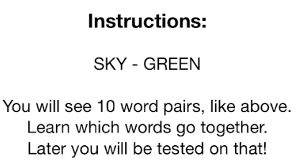
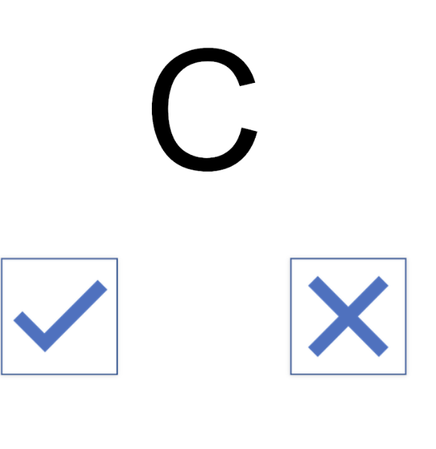
Figure 7. Overview of Mobile Cognitive Tasks
Working Memory (WM)
Processing Speed (PS)
asljk
Episodic Memory (EM)
N-Back Task
Recall whether the presented letter is the same as 2 letters before
Visual Paired Associates
Digit-Symbol Matching
Match as many symbols as possible in 30 seconds
Recall matching word pair

