Slide 1
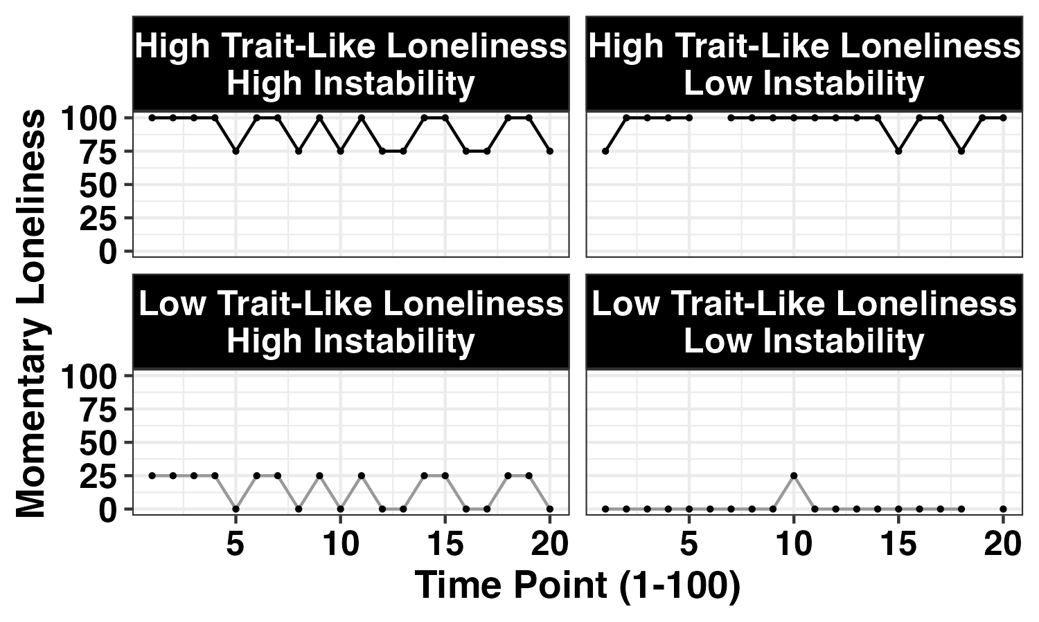



Loneliness and Cognitive Function via EMA
Time
1
2
3
…
100
Loneliness
Cognition

Slide 2
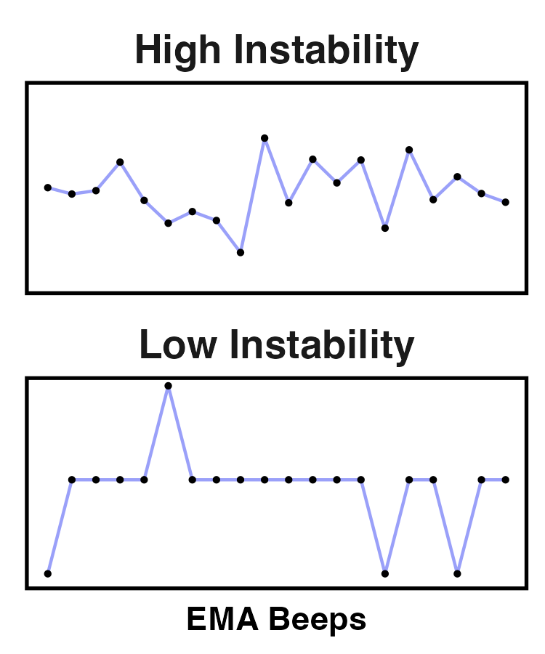
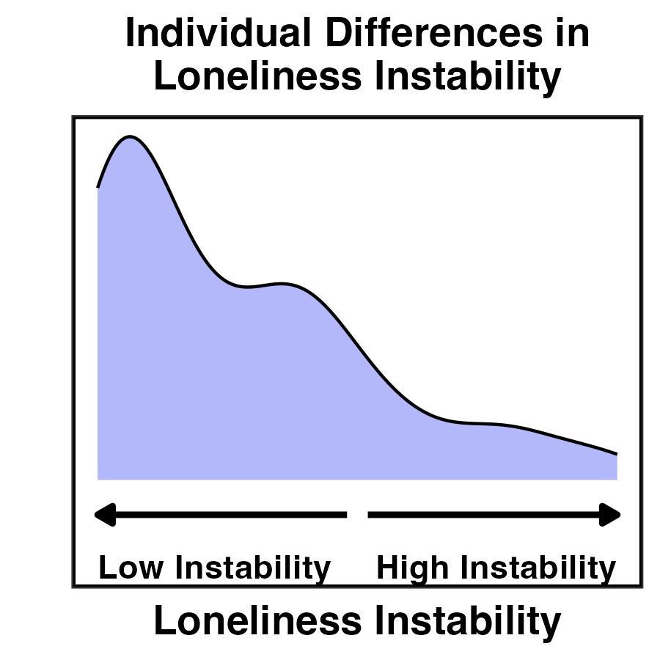
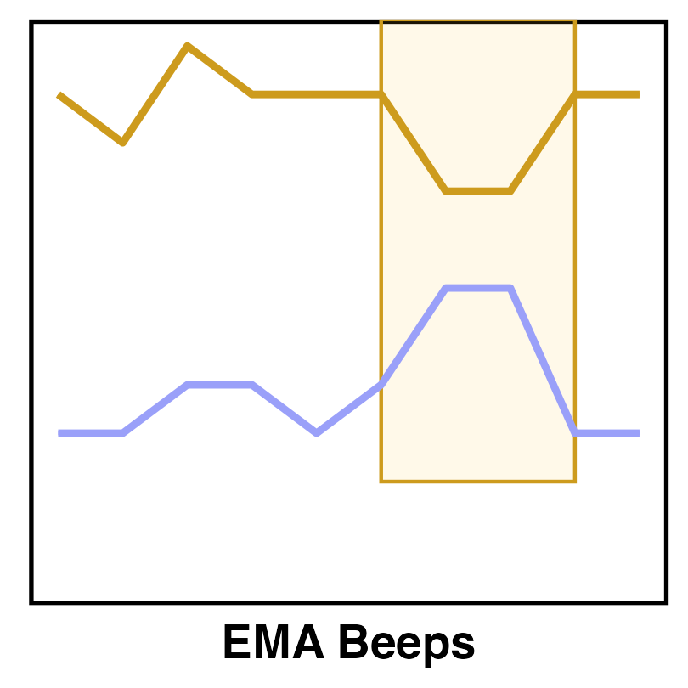
How are loneliness and cognitive function associated in daily life?
RQ 1: Are individual differences in loneliness instability associated with average cognitive function across the full EMA period between-person?
Do individuals with more unstable momentary loneliness show worse or more variable cognitive function?
Is the loneliness instability-cognition relationship moderated by:
1B) Trait-like Loneliness (UCLA Loneliness Scale)
1C) Aggregate Social Interaction Recency across EMAs
1D) Aggregate Social Interaction Quality across EMAs
RQ 2: Is momentary loneliness associated with momentary cognitive function within-person?
;.
In moments when loneliness is higher, is cognitive function worse or more variable?
Loneliness and Cognitive Function via EMA
Is the momentary loneliness-cognition relationship moderated by:
2B) Trait-like Loneliness (UCLA Loneliness Scale)
2C) Momentary Social Interaction Recency
2D) Momentary Social Interaction Quality
Study Overview
EMA, 5 x / day for:
20 days
(Min t = 50; Max t = 100)
Loneliness and Cognitive Function via EMA
N = 157
t = 13,844
Beep
1
2
3
…
100

Slide 4
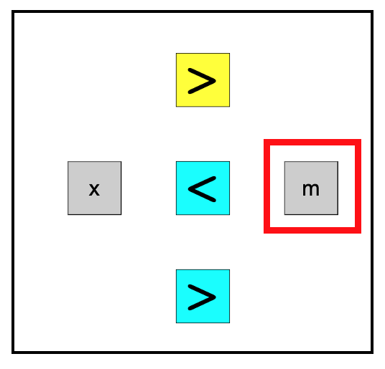

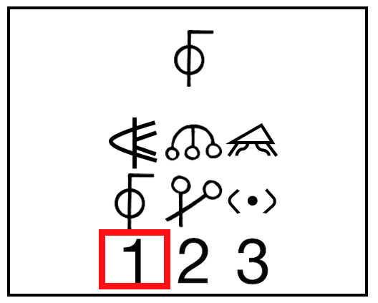
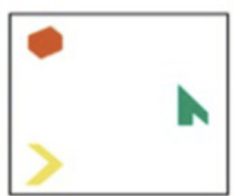
Figure 3. Overview of Mobile Cognitive Tasks
Executive Function (EF)
Short-term Memory (M)
Processing Speed (PS)
Choice Flanker Task
Indicate direction of the odd colored arrow
Memory Binding
Same vs. different combination of colors and shapes
Digit-Symbol Matching
Match as many symbols as possible in 30 seconds
Encoding
Same or different?
Hawks et al., 2022
Cerino et al., 2021
Hawks et al., 2022

