Slide 1




Aim 1: Individuals | Aim 2: Dynamics | Aim 3: Integration | Future Directions
Bottom-Up
(Situational)
Life Satisfaction
Diener, 1984
Health
Income
Housing
Job
Relat-ionship
Domain Satisfaction
*Cheung, *Beck, Thapa, & Jackson (under review)
Notes:
So to talk about how personality unfolds over time and why it's important to consider these individual-level, idiographic structures of personality and not just look at average structures, we're going to shift gears a bit to talk about life satisfaction and satisfaction in domains of life.
Life satisfaction offers a really unique opportunity to work through why disaggragating individual's patterns from average patterns across a population because there is rich theoretical thinking about the patterns and their direction.

Slide 2
Aim 1: Individuals | Aim 2: Dynamics | Aim 3: Integration | Future Directions
Top-Down
(Dispositional)
Life Satisfaction
Diener, 1984
Health
Income
Housing
Job
Relat-ionship
Domain Satisfaction
*Cheung, *Beck, Thapa, & Jackson (under review)

Slide 3
Aim 1: Individuals | Aim 2: Dynamics | Aim 3: Integration | Future Directions
Bidirectional
Life Satisfaction
Kuykendall, Tay, & Ng, 2015
Health
Income
Housing
Job
Relat-ionship
Domain Satisfaction
*Cheung, *Beck, Thapa, & Jackson (under review)
Notes:
f

Slide 4
Population-Level Theoretical Perspectives on Happiness: Which theory is correct for everyone?
Bottom-Up
(Situational)
Top-Down
(Dispositional)
Bi-Directional
Life Satisfaction
Life Satisfaction
Life Satisfaction
Domain Satisfaction
Health
Income
Housing
Job
Relationship
Health
Income
Housing
Job
Relationship
Health
Income
Housing
Job
Relationship
Non-Directional
Life Satisfaction
Health
Income
Housing
Job
Relationship

Slide 5
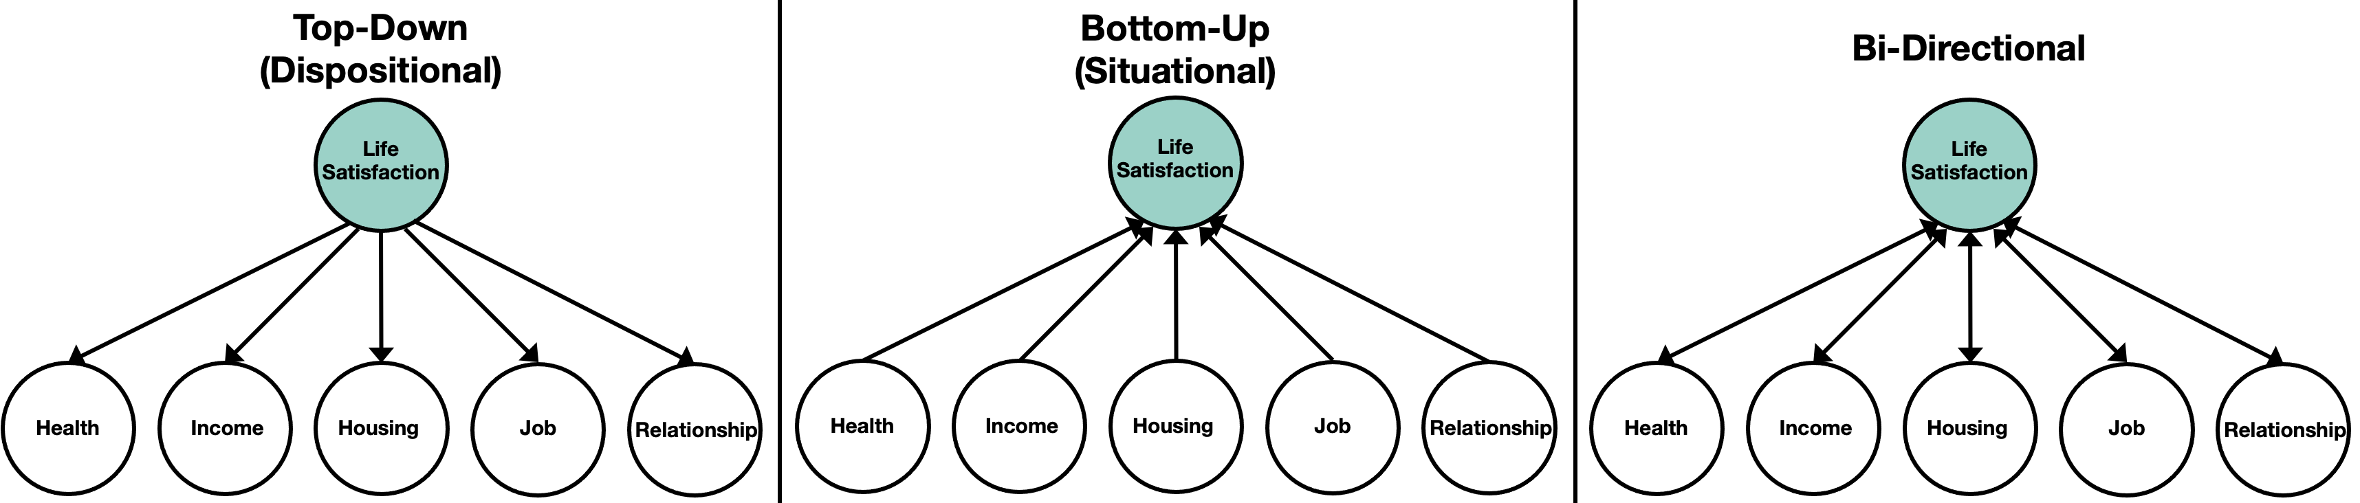

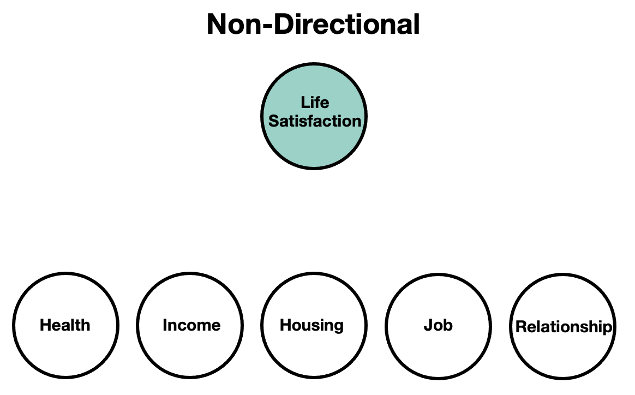
Personalised Perspectives on Happiness:
For whom is each theory correct?
Strong top-down patterns
Weak bottom-up patterns
Strong bottom-up patterns
Weak top-down patterns

