Slide 1


Individual Differences in Daily Rhythms of Cognitive Function
Emorie D. Beck, Ph.D
University of California, Davis
Zoë W. Hawks, Ph.D
@EmorieBeck

Slide 2
Lifespan Cognitive (Level) Decline
Time (Years)

Slide 3
Lifespan Cognitive Variability
Time (Hours)
Time (Years)

Slide 4
Lifespan Cognitive Variability
Time (Hours)

Slide 5
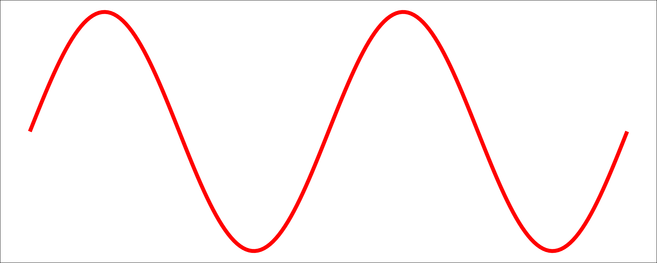
Lifespan Cognitive Variability
Time (Hours)

Slide 6
Lifespan Cognitive Variability
Research Question 1:
Are there detectable daily rhythms of cognitive function in everyday life?
Time (Hours)

Slide 7
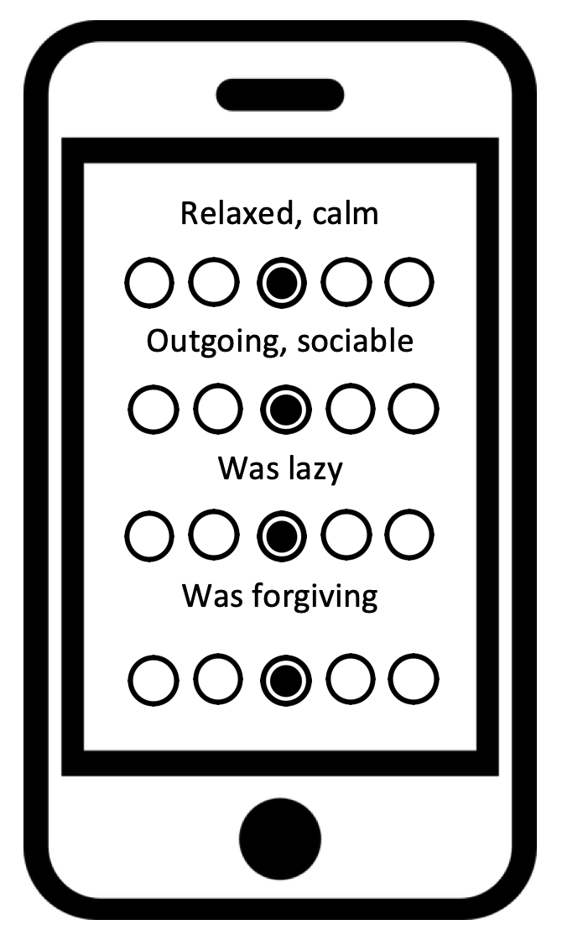

Participants
Social Cognitive EMA Study
N = 117
(8,021 surveys)
M = 67.53, Med = 72
SD = 28
Range = 12-100
75.7% female
M_{age} = 55.31
SD_{age} = 8.18
%_{College} = 71.79%
5x / day,
20 days

Slide 8
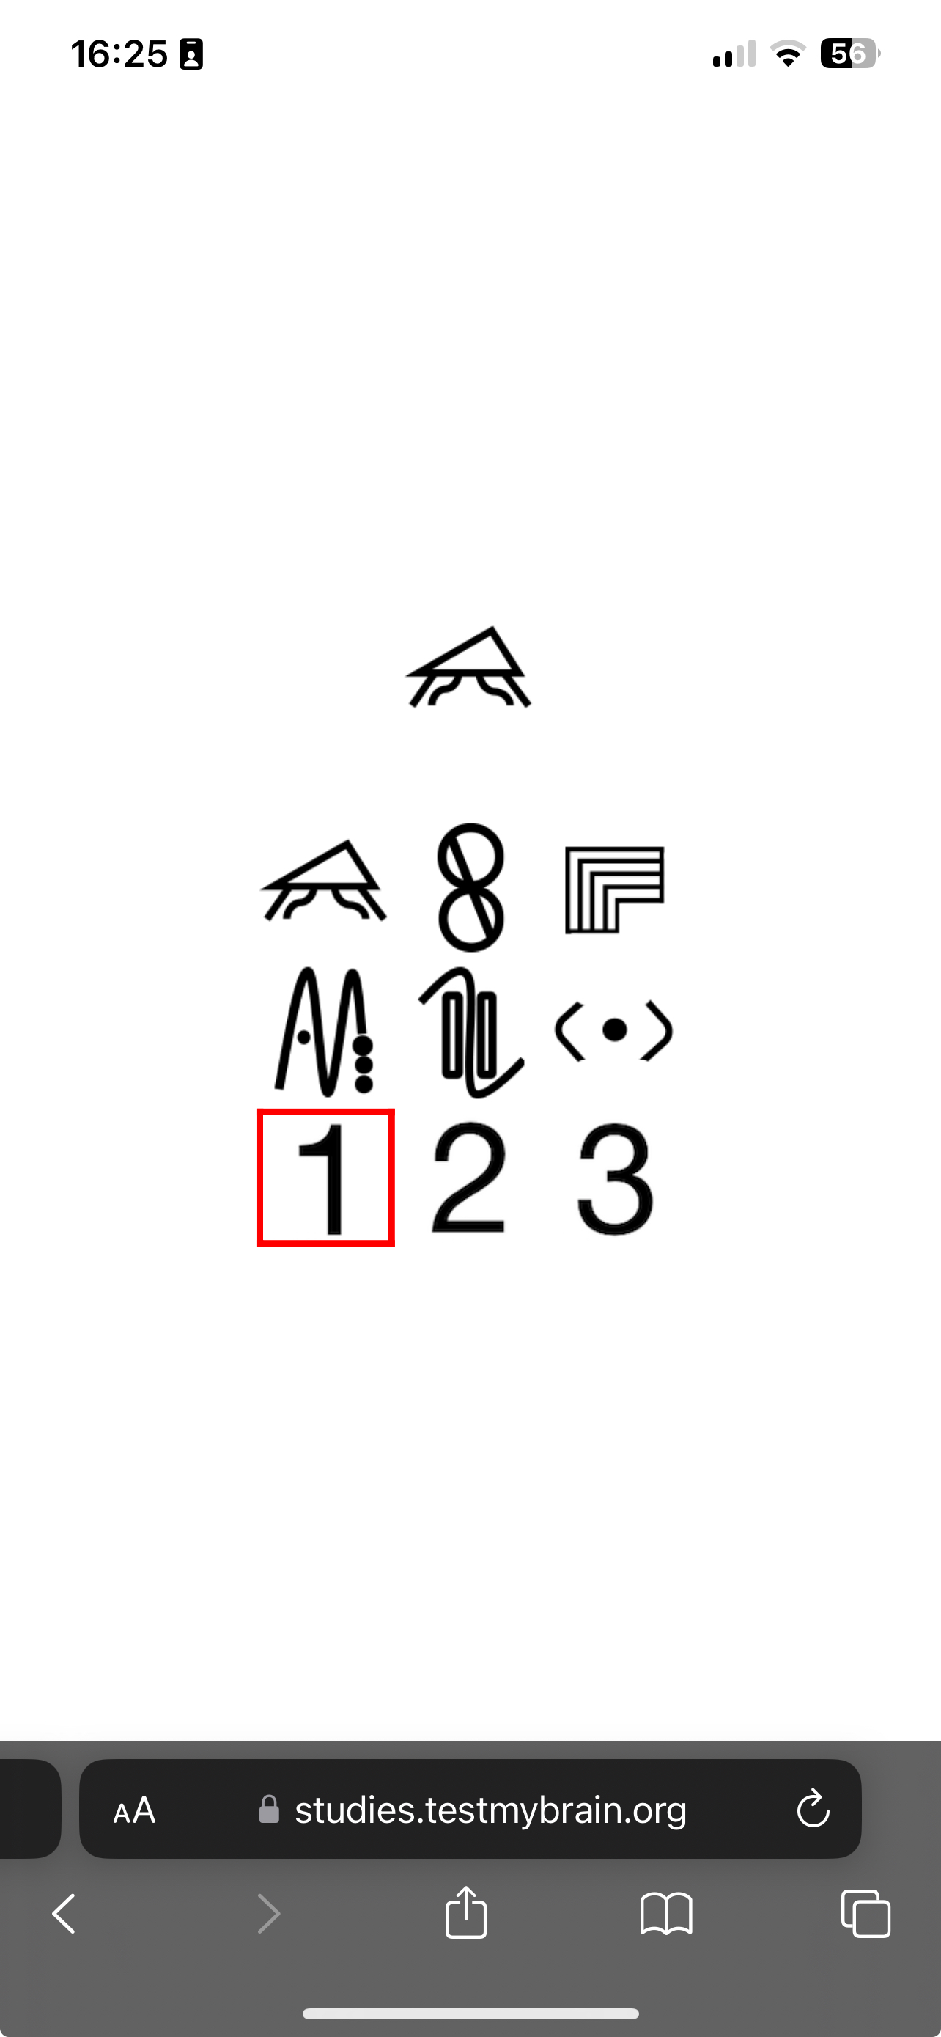
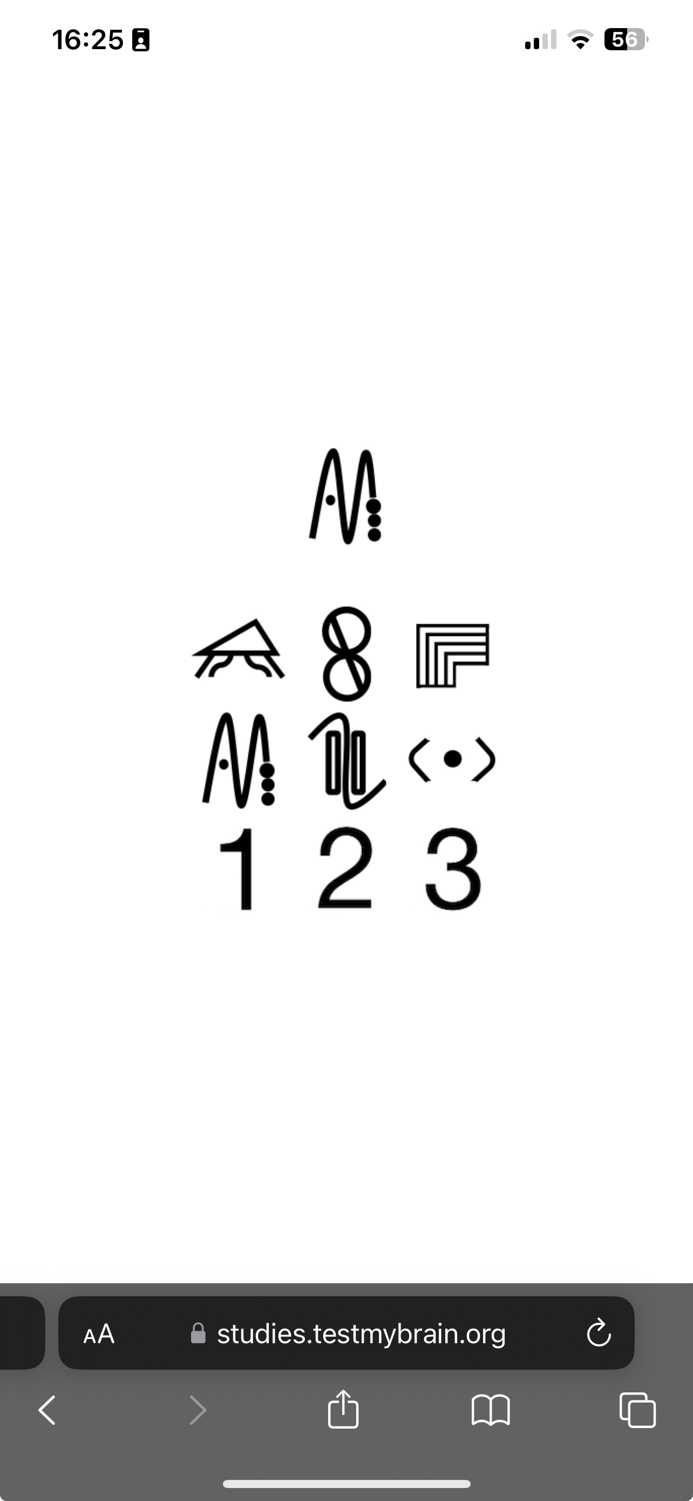
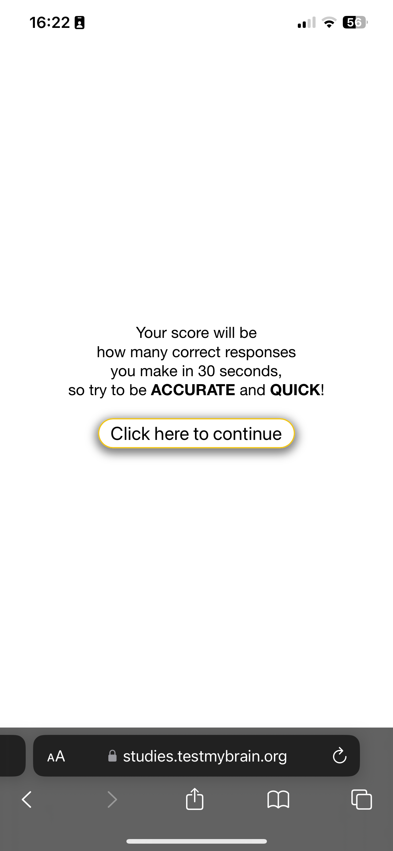
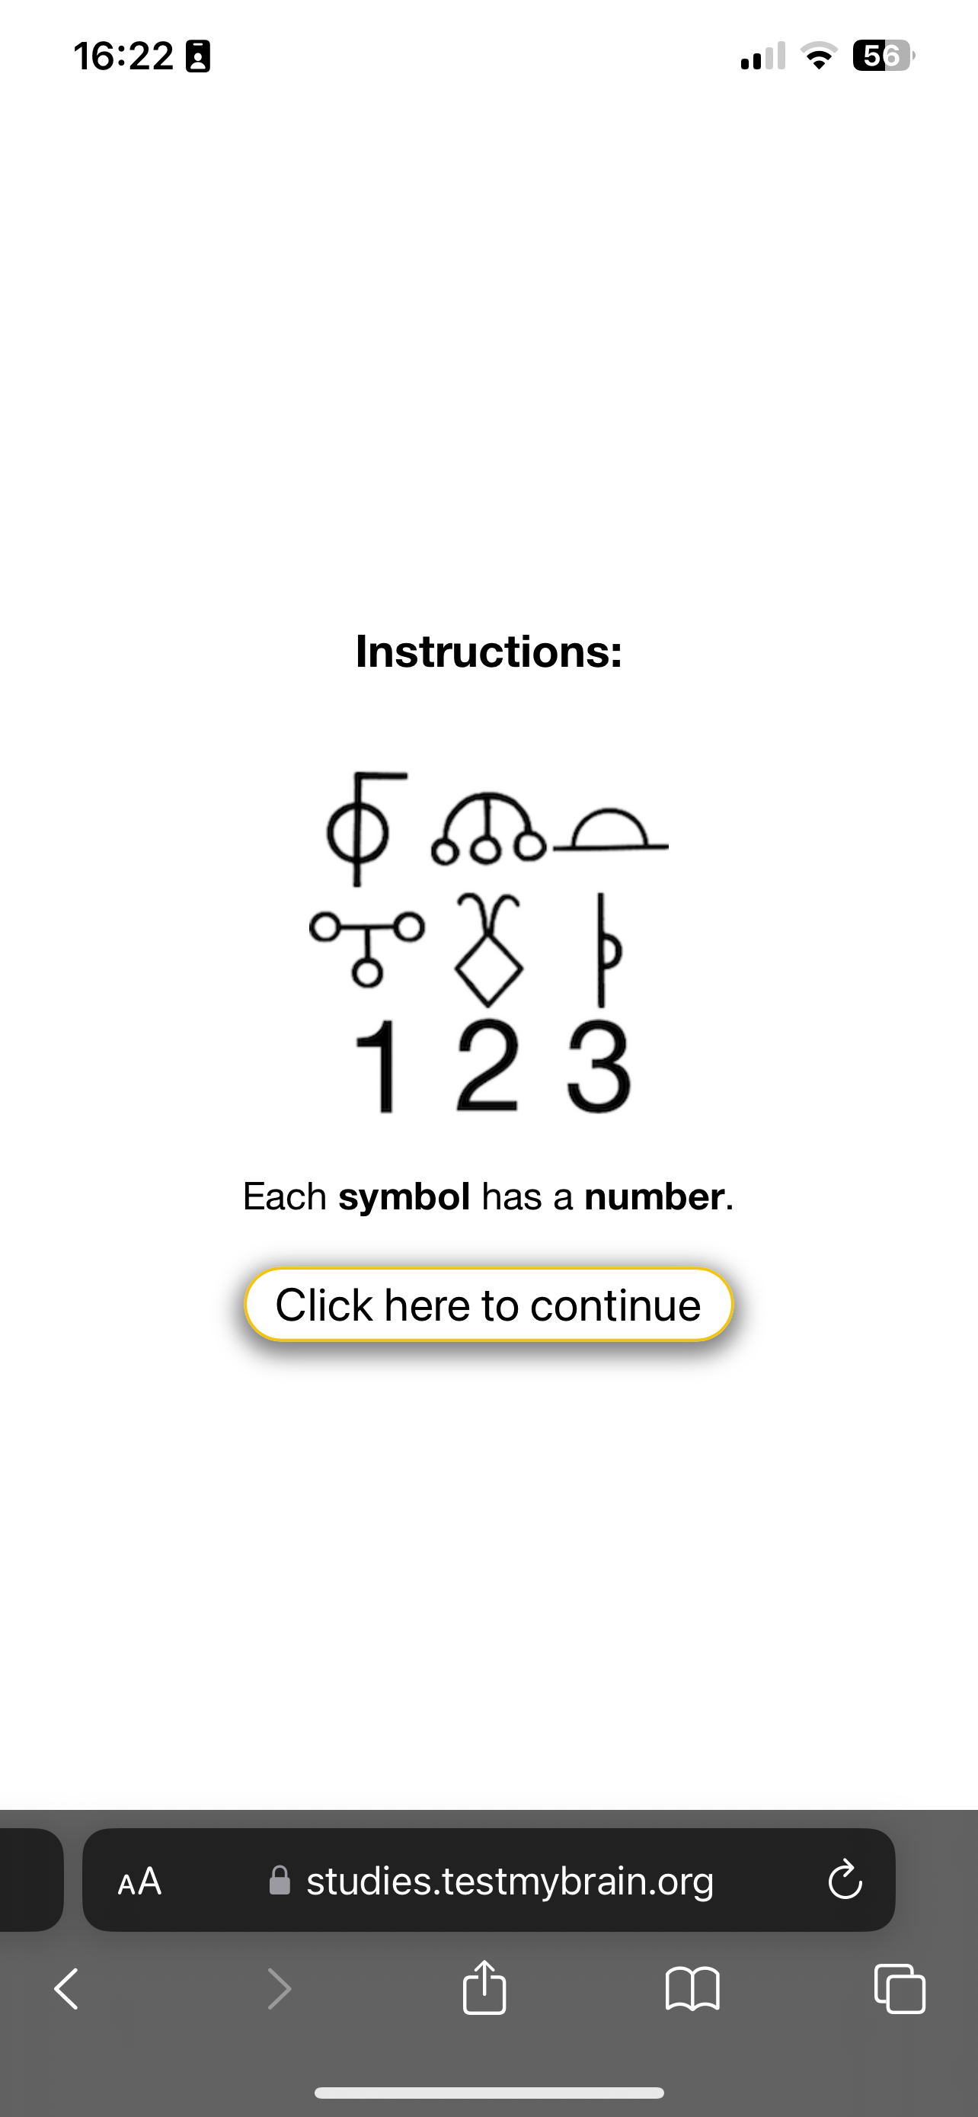
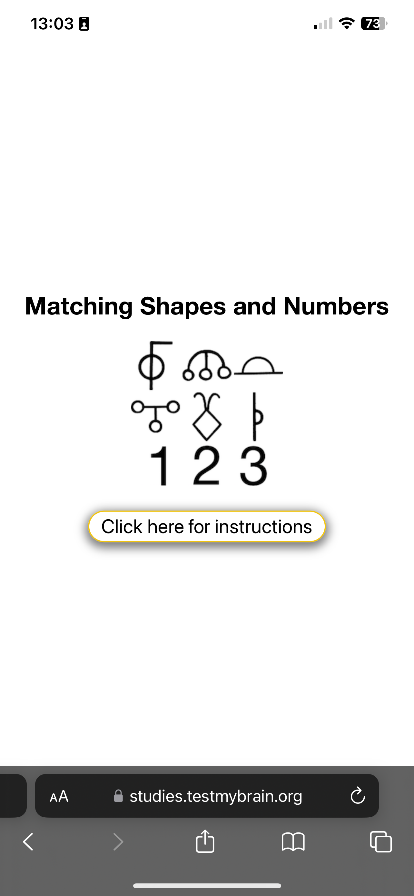
Digit Symbol
(speed)
Three Performance Measures:
Accuracy
Mean RT
Median RT

Slide 9
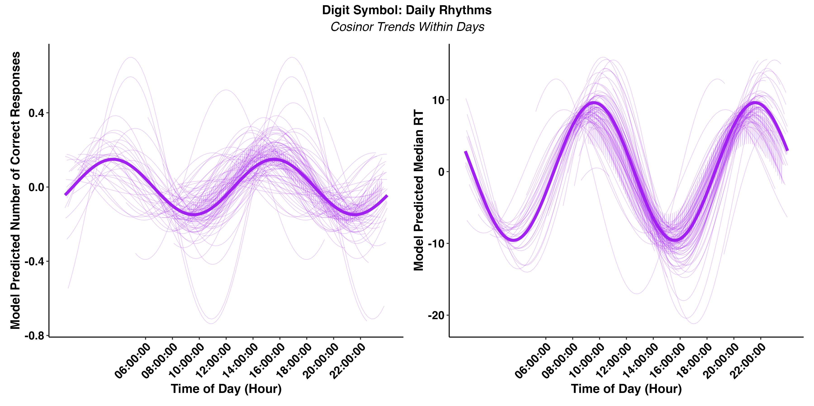
Q2: Individual Differences in Daily Cycles of Cognitive Function

Slide 10
Q2: Individual Differences in Daily Cycles of Cognitive Function

Slide 11
Q2: Individual Differences in Daily Cycles of Cognitive Function

Slide 12
Q2: Individual Differences in Daily Cycles of Cognitive Function
Within-person, there are individual differences in when dips in performance occur (phase shift) and how extreme they are (amplitude).

