Slide 1
SIGDIAL 2026
Tinker Tales
A Tangible Dialogue System for Child–AI Co-Creative Storytelling
Nayoung Choi¹, Jiseung Hong², Peace Cyebukayire¹, Ikseon Choi³, Jinho D. Choi¹
¹Department of Computer Science, Emory University
²Department of Computer Science, Carnegie Mellon University
³School of Nursing, Emory University

Slide 2
MOTIVATION
AI is already a common creative collaborator for adults: brainstorming, writing, design.
Children's AI use tells a different story
🤖
👧🏻
?
Adults & AI
→
Kids & AI, today
→
The real gap
A common creative partner: people brainstorm, draft, and iteratively develop ideas together with AI.
Existing work centers on AI-led, instructional activities; guided reading, adaptive feedback, screen-based.
Not whether kids can co-create with AI; but how its conversation design shapes what they contribute. Underexplored.
Narrative activities naturally invite shared idea-building; but young learners' contributions are directly shaped by how the AI frames questions and structures elaboration.
Notes:
Let's start with the motivation behind the work. AI is already a common creative partner for adults. We brainstorm, draft, and iterate together with AI for the shared artifact. But when we look at AI for children, the picture is different: most existing work is AI-led and instructional, usually screen-based. So the gap here is, children are increasingly exposed to AI co-creative environment, but we don't actually know how to design Child-AI interaction to support co-creative activity properly. For the activity that could be a shared artifact between child and AI, we chose story generation as our testbed because narrative activities naturally invite shared idea-building between a child and a partner.

Slide 3
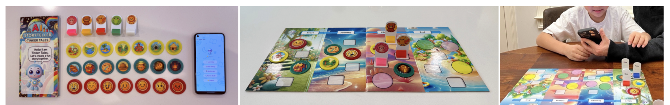
MEET THE SYSTEM
This is what Tinker Tales looks like
🕹️
Physical setup
📱
Mobile app
🤖
Co-creative AI
The story board is laid out as four narrative stages (Start, Journey, Climax, End) with NFC-embedded toys.
The go-between: senses NFC scans and mediates the child–AI interaction through voice.
Not just a narrator but a co-creative partner. Its conversation design is exactly what we study.
Children iteratively develop and refine stories through interaction with a conversational AI while placing and moving tangible story elements on a physical board.
Notes:
Before I explain how it works, let me show you what Tinker Tales actually looks like. It has three parts.
First, the physical setup: a story board laid out as four narrative stages: Start, Journey, Climax, and End, which corresponds to introduction, development, crisis and conclusion in narrative stages, with NFC-embedded toys for characters, places, items, and emotions which are tangible story elements. Second, a mobile app, it senses child’s NFC scans and mediates the conversation between the child and the AI through voice. And third, the AI itself which is a co-creative partner to generate the sotry, and how it talks, its conversation design, is exactly what we study in this work.

Slide 4
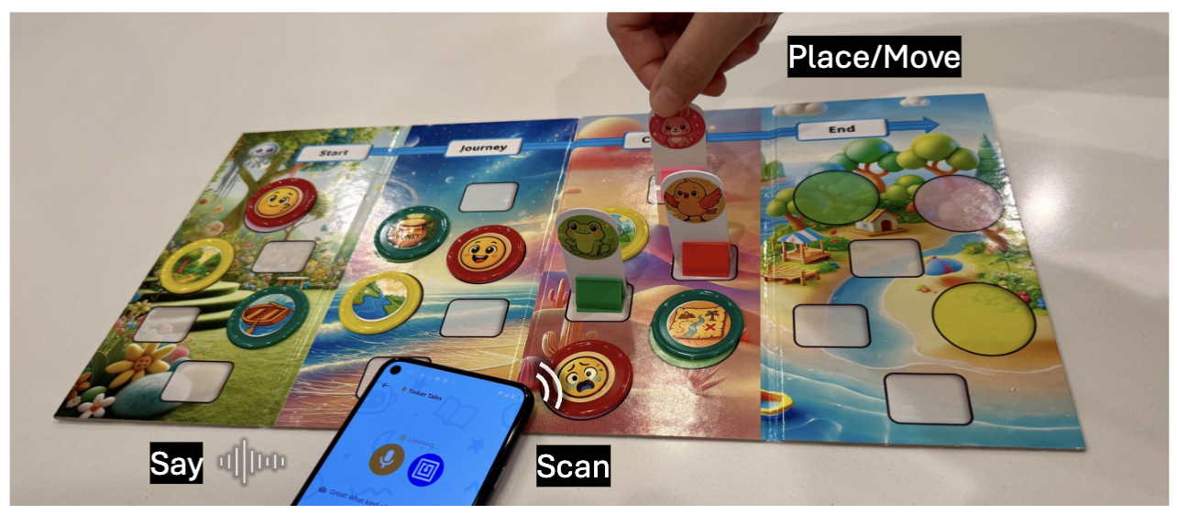
MEET THE SYSTEM
The co-creative loop: Place · Scan · Say
Place and scan NFC toys (story elements: character, place, item, emotion)
→
AI drafts a story segment based on selected story elements
→
Question to help child to elaborate the story further
→
Updates the story and narrates it back
Notes:
Here's the loop that repeats at every narrative stage. The child places and scans an NFC toy (a character, place, item, or emotion). The AI drafts a short story segment using that choice, then asks a question to help the child elaborate the story further, and finally updates the story and narrates it back. This loop repeats across all four narrative stages, so the child and the AI are really building the story together.

Slide 5
RESEARCH QUESTION
How does conversation design shape child–AI co-creative storytelling?
01
Educational scaffolding
Applebee's narrative development model + CASEL's SEL framework, instantiated directly as conversation design.
02
Controllable yet flexible interaction
Structured dialogue graphs per activity phase; allows unscripted questions or side talk.
03
Dialogue analysis
A home-based study with 10 children showing how conversation design shapes child-AI co-creative activity.
Notes:
On top of this tangible, co-creative setup, the question we had is: how should we design the conversation between the child and the AI? Because a collaborator's attitude really shapes how a child responds. So we did three things.
First, we grounded the AI's questions in educational frameworks, Applebee's narrative development model and CASEL's social-emotional learning framework, instantiated directly as conversation design.
Second, we designed the dialogue to be controllable yet flexible: a structured dialogue graph for each activity phase that still allows unscripted questions or side talk.
And third, we ran a home-based user study with 10 children and analyzed the resulting dialogues to see what kind of interaction our design actually produced.

Slide 6
DESIGN RATIONALE
Two design inspirations, two frameworks
Collaborative roles
Educational scaffolding
☑️ Adult–AI creative writing partial ideas in, AI-generated content out, iteratively developed. ☑️ Adult–child storytelling caregivers elicit ideas while children keep control of narrative decisions.
☑️ Applebee's Narrative Development Heap → Sequence → Primitive → Chain → True narratives
scaffolds event & causal elaboration. ☑️ CASEL Social–Emotional Learning socially-oriented competencies guide to elicit characters' emotions & perspectives.
Notes:
Our design rests on two inspirations.
The first axis is collaborative roles: we drew on adult-AI creative writing, where people contribute partial ideas and iteratively develop them together with AI-generated content, and on adult-child storytelling, where caregivers elicit ideas but children keep control of the narrative decisions.
The second axis is educational scaffolding, which is explicitly embedded on our system to help child elicit ideas and is also configurable. We used Applebee's narrative development model, and CASEL's social-emotional learning framework as first step, since narrative and social emotional understanding is skills that are known to be naturally developed with story activities.

Slide 7
DESIGN RATIONALE · Educational Scaffolding
How each framework becomes a question
Applebee — Narrative Development Model
CASEL — Social–Emotional Learning Framework
Narrative stage | Scaffolding
Heap / Sequence | Selection & sequencing of story elements (tangible, not asked)
Primitive narratives | Elaboration prompts for new events or actions
Chain narratives | Elaboration prompts targeting causal relations
True narratives | Post-story prompts: retell, then alternative endings
SEL competency | Scaffolding
Self-awareness / Self-management | not used (story centers on characters, not the child)
Social awareness | Elaboration prompts to infer characters' emotions & perspectives
Relationship skills | Post-story prompts to reflect on characters' interactions
Responsible decision-making | Post-story prompts to suggest alternative actions
Notes:
These two tables show how Applebee's model and CASEL's framework are embedded in our system as questions to help children elaborate the story.
Applebee's model describes children's narrative development progressing from Heap, isolated actions with no theme, through Sequence, to Primitive, Chain, and True narratives, which add causality and structure.
Heap and Sequence are already handled by the tangible activity itself, just selecting and sequencing story elements, Instead, we scaffolds Primitive narratives with questions for new events, Chain narratives with questions targeting causal relations, and True narratives with post-story activity to retell the story and imagine alternative endings.
CASEL works the same way: we skip Self-awareness and Self-management since the story centers on the characters, not the child directly, and scaffold Social awareness, Relationship skills, and Responsible decision-making instead, through elaboration and post-story questions, grounded on each socio-emotional competency.

Slide 8
DESIGN RATIONALE · Educational Scaffolding
How each framework becomes a question
Dialogue Graph:
(A) ...
(B) ...
(C) Ask a question that encourages the child to elaborate and refine the story’s narrative. Ground the question in the story created so far, and phrase it in a way that sparks the child’s imagination. Make sure to scaffold this question for the Chain narratives stage from Applebee’s narrative development model, which emphasizes the emergence of causal connections. For example, the question may be framed along the lines of: "Why did [a character] do [an action]?" or "How did [an event] happen?"
…
(A) -> (B) -> (C) -> …
Applebee — Narrative Development Model
CASEL — Social–Emotional Learning Framework
Narrative stage | Scaffolding
Heap / Sequence | Selection & sequencing of story elements (tangible, not asked)
Primitive narratives | Elaboration prompts for new events or actions
Chain narratives | Elaboration prompts targeting causal relations
True narratives | Post-story prompts: retell, then alternative endings
SEL competency | Scaffolding
Self-awareness / Self-management | not used (story centers on characters, not the child)
Social awareness | Elaboration prompts to infer characters' emotions & perspectives
Relationship skills | Post-story prompts to reflect on characters' interactions
Responsible decision-making | Post-story prompts to suggest alternative actions
Notes:
Here's an example of how this gets instantiated as a prompt to the AI. For the Chain narratives stage, we instruct the AI agent to ask a question that encourages the child to elaborate the story, grounded in what's happened so far, and phrased to spark the child's imagination, specifically scaffolded toward causal connections, like 'Why did [a character] do [an action]?' or 'How did [an event] happen?'. This is really how each educational framework gets translated directly into the AI's language.

Slide 9
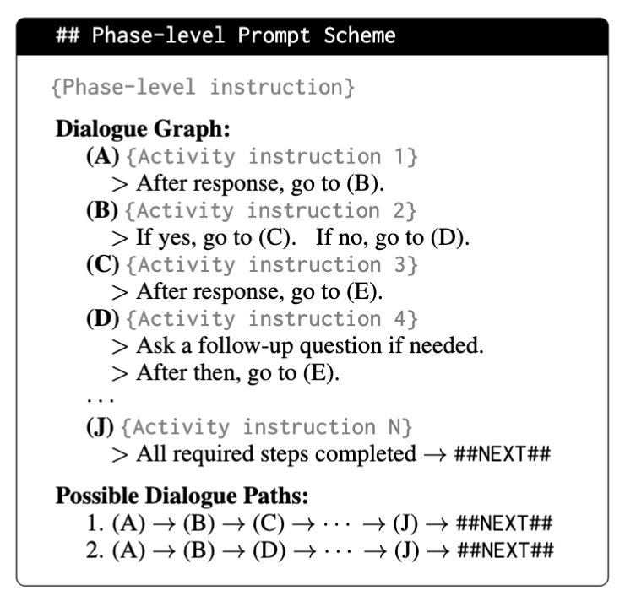
CONVERSATION DESIGN
Eight scripted phases, structured yet flexible conversation
Session
opening
→
Character
selection
→
Start
→
Journey
→
Climax
→
End
→
Post-story
activity
→
Session
closing
Progression rule
Each phase is a dialogue graph with conditional transitions.
AI agent issues an explicit transition marker (##NEXT##) when the current dialogue graph is fulfilled. After the transition marker, the next phase prompt is provided to the AI.
Can still answer unscripted questions or side talk along the way, within a phase.
Notes:
This is how we designed the overall conversation progression. A session moves through eight phases: opening, character selection, the four narrative stages, a post-story activity, and session closing. Each phase is implemented as a dialogue graph with conditional transitions. Once the current phase's dialogue graph is fulfilled, the AI issues an explicit transition marker, ##NEXT##, and only then moves on to the next phase's prompt. But within a phase, the agent can still answer unscripted questions or side talk as instructed in the system prompt, so it stays structured without feeling rigid to the child.

Slide 10
CONVERSATION DESIGN
Eight scripted phases, structured yet flexible conversation
Session
opening
→
Character
selection
→
Start
→
Journey
→
Climax
→
End
→
Post-story
activity
→
Session
closing
Within each narrative stage (Start – End):
Move character pawns from the previous narrative stage
Select and scan story elements (place, item, emotion tokens) for this stage
AI generates a story draft based on the story progression so far
Question to help child further elaborate the story
Story updates
Notes:
The four narrative stages, Start through End, are really the heart of the system. Within each stage, the flow is: move the character pawns forward from the previous stage, select and scan story elements (a place, an item, and an emotion token) for this stage, the AI generates a story draft based on these selection and the story so far, asks questions to help the child elaborate further, and then updates the story.

Slide 11
CONVERSATION DESIGN
Eight scripted phases, structured yet flexible conversation
Session
opening
→
Character
selection
→
Start
→
Journey
→
Climax
→
End
→
Post-story
activity
→
Session
closing
Within each narrative stage (Start – End):
Move character pawns from the previous narrative stage
Select and scan story elements (place, item, emotion tokens) for this stage
AI generates a story draft based on the story progression so far
Question to help child further elaborate the story
Story updates
Notes:
Of everything in this loop, the piece that matters most for our research question is that elaboration question, the scaffolded question the AI asks right after drafting the story.

Slide 12
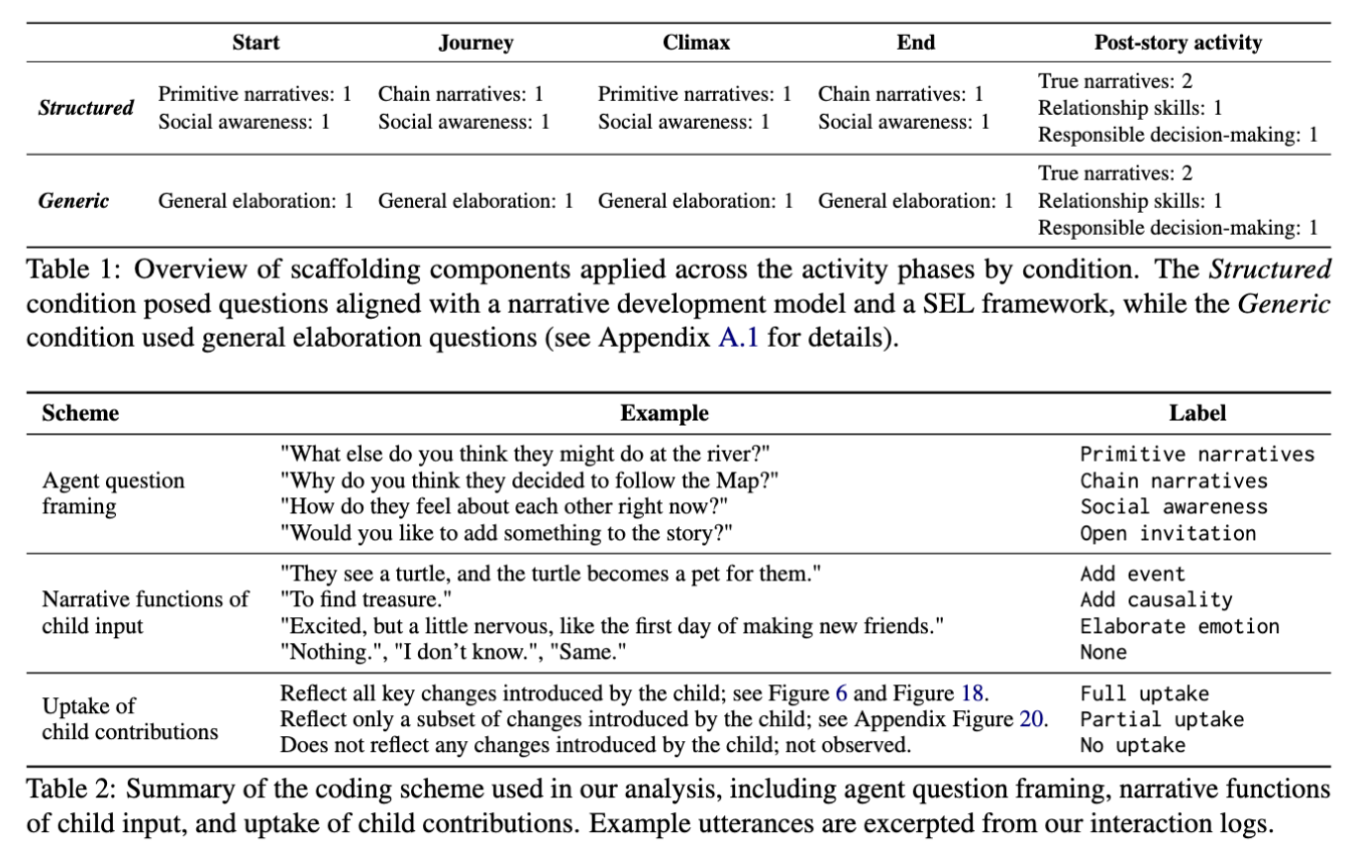
USER STUDY
10 children, two conditions, home-based
10
2
~32
~53
children,
ages 6–8
conditions:
Structured vs. Generic
minutes
per session
turns
per session
Notes:
To see how this plays out, we ran a home-based study with 10 children, ages 6 to 8. Each child experienced two conditions in separate sessions: Structured, where the AI's questions were grounded in Applebee's and CASEL's frameworks, and Generic, where the AI just asked open-ended elaboration questions like “what do you want to add more in the story?”, with the order counterbalanced across children. Sessions ran about 32 minutes on average, with around 53 turns of child-AI exchange.

Slide 13
USER STUDY
Coding child–AI dialogue, turn by turn
How children contributed to and refined narrative ideas, how the AI responded, and how stories were jointly constructed over multiple turns.
Notes:
We then took the resulting dialogue transcripts and coded them turn by turn with our coding scheme on the screen, looking at how children contributed to and refined narrative ideas, how the AI responded, and how the story was jointly constructed over multiple turns.

Slide 14
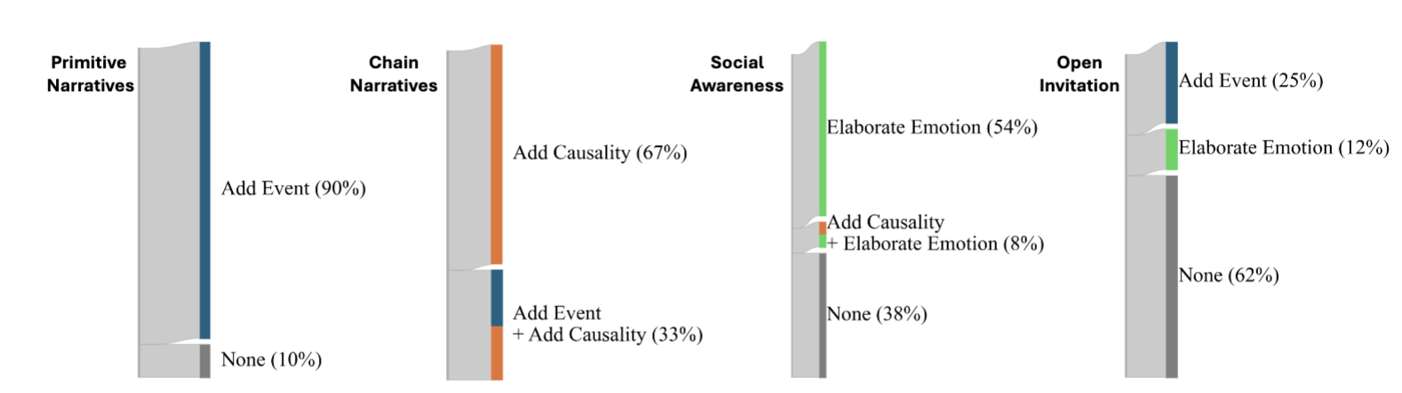
FINDINGS
Scaffolding shapes whether and how children contribute
90%
Primitive narrative
scaffold → Add Event
100%
Chain narrative
scaffold → causal reasoning
62%
Social awareness
scaffold -> Elaborate Emotion
Notes:
Here's what we found. When the AI asked a Primitive narrative-scaffolded question, children added a new event 90% of the time. When it asked a Chain narrative-scaffolded question, children engaged in causal reasoning 100% of the time. And Social awareness-scaffolded questions got children to elaborate on a character's emotion 62% of the time. On the other hand, generic questions with open invitation like “what do you want to add?” only yield 36% of story contribution from children. So scaffolding increased how much children contributed, and also it shaped the specific kind of narrative thinking they did.

Slide 15
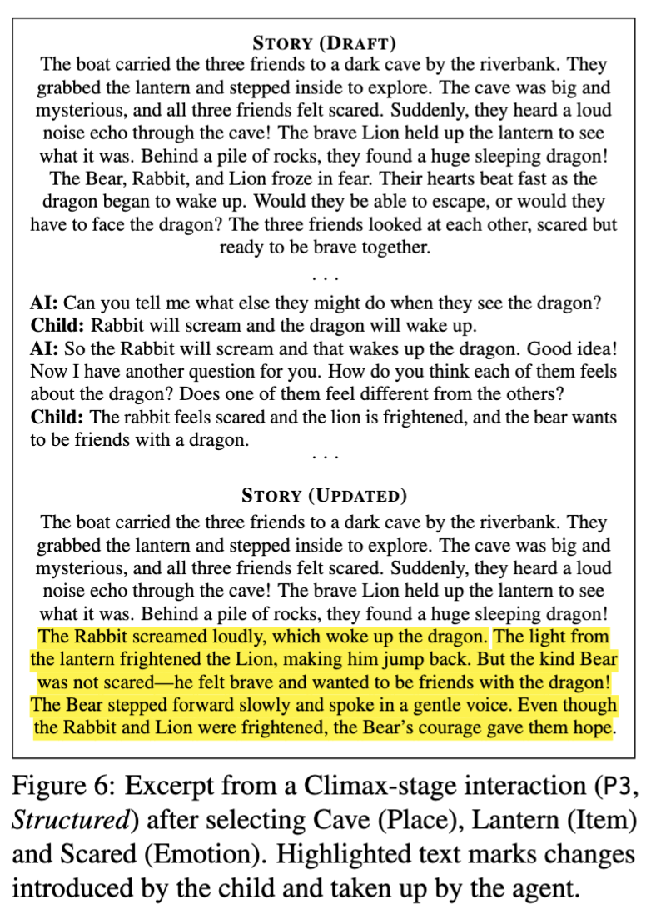
FINDINGS
P3, Structured Condition
AI: “What else might they do when they see the dragon?” Child: “Rabbit will scream and the dragon will wake up.” AI: “How do you think each of them feels about the dragon?” Child: “The rabbit feels scared and the lion is frightened, and the bear wants to be friends with a dragon.”
Notes:
Here's what that actually sounds like. In this Climax-stage, the AI asks, 'What else might they do when they see the dragon?' (a Primitive narrative instructed question) and the child says, 'Rabbit will scream and the dragon will wake up.' Then the AI asks a Social awareness question: 'How do you think each of them feels about the dragon?' And the child responds with: 'The rabbit feels scared and the lion is frightened, and the bear wants to be friends with a dragon.' That's a child doing narrative and emotional reasoning, directly prompted by our scaffolding.

Slide 16
FINDINGS
Breakdowns happen; repair keeps the story going
1
2
Agent-initiated repair
Child-initiated repair
Agent detects ambiguity, rephrases and re-asks before moving on.
Child actively corrects the agent's misinterpretation.
“I'm not sure what you mean. Let me ask again...”
Child: “No, Lion is not a liar, he is friendly and funny.”
Child: “scared and…” → AI: “Scared and… what? Tell me more.”
Child: “It was not a kid turtle. It was a baby turtle”
Notes:
Beside the content, interaction wasn't always perfect, there was background noise, misheard speech, ambiguous input. But breakdowns didn't stall the story, they got repaired. Sometimes the child corrected the agent directly, like when speech-to-text misheard 'Lion' as 'a liar,' and the child immediately said, 'No, Lion is not a liar, he is friendly and funny. It showed us the child had their own agency when participating in the story generation activity as a story owner in our system.

Slide 17
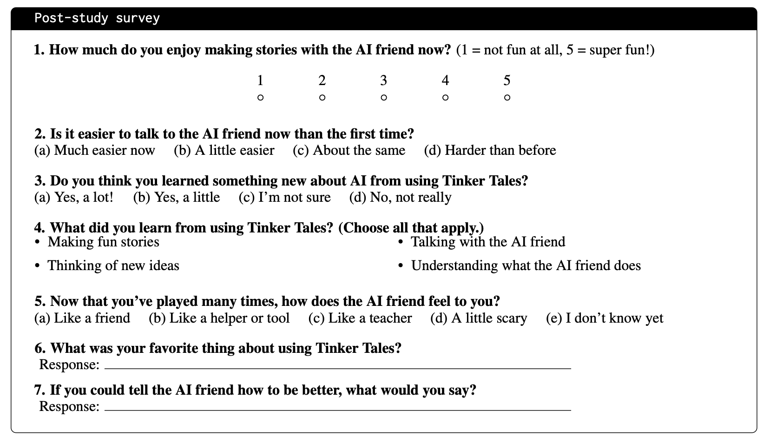
FINDINGS
Children primarily framed their experience as collaboratively making and developing, rather than as learning how the AI works or being instructed by it.
“I enjoyed building the story together.”
“It was fun talking to Tinker Tales and
making a story with Tinker Tales.”
“I can make stories.”
“I made fun stories.”
Notes:
And when we asked the children afterward, they didn't describe this as learning how AI works or being instructed by it — they described it as collaboratively making something together. 'I enjoyed building the story together.' 'It was fun talking to Tinker Tales and making a story with Tinker Tales.' 'I can make stories.' 'I made fun stories.' That framing, as a creative partnership rather than instruction, is exactly what we were aiming for.

Slide 18
TAKEAWAY
Conversation design shapes what children can contribute, while preserving their agency over the story.
Pedagogically-grounded questions → far more consistent, elaborated contributions than open-ended ones
Primitive vs. Chain scaffolds shape different narrative functions: events vs. causal reasoning
Collaborative continuity needs both turn-level repair and monitoring of the broader interaction state
Notes:
So here's the takeaway. Conversation design shapes what children can contribute, while still preserving their agency over the story. Pedagogically-grounded questions led to far more consistent, elaborated contributions than open-ended ones. Primitive versus Chain scaffolds shaped different kinds of narrative thinking, events versus causal reasoning. And collaborative continuity needed both turn-level repair and the agent staying attentive to the broader interaction state, not just individual turns. In short, prompt framing functions as interaction design in child-AI co-creative dialogue.

Slide 19
Thank you
Questions welcome.
Nayoung Choi nayoung.choi@emory.edu Emory University, NLP Lab

