Slide 1
SIGDIAL 2026
Towards Conversational Patient History-Taking
Voice-Interactive AI Agents for Pre-visit Dementia Diagnostic Interviews
Andrew G. Breithaupt* · Nayoung Choi* · James D. Finch · Jeanne M. Powell · Arin L. Nelson
Oz A. Alon · Howard J. Rosen · Jinho D. Choi
*Co-first author
Emory University · University of California, San Francisco
Notes:
~30s. Hook: history-taking is the foundation of an ADRD diagnosis, but the clinic is out of time. We built a voice AI agent that conducts the pre-visit interview. Two takeaways today: (1) how you PROMPT the agent reshapes the whole conversation, and (2) patients open up MORE to the agent than to the time-limited clinician. Note up front: this is a feasibility pilot of the interview SYSTEM, not a clinical-utility claim.

Slide 2
THE PROBLEM & THE GAP
History-taking is the bottleneck — and hard to automate
1
Nuanced symptom elicitation is underexplored
15 min
Prior work mines existing notes or uses rigid state machines — few systems elicit complex cognitive symptoms through live dialogue.
or less for a typical primary-care visit — too short for the extended dialogue ADRD needs
2
Cognitive impairment
Slow speech, effortful recall, and a need for rephrasing and scaffolding.
Specialist waits exceed a year; >50% of diagnoses come late.
3
Multi-party dynamics
An informant often participates alongside the patient
2
Notes:
[1:00] One number to set the stage: primary care gives about 15 minutes — nowhere near enough for a dementia history, and specialist waits already exceed a year. LLMs make flexible dialogue possible without hand-built state machines, so a pre-visit agent is plausible. But three things make it hard here: real-time symptom elicitation is underexplored; the population is cognitively impaired and needs scaffolding; and it's multi-party, with an informant in the room. Those three challenges drive every design decision in the next few slides.

Slide 3
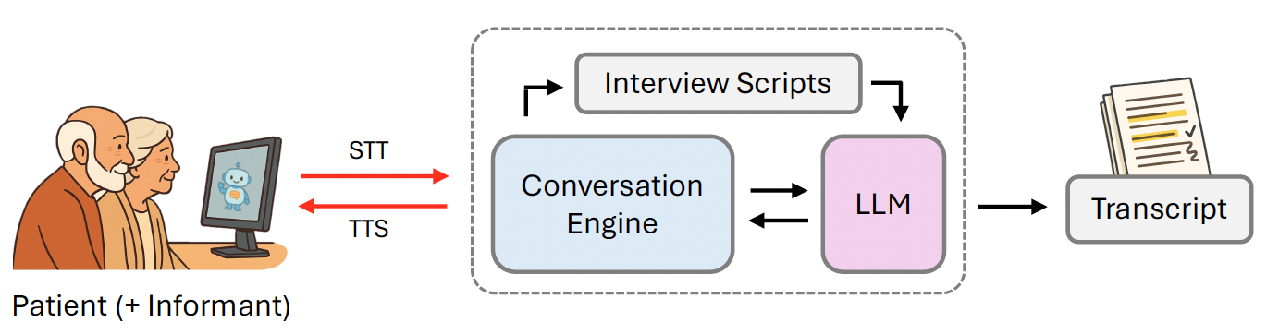
SYSTEM
A voice-interactive pre-visit interview agent
HIPAA compliant AWS environment
The transcript is the system's output later, manually reviewed before analysis, compared to a blinded clinician interview via consensus adjudication.
4
Notes:
~1 min. Patient and informant speak to a web interface. Whisper transcribes their speech, an LLM (Claude 3.5) drives the conversation guided by specialist-developed scripts, and Kokoro speaks the reply. Everything runs in a HIPAA-compliant AWS environment. Key scope point: the system's output is the TRANSCRIPT itself — that's what we evaluate. It's later compared to a blinded clinician interview through consensus adjudication; the agent never produces a summary or diagnosis. Transcripts were manually reviewed against the audio before analysis.

Slide 4
DESIGN · INTERVIEW SCAFFOLDING
Specialist scripts with conditional branching
A
Two-part prompt
~30 topic areas
High-level role & tone + topic-specific scripts
Memory · Language · Personality · Motor changes …
Supportive cues
Main question
"Have you noticed recent problems with your memory?"
3–4 conditional follow-ups
Branch on yes / no, probe for examples, duration, functional impact
Branching rules embedded in the system prompt
B
Memory anchors: "in the past couple of years"
C
Repair misunderstanding
Concise rephrasing
D
Single polite redirect
Not a fixed time limit
5
Notes:
~1 min. The clinical content is a specialist question set (ACCT-AD): ~30 topics, each a main question plus 3-4 conditional follow-ups that branch on the answer and probe for examples, duration, and functional impact. Around that we layer scaffolding designed for cognitively impaired older adults: concrete memory anchors, gentle rephrasing when confused, and a SINGLE polite redirect to keep the session humane in length rather than exhaustive at all costs.

Slide 5
DESIGN · INTERACTION
Turn-taking set for slow, effortful recall
Iteratively refined in preliminary testing to fit older adults with cognitive impairment and multi-party sessions.
⏱
Increased latency
◑
Explicit speaking / listening cues
Up to 5s of silence before the agent takes its turn — 10s for questions needing elaboration. Avoids interrupting effortful recall.
Visual indicators signal when the agent is speaking vs. actively listening.
◎
Role-addressed multi-party scaffolding
◍
Interviewed together
Addresses patient and informant separately to keep turn-taking predictable and reduce ambiguity about who answers.
When informant present interviewed with patient, mirroring most real-world dementia-specialist clinics.
6
Notes:
~50s. A subtle but important inversion: most voice agents minimize latency; we MAXIMIZED it — up to 5, even 10 seconds of silence — because pauses here signal effortful recall, not that the user is done. Visual cues show speaking vs. listening. For multi-party, the agent addresses roles separately to keep turn-taking predictable. Patient and informant are seen together, as in real specialist practice.

Slide 6
THE EXPERIMENT
One system, two prompting strategies
15 participants each. Same scripts and clinical content — only how the LLM receives the scripts differs.
Full-script Prompting (FP)
Sequential Prompting (SP)
All ~30 topic scripts delivered at once, in a single system prompt.
One topic script at a time; advances only when the current topic is addressed.
7
Notes:
~1 min. This is the core experimental manipulation. Same clinical scripts, same content — the only difference is HOW the LLM receives them. Full-script: everything up front — broader coverage, but the agent crams questions together and is rigid. Sequential: one topic at a time — richer, more natural, better alignment and repair, BUT vulnerable to transition errors that skip later topics. Framing point for the anticipated reviewer question: because the two conditions differ ONLY in prompt delivery, the resulting behavioral differences aren't a nuisance confound — they're precisely the object of study. The interesting findings are qualitative (repair, alignment, question-compression), not just raw length.

Slide 7
STUDY
Within-subjects design at a cognitive neurology clinic
1. Agent-led interview
(FP or SP)
2. Clinician-led interview
(blinded to agent)
AES experience
questionnaire
Fixed order mirrors the intended deployment: the agent gathers preliminary information before specialist consultation.
30 participants analyzed · 18 attended with an informant · mean age 72 (47–89)
7
Notes:
[0:40] Within-subjects: every participant did the agent interview first, then a clinician interview where the clinician was blinded and used normal practice. Fixed order mirrors real deployment. Thirty participants analyzed after a five-person design pilot; 18 brought an informant; mean age 72. Full demographics are in a backup slide if anyone wants them.

Slide 8
EVALUATION
Three dimensions: Dialogue, content, and experience
◆
Dialogue analysis
◆
Content elicitation
◆
User experience
Topic coverage, alignment, politeness, input understanding, response opportunity. LLM-annotated, validated against 2 human annotators.
35 symptoms (21 clinically prioritized) labeled present / absent / ambiguous / not-discussed. Absent = raised & denied; not-discussed = never raised.
6-item AES: ease, understandability, enjoyment, helpfulness, time, satisfaction — plus open response.
!
Note on content elicitation: The clinician interview is NOT the reference standard. The gold standard is consensus adjudication of BOTH transcripts by a behavioral neurologist and trained team members.
9
Notes:
~1 min. Three dimensions — dialogue quality, symptom elicitation, user experience. Each interview was labeled across 35 symptoms (21 flagged clinically important). We distinguish 'absent' — a symptom explicitly raised and denied — from 'not-discussed,' never raised. The critical point, and a common reviewer confusion: we do NOT treat the clinician as ground truth. The gold standard is consensus adjudication of both transcripts: when they agree, adopt the label; when they disagree, the annotators re-review both together. So a symptom the agent surfaced but the clinician missed still counts. That's what makes sensitivity/specificity meaningful rather than mere agent-vs-clinician agreement.

Slide 9
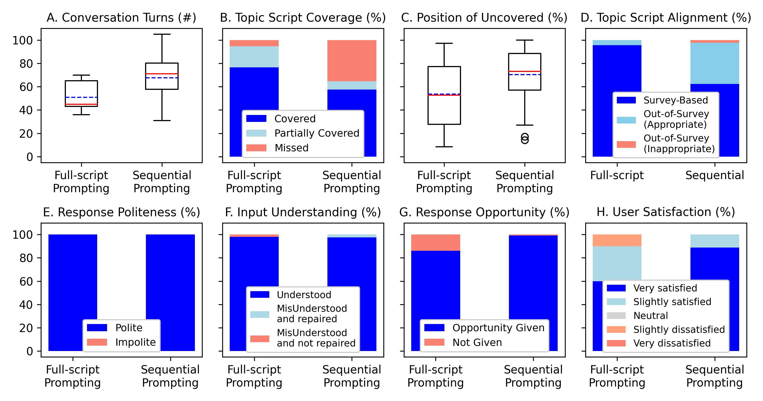
RESULTS · DIALOGUE
Prompting strategy reshapes the conversation
Patients say ~2× more per turn to the agent
31.8 (FP) / 39.5 (SP) words vs. 13.1 with the clinician — more room to describe symptoms.
SP: richer dialogue with more repair, but missed topics
More out-of-survey but mostly appropriate probes; recovers from misunderstandings.
FP: broader coverage with less flow and depth
Covers more topics but with less depth.
10
Notes:
~1.5 min. Two findings. First, the agent takes fewer turns than the clinician but patients say about TWICE as many words per turn — the non-interruptive, patient-time design gives people room to describe symptoms. Second, the prompting strategies diverge qualitatively: SP produces richer dialogue with more repair and better alignment; FP covers more topics but crams questions and limits response opportunity. One framing point: the two conditions differ only in how the same content is delivered, so these behavioral differences are the intended object of study, not a nuisance confound — and the substantive findings are qualitative (repair, alignment, response opportunity), not just raw length.

Slide 10
RESULTS · SYMPTOM ELICITATION
High specificity, strong sensitivity
Fewer omissions than the clinician
Median not-discussed rate (21 core symptoms):
agent 13.0% vs. clinician 30.4%
Ambiguity comparable (13.0% vs 16.7%, p = 0.19)
!
What the 100% specificity means
Zero adjudicated false positives — no symptom the participant reported as present with the agent was later found absent with the clinician.
Systematic querying builds a large pool of denials. Still exploratory: small n.
Specificity = 100% across all conditions (95% CI 95.8–100)
11
Notes:
~1.5 min. Against the consensus gold standard, overall sensitivity was 83.5% — higher for SP (87.6) than FP (78.7). Specificity was 100%, and the paper now leads with it. What that 100% means concretely: zero adjudicated false positives — nothing the agent recorded as present was later found absent. Because the agent queries every symptom systematically while clinicians probe selectively, it accumulates a large pool of explicit denials; combined with no false positives, that drives specificity. Read it as: the agent didn't push people to over-endorse symptoms. The agent also omitted fewer core symptoms than the time-limited clinician (median 13% vs 30%). Per-symptom estimates are unstable (CIs often >40 points), so we rely on pooled numbers and treat per-symptom values as hypothesis-generating.

Slide 11
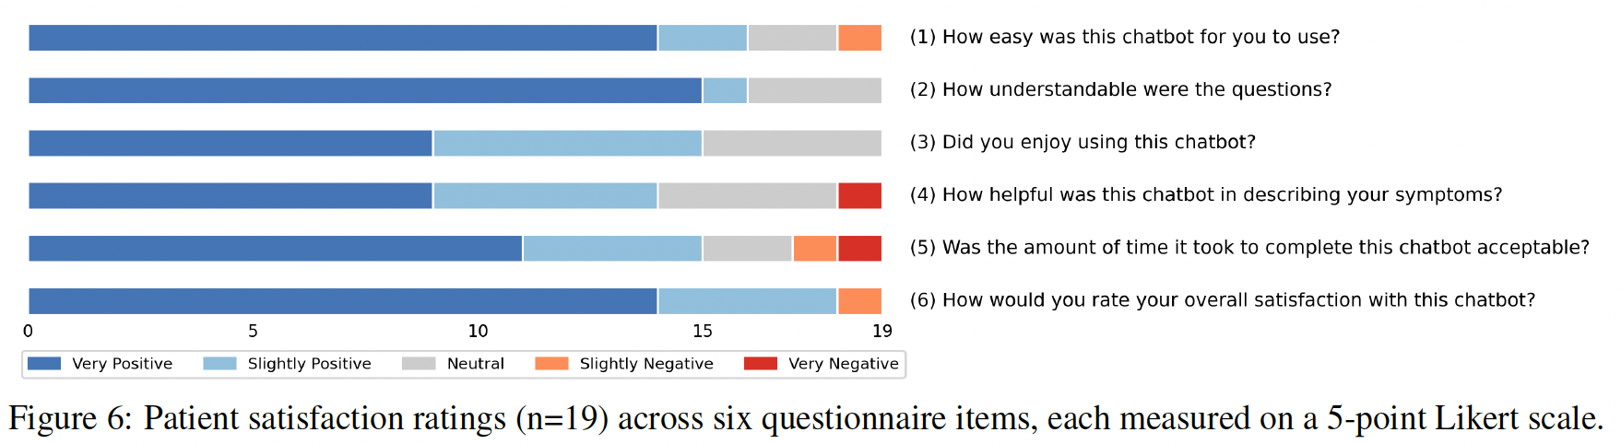
RESULTS · USER EXPERIENCE
Overall positive mainly due to patience & thoroughness
“I appreciate she doesn’t interrupt and gave us time to talk.”
“Very thorough — understood my information more than most doctors. Patient and took time to listen.”
“Some of the questions should be broken down — asked 2 or 3 at once.”
— P24
— P7
— P23
12
Notes:
~1 min. Experience ratings were positive across all six items. Participants repeatedly praised the non-interruptive style and the sense of being given time — one said it understood their history better than most doctors. The negatives are instructive and honest: helpfulness and time drew a few strongly negative ratings, tied to technical stalls and to question-compression — the FP 'two or three questions at once' issue. Note only 19 of 30 completed the questionnaire, mostly for time reasons, which I count as a limitation.

Slide 12
LIMITATIONS & RESPONSIBLE USE
This is a single site pilot study on the interview system
1
Pilot scale, single site
2
Fixed order & timing
n=30, one clinic, English only. Preliminary & hypothesis-generating.
Agent always precedes clinician; intervals up to 3 months. Possible order effects.
3
Co-present setting
4
Scope is interview system only
Informants may soften disclosures with the patient present, suppressing some information.
Feasibility of the interview system — NOT clinician-facing summaries, clinical utility, or deployment readiness.
Informs, never directs care. The agent produces no diagnosis, score, or recommendation — so a model error surfaces as a missed or inappropriate question, not a fabricated clinical conclusion.
13
Notes:
~1 min. Upfront about limits: a 30-person, single-site, English-only pilot; fixed order and variable intervals risk order effects; the co-present setting can suppress informant disclosures. Scope: this establishes feasibility of the INTERVIEW SYSTEM — not clinician-facing summaries, clinical utility, or deployment readiness, and no causal agent-vs-clinician claims. The responsible-use argument that matters most: the agent outputs no diagnosis, risk score, or recommendation. It elicits and records a narrative to INFORM the clinician. So the failure mode is a missed or awkward question — not a fabricated clinical conclusion. That, plus HIPAA hosting and real-time supervision, is our answer to the ethics concern.

Slide 13
TAKEAWAYS
What we learned
1
Prompting shapes conversation outcomes
Next
Sequential vs. full-script meaningfully reshapes coverage, flexibility, and repair behavior.
Hybrid prompting
combine SP flexibility with FP coverage & robust topic transitions
Transcript summarization
clinician-facing summaries + specialist adjudication for diagnosis
Larger, multi-site, multilingual
toward real-world evaluation
2
Patients are verbose with the agent
~2× words per turn and fewer omitted core symptoms than the time-limited clinician.
3
Overall high user satisfaction
Older adults and informants found the interview acceptable, patient, and thorough.
14
Notes:
~1 min. Three takeaways. Prompting strategy is a first-class design lever — it reshapes the entire interview. Patients open up more to the agent than to the rushed clinician. And the system is feasible and genuinely well-received by this hard-to-serve population. Where we're headed: hybrid prompting to get SP's flexibility with FP's coverage; a dedicated summarization-and-adjudication study for the clinician-facing use case; and larger, multi-site, multilingual evaluation.

Slide 14
Thank you
Questions & discussion welcome
Andrew G. Breithaupt · abreith@emory.edu
Department of Neurology, Emory University School of Medicine

Slide 15
RESULTS · DIALOGUE
Prompting strategy reshapes the conversation
10

Slide 16
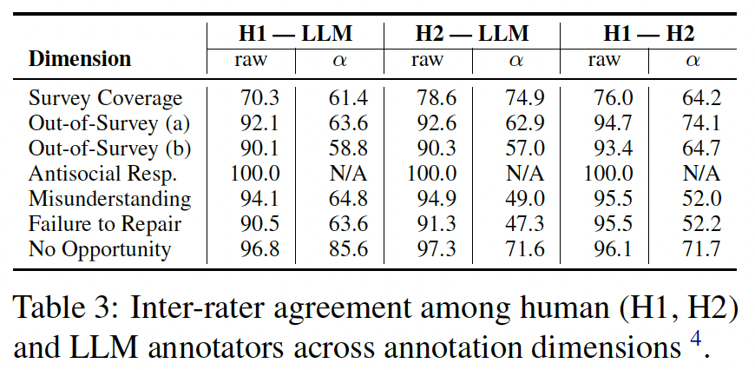
RESULTS · DIALOGUE
Numbers behind LLM annotation with two human annotators
11
Notes:
Lower α values for dimensions involving rare judgments (e.g., Out-of-Survey (b), Misunderstanding, Failure to Repair Misunderstanding) are expected, as chance-corrected measures tend to be conservative under imbalanced label distributions (Krippendorff, 2011; Artstein and Poesio, 2008). Survey Coverage shows moderate agreement, likely reflecting the difficulty of its three-way categorical scheme; notably, human–LLM agreement remains comparable to human–human agreement. For Antisocial / Impolite Responses, all annotators labeled every instance as non-antisocial, yielding perfect raw agreement and undefined α. We note that this analysis is intended to assess plausibility rather
than serve as definitive validation.

Slide 17
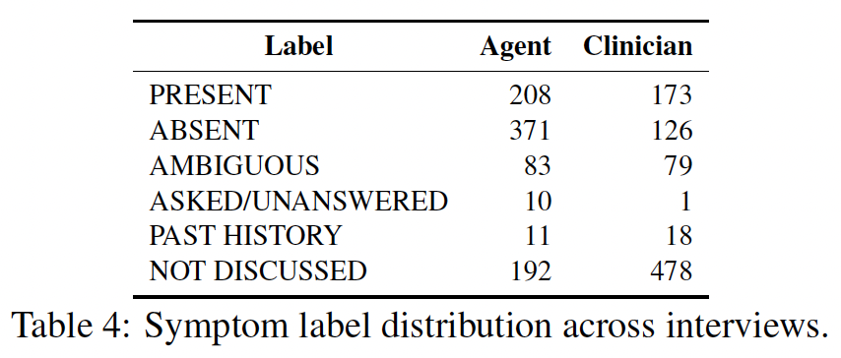
RESULTS · SYMPTOM ELICITATION
Numbers behind sensitivity and specificity
11

