Slide 1

ClarVis: A Dataset of Clarification Requests and Grounding in Collaborative Data Visualization Dialogues
Abari Bhattacharya, Barbara Di Eugenio
University of Illinois Chicago
Natural Language Processing Laboratory

Slide 2
Roadmap
ClarVis Dataset
Grounded Clarification Request Annotation
Prediction Task and Baselines
Notes:
Building on this framing, we introduce ClarVis, a dataset for studying clarification requests in collaborative data visualization dialogues. The data comes from real-time multi-user data-exploration sessions, where two users analyzed data together while interacting with a conversational assistant that generated visualizations.
The first part of the contribution is the dataset and annotation. We identify naturally occurring clarification requests in these dialogues, and for each CR we annotate the grounding modality: whether the clarification is grounded in auditory, visual, or kinesthetic uncertainty.
The second part is the modeling setup. We define two prediction tasks over this resource. The first is CR identification, where the goal is to distinguish clarification requests from the rest of the dialogue. The second is grounding-modality classification, where the goal is to classify a CR as Auditory, Visual, or Kinesthetic.
Finally, we report baseline results using both traditional models and an instruction-tuned language model.
The purpose is to examine how far these distinctions can be recovered from dialogue text and limited context, rather than to claim a final state-of-the-art model

Slide 3
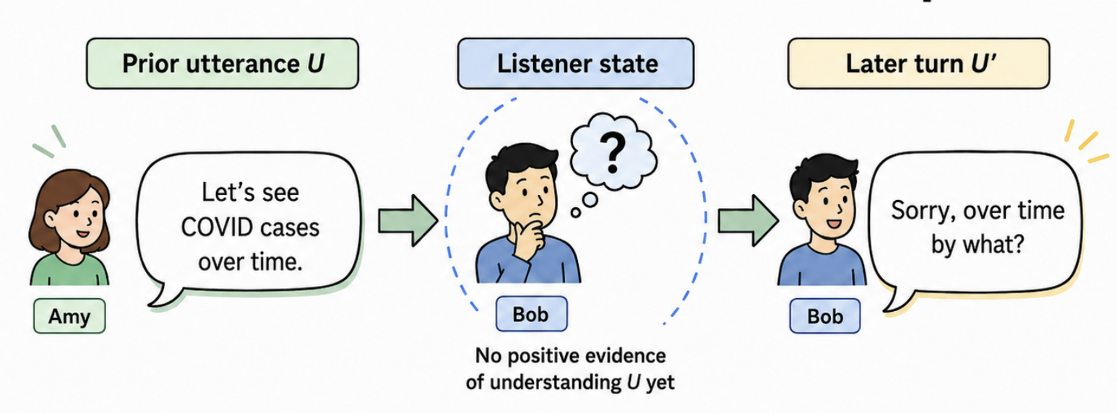
What is a Clarification Request (CR)?
CRs help collaborators:
repair misunderstandings
resolve uncertainty
maintain common ground
stay aligned during collaborative tasks
A CR is a follow-up turn that shows something in the prior dialogue still needs to be negotiated.
When CR signals missing in understanding → source of gap?
Notes:
Given a prior utterance U, a later turn U′ is a clarification request when it signals that the listener does not yet have positive evidence of understanding U.
Before introducing ClarVis, I want to start with the concept the paper builds on. Clarification requests are not just questions. They are repair moves that help speakers resolve uncertainty and maintain common ground. In collaborative settings, this becomes especially important because people need to stay aligned not only on what was said, but also on the shared task context and possible next actions.
This paper follows Benotti and Blackburn’s framing of clarification requests as modality-grounded. In other words, a clarification request can arise because of a problem in hearing or wording, in visual interpretation, or in action and interaction. ClarVis applies this idea to collaborative data visualization dialogues.

Slide 4
Grounded Clarification
Gap in understanding concerns modality m through which listener is trying to understand prior utterance [Benotti & Blackburn ‘21]
Subsequent turn → Clarification grounded in modality 𝑚
If it is not preceded by positive evidence of understanding the prior utterance in modality 𝑚.
CR grounding modality ladder:
Socioperception
Auditory
Vision
Kinesthetic action
Their framework classifies CRs according to modality in which understanding has not yet been established.
Notes:
Before introducing ClarVis, I want to start with the concept the paper builds on. Clarification requests are not just questions. They are repair moves that help speakers resolve uncertainty and maintain common ground. In collaborative settings, this becomes especially important because people need to stay aligned not only on what was said, but also on the shared task context and possible next actions.
This paper follows Benotti and Blackburn’s framing of clarification requests as modality-grounded. In other words, a clarification request can arise because of a problem in hearing or wording, in visual interpretation, or in action and interaction. ClarVis applies this idea to collaborative data visualization dialogues.

Slide 5
Grounding Modalities and ClarVis
ClarVis builds on Benotti & Blackburn’s view of CRs as real-world modality-grounded phenomenon
studies this in collaborative data visualization dialogues.
uses three grounding modalities from their scheme
Auditory Modality
Lack of understanding in hearing or speech channel
Visual Modality
Lack of understanding in what can be seen in the physical environment
Kinesthetic Modality
Lack of understanding concerning action, operation, system capability, or interaction flow
But where do these collaborative visualization dialogues come from?
5

Slide 6
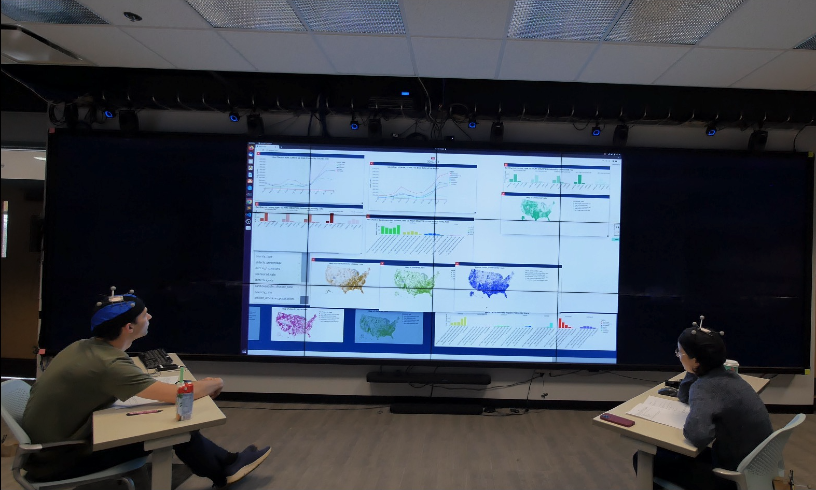
Origins of ClarVis: Source User Study [Bhattacharya et al. (2024)]
Real-time two-user collaborative Exploratory Data Analysis (EDA) session with conversational assistant.
Unscripted
Task-oriented dialogues
Pairs of users explored COVID-19 data together to complete open ended EDA tasks
Conversational assistant generated data visualizations on large display.
Visualizations generated: maps, heat maps, bar charts, and line charts.
15 groups of 2 participants per session
2 timed open ended EDA tasks
29 dialogue transcripts, 6.3K+ user utterances.
Bhattacharya et al. (2024), Statistical Analysis and Data Mining. (CC-BY-NC 4.0)

Slide 7
What Does Grounding Modality Look Like in Dialogue?
Auditory
Visual
Kinesthetic
U1: See this one... this map of cardiovascular disease... U2: Oh, I can’t bring it to the front...
U2: [CR—K] Can I click on this? (while trying to move the generated map)
U1: Oh, so the same time range. U1: I think that’s the...
U2: [CR—A] What’s the same?
S: Line Chart of COVID cases vs. Date, Colored by County type U1: Oh, the same thing.
U1: [CR—V] Is that June or January?
Uncertainty about what was said or meant.
Uncertainty about interpreting what is seen in the physical environment.
Uncertainty about action or interaction.
Notes:
Slide 1 gives the theoretical framing. Now I want to show what that looks like in the actual dialogues. These are not isolated questions, each one depends on the preceding dialogue or the shared visual or action context.

Slide 8


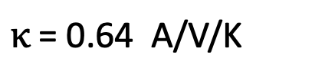
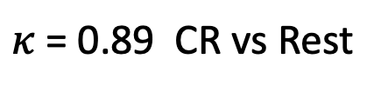
ClarVis Annotation
Surface form was not enough. Annotators used dialogue function and context
Case 1
“What other factors do we have?”
Final label: Rest
Why? Task planning/Data exploration/discussion
Case 2
“Which one do you want?”
Final label: Kinesthetic
Why? Action/coordination
K/V ambiguity→ K by precedence
Agreement
Sample of 565 utterances
Final labels resolved through discussion
$κ$ = 0.89 CR vs Rest
$κ$ = 0.64 A/V/K
Precedence ladder [*] for grounding modality used only when no single cue was clearly primary
K
$$>$$
V
$$>$$
A
Action/Operation/Capability
Display/Visible state
Hearing repair
*Benotti & Blackburn (NAACL, 2021)
Notes:
The key annotation issue was that surface form was not enough. We did not label an utterance as a CR just because it looked like a question. The annotators considered what the utterance was doing in the ongoing dialogue. For example, asking for a graph or map is a new visualization request, so it is Rest. Asking what other factors are available is task planning, also Rest. In contrast, ‘Which one do you want?’ was resolved as Kinesthetic because it involved action coordination. After independent annotation, disagreements were resolved through adjudication to produce the final gold labels..

Slide 9
Most Clarifications are Grounded in Recent Context
Analysis
34 CRs from sample of 440 utterances
For each CR manually inspected up to 10 preceding turns
Identified nearest plausible prior source of uncertainty
73.5%
Of sampled CRs grounded within previous 2 turns
Turn -6
Turn -5
Turn -4
Turn -3
Turn -2
Turn -1
CR
Most CRs
Context for Visual CRs occasionally go farther back
Notes:
To understand how much context may be useful for interpreting CRs, we did a small context-distance analysis. In a separate sample of 440 utterances, there were 34 CRs. For each one, we manually inspected up to ten preceding turns and identified the nearest plausible source of uncertainty.
Most of these clarifications were local: 15 were grounded within one turn and 10 within two turns, so 73.5 percent fell within the previous two turns. But visual CRs sometimes extended farther back, up to six turns. So the takeaway is that short dialogue context is often useful, but for visual grounding the relevant context may persist across several turns.

Slide 10
ClarVis Dataset At A Glance
The Corpus
Grounding Modality Distribution (445 CRs)
29 dialogues
6,927 total turns (all user and system interactions)
6,377 user utterances
550 system generated visualizations
445 Clarification Requests (CRs)
6.4% of all turns, 7.0% of all user utterances
CRs are infrequent but essential
Notes:
The final ClarVis dataset contains 29 dialogues, with 6,927 total turns. Of these, 6,377 are user utterances, and 550 are system-generated visualizations.
Within this corpus, we identify 445 clarification requests. That is 6.4 percent of all turns, or 7 percent of user utterances. So CRs are not frequent, but they mark specific moments where the interaction needs repair.
The modality distribution shows where those repairs occur. Visual CRs are the largest group, with 220 cases, or 49.3 percent. Auditory CRs account for 28.2 percent, and Kinesthetic CRs account for 22.5 percent.
So the key point is that ClarVis does not only capture clarifications about charts. It captures grounding breakdowns across the collaborative interaction: what was said, what was shown, and what action or system behavior should happen next.

Slide 11
Recovering Clarifications from Dialogue Text
Task 1: CR Identification (CR-ID)
Baseline Models
TF-IDF + Logistic Regression DistilBERT Llama-3.2-3B-Instruct (Zero Shot)
Llama-3.2-3B-Instruct (Few Shot)
Input: User utterance + optional dialogue context
Output: CR vs Rest
Context Setting
Base:
Current utterance only
+ Prev1 :
Previous turn + current utterance
+ Prev2 :
Previous two turns + current utterance
Notes:
From the ClarVis annotations, we define two text-based prediction tasks. The first is CR identification, where the model predicts whether a user utterance is a clarification request or not. For this task, we compare reference baselines, TF-IDF with Logistic Regression, DistilBERT, and Llama-3.2-3B-Instruct in zero-shot and few-shot settings.
The second task is grounding-modality classification. Here, the input is a clarification request, and the model predicts whether its grounding modality is Auditory, Visual, or Kinesthetic. We evaluate this in two ways: first, in a Gold-CR setting where modality is classified only for gold clarification requests, and second, in a pipeline setting, CR-to-GMOD, where the model first predicts CR and then assigns the modality.
For both tasks, we compare three context settings: the current utterance alone, the previous turn plus the current utterance, and the previous two turns plus the current utterance.

Slide 12
CR-ID Results
Best Results
Base
0.65
+Prev 1
0.66
+Prev 2
0.61
Best CR-ID: DistilBERT +Prev1
Main Takeaways
CR-ID is learnable from dialogue text.
One-turn context gives the strongest CR-ID result.
Llama zero-shot showed high recall but low precision, suggesting that CR-like surface cues → easy to trigger but not enough for accurate CR detection.
Notes:
On this slide, I summarize the main modeling results. We compare reference baselines, TF-IDF with Logistic Regression, DistilBERT, and Llama-3.2-3B-Instruct.
For CR identification, the strongest result comes from DistilBERT with the previous turn included. It reaches the best CR F1 of 0.66. This suggests that CRs in ClarVis are distinguishable from surrounding task dialogue, but the task is not simply a surface-form question detection problem. The immediately preceding turn helps, which is consistent with the earlier context analysis showing that many CRs are grounded in recent dialogue context.
The Llama results show a different pattern. Llama has very high recall, especially in the zero-shot and few-shot settings, but much lower precision. So it identifies many possible CRs, but it also tends to overpredict CRs, likely because surface cues such as ‘what,’ ‘how,’ or ‘can’ are not enough to distinguish clarification requests from other task-oriented questions.
For grounding-modality classification, I show the Gold-CR setting first, where the model is given the true CRs and only predicts Auditory, Visual, or Kinesthetic modality. In this setting, TF-IDF with Logistic Regression gives the best overall macro F1 of 0.52. Visual grounding has the strongest F1, while Auditory is the hardest. This pattern suggests that some modality distinctions leave clearer textual cues than others.
The pipeline setting, CR-to-GMOD, is different. Here, the system first has to identify CRs and then assign a modality. Llama reaches around 0.50 macro F1 in this setting, but this number needs to be read together with its CR-ID behavior, because the pipeline result reflects both upstream CR selection and modality prediction.
Overall, the results show learnable signal in ClarVis: CR-ID is recoverable from dialogue text to a useful extent, and GMOD reveals structured differences in how Auditory, Visual, and Kinesthetic grounding are expressed in collaborative dialogue.
For CR-ID, the model is deciding whether an utterance is a CR at all. The most useful signal is often the immediately preceding turn, because a CR usually responds to a recent utterance or event. The context analysis supports that many CRs are grounded within the previous two turns, with many within one turn.
For GMOD, the model is not deciding “is this a CR?” It is deciding what kind of grounding the CR depends on. For that, a slightly wider context can help reveal whether the uncertainty is tied to speech/hearing, a visual display, or action/interface flow. So +Prev2 helping A and V in the Gold-CR TF-IDF result is plausible, even though +Prev2 does not help CR-ID. The paper’s task setup explicitly says context settings were used to compare how incremental dialogue context affects both CR identification and modality grounding.

Slide 13
Labeling Grounding Modality
Task 2: Grounding Modality (GMOD)Classification
Task 2: Grounding Modality (GMOD)Classification
Input: A CR+ optional dialogue context
Output: Auditory/Visual/Kinesthetic grounding modality
TF-IDF + Logistic Regression DistilBERT Llama-3.2-3B-Instruct (Zero Shot)
Llama-3.2-3B-Instruct (Few Shot)
Evaluation Setting
Gold-CR: Classify A/V/K for gold CRs only
CR→GMOD: predict CR then classify A/V/K
Context Setting
Base:
Current utterance only
+ Prev1 :
Previous turn + current utterance
+ Prev2 :
Previous two turns + current utterance
Notes:
From the ClarVis annotations, we define two text-based prediction tasks. The first is CR identification, where the model predicts whether a user utterance is a clarification request or not. For this task, we compare reference baselines, TF-IDF with Logistic Regression, DistilBERT, and Llama-3.2-3B-Instruct in zero-shot and few-shot settings.
The second task is grounding-modality classification. Here, the input is a clarification request, and the model predicts whether its grounding modality is Auditory, Visual, or Kinesthetic. We evaluate this in two ways: first, in a Gold-CR setting where modality is classified only for gold clarification requests, and second, in a pipeline setting, CR-to-GMOD, where the model first predicts CR and then assigns the modality.
For both tasks, we compare three context settings: the current utterance alone, the previous turn plus the current utterance, and the previous two turns plus the current utterance.

Slide 14
GMOD Results
GMOD: Gold-CR
Best overall: TF-IDF + Logistic Regression (Macro F1 = 0.52 , Base)
Context affected modalities differently: +Prev2 improved A and V, but K dropped.
Visual strongest, Auditory hardest,
Kinesthetic intermediate.
A
(+Prev2)
0.34
V
(+Prev2))
0.79
K
(Base)
0.55
GMOD: CR→GMOD pipeline
Best overall : Llama-3.2-3B-Instruct, zero-shot (Macro F1 ≈ 0.50 across contexts)
High CR recall passes many true CRs forward;
low CR precision also sends non-CRs into A/V/K classification.
Adding context helped A and K,
while V was strongest without added context.
A
(+Prev2)
0.30
V
(Base)
0.61
K
(+Prev2)
0.27
Notes:
On this slide, I summarize the main modeling results. We compare reference baselines, TF-IDF with Logistic Regression, DistilBERT, and Llama-3.2-3B-Instruct.
For CR identification, the strongest result comes from DistilBERT with the previous turn included. It reaches the best CR F1 of 0.66. This suggests that CRs in ClarVis are distinguishable from surrounding task dialogue, but the task is not simply a surface-form question detection problem. The immediately preceding turn helps, which is consistent with the earlier context analysis showing that many CRs are grounded in recent dialogue context.
The Llama results show a different pattern. Llama has very high recall, especially in the zero-shot and few-shot settings, but much lower precision. So it identifies many possible CRs, but it also tends to overpredict CRs, likely because surface cues such as ‘what,’ ‘how,’ or ‘can’ are not enough to distinguish clarification requests from other task-oriented questions.
For grounding-modality classification, I show the Gold-CR setting first, where the model is given the true CRs and only predicts Auditory, Visual, or Kinesthetic modality. In this setting, TF-IDF with Logistic Regression gives the best overall macro F1 of 0.52. Visual grounding has the strongest F1, while Auditory is the hardest. This pattern suggests that some modality distinctions leave clearer textual cues than others.
The pipeline setting, CR-to-GMOD, is different. Here, the system first has to identify CRs and then assign a modality. Llama reaches around 0.50 macro F1 in this setting, but this number needs to be read together with its CR-ID behavior, because the pipeline result reflects both upstream CR selection and modality prediction.
Overall, the results show learnable signal in ClarVis: CR-ID is recoverable from dialogue text to a useful extent, and GMOD reveals structured differences in how Auditory, Visual, and Kinesthetic grounding are expressed in collaborative dialogue.
For CR-ID, the model is deciding whether an utterance is a CR at all. The most useful signal is often the immediately preceding turn, because a CR usually responds to a recent utterance or event. The context analysis supports that many CRs are grounded within the previous two turns, with many within one turn.
For GMOD, the model is not deciding “is this a CR?” It is deciding what kind of grounding the CR depends on. For that, a slightly wider context can help reveal whether the uncertainty is tied to speech/hearing, a visual display, or action/interface flow. So +Prev2 helping A and V in the Gold-CR TF-IDF result is plausible, even though +Prev2 does not help CR-ID. The paper’s task setup explicitly says context settings were used to compare how incremental dialogue context affects both CR identification and modality grounding.

Slide 15
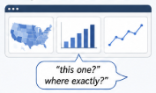


Error Analysis
The modality-level results explained by three recurring error patterns
Cross-modal ambiguity
Underspecified reference
Sparse auditory cues
Visual reference + intended action
Minimal and rarest grounding modality
Reference to visible content, target unclear from text alone
Example:
“Can we see that region?”
Example: “What?” / “Sorry?”
Example: “This one?” / “Where exactly?”
Issue: little textual evidence → unstable precision/recall
Issue:
V/K Overlap
Issue: Visual-auditory confusion

Slide 16
Takeaways
ClarVis captures CRs as part of collaborative interaction:
shaped by language, the shared visual workspace, and users’ ongoing coordination.
ClarVis makes grounding source of CRs explicit through A/V/K labels:
auditory uptake, visual interpretation, and action/interaction flow.
Baseline results show:
Learnable text signals for CR-ID
Modality-specific recoverability for GMOD
Grounding modality is challenging: CRs can combine visual reference, action intent, elliptical wording, and minimal auditory repair.
Notes:
To conclude, ClarVis contributes a dataset of naturally occurring clarification requests from collaborative data visualization dialogues. The key annotation layer is grounding modality: whether a CR is grounded in auditory, visual, or kinesthetic evidence.
The baseline experiments show that CR identification is learnable from dialogue text and local context, while grounding-modality classification is more modality-dependent. Visual CRs are easier to recover, Auditory CRs are harder, and Kinesthetic cases vary more by model family.
The error analysis helps explain this pattern through cross-modal ambiguity, underspecified references, and sparse auditory cues.
We release ClarVis with de-identified dialogue transcripts, visualization captions, CR and grounding-modality labels, and fixed train, validation, and test splits.

Slide 17
Thank you!
Released with ClarVis
De-identified speaker diarized dialogue transcripts
System-generated visualization captions
CR and Grounding modality annotations
GitHub: uic-nlp-lab/ClarVis

Slide 18
Appendix

Slide 19
Clarification Requests are infrequent but essential
 | Corpus / dataset | CRs | Total turns / dialogues | CR rate
1 | British National Corpus — all domains^{[1]} | 374 | 11k turns 59 dialogues | < 3%
2 | Communicator corpus^{[2]} | 98 | 2,098 turns 31 dialogues | 4.6%
3 | Bielefeld corpus^{[3]} | 230 | 3,962 turns; 22 dialogues | 5.8%
4 | SCARE corpus^{[4]} | 772 | 11,350 turns; 15 dialogues | ≈ 6.5–6.8%
5 | CoDraw-iCR corpus^{[5]} | 8,807 iCRs | 77,502 rounds; 9,993 dialogues | 11.36%
6 | ClarVis (Ours) | 445 | 29 Dialogues; 6,927 turns | 6.4%
Not always
explicit questions
CRs often appear as fragments or reprises → interpretation depends heavily on discourse context.[6,7]
Why this matters?
CR detection is challenging when interpretation depends on shared task context, not just explicit question form.
¹ Purver et al. (2001) ; ² Rieser & Moore (2005) ; ³ Rodríguez & Schlangen (2004) ; ⁴ Benotti & Blackburn (2021) ; ⁵ Madureira & Schlangen (2023); ⁶ Purver (2004) ; ⁷ Fernandez(2006)

Slide 20
Why ClarVis?
1. Large-scale CR datasets
Qulac, ClariQ, MIMICS, ClarQ, MSDialog, MANtIS
Typically treat CRs as query refinement or the resolution of underspecified information needs in search, support, or forum-style interaction.
Aliannejadi et al., 2019; Aliannejadi et al., 2021; Zamani et al.; Kumar & Black, 2020; Qu et al., 2018; Penha et al., 2019.
2. Grounded collaborative CR datasets
SCARE CRs grounded in Socioperceptual, Auditory, Visual, and Kinesthetic modalities in a situated instruction-following task. Benotti & Blackburn, 2021
CoDraw-iCR Instruction CRs in a collaborative drawing task. Madureira & Schlangen, 2023
What is still missing?
Dataset of naturally occurring CRs
collaborative interaction around an evolving shared task environment,
where clarification is shaped by human-human and human-system coordination, interpretation, and action.
ClarVis extends grounded CR research to collaborative data visualization, where clarification depends not only on language, but also on the evolving shared visual workspace and users’ ongoing coordination.

Slide 21
Llama GMOD: Two-Step Classification + Cue Routing
Before prompting: lightweight cue-based routing
Examples of training-data cues:
A: “do you mean…”, “what does … mean”
K: “how do/can I”, “click”, “filter”
V: “where”, “which”, “map”
Priority ordering: K > V > A
Two-step prompting strategy
Step 1: K vs Non-Action Identify procedure-, capability-, or action-related CRs.
Step 2: If Non-Action → V vs A Visual/display-oriented vs hearing/wording-oriented clarification.
Why? These checks were used to reduce obvious cue-label mismatches without changing the grounding-modality definitions in the prompts.

Slide 22
Implementation Details
Dialogue-level splits ~68% train / 12% validation / 20% test No overlap in conversational context, vocabulary, or participant style
Splits provided in GitHub Repository

Slide 23




A Question is not Always a Clarification Request
Surface form was not enough. Annotators used dialogue function and context
Agreement
Sample of 565 utterances
Final labels resolved through discussion
Case 1
“Do you have a graph or a map of access to doctors and COVID-19?”
Final label: Rest
Why? New visualization request
Case 2
“What other factors do we have?”
Final label: Rest
Why? Task planning/Data exploration/discussion
Case 3
“Which one do you want?”
Final label: Kinesthetic
Why? Action coordination
K/V ambiguity→ K by precedence
$κ$ = 0.89 CR vs Rest
$κ$ = 0.64 A/V/K
Utterances labeled as CRs when they indicated uncertainty about understanding prior or currently available context.
Precedence ladder for grounding modality used only when no single cue was clearly primary
K
$$>$$
V
$$>$$
A
Action/Operation/Capability
Display/Visible state
Hearing repair
Notes:
The key annotation issue was that surface form was not enough. We did not label an utterance as a CR just because it looked like a question. The annotators considered what the utterance was doing in the ongoing dialogue. For example, asking for a graph or map is a new visualization request, so it is Rest. Asking what other factors are available is task planning, also Rest. In contrast, ‘Which one do you want?’ was resolved as Kinesthetic because it involved action coordination. After independent annotation, disagreements were resolved through adjudication to produce the final gold labels..

Slide 24
Baseline Experiments and Results
CR-ID. DistilBERT
Best CR-ID: DistilBERT +Prev1 suggesting immediately preceding turn is most useful for detecting CRs
Base
0.65
+Prev 1
0.66
+Prev 2
0.61
GMOD: Gold-CR. TF-IDF + Logistic Regression
Context | Macro F1 | A | V | K
Base | 0.52 | 0.30 | 0.73 | 0.55
+ Prev 1 | 0.45 | 0.26 | 0.71 | 0.40
+ Prev 2 | 0.48 | 0.34 | 0.79 | 0.31
Context helps V and A modalities
GMOD: CR→GMOD pipeline.
Llama Zero Shot
Context | A | V | K
Base | 0.28 | 0.61 | 0.26
+ Prev 1 | 0.29 | 0.56 | 0.26
+ Prev 2 | 0.30 | 0.56 | 0.27
Llama zero-shot 0.50 macro F1 across context settings.
High CR recall passes many true CRs forward
Low precision also sends non-CRs into A/V/K classification.
Notes:
On this slide, I summarize the main modeling results. We compare reference baselines, TF-IDF with Logistic Regression, DistilBERT, and Llama-3.2-3B-Instruct.
For CR identification, the strongest result comes from DistilBERT with the previous turn included. It reaches the best CR F1 of 0.66. This suggests that CRs in ClarVis are distinguishable from surrounding task dialogue, but the task is not simply a surface-form question detection problem. The immediately preceding turn helps, which is consistent with the earlier context analysis showing that many CRs are grounded in recent dialogue context.
The Llama results show a different pattern. Llama has very high recall, especially in the zero-shot and few-shot settings, but much lower precision. So it identifies many possible CRs, but it also tends to overpredict CRs, likely because surface cues such as ‘what,’ ‘how,’ or ‘can’ are not enough to distinguish clarification requests from other task-oriented questions.
For grounding-modality classification, I show the Gold-CR setting first, where the model is given the true CRs and only predicts Auditory, Visual, or Kinesthetic modality. In this setting, TF-IDF with Logistic Regression gives the best overall macro F1 of 0.52. Visual grounding has the strongest F1, while Auditory is the hardest. This pattern suggests that some modality distinctions leave clearer textual cues than others.
The pipeline setting, CR-to-GMOD, is different. Here, the system first has to identify CRs and then assign a modality. Llama reaches around 0.50 macro F1 in this setting, but this number needs to be read together with its CR-ID behavior, because the pipeline result reflects both upstream CR selection and modality prediction.
Overall, the results show learnable signal in ClarVis: CR-ID is recoverable from dialogue text to a useful extent, and GMOD reveals structured differences in how Auditory, Visual, and Kinesthetic grounding are expressed in collaborative dialogue.
For CR-ID, the model is deciding whether an utterance is a CR at all. The most useful signal is often the immediately preceding turn, because a CR usually responds to a recent utterance or event. The context analysis supports that many CRs are grounded within the previous two turns, with many within one turn.
For GMOD, the model is not deciding “is this a CR?” It is deciding what kind of grounding the CR depends on. For that, a slightly wider context can help reveal whether the uncertainty is tied to speech/hearing, a visual display, or action/interface flow. So +Prev2 helping A and V in the Gold-CR TF-IDF result is plausible, even though +Prev2 does not help CR-ID. The paper’s task setup explicitly says context settings were used to compare how incremental dialogue context affects both CR identification and modality grounding.

