Slide 1



Accuracy and Satisfaction in Multi-Turn LLM Dialogues for NFR Assessment
University of Maine · University of Notre Dame
Ali Pourghasemi Fatideh
Wilder Baldwin
Maria Dhakal
Collin McMillan
Sepideh Ghanavati
SIGDIAL 2026 · Emory University, Atlanta
Notes:
Hi everyone! I'm Ali Pourghasemi, a Ph.D. student at the University of Maine. In this presentation I want to talk about a gap between what developers THINK an LLM is telling them and what it is ACTUALLY telling them. specifically when the topic is non functional requirements.
The title of our paper is

Slide 2
Problem Statement
LLM assistants are now standard tools for software developers
1
But our benchmarks measure functional correctness
They don’t evaluate NFRs:
which are vague (no unit test for “ensure the integrity of ePHI”)
a property of the whole system rather than one function
and often need domain knowledge like a regulation
2
And they evaluate only a single turn prompt
They don’t evaluate the multi-turn interaction: how developers actually use these tools
SIGDIAL 2026
1
August 2026
Notes:
LLLM coding assistants have become the main tool for developers
But look at how we evaluate them. HumanEval, SWE-bench, All these ask for correctiess of functional requirements by some unit tests
They dont evaluate NFRs which are more challenging. NFRs are vaguely defined, …
And they mostly measure it in a single prompt. But that is not how developers actually use these tools, they use them conversationally, over many turns, refining and pushing back.

Slide 3
Related Work in Evaluating LLMs
Work | MT | SM | Evaluation target
Chen et al. (2021) | – | – | Code generation
Hendrycks et al. (2021) | – | – | Code generation
Yin et al. (2018) | – | – | Code generation
Jimenez et al. (2023) | – | – | Bug fixing
Jain et al. (2024) | – | – | Code generation
Aider (2024) | – | – | Code editing
Wu and Fard (2025) | – | – | Clarification ability
Laban et al. (2025) | ✓ | – | MT degradation
Vaithilingam et al. (2022) | ✓ | – | User expectations
Kumar et al. (2025) | ✓ | – | Agent collaboration
Liu et al. (2024b) | ✓ | – | Code quality
Sarkar et al. (2022) | ✓ | – | User experience
Liang et al. (2024) | ✓ | – | Usability
This work | ✓ | ✓ | NFR assessment
MT = Multi-turn · SM = Satisfaction Modeling
SIGDIAL 2026
August 2026
Notes:
There are manyworks regarding evaluating a code.
Here are some examples. Most of these works focus on things related to functional requirements. for example in code generation given a requirement they test if the generated code passes the unit tests.
and most of them evaluate the code in a single turn setting.
In our work developers can interact with the llm freely and we evaluate the final result in the multi turn setting, and we focus on NFRs.
Remove->Beside that we create a model for estimating the user satisfaction of developers to understand what dialogue characteristics increases the developers satisfaction

Slide 4
Research Questions
How accurately do LLM-based dialogue assistants assess NFRs, and how do users perceive the response quality?
RQ1
What dialogue characteristics significantly correlate with user satisfaction?
RQ2
SIGDIAL 2026
August 2026
5

Slide 5
Methodology

Slide 6


Study Design
NFR
Extraction
SIGDIAL 2026
August 2026
6
Notes:
We first created a set of NFR by extracting requirements from legal documents.

Slide 7






Study Design
Evaluation Tool
Section 3
Section 1
Section 2
Satisfaction Level
Reasoning
NFR
Extraction
Interactive
Tutorial
NFR
Review
Chatbot
Interaction
Code Location
Satisfaction
Survey
Dimension Rating
49 Participants
GitHub
Copilot CLI
iTrust
Codebase
SIGDIAL 2026
August 2026
6
Notes:
Then we invited 49 developers to interact with our tool. in this tool developers ask LLM to evaluate the requirements in a multi turn setting.
Before starting the surveys, participants complete a tutorial to be familiarized with the survey. Then they will proceed to the step which has three sections In the first stage, developers review NFRs to familiarize themselves with the requirements before interacting with the chatbot
In the second stage, developers query the chatbot to assess the NFRs across the three dimensions. The three dimensions are …
The chatbot is basically github copilot
In the third stage, after they are convinced the llm fully assessed the requirements they rate each NFR’s responses on the three dimensions on a Likert scale of 1–4, where 1 is "Strongly Disagree" and 4 is "Strongly Agree".
and in the last step in the tool they complete a user satisfaction survey

Slide 8



Study Design
Evaluation Tool
Section 3
Section 1
Section 2
Analyzing
User Ratings
Satisfaction Level
Remove 15 low-quality
responses
Reasoning
NFR
Extraction
Interactive
Tutorial
NFR
Review
Chatbot
Interaction
Code Location
Satisfaction
Survey
Annotation
Process
Comparing with
Ground Truth
Dimension Rating
49 Participants
PARADISE
Modeling
GitHub
Copilot CLI
iTrust
Codebase
SIGDIAL 2026
August 2026
6
Notes:
once we collected the dialogues from the participants, we annotate the turns based on the dialogue characteristics.
Then we have enough data to answer our research questions. we …

Slide 9
Building the NFR Corpus
140 NFRs
extracted from HIPAA by two privacy & SE experts
HIPAA
HIPAA is a U.S. federal regulation that establishes standards for protecting the privacy and security of individually identifiable health information, known as electronic protected health information (ePHI). We use HIPAA as a representative domain of regulatory NFRs.
e.g., “The system shall ensure the integrity of ePHI that it creates.”
SIGDIAL 2026
August 2026
7
Notes:
HIPAA is a U.S. federal regulation that establishes standards for protecting the privacy and security of individually identifiable health information, known as electronic protected health information (ePHI). We use HIPAA as a representative domain of regulatory NFRs.

Slide 10
Codebase & Ground Truth
iTrust: an EHR system built as a testbed for HIPAA security & privacy requirements
WHAT
Satisfaction level
Satisfied / Weakly Satisfied /
Weakly Denied / Denied
SIGDIAL 2026
August 2026
8
Notes:
Electronic Health Record (EHR) system
so it is a suitable codebase for our set of requirements

Slide 11
Codebase & Ground Truth
iTrust: an EHR system built as a testbed for HIPAA security & privacy requirements
WHAT
WHY
Satisfaction level
Reasoning
Satisfied / Weakly Satisfied /
Weakly Denied / Denied
justification
for the level
SIGDIAL 2026
August 2026
8

Slide 12
Codebase & Ground Truth
iTrust: an EHR system built as a testbed for HIPAA security & privacy requirements
WHAT
WHY
WHERE
Satisfaction level
Reasoning
Code location
Satisfied / Weakly Satisfied /
Weakly Denied / Denied
Justification
for the level
File names and
line numbers
Two experts · independent review · disagreements discussed to consensus
SIGDIAL 2026
August 2026
8
Notes:
For the codebase we use iTrust, an electronic health records system designed as a testbed for HIPAA security and privacy requirements. It gives us a realistic, complex code which is proper for our requirement domain. only binary yes and no does not fully capture how code implements, or relates to requirements One expert annotated all 148, a second reviewed every annotation, and they discussed until they agreed.

Slide 13
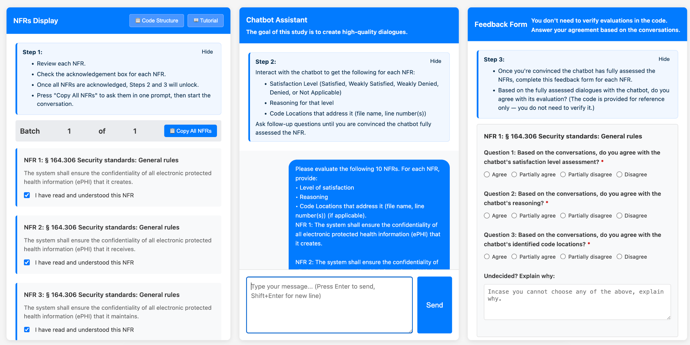
The Study Tool
SIGDIAL 2026
August 2026
9

Slide 14
Turn Annotation
Turn labels drawn from PARADISE + MT-Eval + MT-Bench-101
Label | Count
Given Data | 370
Follow-up | 195
Recollections | 156
Expansion | 152
Refinement | 53
User Initiatives | 37
Proactive Interaction | 36
Content Rephrasing | 29
Check Move (CM) | 27
Self-affirmation | 23
Self-correction | 16
Label | Count
Separate Input | 11
Instruction Clarification | 10
Anaphora Resolution | 9
Unsuitable Request | 3
Abandoned Requests | 2
Help Messages | 2
Format Rephrasing | 2
Inappropriate Responses | 1
Error | 1
Content Confusion | 0
Relevant Data | 0
SIGDIAL 2026
August 2026
11

Slide 15
Results

Slide 16
RQ1: Accuracy vs. Perceived Quality
Actual accuracy
(vs. ground truth)
User Rating
Satisfaction level
0.381
vs.
3.27/4
F1
SIGDIAL 2026
August 2026
12

Slide 17
RQ1: Accuracy vs. Perceived Quality
Actual accuracy
(vs. ground truth)
User Rating
Satisfaction level
0.381
vs.
3.27/4
F1
Reasoning
0.520
vs.
3.31/4
BERTScore F1
SIGDIAL 2026
August 2026
12

Slide 18
RQ1: Accuracy vs. Perceived Quality
Actual accuracy
(vs. ground truth)
User Rating
Satisfaction level
0.381
vs.
3.27/4
F1
Reasoning
0.520
vs.
3.31/4
BERTScore F1
Code location
0.203
vs.
3.34/4
F1
Low accuracy on every row, yet user rating stays significantly above “agree” (t-test, p < .001)
SIGDIAL 2026
August 2026
12

Slide 19
91-94%
developer rating
F1 = 0.203 – 0.520
actual accuracy
SIGDIAL 2026
14
Notes:
The responses are convincing without being CORRECT, and the people we hired to check them could not tell the difference.

Slide 20
Why It Happens: One Case
THE NFR
“The system shall implement procedures for creating passwords.”
SIGDIAL 2026
August 2026
15

Slide 21
Why It Happens: One Case
THE NFR
“The system shall implement procedures for creating passwords.”
THE SYSTEM SAID
Cites ResetPasswordAction.java, conflating password reset with password creation
SIGDIAL 2026
August 2026
15

Slide 22
Why It Happens: One Case
THE NFR
“The system shall implement procedures for creating passwords.”
THE SYSTEM SAID
Cites ResetPasswordAction.java: conflating password reset with password creation
THE PARTICIPANT SAID
Strongly Agree
Semantically adjacent. Functionally distinct. Plausible, and wrong.
SIGDIAL 2026
August 2026
15
Notes:
Let me make that concrete. One NFR requires the system to implement procedures for CREATING passwords. Ground truth points to the dedicated creation actions. The system instead cites ResetPasswordAction.java, it conflates password RESET with password CREATION. Semantically adjacent, functionally distinct, and the model did not discriminate. And the participant STRONGLY AGREED. The response was fluent, it cited a real file, the file had “Password” in the name. It was convincing. It was wrong.

Slide 23
RQ2: Modeling User Satisfaction: The PARADISE Framework
Premise: a dialogue system’s primary objective is to maximize user satisfaction.
Performance = α · N(κ) − Σ wᵢ · N(cᵢ)
κ = task success (from a confusion matrix) · cᵢ = dialogue costs · wᵢ = learned weights · N = Z-score normalization
Dialogue costs
Dialogue interaction patterns
e,g,. number of turns, elapsed time, mean words per response
Number of follow up turns, number of refinement turns
Walker et al. "PARADISE: A general framework for evaluating spoken dialogue agents." ACL 1997
SIGDIAL 2026
August 2026
15
Notes:
a dialogue system’s primary objective is to maximize user satisfaction.
in a dialogue system a performance function which is the estimation of a user satisfaction can then be derived by applying multivariate linear regression (MLR) with user satisfaction as the dependent variable and task-success measures and dialogue costs as the independent variables.

Slide 24
RQ2: Modeling User Satisfaction
PARADISE · 21 candidate predictors · 32 dialogues · backward elimination → 3 survivors
SIGDIAL 2026
August 2026
16
Notes:
ok the rating is high, what causes this high rating. we modeled user satisfaction to see why the users are satisfied with the results.

Slide 25
RQ2: Modeling User Satisfaction
PARADISE · 21 candidate predictors · 32 dialogues · backward elimination → 3 survivors
N̂(US) =
− 0.583
· N(Mean Words per Response)
Verbosity hurts
SIGDIAL 2026
August 2026
16

Slide 26
RQ2: Modeling User Satisfaction
PARADISE · 21 candidate predictors · 32 dialogues · backward elimination → 3 survivors
N̂(US) =
− 0.583
· N(Mean Words per Response)
Verbosity hurts
− 0.485
· N(Given Data)
Information-dumping hurts
SIGDIAL 2026
August 2026
16

Slide 27
RQ2: Modeling User Satisfaction
PARADISE · 21 candidate predictors · 32 dialogues · backward elimination → 3 survivors
N̂(US) =
− 0.583
· N(Mean Words per Response)
Verbosity hurts
− 0.485
· N(Given Data)
Information-dumping hurts
+ 0.422
· N(Proactive Interaction)
Taking initiative helps
Not in the model: task success. Whether the system was right did not predict satisfaction.
SIGDIAL 2026
August 2026
16
Notes:
Second question: what drives satisfaction? We applied PARADISE, which models satisfaction as a function of task success and dialogue costs. We started with 21 predictors after removing zero-variance and highly correlated ones, z-scored everything, ran backward elimination. Eighteen dropped out. Three survived. Mean words per response: NEGATIVE. Verbosity hurts. Given data, turns where the system just supplies what was asked for: also NEGATIVE. Information dumping hurts, even when the information is relevant. The one positive predictor: PROACTIVE INTERACTION. Turns where the system voluntarily asks a probing question, “which of these areas matters most, so I can dig deeper?” Participants valued the system taking initiative. Which option should I start on? Notice what is NOT in there: task success. Whether the system was actually right did not predict how satisfied users were.

Slide 28
Summary
1
91–94% agreement, F1 of 0.203–0.520 against expert ground truth
SIGDIAL 2026
August 2026
18

Slide 29
Summary
1
91–94% agreement, F1 of 0.203–0.520 against expert ground truth
2
Satisfaction is driven by number of given data turns, mean word per turn and proactive interaction
not by being correct
SIGDIAL 2026
August 2026
18

Slide 30
Summary
1
91–94% agreement, F1 of 0.203–0.520 against expert ground truth
2
Satisfaction is driven by number of given data turns, mean word per turn and proactive interaction
not by being correct
3
Corpus + annotated dialogues open-source: github.com/PERC-Lab/DialogueNFR
SIGDIAL 2026
August 2026
18

Slide 31


Thanks!
Any questions?
You can contact me at
ali.pourghasemi@maine.edu

Slide 32
References
Amyot, D., et al. “Evaluating goal models within the goal-oriented requirement language.” IJIS, 2010.
Bai, G., et al. “MT-Bench-101: A fine-grained benchmark for evaluating LLMs in multi-turn dialogues.” ACL 2024.
Burke, M. J., & Dunlap, W. P. “Estimating interrater agreement with the average deviation index.” ORM, 2002.
Hajdinjak, M., & Mihelič, F. “The PARADISE evaluation framework: Issues and findings.” Comput. Ling., 2006.
Kwan, W.-C., et al. “MT-Eval: A multi-turn capabilities evaluation benchmark for LLMs.” EMNLP 2024.
Laban, P., et al. “LLMs get lost in multi-turn conversation.” arXiv:2505.06120, 2025.
Meneely, A., Smith, B., & Williams, L. “iTrust electronic health care system case study.” 2012.
Walker, M., et al. “PARADISE: A framework for evaluating spoken dialogue agents.” ACL 1997.
Zhang, T., et al. “BERTScore: Evaluating text generation with BERT.” arXiv:1904.09675, 2019.
SIGDIAL 2026
August 2026

Slide 33
Building the NFR Corpus
650
statements extracted from HIPAA by a privacy & SE expert
SIGDIAL 2026
August 2026
7
Notes:
HIPAA is a U.S. federal regulation that establishes standards for protecting the privacy and security of individually identifiable health information, known as electronic protected health information (ePHI). We use HIPAA as a representative domain of regulatory NFRs.

Slide 34
Building the NFR Corpus
650
statements extracted from HIPAA by a privacy & SE expert
180
after two filters: SWEBOK software-construction scope + within iTrust scope
SIGDIAL 2026
August 2026
7
Notes:
The system shall support implementing a security awareness and training program for all workforce members, including management.
The system shall require a covered entity to obtain an authorization for any disclosure of psychotherapy notes.

Slide 35
Building the NFR Corpus
650
statements extracted from HIPAA by a privacy & SE expert
180
after two filters: SWEBOK software-construction scope + within iTrust scope
148
after second-expert review
e.g., “The system shall ensure the integrity of ePHI that it creates.”
SIGDIAL 2026
August 2026
7
Notes:
A privacy and software engineering expert read HIPAA and pulled out 650 statements. Two filters: the statement must be about software construction as defined in SWEBOK, and it must fall within the scope of our target system. That got us to 180. A second expert reviewed those, proposed edits, and flagged 32 as out of scope. Final corpus: 148 NFRs, things like “the system shall ensure the integrity of ePHI that it creates.”

Slide 36
Participants
1
49 programmers recruited: 8 pilot + 41 main study
SIGDIAL 2026
August 2026
10

Slide 37
Participants
1
49 programmers recruited: 8 pilot + 41 main study
2
Screened: CS/Math degree, software engineering role, 95–100% approval
SIGDIAL 2026
August 2026
10

Slide 38
Participants
1
49 programmers recruited: 8 pilot + 41 main study
2
Screened: CS/Math degree, software engineering role, 95–100% approval
3
34 dialogues after attention-check and quality filtering (406 turns)
SIGDIAL 2026
August 2026
10

Slide 39
Turn Annotation
1
Turn labels drawn from PARADISE + MT-Eval + MT-Bench-101
Label | Count
Follow-up | 195
Refinement | 53
User Initiatives | 37
Proactive Interaction | 36
Content Rephrasing | 29
Self-affirmation | 23
… | …
SIGDIAL 2026
August 2026
11

Slide 40
The PARADISE Framework
Premise: a dialogue system’s primary objective is to maximize user satisfaction.
Performance = α · N(κ) − Σ wᵢ · N(cᵢ)
κ = task success (from a confusion matrix) · cᵢ = dialogue costs · wᵢ = learned weights · N = Z-score normalization
Efficiency costs
Quality costs
how much effort the task took
what shapes the user’s perception
e.g., number of turns, elapsed time
e.g., response delay, errors, unsuitable responses
Walker et al. "PARADISE: A general framework for evaluating spoken dialogue agents." ACL 1997
SIGDIAL 2026
August 2026
15
Notes:
a dialogue system’s primary objective is to maximize user satisfaction.
a performance function can then be derived by applying multivariate linear regression (MLR) with user satisfaction as the dependent variable and task-success measures and dialogue costs as the independent variables.

Slide 41
Deriving the Performance Function
Fit multivariate linear regression: user satisfaction ~ task success + dialogue costs
Normalize Z-score every variable so the weights are directly comparable ( |w| ≤ 1 )
1
Walker et al. ACL 1997 · Hajdinjak & Mihelič. “The PARADISE evaluation framework: Issues and findings.” Computational Linguistics 2006
SIGDIAL 2026
August 2026
16

Slide 42
Deriving the Performance Function
Fit multivariate linear regression: user satisfaction ~ task success + dialogue costs
Normalize Z-score every variable so the weights are directly comparable ( |w| ≤ 1 )
1
De-correlate Drop predictors with | r | > 0.7 — keep the more significant one of each pair
2
Walker et al. ACL 1997 · Hajdinjak & Mihelič. “The PARADISE evaluation framework: Issues and findings.” Computational Linguistics 2006
SIGDIAL 2026
August 2026
16

Slide 43
Deriving the Performance Function
Fit multivariate linear regression: user satisfaction ~ task success + dialogue costs
Normalize Z-score every variable so the weights are directly comparable ( |w| ≤ 1 )
1
De-correlate Drop predictors with | r | > 0.7 — keep the more significant one of each pair
2
Backward elimination Iteratively remove predictors that are not significant ( p > 0.05 )
3
The surviving weights — and their signs — reveal what drives user satisfaction.
Walker et al. ACL 1997 · Hajdinjak & Mihelič. “The PARADISE evaluation framework: Issues and findings.” Computational Linguistics 2006
SIGDIAL 2026
August 2026
16
Notes:
PARADISE turns those weights into numbers with multivariate linear regression — satisfaction as the dependent variable, the costs as predictors. But the regression only behaves if you respect three constraints, and the Hajdinjak and Mihelič squib is pointed about this. (click) One: Z-score normalize everything, so a weight's magnitude actually reflects its contribution — and no weight exceeds one in absolute value. (click) Two: remove predictors that correlate above 0.7, because near-duplicates make the weights unstable. When two are redundant, you keep the one more significant to satisfaction. (click) Three: backward elimination — drop the least significant predictor, one at a time, until everything left clears p of 0.05. What you're left with is a compact function whose signed weights tell you what actually drives satisfaction — which is exactly what we report next.

Slide 44
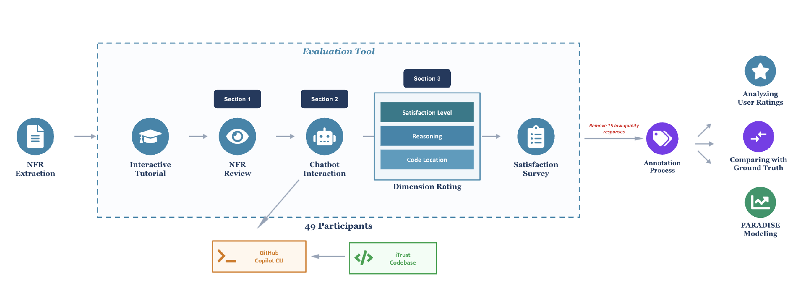
Figure 1 — Methodology Overview
SIGDIAL 2026
August 2026
Notes:
NFR extraction → ground-truth creation → 49 participants interact with GitHub Copilot CLI over iTrust → rate on three dimensions → satisfaction survey → annotation → accuracy comparison and PARADISE modeling.

Slide 45

Figure 2 — Survey Tool Interface
SIGDIAL 2026
August 2026
Notes:
Three panels: review NFRs (left), chatbot interaction (middle), response rating (right).

Slide 46
Table 1 — Related Work in Evaluating LLMs
Work | MT | SM | Evaluation target
Chen et al. (2021) | – | – | Code generation
Hendrycks et al. (2021) | – | – | Code generation
Yin et al. (2018) | – | – | Code generation
Jimenez et al. (2023) | – | – | Bug fixing
Jain et al. (2024) | – | – | Code generation
Aider (2024) | – | – | Code editing
Wu and Fard (2025) | – | – | Clarification ability
Laban et al. (2025) | ✓ | – | MT degradation
Vaithilingam et al. (2022) | ✓ | – | User expectations
Kumar et al. (2025) | ✓ | – | Agent collaboration
Liu et al. (2024b) | ✓ | – | Code quality
Sarkar et al. (2022) | ✓ | – | User experience
Liang et al. (2024) | ✓ | – | Usability
This work | ✓ | ✓ | NFR assessment
MT = Multi-turn · SM = Satisfaction Modeling
SIGDIAL 2026
August 2026

Slide 47
Table 3 — Key Statistics of Collected Dialogues
Statistic | Value
Total # Dialogues | 34
Total # Turns | 406
Avg. # Turns per Dialogue | 11.94
Avg. # Words in Prompt | 60.90
Max. # Words in Prompt | 496
Avg. # Words in Response | 129.46
Max. # Words in Response | 877
Avg. # Words per Turn | 190.36
Max. # Words per Turn | 1206
SIGDIAL 2026
August 2026

Slide 48
Table 2 — Inter-Rater Reliability (Cohen's κ)
Label | R1 | R1-redo | R2
Recollections | 0.000 | 0.640 | 0.772
Expansion | 0.129 | 0.602 | 0.666
Refinement | 0.176 | 0.729 | 0.615
Follow-up | 0.289 | 0.796 | 0.884
User initiatives | 0.668 | 0.898 | 1.000
Unsuitable-request | – | – | –
Inappropriate resp. | – | – | –
Error | – | – | –
Help messages | 0.000 | – | –
Given-data | 0.408 | 1.000 | –
Check move | 0.369 | 0.638 | 0.791
Label | R1 | R1-redo | R2
Relevant data | – | – | –
Abandoned requests | 0.000 | 1.000 | –
Anaphora Resolution | 0.000 | 1.000 | 1.000
Separate Input | – | – | –
Content Confusion | – | – | –
Content Rephrasing | 0.370 | 0.912 | 0.813
Format Rephrasing | 0.000 | – | –
Self-correction | 0.558 | 0.811 | –
Self-affirmation | 0.728 | 0.878 | 0.769
Instruction Clarif. | 0.479 | 0.790 | –
Proactive Interaction | 1.000 | 1.000 | –
Size: 50 / 50 / 54 Average κ: 0.323 / 0.836 / 0.812
– = insufficient variation to compute κ
SIGDIAL 2026
August 2026

Slide 49
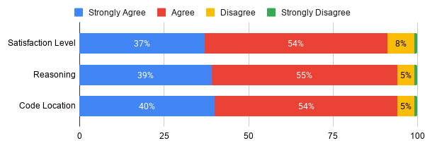
Figure 3 — Participant Agreement Distribution (RQ1)
SIGDIAL 2026
August 2026
Notes:
Distribution of agreement ratings across the three dimensions — overwhelmingly agree / strongly agree.

Slide 50
Table 4 — Accuracy of LLM vs. Ground Truth (RQ1)
Dimension | Metric | Score
Satisfaction Level | Precision | 0.438
 | Recall | 0.418
 | F1 | 0.381
Reasoning | BERTScore Precision | 0.521
 | BERTScore Recall | 0.529
 | BERTScore F1 | 0.520
 | Cosine Similarity | 0.774
 | ROUGE-1 | 0.204
 | ROUGE-2 | 0.037
 | ROUGE-L | 0.156
Code Location | Precision | 0.151
 | Recall | 0.142
 | F1 | 0.203
SIGDIAL 2026
August 2026

Slide 51
Table 8 — One-Sample t-Tests for Agreement (RQ1)
Dimension | Mean | SD | t | p
Satisfaction Level | 3.27 | 0.66 | 7.49 | < .001
Reasoning | 3.31 | 0.63 | 9.05 | < .001
Code Location | 3.34 | 0.60 | 10.41 | < .001
H₀: μ ≤ 3 (the “agree” threshold)
SIGDIAL 2026
August 2026

Slide 52
Table 5 — Mean Agreement & Rating Divergence (RQ1)
Dimension | Mean Agr. | High AD
Satisfaction Level | 3.27 | 19
Reasoning | 3.31 | 13
Code Location | 3.34 | 15
Of the 148 NFRs: 6 diverged on all three dimensions, 6 on two. Single-dimension divergences: code location 9, satisfaction level 7, reasoning 1.
High AD = # NFRs with Average-Deviation index > 0.67 (lack of consensus)
SIGDIAL 2026
August 2026

Slide 53
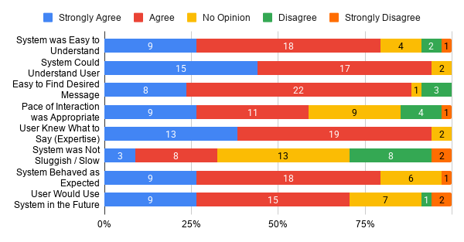
Figure 4 — Participants' PARADISE Ratings (RQ2)
SIGDIAL 2026
August 2026
Notes:
User-satisfaction survey items. Understanding-related items rated highest (~4.3); speed-related items lowest (~3).

Slide 54
Table 6 — Total Counts of Dialogue-Act Labels (RQ2)
Label | Count
Given Data | 370
Follow-up | 195
Recollections | 156
Expansion | 152
Refinement | 53
User Initiatives | 37
Proactive Interaction | 36
Content Rephrasing | 29
Check Move (CM) | 27
Self-affirmation | 23
Self-correction | 16
Label | Count
Separate Input | 11
Instruction Clarification | 10
Anaphora Resolution | 9
Unsuitable Request | 3
Abandoned Requests | 2
Help Messages | 2
Format Rephrasing | 2
Inappropriate Responses | 1
Error | 1
Content Confusion | 0
Relevant Data | 0
SIGDIAL 2026
August 2026

Slide 55
Table 11 — Descriptive Statistics for All Predictors (RQ2)
Variable | Mean | SD | Min | Max
User Satisfaction (US) | 31.26 | 3.65 | 20.00 | 37.00
Number of Turns | 11.94 | 7.95 | 2.00 | 27.00
Mean Response Time (s) | 45.80 | 33.05 | 12.59 | 157.77
Elapsed Time (s) | 3496.4 | 9230.8 | 312.9 | 55369
Mean Words / Request | 60.90 | 42.13 | 9.41 | 229.50
Mean Words / Response | 129.46 | 105.49 | 50.91 | 548.00
User Initiatives | 1.09 | 0.38 | 1.00 | 3.00
Unsuitable Requests | 0.09 | 0.29 | 0.00 | 1.00
Inappropriate Responses | 0.03 | 0.17 | 0.00 | 1.00
Errors | 0.03 | 0.17 | 0.00 | 1.00
Help Messages | 0.06 | 0.24 | 0.00 | 1.00
Given data | 10.88 | 7.47 | 2.00 | 26.00
Check Moves | 0.79 | 1.09 | 0.00 | 4.00
Relevant Data | 0.00 | 0.00 | 0.00 | 0.00
Abandoned Requests | 0.06 | 0.24 | 0.00 | 1.00
Unsuitable Request Ratio | 0.009 | 0.036 | 0.000 | 0.200
Inappropriate Resp. Ratio | 0.004 | 0.021 | 0.000 | 0.125
Variable | Mean | SD | Min | Max
Help Message Ratio | 0.003 | 0.014 | 0.000 | 0.063
Given data Ratio | 0.907 | 0.121 | 0.583 | 1.000
Check Move Ratio | 0.064 | 0.105 | 0.000 | 0.500
Relevant Data Ratio | 0.000 | 0.000 | 0.000 | 0.000
Abandoned Request Ratio | 0.002 | 0.009 | 0.000 | 0.040
Recollections | 4.59 | 3.64 | 0.00 | 11.00
Expansion | 4.47 | 4.01 | 0.00 | 12.00
Refinement | 1.56 | 2.27 | 0.00 | 10.00
Follow-up | 5.74 | 5.48 | 0.00 | 18.00
Anaphora Resolution | 0.26 | 0.57 | 0.00 | 2.00
Content Confusion | 0.00 | 0.00 | 0.00 | 0.00
Self-correction | 0.47 | 1.11 | 0.00 | 5.00
Self-affirmation | 0.68 | 1.39 | 0.00 | 5.00
Instruction Clarification | 0.29 | 0.52 | 0.00 | 2.00
Proactive Interaction | 1.06 | 2.17 | 0.00 | 12.00
Task Success | 0.95 | 0.26 | 0.55 | 1.80
Task Completion | 0.90 | 0.20 | 0.10 | 1.00
SIGDIAL 2026
August 2026

Slide 56
Table 9 — Predictors Removed for High Correlation (RQ2)
Removed | Retained | r
Errors | Inappropriate Resp. | 1.000
Inappropriate Resp. Ratio | Inappropriate Resp. | 1.000
Abandoned Requests | Abandoned Req. Ratio | 0.999
Help Message Ratio | Help Messages | 0.996
Number of Turns | Given data | 0.981
Expansion | Given data | 0.867
Follow-up | Given data | 0.860
Recollections | Given data | 0.853
Unsuitable Req. Ratio | Unsuitable Requests | 0.806
|r| > 0.7; for each pair the predictor with the higher p-value against US was removed
SIGDIAL 2026
August 2026

Slide 57
Table 10 — Backward-Elimination Sequence (RQ2)
# | Removed predictor | p | R²
1 | Mean Words Request | .853 | .728
2 | Given data Ratio | .802 | .727
3 | Mean Response Time | .865 | .726
4 | Task Completion | .803 | .725
5 | Instruction Clarification | .725 | .724
6 | Self-correction | .681 | .721
7 | Check Move Ratio | .652 | .718
8 | Check Moves | .688 | .714
9 | Unsuitable Requests | .534 | .711
# | Removed predictor | p | R²
10 | Inappropriate Responses | .484 | .705
11 | Anaphora Resolution | .446 | .697
12 | User Initiatives | .138 | .688
13 | Elapsed Time | .074 | .652
14 | Refinement | .111 | .597
15 | Help Messages | .150 | .549
16 | Self-affirmation | .157 | .507
17 | Abandoned Request Ratio | .166 | .465
18 | Task Success | .134 | .423
Highest-p predictor removed at each step; stopped when all remaining were significant (p < 0.05)
SIGDIAL 2026
August 2026

Slide 58
Table 7 — PARADISE Performance-Function Coefficients (RQ2)
Predictor | β | SE | t | p
Mean Words per Response | −0.583 | 0.174 | −3.35 | .002
Given data | −0.485 | 0.162 | −2.99 | .006
Proactive Interaction | 0.422 | 0.163 | 2.60 | .015
N̂(US) = −0.583·N(Mean Words/Response) − 0.485·N(Given Data) + 0.422·N(Proactive Interaction)
β: standardized coefficient · SE: standard error · t: test statistic
SIGDIAL 2026
August 2026

Slide 59
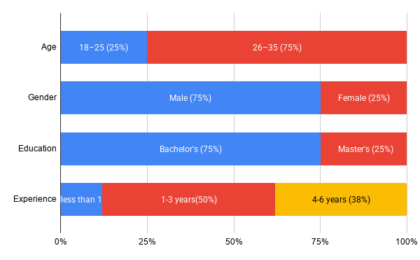
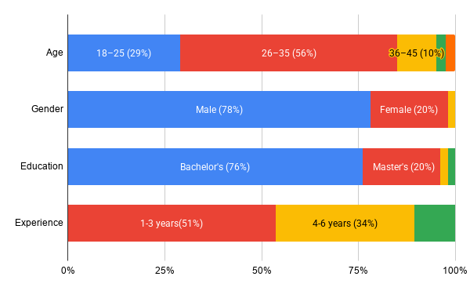
Figure 5 — Participant Demographics
Pilot study (n = 8)
Main study (n = 41)
SIGDIAL 2026
August 2026

Slide 60
What causes high satisfaction
Be concise. Be proactive. Don’t dump information.
SIGDIAL 2026
August 2026
17

Slide 61
What causes high satisfaction and a Warning
Be concise. Be proactive. Don’t dump information.
Do not optimize an agent against this function.
It would not produce a more accurate system, it would produce a system whose
inaccurate responses are more convincing, which may cause the gap we report.
SIGDIAL 2026
August 2026
17
Notes:
So the design guidance is: be concise, ask questions, do not flood the user with information. But I want to end with a warning, and it is the most important sentence in the paper. Our satisfaction function should NOT be used to increase user satisfaction. If you optimize an LLM agent against these coefficients, you do not get a more accurate system, you get a system that makes INACCURATE responses more convincing. Satisfaction and accuracy are decoupled here, and optimizing the one we can measure easily would widen exactly the gap we are reporting.

