Slide 1


GBC:
Gradient-Based Connections for Optimizing Multi-Agent Systems
Xiaocheng Yang, Abdulrahman Alrabah,
Dilek Hakkani-Tür, Gokhan Tur

Slide 2



Motivation
Multi-agent systems are hard to debug
Worker 1
Input
Output
Verbal Loss
Manager
Worker 2
Responder
Worker 3
● ●●
A final failure often hides where the failure actually started.
● ●●
But optimization needs: which agent, step, or token caused the error?
● ●●
Without attribution, prompt updates become broad and noisy.

Slide 3

Intuition
Core idea: build credit paths backward from loss
Worker 1
Input
Output
Verbal Loss
Manager
Worker 2
Responder
Worker 3
● Can we treat a multi-agent workflow as a computational graph, then estimate how each predecessor output influences downstream generation?

Slide 4



Method
GBC pipeline: Forward→Attribution→Backward→Update
Forward
Backward
1.0
LLM Output
Tool Output
LLM Output
Tool Output
1.0
0.2
Input
Loss
Input
0.2
0.5
1.0
Loss
LLM Output
LLM Output
LLM Output
LLM Output
LLM Output
LLM Output
1.0
0.8
0.3
LLM Output
1.0
LLM Output
Attribution
1.0
Update
LLM Output
Tool Output
1.0
0.2
Input
Loss
Input
Loss
LLM Output
0.2
LLM Output
0.5
LLM Output
1.0
LLM Output
LLM Output
LLM Output
1.0
0.8
0.3
Optimizer
Rewrite prompt
Target
1.0
LLM Output
1. Forward
Run the agent graph and produce the output.
2. Attribution
Compute connection weights.
3. Backward
Propagate the loss through the attribution graph.
4. Update
Rewrite the target prompts with an optimizer LLM.

Slide 5
Method
Gradient-based connections quantify influence
Predecessor
O_{u}
(Input sequence length × 1)
Token-level gradient
∇∏_{w∈Ov}P(w | Embed(O_{u}))
(Input sequence length × hidden size)
LLM Output
LLM Output
LLM Output
O_{v}
Token-level weight
Aggregation over dimension of hidden size
(Input sequence length × 1)
Connection weight
Aggregation over dimension of sequence length
(Scalar)
LLM Output
O_{u}
O_{u} Example
The hotel named Bedouin has been booked. Reference number is FRQZWQL2. Please inform the user of the information.
● L1 norm
|| ∇∏_{w∈Ov}P(w | Embed(O_{u})) ||_{L1}
● Product with Input
∇∏_{w∈Ov}P(w | Embed(O_{u})) · Embed(O_{u})
● Average effect of each token
Avg( · )
● Effect of the most important token
Max( · )

Slide 6
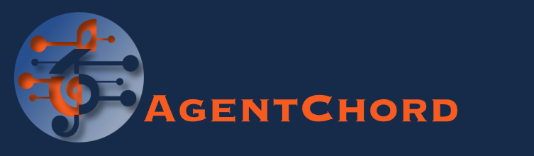
Implementation
Prefix trick makes optimization loop practical
W/o prefix trick
Prompt
Input
Output
W/ prefix trick
Prompt
(no grad required)
KV Cache
● ●●
Gradient-Based Connections for automated multi-agent system optimization.
● ●●
Handy visualization of Gradient-Based Connections.
● ●●
Connected to W&B to easily monitor the optimization process.
Output
Input
(grad required)
● Prompt tokens are treated as a fixed prefix.
● Gradients are only stored for input tokens.
● Autograd activation memory: O(n · d · L) → O((n - k) · d · L)
● AgentChord, a practical, lightweight framework is built around this prefix trick.

Slide 7
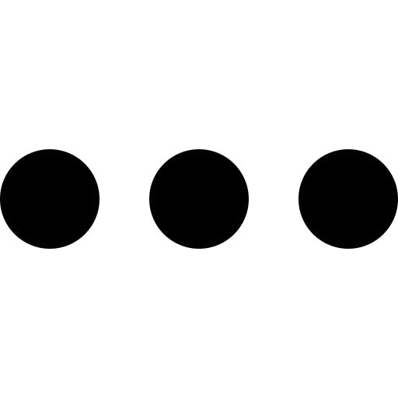
Experiment
Evaluation: dialogue + tool-use multi-agent systems
MultiWOZ 2.4
Task-oriented dialogue.
τ-bench
Interactive multi-step tool-use with a user simulator.
Attraction
Worker
Input
[User] xxx
Input
[User] xxx
Output
(1st Turn)
Post Delivery
Worker
Output
(1st Turn)
Hotel
Worker
User Resolution
Worker
Retrieval
Worker
Input
[User] xxx
[Agent] xxx
[User] xxx
Input
[User] xxx
[Agent] xxx
[User] xxx
Reward Loss
Output
(2nd Turn)
JGA Loss
User Simulator
Order Modification
Worker
Output
(2nd Turn)
Manager
Restaurant
Worker
Responder
Responder
Train
Worker
Inform & Success Loss
User Profile
Worker
Input
(Last Turn)
Output
(Last Turn)
Input
(Last Turn)
Output
(Last Turn)
Taxi
Worker
Manager
6
Metrics
Inform, Success, JGA, and Slot metrics
10
Steps
Update every 3 samples
3
Metrics
Action, Output, and Overall Reward
10
Steps
Update after each complete conversation

Slide 8
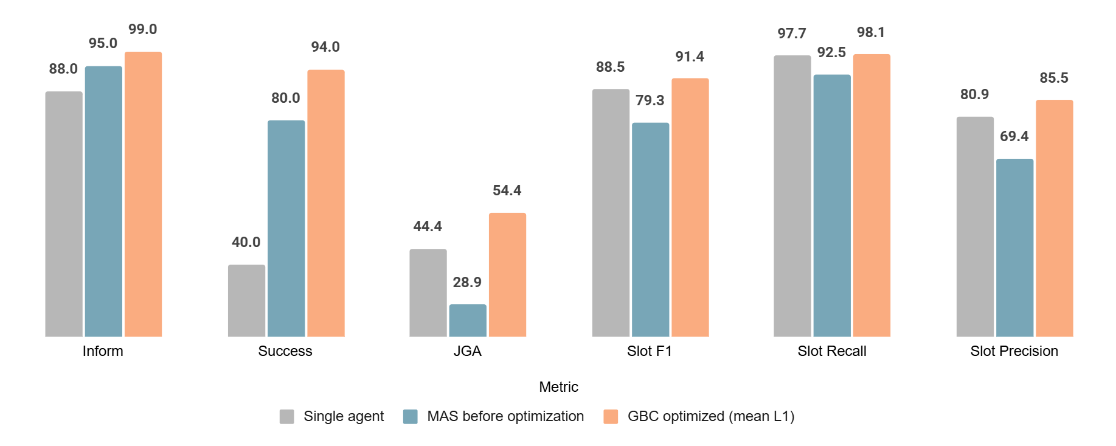
Result
MultiWOZ: GBC builds a strong TOD system
+25.5
JGA
28.9→54.4
+12.1
Slot F1
79.3→91.4
99.0
Inform
Best score
94.0
Success
2nd best score
● Qwen-3-32B multi-agent system before optimization had high Inform/Success but weaker state tracking; GBC fixes the bottleneck.
● The optimized MAS surpasses the Qwen-3-32B single-agent baseline on Inform, Success, JGA, and Slot metrics.

Slide 9
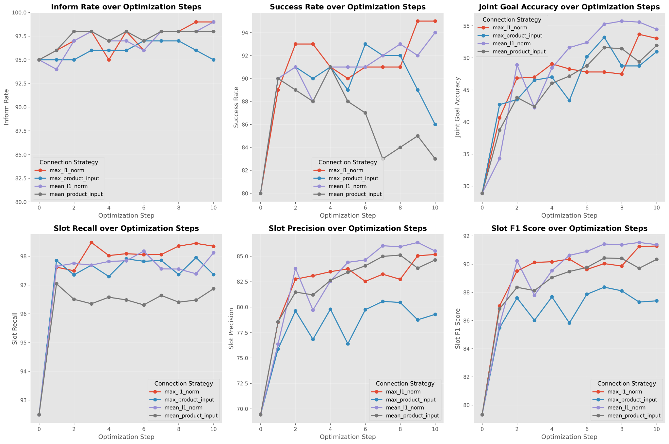
Result
Optimization dynamics: most metrics improve steadily
● ●●
JGA rises and continues trending upward.
● ●●
Slot precision and slot F1 improve, indicating fewer over-predicted slots.
● ●●
Success is more variable, reflecting higher requirement of the metric.
● ●●
L1-norm-based connection weights yield the strongest performance.

Slide 10
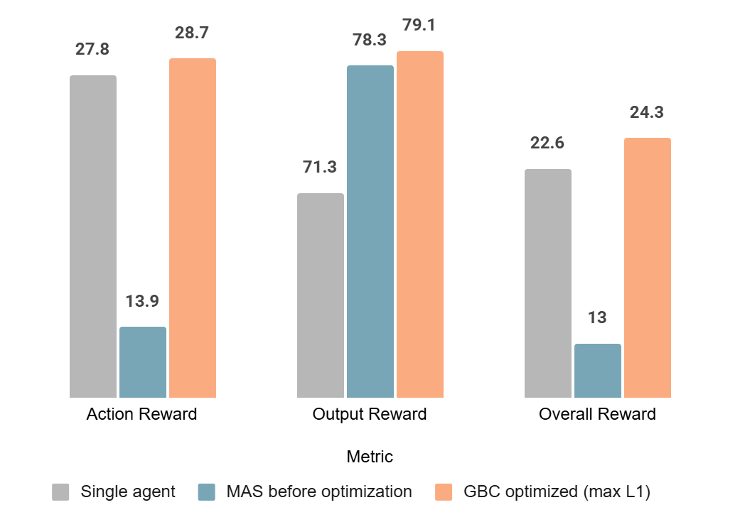
Result
τ-bench: GBC improves interactive tool use
Retail
Task Domain
Availability of training data
13.9 → 28.7
Action Reward
Best score
13.9 → 24.3
Overall Reward
Best score
● GBC enables the Qwen multi-agent system to surpass the strong single-agent baseline.
● The gain mainly comes from improved interactive tool-use capability.
*Output Reward shown with axis break.

Slide 11
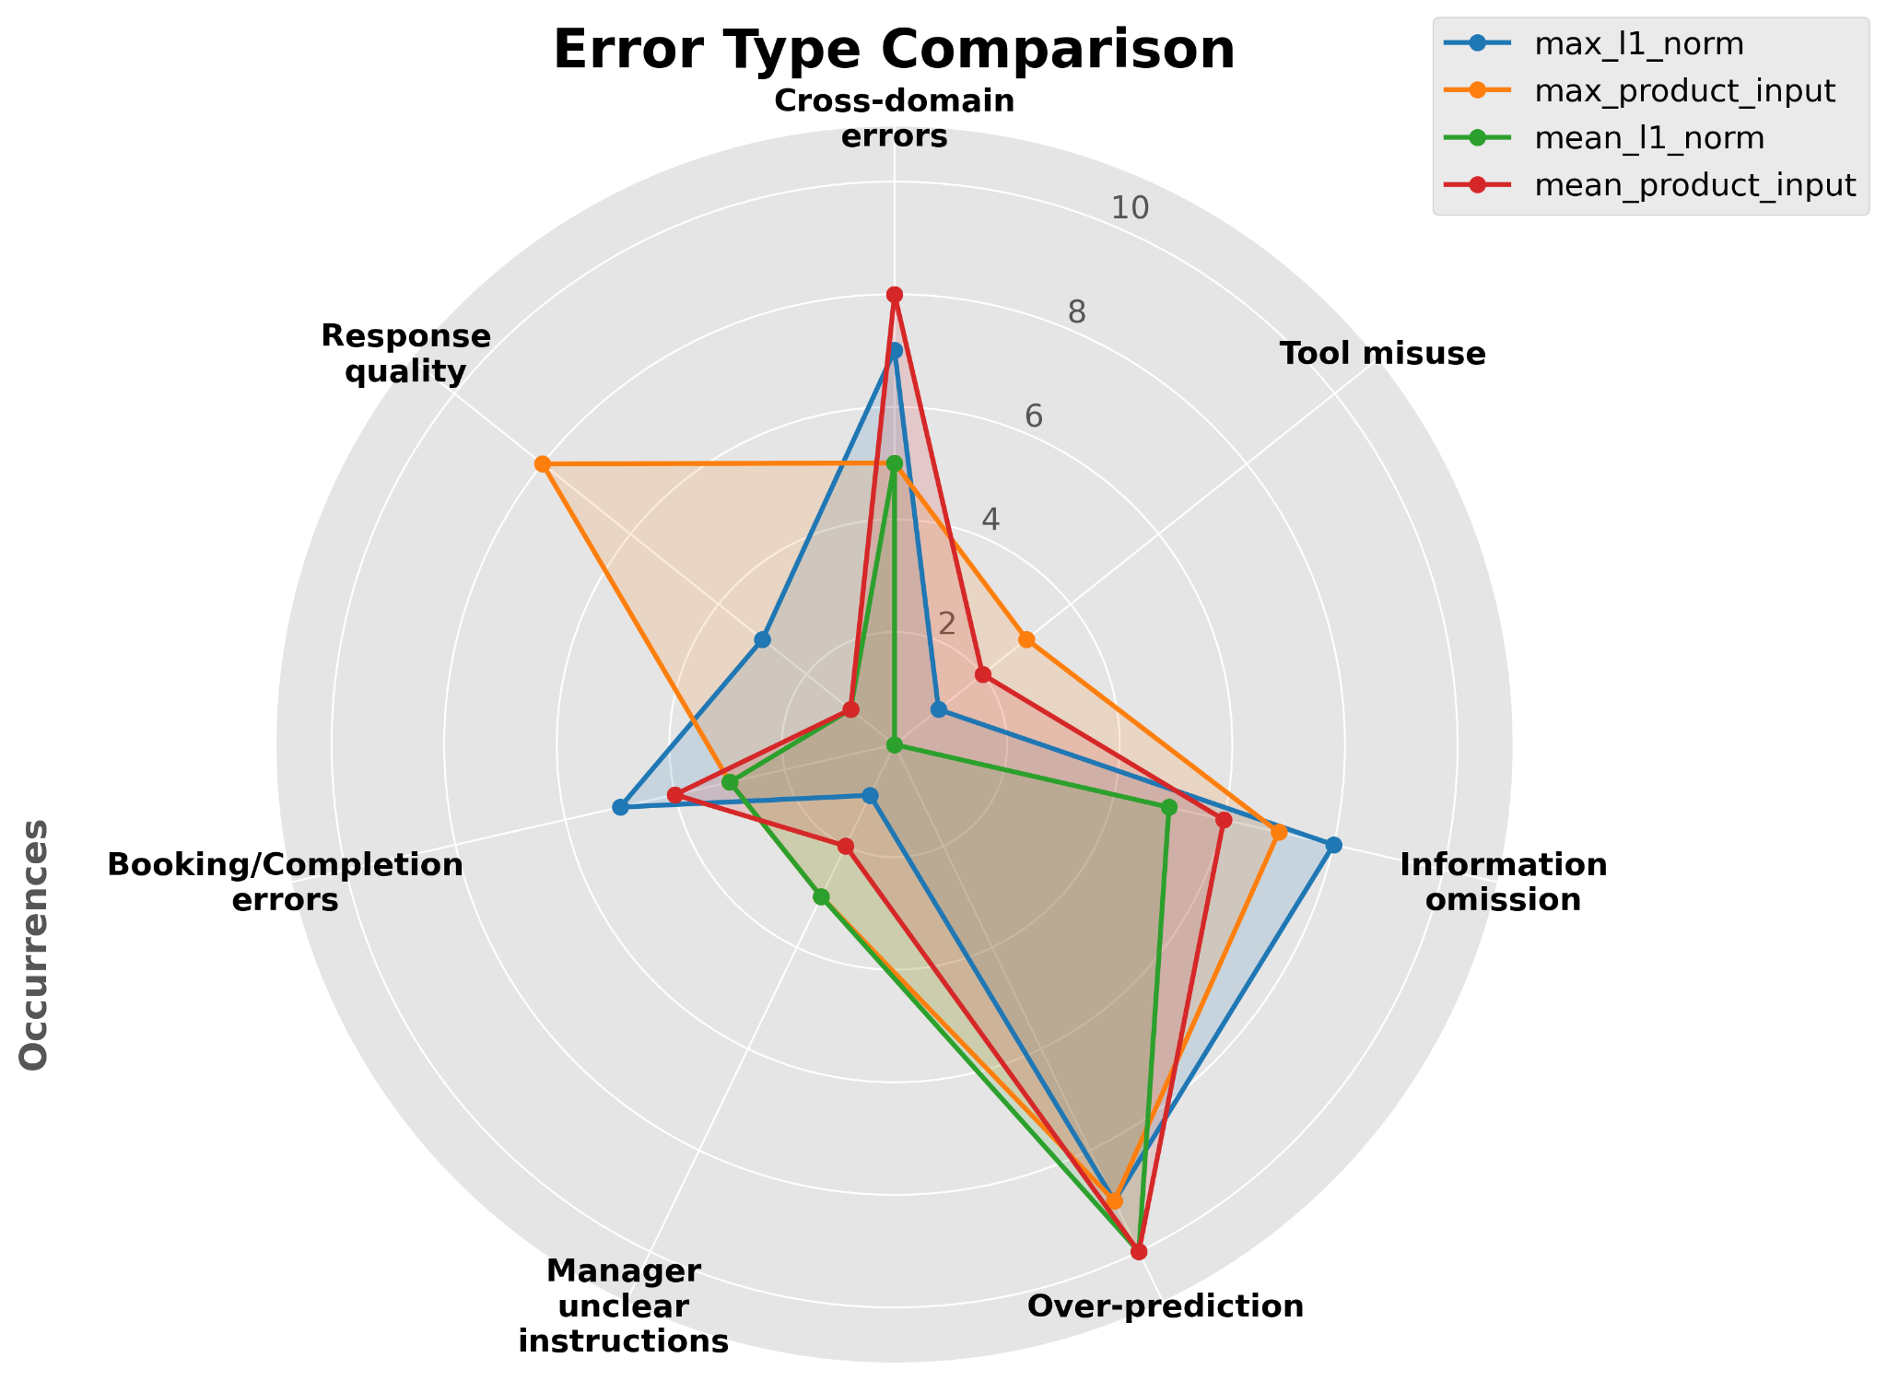
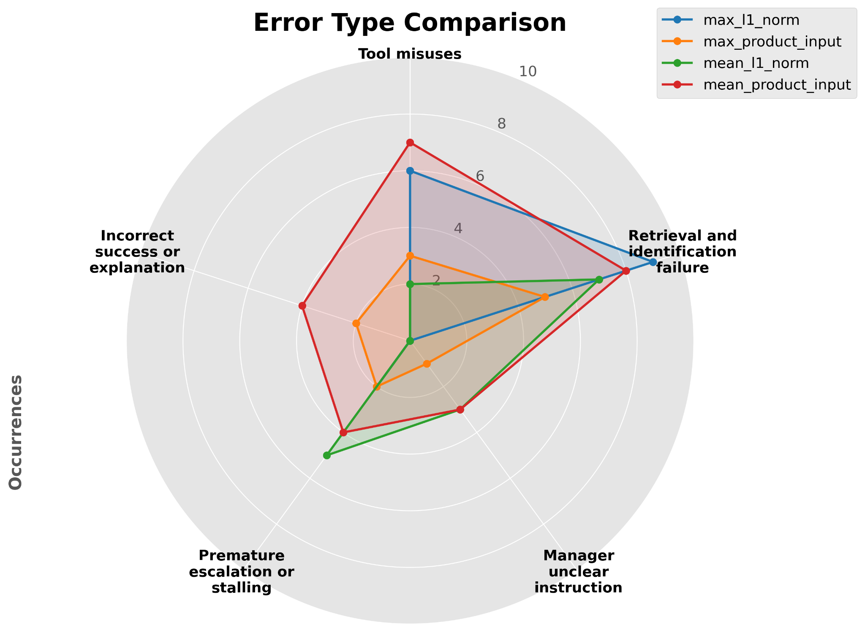
Analysis
Diagnostics: GBC shows what still fails and why
MultiWOZ 2.4
Cross-domain errors, information omission, and over-prediction dominate.
τ-bench
Retrieval and identification failure, tool misuse, and premature escalation or stalling dominate.

Slide 12
Conclusion
● GBC makes multi-agent optimization more targeted by assigning credit across agents using gradient signals at token level.
● ●●
Model the MAS as a computational graph.
● ●●
Use gradient-based connections to construct attribution trajectories.
● ●●
Update only the prompts implicated by those trajectories.
Empirical message
GBC improves MultiWOZ and τ-bench performance, and can enable optimized multi-agent systems to surpass strong single-agent baselines.
Open directions
More efficient gradient approximations, improved verbal loss design, reinforcement learning integration, and dynamic agent topologies.

Slide 13
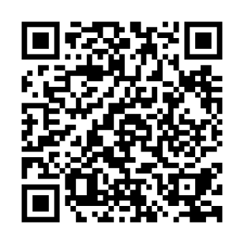
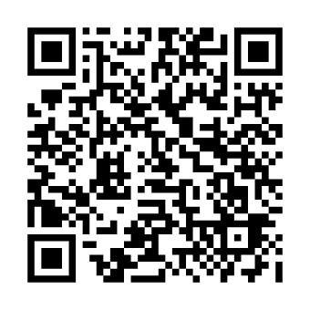
GBC:
Gradient-Based Connections for Optimizing Multi-Agent Systems
Code
Paper

