Slide 1

E
R
E
Do LLMs actually use
relations in a KG?
Evidence from Entity and Relation Perturbation
Dominic Okonkwo · Ismailcem Budak Arpinar
NeSLab · School of Computing · University of Georgia
1 / 18

Slide 2
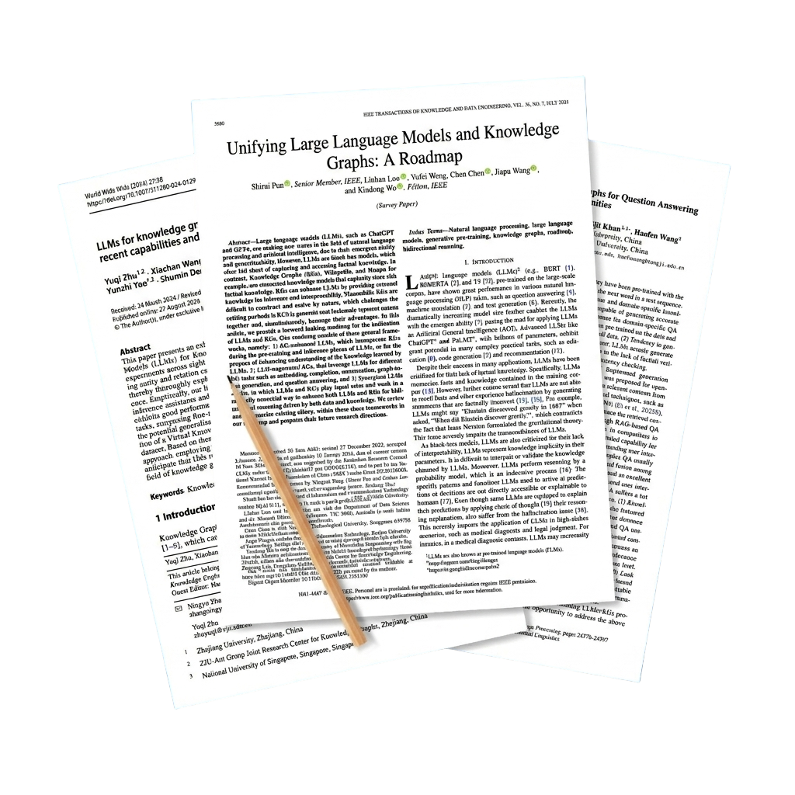
BACKGROUND
Knowledge Graphs are becoming a
key component of LLM systems.
KG-grounded dialogue · KG-LLM integration · Graph reasoning, well-cited, actively growing research area
Okonkwo & Arpinar · SIGDIAL 2026

Slide 3
THE UNTESTED ASSUMPTION
KG-dialogue systems assume the LLM
understands and uses the relation.
Dialogue
Retrieve KG Facts
Iron Man
── starred_actor ──►
Robert Downey Jr
Moon '19
Kang '23
Park '24
Wang '22
Tuan '22
LLM
Response
The gap: All of these systems build relation types into the model, but none test whether the model actually uses the typed label at inference.
Okonkwo & Arpinar · SIGDIAL 2026

Slide 4
SO WE ASKED
Do models actually use the relation,
or just the entities?
These systems produced good results.
Researchers assumed KG grounding helped.
Original KG triple
( Iron Man, starred_actor, Robert Downey Jr. )
But when a model generates a response, you cannot tell from the output alone whether it used the relation label, or whether it already knew the answer from training.
LLM generates
"Robert Downey Jr. starred in Iron Man, the 2008 Marvel superhero film…"
If the relation drove the response
removing or corrupting it should change the output
❓ Did it use starred_actor?
If the entity dominated
Or did it already know Robert Downey Jr. starred in Iron Man from pretraining ,making the relation label irrelevant?
the output looks the same regardless of the relation
Nobody had directly tested which one it is.
Okonkwo & Arpinar · SIGDIAL 2026
4 / 18

Slide 5
METHOD — THREE CONDITIONS
Our idea: hold everything constant.
Change only the relation.
Any change in response is caused by the relation, nothing else.
C1
Intact
C2
Shuffled
C3
Entities Only
Iron Man
Iron Man
Iron Man
starred_actors
written_by
—
Robert Downey Jr.
Robert Downey Jr.
Robert Downey Jr.
Correct relation · Full KG triple
Same entities · Corrupted relation
No relation · Entity baseline
If model uses the relation → C1 and C2 responses diverge.
If model ignores the relation → C1 and C2 responses look identical.
C3 = ceiling: what "no relation" looks like — maximum disruption.
Okonkwo & Arpinar · SIGDIAL 2026

Slide 6
EVALUATION — TWO KNOWLEDGE GRAPHS
Evaluation on Two Knowledge Graphs
OpenDialKG
WoW-KG (ours)
Widely used benchmark
Built from Wikidata, independent testbed
Human-human dialogues grounded in Freebase paths.
Wizard of Wikipedia augmented with Wikidata triples.
Freebase · 175 relations · 3,216 test turns
Wikidata · 219 relations · 778 test turns
Relation style: short, close to natural language
Tests whether findings generalise beyond one benchmark
starred_actors · written_by · has_genre
instance_of · occupation · country
4 domains: movies, books, sports, music
More abstract labels, harder to guess from wording alone
Okonkwo & Arpinar · SIGDIAL 2026

Slide 7



SETUP — MODELS
6 Models · 3 Families · Same Zero-Shot Prompt
Large and small variants of each family, to test whether scale changes the finding.
OpenAI
Meta
Alibaba
▸ GPT-4o
▸ Llama-3.1-70B
▸ Qwen2.5-32B
▸ GPT-4o-mini
▸ Llama-3.1-8B
▸ Qwen2.5-7B
Zero-shot. No fine-tuning. No few-shot examples. Same prompt template across every model and every condition.
Okonkwo & Arpinar · SIGDIAL 2026

Slide 8
SETUP — THE PROMPT
The Prompt
Identical across all 6 models and all 3 conditions. Only the {knowledge} field changes.
SYSTEM
You are a knowledgeable conversational assistant.
Use the knowledge to continue the conversation naturally.
Respond in 1–3 sentences only.
USER
Topic: {dialogue topic}
Knowledge:
C1
Iron Man --[starred_actor] --> Robert Downey Jr.
C2
Iron Man --[written_by] --> Robert Downey Jr.
C3
Entities: Iron Man, Robert Downey Jr.
Continue the conversation as the Assistant:
Okonkwo & Arpinar · SIGDIAL 2026
8 / 18

Slide 9
METRIC
How do we measure relation sensitivity?
If changing only the relation barely changes the response,
the model likely did not use the relation.
Relation Sensitivity Score (RSS)
RSS = 1 − ROUGE-L( ResponseOriginal , ResponsePerturbed )
RSS ≈ 0
Responses nearly identical
RSS ≈ 1
Responses very different
→ Low relation sensitivity
→ High relation sensitivity
Also computed:
Div-C3
Divergence when relation is removed entirely (C3 baseline)
Ratio
= RSS ÷ Div-C3 → near 1.0 means shuffling ≈ removing
Okonkwo & Arpinar · SIGDIAL 2026

Slide 10
HUMAN VALIDATION — TEASER
We also asked Humans
RSS is computed automatically, but we also validated it with blinded human judgments.
3 independent raters
100
turns
GPT-4o on OpenDialKG
given to 3 blind raters
Okonkwo & Arpinar · SIGDIAL 2026
Notes:
TEASER SLIDE — Between slide 9 (RSS) and slide 10 (Ratio) (~30 sec) "Before I show you the result — I want to address the obvious question: RSS is computed automatically using text similarity. How do we know it actually captures whether the model used the relation?" "We ran a human evaluation. 100 turns. Three independent raters. Blind to condition." "When RSS is near zero — when we say the model ignored the relation — 95% of the time human raters couldn't tell the difference between the valid-KG and corrupted response either. The corruption left no trace." "That's our validation. The metric is real. Now let's see what it found." Move to slide 10.

Slide 11
UNDERSTANDING THE RATIO
Before the result, what should we expect?
How much did shuffling disrupt, relative to removing the relation entirely?
If models USE the relation
If models IGNORE the relation
Shuffling (C2) causes much LESS disruption
than removing (C3).
Shuffling (C2) causes SIMILAR disruption
to removing (C3).
Ratio near 0 → GOOD: the relation did real work.
Ratio near 1 → BAD: the relation added almost nothing.
⚠️ Key direction: Higher Ratio = worse. Ratio near 1.0 means the correct relation added almost nothing beyond the entities alone.
Okonkwo & Arpinar · SIGDIAL 2026

Slide 12
MAIN RESULT
Shuffling a relation changes the response
almost as little as removing it entirely.
Ratio range
0.82–0.98
across all 12
model-dataset pairs
Wilcoxon p < 0.001
all 12 pairs
≥ 0.95 — extreme
0.90–0.95
< 0.90
Okonkwo & Arpinar · SIGDIAL 2026

Slide 13
STATISTICAL EVIDENCE
This is not noise.
It holds everywhere.
RSS(t) < Div_C3(t) for every single model, on every single dataset.
GPT-4o
GPT-4o-mini
Llama-3.1-70B
Llama-3.1-8B
OpenDialKG
OpenDialKG
OpenDialKG
OpenDialKG
p <0.001
p <0.001
p <0.001
p <0.001
GPT-4o
GPT-4o-mini
Llama-3.1-70B
Llama-3.1-8B
WoW-KG
WoW-KG
WoW-KG
WoW-KG
p <0.001
p <0.001
p <0.001
p <0.001
Qwen2.5-7B
Qwen2.5-32B
Qwen2.5-7B
Qwen2.5-32B
OpenDialKG
OpenDialKG
WoW-KG
WoW-KG
p <0.001
p <0.001
p <0.001
p <0.001
One-sided Wilcoxon signed-rank test: H₁: RSS(t) < Div_C3(t)
Okonkwo & Arpinar · SIGDIAL 2026

Slide 14
FINDING — SCALE
You might think bigger models fix it.
They don't. They make it worse.
Llama-3.1
Qwen-2.5
8B
0.821
7B
0.915
Smaller model
Smaller model
70B
0.959
32B
0.978
Larger model
Larger model
Larger model: +0.063 - 0.138 worse
Why? Stronger parametric recall means the model leans even harder on what it already knows about the entity.
More world knowledge → more entity salience → relation label becomes even more irrelevant.
Okonkwo & Arpinar · SIGDIAL 2026

Slide 15
EXPLANATION — TWO MECHANISMS
The Ratio distribution has two explanations.
1
Entity Salience
2
Surface-Form Confusion
The model already knows enough about
the entity from pretraining.
The relation becomes irrelevant, the
response is entity-anchored regardless
of which relation it receives.
The shuffled relation's wording carries
real semantic content.
The model reads the label as natural
Language, not as a typed ontological
pointer, and follows the wording somewhere wrong.
Spearman ρ = −0.108 (OpenDialKG)
ρ = −0.071 (WoW-KG)
p < 0.001 · replicated across all 6 models
[sport played] → Robert Duvall
→ Model pivots to his real baseball interest
RSS = 0.771 (factually true, contextually wrong)
→ This explains low-RSS turns.
Model ignores the relation whether it's correct or wrong.
→ This explains high-RSS turns.
But it's the wrong reason, wrong label hijacked the response.
Okonkwo & Arpinar · SIGDIAL 2026

Slide 16
EXAMPLES — WHAT THIS LOOKS LIKE
Let me show you both in action.
RSS ≈ 0 · Entity Salience
RSS = 0.771 · Surface-Form Confusion
C1 Blood Promise – [has_genre] → young-adult fiction
C1 The Apostle – [written_by] → Robert Duvall
"Blood Promise is a young adult fantasy novel, part of the Vampire Academy series by Richelle Mead."
"Robert Duvall both wrote and directed The Apostle, a 1997 drama in which he starred as a Pentecostal preacher."
C2 Blood Promise – [starred_actors] → young-adult fiction
C2 The Apostle – [sport played] → Robert Duvall
"Blood Promise is a young adult fantasy novel, part of the Vampire Academy series by Richelle Mead."
"Robert Duvall is known for his versatility as an actor. He has played many roles, including baseball-related ones…"
Word-for-word identical. Entity salience took over.
[sport played] sent the model to Duvall's baseball interest.
The entity "Blood Promise" is domain-specific enough that relation label could not redirect the response.
Factually true. Completely wrong for the context.
High RSS, but for the wrong reason.
Okonkwo & Arpinar · SIGDIAL 2026

Slide 17
HUMAN EVALUATION
We asked humans to verify.
100 turns · GPT-4o · OpenDialKG · 3 raters · blind to condition
53%
58%
95%
preferred the
valid-KG response
couldn't tell which
response was corrupted
couldn't detect corruption
on zero-RSS turns
vs only 8% shuffled
Why we ran it:
RSS is automatic text comparison. A skeptic could say the responses just sound different but mean the same thing.
When entity salience dominates, the two responses are so similar that 95% of the time a careful human reader sees no difference. The wrong relation left no trace, because it was never used.
Okonkwo & Arpinar · SIGDIAL 2026

Slide 18
What we showed.
✓
Relations are systematically underutilized. Ratio 0.82–0.98. p < 0.001. 12 of 12 pairs.
✓
Two mechanisms: entity salience (low RSS) and surface-form confusion (high RSS). Neither is genuine relational reasoning.
✓
Scale amplifies the problem. Larger models lean harder on parametric recall, relation labels matter even less.
✓
Humans confirm it. 58% undetectable overall. 95% on zero-RSS turns. The wrong relation left no trace.
✓
New tools: WoW-KG (219 relation types, released) and RSS (reusable behavioral metric).
Current LLMs in KG-grounded dialogue mostly use entities, not typed relations.
Okonkwo & Arpinar · SIGDIAL 2026

Slide 19
Thank you.
Dominic Okonkwo · dominic.okonkwo@uga.edu
NeSLab · School of Computing · University of Georgia
Questions?
Okonkwo & Arpinar · SIGDIAL 2026

