Slide 1
SIGDIAL 2026 · ORAL PRESENTATION
DiPS
Dialogue Policy Selection for
High-Stakes Persuasion Agents
Tianyi Zhang* · Mousumi Das* · Abrar Anwar · Jesse Thomason · David Traum
University of Southern California

Slide 2


MOTIVATION
A wildfire is coming. Someone won't leave.
OPERATOR
Hi. Do you need assistance leaving?
Stakes are asymmetric
A failed dialogue is not a bad user experience. It is property loss, injury, or death.
RESIDENT
I'm not leaving. I have too much work here.
OPERATOR
You need to leave. It's not safe.
RESIDENT
There are never enough operators
You really think it's that bad?
Human dispatchers can't reach every resident in an affected area, which motivates an artificial operator (Vaidyanath & Georgila, 2020).
OPERATOR
It is. You must leave now. Do you need a vehicle?
RESIDENT
Alright, I'll wait for the vehicle.
The operator reaches residents through a drone relay (Chaffey et al., 2020).
DiPS · SIGDIAL 2026
2

Slide 3
THE IDEA, UP FRONT
DiPS: pick the persuasion strategy, turn by turn
Strategy is the action the model chooses a persona, not a sentence
Dialogue Policy Selection
✓
Learned offline no live wildfire to explore; we only have logged data
Instead of learning what words to say, DiPS learns which of a few persuasion strategies to deploy at each turn, using offline reinforcement learning over logged dialogues.
✓
Reused across residents a strategy learned from some residents transfers to new ones
✓
Why it matters
The result to expect
Different residents need completely different persuasion. A single fixed policy can't fit them all, and that gap is exactly what DiPS closes.
On residents it never trained on, DiPS is the most persuasive method in our human study (79% overall), and reaches ~92% in simulation, close to the ~85% acceptance rate reported for human operators.
DiPS · SIGDIAL 2026
3

Slide 4
THE CORE DIFFICULTY
One-size-fits-all protocols fail, because residents differ
M
Michelle skeptical
R
Ross logistically blocked
Believes her house is well prepared. Needs the risk reframed, not repeated.
Stranded van, passengers in wheelchairs. Needs a concrete transport commitment.
L
Lindsay responsible for others
B
Bob disengaged
Babysitting two children, no parental approval. Needs reassurance and permission.
Working from home, thinks there's still time. Needs a stay-vs-leave cost comparison.
Uniform instructions (“you must evacuate now”) ignore these differences. The strategy has to adapt to the person.
DiPS · SIGDIAL 2026
4

Slide 5
TESTBED
An offline dataset where one fixed policy won't fit everyone
The simulation (existing framework)
10
resident profiles
A forest fire advances on a small town. A control-center operator manages drones, a ground vehicle, and an AI assistant to locate residents and get them out.
5 from the original study, 5 new profiles with similar concerns but distinct backstories
Humans played the operator; experimenters wizarded the residents. Dialogues were transcribed and annotated (Chaffey et al., 2020; Nasihati Gilani et al., 2023).
5
operator policies
each a consistent persuasion strategy derived from one operator's style
This is our offline dataset: real human persuasion attempts, both successful and failed, that a single fixed policy could never fit uniformly.
85%
human baseline
acceptance rate reported for human operators (Nasihati Gilani et al., 2023)
DiPS · SIGDIAL 2026
5

Slide 6
Part I
1
Persuasion as a POMDP
Dialogue Policy
Selection
the resident's state is latent; we only see utterances
2
A policy over policies
the action is a strategy, not an utterance
3
Implicit Q-Learning
learn the selector offline, from logged dialogues

Slide 7
FORMULATION
Persuasion under partial observability
M = ( S, O, A, P, R, γ )
sₜ ∈ S
Latent state
Objective
The resident's beliefs, emotional state, and risk perception. We never observe this.
maxπ 𝔼π,P [ Σᵀₜ₌₁ γᵗ⁻¹ rₜ ]
oₜ ∈ O
Observation
The resident's reply to our previous utterance aₜ₋₁. That is all we actually get.
Expected discounted return over a finite horizon T, where rₜ = R(sₜ).
hₜ
History
hₜ = (a₀, o₁, a₁, …, oₜ). The operator's sufficient statistic in place of sₜ.
In this domain the return has exactly one meaning: does the resident actually evacuate?
π(hₜ) = aₜ
Policy
Maps history to the next operator action; then sₜ₊₁ ~ P(· | sₜ, aₜ).
DiPS · SIGDIAL 2026
7

Slide 8
THE KEY IDEA
Choose a strategy, not an utterance
hₜ
zₜ ∈ {1, …, K}
aₜ ~ π⁽ᶻᵗ⁾( · | hₜ )
dialogue history
learned selector
the operator's utterance
Conventional
DiPS
What is a policy πₖ, concretely?
One monolithic policy over natural-language responses.
A policy over policies.
a persona-specific block added to the operator prompt, plus
its own retrieval index of (history → operator response) pairs from that policy's dialogues.
Π = { π⁽¹⁾, …, π⁽ᵏ⁾ }
Each π⁽ᵏ⁾ is one persuasion strategy: empathetic, directive, informational, assertive.
Policies are reused across residents, so a strategy transfers to residents it never saw.
Built from offline data, per operator. The selector over them is learned across the whole dataset.
Huge action space · sparse reward · few hundred dialogues
DiPS · SIGDIAL 2026
8

Slide 9
LEARNING THE SELECTOR
Why offline RL, and why Implicit Q-Learning
✕
The problem: distributional shift
✓
IQL (Kostrikov et al., 2021)
We cannot let an agent explore. There is no live wildfire to practice on, so learning must come from a static, previously collected dataset (Kumar et al., 2020).
But an offline-learned Q-function overestimates values for out-of-distribution actions, ones never taken in the data, and the policy then chases those phantom values (Fujimoto et al., 2019).
With a few hundred dialogues and sparse terminal reward, this failure mode is not hypothetical.
Never queries the Q-function on unseen actions at all.
Approximates the max over actions using expectile regression on a state-value function trained only on in-distribution data.
Extracts the policy by advantage-weighted regression.
Well-suited to complex action spaces with limited data coverage, exactly our regime.
Intuition: up-weight the personas that appear when the resident evacuated, down-weight those in failures. The model infers which strategies work for which kinds of resident.
DiPS · SIGDIAL 2026
9

Slide 10
DATASET
Turning dialogues into transitions
Each dialogue
→
( sₜ , aₜ , rₜ , sₜ₊₁ )
sₜ
State
Evaluating generalization
A MiniLM sentence embedding of the resident's recent utterances, our observable proxy for the latent state.
Residents are partitioned into disjoint train and test sets.
The selector is trained only on training residents, and evaluated on unseen residents with distinct profiles.
Each training dialogue supplies one action per turn: the operator persona learned for that resident.
aₜ
Action
A discrete operator policy index. Not the message to the resident, but the strategy used to condition the LLM that writes it.
rₜ
Reward
Sparse. 1 at the final turn of a successful dialogue (the resident agrees to evacuate), 0 everywhere else.
DiPS · SIGDIAL 2026
10

Slide 11
INFERENCE · 1 OF 2
From the dialogue, choose a strategy
The dialogue so far
Mary · held-out
IQL policy selector
OP
score every strategy with the learned Q-function
There's a mandatory evacuation order for your area.
Q(Hₖ, Bob)
1.31
MARY
I can't just go. My husband isn't back yet.
Q(Hₖ, Niki)
1.92
OP
▶
The fire is moving fast; we need to act now.
Q(Hₖ, Lindsay)
2.44
MARY
Q(Hₖ, Ross)
2.20
Then help me reach him. I won't leave him behind.
Q(Hₖ, Michelle)
1.18
the last k turns = Hₖ
Mary is one of the 5 held-out residents. The selector was trained on other residents entirely.
zₜ = argmaxₓ Q(Hₖ, z) → Lindsay
DiPS · SIGDIAL 2026
11

Slide 12
INFERENCE · 2 OF 2
Assemble the prompt, generate the reply
What the selected strategy puts into the operator prompt
Generated operator turn
Hₖ
the recent dialogue turns
“Mary, we won't leave him behind. I'm dispatching a unit to locate your husband now, and I'll stay on the line with you. Can we start moving you toward the pickup point while they reach him?”
“…husband isn't back yet… won't leave him behind”
▶
Strategy description
the empathetic policy (general, not about Mary)
validate the concern first, then offer a concrete
coordinated action; de-escalate before directing
Top-k examples
retrieved from the empathetic policy's index
…won't leave without X → we'll send a unit to locate them
Then the loop closes
…scared to go alone → an assistant stays on the line with you
Mary replies, the judge checks whether she agreed, and the strategy is re-selected every turn, so tone and approach adapt mid-dialogue.
DiPS · SIGDIAL 2026
12

Slide 13
Part II
Does it
generalize?
Success = the resident ultimately agrees to evacuate.
The real test: residents held out from training, with behavioral profiles the selector never saw.

Slide 14
SETUP
Three dialogue strategies, one question: does it transfer?
Evaluating generalization
Zero-shot
Residents are split into disjoint train and test sets.
The selector is trained only on training residents.
Every method is then evaluated on unseen residents with distinct behavioral profiles.
the base operator prompt only. No retrieval, no selection.
RAG
prompt + top-k examples from one global pool of successful operator turns. Still no selection.
DiPS
our method
Same test-bed for all three: text dialogue, ≤ 15 turns.
per-policy retrieval + the learned IQL selector choosing a strategy every turn.
DiPS · SIGDIAL 2026
14

Slide 15
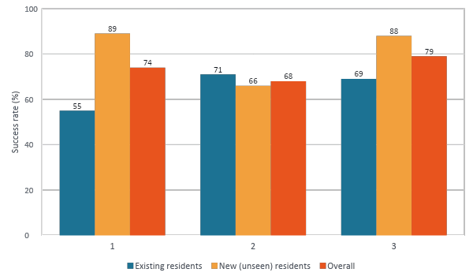
RESULT · HUMAN ROLE-PLAYERS
DiPS wins with real people, and holds up on unseen residents
DiPS is best overall (79%), and the only method robust on both existing and unseen residents.
Zero-shot
RAG over all operator utterances
DiPS
The baselines are brittle in opposite directions
Zero-shot collapses to 55% on existing residents; RAG drops to 66% on unseen ones. Only DiPS holds up on both
Corroborated in simulation
With a faithful simulator, DiPS reaches 92%, close to the 85% acceptance rate reported for human operators, in the fewest turns.
DiPS · SIGDIAL 2026
15

Slide 16
TAKEAWAYS
Adaptive strategy selection reaches near human-level persuasion
The method, in one line
It works, on residents it never trained on
Treat the persuasion strategy as the action. Learn, from offline data, which strategy to deploy each turn.
1
Offline RL learns turn-level strategy selection from heterogeneous dialogue data, and reaches near human-level evacuation success on unseen residents.
The selection is what carries it
Thank you
2
Ablations show every piece is load-bearing: scoped per-policy retrieval, persona conditioning, and the learned choice. Good personas aren't enough; you have to pick the right one each turn.
Questions welcome.
{tzhang62, mousumid}@usc.edu
Supported by ARL A2I2 (W911NF-23-2-0010) and Cooperative Agreement W911NF-20-2-0053.
16

Slide 17
Backup
Backup slides
In a naive simulator, the ranking reverses
How much can we trust an LLM judge?
Where LLM operators still lose to humans
Improved simulation: full baseline & ablation sweep
Ablations: every component earns its place

Slide 18
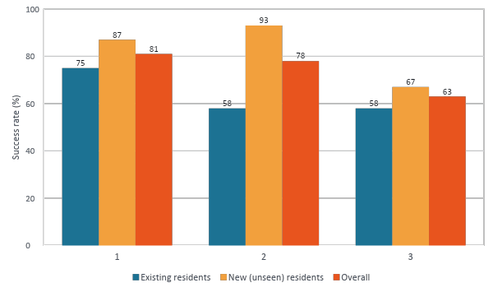
BACKUP · NAIVE SIMULATION
In a naive simulator, the ranking reverses
Here DiPS is last on both groups, the opposite of the human result.
Three candidate explanations
a
The simulator isn't human
LLM residents may not reproduce human resistance.
b
The prompts are too thin
Maybe the selector isn't given enough to choose well.
c
The method is wrong here
Switching personas mid-dialogue could break coherence.
The human study (main talk) resolved this: it was (a).
DiPS · SIGDIAL 2026
18

Slide 19
BACKUP · EVALUATION
How much can we trust an LLM judge?
Setting | Agreement | κ | Human | LLM judge
Zero-shot | 66.7% | 0.22 | 76.7 | 63.3
RAG | 66.7% | 0.30 | 70.0 | 56.7
DiPS | 83.3% | 0.67 | 56.7 | 46.7
Overall | 72.2% | 0.42 | 67.8 | 55.6
The three-way scheme
yes
explicit agreement + a viable plan, no unresolved blocker
maybe
conditional compliance, time-dependent promises, ends mid-negotiation
no
explicit refusal, or a precondition that cannot be met in time
n = 30 dialogues per setting (Table 2)
Identical instructions for human annotators and the judge. Annotators agreed with each other > 80%.
Two findings
Takeaway
DiPS dialogues are the most interpretable (83.3%, κ = 0.67). Baselines produce more borderline endings where commitment is open to reading.
The judge is systematically conservative (55.6 vs 67.8), labelling conditional agreements “maybe” where humans say yes.
An LLM judge is a usable training and evaluation signal at scale, but not a substitute for human evaluation, especially on the ambiguous interactions that matter most.
DiPS · SIGDIAL 2026
19

Slide 20
BACKUP · DIAGNOSIS
Where LLM operators still lose to humans
Character | Human op. | LLM op. | p
Bob | 77% | 78% | 1.000
Lindsay | 100% | 82% | 0.183
Niki | 100% | 50% | 0.044 *
Ross | 93% | 50% | 0.0001 **
Overall | 89% | 72% | 0.043 *
1
The logistical commitment gap
LLM operators produce plausible language but won't commit to concrete action. Failures cluster on Ross and Niki, who need dispatch and coordination, not argument.
2
The off-script adaptation gap
When participants follow the expected script, success is 77-84%. When they introduce new demands, it falls to 47-60%.
Fisher's exact test vs. the human-operator WoZ data (Table 3)
Ross, stranded with wheelchair passengers:
HUMAN OPERATOR → convinced, 7 turns
LLM OPERATOR → failed, 15 turns (call abandoned)
“I'm going to send a van out to you so we can get you evacuated. Does that sound good?”
“Rescue units are overwhelmed and cannot send a vehicle. You must evacuate on your own.”
DiPS · SIGDIAL 2026
20

Slide 21
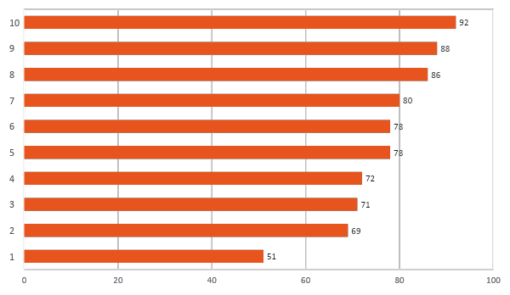
BACKUP · IMPROVED SIMULATION
Fix the environment, and the picture inverts
What we changed
Residents
Prompts now encode explicit barriers: Ross requires a concrete transport plan; Bob requires a stay-vs-leave cost comparison.
Judge
Simplified, shortened, manually verified. About 90% agreement with a human judge.
Operators
Policy descriptions add structured resident concerns from training data, valuable even on unseen residents.
Not tuning for DiPS. Encoding the resistance real humans showed us.
Success rate (%) under the improved simulation (Table 4)
DiPS 92% · fewest turns (11.2 vs 11.9)
Wrong strategy, held throughout: 51%
DiPS · SIGDIAL 2026
21

Slide 22
BACKUP · ABLATIONS
Every component earns its place
success
avg turns
DiPS (full)
92%
11.2
Reading this
policy selection + persona prompt + per-policy retrieval
Removing anything costs both success and efficiency; dialogues get longer as well as worse.
Retrieval matters, but scoped retrieval matters more: a global pool of “good” utterances is worth 6 points less than the selected policy's own examples.
Selecting a policy but not describing it costs as much as dropping retrieval altogether. The choice has to reach the generator.
– per-policy retrieval
86%
13.0
swap the policy's own index for one global pool of successful operator utterances
– retrieval entirely
80%
12.9
persona conditioning only, no in-context examples
– strategy prompt
80%
12.9
policy still selected, but its description is withheld from the prompt
Table 5
DiPS · SIGDIAL 2026
22

