Slide 1
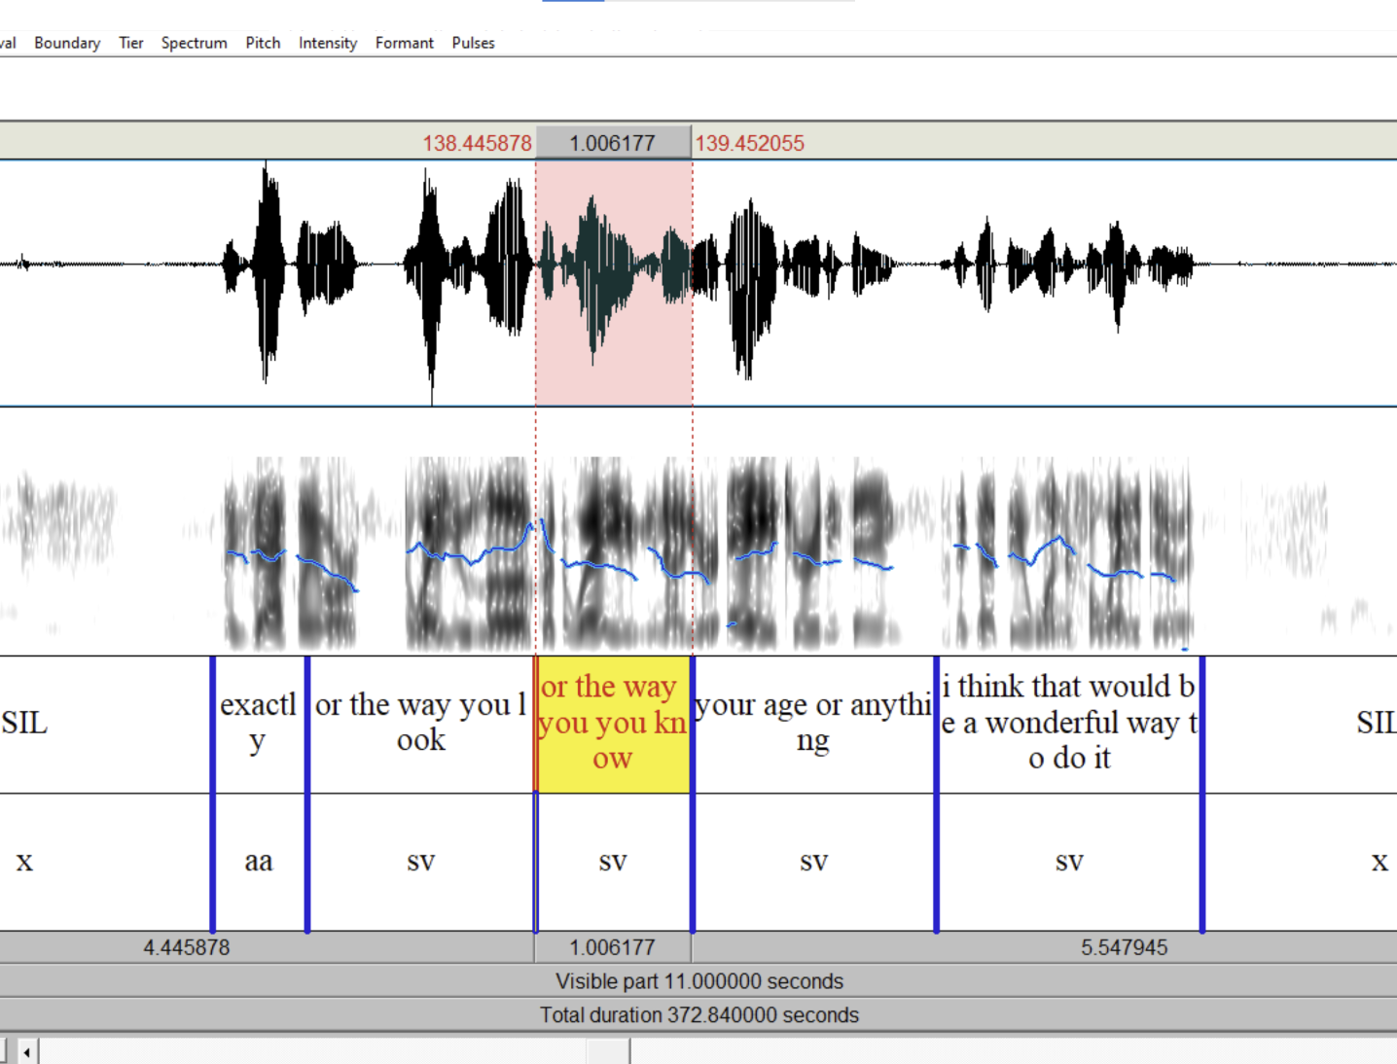
SIGDIAL 2026
Disentangling
Annotator Skill from
Verifier Strictness
in Cross-Verified Dialogue Annotation
Zihao Tao · John A. Prado · Ignazio Steven LaManna
Ryan Puterbaugh · Mim Datta · Julia Hirschberg
Columbia University · University of Alberta
What does the paper’s correction count actually measure?

Slide 2
SIGDIAL 2026
One observed count can have three workflow sources
100
1
2
3
could reflect
derived records
Annotator
Verification
File
More differences left
for verification
More extensive edits
during review
Harder audio or
conversation structure
Observed record count ≠ annotator quality
2

Slide 3
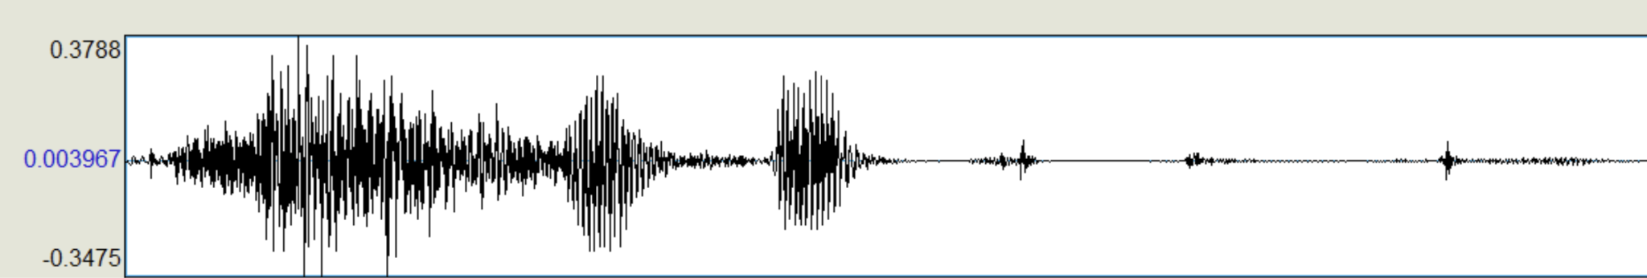
SIGDIAL 2026
RASwDA derives analysis records from two TextGrid versions
1 · Annotate
2 · Verify
3 · Derive records
Realign SwDA intervals
to the original audio
Review and edit the submitted
TextGrid against the audio
Match submitted and
verified TextGrids
ANALYSIS UNIT
One algorithm-derived change record
MATCH → CLASSIFY → COUNT
5 ACTION TYPES
1,045
105,005
5
file sides
derived records
action types
3

Slide 4
SIGDIAL 2026
Crossed assignments identify role effects
Verifier
Annot.
T1
T2
T3
T4
T5
Every annotator
T1
—
164
63
13
43
was checked by all four other team members
T2
49
—
44
16
13
T3
38
38
—
46
10
537
complete cases
with both roles identified
Off-diagonal overlap separates annotator and verifier effects.
4

Slide 5
SIGDIAL 2026
The model asks two symmetric questions
Outcome used in the paper
normalized correction rate = derived change records / non-silence intervals
Do annotators differ
Do verifiers differ
after controlling for
who verified the file?
after controlling for
who annotated the file?
Controls
personal batch index · verifier batch index · log(file length)
Random effects
annotator · verifier · batch within annotator · file residual
5

Slide 6
SIGDIAL 2026
Residual dominates; verifier variance = 0
10.8%
0.0%
80.6%
Annotator identity
Verifier identity
File-level residual
modest component
singular-fit boundary
difficulty + measurement noise
8.7%
batch within annotator
10.8 annotator
8.7 batch
80.6 file residual
No detectable verifier effect ≠ no verification value
6

Slide 7
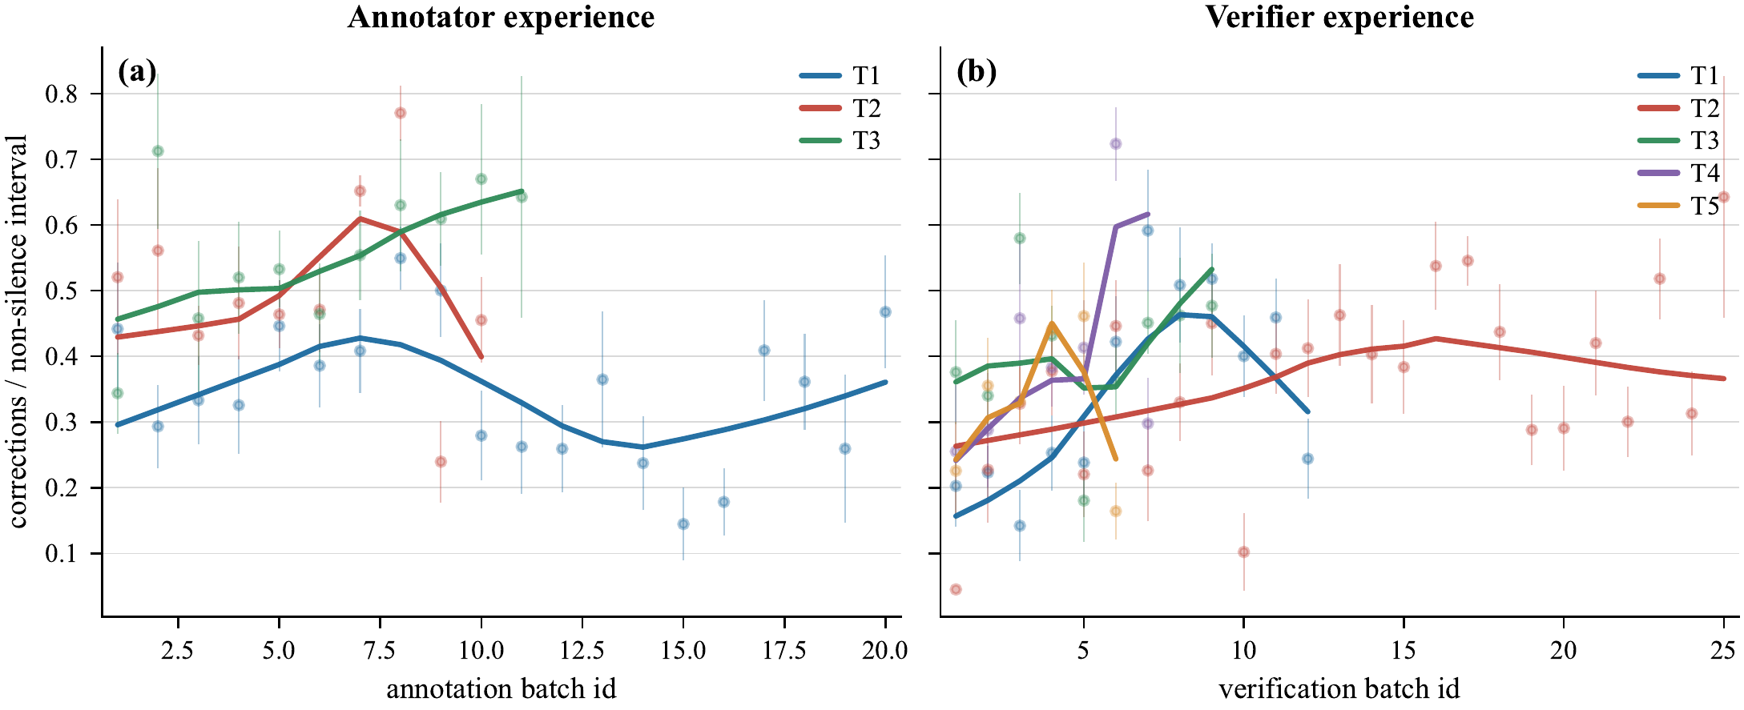
SIGDIAL 2026
Experience does not explain the remaining variation
Annotator batch
p = 0.60
Verifier batch
p = 0.06
No coherent
downward drift
7

Slide 8
SIGDIAL 2026
Estimated verifier variance = 0 in all seven fits
σ²ᵥ = 0 in all seven fits
Power limit
5 verifiers
537 complete cases
Small effects may remain
0
0
0
0
0
0
0
Main
−T1
−T2
−T3
−T4
−T5
Raw count
No detectable effect ≠ identical verifiers
8

Slide 9
SIGDIAL 2026
Most reconstructed changes involve boundary placement
Share of 105,005 derived change records
58.5%
26.1%
9.4%
BOUNDARY_SHIFT
INSERT
DELETE
DA_CHANGE 3.0%
MODIFY 2.9%
58.5%
audio-anchored
boundary shifts
3.0%
pure dialogue-act
label changes
Boundary-shift records are audio-anchored, not pure label judgments.
9

Slide 10
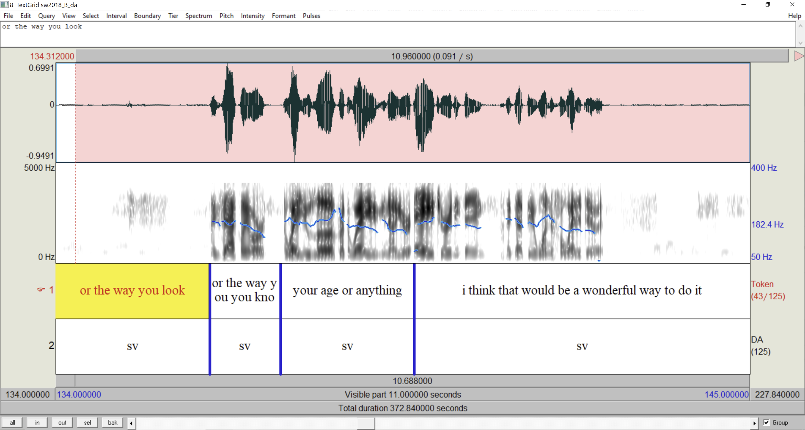
SIGDIAL 2026
Audio anchors boundaries; label shares vary
Semantic choices leave room to diverge
sd ↔ sv
b / aa / ny
Semantic-edit share
T1
1.4%
T2
2.8%
T3
20.3%
Audio constrains where speech begins and ends
T3: 12.8% DA_CHANGE + 7.5% MODIFY
10

Slide 11
SIGDIAL 2026
Version differences are not always annotator errors
Original
Annotated
Verified
forced alignment
manual realignment
final refinement
50.3%
32.2%
16.2%
Further refinement after
annotator improvement
Original error unchanged
after annotation
Annotator change moved
away from final
Neutral / equivalent
The derived rate is a process measure—not a pure error rate.
11

Slide 12
SIGDIAL 2026
Make verification auditable
1
2
3
Preserve evidence
Cross assignments
Release data + method
Log edit events directly—or derive typed records
from versioned files—with metadata.
Use at least two verifiers
per annotator, with overlap.
Share versions, derived records,
and comparison code.
For RASwDA: improve boundary-placement support first.
12

Slide 13

Correction count is a derived joint measure
Crossed design + derived records
separate annotator, verifier, batch, and residual components.
10.8% vs. 0.0%
Annotator identity matters modestly; verifier identity does not detectably differ.
58.5% boundary-shift records
Read the paper
Audio anchoring is consistent with limited room for verifier-specific differences.
aclanthology.org/2026.sigdial-1.29
Questions?

