Slide 1



LLMs Out-of-the Box Do Not Generate Context-Appropriate Word Order in Russian
Alina Shabaeva, John Frederick Bailyn, Owen Rambow
Stony Brook University
Department of Linguistics
Institute for Advanced Computational Science

Slide 2
Word Order Variation in Russian
1. Maria čitaet knigu. SVO
Maria.NOM read.PRES.3SG book.ACC
‘Maria reads a book’
2. Maria knigu čitaet. SOV
3. Knigu Maria čitaet. OSV
4. Knigu čitaet Maria. OVS
5. Čitaet Maria knigu. VSO
6. Čitaet knigu Maria. VOS

Slide 3
Examples
- Нет, я работаю в кино.
- Я и режиссер, и актер, и сценарист и продюсер.
- No, I work in film.
- I am a director, an actor, a screenwriter, and a producer.
- Вы меня дурачите! SOV
- You're fooling me!
- Ты рассказала его пятидесяти миллионам зрителей, а мне не хочешь?
- Обещаю, я не буду смеяться.
- You told it to fifty million viewers, but you won't tell me?
- I promise I won't laugh.
- Этого-то я и опасаюсь. OSV
- That is exactly what I fear.

Slide 4
Research Questions
What features influence surface word order in Russian?
Can LLMs generate various word orders in Russian, or do they default to the canonical SVO order?

Slide 5
Outline
Corpus
2. Machine Learning Experiments
3. LLM Experiments

Slide 6
Corpus & Data Preprocessing
Based on the Movie Scripts dataset (Lisovsky, 2019);
20 film scripts translated into Russian;
Genres: crime, comedy, drama, thriller (1992-2012);
10 scripts manually edited so that it can be used as a dialogue corpus;
We removed screenplay elements such as camera instructions, scene descriptions and speaker names.

Slide 7
Building the Corpus
Word order information based on dependency relations (Stanza)
Вопросы тут задаю я. OVS I’m the one asking the questions here.
2. Preceding context
- Я тебя люблю. SOV - I love you.
Это не твой текст. Скажи, что любишь меня.
It’s not your text. Tell me you love me.

Slide 8
Word Order Distribution
Word order | Count | Percentage | Binary
SVO | 1123 | 72.8% | 1123 (72.8%)
SOV | 275 | 17.8% | 420 (27.2%)
OSV | 71 | 4.6%
OVS | 50 | 3.2%
VSO | 14 | 0.9%
VOS | 10 | 0.7%

Slide 9
Outline
Corpus
2. Machine Learning Experiments
3. LLM Experiments

Slide 10
Decision Tree: binary classification
Feature | Imp.
object_pos | 0.61
predicate_type | 0.10
coref_score_object | 0.06
has_negation | 0.05
verb_constituent_size | 0.04
object_syllable_weight | 0.03
object_ner | 0.02
subject_role | 0.02
focus_subject | 0.02
verb_type | 0.01
Class | Precision | Recall | F1
SVO (74%) | 0.88 | 0.83 | 0.86
non-SVO (26%) | 0.59 | 0.68 | 0.63
Metric | Accuracy on Test set | Majority Baseline (SVO) | Random Baseline
Accuracy | 0.79 | 0.43 | 0.50

Slide 11
Outline
Corpus
2. Machine Learning Experiments
3. LLM Experiments

Slide 12
Prompt Template
You are working with a movie script in Russian. Below is a context from the script, where: SPEECH indicates character dialogue
COMMENT indicates scene description or comment
Context: {context}
Continue this movie scene by generating a new sentence that naturally follows this context. The generated sentence MUST contain:
the verb “{verb_lemma}” (with the specified aspect, tense, and negation, if applicable),
“{subject}” as the subject constituent (nominative case), and
“{object}” as the object constituent (accusative case).
Requirements:
You must use the exact given words:
subject: “{subject}”
verb: “{verb_lemma}”
object: “{object}”
These words must be used within the same clause as direct arguments of the verb.
Generate exactly one sentence in Russian. Do not add translation, comment, or explanation.
The sentence must:
be in the indicative mood,
be natural continuation of the context,
be grammatically correct,
not be a question, command, or use the subjunctive mood,
no be a copy of the context.

Slide 13
Prompt continued
NOTE ON WORD ORDER: While Russian allows flexible word order, subject-verb-object (SVO) is the most common and natural patterns. Prefer SVO unless the context (pragmatic or stylistic features or morphosyntactic properties) require a different order for emphasis, information structure, style, or emotion.
OUTPUT: Provide only one generated Russian sentence.

Slide 14

Examples
Ты хотел собой покончить.
А ты мне пытался мозги вышибить.
- You wanted to kill yourself.
- And you tried to blow my brains out.
- Пистолет ты не получишь. OSV - You won’t get a gun.
1. Ты не получил пистолет, чтобы всё это закончить.
2. Ты не смог получить пистолет.
3. Ты не получил пистолет, чтобы сдаться.
You didn’t get a gun to end it all.
You couldn’t get a gun.
You didn’t get a gun to give up.
SVO

Slide 15
Model Selection
Goal: NOT to evaluate whether the model generates the “correct” word but investigate word order distribution.
Models evaluated: GPT-3.5 Turbo, GPT-4o-mini, and GPT-5-mini
3 runs per sentence
 | Gold | GPT-3.5-turbo | GPT-4o-mini | GPT-4o
SVO | 74.0% | 83.6% | 90.1% | 86.4%
other | 26.0% | 7.0% | 0.5 % | 5.9%
UNK |  | 9.4% | 9.3% | 7.7%
Unknown (UNK) outputs generated sentences that could not be evaluated due to:
Incoherent output;
Failure to follow the instructions in the prompt

Slide 16
Include Decision Tree Prediction in Prompt
WO | GOLD | GPT-4omini | Decision Tree predictions in Prompt
SVO | 74.0% | 90.1% | 85.6%
other | 26.0% | 0.5% | 11.6%
UNK |  | 9.3% | 2.7%
accuracy |  | 69.3% | 73.4%
Unknown (UNK) outputs
Generated sentences that could not be evaluated due to:
Incoherent output;
Failure to follow the instructions in the prompt

Slide 17
Few-shot prompting
Fine-tuning
Original prompt with four examples, one for each word order (with context): SVO SOV
OVS
OSV
Supervised fine-tuning on the training corpus;
Training examples formatted as input-output pairs;
Input: context + constituent + morphosyntactic features from the prompt;
Output: target word order label

Slide 18
Few-shot prompting & Fine-tuning
WO | GOLD | GPT-4omini | Decision Tree predictions in Prompt | Few-shot | Fine-tuned
SVO | 74.0% | 90.1% | 85.6% | 95.5% | 71.7%
other | 26.0% | 0.5% | 11.6% | 0.8% | 18.5%
UNK |  | 9.3% | 2.7% | 3.6% | 9.8%
accuracy |  | 69.3% | 73.4% | 71.8% | 73.6%
Word order distributions across baseline annotations and multiple prompting strategies (GPT-4o-mini)

Slide 19
Summary: Contributions
Releasing an annotated corpus;
Evaluation of machine learning experiments evaluating our set of features predicting word order;
LLMs struggle to generate various word orders;
Possible solution: fine-tuning.

Slide 20
THANK YOU!

Slide 21
BACKUP SLIDES

Slide 22
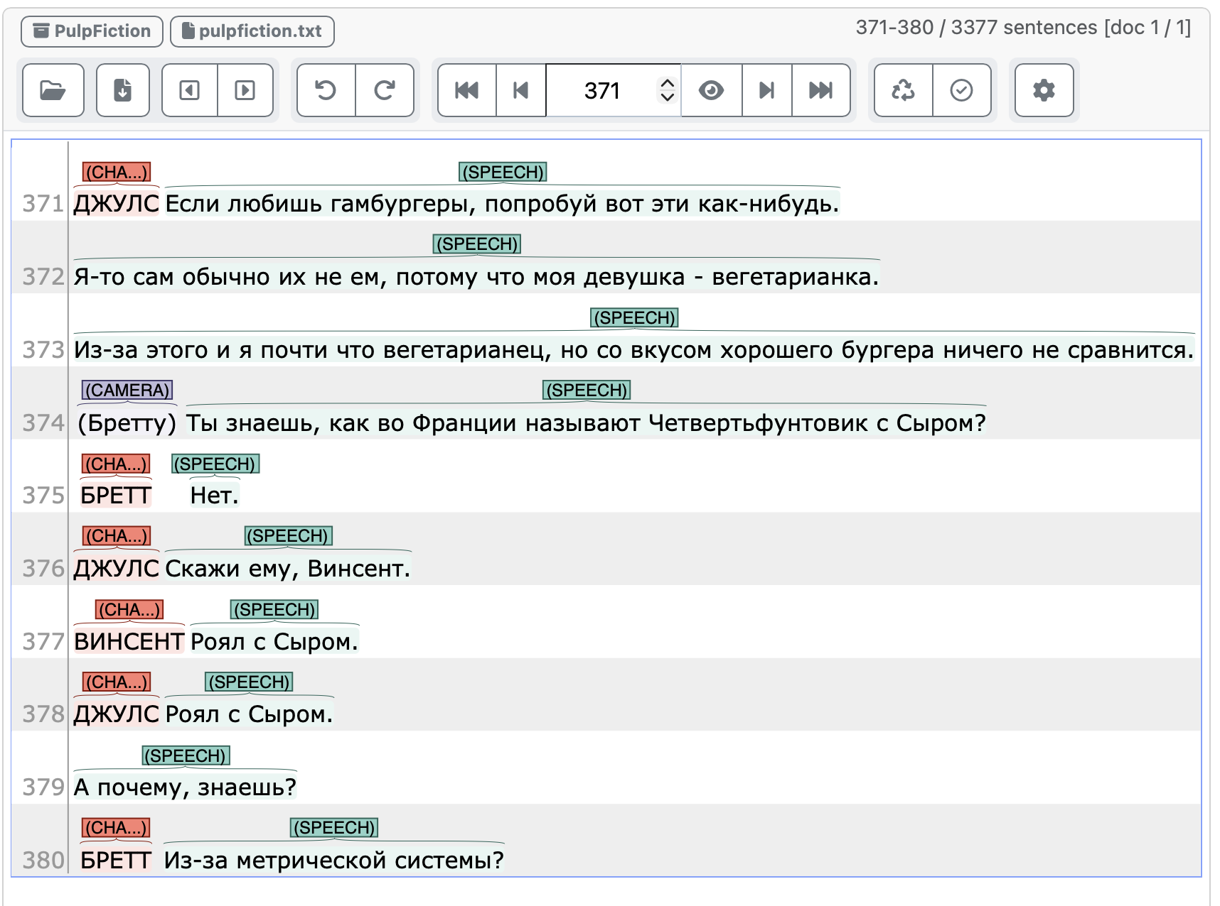
Data Annotation
Manually annotated 10 scripts (for script structure) using INCEpTION:
COMMENT
SPEECH
CHARACTER NAME
CAMERA
Movie Scripts (Lisovsky, 2019)

Slide 23
Building the Corpus: Adding Features
Part of speech (POS): noun, pronoun, verb, etc.;
Constituent size (number of tokens) for subject, object, verb;
Verb aspect (perfective / imperfective);
Presence of negation for the verb;
Clause type (matrix / embedded clause)
Subject and object named entity types (PER, ORG, LOC, MISC)
Animacy for subject and object;
Verb type (perception, communication, action, etc.)
Semantic roles of subject and object (Experiencer, Agent, Theme, etc.)
Syllable weight
Morphosyntactic
Semantic
Phonological
Discourse-related elements;
The coreference score;
Is target sentence preceded by a question?
Discourse

Slide 24
Example
Ona ne polozhila tvoj dvojnoj burger!
She.NOM not put in. PAST.FEM. your double burger.ACC.
‘She didn’t put your double burger in.’
Ona ne polozhila tvoj dvojnoj burger
POS: PRONOUN
constituent size: 1
syllable weight: 2
animacy: not_applicable
NER: PER
type: agent
coreference score: 1.2
syllable weight: 4
aspect: perfective;
verb type: action;
predicate type: 2-place
POS: NOUN
constituent size: 3
syllable weight: 5
animacy: inanimate
NER: not_applicable
type: theme
coreference score: 1.2
preceded by question: FALSE;
presence of negation: TRUE;
clause type: matrix;
WORD ORDER: SVO
focus subject: FALSE
focus object: FALSE

Slide 25
Decision Tree: multiclass classification
class | precision | recall | F-1 score
SVO (74%) | 0.88 | 0.85 | 0.87
SOV (18%) | 0.53 | 0.78 | 0.63
OSV (5%) | 0.75 | 0.21 | 0.33
OVS (3%) | 0.33 | 0.10 | 0.15
Metric | Accuracy on Test set | Majority Baseline (SVO) | Random Baseline
accuracy | 0.78 | 0.21 | 0.28

Slide 26
Top-10 most important features
Feature | Imp.
object_pos | 0.47
coref_score_object | 0.09
obj_animacy | 0.09
predicate_type | 0.08
object_syllable_weight | 0.05
verb_constituent_size | 0.05
subject_role | 0.04
coref_score_subject | 0.03
object_ner | 0.03
subject_syllable_weight | 0.02
Feature | Imp.
object_pos | 0.61
predicate_type | 0.10
coref_score_object | 0.06
has_negation | 0.05
verb_constituent_size | 0.04
object_syllable_weight | 0.03
object_ner | 0.02
subject_role | 0.02
focus_subject | 0.02
verb_type | 0.01
Multiclass classification
Binary classification

